Slide 1

UEEN 3113 / 3413
Server Configuration and management

Slide 2
Storage Management
To view disk space usage:
df -h
Scenario:
Error occurs while creating a file, error message states that the disk is full.
However, output from df -h shows that the disk still contain free space!
The reason: out of inodes!

Slide 3
Storage Management
Inode holds all the information about a file except its name and the actual data contents of the file.
Inode is associated with each file.
There are limited number of inodes (set when the filesystem is first created), but the number is extremely large and hard to reach.
To display the usage of inodes:
df -i

Slide 4
Storage Management
Created a lots of directories, symlinks, and small files can cause the system runs low on inodes.
Solutions:
Increase the size of volume in LVM (if it is used)
Back up and create a new filesystem with higher limit of inodes.
Use other filesystem such as btrfs, which uses dynamic inodes.

Slide 5
Storage Management
In order to know which file or directory that uses a lot of space:
du -hsc *
Run du -hsc * within a directory that's as close as possible to where the problem is.
The du command is only able to scan directories that its calling user has permission to scan.

Slide 6
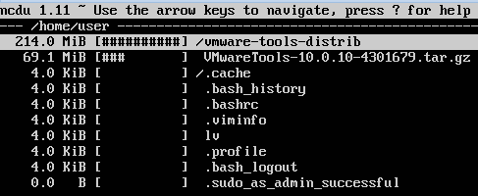
Storage Management
Another useful application: Ncurses Disk Usage Utility (ncdu), with the ability to traverse the results without having to run a command over and over again.
Sample output from ncdu

Slide 7
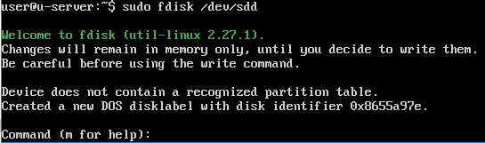
Storage Management
To view all the disks and the partitions:
fdisk -l
To configure a disk, for example a new disk /dev/sdd:
fdisk /dev/sdd

Slide 8
Storage Management
By default, fdisk will create MBR partition table which has limitations:
Maximum 4 primary partitions
Maximum disk size can be handled is 2TB
It’s better to use a newer partition table: GPT partition table.

Slide 9
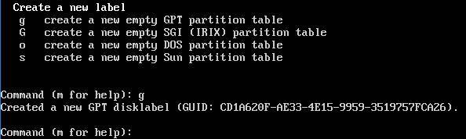
Storage Management
In order to create GPT partition table, run command g in fdisk prompt

Slide 10


Storage Management
Next, enter n in fdisk prompt to add a new partition.
Press [Enter] to accept the default partition number.
Press [Enter] again to accept the default first sector.

Slide 11


Storage Management
fdisk will prompt to enter the last sector.
If we press [Enter] to accept the default last sector, the entire free space will used for the new partition.
If we wish to create a new partition with desired size, enter the size in the prompt.

Slide 12
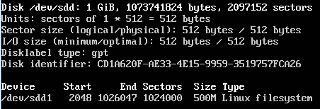
Storage Management
Enter w in fdisk prompt to write the changes and exit fdisk.
Run fdisk -l to view the new partition.

Slide 13
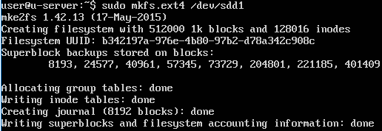
Storage Management
After we have created all necessary partitions, we need to format the partitions, using the mkfs command.
Example, to format the partition with ext4 filesystem
mkfs.ext4 /dev/sdd1

Slide 14
Storage Management
In order to use the new partition, we need to mount it.
First, we need decide the mount point. For example, /mnt/data (the data folder in /mnt must be created manually)
mount /dev/sdd1 /mnt/data

Slide 15
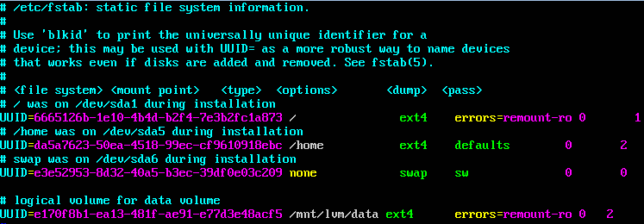
Storage Management
To mount disk automatically when the system starts, we need to configure the /etc/fstab file.
Example of /etc/fstab

Slide 16
Storage Management
There are 6 columns in /etc/fstab:
File system (partition): identified by UUID (can be obtained by running blkid command)
Mount point
Type (ext4, ext3, etc.)
Options: examples, errors=remount-ro, tells the system to remount the filesystem as read-only if an error occurs, auto: automatically mount the device at boot time
Dump: rarely used, always set to 0 (zero)
Pass: the order in which fsck will check the file systems
0: never check, 1: check first, 2: check last

Slide 17
Storage Management
With LVM (Logical Volume Management), we are able to resize filesystems without needing to reboot server.
Volume group is a namespace given to all the physical and logical volumes on system. Examples: vg-backup
Physical volume is a physical or virtual hard disk that is a member of a volume group.
Logical volumes (similar to partitions), can take up a portion of, or an entire disk, but unlike standard partitions, they may span multiple disks. Example, a logical volume include three 100 GB disks and configured to be cumulative total of 300 GB.

Slide 18
Storage Management
In order to use LVM, make sure the lvm2 package is installed. It can be installed by running
apt install lvm2
We need to configure each disk to be used with lvm, by setting up each one as a physical volume with pvcreate command. Examples:
pvcreate /dev/sdb
pvcreate /dev/sdc

Slide 19
Storage Management
To list the physical volumes, run the pvdisplay command.
Next, we need to create volume group, with vgcreate command.
Syntax: vgcreate group_name physical_volume
Example:
vgcreate vg-data /dev/sdb
Use vgdisplay to view all volume groups.

Slide 20
Storage Management
Then, create logical volume with lvcreate command.
Syntax: lvcreate -n volume_name -L size volume_group_name
Example:
lvcreate -n datavol -L 3g vg-data
Use lvdisplay command to view all logical volumes.

Slide 21
Storage Management
In order to format the logical volume, we need to find the full name for logical volume.
ls /dev/mapper
We should be able to identity the logical volume from the output.
Use mkfs command to format logical volume.
mkfs.ext4 /dev/mapper/logical_volume_name

Slide 22
Storage Management
Once formatted, it is ready to mount the device.
assume that the logical volume is to be mounted at /mnt/lvm/data, which must be created before we mount it
mount /dev/mapper/logical_volume_name /mnt/lvm/data
We might want to edit the /etc/fstab file as well, but we must get the UUID by running blkid.

Slide 23
Storage Management
To check free space on physical volume, use pvs command.
To extend the size of logical volume, use lvextend command with -l or -L option. Examples:
extend by taking up the remainder of a physical volume:
lvextend -n /dev/mapper/logical_volume_name -l 100%FREE
extend 1GB:
lvextend -n /dev/mapper/logical_volume_name -L +1g /dev/disk_to_be_used

Slide 24
Storage Management
If we run the df -h command after lvextend, the output shows that the size of the logical volume has not been changed, because the ext4 file system has not been resized.
We need resize it using resize2fs command. Example
resize2fs /dev/mapper/logical_volume_name
Then run the df -h command again to view the updated size.

Slide 25
Storage Management
We can always add new physical volume to a volume group by using vgextend command. Example:
vgextend vg-data /dev/sdc

Slide 26
Storage Management
Another capability of LVM is snapshot.
Snapshots allow us to capture a logical volume at certain point in time and preserve it. We can mount a snapshot like other logical volume and even revert the volume group to the snapshot in case something fails.
It is useful if you want to test some potentially risky changes to files stored within a volume, but want the insurance that if something goes wrong, you can always undo your changes and go back to how things were.

Slide 27
Storage Management
Another capability of LVM is snapshot.
Snapshots require the volume group to have some unallocated space.
We can use snapshots to test how security updates will affect the server if LVM is used for the root file system. If the new updates start to cause problems, we can always revert back. When testing is done, we should merge or remove the snapshot.

Slide 28


