Slide 1

UEEN 3113 / 3413
Server Configuration and management

Slide 2
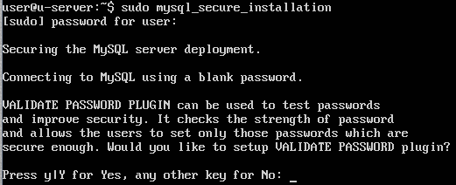
MySQL
To setup mysql after the installation:
mysql_secure_installation
First, we need to set the password for mysql root user.

Slide 3
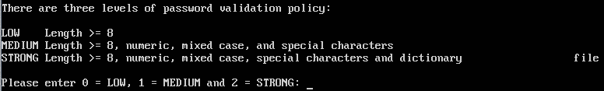
MySQL
Set the password validation policy
Notes:
Medium level example: mySQL605

Slide 4
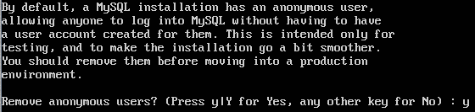
MySQL
Remove anonymous users

Slide 5
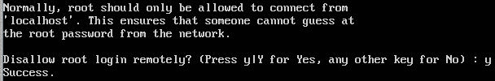
MySQL
Disable remote root login

Slide 6
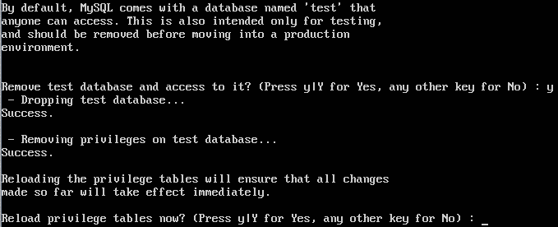
MySQL
Remove “test” database

Slide 7

MySQL
Reload privilege tables

Slide 8
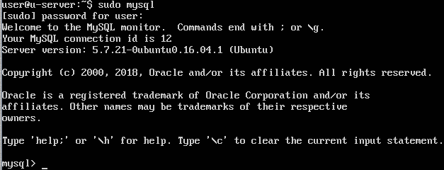
MySQL
Start the mysql command prompt: sudo mysql

Slide 9
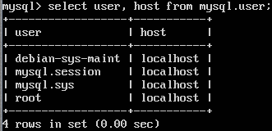
MySQL
To view user: select user, host from mysql.user;

Slide 10
MySQL
Reserved users
debian-sys-maint
Used by the init scripts to stop the server.
mysql.sys
Used as the DEFINER for sys schema objects, avoids problems that occur if root account is removed / renamed.
It’s locked and cannot be used for client connections.
mysql.session
Used internally by plugins to access to the server.
It’s locked and can’t be used for client connections.

Slide 11
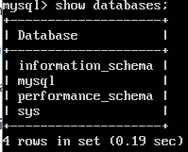
MySQL
Show all databases: show databases

Slide 12

MySQL
Output might not fix into screen (depend on the resolution), in order to view all the lines, we can pipe the output to less.
pager less
This is only effective in current logged in session.
To list in vertical mode, use \G, example:
select * from mysql.user \G

Slide 13
MySQL
Passwords can be written as plain text in SQL statements that invoke the PASSWORD() function.
If it is logged by the MySQL server, it is visible to anyone that can access to the log file.
However, logging will avoid writing passwords in clear text for a the following statements
CREATE USER, ALTER USER, GRANT, SET PASSWORD, SLAVE START, CREATE SERVER, ALTER SERVER

Slide 14
MySQL
To create a database:
CREATE DATABASE database_name;
Example: CREATE DATABASE stdb;
To make a database as current database:
USE database_name;
Example: USE stdb;
To know the current database in use:
SELECT database();

Slide 15
MySQL
To create a table:
CREATE TABLE table_name (field_name field_type(length));
Example:
CREATE TABLE st_item (item_id varchar(15), name varchar(25), location varchar(20));
Add primary key after a table is create:
ALTER TABLE table_name ADD PRIMARY KEY(filed_name);
Example:
ALTER TABLE st_item ADD PRIMARY KEY(item_id);

Slide 16
MySQL
Examples to create a table with primary key:
CREATE TABLE st_item (item_id varchar(15), name varchar(25), location varchar(20), primary key(item_id));
CREATE TABLE st_order (order_id int auto_increment, name varchar(30), primary key(order_id));

Slide 17
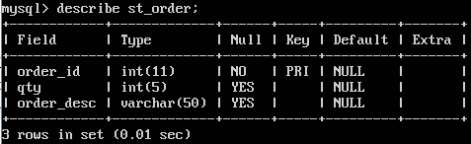
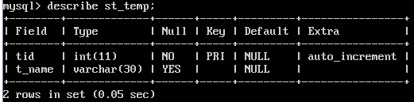
MySQL
To display the structure of a table:
DESCRIBE table_name;

Slide 18
MySQL
To remove a table:
DROP TABLE table_name;
To rename a table:
ALTER TABLE table_name RENAME new_table_name;
ALTER TABLE can be used to modify fields in a table:
ALTER TABLE st_item MODIFY st_item varchar(10), CHANGE name item_name varchar(20);

Slide 19
MySQL
To remove a field/column:
ALTER TABLE table_name DROP field_name;
To add a field/column:
ALTER TABLE table_name ADD new_field_name type;
Examples:
ALTER TABLE st_item ADD pic varchar(20);
ALTER TABLE st_item ADD item_brand varchar(20) AFTER item_name;
ALTER TABLE st_item ADD sup_id int AFTER item_name, ADD foreign key(sup_id) references item_sup(id);

Slide 20
MySQL
To create user:
CREATE USER ‘username’@;’host’ IDENTIFIED BY ‘password’;
Examples:
CREATE USER ‘stadmin’@;’localhost’ IDENTIFIED BY ‘stmin605’;
CREATE USER ‘stadmin’@;’%’ IDENTIFIED BY ‘
Then, grant privileges to user:
GRANT privileges_list ON database.table TO ‘user’@’host’;
Example:
GRANT all privileges ON stdb.* TO ‘stdmin’@’localhost’;
Notes:
% is wildcard, means stadmin can connect from any host.

Slide 21
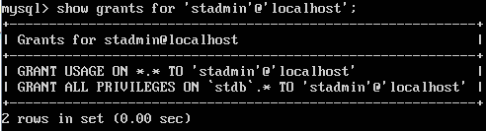
MySQL
To show the privileges granted to user:
SHOW GRANTS FOR ‘user_name’@’host’;
Example
SHOW GRANTS FOR ‘stadmin’@’localhost’;

Slide 22
MySQL
To remove privileges granted:
REVOKE privilges_list ON database.table FROM ‘user_name’@’host’;
Example:
REVOKE all privileges ON *.* FROM ‘stadmin’@’localhost’;
The following will remove all privileges (all global, database, table, column, and routine privileges)
REVOKE all privileges, grant option FROM ‘user_name’@’host’;

Slide 23
MySQL
Privilege | Column (in mysql.user) | Context
ALL PRIVILEGES | Synonym for “all privileges” | Server administration
ALTER | Alter_priv | Tables
CREATE | Create_priv | Databases, tables, or indexes
CREATE TABLESPACE | Create_tablespace_priv | Server administration
CREATE USER | Create_user_priv | Server administration
CREATE VIEW | Create_view_priv | Views
DELETE | Delete_priv | Tables
DROP | Drop_priv | Databases, tables, or views

Slide 24
MySQL
Privilege | Column (in mysql.user) | Context
GRANT OPTION | Grant_priv | Databases, tables, or stored routines
INDEX | Index_priv | Tables
INSERT | Insert_priv | Tables or columns
SELECT | Select_priv | Tables or columns
SHOW DATABASES | Show_db_priv | Server administration
SHOW VIEW | Show_view_priv | Views
UPDATE | Update_priv | Tables or columns
USAGE | Synonym for “no privileges” | Server administration

Slide 25
MySQL
For the full list of privileges, visit
https://dev.mysql.com/doc/refman/5.7/en/privileges-provided.html

Slide 26
MySQL
mysqldump can be used to backup databases
By default, mysqldump writes output to standard output, we need to redirect the output to a file in order to backup the databases into file.
mysqldump option > filename
Examples
mysqldump --all-databases > backup.sql
mysqldump --databases stdb salesdb > dump.sql
mysqldump –u root –p --all-databases > dumpall.sql

Slide 27
MySQL
To reload from dump file:
From shell: mysql < dump_file
From within mysql: source dump_file

Slide 28
MySQL
We can schedule the database backup using Cron.
Each user has their own set of Cron jobs.
To list the tasks scheduled by current user:
crontab -l
To list the tasks scheduled by other user:
crontab –u user_name -l

Slide 29
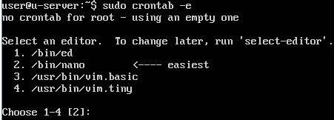
MySQL
To create Cron job:
crontab –e (for current user)
sudo crontab –e (for root user)
We are required to choose an editor if there are more than one editor.

Slide 30
MySQL
Each Cron job is specified in one line, which consists of 6 fields, separated by at least one space or tab.
m h dom mon dow command
m – minute
h – hour in 24-hour format (0 – 23)
dom – day of month (1 – 31)
mon – month (1 – 12)
dow – day of the week (0 – 6, represent Monday – Sunday)
We might want to use full path in command to make sure that it will run.

Slide 31
MySQL
Examples:
0 0 * * * /usr/bin/apt-get update
Run the apt update everyday at 12am. (* is a wildcard)
0 1 1 * * /usr/local/bin/monthly_cleanup.sh
Run a script on the first day of every month at 1am.

Slide 32
MySQL
However, mysqldump requires user name and password and definitely is unsafe to include password in the Cron job’s command.
Solution: place the password in user configuration file for mysql.
Copy /etc/alternatives/my.cnf to home directory as store as .my.cnf

Slide 33

MySQL
Open .my.cnf and add a [client] section.
We place the password under this section. Example:
Make sure that this file can only read by our own.
chmod 600 .my.cnf

Slide 34

MySQL
Now we can create a Cron job for mysqldump. Example

Slide 35
MySQL
Table maintenance statements
CHECK TABLE checks a table or tables for error.
Example: CHECK TABLE mysql.user;
OPTIMIZE TABLE reorganises the physical storage of table data and associated index data, to reduce storage space and improve I/O efficiency.
REPAIR TABLE repairs a possibly corrupted table.
Visit https://dev.mysql.com/doc/refman/5.7/en/table-maintenance-sql.html for more details

Slide 36


