Slide 1

UEEN 3113 / 3413
Server Configuration and management

Slide 2
SSH (Secure Shell)
A suite of network communication tools that allows users to connect to a remote server with encrypted session.
There are 2 packages for SSH in Ubuntu (other distributions might use different name for the packages):
openssh-server
openssh-client (usually installed by default)
We will install openssh-server in the server.
Any client that needs to connect to server using SSH must install openssh-client.
Notes:
<number>

Slide 3
SSH (Secure Shell)
To check if the SSH server is running / installed:
service ssh status OR
systemctl status ssh OR
which sshd
If SSH is disabled, we can enable it by:
systemctl enable ssh
Notes:
<number>

Slide 4
SSH (Secure Shell)
To check the listening port (default port is 22):
netstat -tulpn | grep ssh
To connect to server / other machine, using currently logged in username:
ssh host_name OR ssh ip_address
Example: ssh u-server
Notes:
<number>

Slide 5
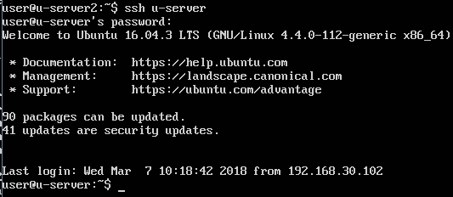
SSH (Secure Shell)
To connect with other username:
ssh username@host_name OR ssh username@ip_address
Notes:
<number>

Slide 6
SSH (Secure Shell)
If the ssh is listening to a non-standard port (other than 22), we need to specify the port number with the -p option.
ssh -p port_number username@hostname
Example, ssh –p 13300 user2@u-server
To disconnect: enter the exit command or press Ctrl+D.
If we started background processes on target machine via ssh, use Ctrl+D to end the session, otherwise the processes will be terminated.
Notes:
<number>

Slide 7
SSH (Secure Shell)
Notice that we are asked for password when we connect to server / machine, which means the password will be transmitted during the connecting process. (Is this risky?)
It’s better to disable password authentication and implement Public Key Authentication.
Notes:
<number>

Slide 8
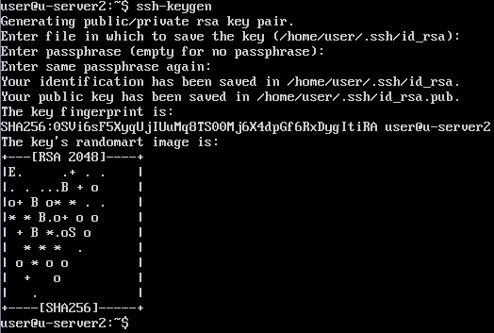
SSH (Secure Shell)
First, we nee to generate a public/private key pair .
ssh-keygen
Notes:
<number>

Slide 9
SSH (Secure Shell)
The passphrase can be empty but it’s recommended to provide one, which should be different from system password.
2 files will be generated and stored in the default directory (/home/user_name/.ssh)
id_rsa (private key)
id_rsa.pub (public key)
Private key (id_rsa) should never leave the machine, be given to someone or stored on external storage media.
Notes:
<number>

Slide 10
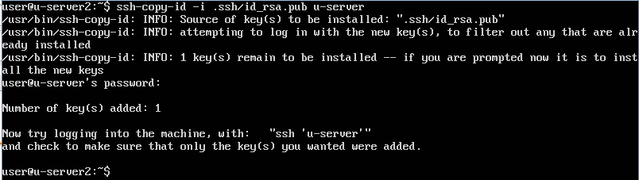
SSH (Secure Shell)
The public key is to be copied to target servers / machines that we wish to connect to using ssh.
ssh-copy-id -i ~/.ssh/id_rsa.pub host_name
Example: ssh-copy-id -i ~/.ssh/id_rsa.pub u-server
Notes:
<number>

Slide 11
SSH (Secure Shell)
In the target server / machine, .ssh directory will be created to store the public key in a file named authorized_keys
If we connect from multiple machines (a key is generated by each machine), additional keys will be appended to the bottom of this file, one per line.
Notes:
<number>

Slide 12
SSH (Secure Shell)
To simplify ssh connection, we can create a config file in .ssh directory to store all necessary information for ssh connection.
nano ~/.ssh/config
Content of config file:
host host_name (host_name here serves as shortcut)
Hostname actual_host_name OR ip_address
Port port_number
User user_name
Notes:
<number>

Slide 13
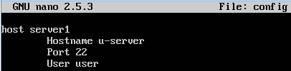
SSH (Secure Shell)
Example of config file:
host server1
Hostname u-server
Port 22
User user
To connect to u-server, with config file created:
ssh server1
Notes:
<number>

Slide 14
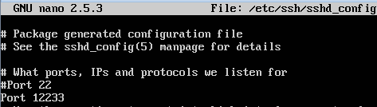
SSH (Secure Shell)
Configuration file for ssh daemon is /etc/ssh/sshd_config
It’s safer to create a backup copy of the configuration file before we change the configuration.
Some suggestions to secure the ssh
Change the port number (preferably a high number that's above 10000 and not in use by any other service).
Notes:
<number>

Slide 15
SSH (Secure Shell)
Some suggestions to secure the ssh
Change the port number (preferably a high number that's above 10000 and not in use by any other service).
Make sure that ssh is listening to Protocol 2 (should be default in newer server)
Allow only specified users / groups to connect via ssh (by default every user created is allowed) by adding the following sections in config
AllowUsers users_separated_by_a_space
AllowGroups groups_separated_by_a_space
Notes:
<number>

Slide 16

SSH (Secure Shell)
Some suggestions to secure the ssh
Examples for AllowUsers and AllowGroups
AllowUsers user user2 john
AllowGroups admins sshuser
Turn off PermitRoorLogin
Default setting is prohibit-password, means key authentication is allowed for root but passwords for root aren't accepted
To turn off, replace prohibit-password with no
Notes:
<number>

Slide 17
SSH (Secure Shell)
Some suggestions to secure the ssh
Disable password authentication after key authentication has been setup successfully
Restart the ssh service whenever we change the configuration.
systemctl restart ssh
Notes:
<number>

Slide 18
SSH (Secure Shell)
If firewall is enable, make sure that we enable traffic via SSH.
To check if firewall is enabled and running in Ubuntu:
sudo ufw status
To allow traffic from specific machine to SSH port (TCP and UDP):
ufw allow from ip_address to any port port_number
To allow traffic from a subnet:
ufw allow from subnet to any port port_number
Notes:
<number>

Slide 19

Notes:
<number>

