Slide 1
Home Surveillance Security System (HSSS)
makes your home smart, secured and safe

Slide 2
Group Members
Group no – 9
NAME ID
A.H.M Kabirul Ahshan Zishan 1530062
Aurpa Anindita 1530223

Slide 3
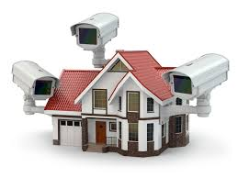
History leading to the project
House, a safe haven for us we call home, the place of comfort and security, but danger does not come knocking your door, we always have to prepare ourselves for any threats. When we are asleep in the night, any criminal can create any occurrence and we face trouble. Sometimes we overcome our fear and face trouble head on. But what happens when we are out at work or out of town? What happens when we leave our precious home with no one in, with no surveillance? There are more chances of theft, burglary and trespassing. Or there could be fire. For this we need something intelligent, fast and accurate to observe/understand these incidents and take immediate actions. We need something active, observant and automated.

Slide 4
Product description
Home Surveillance Security System (HSSS) is a System designed primarily for house hold security solutions. It is a replacement for conventional Surveillance available in the market. It does not record continuous video footage but only takes continuous still pictures when only the System detects any threat or danger. This takes away the over expensive tape recording needed by usual Surveillance system.
This also utilizes revolutionary state of the arc software which has a very intelligent AI to detect small changes in environment, movement, body language/gesture, facial expression and much more to understand the gravity of the situation and takes necessary steps automatically and instantly. It uses a computer as a server and where the software is installed. The server is connected to the Police server, to the fire department, to the hospital and to the Users Phone(s). When the System detects any suspicious events and analyzes it to be a threat, it immediately notifies the necessary authorities and also the user.

Slide 5
Software key technical features
Intelligent AI.
Decision making tools.
Sensor that detects Minor Changes in the Surrounding.
Motion sensor that detects Suspicious Movements.
Understands Human gestures and behavior.
Understands difference between Threat and Non Threat.
Understands when to notify which Authority.
Notifies and updates user about any incident.
Smartly designed interface and easy controls
Better version is always available for update to cope up with the latest technology.
Takes less space to install.

Slide 6
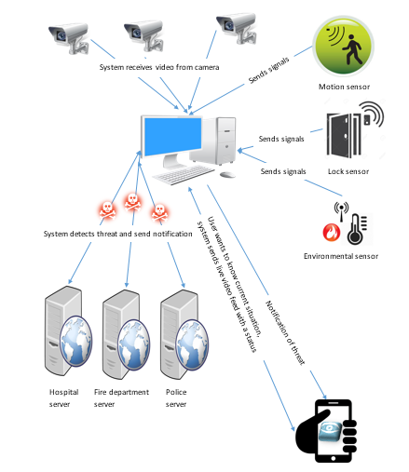
Home Surveillance Security System (HSSS) Rich Picture

Slide 7
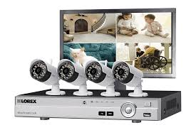
Problems with conventional surveillance system
Setting up surveillance cameras in every corner of the house is very expensive.
Recording surveillance footages needs tapes, computer server and other hardware equipment. Which is also costs very high.
Takes a separate room for computer server and surveillance recording storage.
Consumes high electricity.
High maintenance cost
There might be no one in the house and there is a burglary. There may or may not be an alarm, but no one might have paid attention or called the police, or the police might have been notified but it was too late.
If you are outside of the house, just cameras, tapes and alarms are not enough because
there is no way to get notified unless or until someone calls you.

Slide 8
Solutions with Home Surveillance Security System (HSSS)
Requires the set up of motion sensor cameras and anti-theft lock sensors only So less expensive.
No tapes, no recording, so no extra expenses, Only a small computer server with our software is needed for the Surveillance and networking.
Only still pictures would be taken as evidence and sent on mobile phone(s) of the User and to The Police server and they will be notified about possible crime immediately.
Only needs a small corner of the room.
Less Equipment so less Maintenance cost
Consumes less electricity.

Slide 9
How Home Surveillance Security System (HSSS) is unique
The Home Surveillance Security System (HSSS) can detect any intrusion through sensor and intelligent AI to recognize known/unknown face and understand environment, gesture and movements of the suspect for their motives.
The system detects the changes of pattern and take decision to notify appropriate authorities through decision making tools. By doing this it can reduce the amount of loss or can prevent the threat.
During any occurrence it takes still pictures as evidence and sent on mobile phone(s) of the User and to The Police server and notifies them about of possible crime immediately. This would help the police to take actions rapidly and let the user know about the situation instantly. So even if the User is outside he/she will know what happens inside his/her house.
Also the User can request to view the current situation of the house any time and from anywhere through his/her mobile phone(s). And as depends on the situation the Home Surveillance Security System (HSSS) notifies necessary authorities by itself, there is no need for 24 hour monitoring.

Slide 10
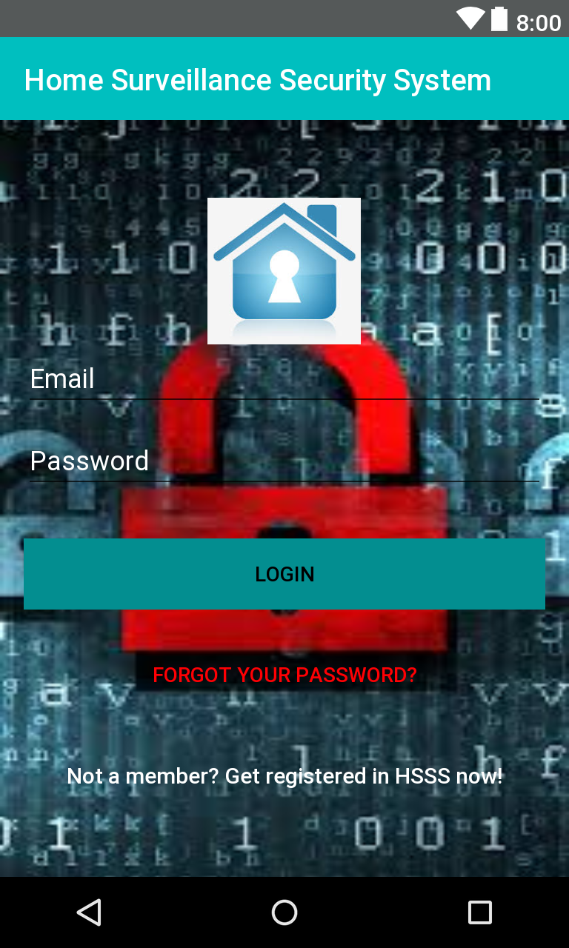
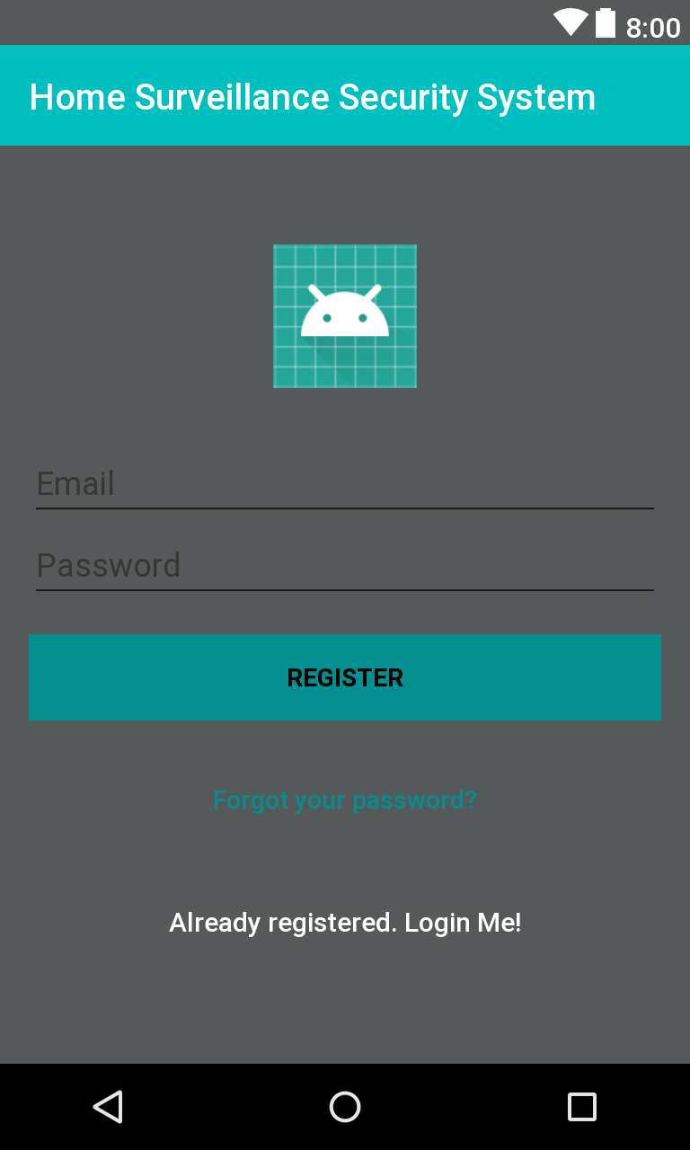
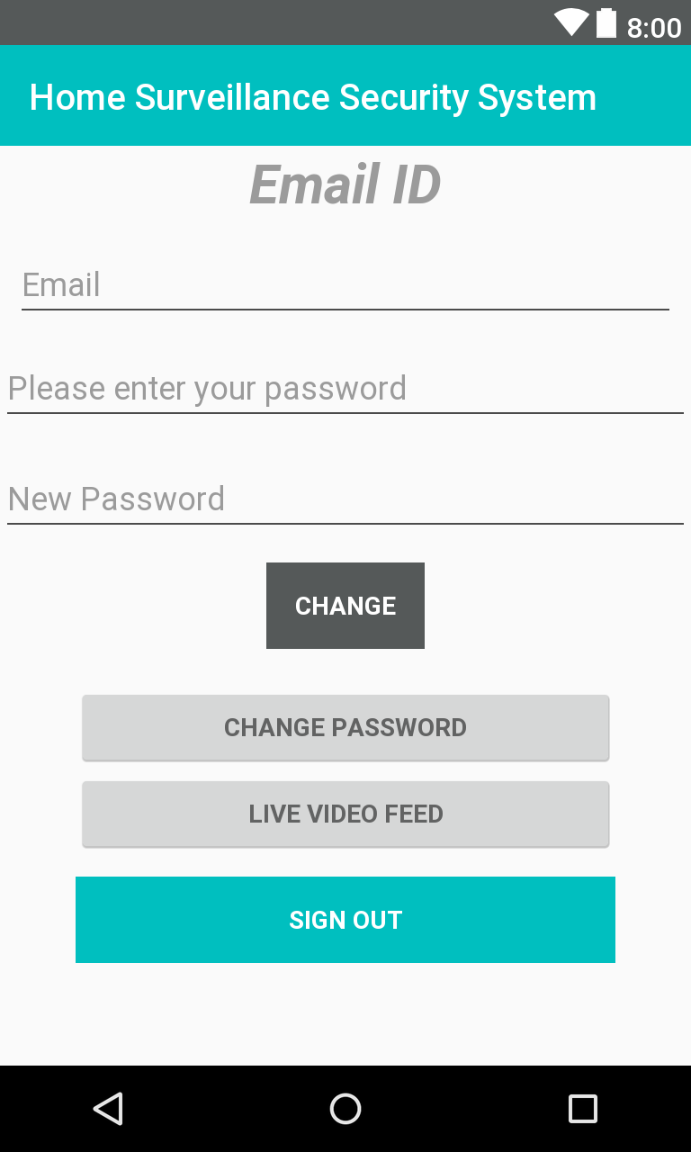
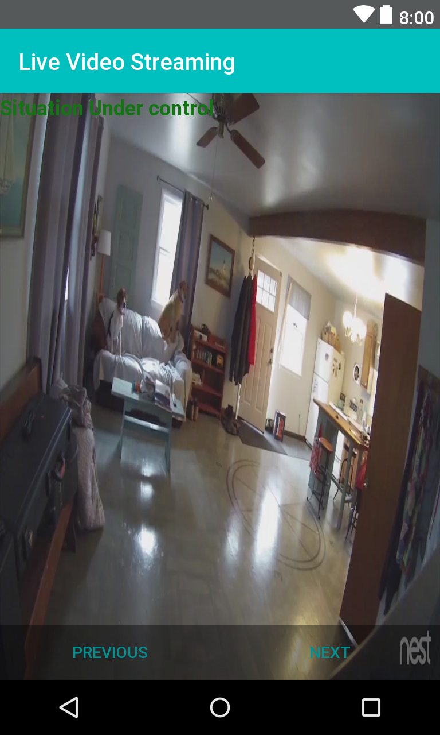
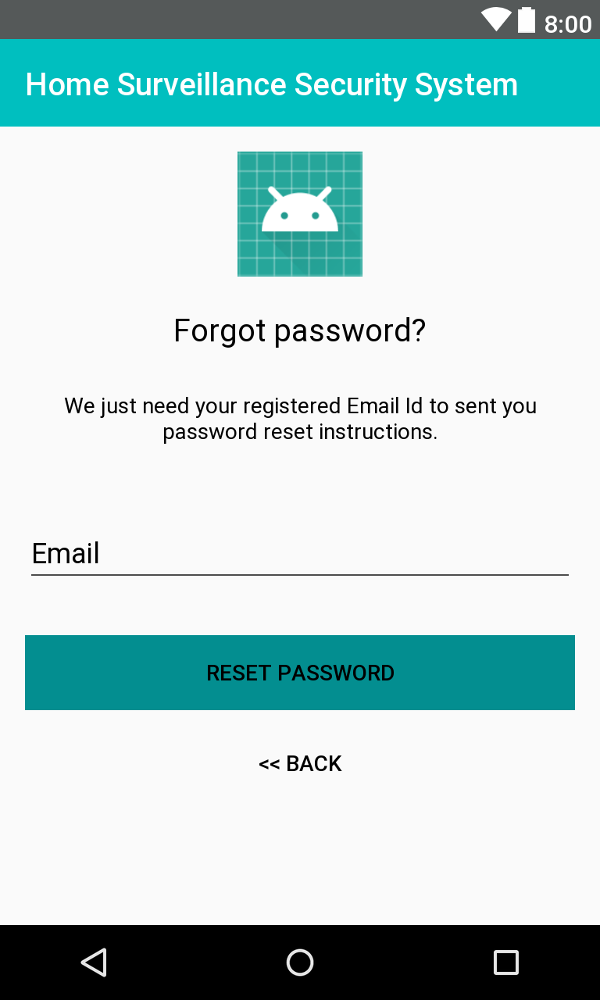
Mobile App for HSSs users

Slide 11
Mobile App for HSSs users
Developed to establish communication between User and the Server.
User can easily use the App to see current situation of the house with live video feed.
Gets notification instantly if there is any incident
Directly connected with the HSSS server through the Internet so faster response.
Gets constant update of the situation.
Easy to use and very helpful.

Slide 12
Why HSSs ??
Best Home Surveillance System in the market with High quality equipment's and top of the line services.
State of the arc technology, used for the software of the System.
Very low maintenance cost, takes less space and easy to install.
All these, but at a very affordable price.
Efficient, Dependable, Easy.
Buy HSSS and make your home smart, secured and safe. Live life tension free.

Slide 13


