Slide 1
Team 6
Mutual Fund Performance Analysis

Slide 2
Introduction
Investigation of Mutual Fund Performance
Comparison of performance of open-ended, growth and Dividend oriented equity schemes for the last five years i.e. from January 2013 to December 2017 of transition economy for a total of 8 Mutual Fund Houses. Asset under Management (AUM) and Net Asset Value (NAV) growth values were used to compare the different fund houses and their scheme.
To investigate the better performance we also measure some other financial ratios i.e. Sharpe ration and Jensen’s alpha measure of each individuals scheme
Feature importance of Age of Fund Family, Minimum Initial Investment on Net annual Return of each individual scheme and we also looked other Macro economical factor which influence the Net annual Return of Mutual Fund Industry.

Slide 3
DATA Featuring
We have separated the NAV data of 8 Mutual funds of each individual open-ended, growth and Dividend oriented equity schemes and their AUM value from amfiindia.com Quarterily.
For Further performance comparisons
Age of Fund
Minimum Initial investment
Expense Ratio
Commodity Exchange rate
Indian Stock indices: Nifty 50, Nifty Pharma, Nifty Banking etc.
US stock exchange: S&P 500 index, NASDAQ Composite, Dow Jones Industrial Average
Macro & Micro Economic factor
Quarterly AUM_Weighted_NAV rate of return (%) sector wise
We have used all this data quarterily measure and compare performance of mutual fund scheme

Slide 4
PART 1
Performance of Eight Mutual Funds House
Based on Total AUM
Based of AUM weighted NAV rate of return
Based on Financial Ratio i.e. Sharpe Ration, Jensen's alpha

Slide 5
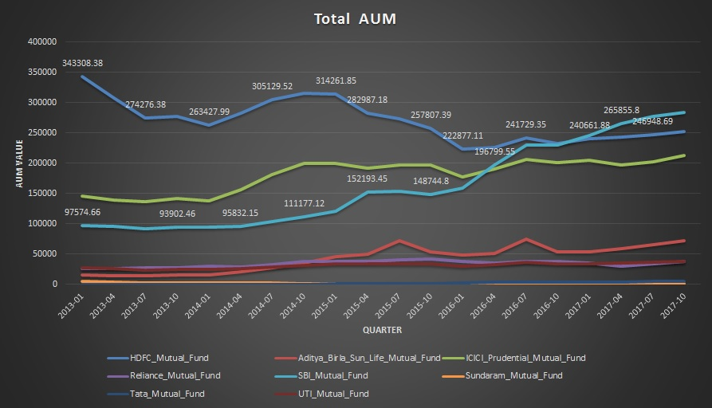
Comparison of Total AUM of eight Fund houses
We compared Total Asset Under Management (AUM) Growth of all the 8 house, where AUM growth signifies the increasing trust and Positive sentiments of investor toward that particular Fund house.

Slide 6
{CODE} and procedure
Result:
The above graph shows us the value of AUM over the years for the different fund houses. Looking at the total AUM value of each individual fund house, we observed that the AUM of SBI Mutual Fund increased significantly over the period of five years while some of the fund houses showed a steady growth except HDFC mutual fund which showed a decrease of the AUM value. It basically shows the increasing trust of investors in SBI Mutual Fund and thus the better performance of SBI mutual Fund compared to others.

Slide 7
Performance comparisons of NAV Growth rate
Each funds house have many scheme for specific sector like Pharma, FMCG etc. So we compared the sector performance of each houses instead to individual scheme.
we measured quarterly AUM_weighted_NAV growth rate of each sector i.e. Pharma & Healthcare, Large Cap, Banking & Finance, FMCG, Technology. AUM_weighted_NAV helps to avoid the problem of having different number of scheme in each Mutual Fund house
We compared these values to the benchmark index to understand which fund house sector is performing better relative to the other. A good mutual fund scheme is the one that consistently manages to outperform its benchmark over 3-5 years.
To compare the Fund House based on NAV growth rate,
{CODE}

Slide 8
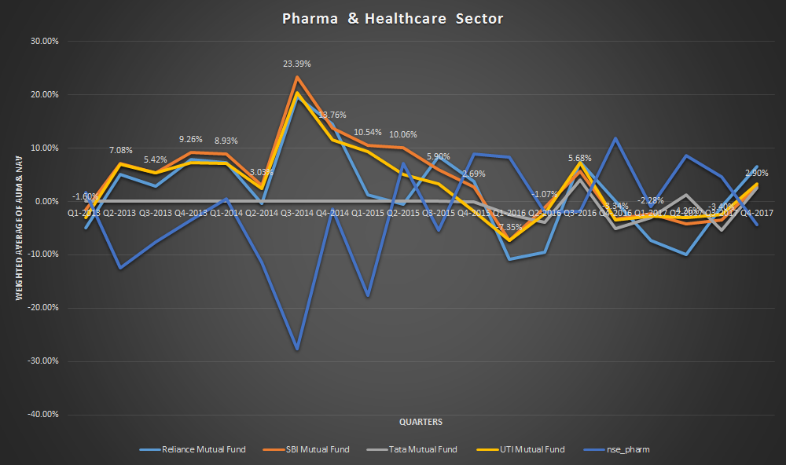
Pharma & Healthcare
UTI Mutual fund perform better than NSE pharma Benchmark while TATA fund house performance is almost close enough and other fund house underperformed

Slide 9
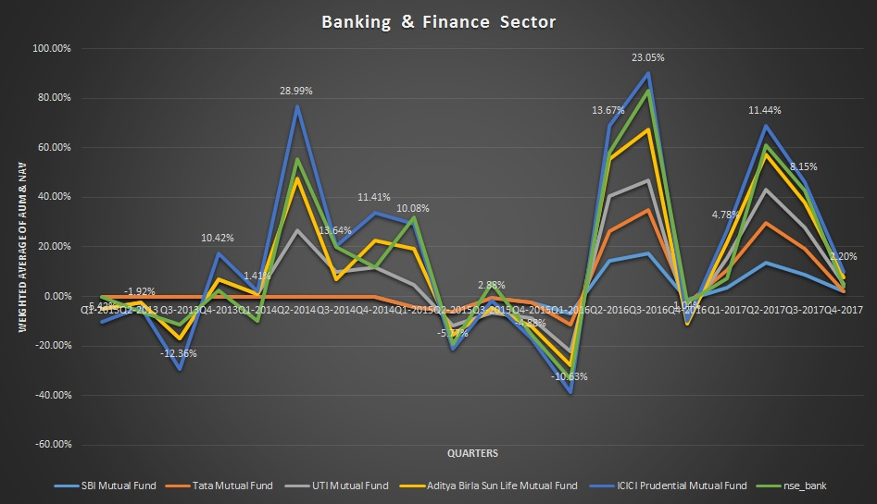
Banking & Finance
ICICI fund house performance is better while Aditya Birla Sun Life Mutual Fund performance is almost close enough to nse_bank benchmark and other fund house underperformed.

Slide 10
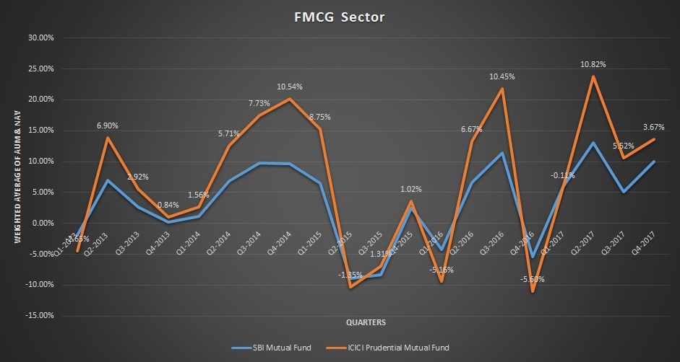
FMCG
ICICI fund perform better than other fund houses.

Slide 11
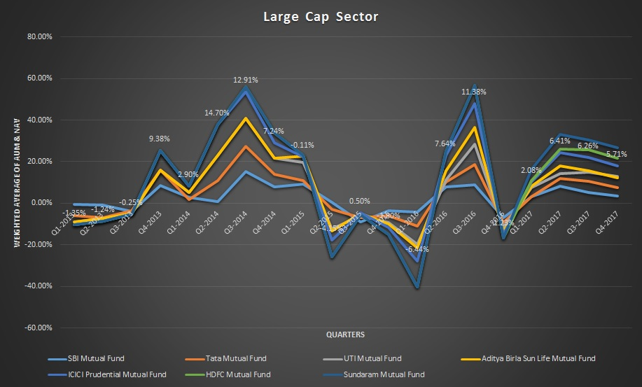
Large Cap
ICICI mutual fund & Sundaram Mutual Fund perform better than other

Slide 12
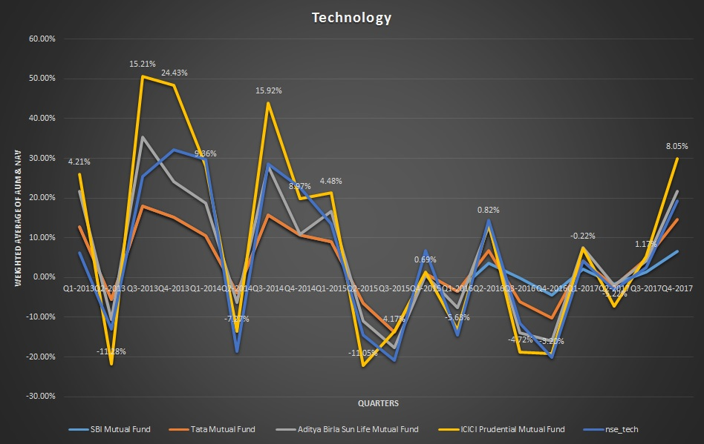
Technology
ICICI fund house performance is better while Aditya Birla Sun Life Mutual Fund performance is almost close enough and other fund house which includes Tata Mutual Fund, SBI Mutual Fund etc. underperformed. The benchmark taken here is NSE Nifty Technology and thus the comparison is done with respect to it.

Slide 13
Overall NAV Growth Analysis
SECTOR | Better Fund house performance
Pharma & Healthcare | UTI Mutual Fund, TATA
Banking & Finance | ICICI, Aditya Birla Sun life
FMCG | ICICI
Large Cap | ICICI, Sundaram
Technology | ICICI, Aditya Birla Sun Life

Slide 14
Performance based on Financial Ratio
1. Sharpe Ratio
This ratio measures risk-adjusted performance. It is calculated by subtracting the risk-free rate of return (Here we have chosen annually Bond interest rate) from the rate of return for an investment and dividing the result by the investment's standard deviation of its return.
The Sharpe ratio tells investors whether an investment's returns are due to smart investment decisions or the result of excess risk. The higher the Sharpe Ratio, the better the fund has performed in proportion to the risk taken by it.
Sharpe ratio(SR) = (Mean portfolio return − Risk-free rate)
Standard deviation of portfolio return
.
{CODE} and Description

Slide 15
We have analyzed the Sharpe ratio of 34 mutual fund schemes for last 5 years and found that those greater than 1 are better for investment purpose. Higher the value of Sharpe ratio, better the scheme for investment
Fund_Name | Id | Sharpe
SBI Magnum Equity Fund (D) | 101295 | 28.65702355
UTI Top 100 Fund - Direct Plan (D) | 120664 | 14.056
Aditya Birla Sun Life Banking And Financial Services Fund - Direct Plan (D) | 125598 | 9.86
HDFC Large Cap Fund (D) | 130497 | 7.926
SBI Banking & Financial Services Fund - Direct Plan (D) | 133860 | 7.021
Tata Banking and Financial Services Fund - Regular Plan (Dividend Payout) | 135790 | 5.228
Tata Digital India Fund - Direct Plan (Dividend Payout) | 135795 | 5.068
Tata Digital India Fund - Regular Plan (Dividend Payout) | 135796 | 4.221
Tata India Pharma & HealthCare Fund - Direct Plan (Dividend Payout) | 135807 | 3.928
Sundaram Smart NIFTY 100 Equal Weight Fund - Direct Plan (D) | 140448 | 1.002
SBI Pharma Fund - Direct Plan (D) | 119782 | -0.858041663

Slide 16
2. Jensen’s alpha
Alpha measures the difference between a fund's actual returns and its expected performance, given its level of risk. It represented by percentage indicates underperformance or Outperformance of a portfolio. A positive alpha means the fund has outperformed its benchmark index. Correspondingly, a negative alpha would indicate an underperformance.
As a fund's return and its risk both contribute to its alpha, two funds with the same returns could have different alphas.
Alpha = {(Fund return-Risk free return) – (Funds beta) *(Benchmark return- risk free return)}.
Fund return: Quarterly NAV growth rate of each scheme.
Risk Free Return: Interest rate of Annually government bond
Funds Beta: a measure of the volatility, or systematic risk, of each scheme in comparison to the market as a whole (NIFTY 50).
{Code & Description }

Slide 17
We have analyzed the Jensen's Alpha of 34 mutual fund schemes for last 5 years.
Fund_Name | Scheme ID | Alpha
SBI Magnum Equity Fund (D) | 11295 | 28.66
UTITop 100 Fund - Direct Plan (D) | 120664 | 14.06
Aditya Birla Sun Life Banking And Financia lServices Fund - Direct Plan (D) | 125598 | 9.86
HDFC Large Cap Fund (D) | 130497 | 7.93
SBI Banking & Financial Services Fund - Direct Plan (D) | 133860 | 7.02
Tata Banking and Financial Services Fund - Regular Plan (Dividend Payout) | 135790 | 5.23
Tata Digital India Fund - Direct Plan (Dividend Payout) | 135795 | 5.07
Tata Digital India Fund - Regular Plan (Dividend Payout) | 135796 | 4.22
Tata India Pharma & HealthCare Fund - Direct Plan (Dividend Payout) | 135807 | 3.93
Sundaram Smart NIFTY 100 Equal Weight Fund - Direct Plan (D) | 1404481 | 1.02
SBI Pharma Fund - Direct Plan (D) | 119782 | -0.85804
Sundaram Equity Plus (D) | 15242 | -16.0506
HDFC Top 200 Fund (D) | 02001 | -16.7313
UTI Banking Sector Fund (D) | 02402 | -17.059
SBI Blue Chip Fund (D) | 03616 | -19.1309
SBIIT Fund (D) | 100643 | -19.48

Slide 18
PART 2
Feature importance of Age of Fund Family, Minimum Initial Investment on

