Slide 1
Distributed Consensus and Coordination in Hardware
Birds of a feather session at Middleware’18
Hosted by: Zsolt István and Marko Vukolić

Slide 2
Outline
Specialized hardware 101
Programmable Switches (P4)
Programmable NICs (ARMs)
Programmable NICs (FPGAs)
RDMA
Spectrum of accelerated solutions
Examples by scope
Examples by location
Discussion

Slide 3

P4
Language to express forwarding rules on switches (and more)
Flexibility: packet-forwarding policies as programs
Expressiveness: hardware-independent packet processing algorithms using general-purpose operations and table lookups.
Resource mapping and management: compilers manage resource allocation and scheduling.
Software engineering: type checking, information hiding, and software reuse.
Decoupling hardware and software evolution: architecture independent, allowing separate hardware and software upgrade cycles.
Debugging: software models of switch architectures

Slide 4
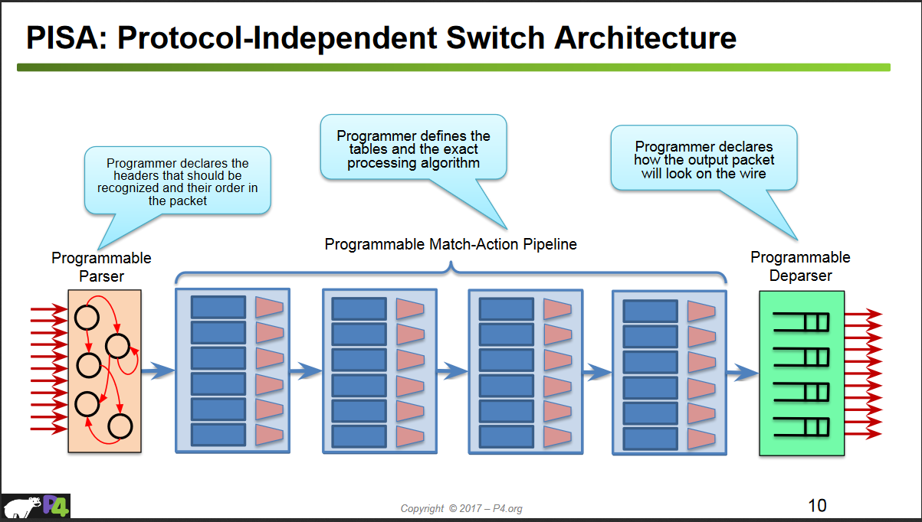
P4 Deployment

Slide 5
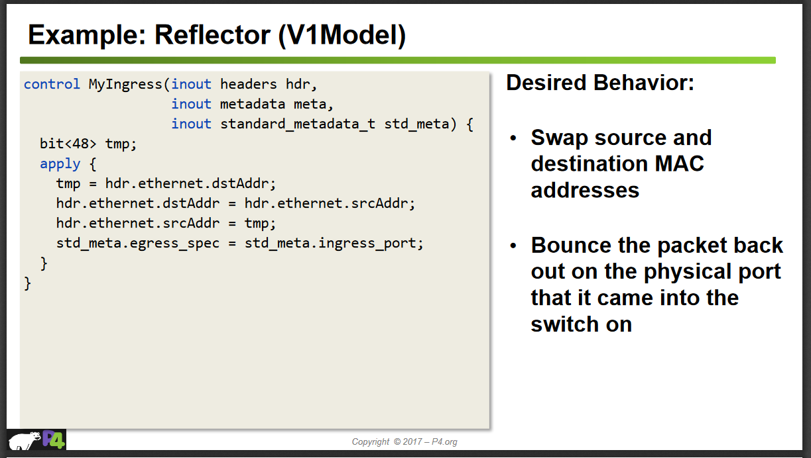
P4 Code Example

Slide 6
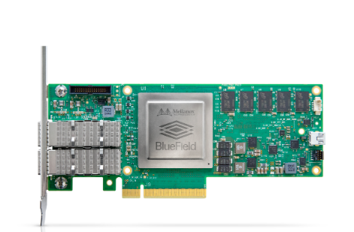
SmartNIC (Arm)
Mellanox Bluefield
2x 25/100 Gbps NIC
Up to 16 Arm A72 cores
Up to 16GB Onboard DRAM
Arms can run commodity software
Best used to implement something like OpenVSwitch
If compute-bound can’t keep up with packets!

Slide 7
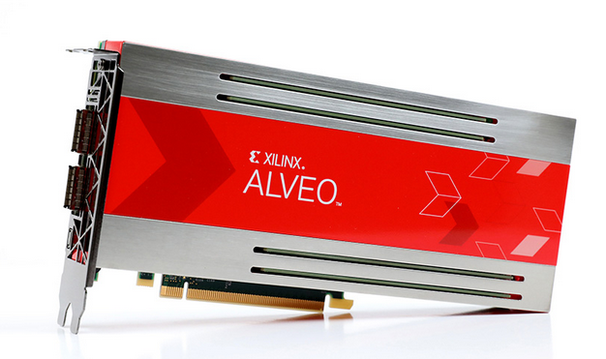
SmartNIC (FPGA)
Xilinx Alveo cards
2x 100 Gbps NIC
Up to 64GB Onboard DRAM
Up to 32MB Onchip BRAM
FPGA
Can guarantee line-rate performance by design
Breaks traditional software tradeoffs

Slide 8
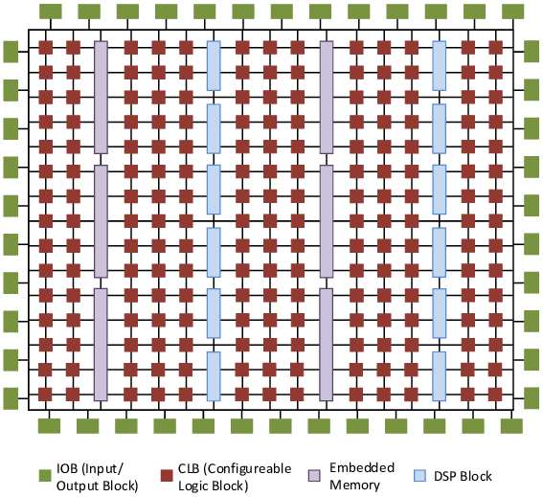
Re-programmable Specialized Hardware
Field Programmable Gate Array (FPGA)
Free choice of architecture
Fine-grained pipelining, communication, distributed memory
Tradeoff: all “code” occupies chip space
Op 1
Op 2
Op 3

Slide 9
Programming FPGAs
Challenge: adapting algorithms to the parallelism of the FPGA
Coding: Hardware definition languages, high level languages
Synthesis: Produce a logic-gate level representation (any FPGA)
Place & route: Circuit that gets mapped onto specific FPGA
Synthesized Circuit
Placed & Routed
Code

Slide 10
FPGA Benefits and Drawbacks
Massive parallelism – both pipeline and data-parallel execution
Arithmetic operations boosted by DSPs
Compute & Data close together thanks to BRAM
Can’t “page” code in or out
Problem is if algorithm core state doesn’t fit in BRAM
10x Less power efficient then ASICs, >10x more power efficient than CPUs

Slide 11
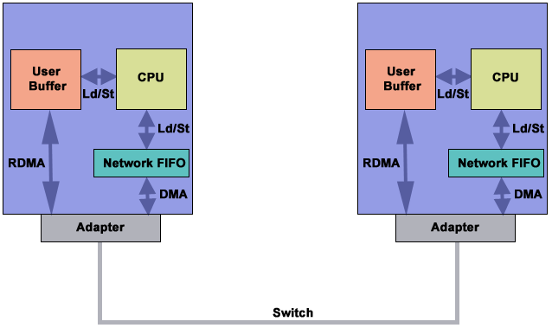
RDMA

Slide 12
Hardware summary
Programmable Switches (P4)
Use forwarding tables
Guarantee line-rate processing
Very high bandwidth
Limited state on device, limited complexity code (e.g. branches, loops)
Programmable NICs (ARMs)
Arbitrary processing
Can’t guarantee line-rate processing
Lower bandwidths
Programmable NICs / Switches (FPGAs)
Arbitrary processing*, supports complex state on device
Can guarantee line-rate processing
High bandwidths
RDMA NICs
No processing, only data manipulation with low latency
Low latency buy removing OS overhead

Slide 13
Hardware landscape
P4 adoption by Chinese companies
https://www.sdxcentral.com/articles/news/barefoot-scores-tofino-deals-with-alibaba-baidu-and-tencent/2017/05/
Smart NICs
E.g., Mellanox
Microsoft Catapult
FPGAs in the cloud
Amazon, Baidu
RDMA support in Azure
https://docs.microsoft.com/en-us/azure/virtual-machines/windows/sizes-hpc?toc=%2Fazure%2Fvirtual-machines%2Fwindows%2Ftoc.json

Slide 14
Consensus in Hardware
Tight integration with network (latency)
Low latency decision making (latency)
Pipelining (throughput)
Follower
Propose
Ack.
Commit
Write
Leader
Propose
Ack.
Commit
Follower
Ordered, reliable channels
Sequencing/reliability in network
Protocol described in: F. P. Junqueira, B. C. Reed, et al. Zab: High-performance broadcast for primary-backup systems. In DSN’11.

Slide 15
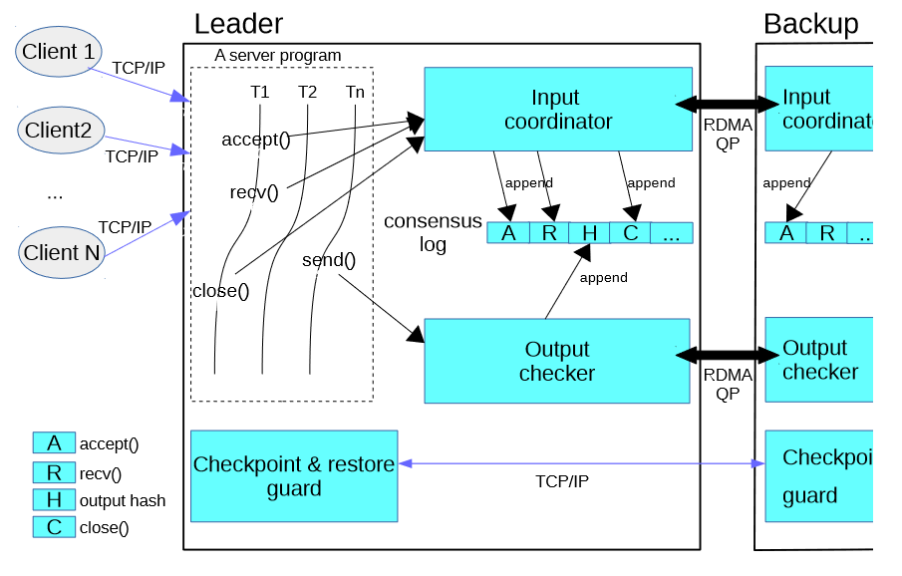
Scope of Acceleration (NICs)
KVS
Replicated operations
Full Protocol
DARE [1]
FARM [2]
Common-case
APUS [3]
Operations
Mellanox Fabric Collective Accelerator (FCA)
Remote log
[1] Poke, Marius, and Torsten Hoefler. "Dare: High-performance state machine replication on rdma networks." Proceedings of the 24th International Symposium on High-Performance Parallel and Distributed Computing. ACM, 2015.
[2] Dragojević, Aleksandar, et al. "FaRM: Fast remote memory." 11th {USENIX} Symposium on Networked Systems Design and Implementation ({NSDI} 14). 2014.
[3] Wang, Cheng, et al. "APUS: Fast and scalable Paxos on RDMA." Proceedings of the 2017 Symposium on Cloud Computing. ACM, 2017.

Slide 16
Scope of Acceleration
Full Protocol
Consensus in a Box [1] – FPGA
NetChain [2] – P4 Switch
Common-case
P4Paxos [3] (NetPaxos [4]) – P4 Switch
Operations
SpecPaxos [5] – OpenFlow Switch
[1] István, Zsolt, et al. "Consensus in a Box: Inexpensive Coordination in Hardware." NSDI. 2016.
[2] Jin, Xin, et al. "NetChain: Scale-Free Sub-RTT Coordination." NSDI 2018
[3] Dang, Huynh Tu, et al. "Paxos made switch-y." ACM SIGCOMM Computer Communication Review 46.2 (2016): 18-24.
[4] Dang, Huynh Tu, et al. "Netpaxos: Consensus at network speed." Proceedings of the 1st ACM SIGCOMM SDN. ACM, 2015.
[5] Ports, Dan RK, et al. "Designing Distributed Systems Using Approximate Synchrony in Data Center Networks." NSDI. 2015.

Slide 17
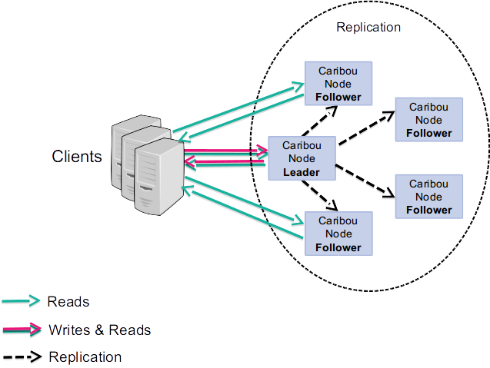
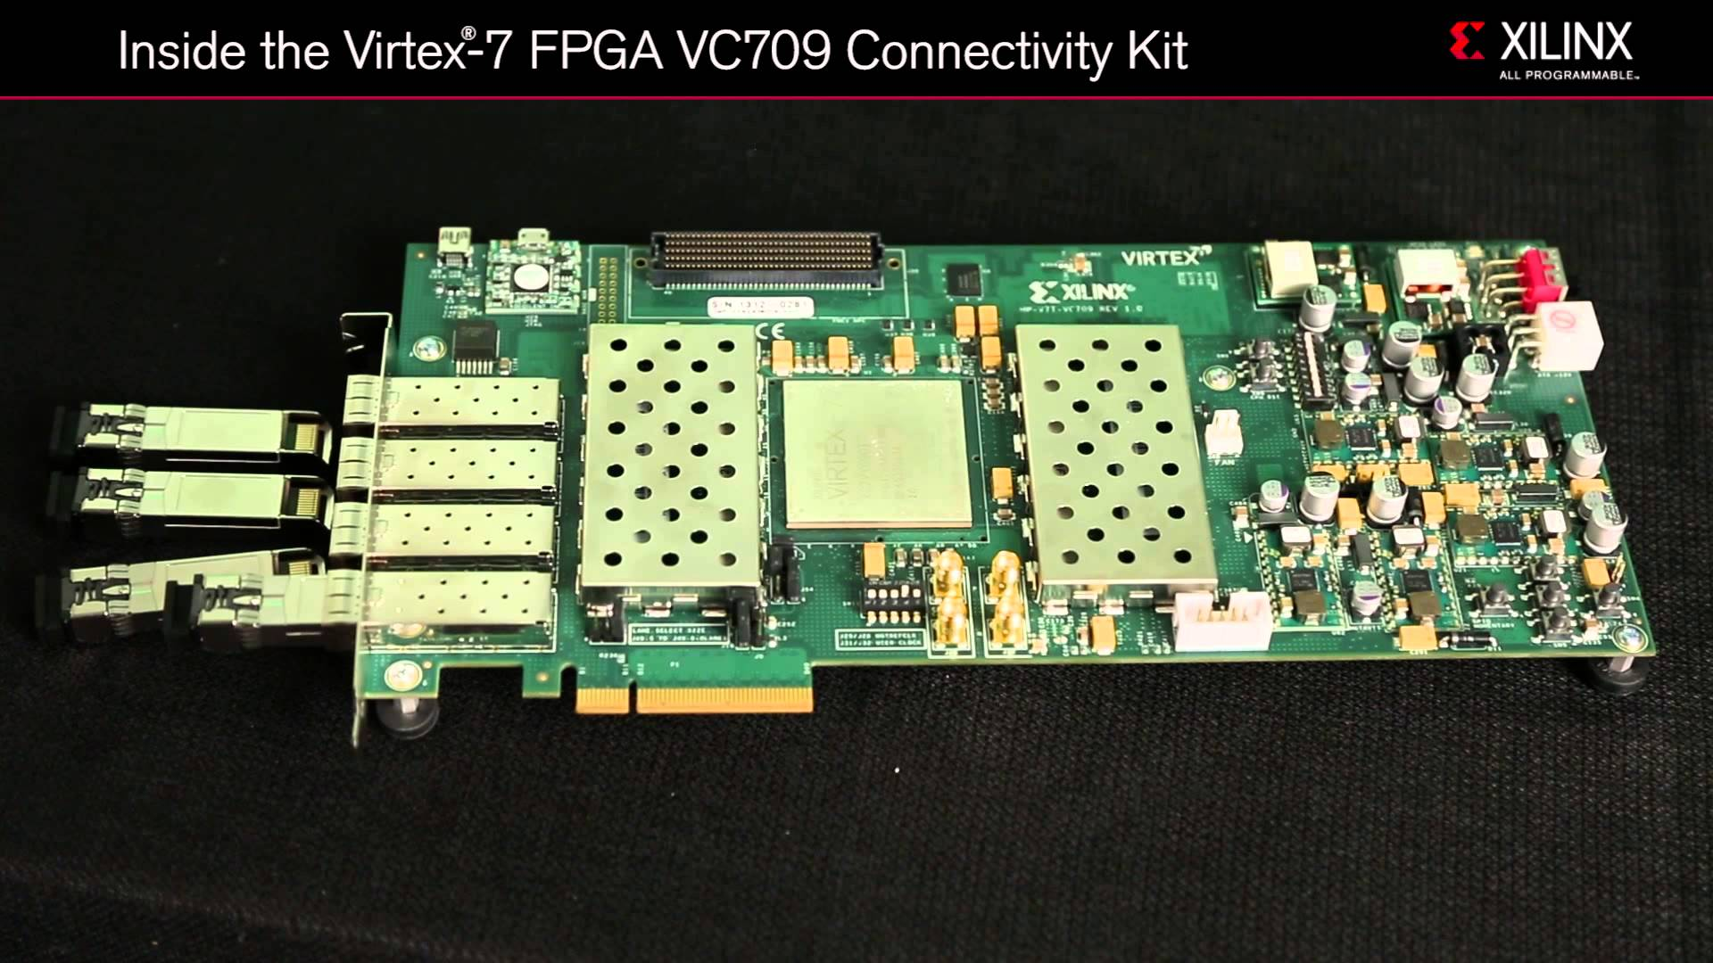
Consensus in a Box (Caribou)
Software clients (>10 machines simulating 1000s of clients)
Binary protocol, but can be used as drop-in replacement for SW key-value stores (e.g. Memcached)
Client-facing and inter-node traffic: 10Gbps TCP
<10μs consensus latency, >1M consensus rounds/s
10Gbps Ethernet
Extension to e.g. SATA, NVMe
FPGA
8GB DDR3 Memory

Slide 18
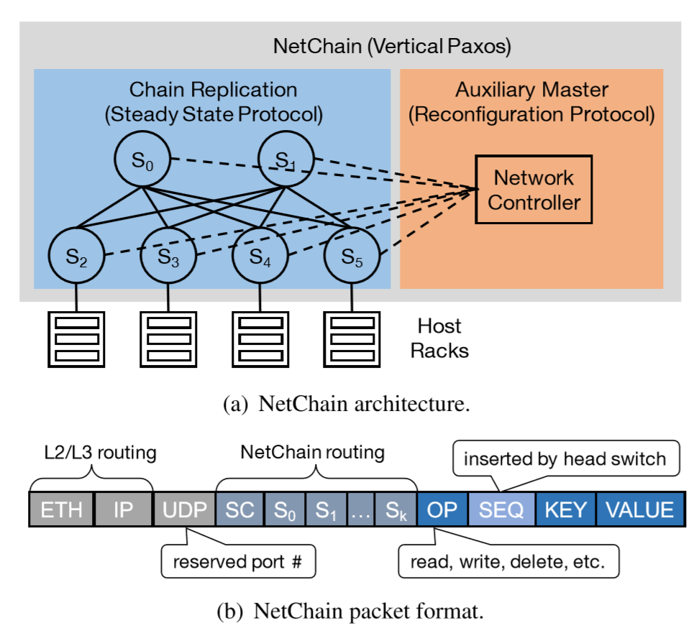
NetChain
Implements KVS in switches
Meta-data store, coordination
“HalfRTT” because no need to reach an other end-host
μs replication (strong consistency)
>100Gbps bandwidth
Limitations on key/value sizes

Slide 19
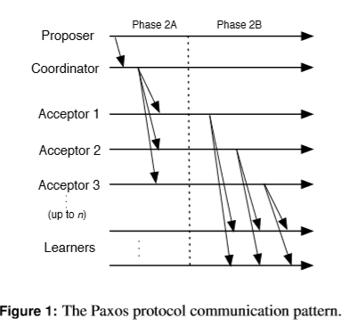
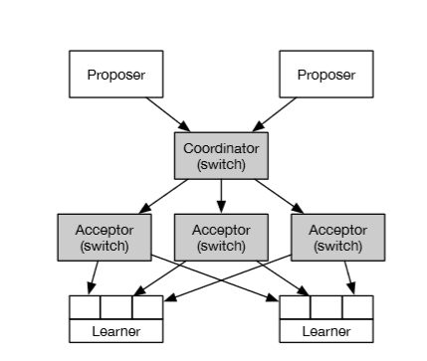
Paxos Made Switchy
Implements the Coordinator and Acceptor roles in P4 Switch
Reconfiguration and recovery, as well as management, are external
Reduces latency and cost on end-hosts

Slide 20
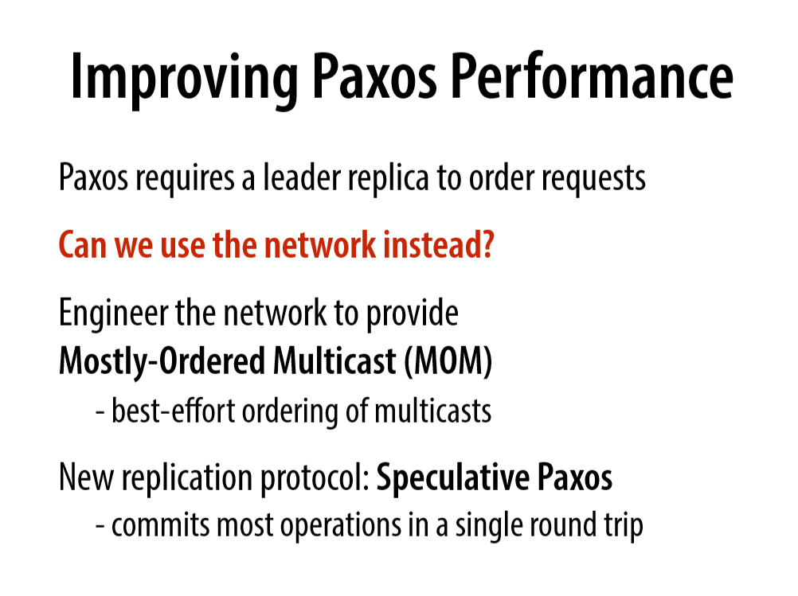
Speculative Paxos

Slide 21
Scope of Acceleration – Gains
Full Protocol
Rely on tight integration of different layers to deliver high throughput/low latency
Specializing the processing to the protocol
Common-case
Benefit from cheaper processing in best case, less egress on end-host
Detect when we are not in best case, fall back logic
Uses less state on the devices then performing entire protocol
Operations
Allow the end hosts to push simple “tasks” of some domain into the network
Generate packets, gain from reducing data movement on egress link

Slide 22
Integration of Acceleration
End hosts (DARE, FARM, Caribou)
Easiest integration
Most control
Split (PaxosMadeSwitchy, ERIS [1])
Integration more complex
Less control
Switch/Middlebox (NetChain)
Packaged as “service”
Independently controlled
[1] Li, Jialin, Ellis Michael, and Dan RK Ports. "Eris: Coordination-free consistent transactions using in-network concurrency control." Proceedings of the 26th Symposium on Operating Systems Principles. ACM, 2017.

Slide 23
Coordinating control plane ops.
A special type of application – Update the changes in the SDN controller, detect errors, etc.
Low latency operation required
Strongly consistent view
Molero, Edgar Costa, Stefano Vissicchio, and Laurent Vanbever. "Hardware-Accelerated Network Control Planes." Proceedings of the 17th ACM Workshop on Hot Topics in Networks. ACM, 2018.
Schiff, Liron, Stefan Schmid, and Petr Kuznetsov. "In-band synchronization for distributed SDN control planes." ACM SIGCOMM Computer Communication Review 46.1 (2016): 37-43.

Slide 24
Application scenarios
Replicated KVS
Maintain consistent view across replicas
Cheaper consensus → switch to strong consistency instead of eventual
Both throughput and latency is important
Could offload at NIC or Switch
Part of a larger application
OLTP Database transactions – lock management
Not necessarily KV pairs, could be a tree
Many concurrent operations – not locking the actual data – throughput and latency both important
Could be done as offload or as independent service
Targeting Distributed Ledgers
Each node (many) takes part in consensus
Operations on top can be expensive (crypto) – unclear how much it is worth optimizing the consensus layer for throughput or latency…
In non-geo replicated scenarios coordination should become the bottleneck
Could be done as offload or as independent service

Slide 25
Application spectrum
1ms app time / coordination op
Distributed ledgers (core ordering)
Machine learning frameworks (parameter server)
100μs app time / coordination op
Relational database engine (lock management)
Some HPC workloads (MPI barriers)
<10μs app time / coordination op
NoSQL database engines (distributed transactions, replication)
Metadata stores (replication)
SDN control plane management (update propagation)

Slide 26
Question1: What about Geo-distribution?
Intuitively hardware acceleration is not useful in this scenario
Or: Can hardware make a difference in keeping algorithms in best case and reduce cost of reconfig/recovery?
Or: …?

Slide 27
Question1: Geo-Distribution
Papers discussed
World-scale
Continent-sc.
City-scale
Datacenter

Slide 28
Question2: What about BFT?
BFT involves more computation → less amenable to low level HW optimization
Could we use hardware to keep algorithm in best case? Anything more?
Could we use some “certification” of hardware to relax assumptions? Etc.

Slide 29
Question3: TPUT vs. Latency?
What ranges are of interest?
What combinations are of interest?
Is the gain a linear or step function?

Slide 30
Question3: TPUT vs Latency + Additional requirement?
ms
Traditional Software Solutions
Most accelerated work
μs
<1k rounds/s
10k rounds/s
>1M rounds/s

Slide 31
Question4: What about programmability?
If we had an Paxos ASIC, would that be useful?
Are algorithms still changing, or we can use common building blocks?

Slide 32
Temperature check
Do we feel that there is more to achieve in this space?
Which direction should we be looking at?

Slide 33

9th Workshop on Systems for Multi-core and Heterogeneous Architectures (SFMA 2019)
https://sites.google.com/site/sfma2019eurosys/
Researchers from operating systems, language runtime, virtual machine and architecture communities
Focuses on system building experiences with the new generations of parallel and heterogeneous hardware
No proceedings!
Important Dates:
Submission: January 17, 23:55 (GMT)
Acceptance: February 10th

