Slide 1

Bug Slayer’s UMLs
Nicci Kellogg, Nina Ivanenko, MacKenzie Miller, Rayleen Roberts, Yareni Perez

Slide 2
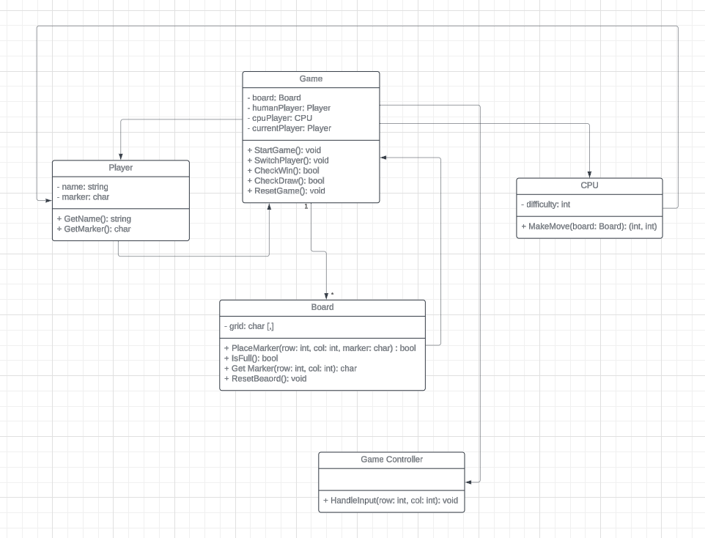

Slide 3
