Slide 1
Advanced Programming
Lab 14, Exceptions, assertion
廖琪梅，王大兴，于仕琪，王薇

Slide 2
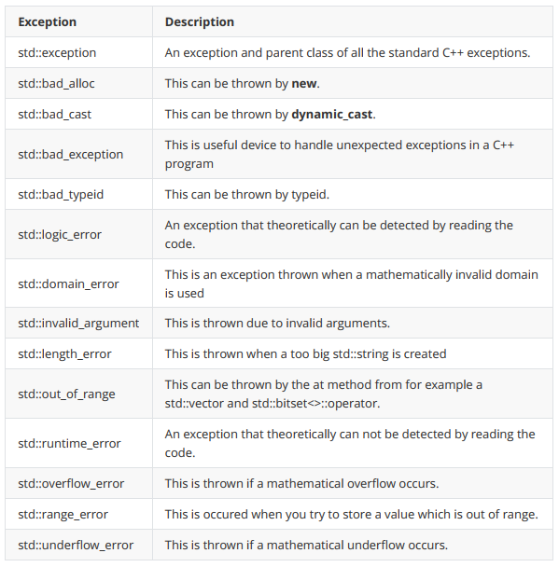
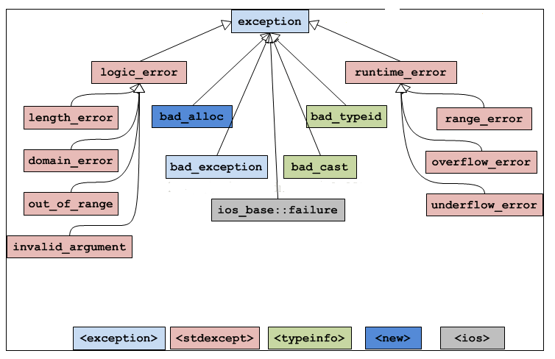
C++ Standard Exceptions
C++ provides a list of standard exceptions defined in which we can use in our programs.

Slide 3
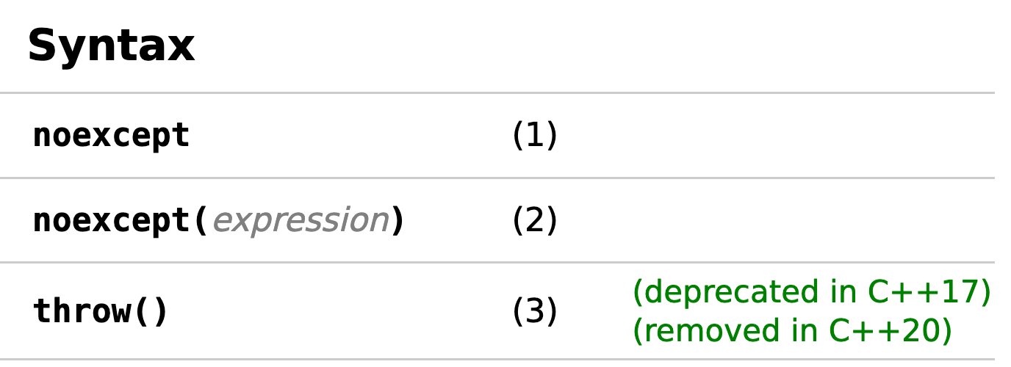
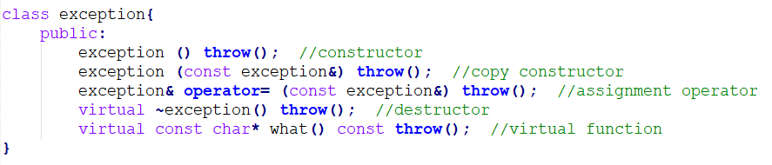
noexcept, noexcept(true), and throw() are equivalent.
Exception specification used in function declaration, with no argument indicates that the function is not allowed to throw any exceptions.
what() is a public method provided by exception class which returns a string and it has been overridden by all the child exception classes.

Slide 4
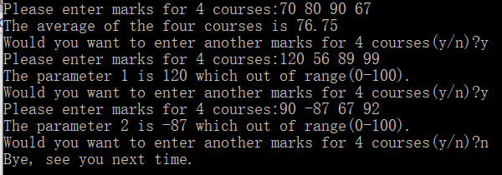
Exercise:
1. Write a function calculateAverage() which takes four int arguments, which are marks of four courses, and returns their average as a float number.
The calculateAverage() function should take only valid range for marks which is between 0-100. If the marks are out of range throw an OutOfRangeException – define this exception as a class.
Invoke the calculateAverage() function in main function and get the following inputs and outputs:

Slide 5
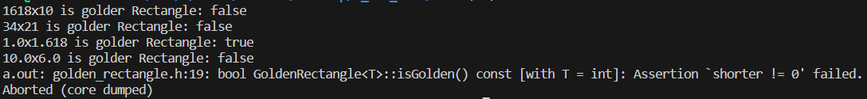
2. Define a generic class “GoldenRectangle” for a golden rectangle in the “golden_rectangle. h” , When testing based on the following main methods, the test results are shown in the bottom figure.
GoldenRectangle class:
two private properties: length and width, and a generic data type.
a public method, which returns a Boolean value.
The method calculates by dividing the long side by the short side. If the quotient is 1.618, it returns true; otherwise, it returns false.
In this method, If the shorter side is 0 (i.e. the divisor is 0), an assertion is triggered.
#include "golden_rectangle.h"
int main() {
GoldenRectangle<int>rect0(1618, 10);
std::cout <<"1618x10 is golder Rectangle: "<<std::boolalpha <<rect0.isGolden() <<std::endl;
GoldenRectangle<int>rect1(34, 21);
std::cout <<"34x21 is golder Rectangle: "<<std::boolalpha <<rect1.isGolden() <<std::endl;
GoldenRectangle<double>rect2(1.0, 1.618);
std::cout <<"1.0x1.618 is golder Rectangle: "<<rect2.isGolden() <<std::endl;
GoldenRectangle<float>rect3(10.0f, 6.0f);
std::cout <<"10.0x6.0 is golder Rectangle: "<<rect3.isGolden() <<std::endl;
GoldenRectangle<int>rect4(10, 0);
std::cout <<"10x0 is golder Rectangle: "<<rect4.isGolden() <<std::endl;
return 0;
}

