Slide 1
Advanced Programming
Lab 2, data types and arithmetic operators in C/C++
廖琪梅，于仕琪，王大兴, 王薇

Slide 2
Topics
1. Formatting with cout and fprintf()
1.1 Using member functions of ios class
1.2 Using iomanip manipulators
2. Exercises
Data types and arithmetic operators

Slide 3
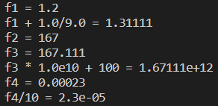
1. Formatting with cout
Floating-point types are displayed with a total of six digits, except that trailing zeros aren’t displayed. The float number is displayed in fixed-point notation or else in E notation depending on the value of the number. In particular, E notation is used if the exponent is 6 or larger or -5 or smaller.
int main()
{
double f1 = 1.200;
std::cout << "f1 = " << f1 << std::endl;
std::cout << "f1 + 1.0/9.0 = " << f1 + 1.0/9.0 << std::endl;
double f2 = 1.67E2;
std::cout << "f2 = " << f2 << std::endl;
double f3 = f2 + 1.0/9.0;
std::cout << "f3 = " << f3 << std::endl;
std::cout << "f3 * 1.0e10 + 100 = " << f3 * 1.0e10 + 100 << std::endl;
double f4 = 2.3e-4;
std::cout << "f4 = " << f4 << std::endl;
std::cout << "f4/10 = " << f4/10 << std::endl;
return 0;
}
Notes:
exponent 指数
科学计数法一般用于指数大于等于6或者小于等于-5的情况
图中示例是c++，c语言里也如此吗

Slide 4
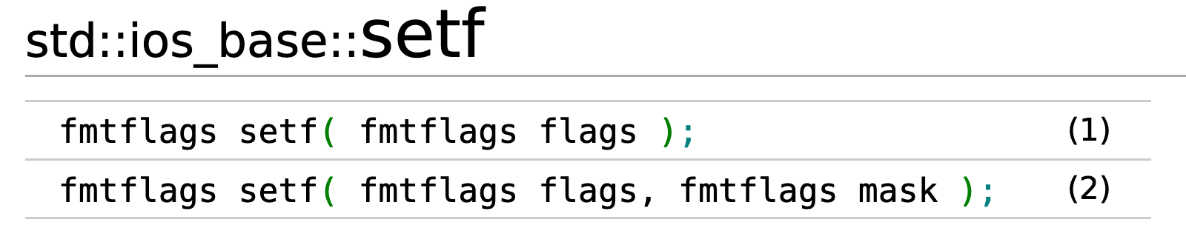
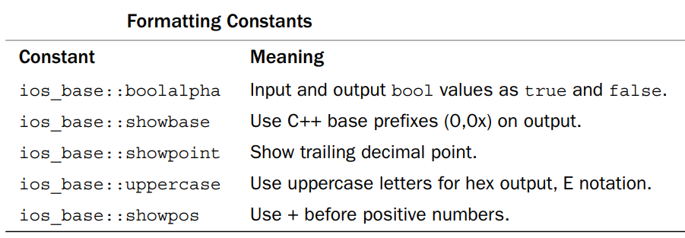
C++ provides two methods to control the output formats
1.1 Using member functions of ios class
1.2 Using iomanip manipulators
1.1 Using member functions of ios class
1.1.1 cout.setf(): The setf() function has two prototypes,the first one is:
cout.set(fmtflags);
Notes:
两种方法：
1. ios中的成员函数
cout 与ios的关系是？
1.1 setf
2. iomanip的 manipulator ？操纵符

Slide 5
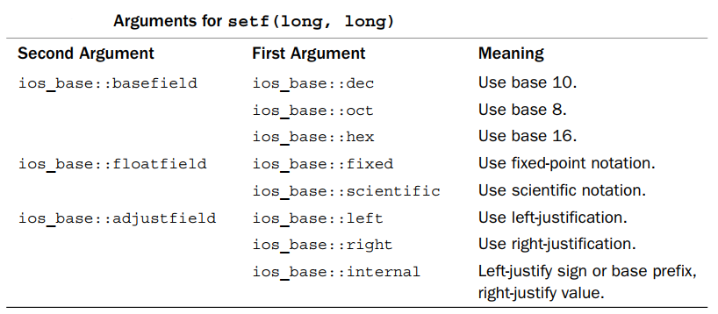
1.1 Using member functions of ios class
The second one is:
cout.set(fmtflags,fmtflags);

Slide 6


1.1 Using member functions of ios class
1.1.2. cout.width(len) //set the field width
1.1.3. cout.fill(ch) // fill character to be used with justified field
1.1.4. cout.precision(p) // set the precision of floating-point numbers
#include <iostream>
using namespace std;
int main()
{
cout << 56.8 << endl;
cout.width(12);
cout.fill('+');
cout << 456.77 << endl;
cout.precision(2);
cout << 123.356 << endl;
cout.precision(5);
cout << 3897.678485 << endl;
return 0;
}
#include <iostream>
using namespace std;
int main()
{
cout.setf(ios_base::fixed, ios_base::floatfield);
cout << 56.8 << endl;
cout.width(12);
cout.fill('+');
cout << 456.77 << endl;
cout.precision(2);
cout << 123.356 << endl;
cout.precision(5);
cout << 3897.678485 << endl;
return 0;
}
significant digits
precision of
floating number
Notes:
科学计数法默认精度是 >=6, 123.256 (1.2e2) 为什么也用科学计数法？

Slide 7

The effect of calling setf() can be undone with unsetf().
#include <iostream>
using namespace std;
int main()
{
bool flag = true;
float f = 0.20f;
cout.setf(ios::showpoint);
cout.setf(ios::boolalpha);
cout << flag << endl;
cout << f << endl;
cout.unsetf(ios::boolalpha);
cout.unsetf(ios::showpoint);
cout << flag << endl;
cout << f << endl;
return 0;
}
Notes:
究竟是 unset（原文） 还是 unsetf（代码中）

Slide 8
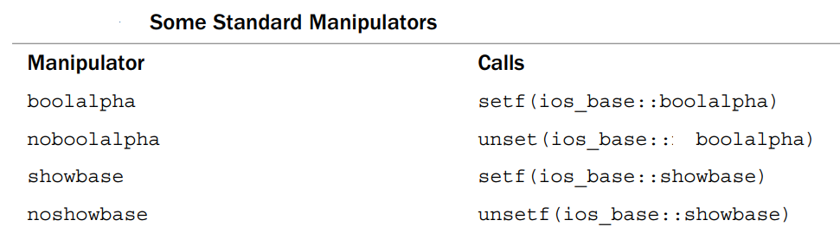
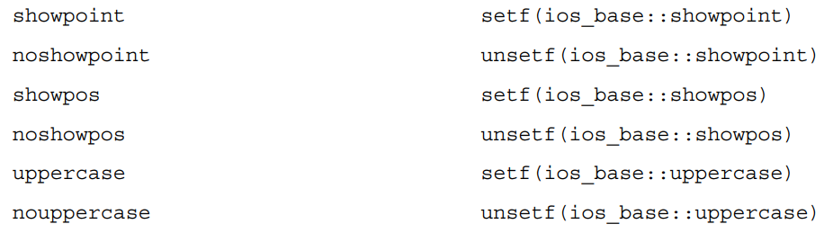
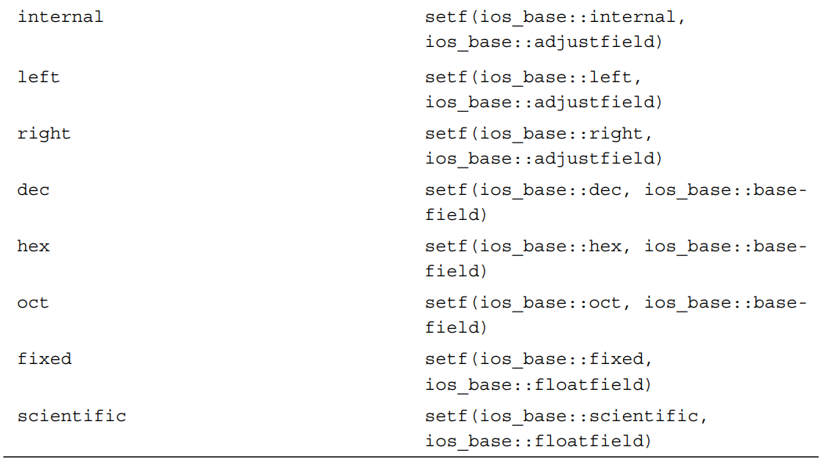
Standard Manipulators
C++ offers several manipulators to invoke setf(),automatically supplying the right arguments.

Slide 9

#include <iostream>
using namespace std;
int main()
{
bool flag = false;
double a = 2.3876;
double b = 0.46e2;
cout << boolalpha << flag << endl;
cout << fixed << a << endl;
cout << b << endl;
cout << noboolalpha << flag << endl;
cout.unsetf(ios::fixed);
cout << a << endl;
cout << b << endl;
return 0;
}
Notes:
cout<<b 是否按fixed来操作？（从代码的运行结果来看是的）

Slide 10
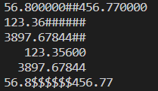
1.2 Using iomanip manipulators
#include <iomanip>
1. setw(p) 2. setfill(ch) 3. setprecision(d)
#include <iostream>
#include <iomanip>
using namespace std;
int main()
{
cout.setf(ios_base::fixed, ios_base::floatfield);
cout << 56.8 << setw(12) << setfill('#') << 456.77 << endl;
cout << left;
cout << setw(12) << setprecision(2) << 123.356 << endl;
cout << setw(12) << setprecision(5) << 3897.6784385 << endl;
cout << right;
cout << setw(12) << setfill(' ') << 123.356 << endl;
cout << setw(12) << setfill(' ') << 3897.6784385 << endl;
cout.unsetf(ios_base::fixed);
cout << 56.8 << setw(12) << setfill('$') << 456.77 << endl;
return 0;
}

Slide 11
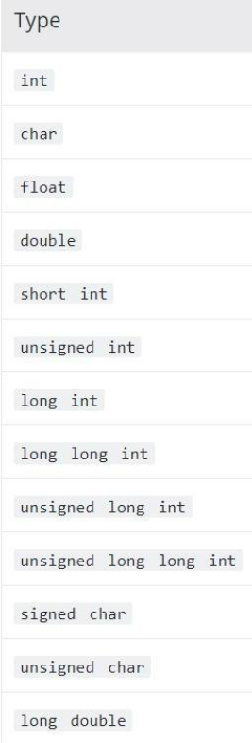
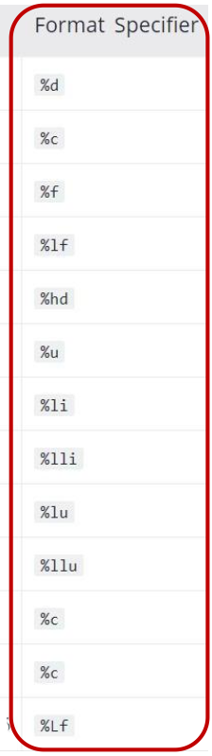
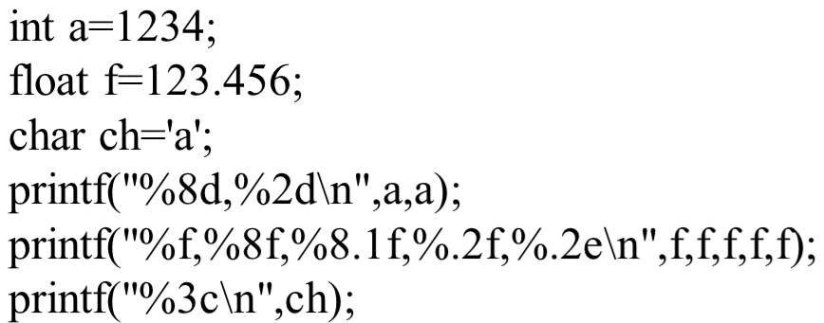
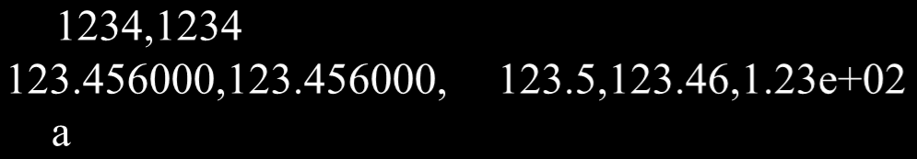
printf() vs cout
Which one do you prefer?
Example:
Sample output:
Notes:
printf vs cout， 性能，资源， 实现原理上区分

Slide 12
2. Exercises
1.Compile and run the following source code, what is the output?
#include <stdio.h>
int main()
{
signed char a = 127;
unsigned char b = 0x7f;
char c = 0x7f;
a=a<<1;
b=b<<1;
c=c<<1;
printf("a=%x\nb=%x\nc=%x\n",a,b,c);
printf("a=%d\nb=%d\nc=%d\n",a,b,c);
a=a>>1;
b=b>>1;
c=c>>1;
printf("a=%x\nb=%x\nc=%x\n",a,b,c);
printf("a=%d\nb=%d\nc=%d\n",a,b,c);
return 0;
}

Slide 13
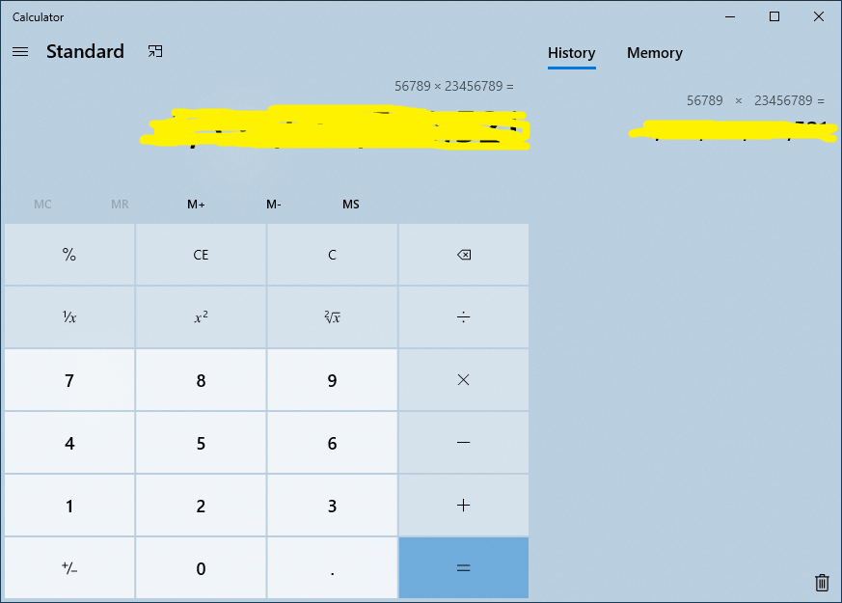
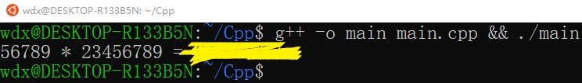
2. Write a program to calculate integer multiplication: 56789 * 23456789, and then print the result. Verify the result using a calculator. If the result is wrong, what is the reason? How to get the correct result?
2. Exercises
Notes:
溢出的问题
结合先加后用，先用后加的问题 （找到临界点的数字，/2 * 一个 i++
或者结合移位进行判断

Slide 14


2. Exercises
3. Run the following source code and explain the result.
#include <iostream> //file name: lab3_p4_3.cpp
using namespace std;
int main()
{
cout << fixed;
float f1 = 1.0f;
cout<<"f1 = "<<f1<<endl;
float a = 0.1f;
float f2 = a+a+a+a+a+a+a+a+a+a;
cout<<"f2 = "<<f2<<endl;
if(f1 == f2) //TIPS: Modify the code here
cout << "f1 == f2" << endl;
else
cout << "f1 != f2" << endl;
return 0;
}
Then using the method learnt in lecture2 to make the output of the code same as following picture .
NOTE: DO NOT use if (f1=f2) instead of if(f1==f2).
Notes:
浮点数的大小 以及 浮点数的比对
使用lecture上介绍的方法来解决

Slide 15
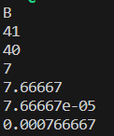
2.Exercises
#include <iostream>
using namespace std;
int main()
{
int a, b;
double c, d,f,g;
char h;
a = 19.99 + 21.99;
b = (int)19.99 + 21.99;
c = 23 / 3;
d = 23 / 3.0;
f = 23 / 3.0e4;
g = 23 / 3.0e5;
h = 'b' - 32;
//complete code here
return 0;
}
4. Complete the following source code to print the variables as the following picture and explain the result.
Why the value of a and b are not equal? Explain the division operation with different types.
Notes:
数据类型转换：强制转换 以及 自动转换
记录c和d中的16进制数 进行展示（可以打印，也可以用debug的方式进行展示

Slide 16
4.Exercises
4.5. What is the output of the code as follows? What is the meaning of auto when defines a variable in C++?
You need to explain the reason to a SA to pass the test.
#include <iostream>
int main()
{
auto a = 10;
a = 20.5;
a += 10.5;
std::cout << a << std::endl;
auto b=10.0;
b = 20.5;
b +=a;
std::cout << b << std::endl;
return 0;
}

