Slide 1
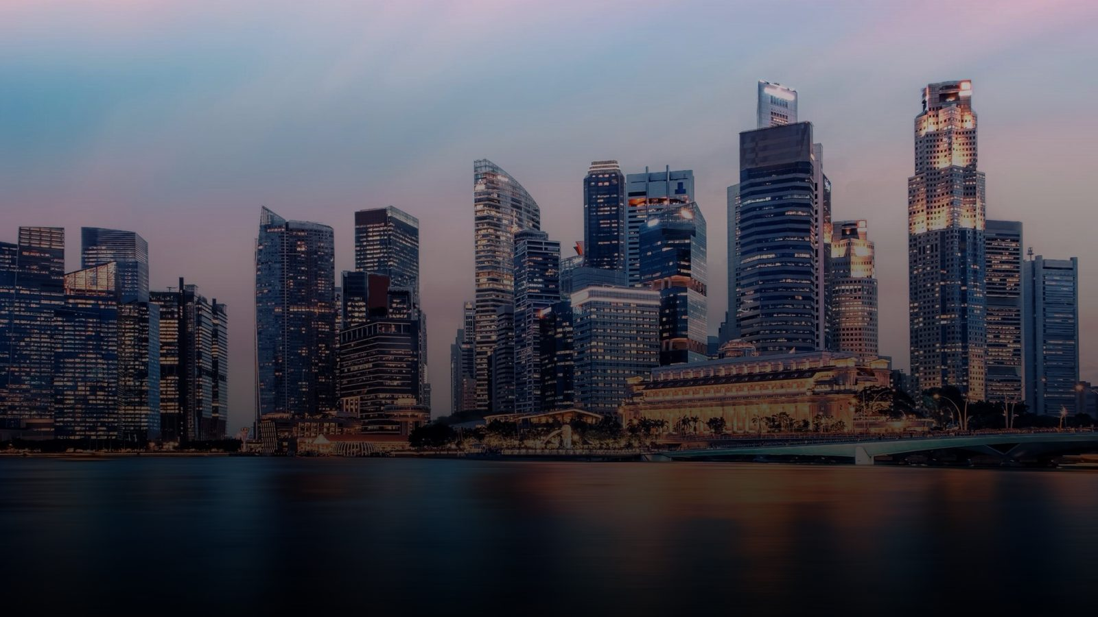
PARTNER PRESENTATION
AsiaGO Pass!
Taste the City. Live the Story.
Connecting discerning travellers with Singapore's dining experiences.

Slide 2

INVESTOR & PRODUCT OVERVIEW
Singapore's Smart Travel
& Lifestyle Pass
AsiaGO Pass! is an advanced, technology-driven platform built around convenience, personalization and customer engagement.
One Pass. Unlimited Discoveries.
SG GO!
13

Slide 3



THE MODEL
AsiaGo Pass! Digital Credit Wallet
Build Your Own Itinerary
Flexible travel your way : Design your own itinerary and choose the experiences that matter most to you. AsiaGO Pass gives you the freedom to travel according to your interests and budget –without being tied to fixed package
Save More with Curated Package : Take advantage of our specially curated packages and enjoy saving of up to 50% on more, helping you experience more while spending less on your trip.
A Credit Wallet System
Customers purchase Asia GO! Pass credits and spend them across participating attractions, restaurants, hotel Packages, transport services and retail partners.
Loyalty & Rewards
Bonus credits, exclusive privileges and VIP benefits on top-ups or spend above set thresholds drive repeat engagement.
SG GO!
15

Slide 4
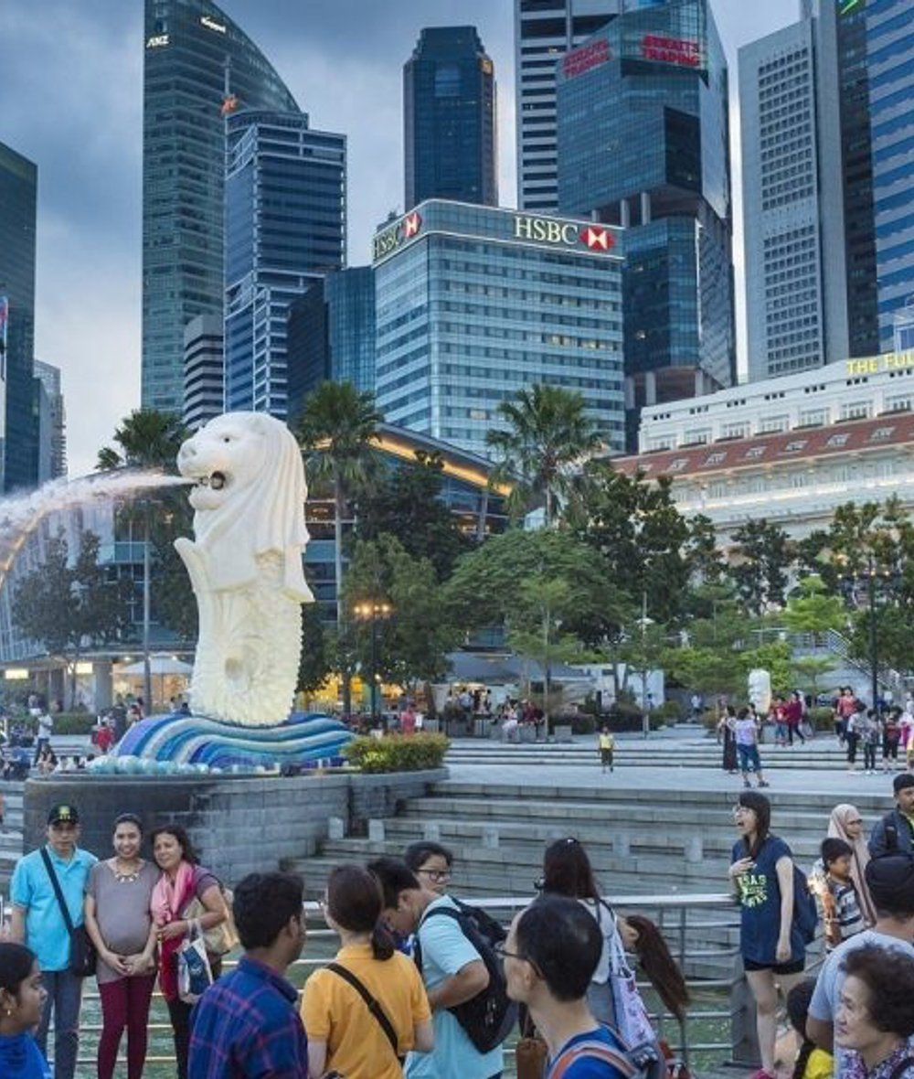

THE OPPORTUNITY
Singapore welcomes millions
of visitors every year
Despite strong tourism growth, many restaurants, wellness still struggle to:
Attract new international customers
Gain visibility beyond hotel concierge recommendations
Fill off-peak dining periods
Reach younger, affluent travellers
Stand out in a competitive dining landscape
The time-poor professional
The long-layover traveller
Seeking premium, curated evening experiences.
Exploring Singapore without the stress of planning.
AsiaGo Pass ! helps bridge this gap.

Slide 5





Attractions & Experiences ⭐
THE PROBLEM
The Current Tourist Journey
Four Disconnected Tools
A Fragmented Experience
Too many websites
Separate attraction tickets
Attractions & Experiences
Dinning Privilege Benefit & Restaurant reservations
Hard to discover hidden gems
Limited dining recommendations
Ride and Transfer Service
Partners Exclusive Benefit
No unified rewards system
AsiaGO Pass!
17

Slide 6
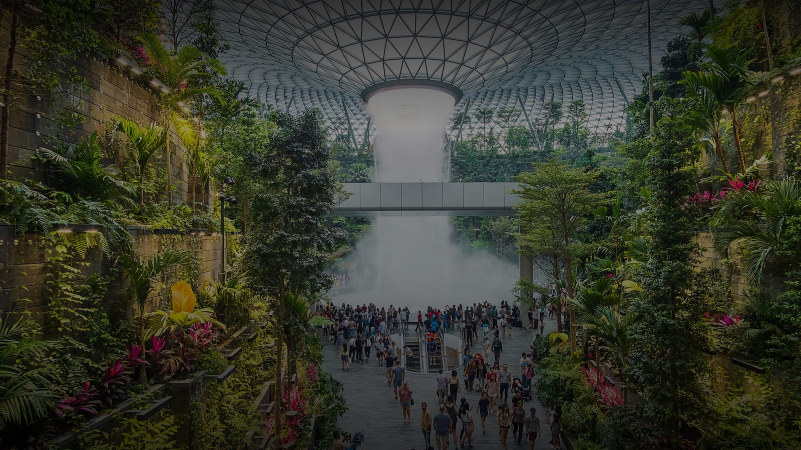


OUR VISION
Building Singapore's leading
experience platform
Taste
Discover
Experience
Asia
Asia
Asia
All through one seamless ecosystem.
All through one seamless ecosystem.
All through one seamless ecosystem.
Together with our restaurant partners, we create unforgettable visitor experiences — and measurable business growth.

Slide 7


HOW IT WORKS
A Fully Digital Experience
Customers purchase and manage their travel packages before arriving in Singapore — through a dedicated mobile app and website.
Buy & Manage Anywhere
No Physical Cards
Everything Digital
Purchase and manage travel packages before arriving in Singapore via the dedicated app and website.
Unlike traditional tourist passes, there is no need to collect physical cards on arrival.
All access, redemption and booking management is handled digitally through the AsiaGO Pass platform.
AsiaGO! Pass
14

Slide 8

THE EXPERIENCE
Seamless QR Redemption
“Tourists enjoy seamless entry to Singapore's top attractions with a single QR code. No physical tickets, no voucher printing, and no complicated redemption process.”
This helps investors and attraction partners immediately understand how AsiaGO! Pass simplifies the visitor experience while making redemption fast for merchants and attractions.
One Pass. Unlimited Discoveries.
AsiaGO! Pass
23

Slide 9


PRICING
AsiaGO! Pass Packages
AsiaGO Privilege Pass
3-day pass
AsiaGO Signature Pass
1-day Pass
AsiaGO Experience Pass
SGD 498 Child 299
2-Day Pass
-
Optional 10 attractions and Lifestyle experience
AsiaGo Welcome drink
Exclusive member privilege benefit
Valid 3 consecutive days
Wellness retreat (Spa massage Yoga)
Shopping Lifestyle offer
🍽️ 3 Dinning Experience ( Restaurant afternoon tea, Rooftop bar ,Buffet Access only Restaurant privilege
Save more on your AsiaGO pass member dinning befefit (Discount & special offeres at selected Restaurant
SGD 158 Child 98
SGD 358 Child 259
2 Attractions of your choice
Enjoy Bonus Dinning Experience
Complimentary member rewards
Member dinning benefit (Discount and
Special offers at selected Restaurant
5 Top attractions
Valid 2 consecutive days
AsiaGO welcome drink
2 Dinning experience included
Complimentary member Rewards.
Kid- Friendly Restaruant experience
Save more on your AsiaGO Pass
Member dinning benefit (discount & special offers at selected Restaurant
TARGET
Perfect for every Travelers
TARGET
TARGET
Families ,Couples, friends
Flexible-Spending Travelers
AsiaGO! Pass
19

Slide 10
AsiaGO PASS · FEATURED EXPERIENCE PACKAGE
Universal Studios + Oceanarium
Two world-class destinations in one epic day — blockbuster rides and movie magic by morning, the wonders of the ocean by afternoon.
ADULT
S$148
per person · fully inclusive
CHILD
S$148
per person · fully inclusive
FAMILY OF 4
S$592
2 adults + 2 children
WHAT'S INCLUDED
WHY TRAVELLERS CHOOSE THIS
Complimentary shared hotel pick-up & drop-off
AsiaGO signature welcome drink
Universal Studios Singapore — all 7 themed zones, all rides
Thrill rides, live shows & character meet-and-greets
S.E.A. Oceanarium — 100,000+ marine animals, 800 species
Open Ocean panel: manta rays, sharks & dazzling fish
10 ocean zones — dolphins, rays, seahorses & coral reefs
Two world-class venues
SEA's only Universal Studios + one of the world's largest aquariums
Truly all-inclusive
Every ride, zone & exhibit — no surprise gate add-ons
Thrills meets tranquillity
High-energy park by morning, ocean calm by afternoon
Built for every age
Toddler-friendly Oceanarium + teen-thrilling USS rides
Side by side in Sentosa
No extra travel between the two venues
One Pass. Unlimited Discoveries.
AsiaGO! Pass

Slide 11
AsiaGO PASS · FEATURED EXPERIENCE PACKAGE
Singapore City Tour & Night Safari
See Singapore from two worlds — a guided panoramic city tour by day, then the world's first nocturnal wildlife park after dark.
ADULT
On request
per person · all-inclusive
CHILD
On request
per person · all-inclusive
FAMILY OF 4
On request
2 adults + 2 children
WHAT'S INCLUDED
WHY TRAVELLERS CHOOSE THIS
Complimentary hotel pick-up & English-speaking guide
Merlion Park & Marina Bay skyline views
Colonial Quarter — Raffles, Esplanade & City Hall
Chinatown & Sri Mariamman Temple
Little India & Kampong Glam
Orchard Road & Fountain of Wealth drive
Night Safari + 40-min tram ride (7 zones, 900+ animals)
Creatures of the Night live show + walking trails
Best intro to Singapore
City culture by day + nocturnal wildlife by night
Nowhere else on earth
The world's original and greatest Night Safari
Iconic photo stops
Merlion, Marina Bay Sands, Chinatown, Raffles & more
Expert guide all day
A local guide from pick-up to Night Safari
Fully hassle-free
All tickets & transfers handled — nothing to queue for
Pricing to be confirmed (placeholder in source).
One Pass. Unlimited Discoveries.
AsiaGO! Pass

Slide 12
AsiaGO PASS · FEATURED EXPERIENCE PACKAGE
Singapore Skyline Discovery
Soar above the city, walk through otherworldly gardens, and end with a view that takes your breath away — seven iconic experiences in one day.
ADULT
S$149
per person · all-inclusive
CHILD
S$119
per person · all-inclusive
FAMILY OF 4
S$536
2 adults + 2 children
WHAT'S INCLUDED
WHY TRAVELLERS CHOOSE THIS
Complimentary hotel pick-up & drop-off
AsiaGO signature welcome drink
Singapore Flyer — Asia's largest observation wheel
Marina Bay Sands SkyPark — 360° at 200m
Gardens by the Bay & the Supertree Grove
Flower Dome — world's largest glass greenhouse
Cloud Forest — world's tallest indoor waterfall
Jurassic World immersive experience
Two sky-high viewpoints
Singapore Flyer + MBS SkyPark — the city from every angle
Three world records
Largest wheel, largest greenhouse, tallest indoor waterfall
Nature meets architecture
Gardens by the Bay — a marvel unlike anywhere on earth
7 iconic stops
A full day of the very best of modern Singapore
Door-to-door comfort
City hotel pick-up and drop-off, both ways
One Pass. Unlimited Discoveries.
AsiaGO! Pass

Slide 13
AsiaGO PASS · FEATURED EXPERIENCE PACKAGE
Adventure Tour Package
A full day of thrills, wildlife and waterfront magic — welcome drinks, tram rides, ice cream and a river cruise all rolled in.
ADULT
S$129
per person · all-inclusive
CHILD
S$109
per person · all-inclusive
FAMILY OF 4
S$476
2 adults + 2 children
WHAT'S INCLUDED
WHY TRAVELLERS CHOOSE THIS
Complimentary hotel pick-up & drop-off
AsiaGO signature welcome drink
Singapore Zoo with scenic tram ride (300+ species)
Complimentary ice cream at Kidzworld Café
Evening Singapore River Cruise under the city lights
World-class zoo
Among Asia's top wildlife experiences — 2,800+ animals
Day meets night
Zoo by day, river cruise by night — two experiences in one
Three freebies inside
Welcome drink, tram ride & ice cream — genuine extras
Perfect for families
Designed to delight kids and adults alike
Door-to-door comfort
City hotel pick-up and drop-off, both ways
One Pass. Unlimited Discoveries.
AsiaGO! Pass

Slide 14
AsiaGO PASS · FEATURED EXPERIENCE PACKAGE
5-in-1 Wildlife Hopper
One pass. Singapore's iconic wildlife attractions. Explore at your own pace, across day and night.
ADULT
S$145
per person
CHILD
S$110
per person
FAMILY OF 4
S$510
2 adults + 2 children
WHAT'S INCLUDED
WHY TRAVELLERS CHOOSE THIS
Night Safari — evening, 7:30pm onwards
Bird Paradise — daytime, 9am–6pm
Rainforest Wild Asia — daytime, 9am–6pm
Singapore Zoo — daytime, 9am–6pm
Complimentary round-trip hotel transfer
All-in-one pass
Skip individual ticket queues at every attraction
Flexible timing
Visit attractions on different days, at your own pace
Day + night combo
Daytime wildlife and the Night Safari in one package
Door-to-door transfer
Hassle-free ride from any city-area hotel
Source card lists 4 attractions under a 5-in-1 title — confirm the 5th.
One Pass. Unlimited Discoveries.
AsiaGO! Pass

Slide 15
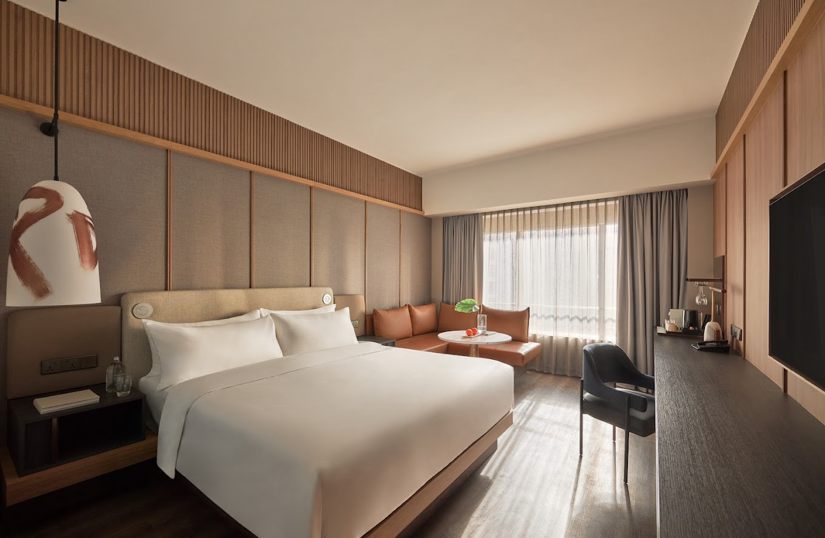
AsiaGO PASS · HOTEL COLLECTION
Amara Singapore
Club Room for 2 · 165 Tanjong Pagar Road — Club Lounge living in the heart of the city.
STAY
3 Nights
minimum stay
ROOM
Club Room
for 2 guests
FROM
888
AsiaGO! Pass Credits, total
WHAT'S INCLUDED
WHY GUESTS LOVE IT
Daily buffet breakfast at The Club or Element
Nightly 2-hour free-flow cocktails & canapés at The Club Lounge (12+)
Club privileges — evening cocktails & daily breakfast
In-room non-alcoholic minibar, replenished daily
One-time dining credit at Element & Cafe Oriental
2pm late check-out (subject to availability)
Heart of the city
Tanjong Pagar — steps from dining, MRT & the CBD
Club Lounge access
Breakfast, evening cocktails & canapés included daily
All-day dining credit
One-time credit to spend at Element or Cafe Oriental
Relaxed check-out
Late 2pm check-out to ease into your day
Pay with AsiaGO! Pass Credits · AsiaGO Hotel Collection
AsiaGO! Pass

Slide 16
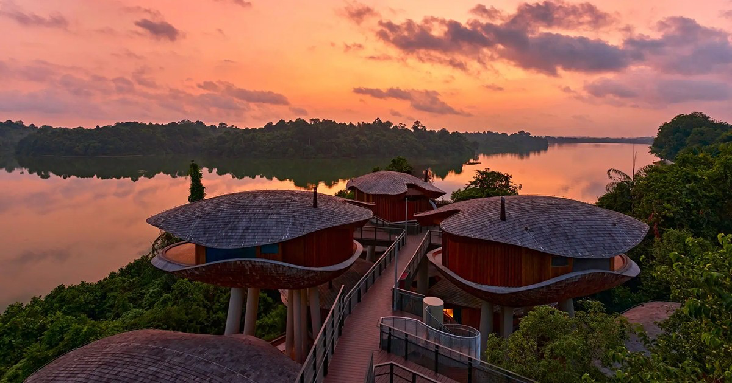
AsiaGO PASS · HOTEL COLLECTION
Mandai Rainforest Resort
by Banyan Tree · Sanctuary Room — Singapore's only rainforest resort, wrapped in wildlife and greenery.
STAY
3 Nights
minimum stay
ROOM
Sanctuary Room
Double or King
FROM
1,998
AsiaGO! Pass Credits, total
WHAT'S INCLUDED
WHY GUESTS LOVE IT
Daily breakfast for 2
Afternoon tea with reservoir & jungle views
Complimentary welcome drink & in-room minibar
Late check-out (subject to availability)
Rainforest Wild Adventure + Adventure+ for 2 (1-day)
5 wildlife parks — Night Safari, Bird Paradise, Rainforest Wild Asia, Zoo & River Wonders
One-of-a-kind
Singapore's only resort set within the rainforest
Wildlife on your doorstep
Five world-famous Mandai parks included
Nature immersion
Treetop sanctuary rooms, reservoir & jungle views
Perfect for families
Adventure activities and gentle nature for all ages
Pay with AsiaGO! Pass Credits · AsiaGO Hotel Collection
AsiaGO! Pass

Slide 17
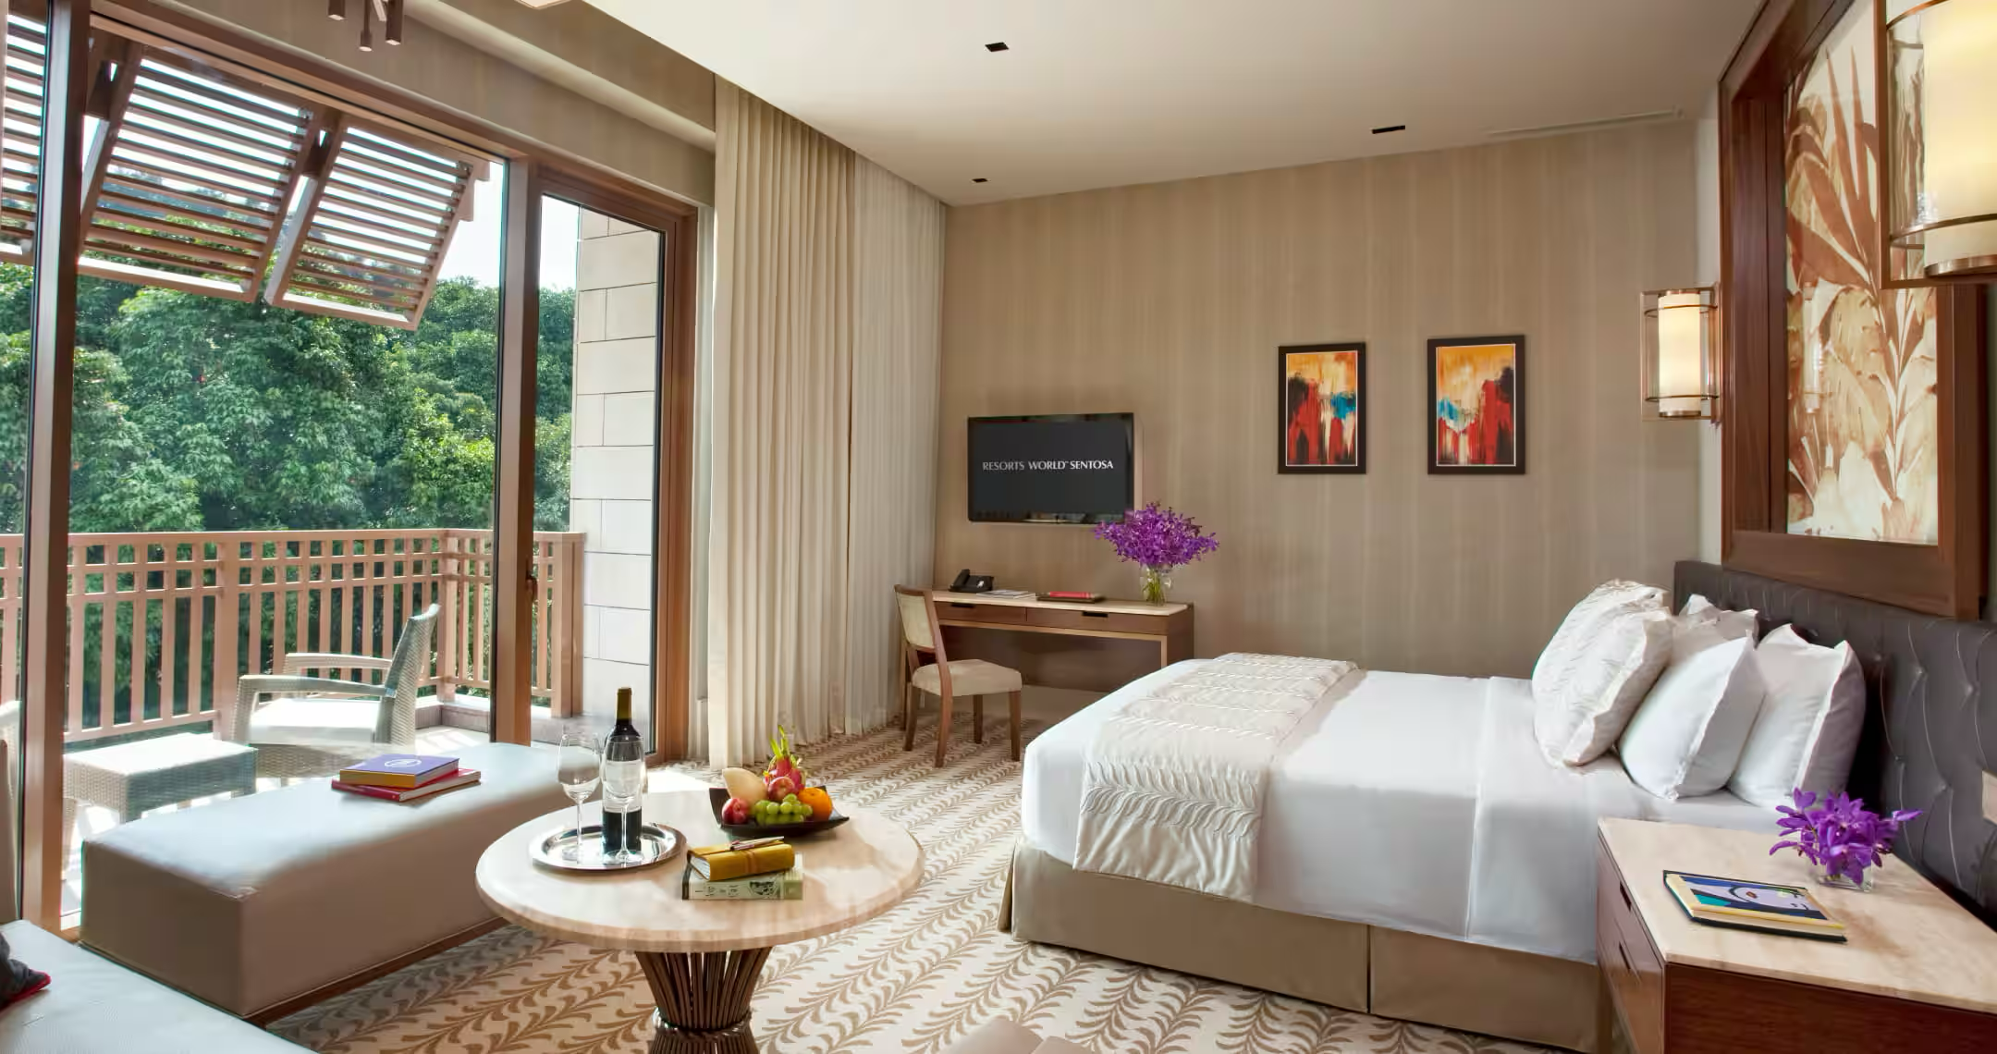
AsiaGO PASS · HOTEL COLLECTION
RWS Stay & Play
Stay & Play inside Resorts World Sentosa — a hotel stay plus two world-class attractions.
STAY
2 Nights
minimum stay
ROOM
Equarius / Michael
Deluxe Room
FROM
999
AsiaGO! Pass Credits, from
WHAT'S INCLUDED
WHY GUESTS LOVE IT
2 nights at Equarius Hotel or Hotel Michael (Deluxe)
2× Universal Studios Singapore 1-day tickets
2× S.E.A. Oceanarium 1-day tickets
2× daily breakfast
Early check-in & late check-out (subject to availability)
Stay where the fun is
Inside Resorts World Sentosa, steps from the parks
Two attractions included
Universal Studios + S.E.A. Oceanarium for two
Choice of hotels
Pick Equarius Hotel or Hotel Michael
Effortless days
Early check-in & late check-out to maximise play
Pay with AsiaGO! Pass Credits · AsiaGO Hotel Collection
AsiaGO! Pass

Slide 18
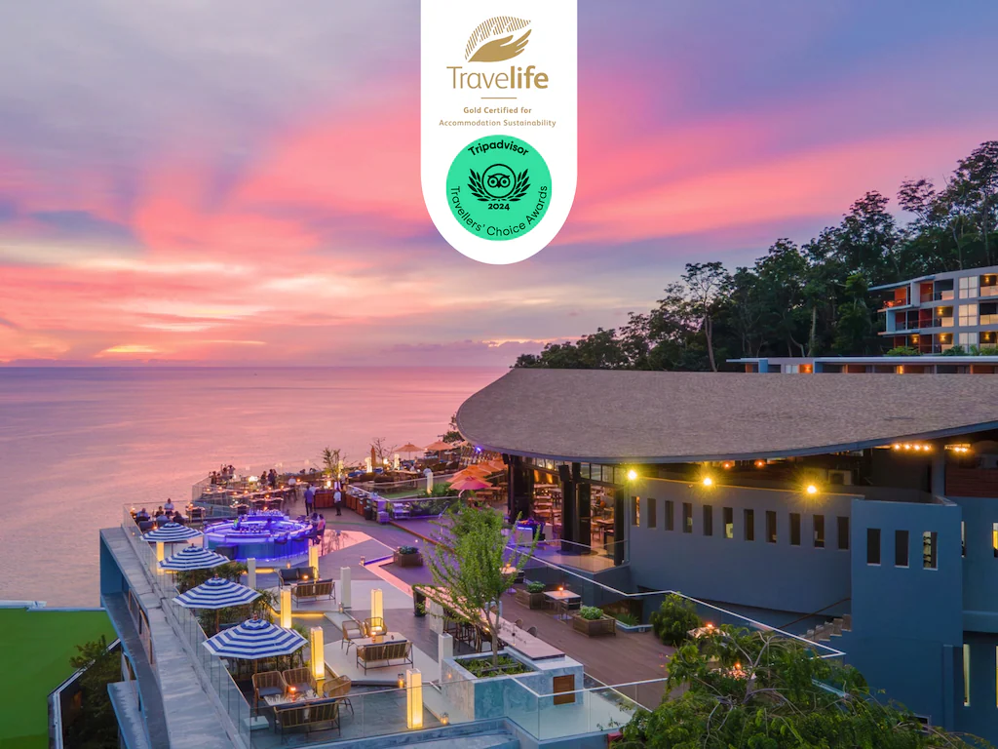
AsiaGO PASS · HOTEL COLLECTION
Kalima Resort & Spa
Deluxe Seaview — a five-night beachfront escape with sky-bar dining and airport transfers.
STAY
5 Nights
minimum stay
ROOM
Deluxe Seaview
for 2 guests
FROM
789
AsiaGO! Pass Credits, total
WHAT'S INCLUDED
WHY GUESTS LOVE IT
Daily breakfast for 2
Round-trip airport transfer for 2
Welcome local snack & welcome drink
Cocktails at Malika Sky Bar for 2
BBQ Seafood Tower terrace set for 2 at Malika Sky Bar
Teppanyaki & sushi tasting dinner for 2 at Gin
Early check-in / late check-out & in-room minibar
Five-night escape
A proper unwind by the sea — not just a quick stay
Sky-bar dining
Cocktails & seafood tower with elevated views
Transfers included
Round-trip airport transfers handled for you
Gourmet inclusions
Teppanyaki, sushi & welcome treats throughout
Pay with AsiaGO! Pass Credits · AsiaGO Hotel Collection
AsiaGO! Pass

Slide 19
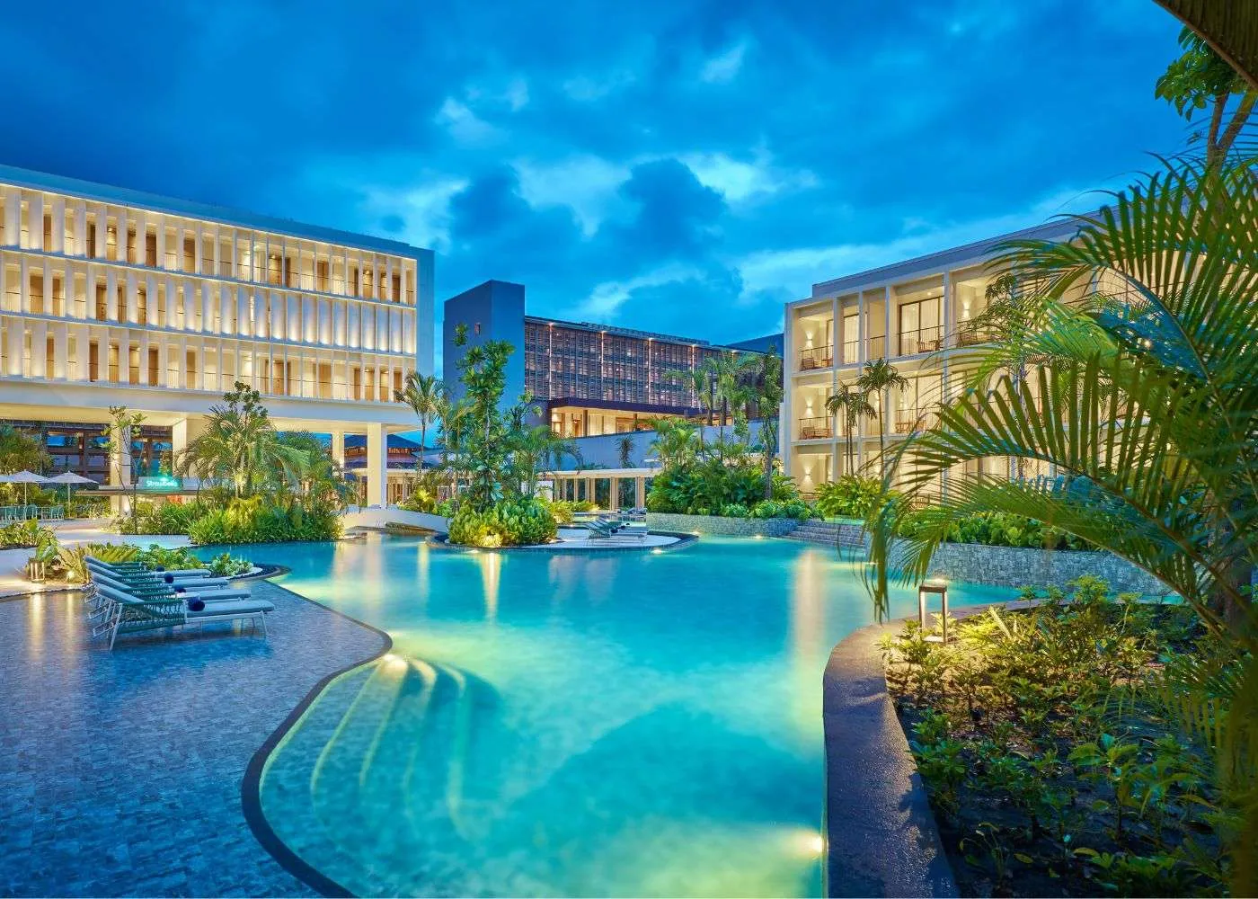
AsiaGO PASS · HOTEL COLLECTION
Holiday Inn Resort Bintan
A vibrant, family-friendly beachfront escape — just a short ferry from Singapore (2D1N).
STAY
2D1N
2 days · 1 night
ROOM
Pond View Room
2 adults + 2 kids
FROM
678
AsiaGO! Pass Credits, total
WHAT'S INCLUDED
WHY GUESTS LOVE IT
1-night stay, Standard Pond View Room
Daily breakfast for 2 at Warung Pak Lagoi
2-way return economy ferry by Bintan Resort Ferries
Shared hotel ↔ ferry terminal transfers
Welcome drink & cold towel on arrival
Optional half-day tour — Blue Lake, Sand Dunes & ATV
Quick island getaway
A short ferry hop from Singapore to the beach
Family-friendly
Room fits 2 adults + 2 children under 11
Travel sorted
Return ferry and shared transfers included
Add adventure
Optional Blue Lake, Sand Dunes & ATV day tour
Excludes visa on arrival, personal expenses & additional meals.
Pay with AsiaGO! Pass Credits · AsiaGO Hotel Collection
AsiaGO! Pass

Slide 20





PRODUCT CONCEPT
App Concept — Home Screen
Key Features To Redeems
SG GO!
Cruises packages
500
Credits Balance
Cultures- Experiences Nearby
Discover Singapore
Attractions : build your own adventure
Restaurants & Wellness Recommendation
Attractions
Dining/Wellness
Credits Balance
Guided Experience
Cultures Experience Nearby
Best Valued-Hotel Packages
AsiaGO Hotel Collection
SG GO!
20

Slide 21
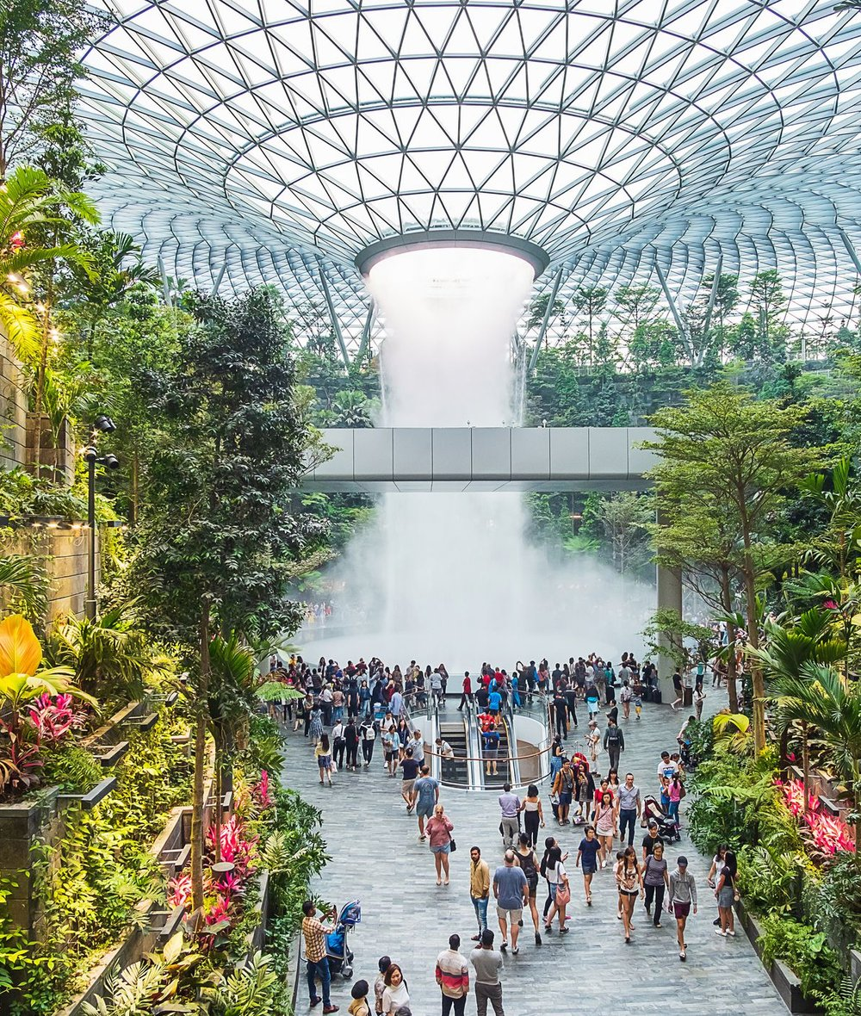





WHAT IS AsiaGO! Pass?
A curated tourism &
lifestyle experience platform
We help visitors discover the very best of Singapore through:
Luxury Dining
Attractions
Signature tables & chef experiences
Iconic sights and exclusive access
Wellness Experiences
Cultural Activities
Spa, retreats & restorative escapes
Heritage, arts and local life
Exclusive Privileges
Local Food Discovery
Members-only perks across the city
Hawker gems & culinary stories
We transform tourism spending into memorable lifestyle experiences.

Slide 22


THE SOLUTION
Introducing AsiaGO! Pass
Singapore's first experience credit ecosystem.
Attractions
Dining, Wellness
Experiences
Shopping Benefits
QR Redemption
Travel Credits
THE TRAVELLER JOURNEY
Purchase Pass
>
Browse
>
Book Instantly
>
Redeem QR
>
Enjoy Benefits
>
Earn Rewards
AsiaGO! Pass
18

Slide 23


PRODUCT CONCEPT
Attraction Detail Screen
Use large, immersive photography to bring each destination to life.
Possible Attraction Examples
Gardens by the Bay
Marina Bay Sands & Downtown Core
Gardens by the Bay
About Attraction
Benefits Included
Fine Print
Sentosa Island
Redeem
35 Creadits
SG GO!
21

Slide 24
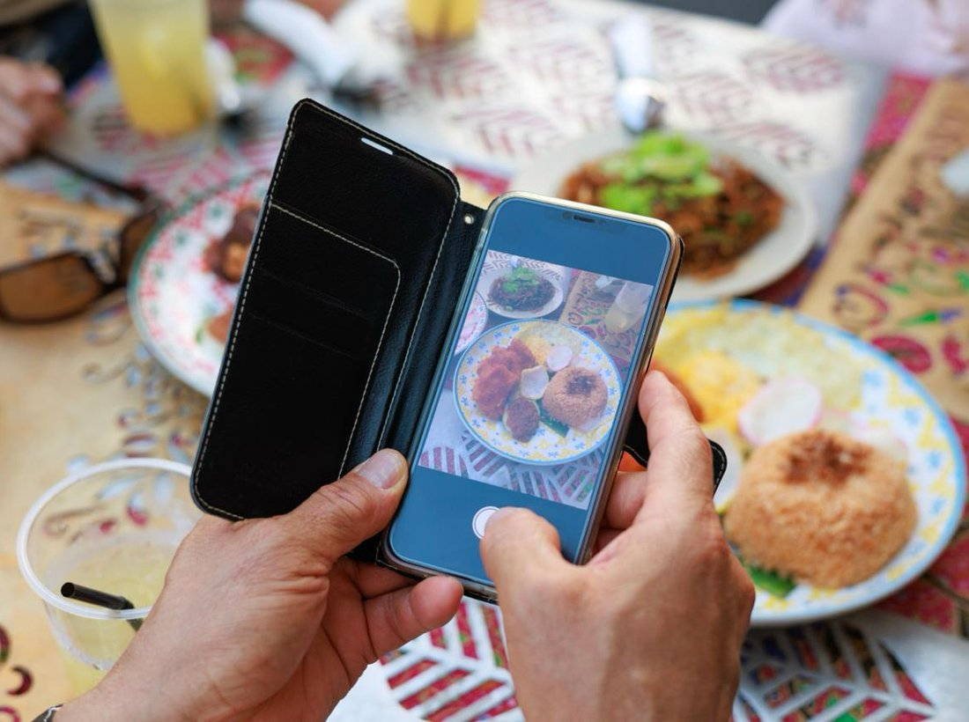
THE TRAVELLER JOURNEY
How customers discover you
1
Purchases the AsiaGo! Pass And Redeem the Attractions
5
Redeems the benefit instantly via QR
2
Browses curated dining experiences & hidden gems
6
Shares the experience online
3
Reads your restaurant's story and highlights
7
Your restaurant gains a new customer
4
Makes a reservation or visit

Slide 25
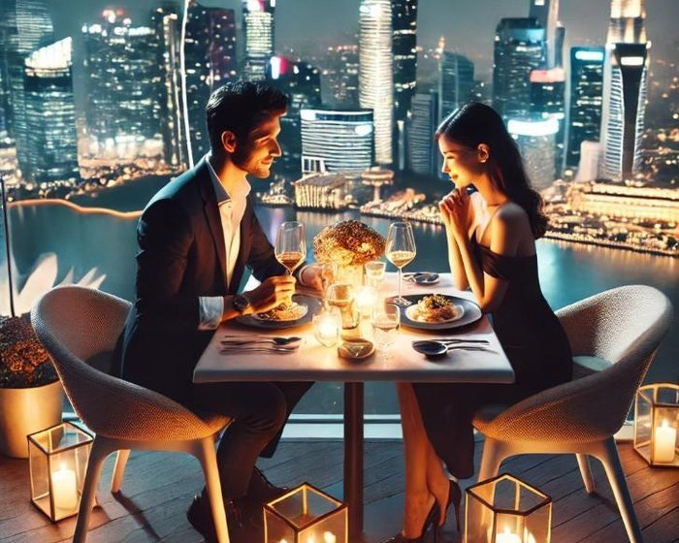
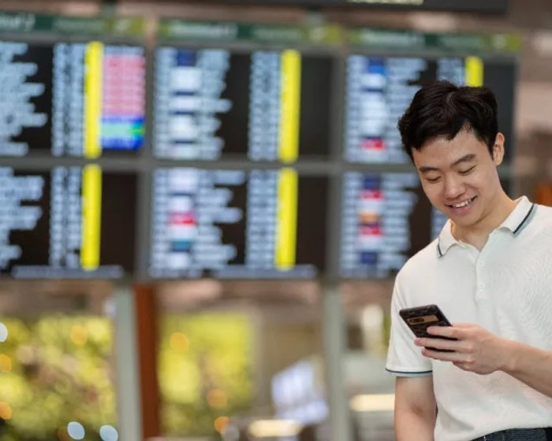
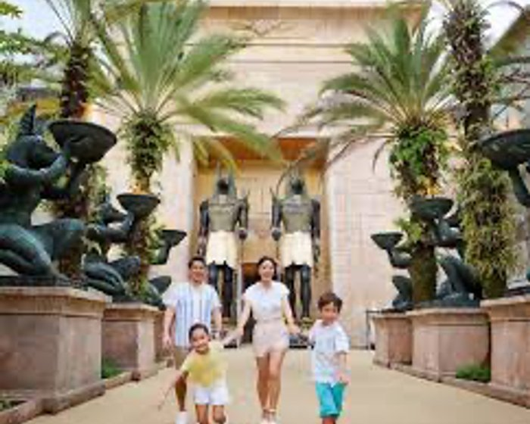
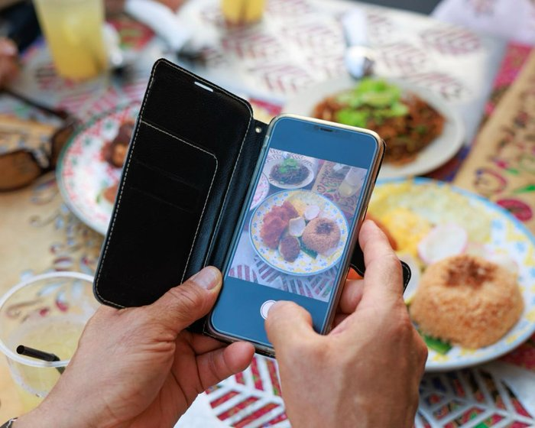
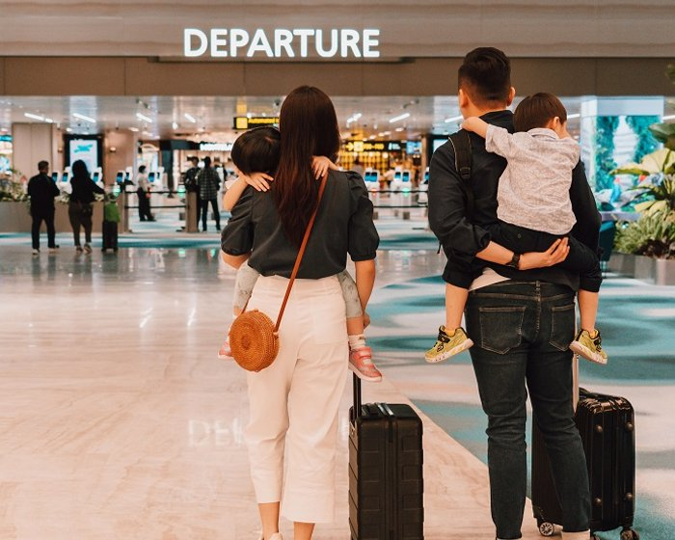




WHO WE TARGET
The guests we bring to your Table
Luxury Travellers
Business Travellers
Families
Foodies
Transit Visitors
Seeking refined, exclusive dining
Premium evenings, limited time
Memorable shared experiences
Culinary stories worth sharing
Via our travel-agency partners
These customers are actively searching for memorable dining experiences.

Slide 26
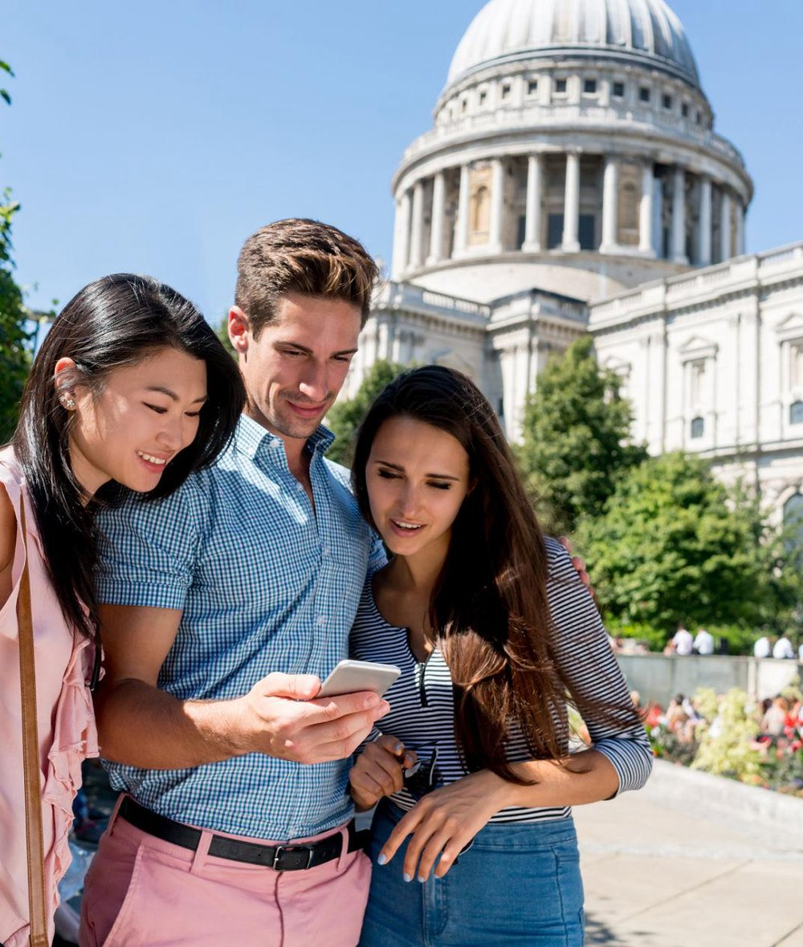

MARKETING SUPPORT
What AsiaGO! Pass provides
Restaurant Experience-base gimmick
Storytelling content & social promotion
Travel itinerary inclusion
Destination guides
Partner spotlight campaigns
Exposure to international markets
Your restaurant becomes part of the Singapore experience.

Slide 27
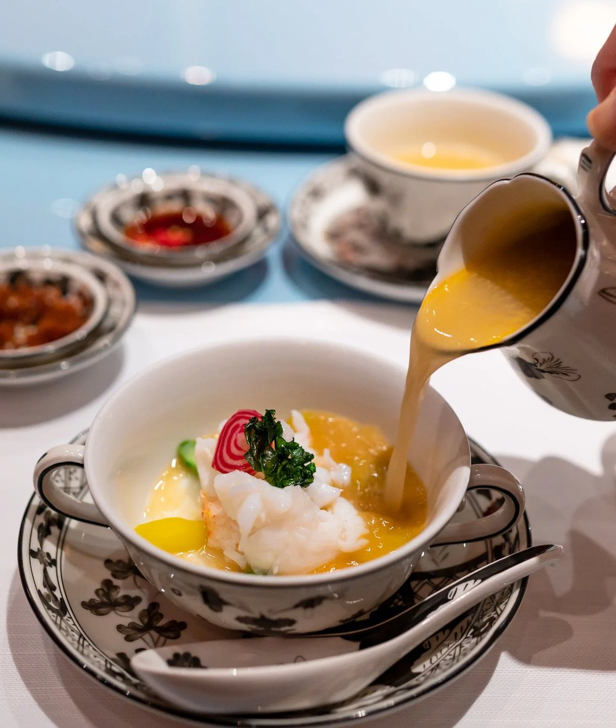
OUR DIFFERENCE
We sell experiences, not discounts
TRADITIONAL PLATFORMS
AsiaGO pass!
Compete on price
Promote discounts
Transaction-focused
Promotes experiences
Highlights culinary stories
Creates destination dining moments
Enhances brand prestige
EXAMPLE — WELCOME LUXURY TREAT
“A complimentary welcome cocktail or premium mocktail on arrival.”
Complimentary signature Peking duck tasting for two with a minimum dining spend.

Slide 28
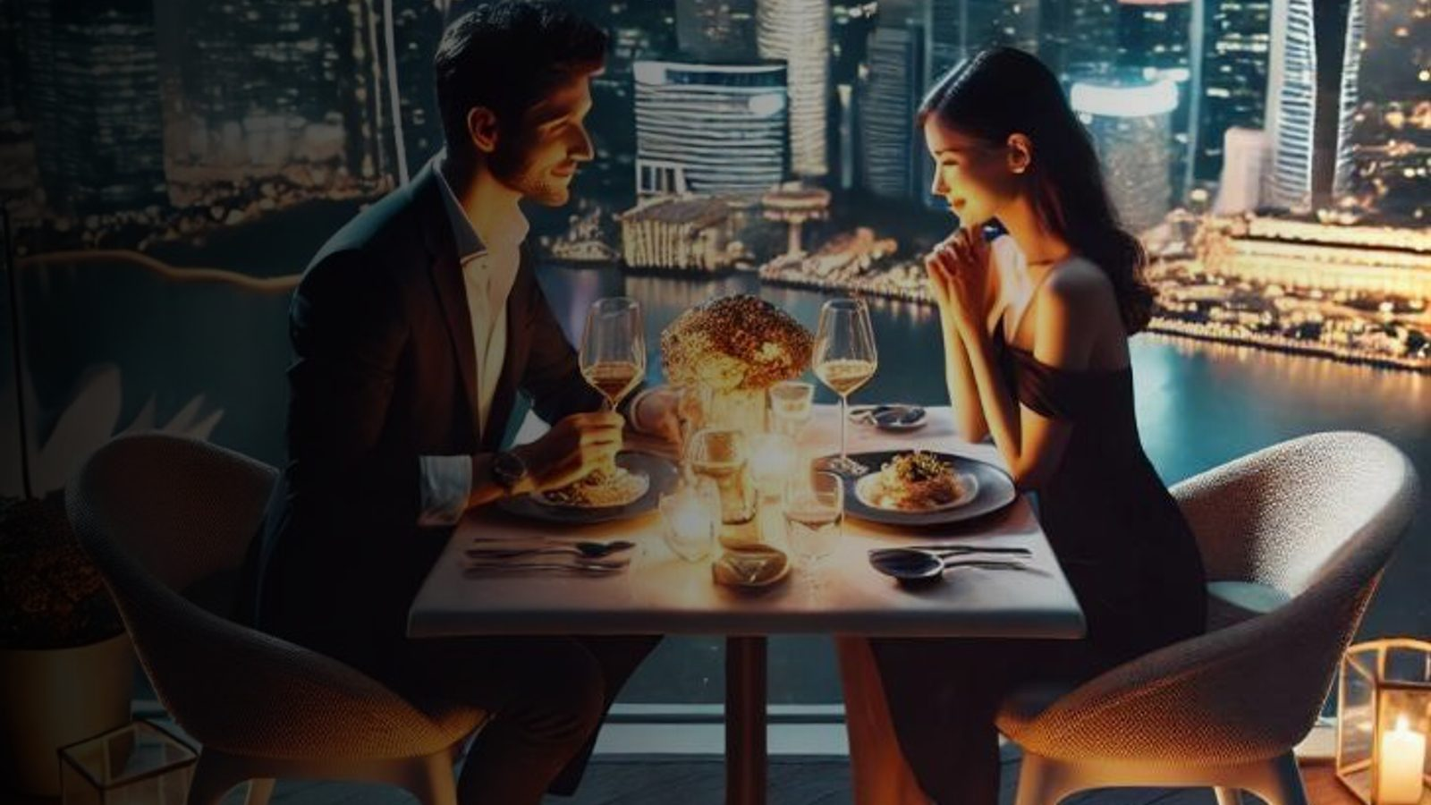
🎟️ Beyond Attractions
THE DISTINCTION
Why AsiaGo Pass! is different
OTHER PLATFORMS
AsiaGO Pass!
Restaurant listings
Discount marketplaces
Voucher websites
Beyond Attractions
Dining + Attractions + Experiences
Best-Valued Hotel Packages in Asia
Hotel Package with Guided Tours
Story-driven discovery
Exclusive Member Privilege
We bring diners who are already exploring Singapore.

Slide 29
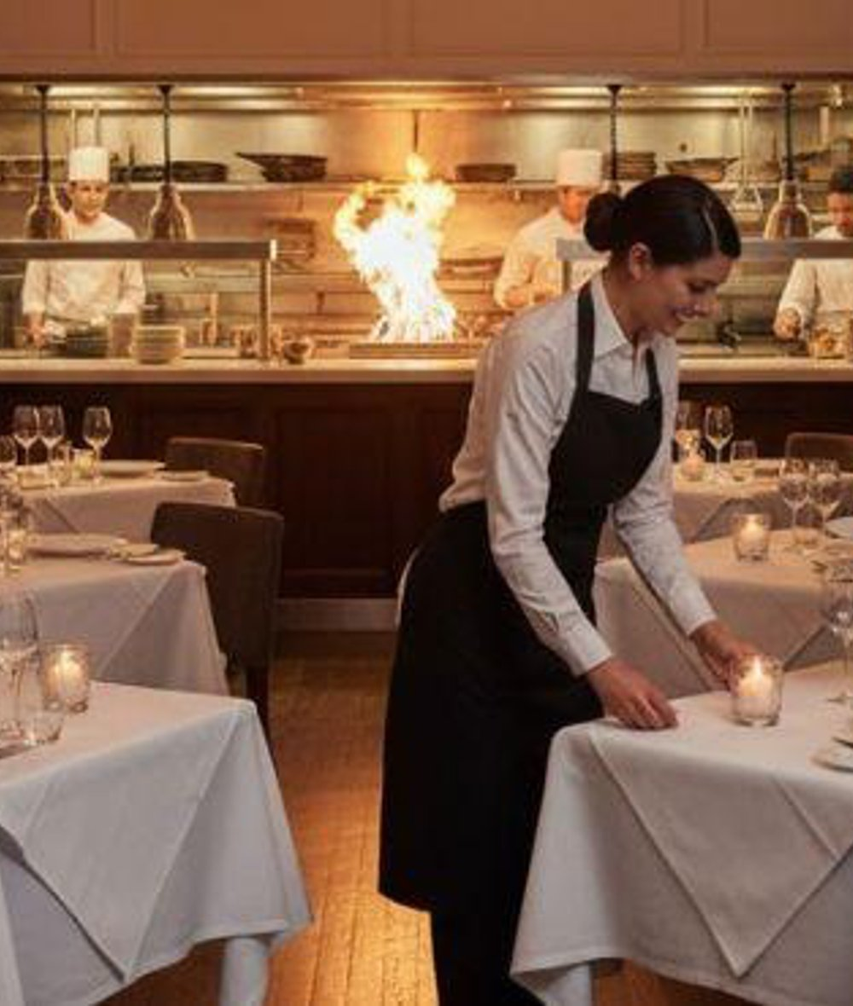
WHY PARTNER WITH SG GO!?
Turn tourist traffic into
restaurant revenue
New customer acquisition from a global audience
Increased occupancy during off-peak hours
Exposure to international travellers before arrival
Featured storytelling and content marketing
Direct digital redemption system
Performance-based partnership model
No large advertising spend required

Slide 30

PRODUCT CONCEPT
Dining Experience Screen
Focus on storytelling, not discounts.
Chef Highlights
Menu Preview
Story About the Restaurant
This all-day Marina Bay buffet restaurant reflects the journey and aesthetic of British colonial times, with local and Asian cuisines from seven ‘live’ kitchens. The popular Sunday brunch features unlimited pours of champagne.
Redeem Credits
SG GO!
22

Slide 31
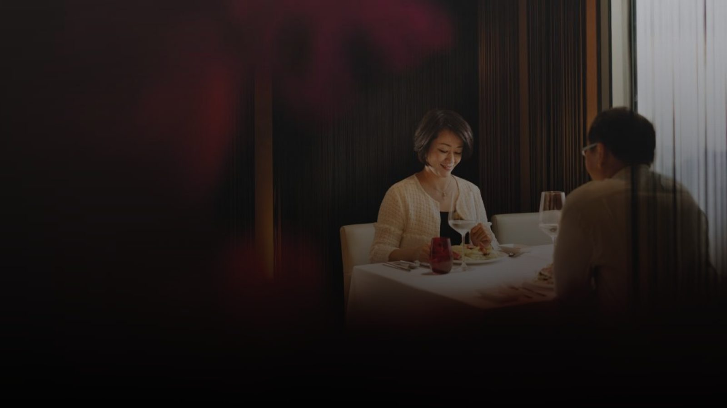
PARTNERSHIP INVITATION
Let's showcase the best of
Singapore's culinary excellence
We would be honoured to feature your restaurant as one of SG GO!'s curated dining partners.
Taste the City. Live the Story.
CONTACT
Chayada Jumrean
Business Development Manager
+65 9165 3089

