Slide 1
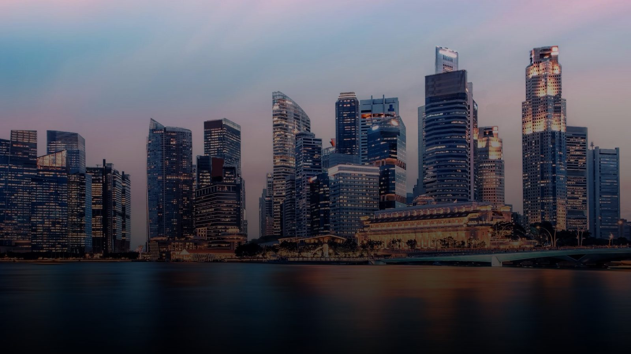
PARTNER PRESENTATION
AsiaGO Pass!
Taste the City. Live the Story.
Connecting discerning travellers with Singapore's dining experiences.

Slide 2

INVESTOR & PRODUCT OVERVIEW
Singapore's Smart Travel
& Lifestyle Pass
AsiaGO Pass! is an advanced, technology-driven platform built around convenience, personalization and customer engagement.
One Pass. Unlimited Discoveries.
SG GO!
13

Slide 3



THE MODEL
AsiaGo Pass! Digital Credit Wallet
Build Your Own Itinerary
Flexible travel your way : Design your own itinerary and choose the experiences that matter most to you. AsiaGO Pass gives you the freedom to travel according to your interests and budget –without being tied to fixed package
Save More with Curated Package : Take advantage of our specially curated packages and enjoy saving of up to 50% on more, helping you experience more while spending less on your trip.
A Credit Wallet System
Customers purchase Asia GO! Pass credits and spend them across participating attractions, restaurants, hotel Packages, transport services and retail partners.
Loyalty & Rewards
Bonus credits, exclusive privileges and VIP benefits on top-ups or spend above set thresholds drive repeat engagement.
SG GO!
15

Slide 4
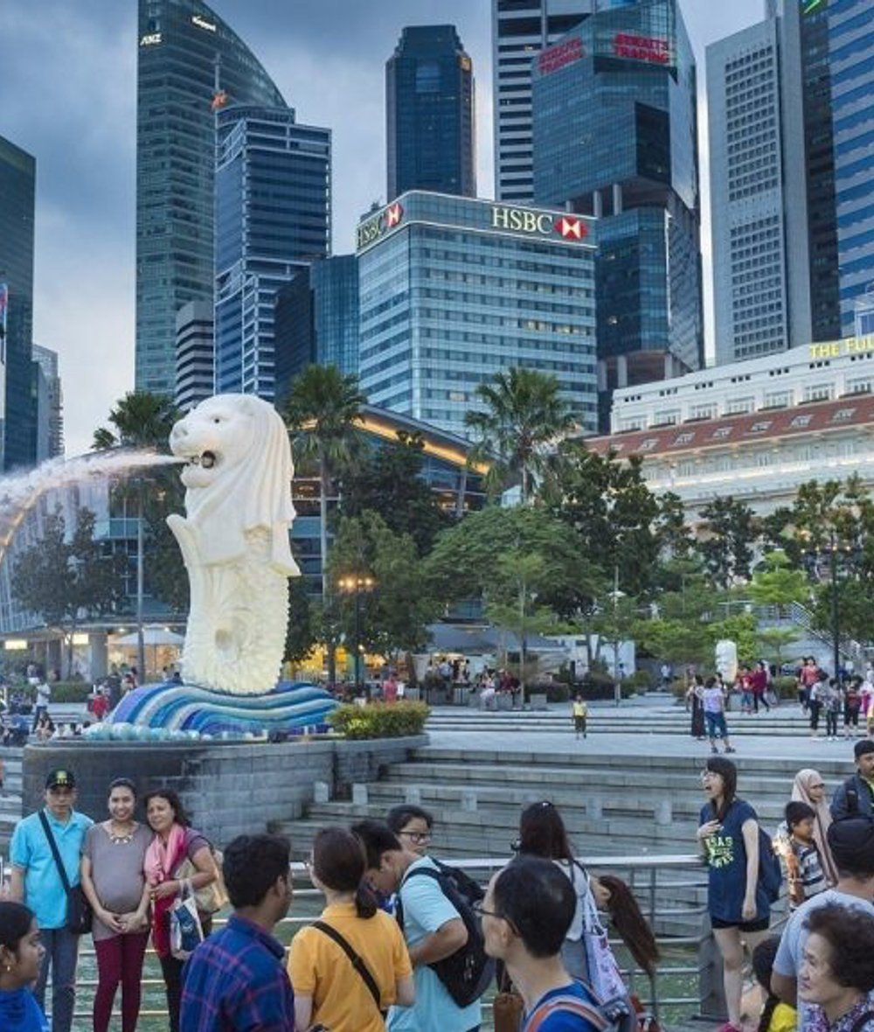

THE OPPORTUNITY
Singapore welcomes millions
of visitors every year
Despite strong tourism growth, many restaurants, wellness still struggle to:
Attract new international customers
Gain visibility beyond hotel concierge recommendations
Fill off-peak dining periods
Reach younger, affluent travellers
Stand out in a competitive dining landscape
The time-poor professional
The long-layover traveller
Seeking premium, curated evening experiences.
Exploring Singapore without the stress of planning.
AsiaGo Pass ! helps bridge this gap.

Slide 5





Attractions & Experiences ⭐
THE PROBLEM
The Current Tourist Journey
Four Disconnected Tools
A Fragmented Experience
Too many websites
Separate attraction tickets
Attractions & Experiences
Dinning Privilege Benefit & Restaurant reservations
Hard to discover hidden gems
Limited dining recommendations
Ride and Transfer Service
Partners Exclusive Benefit
No unified rewards system
AsiaGO Pass!
17

Slide 6
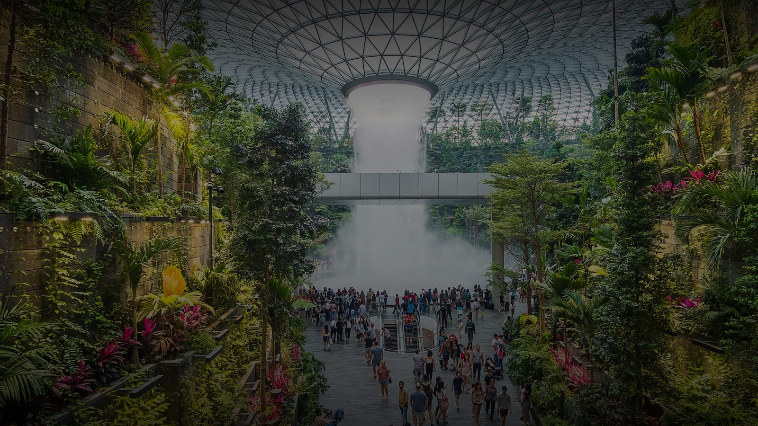


OUR VISION
Building Singapore's leading
experience platform
Taste
Discover
Experience
Asia
Asia
Asia
All through one seamless ecosystem.
All through one seamless ecosystem.
All through one seamless ecosystem.
Together with our restaurant partners, we create unforgettable visitor experiences — and measurable business growth.

Slide 7


HOW IT WORKS
A Fully Digital Experience
Customers purchase and manage their travel packages before arriving in Singapore — through a dedicated mobile app and website.
Buy & Manage Anywhere
No Physical Cards
Everything Digital
Purchase and manage travel packages before arriving in Singapore via the dedicated app and website.
Unlike traditional tourist passes, there is no need to collect physical cards on arrival.
All access, redemption and booking management is handled digitally through the AsiaGO Pass platform.
AsiaGO! Pass
14

Slide 8

THE EXPERIENCE
Seamless QR Redemption
“Tourists enjoy seamless entry to Singapore's top attractions with a single QR code. No physical tickets, no voucher printing, and no complicated redemption process.”
This helps investors and attraction partners immediately understand how AsiaGO! Pass simplifies the visitor experience while making redemption fast for merchants and attractions.
One Pass. Unlimited Discoveries.
AsiaGO! Pass
23

Slide 9


PRICING
AsiaGO! Pass Packages
AsiaGO Privilege Pass
3-day pass
AsiaGO Signature Pass
1-day Pass
AsiaGO Experience Pass
SGD 498 Child 299
2-Day Pass
-
Optional 10 attractions and Lifestyle experience
AsiaGo Welcome drink
Exclusive member privilege benefit
Valid 3 consecutive days
Wellness retreat (Spa massage Yoga)
Shopping Lifestyle offer
🍽️ 3 Dinning Experience ( Restaurant afternoon tea, Rooftop bar ,Buffet Access only Restaurant privilege
Save more on your AsiaGO pass member dinning befefit (Discount & special offeres at selected Restaurant
SGD 158 Child 98
SGD 358 Child 259
2 Attractions of your choice
Enjoy Bonus Dinning Experience
Complimentary member rewards
Member dinning benefit (Discount and
Special offers at selected Restaurant
5 Top attractions
Valid 2 consecutive days
AsiaGO welcome drink
2 Dinning experience included
Complimentary member Rewards.
Kid- Friendly Restaruant experience
Save more on your AsiaGO Pass
Member dinning benefit (discount & special offers at selected Restaurant
TARGET
Perfect for every Travelers
TARGET
TARGET
Families ,Couples, friends
Flexible-Spending Travelers
AsiaGO! Pass
19

Slide 10





PRODUCT CONCEPT
App Concept — Home Screen
Key Features To Redeems
SG GO!
Cruises packages
500
Credits Balance
Cultures- Experiences Nearby
Discover Singapore
Attractions : build your own adventure
Restaurants & Wellness Recommendation
Attractions
Dining/Wellness
Credits Balance
Guided Experience
Cultures Experience Nearby
Best Valued-Hotel Packages
AsiaGO Hotel Collection
SG GO!
20

Slide 11
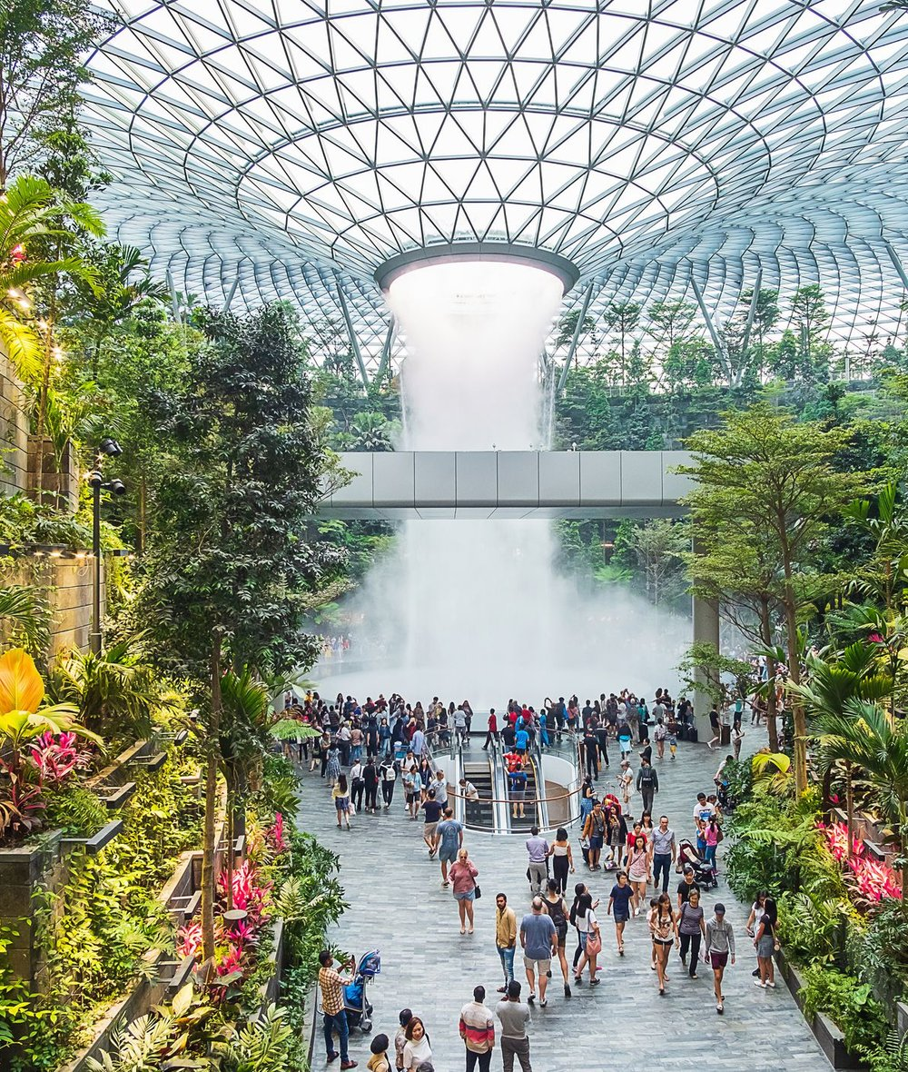





WHAT IS AsiaGO! Pass?
A curated tourism &
lifestyle experience platform
We help visitors discover the very best of Singapore through:
Luxury Dining
Attractions
Signature tables & chef experiences
Iconic sights and exclusive access
Wellness Experiences
Cultural Activities
Spa, retreats & restorative escapes
Heritage, arts and local life
Exclusive Privileges
Local Food Discovery
Members-only perks across the city
Hawker gems & culinary stories
We transform tourism spending into memorable lifestyle experiences.

Slide 12


THE SOLUTION
Introducing AsiaGO! Pass
Singapore's first experience credit ecosystem.
Attractions
Dining, Wellness
Experiences
Shopping Benefits
QR Redemption
Travel Credits
THE TRAVELLER JOURNEY
Purchase Pass
>
Browse
>
Book Instantly
>
Redeem QR
>
Enjoy Benefits
>
Earn Rewards
AsiaGO! Pass
18

Slide 13


PRODUCT CONCEPT
Attraction Detail Screen
Use large, immersive photography to bring each destination to life.
Possible Attraction Examples
Gardens by the Bay
Marina Bay Sands & Downtown Core
Gardens by the Bay
About Attraction
Benefits Included
Fine Print
Sentosa Island
Redeem
35 Creadits
SG GO!
21

Slide 14
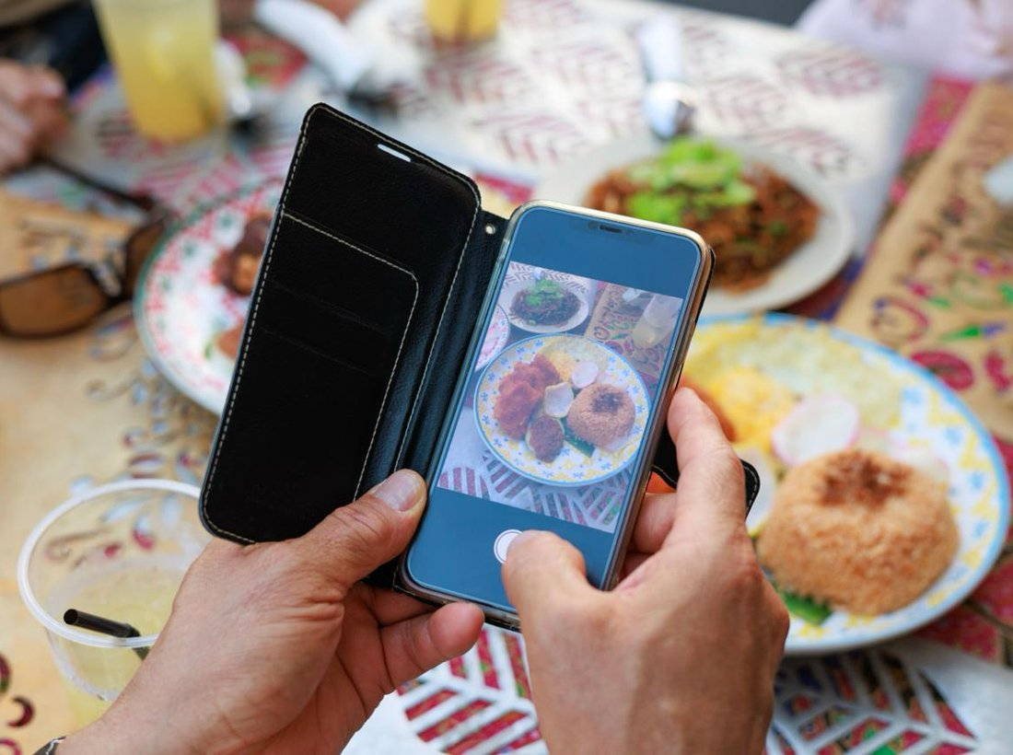
THE TRAVELLER JOURNEY
How customers discover you
1
Purchases the AsiaGo! Pass And Redeem the Attractions
5
Redeems the benefit instantly via QR
2
Browses curated dining experiences & hidden gems
6
Shares the experience online
3
Reads your restaurant's story and highlights
7
Your restaurant gains a new customer
4
Makes a reservation or visit

Slide 15

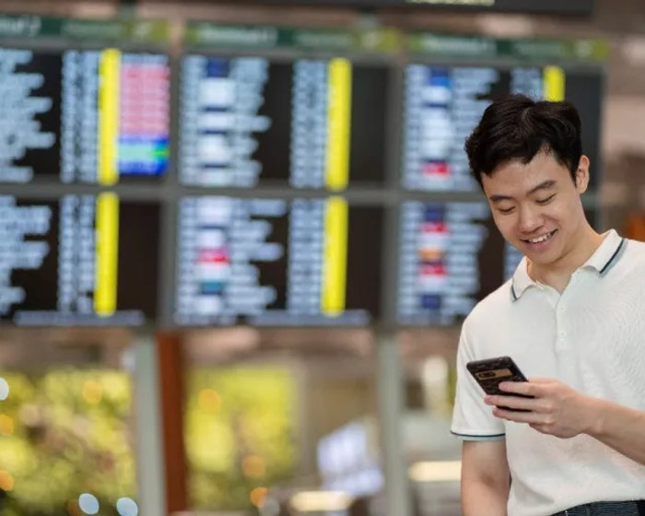
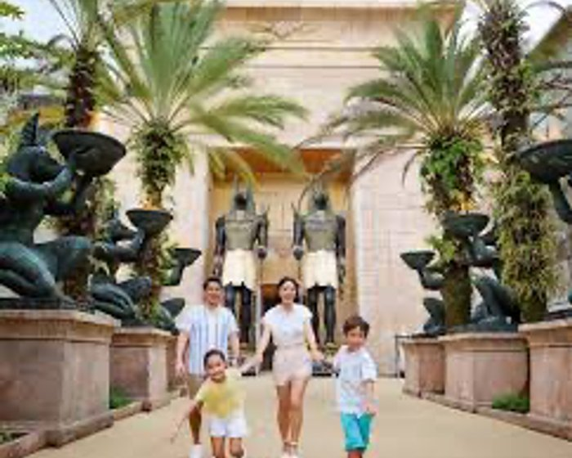
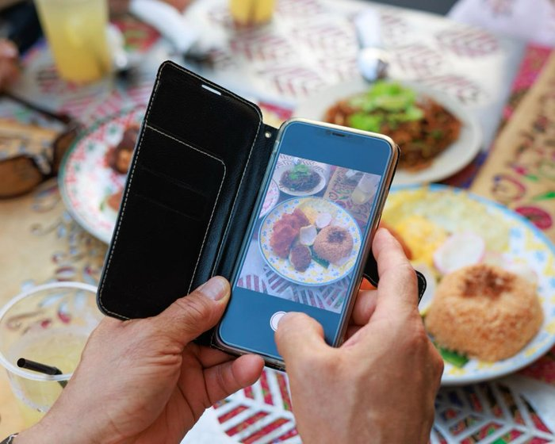
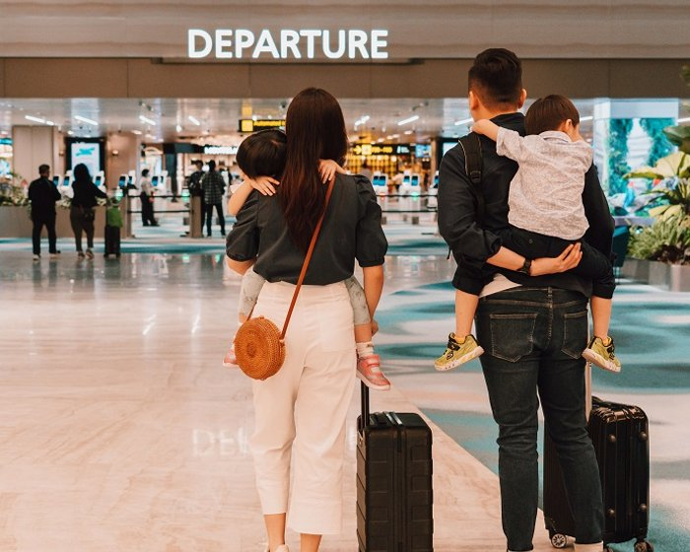




WHO WE TARGET
The guests we bring to your Table
Luxury Travellers
Business Travellers
Families
Foodies
Transit Visitors
Seeking refined, exclusive dining
Premium evenings, limited time
Memorable shared experiences
Culinary stories worth sharing
Via our travel-agency partners
These customers are actively searching for memorable dining experiences.

Slide 16
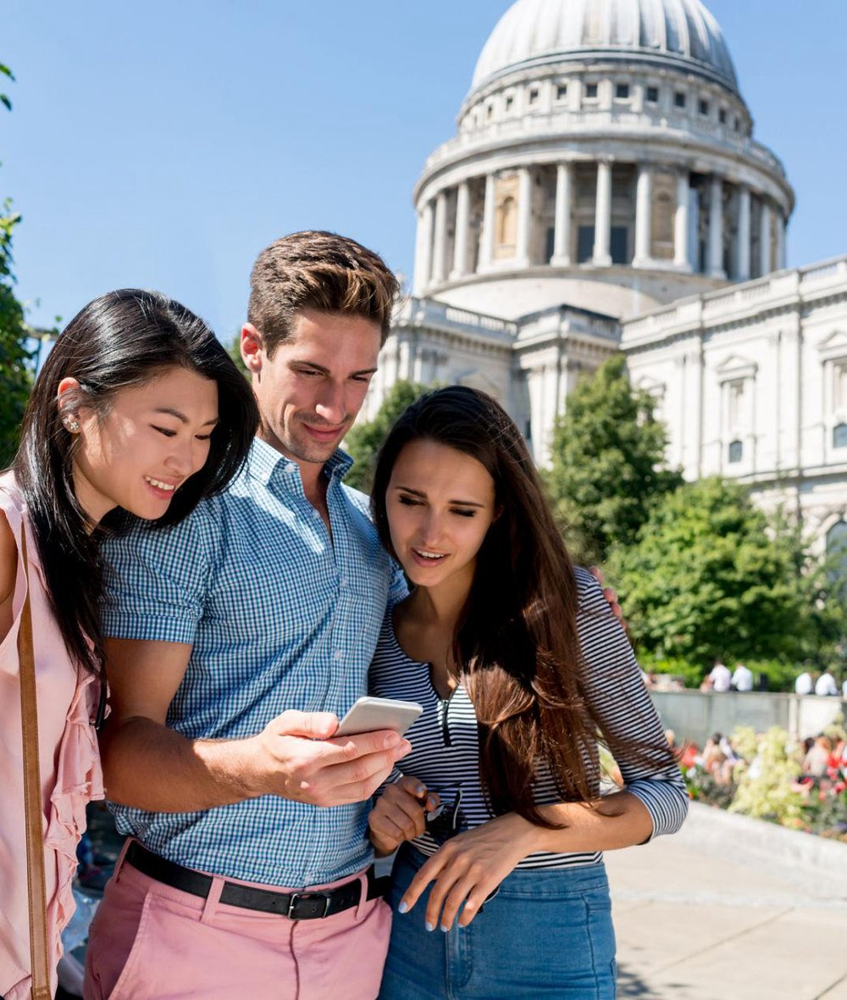

MARKETING SUPPORT
What AsiaGO! Pass provides
Restaurant Experience-base gimmick
Storytelling content & social promotion
Travel itinerary inclusion
Destination guides
Partner spotlight campaigns
Exposure to international markets
Your restaurant becomes part of the Singapore experience.

Slide 17
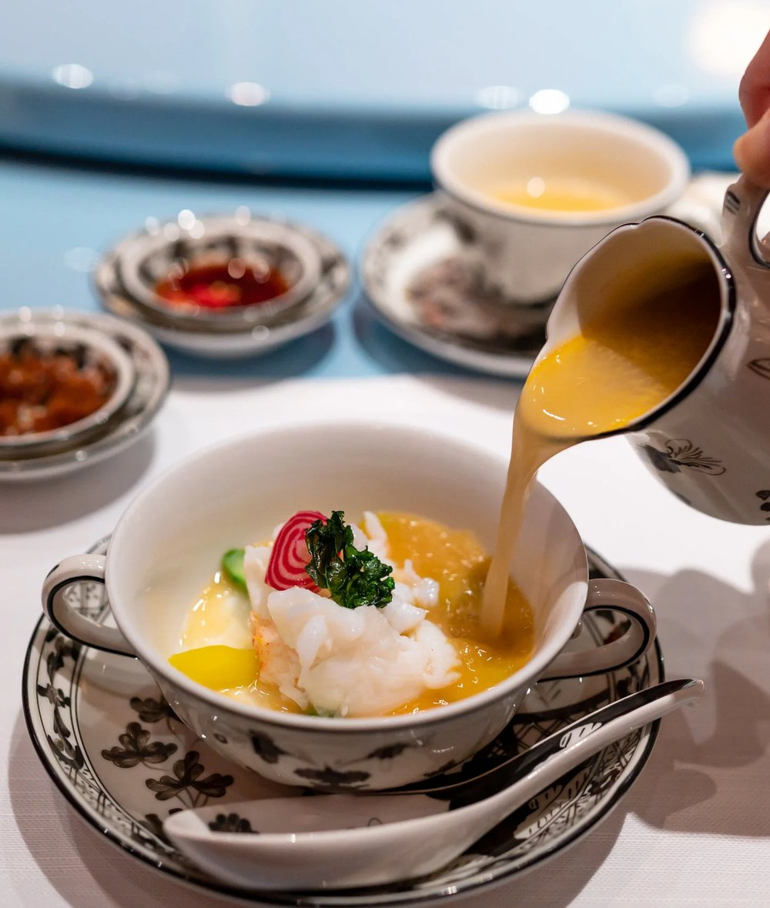
OUR DIFFERENCE
We sell experiences, not discounts
TRADITIONAL PLATFORMS
AsiaGO pass!
Compete on price
Promote discounts
Transaction-focused
Promotes experiences
Highlights culinary stories
Creates destination dining moments
Enhances brand prestige
EXAMPLE — WELCOME LUXURY TREAT
“A complimentary welcome cocktail or premium mocktail on arrival.”
Complimentary signature Peking duck tasting for two with a minimum dining spend.

Slide 18
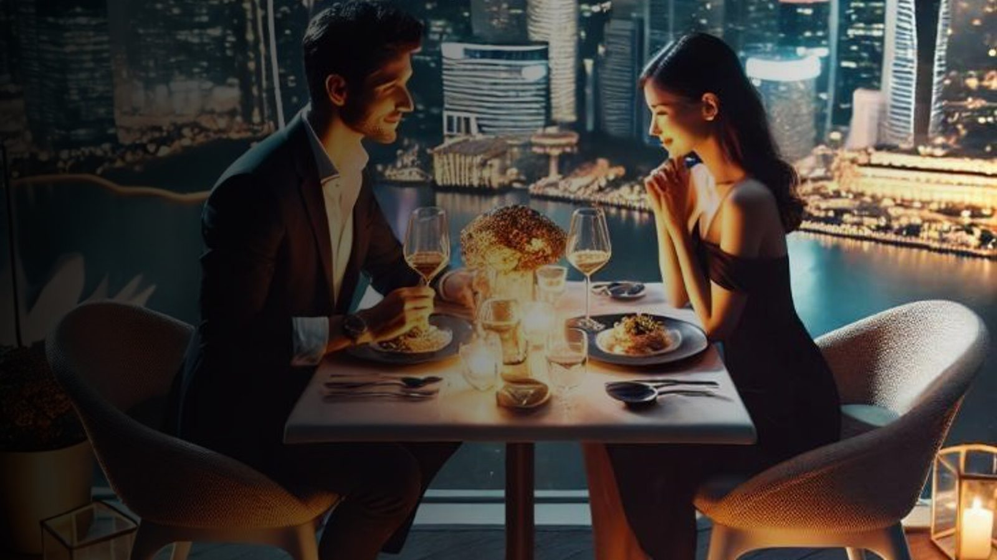
🎟️ Beyond Attractions
THE DISTINCTION
Why AsiaGo Pass! is different
OTHER PLATFORMS
AsiaGO Pass!
Restaurant listings
Discount marketplaces
Voucher websites
Beyond Attractions
Dining + Attractions + Experiences
Best-Valued Hotel Packages in Asia
Hotel Package with Guided Tours
Story-driven discovery
Exclusive Member Privilege
We bring diners who are already exploring Singapore.

Slide 19
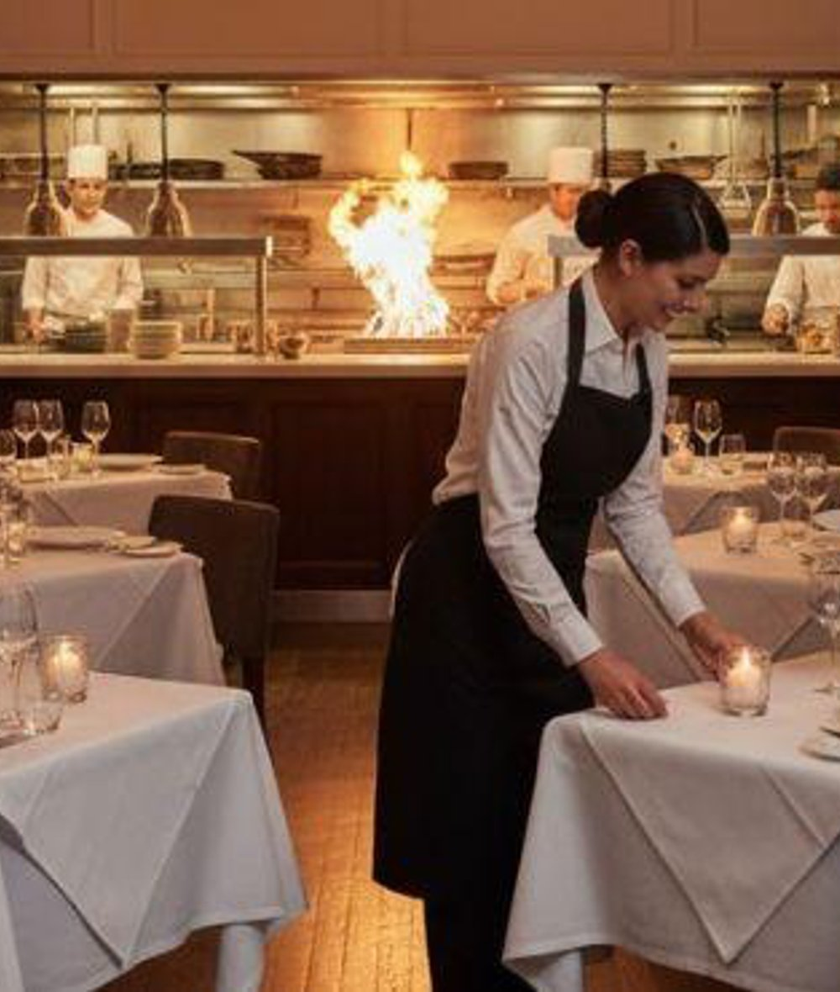
WHY PARTNER WITH SG GO!?
Turn tourist traffic into
restaurant revenue
New customer acquisition from a global audience
Increased occupancy during off-peak hours
Exposure to international travellers before arrival
Featured storytelling and content marketing
Direct digital redemption system
Performance-based partnership model
No large advertising spend required

Slide 20

PRODUCT CONCEPT
Dining Experience Screen
Focus on storytelling, not discounts.
Chef Highlights
Menu Preview
Story About the Restaurant
This all-day Marina Bay buffet restaurant reflects the journey and aesthetic of British colonial times, with local and Asian cuisines from seven ‘live’ kitchens. The popular Sunday brunch features unlimited pours of champagne.
Redeem Credits
SG GO!
22

Slide 21
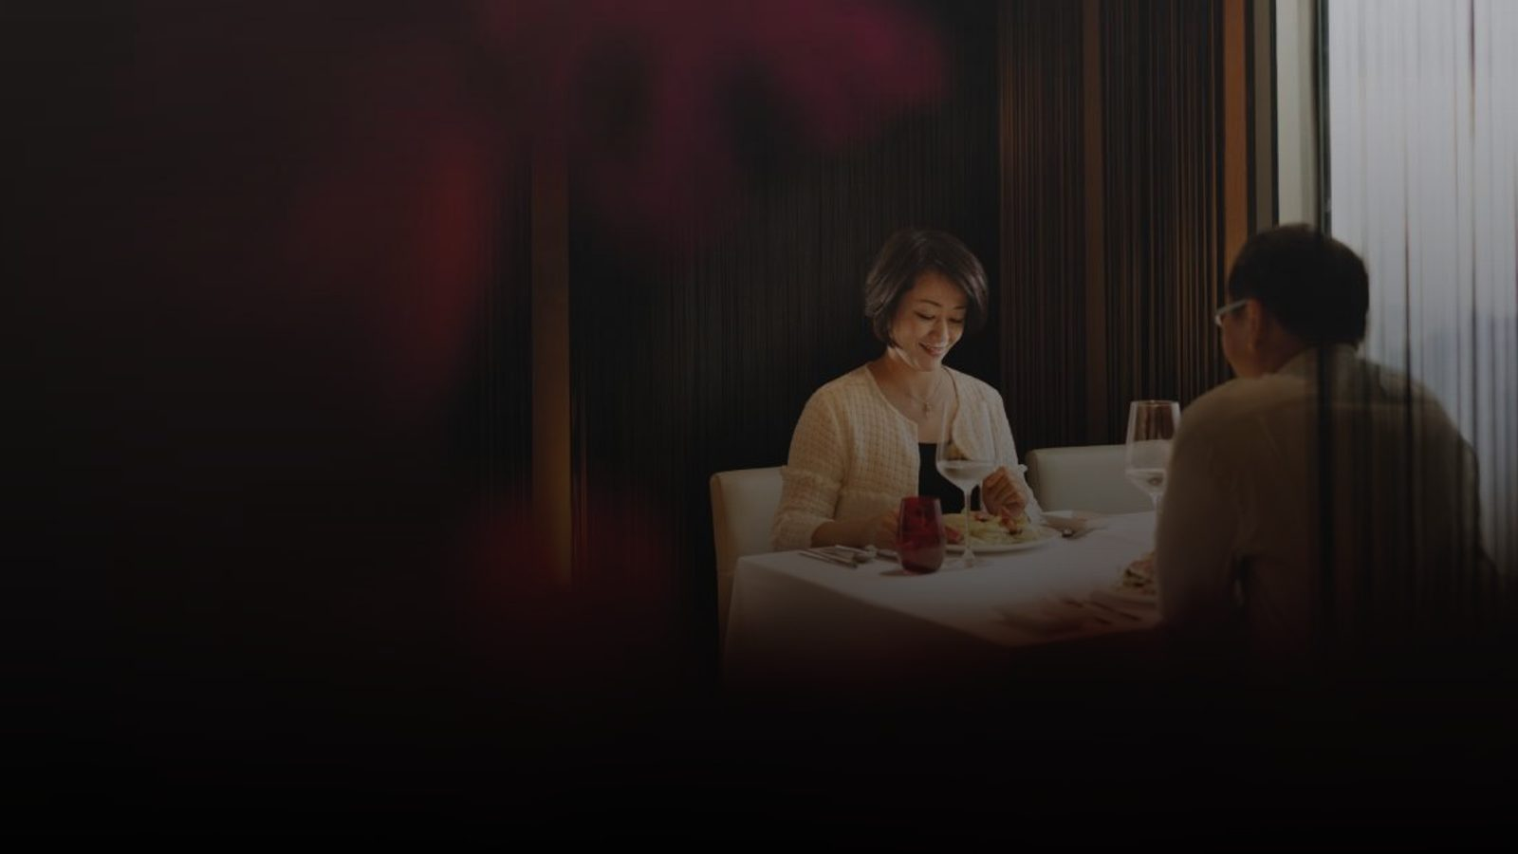
PARTNERSHIP INVITATION
Let's showcase the best of
Singapore's culinary excellence
We would be honoured to feature your restaurant as one of SG GO!'s curated dining partners.
Taste the City. Live the Story.
CONTACT
Chayada Jumrean
Business Development Manager
+65 9165 3089

