Slide 1

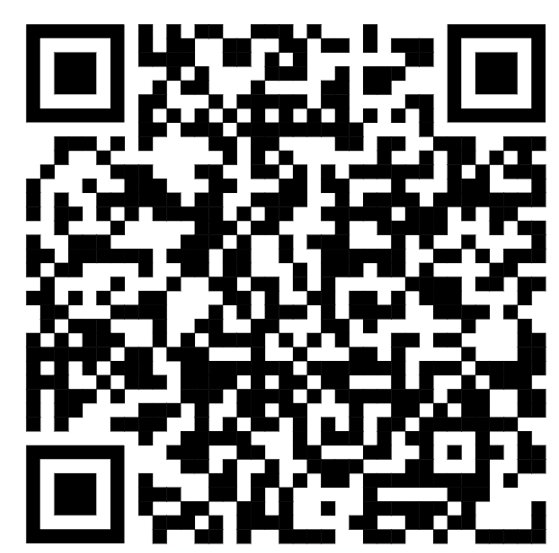



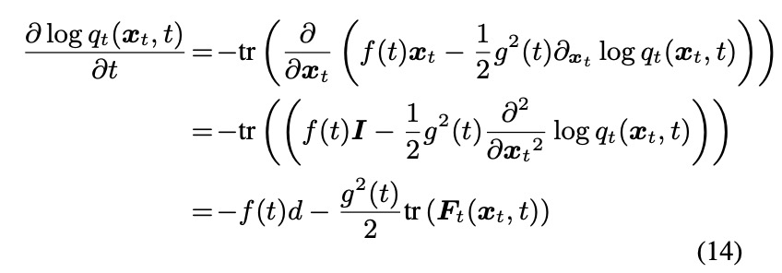
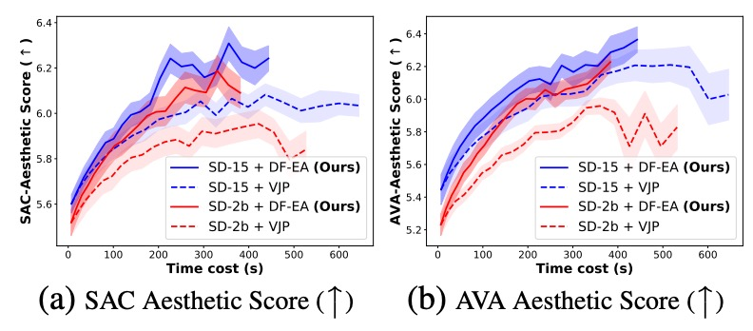
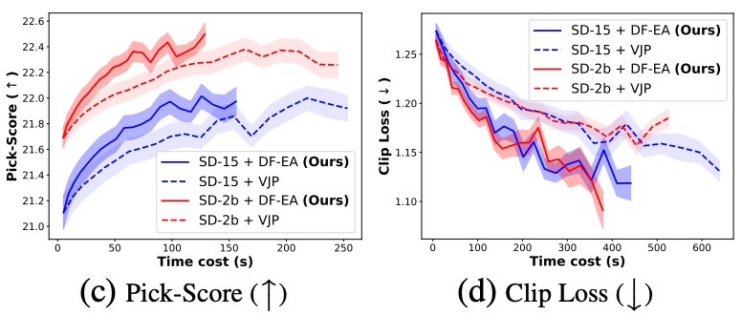
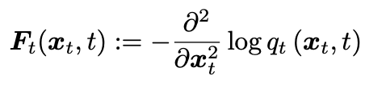
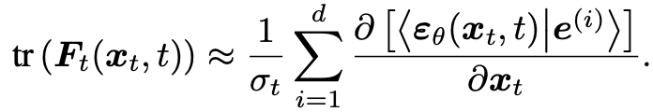
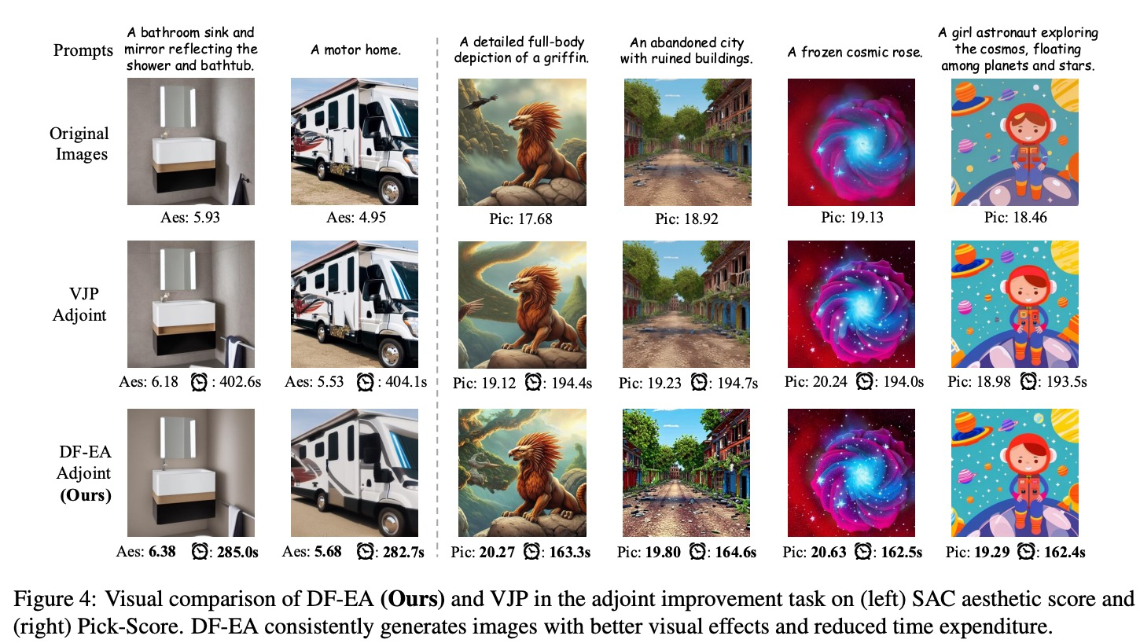
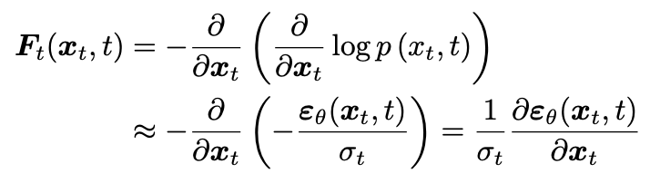
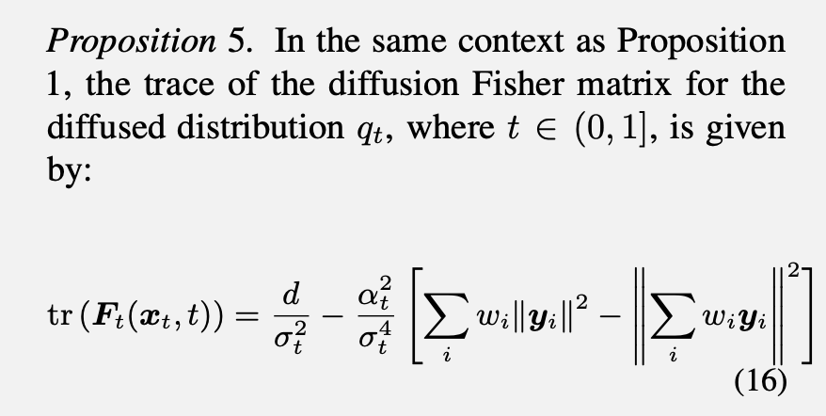
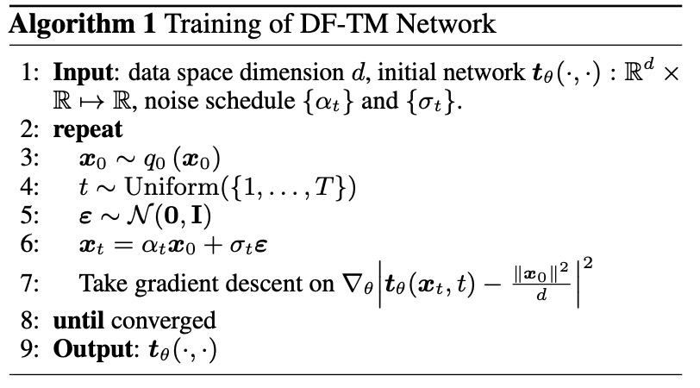
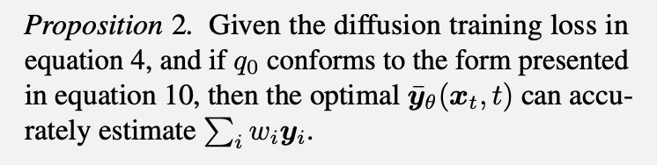
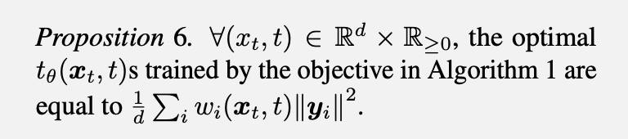
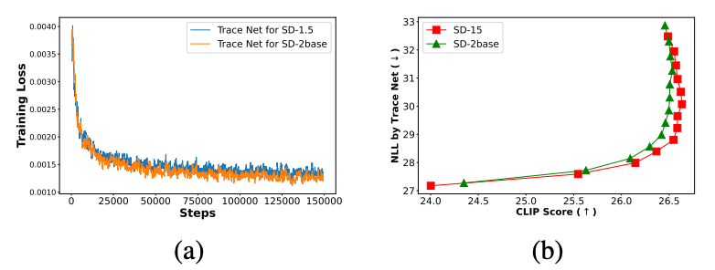
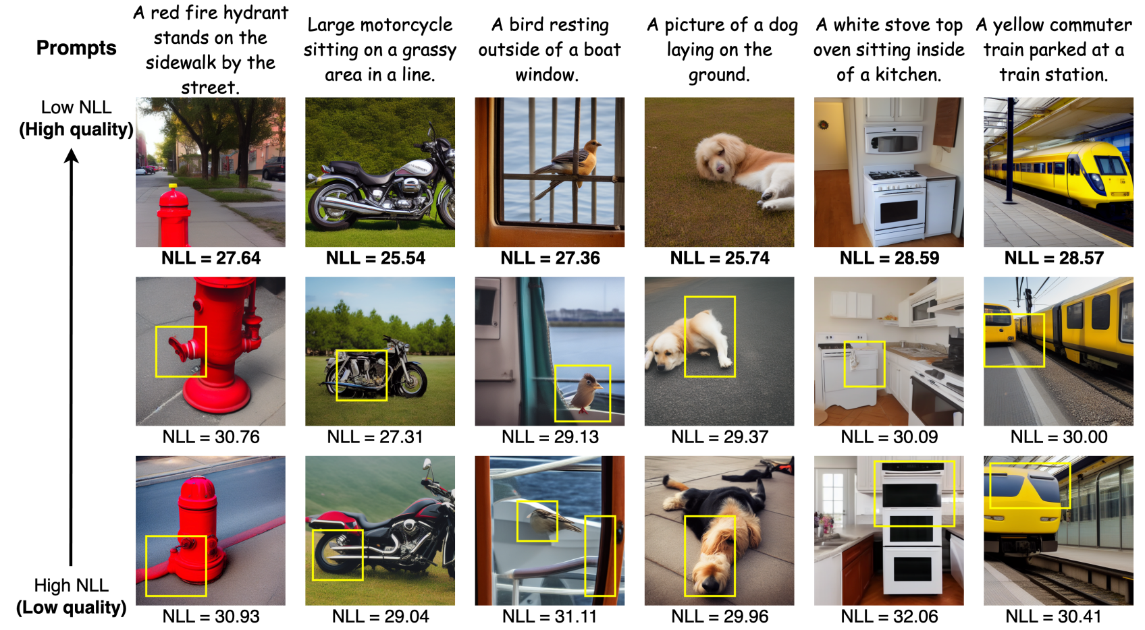
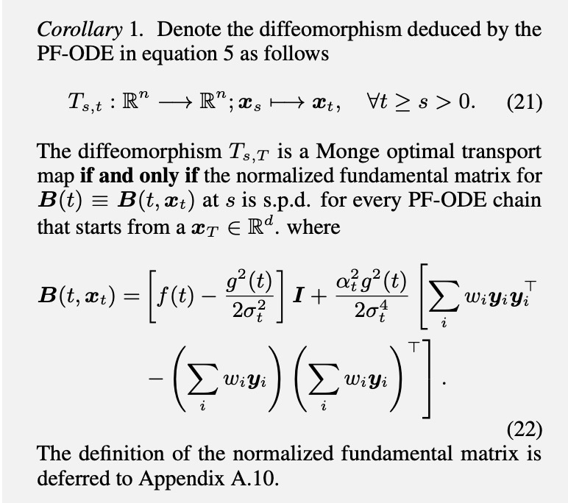
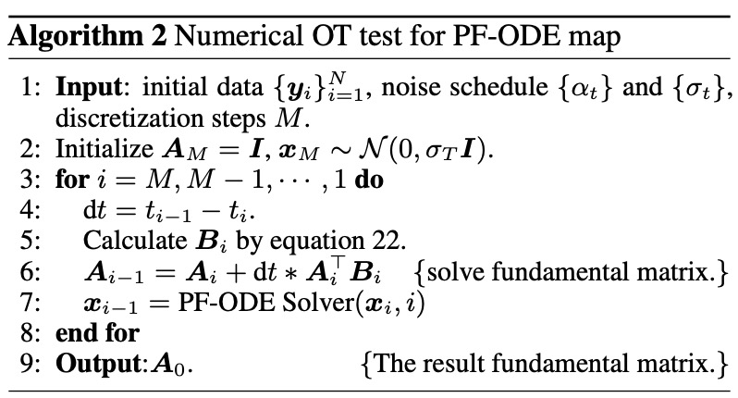
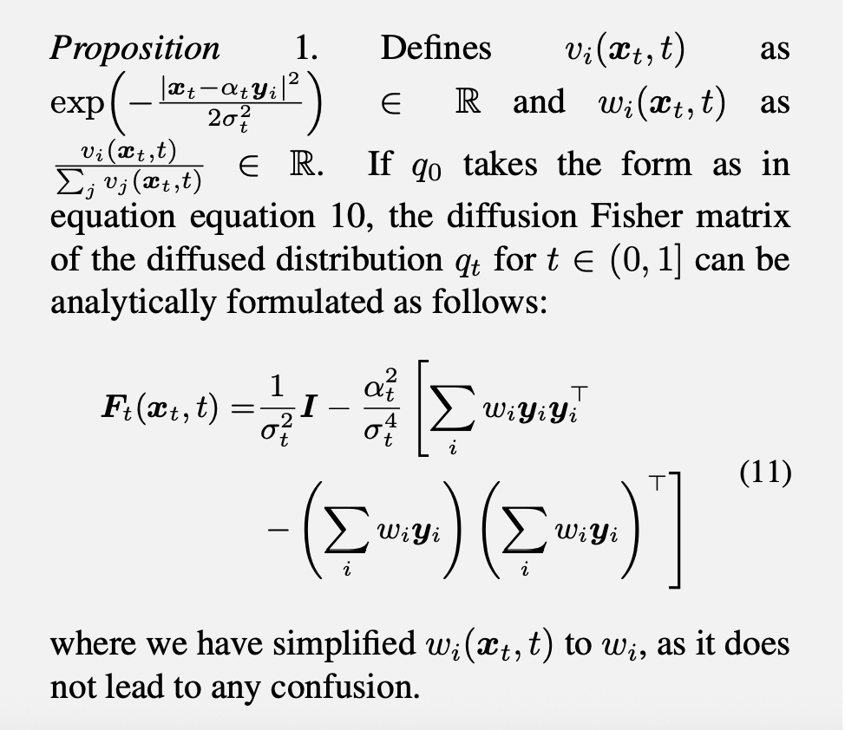
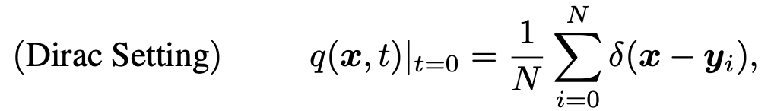
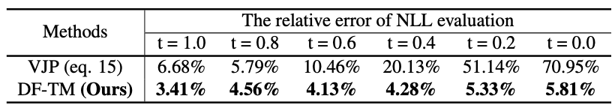
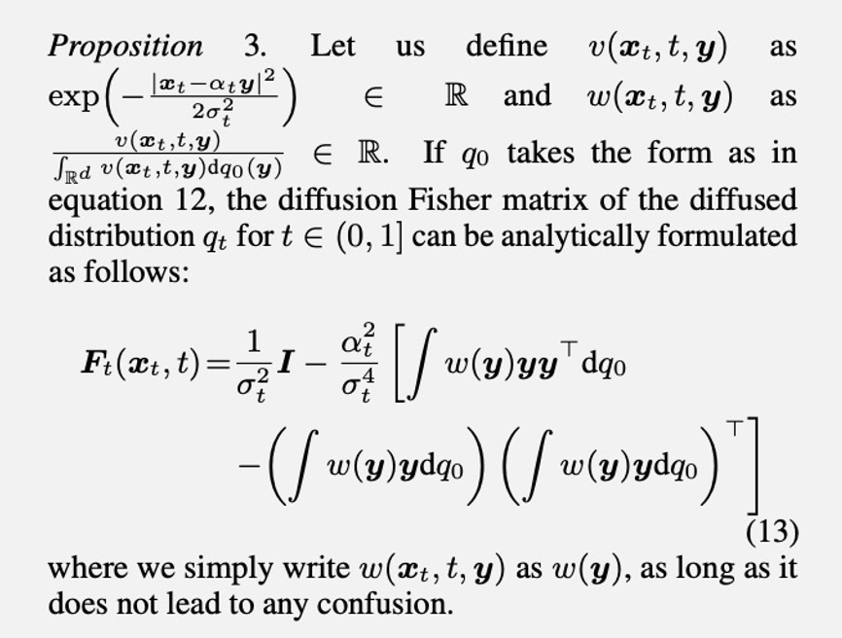
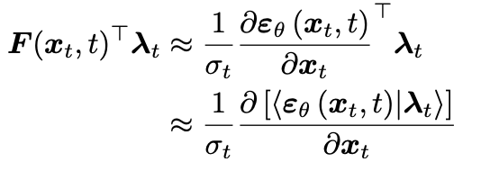

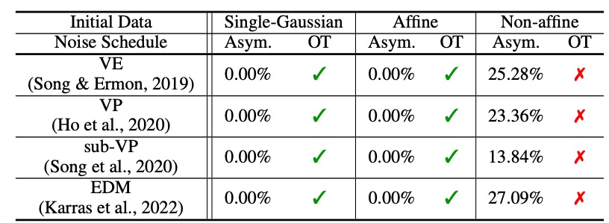
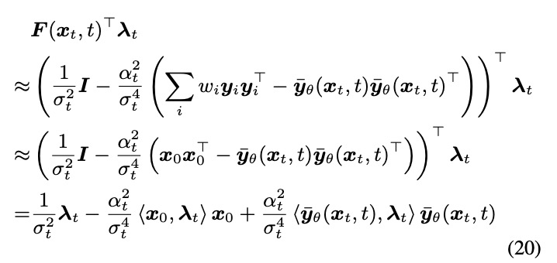

Efficiently Access Diffusion Fisher: Within the Outer Product Span Space
Fangyikang Wang^{1*}, Hubery Yin^{2*}, Shaobin Zhuang³, Huminhao Zhu¹, Yinan Li¹, Lei Qian¹, Chao Zhang^{1†}, Hanbin Zhao¹, Hui Qian¹, Chen Li²
code available
¹ Zhejiang University, ² WeChat, Tencent Inc., ³ Shanghai Jiao Tong University
1. Background: Fisher Information in Diffusion Models
3. DF Trace Matching
The diffusion Fisher (DF) in DMs, defined as the negative Hessian of the diffused distributions’ log density:
The likelihood evaluation of DMs would require access to diffusion Fisher’s trace. The log-likelihood of DM can be computed through:
We need to access the trace of diffusion Fisher!
Figure 3. Comparison between our DF method and the VJP method on adjoint guidance sampling across five objective scores: SAC/AVA aesthetic score, Pick-Score, clip loss, and Face ID loss. Notably, our DF consistently achieves superior scores with less time expenditure.
The DF provides valuable second-order information on DMs and plays a crucial role in downstream tasks, e.g., likelihood evaluation, adjoint optimization, and the optimal transport analysis of DMs.
The current VJP must iterate through each dimension to compute the individual elements on the diagonal, and then sum them up:
A time complexity of $𝒪(d^{2})$
Current practices typically approximate the diffusion Fisher by applying auto-differentiation to the learned score network:
We propose our DF-Trace Matching method to directly obtain the analytical form of the trave of diffusion Fisher and train a network to match it.
Learned via a trace network
Straightforward, but lacks accuracy guarantee, and is time-consuming.
Figure 4. Visual comparison of DF-EA (Ours) and VJP in the adjoint improvement task on (left) SAC aesthetic score and (right) Pick-Score. DF-EA consistently generates images with better visual effects and reduced time expenditure.
2. The analytical formulation of the Diffusion Fisher
5. The OT property of PF-ODE map
Approximated via learned score
We first derive a corollary for the optimal transport property of the diffusion-ODE deduced map. Subsequently, we design the DF OT method based on the corollary.
We derive a novel analytical form for the diffusion Fisher, which is composed of weighted outer-product sums. This innovative formulation uncovers that the diffusion Fisher invariably lies within the span of a set of outer-product bases.
Data distribution under the Dirac assumption
Figure 1. (a) The training loss of DF-TM for SD-1.5 and SD2base. It demonstrates commendable convergence behavior. (b)The trade-off curve of NLL and Clip score of SD-1.5 and SD-2base across various guidance scales in [1.5, 2.5, ..., 12.5, 13.5]
DF resides within a space spanned by the outer products of score and initial data.
Table 1. Comparison of the VJP method and our DF-TM in terms of the diffusion Fisher trace evaluation error across different timesteps. The error is evaluated on the 2-D chessboard data with the VE schedule.
Figure 2. Our DF-TM method facilitates the effective evaluation of the NLL of generated samples with varying seeds. It can be demonstrated that a lower NLL signifies a region of higher possibility, thereby consistently indicating superior image quality.
Our numerical experiments indicate that for all commonly employed noise schedules, including VE, VP, sub-VP, and EDM, the diffusion ODE map exhibits the OT property when the initial data follows a single Gaussian distribution or has an affine form. Conversely, it does not show this property when the initial data is non-affine.
4. Endpoint Approximation
Data distribution under the general assumption
When doing adjoint ODE, we need to access the matrix multiplication of the diffusion Fisher:
The current method mainly uses the VJP-based method, which needs time-consuming auto-differentiation.
DF resides within a space spanned by an infinite outer product basis of score and data.
Our DF-EA method utilize the endpoint sample x0 to approximate the diffusion Fisher matrix-multiplication operation. The formulation for DF-EA in the adjoint ODE is as follows:
Table 2. Comparison of numerical OT verification results of four
commonly used noise schedulers with different initial data..

