Slide 1






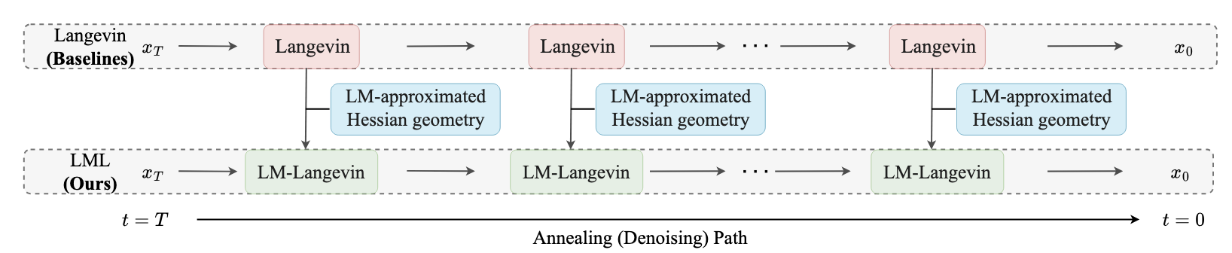
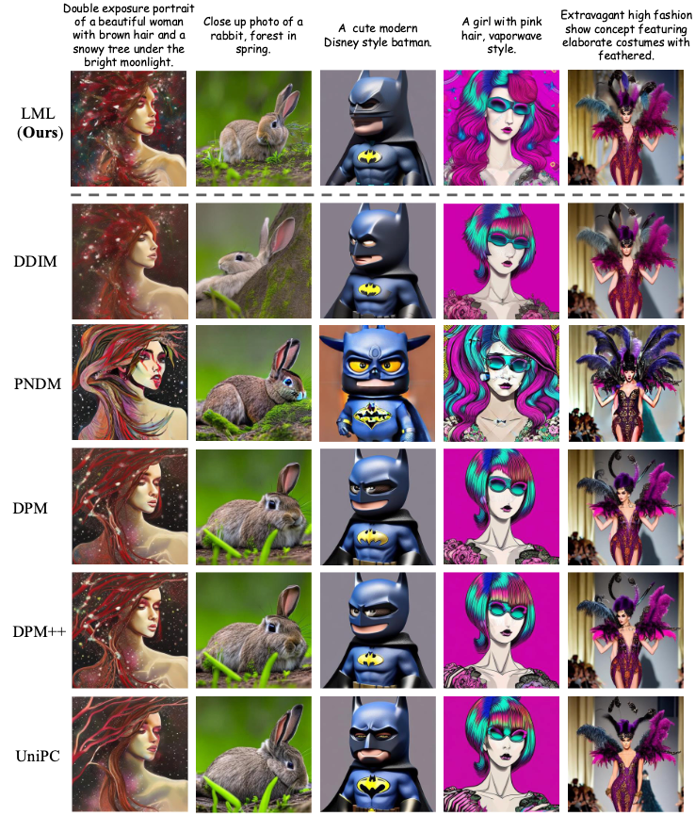
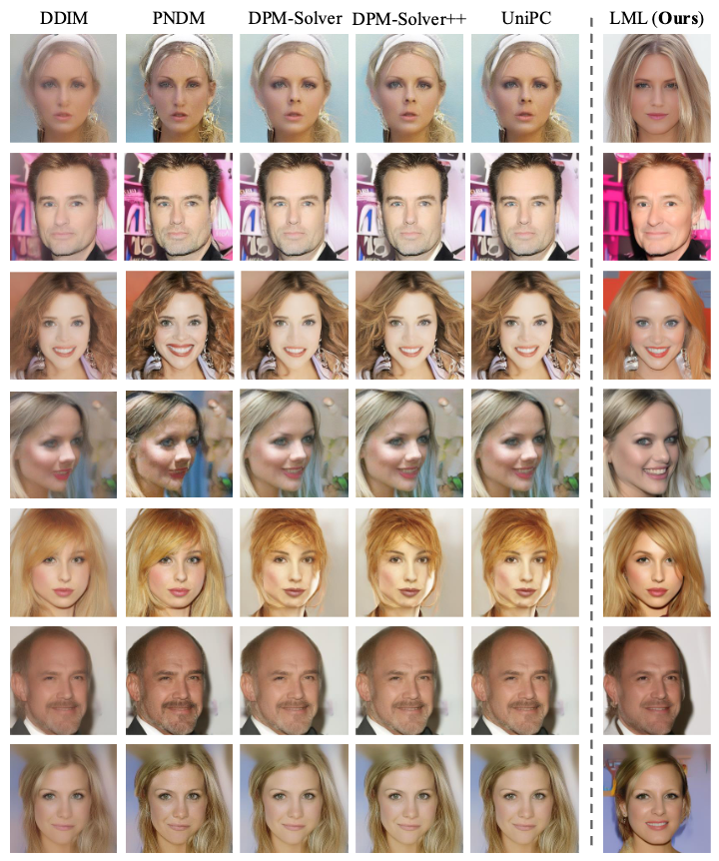
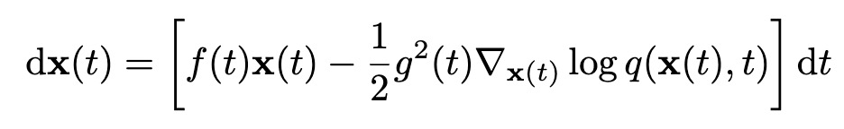
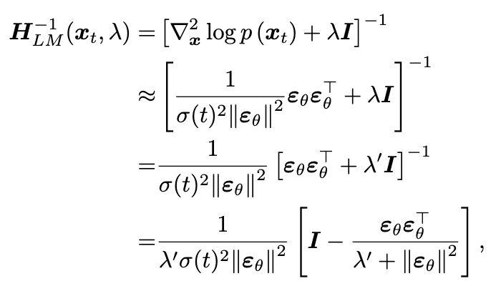

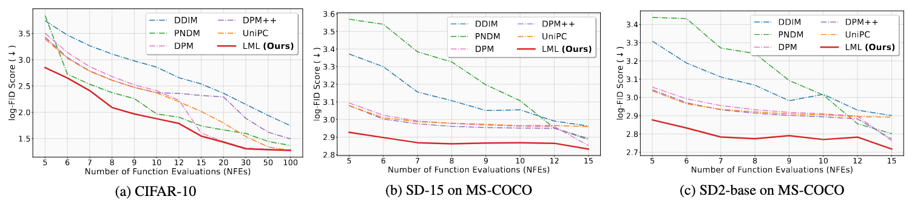
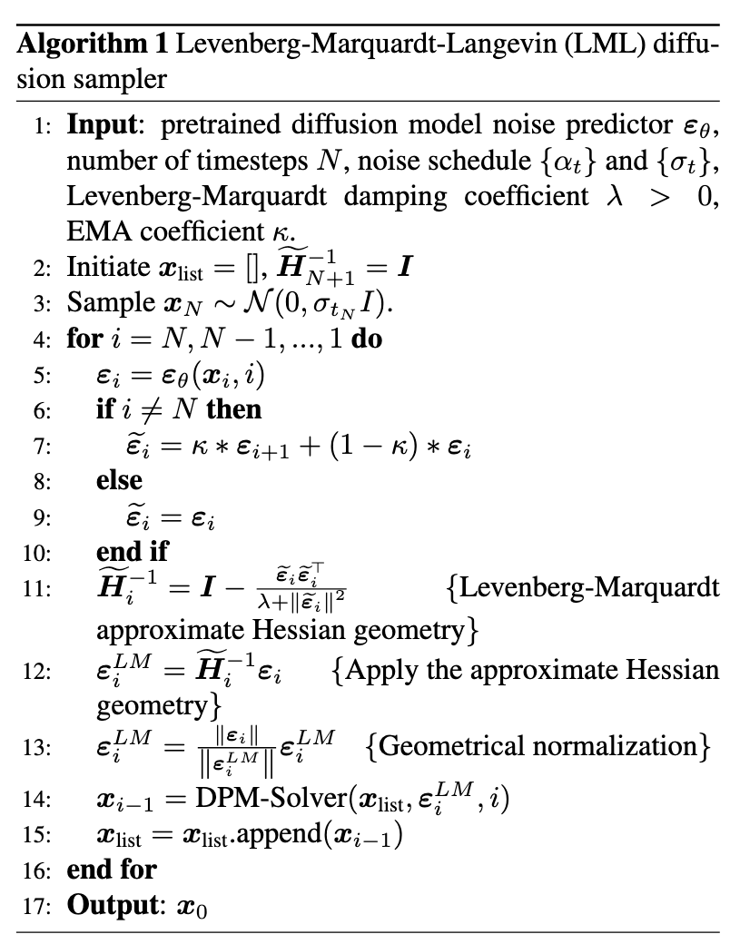
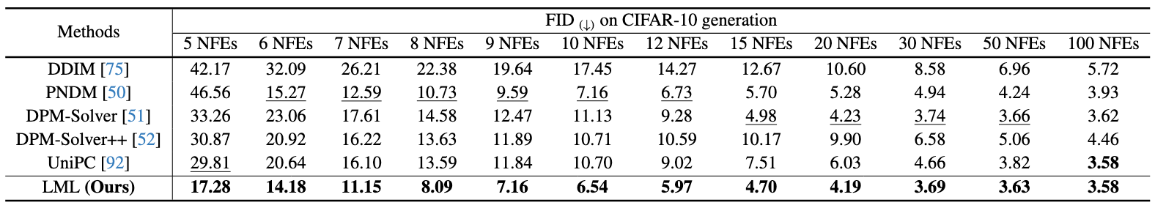
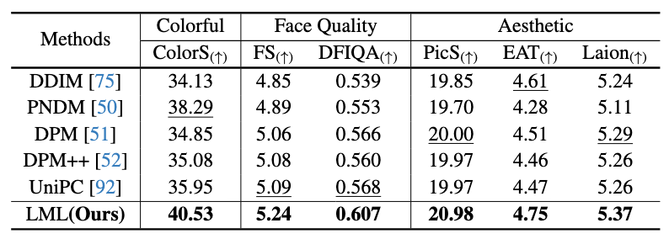
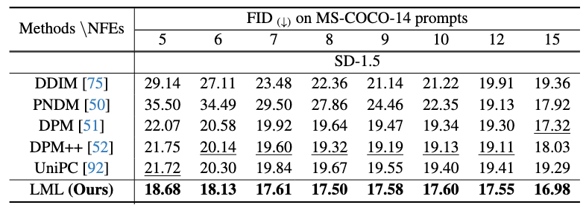
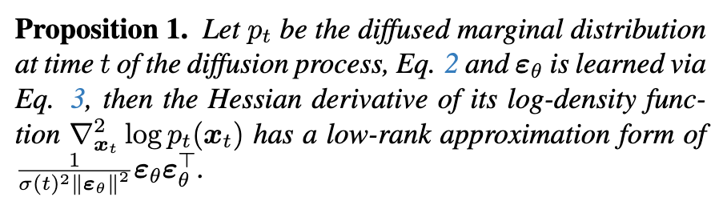
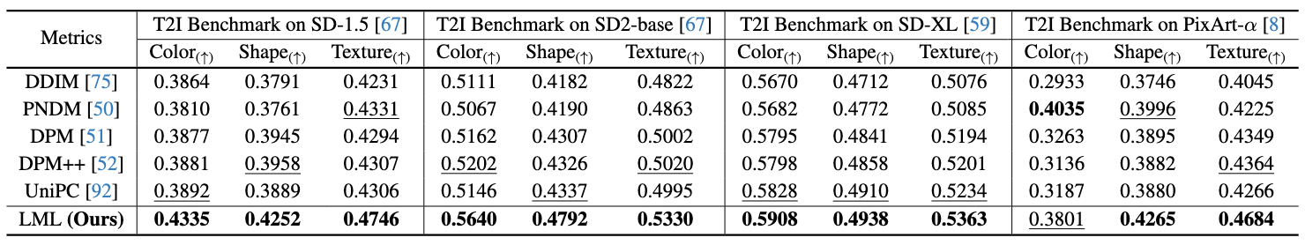
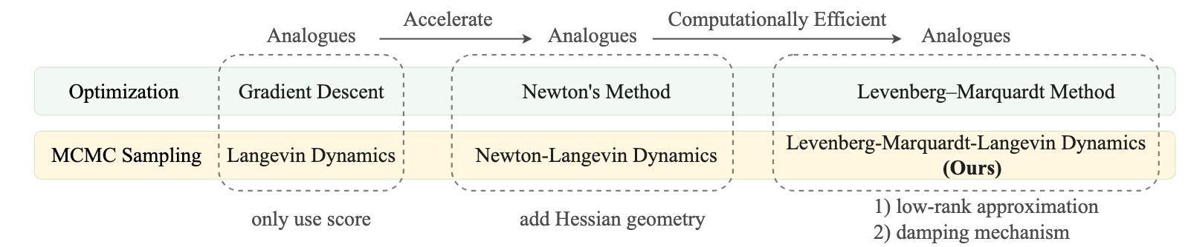
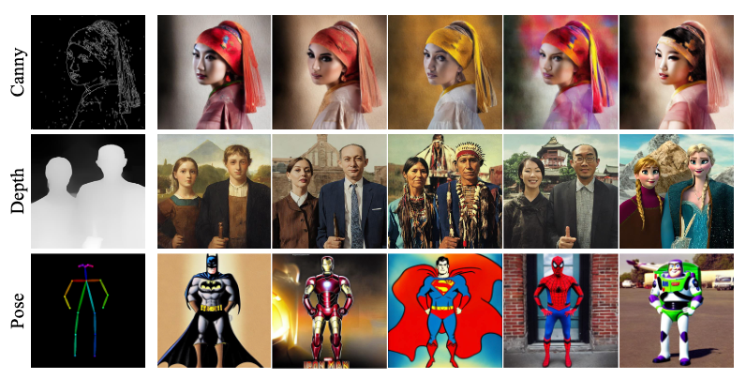
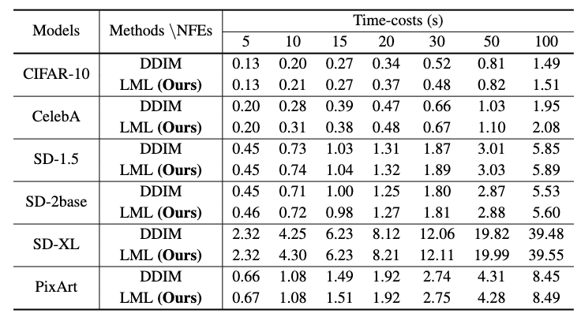
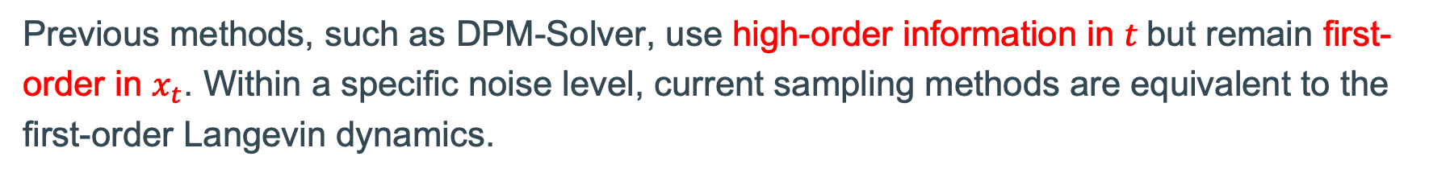
Unleashing High-Quality Image Generation in Diffusion Sampling Using Second-Order Levenberg-Marquardt-Langevin
Fangyikang Wang^{1*}, Hubery Yin^{2*}, Lei Qian¹, Yinan Li¹, Shaobin Zhuang³, Huminhao Zhu¹, Yilin Zhang¹, Yanlong Tang⁴, Chao Zhang^{1†}, Hanbin Zhao¹, Hui Qian¹, Chen Li²
code available
¹ Zhejiang University, ² WeChat Vision, Tencent Inc., ³ Shanghai Jiao Tong University, ⁴ Tencent Lightspeed Studio
1. The background
5. Experiments
The current deterministic sampling methods of diffusion models are typically different discretization of the following PF-ODE, where the score is matched via a score network.
We observe that the PF-ODE is a PDE on the ($x_{t}$, $t$) product space. Its infinitesimal total
variation has partial derivatives with respect to both $x_{t}$ and $t$:
Figure 2. Schematic comparison between our LML method and baselines. Our approach proposes to leverage the Levenberg-Marquardt approximated Hessian geometry to guide the Langevin update to be more accurate..
2.2 Damping Mechanism
Previous methods, such as DPM-Solver, use high-order information in $t$but remain first-order in $x_{t}$. Within a specific noise level, current sampling methods are equivalent to the first-order Langevin dynamics.
The low-rank approximated diffusion Hessian is significantly ill-conditioned. To address this issue, we propose adopting the damping mechanism used in the LML method. We introduce an additional damping identity matrix to the approximate Hessian, and consequently derive the following damping dynamics and Hessian geometry inverse:
In MCMC sampling, it is common to leverage additional second-order Hessian geometry to enhance the sampling quality of Langevin, which is called Newton Langevin dynamics:
Figure 3. Visual comparison on Celeb-A-HQ 256.
Figure 4. Visual comparison on SD-2-base.
Additional Hessian information to guide the gradient
3. Practical LML Diffusion Sampler
Current methods of leveraging Hessian information in DMs and challenges:
(1) Directly use Jacobian-vector-product (JVP) to access the diffusion Hessian.
Primarily, our sampler substitutes the first-order Langevin dynamics with LML at each noise level. At each noise level, we initially compute the LM low-rank approximated and damping Hessian geometry, as detailed in step 11. We incorporate the network output from previous
steps, as shown in step 7. We then apply this approximate Hessian geometry to our initial gradient, as detailed in step 12. We ensure that the Hessian geometry has a unit spectrum, which can be easily implemented through a normalization operation, as shown in step 13. We adopt the DPM-Solver as our denoising scheme, as shown in step 14.
Extremely slow in sampling, because of quadratic-complexity!
(2) Distill a diffusion Hessian network from the JVP calculation. [1]
Figure 5. This line chart compares the log-FID scores (↓) on (a) CIFAR-10, (b) MS-COCO with SD-15 and (c) MS-COCO with SD2-base.
Need model-specific training, not plug-and-play.
2. Levenberg-Marquardt-Langevin Dynamics
2.1 Low-rank Approximation of Diffusion Hessian
We follow the intuition of the Levenberg-Marquardt method to approximate the diffusion Hessian by simplifying the second-order partial derivatives. The low-rank approximate Hessian of diffusion models that we obtained is shown below:
Table 1. Comparison of different samplers on FID score( ↓) on CIFAR-10 unconditional generation.
Table 2. Comparison of different samplers on CelebA-HQ.
Table 3. Comparison of FID score (↓) on SD-15.
Notice that this approximation form is a scaled outer product of the score. It is training-free; however, its inverse is hard to calculate due to low-rankness.
Table 4. Comparison of different samplers in text-guided image generation task on the T2I-BC benchmark.
4. Theoretical Analysis
We also conduct comprehensive theoretical analyses for our low-rank approximation and damping mechanism.
First, we establish the error bound for the low-rank approximation of the diffusion Hessian.
Subsequently, we prove that the damping mechanism preserves an unbiased stationary measure and exhibit exponentially fast convergence in terms of χ2-divergence.
Figure 1. Drawing inspiration from the Levenberg-Marquardt method used in optimization, our method incorporates low-rank approximation and damping techniques. This enables us to obtain the Hessian geometry in a computationally affordable manner. Subsequently, we use this approximated Hessian geometry to guide the Langevin updates.
Figure 6. LML integrates seamlessly with ControlNet.
Table 5. Average wall-clock time cost.
References :
[1] Dockhorn, Tim, Arash Vahdat, and Karsten Kreis. "Genie: Higher-order denoising diffusion solvers. NeurIPS 2022

