Slide 1
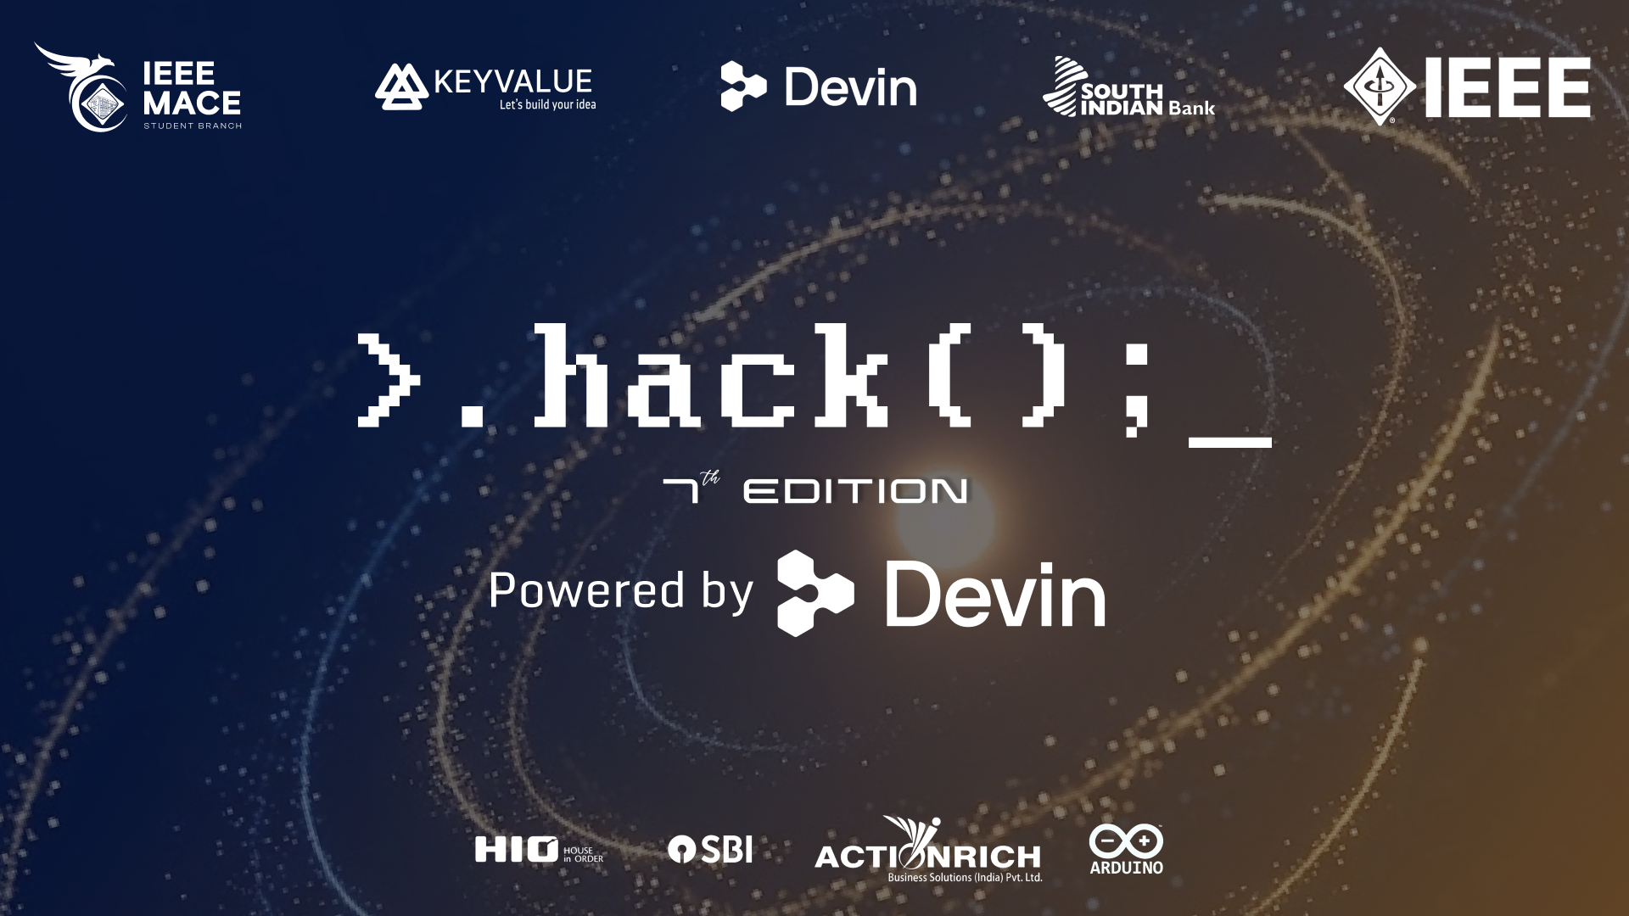

Slide 2
Project Title: CHEEZER — Autonomous Infrastructure Recovery Control Plane
Team name: [Team Name]
Team members: [Member 1] · [Member 2] · [Member 3]

Slide 3
Problem statement
Problem Statement Overview
● Declarative Problem: Teams can observe infrastructure metrics, but turning telemetry signals into affordable, safe, and autonomous recovery remains fragmented, high-risk, and operationally expensive.
● Target & Scale: Engineering teams & SaaS platforms running K8s without 24/7 SREs. Over 70% of outages stem from manual triage error under stress; MTTR averages 38-45 mins (k-k/min downtime cost).
● Current Gaps: Passive alert fatigue (Grafana/Datadog page after crash), manual 3 AM SSH/kubectl intervention, unsafe raw AI agents with blast-radius risks, and prohibitive enterprise AIOps costs.

Slide 4
Solution
Solution & Value Proposition
● Value Proposition: Cheezer is an autonomous reliability control plane that turns live infrastructure telemetry into zero-downtime, safety-verified, and cost-optimized recovery before or during incidents.
● 7-Stage Pipeline: Predict → Prevent → Detect → Reason → Authorize → Remediate → Verify → Learn.
● Key Use Cases: (1) Preventive memory/disk scaling 15 mins before OOM/Disk fill. (2) Sub-50ms reactive incident remediation for CrashLoopBackOff. (3) Bounded LLM log reasoning. (4) GitOps PR escalation.
● Development Roadmap: Autonomous Reactive Recovery (Shipped) → Multi-Metric Predictive Failure Engine (Shipped) → Multi-Cluster Mesh Governance (Next 6 Mo).

Slide 5
Structural breakdown (with demonstration)
Architecture & Live Demonstration
● Architecture: OTel/Prometheus Telemetry → Cheezer Core (Rust Async) → Predictive Engine (EWMA/Holt-Winters) / Fast Path → TOCTOU Revalidation → OPA Rego Gate → RemediationGuard → Multi-Cloud Executor → Synthetic Verification → Closed-Loop Log.
● User Workflow: Deploy Helm chart → Ingest webhooks → Auto-forecast failure trends → Revalidate live K8s state & OPA Rego rules → Execute sub-50ms remediation → Verify synthetic probe → Audit in Material 3 UI.
● Live Demonstration: (1) Reactive CrashLoopBackOff remediation executed & verified in 42ms. (2) Predictive memory leak detection & pre-emptive pod expansion with zero downtime.

Slide 6
Technologies used
Technology Stack & Rationale
● Rust (Edition 2021) & Tokio/Axum: Zero GC pauses, memory safety guarantees, sub-millisecond execution, and tiny memory footprint (<25MB RSS RAM).
● kube-rs & bollard: Native programmatic Kubernetes & Docker control bindings; eliminates shell execution vulnerabilities and overhead.
● Open Policy Agent (OPA): Declarative Rego policy engine ensuring enterprise fail-closed safety bounding.
● SQLite & SQLx: Embedded ACID store for prediction tracking and audit history with bash external database costs.
● NVIDIA NIM / Llama 3: AI fallback reasoning with strict context-trimming (90%+ alerts resolved by bash Fast Path rules).

Slide 7
Scalability and feasibility
Scalability & Technical Feasibility
● Scaling Architecture: Stateless Rust controller with watchdog.rs leader-lease locking for HA; async non-blocking Tokio workers; adaptive telemetry sampling (NORMAL: 60s → INCIDENT: 1s).
● Challenges at Scale & Mitigations: Telemetry storms handled by adaptive resolution; automation blast radius controlled by OPA Rego budgets; race conditions eliminated via TOCTOU live re-checks.
● Technical Feasibility: 100% production-ready. Rust core compiled with 22/22 passing integration tests, zero-mock metric parsers, and live /proc/self/stat profiling.

Slide 8
Marketing real world USP
Marketing & Real-World USP
● Unique Selling Proposition (USP): Cheezer is the only vendor-neutral control plane combining predictive statistical modeling, fail-closed safety (OPA + TOCTOU), and adaptive LLM cost-routing.
● Differentiators: Sub-50ms recovery vs 45-min human MTTR; fail-closed safety vs raw LLM hallucination risk; 96.7% lower operating costs than traditional AIOps.
● Target Segments: Mid-market SaaS startups & Tech companies without 24/7 SREs; Enterprise DevOps teams eliminating tier-1 paging.
● Go-To-Market: Open-source developer core (helm install cheezer), Grafana/Prometheus plugin ecosystem, PLG model (free tier up to 20 workloads).

Slide 9
Unit economics
Unit Economics & SWOT Analysis
● Cost to Serve (COGS): $13.70 / month per cluster (vs $425/mo baseline — a 96.7% infrastructure cost reduction).
● Revenue & Margins: Pro Subscription @ $299/mo per cluster yielding a 95.4% Gross Margin.
● Customer ROI: Saves 40+ SRE hours/month ($3,400 in labor savings), delivering an immediate 11.3x ROI.
● SWOT: Strengths (sub-50ms speed, fail-closed safety, 96.7% COGS saving); Weaknesses (trust barrier for automated mutations); Opportunities (AIOps growth & SRE shortage); Threats (cloud provider auto-scaling).

Slide 10
Future plans
Future Plans & Long-Term Vision
● Immediate Next Steps: Automated GitOps PR patching for code/config bugs + Wasm plugin extension engine.
● 6-Month Horizon: Multi-cluster federated mesh governance, self-tuning anomaly detection, and native AWS/GCP/Azure integrations.
● 1-Year Vision & Beyond: Autonomous Reliability Standard (ARS) benchmark suite and a fully autonomous, self-healing cloud control plane.

Slide 11


