Slide 1
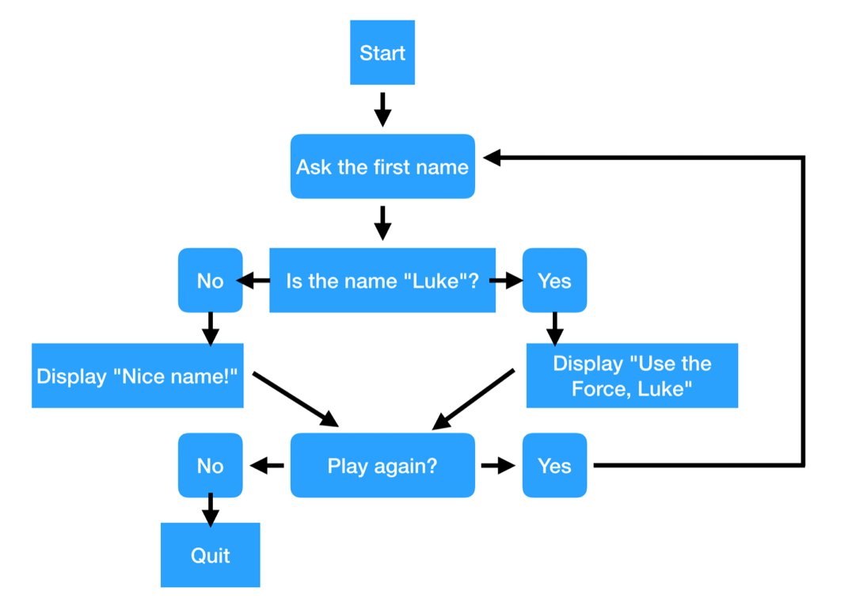

Slide 2
you will need to write a game in Python with the following rules:
When starting the game, a secret number between 1 and 100 is generated.
The game asks the user to enter a number.
The game will tell the user if the secret number is bigger or smaller than the guess.
As long as the user doesn't find the secret number, the game continues.
As soon as the user finds the secret number, the game stops and tells the user how many attempts it took to win. Make sure to use the right wording (attempt or attempts)
In case the user enters anything else than a number, the game should tell that to the user and quit gracefully.

Slide 3
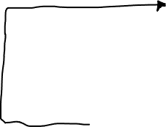
Generate a secret number between 1 and 100
Ask the user to enter the secret number between 1 and 100
Is there a number ?
Display: The wrong input. Program will quit.
No
Yes
Display: Congratulations! It took you one attempt to win.
Or
Display:
Congratulations! It took you xx attempts to win.
Display: The number is bigger
Is the number correct?
No
Yes
OR
Display: The number is smaller
Quit
Program stops

