Slide 1
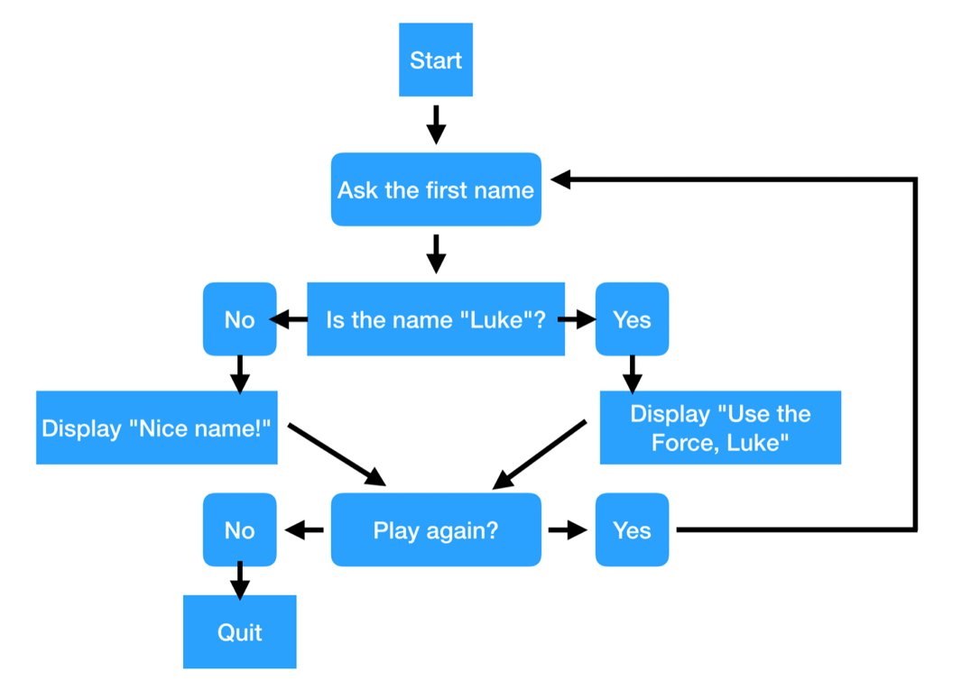

Slide 2
you will need to write a game in Python with the following rules:
When starting the game, a secret number between 1 and 100 is generated.
The game asks the user to enter a number.
The game will tell the user if the secret number is bigger or smaller than the guess.
As long as the user doesn't find the secret number, the game continues.
As soon as the user finds the secret number, the game stops and tells the user how many attempts it took to win. Make sure to use the right wording (attempt or attempts)
In case the user enters anything else than a number, the game should tell that to the user and quit gracefully.

Slide 3
# 1-set up phase
# 2 start the game logic > loop
# inside your input insert number (indent get user input)
# check the user input meaning number not a string
# error message
# increase the attempt count
# check the user answer against the secret_number
# 3 get the spelling of the "attempt" word
# 4 display congratulations message.

Slide 4
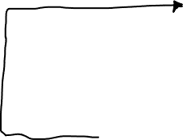
Generate a secret number between 1 and 100
Ask the user to enter the secret number between 1 and 100
Is there a number ?
Display: The wrong input. Program will quit.
No
Yes
Display: Congratulations! It took you one attempt to win.
Or
Display:
Congratulations! It took you xx attempts to win.
Display: The number is bigger
Is the number correct?
No
Yes
OR
Display: The number is smaller
Quit
Program stops

Slide 5
# 1-set up phase
import random
answer = random.randint(1,101)
user_wins = False
attempts = 0
attempt_word = ""

Slide 6
# 2-start the game logic > loop
while user_wins != True:
# get user input (inside your input insert number)
guess = int(input("Enter a number between 1 and 100: "))
# check the user input meaning number not a string
try:
guess_number = int(guess)
# error message
except:
print("Error: You need to enter a valid number! ")
quit()

Slide 7
# increase the attempt count
attempts += 1
# check the user answer against the secret_number
if guess_number == answer:
user_wins = True
elif guess_number > answer:
print("The secret number is smaller!")
else:
print("The secret number is bigger!")

Slide 8
# 3-get the spelling of the "attempt" word
if attempts == "1":
attempt_word = "attempt"
else:
attempt_word = "attempts"
# 4-display the result.
print("you won!!! It took " + str(attempts) + attempt_word)

