Slide 1
Exercice -> develop an app for note taking
Insert a complete note taking app inside your terminal :
It is Terminal based app
Able to enter a new note
Able to search for a new note
Upgrade or expand it
Name it noteApp.py

Slide 2
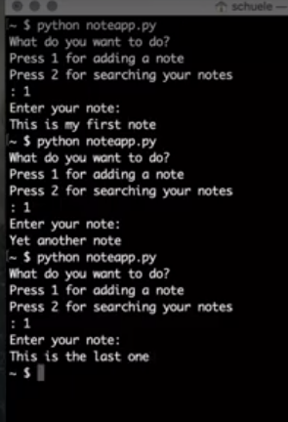
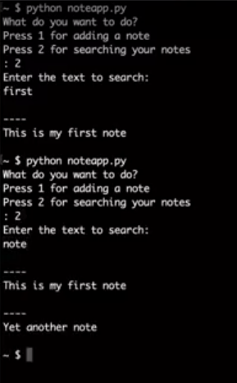
Exercice note taking app: final result

Slide 3
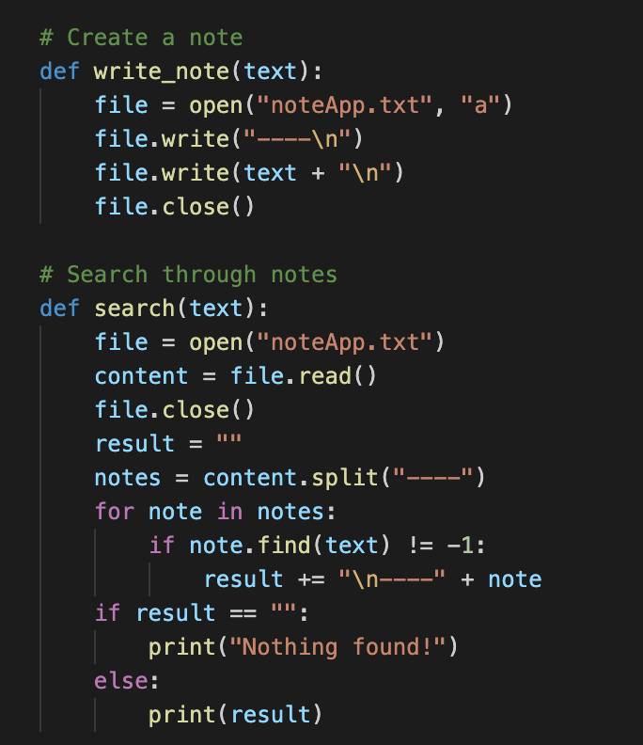
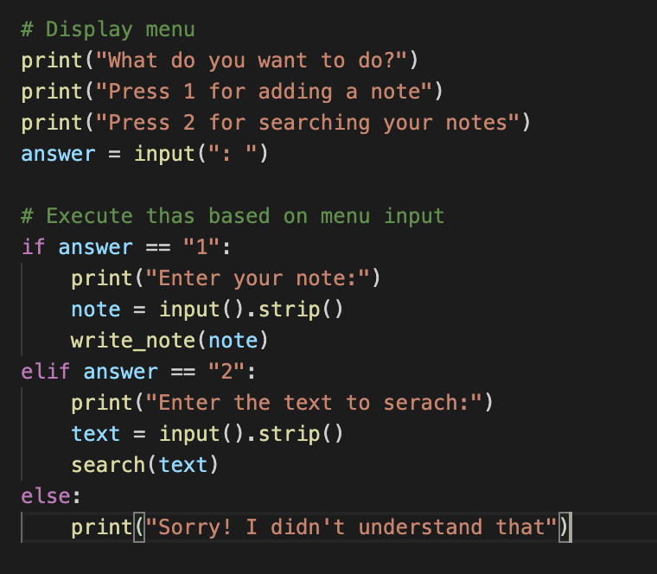
Exercice note taking app: solution

Slide 4
Develop a note taking application in Terminal
Create a note in txt / terminal
Search trought notes
Display menu
Execution
Note taking application fonctions by 2 choises:
1) Press 1 for adding a note
2) Press 2 for searching your notes

