Slide 1
rnavail
SEQUENCE
Is this RNA target actually available to bind?
AUGC…
↓
A practical, provenance-aware screen for RNA target-region accessibility
OPEN?
P + ΔG
Repository presentation • September 2026

Slide 2
THE PROBLEM
The sequence can be right — and the target still unreachable
RNA folds back on itself
The decision question
A complementary site may already be paired inside a stem. A binder cannot use bases that are structurally occupied.
How often is the complete target footprint open at the same time?
PRESENT ≠ AVAILABLE
Relevant to antisense oligos, toehold triggers, CRISPR spacers, primers and miRNA seeds.
The molecule samples an ensemble of structures, so “open” is a probability—not a single drawing.
Source: README.md; docs/01-the-question.md

Slide 3
THE NEED
Designers need a shortlist—not another plausible-looking number
01
Correct event
02
Comparable evidence
Whole-footprint joint opening, with seed opening kept separate.
Label model family and scope; do not count duplicate interfaces as independent votes.
03
Actionable output
04
Honest uncertainty
Scan hundreds of windows cheaply, then deeply evaluate a small non-overlapping shortlist.
Surface failures, protocol disagreement, conditioning gaps and missing physics.
Source: README.md; docs/03-architecture.md; docs/05-consensus-and-scoring.md

Slide 4
THE SOLUTION
rnavail turns one RNA into ranked, traceable candidates
INPUT
OUTPUT
FASTA or literal sequence
RNAVAIL
Ranked candidates
→
Local screen
+ global confirmation
+ structural diagnostics
→
+ footprint, recognition,
conditions, optional probing
• joint P(unpaired)
• ΔGopen
• seed accessibility
• warnings + lineage
One request → compatible readings + provenance
Text • JSON • TSV • HTML
Source: README.md; docs/02-pipeline.md; docs/06-outputs.md

Slide 5
PIPELINE
How it works: screen broadly, confirm deeply
1
2
3
4
5
6
Declare
Tile
Screen
Shortlist
Deep stage
Report
Sequence, footprint, event, protocol
Every candidate window
RNAplfold local joint opening
Seed-first when mechanism supports it; remove overlap
Exact global PF + orthogonal diagnostics
Rank, disagreement, notes, provenance
Key rule
The displayed probability and ΔG come from one coherent opening observation; model disagreement stays visible instead of being averaged away.
Source: docs/02-pipeline.md; docs/05-consensus-and-scoring.md

Slide 6
A LITTLE BACKGROUND
Accessibility is an ensemble property
1 • RNA is not one shape
2 • Ask for an event
3 • Convert probability to work
The sequence samples many secondary structures. Their relative energies determine how often each structure occurs.
For interval i…j, sum the ensemble weight of every structure where all bases in that interval are unpaired.
ΔGopen = −RT · ln(Pᵤₙₚ)
At 37 °C, RT ≈ 0.616 kcal/mol
Boltzmann ensemble
Pᵤₙₚ(i,j)
LOW ΔGopen = easier to expose
low-energy structures
carry more statistical weight
0 = shut • 1 = open
ΔG per nucleotide supports comparisons across footprint lengths.
Source: docs/01-the-question.md; docs/04-tools.md

Slide 7
CORE CALCULATIONS
Two calculations answer the same event at different scopes
LOCAL SCREEN • RNAplfold
GLOBAL CONFIRMATION • Vienna exact
Slide a 200-nt context along the RNA
Fold the whole molecule twice
• One partition-function sweep gives all candidate intervals
• Default maximum pair span: 150 nt
• Fast enough to screen a full transcript
• Produces joint opening and seed-opening lookup tables
G₀
unconstrained ensemble
G₁
target forced unpaired
ΔGopen = G₁ − G₀
More expensive, preferred coherent headline observation when compatible
Approximate scope
Source: docs/04-tools.md §4.3; docs/02-pipeline.md

Slide 8
TOOLCHAIN
The tools play different roles—they are not twelve equal votes
JOINT ACCESSIBILITY
ENSEMBLE / CROSS-CHECK
• RNAplfold — local, scalable screen
• RNAplfold CLI — parity check, same algorithm
• Vienna exact — global constrained PF
• RNAfold — global ensemble + entropy
• RNAstructure PF — independent code/parameters
• Ensemble sample — Monte Carlo state check
ALTERNATIVE MODELS
BLIND-SPOT DIAGNOSTICS
• CONTRAfold — learned posterior
• EternaFold — measurement-trained posterior
• LinearFold — fast single structure
• ProbKnot — pseudoknots
• G4 scan — quadruplex propensity
• Kinwalker — co-transcriptional traps
Only compatible probability estimands are pooled. Posteriors and single structures remain visible diagnostics.
Source: docs/04-tools.md; docs/05-consensus-and-scoring.md

Slide 9
WHAT EACH LIBRARY CONTRIBUTES • 1 OF 3
The main calculators: fast search first, careful confirmation second
RNAplfold
RNAplfold CLI
WHAT IT DOES
Estimates how often every short stretch is fully open inside a moving local neighborhood.
WHAT IT DOES
Runs the same RNAplfold method through ViennaRNA’s official command-line program.
ADVANTAGE
Very fast: one pass scores the whole transcript.
ADVANTAGE
Checks that the Python integration is producing the same result.
HOW RNAVAIL USES IT
First-pass screen, seed search, profile and landscape.
HOW RNAVAIL USES IT
Quality-control duplicate—not a second vote.
Vienna exact
RNAfold
WHAT IT DOES
Folds the complete RNA with and without the chosen region forced open; the energy difference is ΔGopen.
WHAT IT DOES
Describes the whole equilibrium ensemble and its most likely low-energy structure.
ADVANTAGE
Direct whole-molecule answer for the exact target interval.
ADVANTAGE
Shows overall folding, uncertainty and per-base pairing.
HOW RNAVAIL USES IT
Preferred headline opening value for shortlisted sites.
HOW RNAVAIL USES IT
Structural context and sanity checks—not a separate joint-opening vote.
Plain-language summary of docs/04-tools.md. “Library” here means the external engine; rnavail supplies an adapter around it.

Slide 10
WHAT EACH LIBRARY CONTRIBUTES • 2 OF 3
Cross-checks: ask whether another model tells the same story
RNAstructure partition
Ensemble sample
DOES
Calculates pairing probabilities with a separate software codebase and parameter tables.
DOES
Randomly draws thousands of structures in proportion to how likely they are.
EDGE
Best independent thermodynamic cross-check; disagreement means genuine model sensitivity.
EDGE
Shows whether a site is exposed, partly exposed or buried across actual sampled states.
USED
Adds per-base probability evidence and disagreement diagnostics.
USED
Checks the global Vienna ensemble; rare open events become honest upper bounds.
LinearFold
CONTRAfold
DOES
Quickly predicts one likely fold for the entire transcript using beam search.
DOES
Uses a machine-learned scoring model instead of laboratory-derived thermodynamic energies.
EDGE
Scales well and can reveal long-distance pairing missed by a local window.
EDGE
A different model class; agreement with thermodynamic tools is reassuring.
USED
Fast structural warning only; one drawing is not an opening probability.
USED
Provides a confidence-like posterior for comparison, never converted to ΔG.
Source: docs/04-tools.md §4.4

Slide 11
WHAT EACH LIBRARY CONTRIBUTES • 3 OF 3
Specialists look for structures ordinary folding tools cannot see
EternaFold
ProbKnot
DOES
A learned model trained on roughly one million chemical-mapping measurements.
DOES
Builds a structure that may contain crossing base pairs called pseudoknots.
EDGE
Tests whether data-trained parameters agree with conventional folding.
EDGE
Catches a major blind spot shared by normal nested-structure algorithms.
USED
Posterior diagnostic; kept separate from physical probabilities.
USED
If it locks the target, rnavail warns that accessibility may be too optimistic.
G4Hunter scan
Kinwalker
DOES
Searches the letters themselves for G-rich patterns likely to form G-quadruplexes.
DOES
Simulates one possible folding path while the RNA is being transcribed from 5′ to 3′.
EDGE
Always available and detects non-standard structures ordinary base-pair matrices omit.
EDGE
Can expose kinetic traps hidden by equilibrium calculations.
USED
Warning signal only; it does not produce a corrected opening probability.
USED
Short constructs only; refuses long transcripts rather than hanging the run.
Source: docs/04-tools.md §4.4

Slide 12
FROM CALCULATIONS TO RANK
Ranking is transparent: four evidence gates, then four criteria
CONSENSUS GATES
Deduplicate shared calculation groups
DEFAULT SCORE
1
Seed P(open)
40%
10⁻⁴ → 0.5 • log ramp
2
Keep estimands separate
ΔGopen / nt
30%
1.0 → 0.05 • linear
3
Match probing/conditioning
Model spread
15%
4.0 → 0.5 kcal/mol
4
Require protocol compatibility
Length spread
15%
0.15 → 0.01 kcal/mol/nt
Median is taken across independent compatible groups; disagreement is retained as spread.
score = exp[ Σ wᵢ ln(dᵢ) / Σ wᵢ ]
Geometric mean: one poor required property can sink the rank. Missing criteria reduce coverage; they are not silently scored as zero.
Source: docs/05-consensus-and-scoring.md §5.1–5.2

Slide 13
SAVED TRANSCRIPT RUN
Worked rank calculation: candidate w1814
RAW OBSERVATION
20 nt • positions 1814–1833
DESIRABILITY
WEIGHTED
GEOMETRIC MEAN
Seed P = 0.760
Seed
1.000
→
→
0.963
ΔGopen = 2.62 kcal/mol
Opening
0.915
ΔGopen / nt = 0.131
Model robustness
missing
coverage 70%
Joint P = 0.014
Length robustness
missing
This is a preference score, not a 96.3% binding probability.
Because robustness sweeps were not requested, the score uses only 70% of intended weight. Run --robustness and --length-robustness for a better-founded rank.
Saved run: runs/20260913-175402/report.json; scoring anchors: docs/05-consensus-and-scoring.md

Slide 14
HOW ALL THE INFORMATION IS USED
Not every tool changes the score—and that is intentional
DIRECTLY RANKS
SELECTS / CROSS-CHECKS
WARNS, BUT DOES NOT SCORE
• Can an initial seed become exposed?
• How much work per base opens the full site?
• Does the answer survive changes in folding settings?
• Does it survive nearby footprint lengths?
• Exact global result supplies the coherent headline P and ΔG
• Compatible probability tools form a de-duplicated consensus
• Local-versus-global difference measures scope sensitivity
• Sampling and alternative models test the story
• Possible pseudoknot
• Possible G-quadruplex
• Kinetic folding trap
• Mutation or transcript-context sensitivity
• Tool failure or unsupported condition
→ four desirabilities → one geometric mean
→ confidence and interpretation
→ reasons to test, reject or investigate
The score stays small and auditable; important non-comparable evidence remains visible instead of being forced into one number.

Slide 15
CORE METRIC
The important distinction: each base open vs. all bases open
Marginal view
Joint event
Mean per-base unpaired
P(all 12 nt unpaired together)
≈3,100×
0.81
0.00026
different answer
Looks 81% open
≈ 1 time in 3,800
Different nucleotides breathe at different times. A full-footprint binder needs them open simultaneously; a shorter seed is a separate event.
Repository test molecule, region 9–20; README.md and docs/01-the-question.md

Slide 16
SAVED RUN
Worked example: a toehold switch with an mCherry off-target
TARGET
Candidate 1 switch
95 nt • GC 52.6%
TRIGGER
COMPETITOR
TOEHOLD
+
35 nt
+
mCherry
positions 1–26
seed length 8
off-target sequence
MAIN STEM • 27–32
Run protocol: 37 °C • Turner 2004 • 12 tools ran • 3.3 s
Saved run: runs/20260905-133646-candidate1-alltools/meta.json

Slide 17
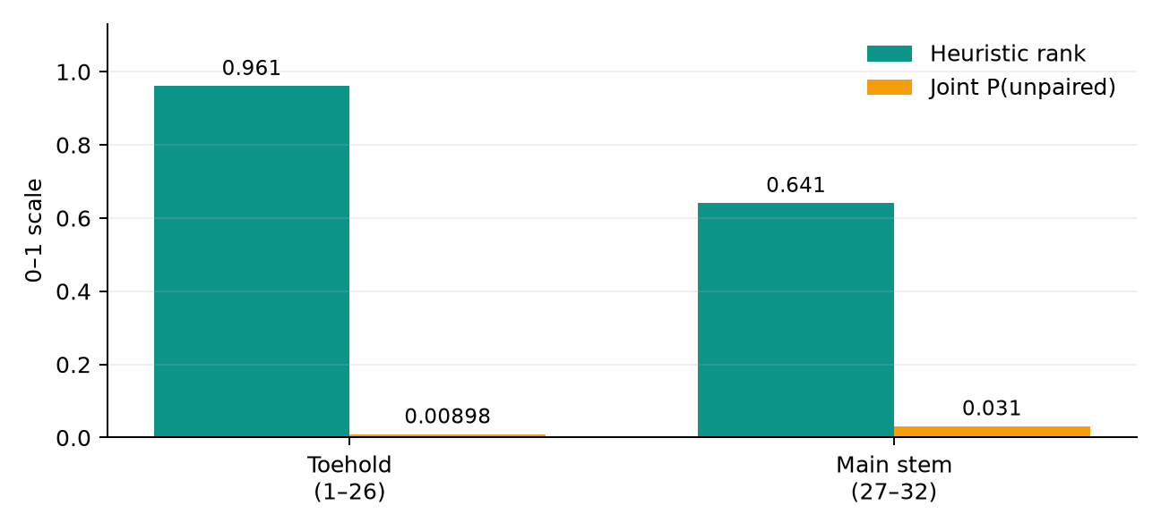
RESULTS
mCherry run: the toehold ranks strongly, but “open” is nuanced
TOEHOLD • 26 nt
Rank 0.961
• Joint P(open) = 0.00898
• ΔGopen = 2.90 kcal/mol
• Best 8-nt seed P(open) = 0.211
• Saved interaction-stage estimate: ΔGtotal = −29.67 kcal/mol
Interpretation
The full footprint is rarely pre-open, but seed nucleation is much more plausible. The rank is a heuristic—not a 96% success probability.
Saved run: runs/20260905-133646-candidate1-alltools/report.txt. Historical interaction metrics are no longer in the current single-molecule scope.

Slide 18
RUN EVIDENCE
A current transcript scan shows the intended workflow at scale
1,833 nt
1,814
10
12
transcript
20-nt windows screened
candidates deep-tested
tools completed
Candidate
Rank
Seed P
Joint P
ΔGopen
w1814
0.963
0.760
0.014
2.62
w344
0.929
0.835
0.00156
3.98
w150
0.906
0.314
0.00230
3.74
Important warning: local-window and global calculations differed by 1.6–5.5 kcal/mol for several candidates; one site also carried a pseudoknot warning.
Saved run: runs/20260913-175402/report.txt and meta.json

Slide 19
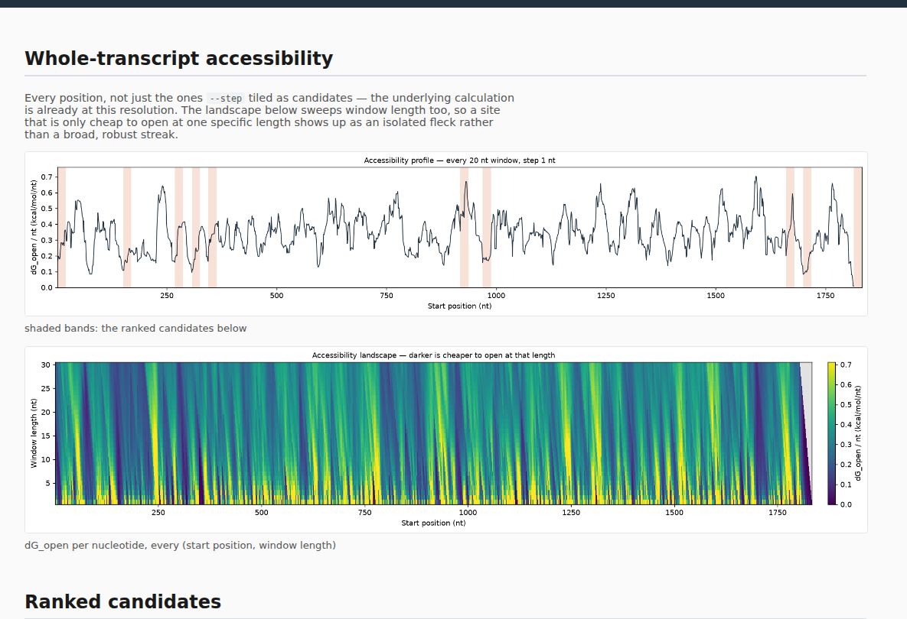
ACTUAL OUTPUT
What the real HTML report looks like: transcript overview
HOW TO READ IT
1
Profile
Low valleys cost less energy to open. Shaded bands are shortlisted locations.
2
Landscape
Shows whether a location remains accessible when the binder length changes.
3
Ranked table
Links every proposed site to its detailed evidence card.
Screenshot of runs/20260913-175402/report.html — the report is self-contained and can be opened in any browser.

Slide 20
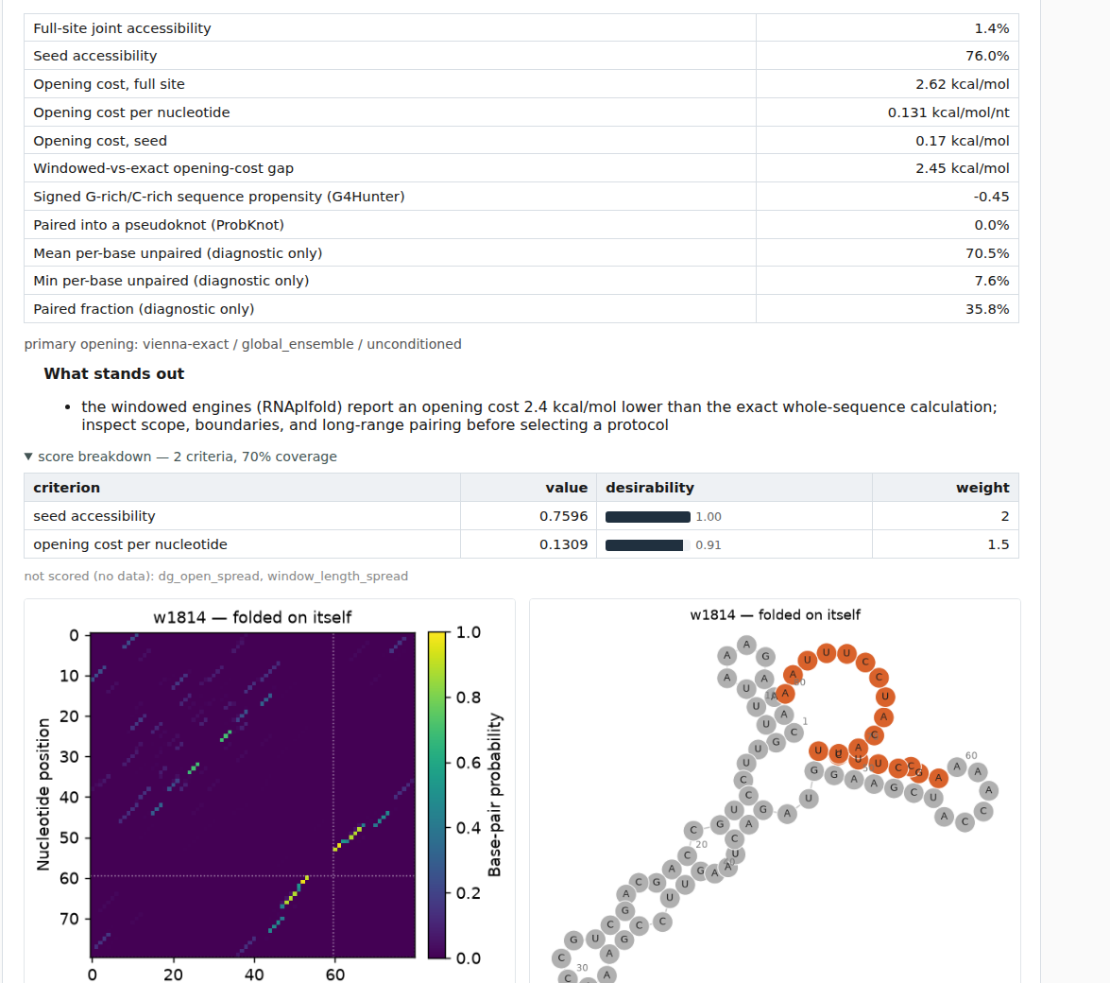
ACTUAL OUTPUT
What the real HTML report looks like: one candidate explained
THE CARD ANSWERS
Example w1814
• What are the physical values?
• Which tool supplied the headline?
• What warning changes interpretation?
• Exactly how was the rank built?
• What pairing pattern and fold are predicted?
Full site open
1.4%
Seed open
76.0%
The report immediately explains the gap: nucleation may be plausible even when the whole footprint is rarely pre-open.
Screenshot of runs/20260913-175402/report.html, candidate w1814.

Slide 21
LIMITATIONS & CAVEATS
Use the ranking as a shortlist, not a binding prediction
BOUNDARY OF THE CLAIM
MODEL & INPUT SENSITIVITY
• Single-molecule secondary structure only
• No partner binding, concentration, specificity or cellular endpoint
• Equilibrium-focused; kinetics mostly absent
• Mg²⁺, pH, crowding, proteins, ribosomes and 3D contacts are not modeled
• Most joint-opening estimates share ViennaRNA lineage
• Local vs. global scope can disagree
• Pseudoknots/G-quadruplexes need special diagnostics
• Window length, transcript boundaries, isoform and variants can reorder results
• Heuristic weights are not experimentally calibrated
Source: docs/07-limitations.md

Slide 22
FUTURE STEPS + SUMMARY
Next: connect structural accessibility to measured performance
1
Validate
Test accessible, buried and disagreement candidates in matched conditions.
TAKEAWAY
2
Calibrate
Fit assay-specific rank/endpoint models on held-out transcripts.
Sequence presence
is not accessibility.
3
Extend
Optional partner-specific interaction command with chemistry checks.
Contextualize
Isoform/haplotype analysis and condition-matched biological evidence.
rnavail identifies structurally plausible targets, separates seed from full-footprint opening, and preserves the caveats needed to interpret the rank.
4
5
Research
Kinetic and CGMD modules only with direct experimental validation.
Source: docs/09-rna-accessibility-implementation-proposal.md; README.md

