Slide 1
PROBLEM & FORMULATION
Temporal antenna tilt optimization
Optimize the trajectory — not isolated snapshots
• One-hot tilt choice per sector and time step
• Spatial interference + temporal switching edges
• Constrained XY-QAOA, DCQO and BF-DCQO
J = network cost + λ · switching cost
9 × 4 × 8
27 qubits
ρ = −0.849
temporal study
direct QUBO
coverage ↔ outage
Moving demand changes the best tilt; switching itself has a cost.
Goal: exploit temporal coherence while remaining feasible by construction.
Notes:
[Sources] - Repository README.md — formulation, constrained XY-QAOA and surrogate validation summary. - Repository STATUS.md — direct temporal QUBO and verified temporal implementation. - Animation is a compact conceptual reconstruction of repository asset tilt_people_sim.gif. [/Sources]

Slide 2
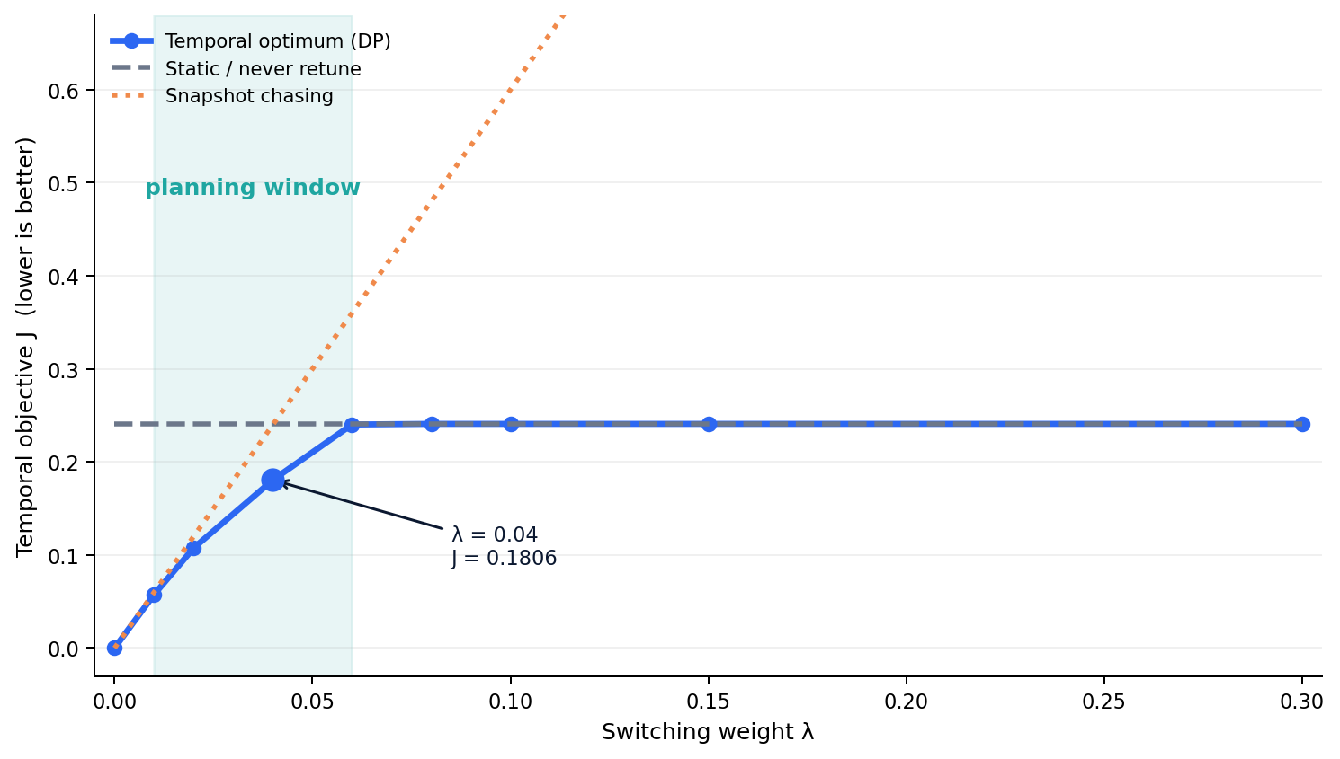
MAIN TEMPORAL RESULT
Temporal planning has a real operating window
9 sectors × 4 tilts × H = 8
λ = 0.04
J = 0.1806
vs 0.2408 static · 0.2400 snapshot
25% lower
surrogate objective vs static
3 moves · 1 event
snapshot: 6 moves across 4 events
Caveat: KPI gain ≈ 0 on this test (−0.03 dB SINR, +0.3 pp handover failure).
Notes:
[Sources] - results/2026_09_08__17_38_03/temporal_results.json — lambda sweep, policy objectives, switching counts and KPI ceiling. - STATUS.md — temporal benchmark interpretation and event-count summary. [/Sources]

Slide 3
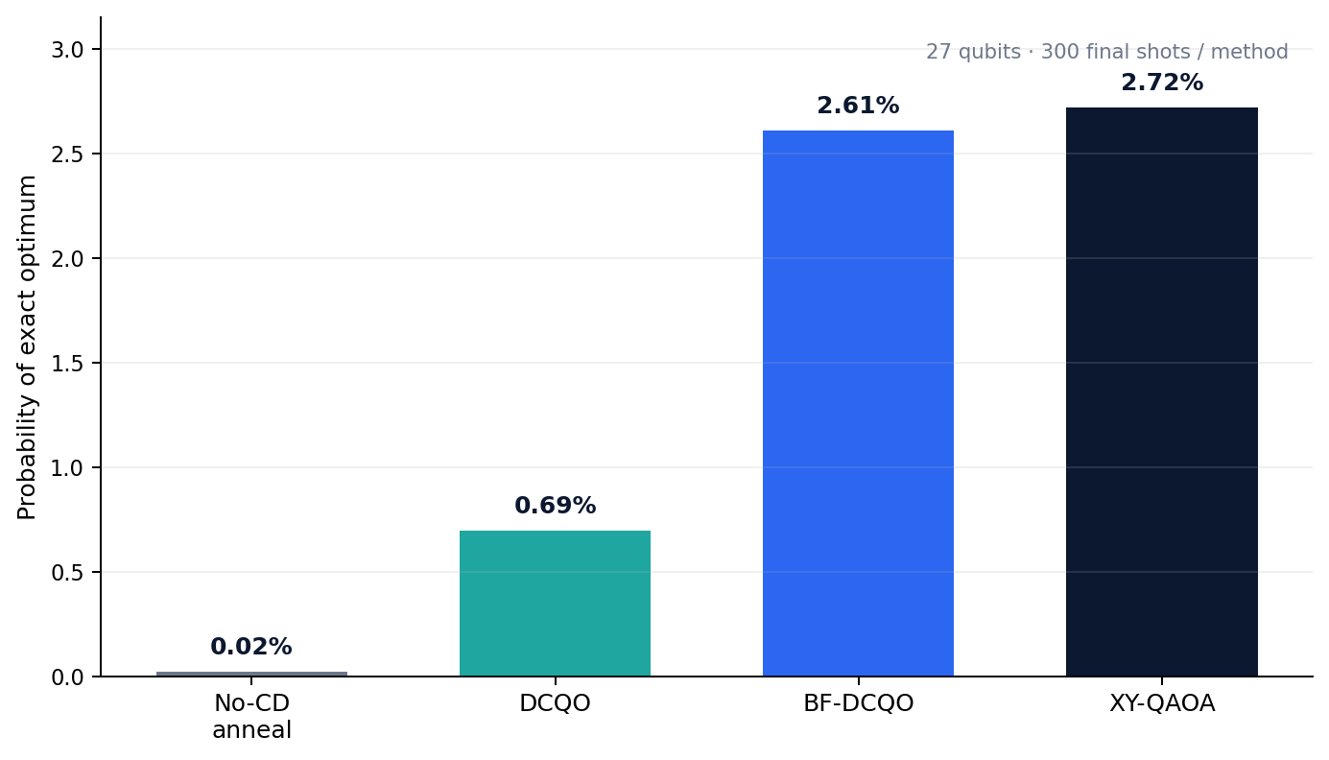
27-QUBIT CORRECTNESS TIER
Quantum methods recover the exact temporal trajectory
3 sectors × 3 tilts × H = 3 · 19,683 feasible trajectories
Exact reference
J* = −4.593870
MILP = brute force
• XY-QAOA, DCQO and BF-DCQO sampled J*
• Matched no-CD anneal missed: gap = 0.421
• Strong classical heuristics also hit J* in milliseconds
Defensible takeaway
All constrained quantum methods: 100% feasible shots
XY-QAOA is the primary constraint-preserving method; DCQO/BF-DCQO are promising alternatives. This tier validates correctness — not quantum advantage.
Success probability is from local reduced-subspace simulation.
Notes:
[Sources] - results/2026_09_09__06_23_54_utc/direct_temporal_results.json — exact objective, quantum success probabilities, feasibility and classical runtimes. - STATUS.md — corrected 27-qubit run is explicitly a correctness tier, not evidence of quantum advantage. [/Sources]

