Slide 1
QUBIT HACKATHON 2026 · AT&T CHALLENGE 1 · BUILT ON CLASSIQ
Antenna Tilt Optimization
with Constrained QAOA
Every sector antenna has an adjustable downtilt. Tilt one sector down and you cut interference into its neighbor — but you can strand that neighbor's cell-edge users. We formulate the network-wide trade-off as a QUBO and solve it with a feasibility-guaranteed QAOA on Classiq.
18 → 36
100%
+14.6%
6,781×
qubits validated, exact simulation
of QAOA shots are valid configs
throughput vs. uniform-tilt baseline
amortized advantage vs. random
Team Shiran · Guy · Ziv classiq_hack

Slide 2
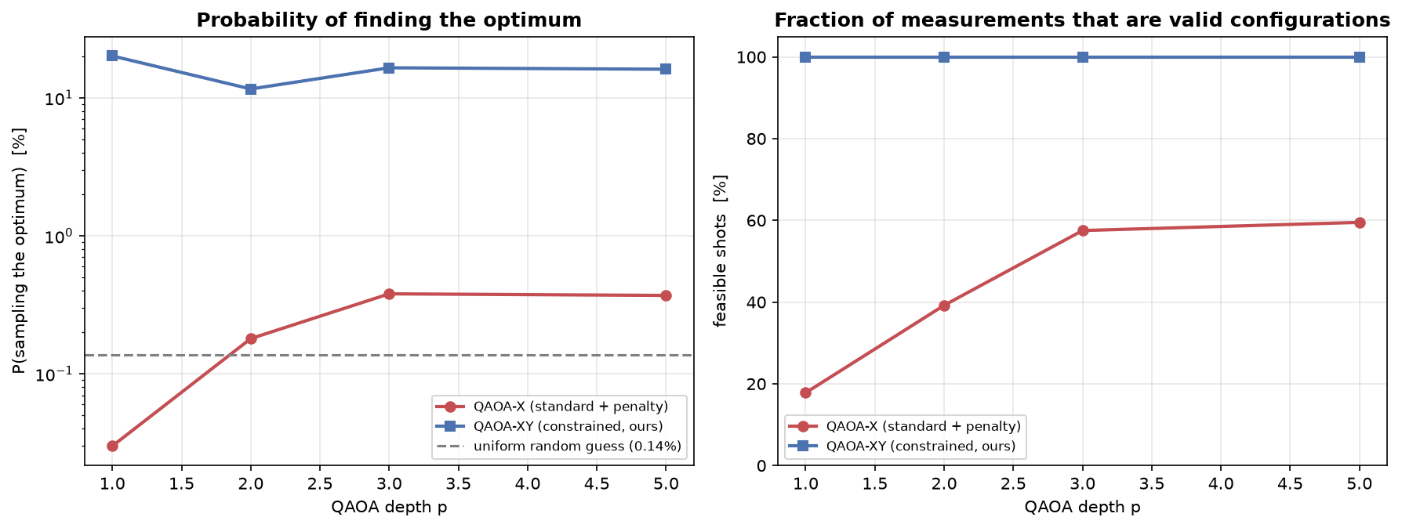
What we built
A QUBO formulation validated against a physics simulator, solved with a mixer that can never leave the feasible subspace.
1 · The trade-off
4 · Our fix: a constrained XY mixer
Too little downtilt → beams overshoot into neighboring cells (interference). Too much → coverage holes and handover failures. With T tilt levels and S sectors there are Tˢ configurations — 2.8×10¹⁴ for just eight towers.
We swap the transverse-field mixer for an XY mixer inside each sector's one-hot block, seeded with a W state. RXX(β)·RYY(β) conserves Hamming weight, so the state can never leave the feasible subspace — for any parameter values. The penalty term is dropped entirely.
2 · QUBO with 3 validated terms
Coverage — demand-weighted SNR. ρ = −0.85 vs. outage
Interference — pairwise dB-domain SINR. ρ = −0.65 vs. mean SINR
Handover — cell-edge failure rate. ρ = +0.89 vs. handover fail %
Interference and handover genuinely oppose each other — that tension is what makes the landscape multi-modal, and the honest reason a global optimizer has anything to contribute.
3 · The problem with textbook QAOA
One-hot encoding leaves only 0.28% of the Hilbert space feasible. The penalty needed to enforce it dominates the spectrum — at p=1, standard QAOA scored worse than random guessing.
855×
454
100%
better than standard QAOA at p=1
gate depth — lower than standard's 472
feasible shots at every depth
classiq_hack · page 2 of 4

Slide 3
Results: what holds up, what doesn’t
We report the trade-off frontier and the limitations plainly — the honest version is more useful than the hyped one.
+1.40 dB mean SINR vs. uniform tilt
+14.6% spectral efficiency / throughput
−0.2 pp outage (essentially flat)
STRENGTHS
LIMITATIONS — STATED PLAINLY
Feasibility is structural, not statistical — the XY mixer guarantees every shot is a valid network config, for any parameters.
No quantum advantage: on every checkable instance, classical solvers match or beat QAOA in wall-clock time.
Every QUBO term is validated against an exact joint-SINR simulator, not assumed.
Simulator only, noiseless — no real quantum hardware run; current devices would be noise-dominated at 36+ qubits.
Scales to 36 qubits via exact feasible-subspace simulation — 262,144× fewer amplitudes than full statevector.
QAOA parameter optimization is itself hard — needs INTERP initialization or deeper circuits perform worse.
Parameter transfer is measured, not asserted: zero-shot transfer retains 47% of retrained performance, 6,781× better than random.
RF model is simplified: no terrain, shadowing, ray tracing, or user mobility. Absolute KPIs aren’t network predictions.
Trade-offs reported as a full Pareto frontier, not one cherry-picked operating point.
QUBO is a surrogate, and parameter transfer was tested only within one instance family so far.
classiq_hack · page 3 of 4

Slide 4
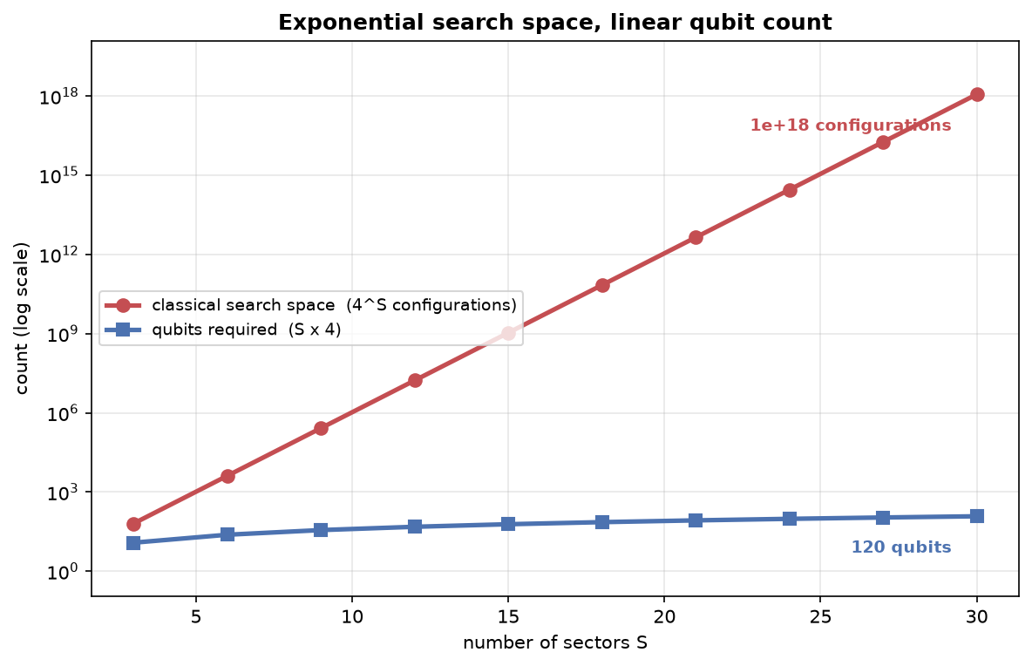
Scalability & potential
Qubits grow linearly with network size while the search space grows exponentially — that gap is where this approach has room to matter.
The honest advantage: amortization
Trained once on a 36-qubit instance and applied verbatim to six unseen networks. Per instance after training:
1.9×
9
42%
fewer repetitions/instance
instances to repay training cost
greedy's global-optimum rate at 36 qubits
Where this goes next
Run on real quantum hardware via Classiq to test whether transfer survives noise.
Add terrain, shadowing and mobility to the RF model for network-realistic KPIs.
Test parameter transfer across instance families, not just one generator.
3 towers / 9 sectors • 36 qubits • 2.9 s exhaustive
5 towers / 15 sectors • 60 qubits • 3.3 hours exhaustive
Target the continuous re-optimization use case, where amortization is the natural fit.
8 towers / 24 sectors • 96 qubits • 99 years exhaustive
classiq_hack · page 4 of 4

