Slide 1
Signal Processing Tutorial
邱锦灏 qiujh@shanghaitech.edu.cn
叶敏锐yemr2022@shanghaitech.edu.cn
SP_Tutorial3 2022.11

Slide 2
Outline
Types of signal
Signal in time domain
Signal in frequency domain
Discrete Fourier Transform (DFT)
Filters
Spectrogram

Slide 3
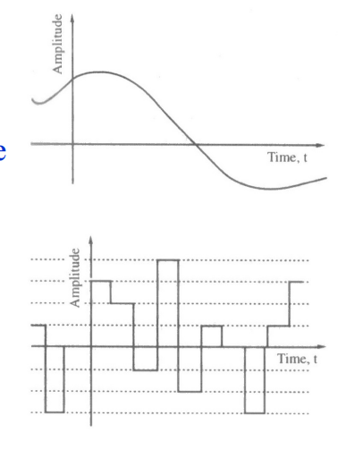
Types of signal
Analog signal
Continuous-time signal with continuous-valued amplitude
Quantized boxcar signal
Continuous-time signal with discrete-valued amplitude

Slide 4
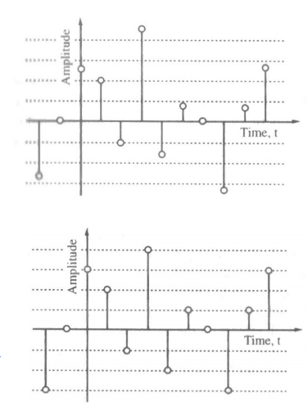
Cont’d
Sampled-data signal
Discrete-time signal with continuous-valued amplitude
Digital signal
Discrete-time signal with discrete-valued amplitude

Slide 5
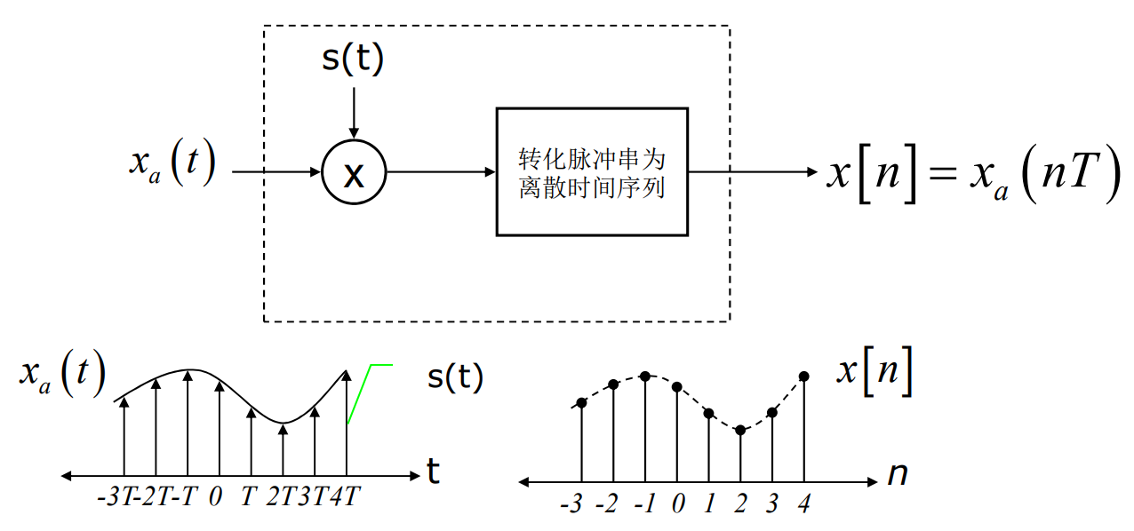
Discrete-Time Signal: Sampling
S(t)
τ
1
Convert impulse signal to discrete time sequence
t
T
Fs=1/T

Slide 6
Sampling: Sine
Fs: the number of sampling points in a second
T: the time interval between two sampling points
Fs = 100 T= 0.01

Slide 7
Sampling: corresponding time of sampling point
Fs = 100hz n = 88 t = 0.87s

Slide 8
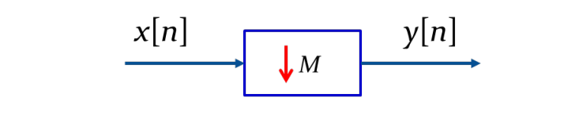
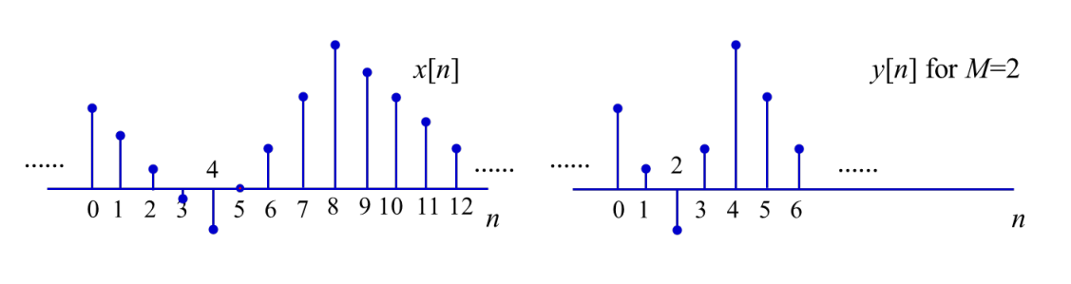
Downsampling:
y[n] = x[Mn] for M>1

Slide 9
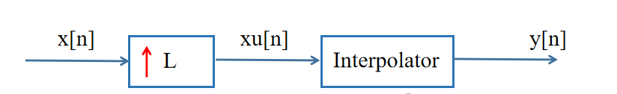
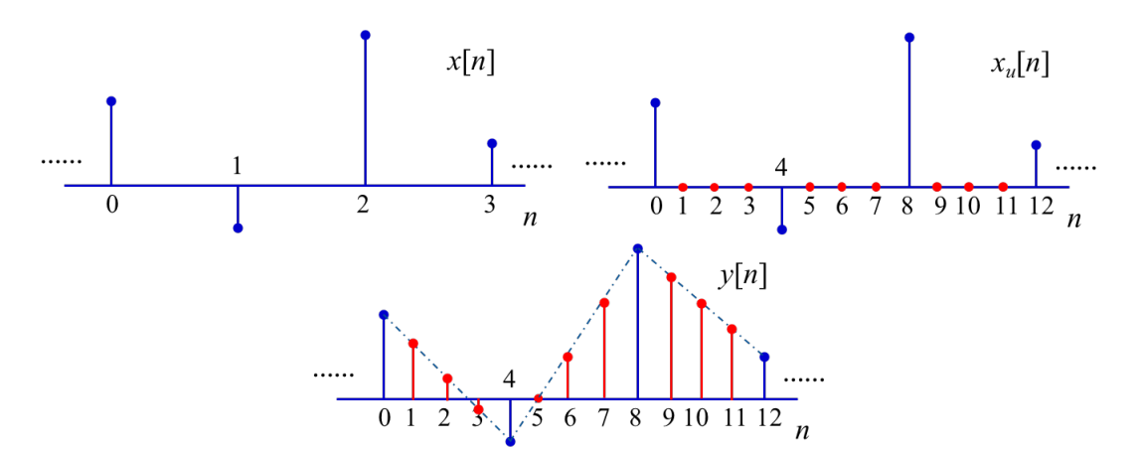
Upsampling

Slide 10
Resampling: Downsampling & Upsampling
THIS is all You Need (For Discrete-time Signal)
y = resample(x, p, q);
x: the signal to be resampled
p: downsampling rate
q: upsampling rate
Note: When you resample the signal, the length of signal will change.

Slide 11
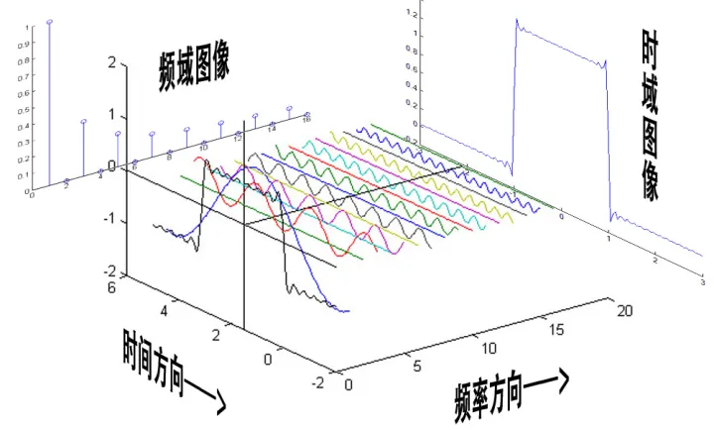
Spectrum Analysis
Notes:
频谱分析是借助于傅里叶变换，将信号转换到频率域，揭示出构成信号的不同频率成分，各频率分量的贡献曲线就称为信号的频谱。

Slide 12
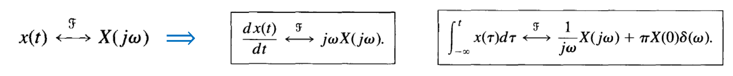
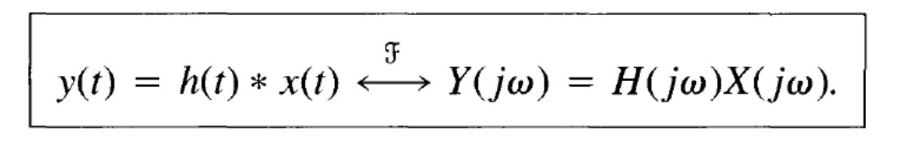
Why frequency domain
Time domain: strong logic
mathematical significance
corresponds directly to the algorithm
Frequency domain: easy to calculate
essence of signals
physical significance

Slide 13
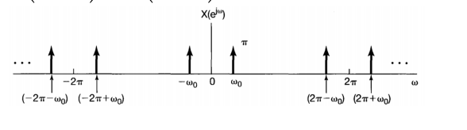


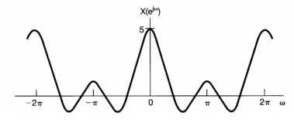
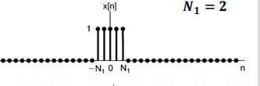

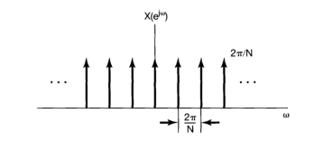
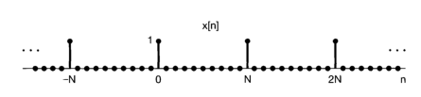
Signal in frequency domain

Slide 14
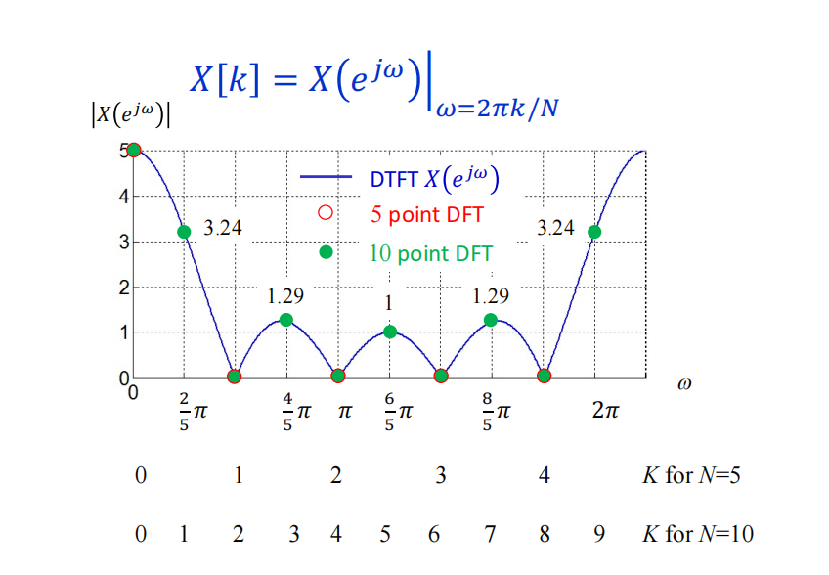
Discrete Fourier Transform (DFT)
Apply for finite length of discrete-time signal
Both domains are discrete and finite duration
Sampling of DTFT
Complicated in computation
(requires N*N operations)

Slide 15
Fast Fourier Transform (FFT)
An algorithm that computes the discrete Fourier transform of a sequence
The basic idea is to decompose successively the N-point DFT into small-size DFTs
Improvement of speed N^2 to NlogN
A classical one is Cooley-Tukey FFT

Slide 16
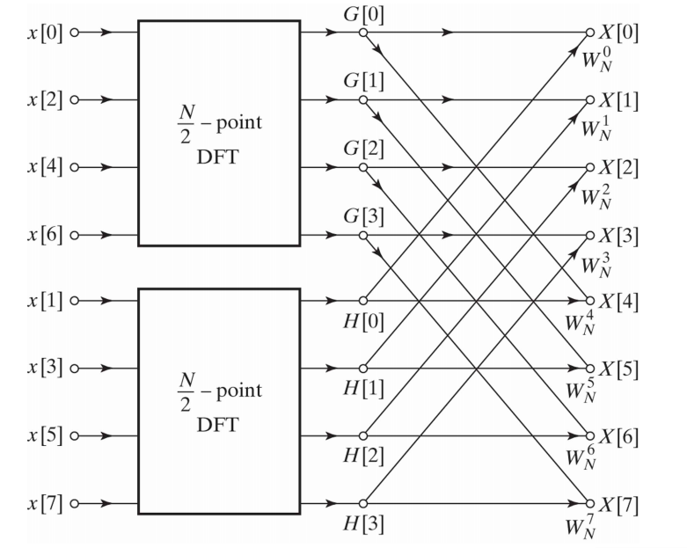
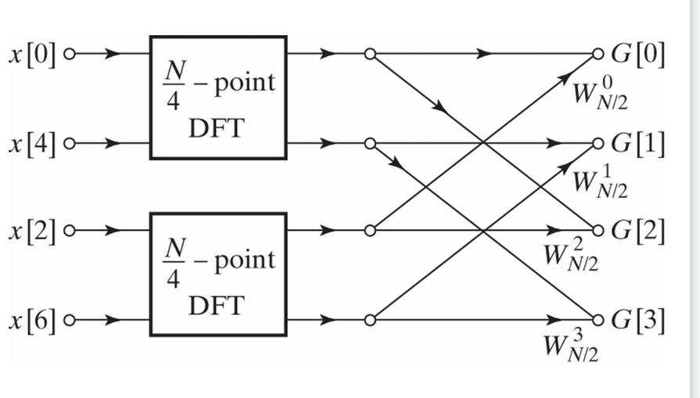

Slide 17
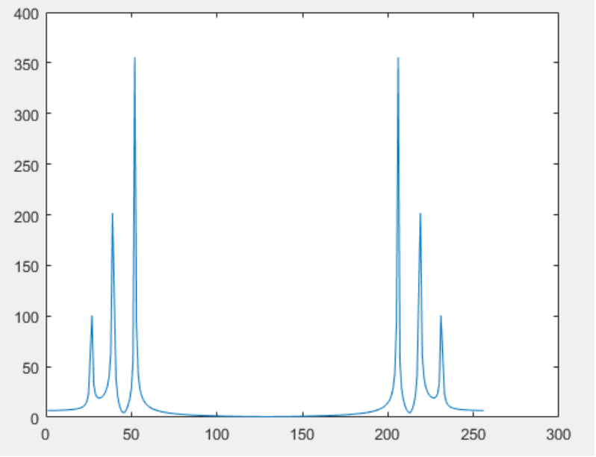
Matlab implementation
fft(x,n) returns the n-point DFT
conjugate symmetry
Same in amplitude
two-sided spectrum
-> single-sided spectrum

Slide 18

Z-Transform: Extension of Fourier transform
An example to delay the signal:
$$H\left(z\right)=\frac{b\left(1\right)+b\left(2\right)z^{−1}+...+b\left(n+1\right)z^{−n}}{a\left(1\right)+a\left(2\right)z^{−1}+...+a\left(n+1\right)z^{−n}}$$
The transfer function can be obtained by using Z-Transform, and the numerator and denominator coefficients in the transfer function can be used as input parameters of the function filter to generate FIR filtering.

Slide 19

Z-Transform: An example to delay the signal
a=[1];b=[zeros(1,3),1];
y=filter(b, a, x);
$$H\left(z\right)=\frac{b\left(1\right)+b\left(2\right)z^{−1}+...+b\left(n+1\right)z^{−n}}{a\left(1\right)+a\left(2\right)z^{−1}+...+a\left(n+1\right)z^{−n}}$$

Slide 20
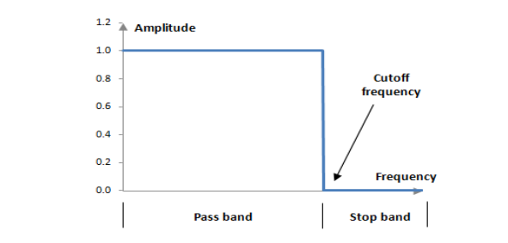
Filters
Filtering is one of the most widely used complex signal processing operations
The system implementing filtering is called filters
An ideal filter passes certain frequency components without any distortion and blocks other frequency components
Passband : the range of frequency that is allowed to pass through
Stopband : the range of frequency that is blocked
Cutoff frequency: the boundary of passband and stopband

Slide 21
The role of filters
Removal of unwanted background noise
Separation of frequency bands
Removal of interference
Shaping of the signal spectrum

Slide 22
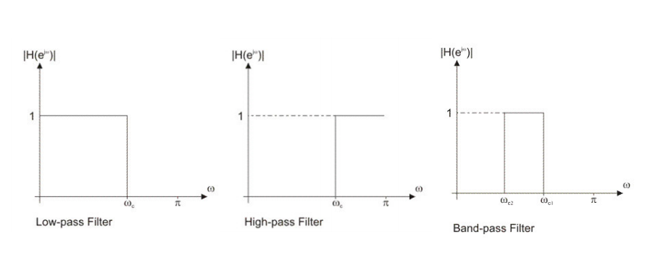
Type of filters
low-pass high-pass band-pass

Slide 23
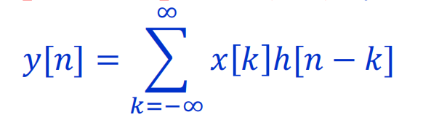
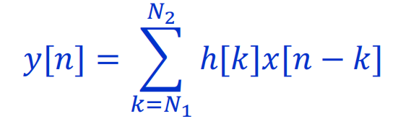
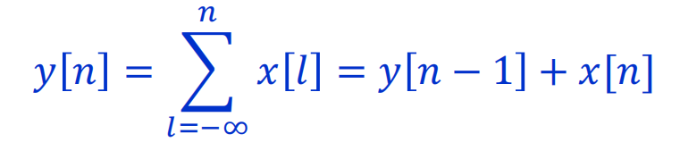
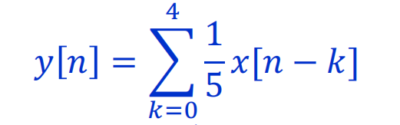
Cont’d
Infinite Impulse Response (IIR) Finite Impulse Response (FIR)
IIR: h[n] is of infinite length FIR: h[n] is of finite length
Example: accumulator moving-average filter

Slide 24
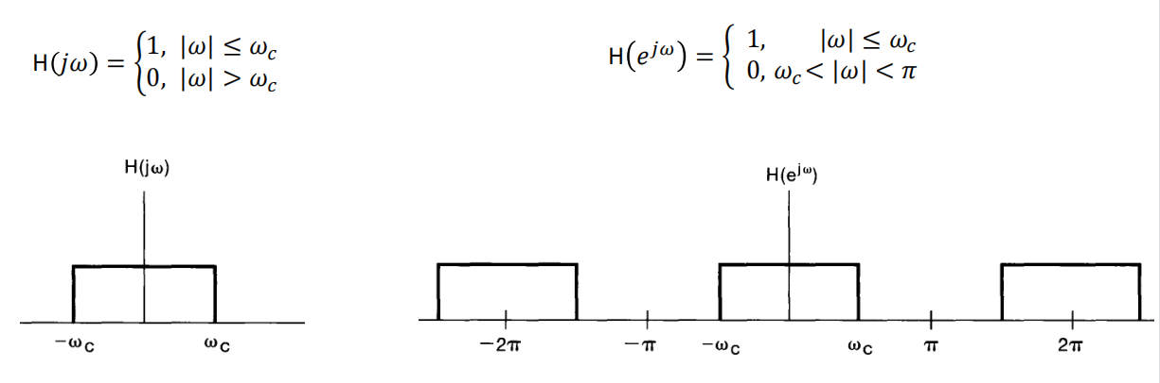
Ideal Low-Pass Filters
CT DT

Slide 25
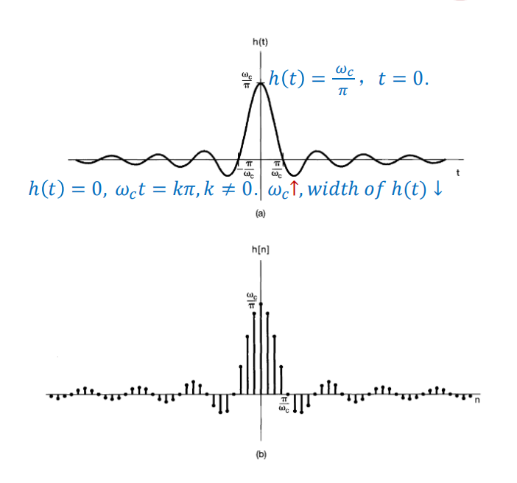
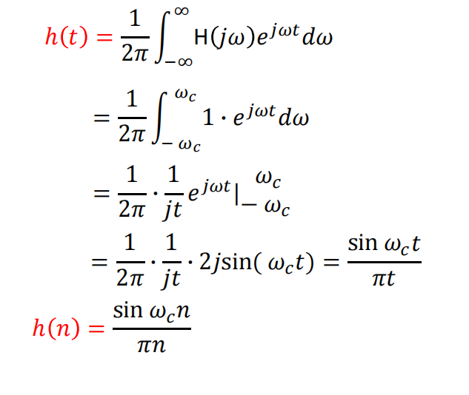
Time domain presentation
lmpulse response:

Slide 26
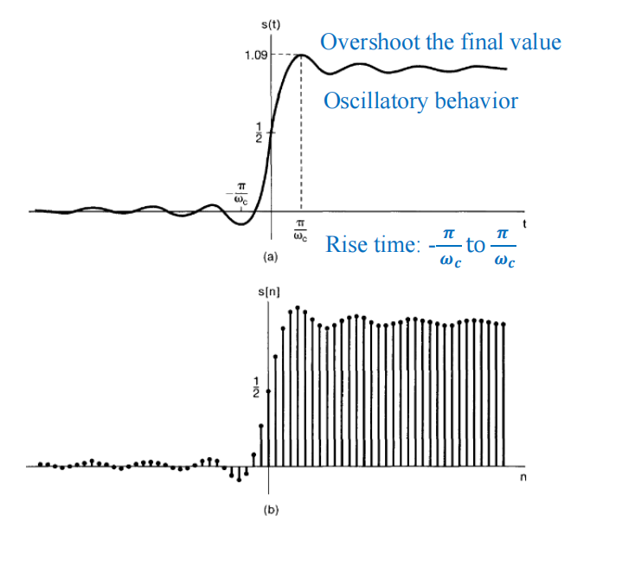
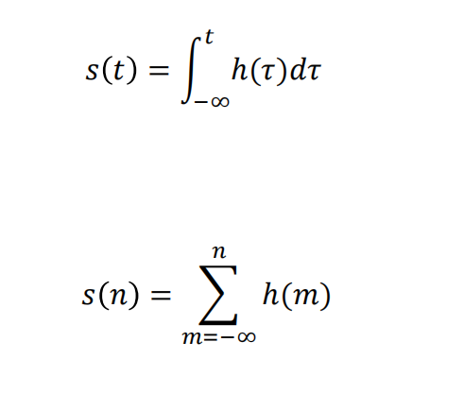
Cont’d
step response:

Slide 27
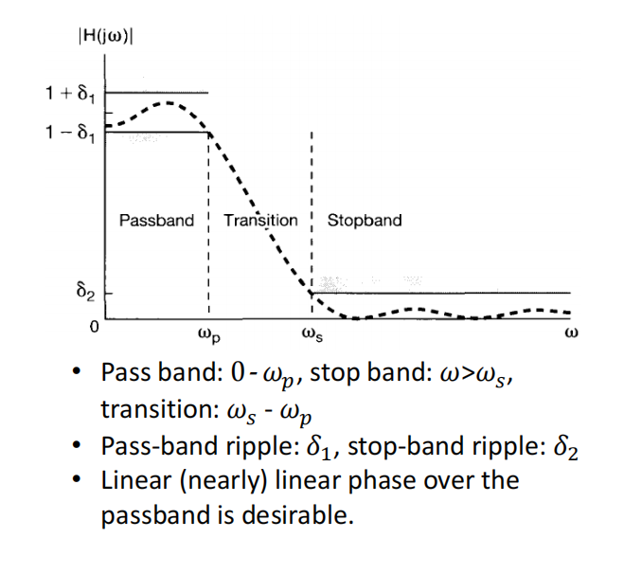
Non-ideal Filters
Drawbacks of ideal filter:
infinite length
non-causal
non absolutely summable
Not implementable in real case !

Slide 28
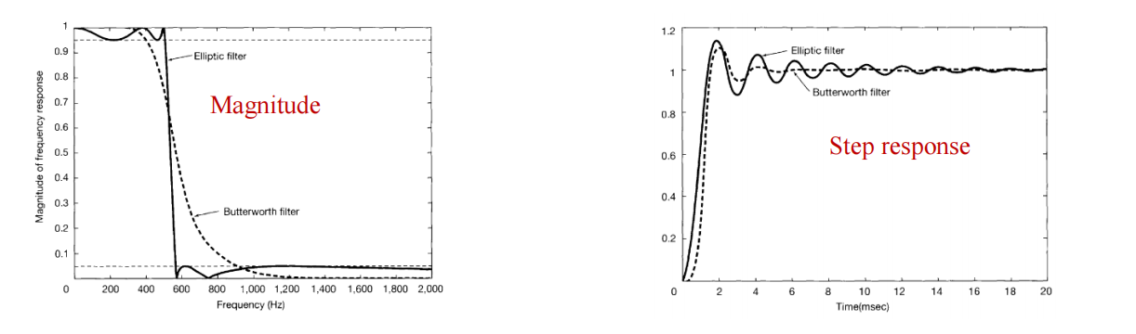
Examples
Fifth order Butterworth filter and elliptic filter
Same cutoff frequency
Same passband and stopband ripple
Trade-off bewteen time-domain and frequency-domain

Slide 29
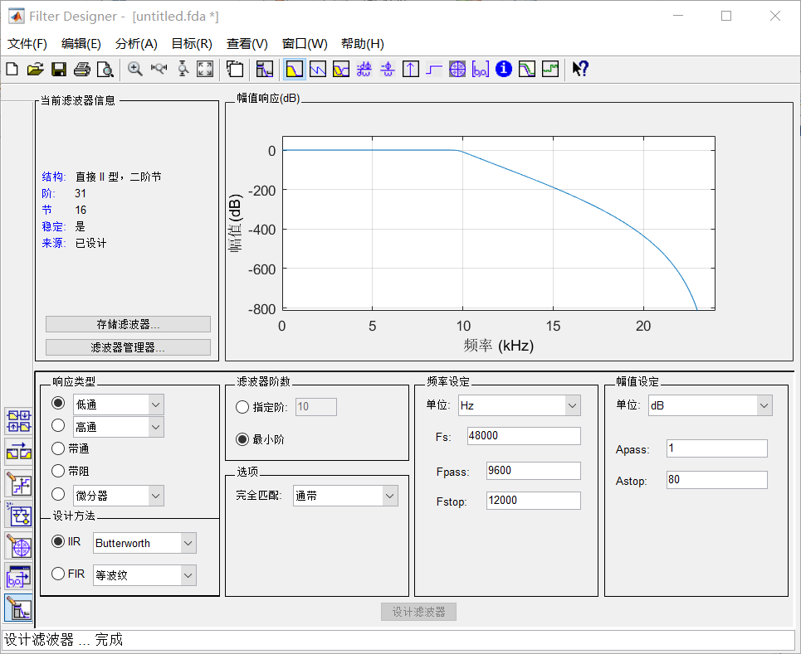
Matlab implementation---fdatool

Slide 30
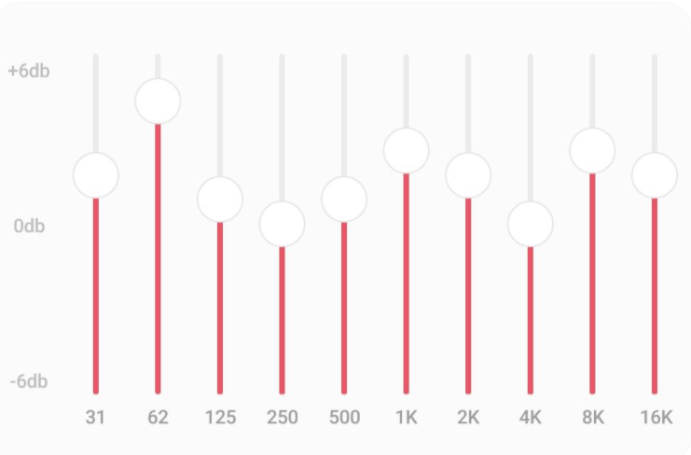
Equalizer
Design 8 band-pass filters to filter the original signal
Splice signals of different frequency band
Make sure the composite signal is restored
Assign weights for each filter

Slide 31
Spectorgram
Speech can be expressed directly by its time waveform, which is a continuous function of time and changes dynamically with time. According to the short-term stationarity, windowed 10~30ms is performed to get a frame speech.

Slide 32
Spectorgram

Slide 33
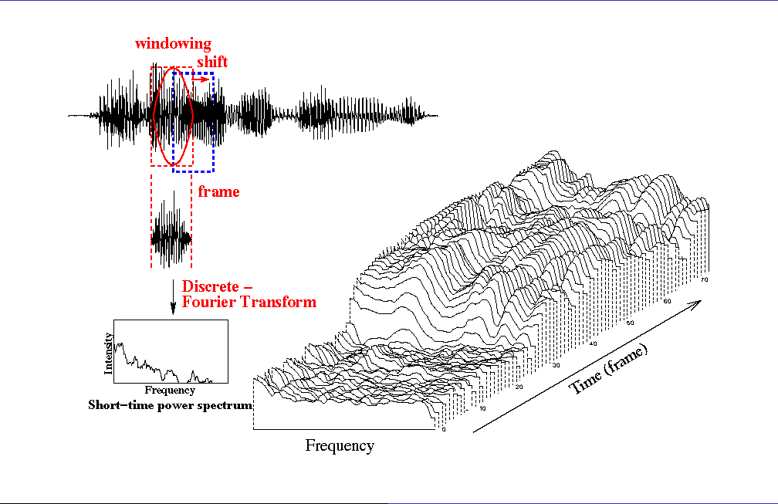
Spectorgram
Time, Frequency, Amplitude：A three-dimensional coordinates, spectrum frame changes with time (dynamic spectrogram)

Slide 34
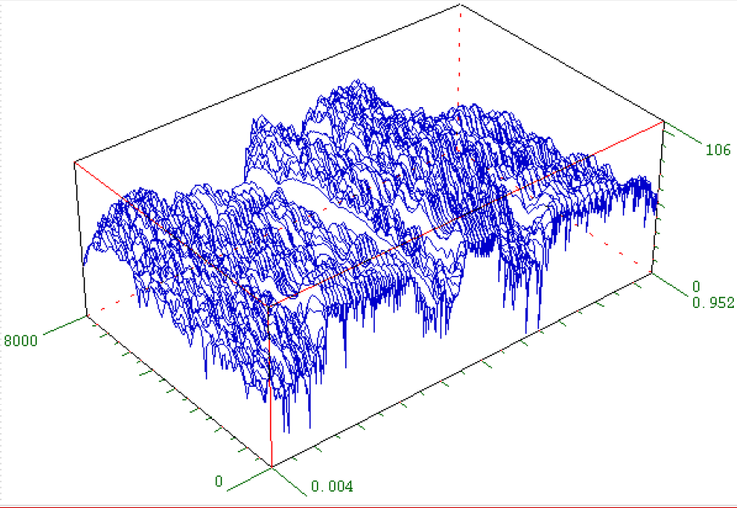
Spectorgram
Time, Frequency, Amplitude：A three-dimensional coordinates, spectrum frame changes with time (dynamic spectrogram)
Matlab implement

Slide 35
Spectorgram
Spectrogram was invented by researchers at Bell Labs in 1941. It shows the characteristics of speech spectrum (converted to two-dimensional spectrogram) in a visual way, the vertical axis represents the frequency, the horizontal axis represents the time, and the depth of color represents the energy of a specific frequency band. the invention of spectrogram is a milestone in speech research, which presents many features of speech intuitively.

Slide 36
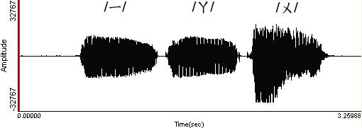
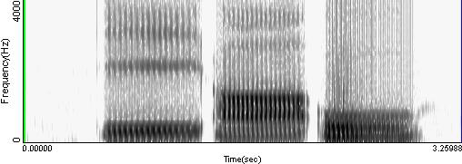
Time Waveform and Spectrum characteristics of speech
The spectrogram of three vowels（i, a, u in chinese）
In the frequency domain, the energy concentration is where the formant is, and on the spectrogram it is the darker position.

Slide 37
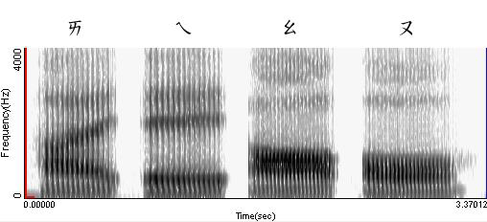
Time Waveform and Spectrum characteristics of speech
The phenomenon of formant transition of double vowels on spectrogram( double vowels ai, ei, ao, ou in chinese)

Slide 38
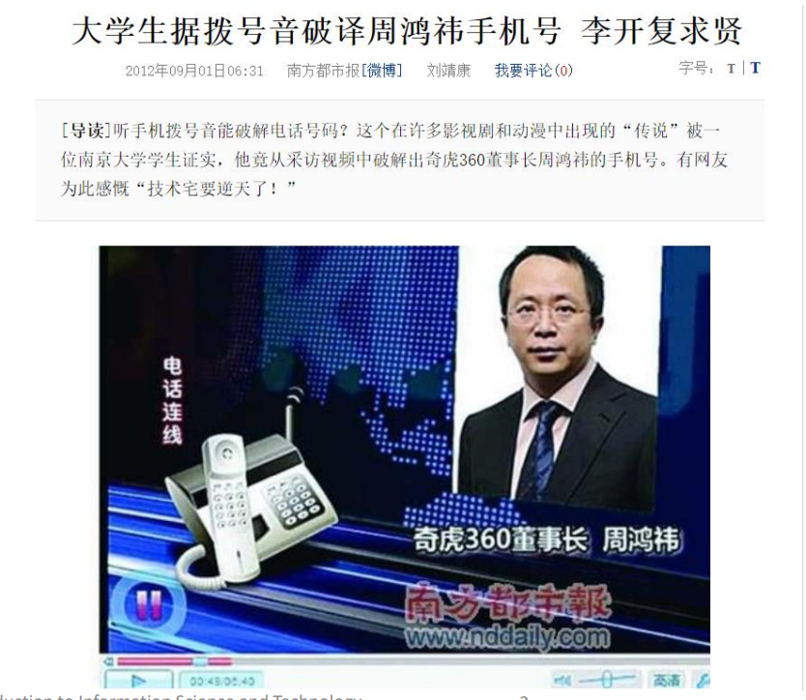
Spectorgram
What does spectrogram inspire you?

