Slide 1

SI100B Introduction to Information Science and Technology (Python Programming)
高盛华
School of Information Science and Technology
ShanghaiTech University

Slide 2
Learning Objectives
Variables
Expressions
Statements

Slide 3
Constants
Fixed values such as numbers, letters, and strings are called “constants” because their value does not change.
Numeric constants: e.g. 100 280 8.8
String constants use single quotes (‘) or double quotes (“)
>>> print(123)
123
>>> print(98.6)
98.6
>>> print('Hello world’)
Hello world
Notes:
常量，被称为常量因为它们的值不变，

Slide 4
Variables
A variable is a named place in the memory where a programmer can store data and later retrieve the data using the variable “name”.
Programmers need to choose the names of the variables.
You can change the contents of a variable in a later statement.
x
12.2
x = 12.2
y = 14
y
14

Slide 5
Variables
A variable is a named place in the memory where a programmer can store data and later retrieve the data using the variable “name”.
Programmers need to choose the names of the variables.
You can change the contents of a variable in a later statement.
100
x
12.2
x = 12.2
y = 14
x = 100
y
14

Slide 6
Variable name rules
Must start with a letter or underscore _
Only consist of letters, numbers, and underscores
Case sensitive
Different: smith Smith SMITH SmiTH
You can not use reserved words as variable names
smith $smiths smith23 _smith _23_
23smith smith.23 a+b smiTH -smith

Slide 7
Variable name rules
Must start with a letter or underscore _
Only consist of letters, numbers, and underscores
Case sensitive
Different: smith Smith SMITH SmiTH
You can not use reserved words as variable names
smith $smiths smith23 _smith _23_
23smith smith.23 a+b smiTH -smith
Green: Good var names Red: Bad var names

Slide 8
Reserved words
and del for is raise assert elif from lambda return break else global not try class except if or while continue exec import pass yield def ﬁnally in print as with
>>> 32smith = ‘hello world’
SyntaxError: invalid syntax
>>> class = 27
SyntaxError: invalid syntax

Slide 9
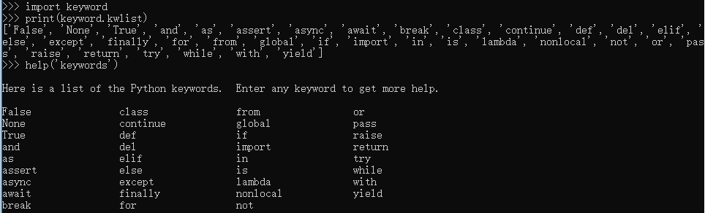
Reserved words
Check reserved words (keywords)
help(‘keywords’)
import keyword
print(keyword.kwlist)

Slide 10
Variable type
The programmer (and the interpreter) can identify the type of a variable.
You do not need to explicitly define or declare the type of a variable.
int x = 3 (for most other languages)
x = 3 (for Python)
Python’s data types
Numbers
String
List
Tuple
Dictionary
Bool
Notes:
数字，字符串，表，元组，字典

Slide 11
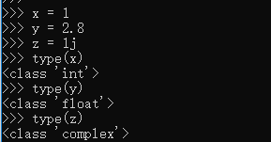
Numbers
Python 3.X supports three numerical types:
int (signed integers)
float (floating point real values)
complex (complex numbers)
Variables of numeric types are created when you assign a value to them:

Slide 12
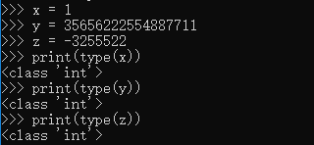
Int
Int, or integer, is positive or negative, without decimals, of unlimited length.

Slide 13
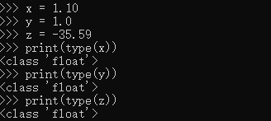
Float
Float, or "floating point number" is a number, positive or negative, containing one or more decimals.

Slide 14
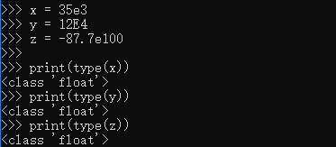
Float
Float can also be scientific numbers with an "e" to indicate the power of 10.

Slide 15
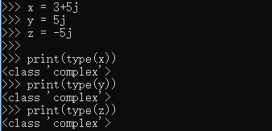
Complex
Complex numbers are written with a "j" as the imaginary part:
Notes:
虚数部分用j表示

Slide 16
Strings
Strings in Python are identified as a contiguous set of characters represented in the single or double quotes.
Subsets of strings can be taken using the slice operator ([ ] and [ : ]) with indexes starting at 0 in the beginning of the string.
#!/usr/bin/python
mystr = 'Hello World!'
print(mystr) # Prints complete string
print(mystr[0]) # Prints first character of the string
print(mystr[2:5]) # Prints characters starting from 3rd to 5th
print(mystr[2:]) # Prints string starting from 3rd character
Output:
Hello World!
H
llo
llo World!
String | H | e | l | l | o |  | W | o | r | l | d | !
Index | 0 | 1 | 2 | 3 | 4 | 5 | 6 | 7 | 8 | 9 | 10 | 11
Location | 1 | 2 | 3 | 4 | 5 | 6 | 7 | 8 | 9 | 10 | 11 | 12

Slide 17
String methods
The strip() method removes any whitespace from the beginning or the end:
The len() method returns the length of a string: len(a)
String concatenate: print(a+’!!!!’) # Hello, World! !!!!
The lower() method returns the string in lower case a.lower()
The upper() method returns the string in upper case a.upper()
The replace() method replaces a string with another string:
The split() method splits the string into substrings if it finds instances of the separator:
a = " Hello, World! " print(a.strip()) # returns "Hello, World!"
a = "Hello, World!" print(a.replace("H", "J")) #Jello, World!
print(a) #but string a is not changed
a = "Hello, World!" print(a.split(",")) # returns ['Hello', ' World!']
print(a.split()) #default splitter " ", returns ['Hello,', 'World!']
https://docs.python.org/3/library/stdtypes.html#string-methods

Slide 18
Lists
A list contains items separated by commas and enclosed within square brackets([]).
The values stored in a list can be accessed using the slice operator ([ ] and [ : ]) with indexes starting at 0 in the beginning of the list.
Index: 0 1 2 3 4
thislist = [ 'abcd', 786 , 2.23, 'john', 70.2 ]
tinylist = [123, 'john']
print(thislist) # Prints complete list
print(thislist[0]) # Prints first element of the list
print(thislist[1:3]) # Prints elements starting from 2nd till 3rd
print(thislist[2:]) # Prints elements starting from 3rd element
Output:
['abcd', 786, 2.23, 'john', 70.2]
abcd
[786, 2.23]
[2.23, 'john', 70.2]
Notes:
列表

Slide 19


Lists
To change the value of a specific item, refer to the index number:
loop through the list items by using a for loop:
thislist = ["apple", "banana", "cherry"] for x in thislist: print(x)

Slide 20
Lists
To determine if a specified item is present in a list use the in keyword:
len(thislist)
thislist.append("orange")
thislist.insert(1, "orange")
thislist.remove("banana")
if "apple" in thislist: print("Yes, 'apple' is in the fruits list")
https://docs.python.org/3/tutorial/datastructures.html#more-on-lists

Slide 21
Tuples
A tuple is another sequence data type that is similar to the list.
A tuple contains items separated by commas and enclosed within parentheses ().
Difference between lists and tuples:
Elements and size in lists can be changed, while in tuples cannot be changed…
#!/usr/bin/python
thistuple = ( 'abcd', 786 , 2.23, 'john', 70.2 )
tinytuple = (123, 'john')
print(thistuple) # Prints complete list
print(thistuple[0]) # Prints first element of the list
print(thistuple[1:3]) # Prints elements starting from 2nd till 3rd
print(thistuple[2:]) # Prints elements starting from 3rd element
Output:
('abcd', 786, 2.23, 'john', 70.2)
abcd
(786, 2.23)
(2.23, 'john', 70.2)
Notes:
元组

Slide 22
Tuples
You cannot change values in a tuple:
Loop Through a Tuple
Check if Item Exists
thistuple = ("apple", "banana", "cherry") thistuple[1] = "blackcurrant" # The values will remain the same: print(thistuple)
thistuple = ("apple", "banana", "cherry") for x in thistuple: print(x)
thistuple = ("apple", "banana", "cherry") if "apple" in thistuple: print("Yes, 'apple' is in the fruits tuple")

Slide 23
Dictionary
A dictionary is a collection which is unordered, changeable and indexed.
Consists of a number of key-value pairs.
It is enclosed by curly braces ({ })
thisdict={"brand": "Ford","model": "Mustang","year": 1964} print(thisdict)

Slide 24
Dictionary
Get value
Change Values
Loop through keys
Loop through values
Add/delete items
x = thisdict["model"]
How to loop through keys and values simultaneously?
thisdict.items()
thisdict["year"] = 2018
for x in thisdict: print(x)
for x in thisdict.values(): print(x)
thisdict["color"] = "red"
del thisdict["model"]

Slide 25
Set
A collection which is unordered and unindexed, written with curly brackets.
{1,2,’a’,’b’}
set() # empty set, not {}
Common uses include
membership testing
removing duplicates from a sequence
intersection, union, difference, and symmetric difference

Slide 26
Set
>>> a = {3, 'a', 2, 1,11,15,'1','2'}
>>> a.pop()
1
>>> a.remove(11)
>>> a
{2, 3, '2', '1', 15, 'a'}
>>> a.add(20)
>>> a
{2, 3, '2', '1', 15, 20, 'a'}
>>> b = {2,3}
>>> b.issubset(a)
True
>>> c = {5,6}
>>> c.isdisjoint(a)
True
>>> x = {1,1.0,1.00}
>>> x
{1}
pop: remove and return an arbitrary set element
pop and remove raise KeyError if the set does not contain the element
Elements are compared via ==
Notes:
Raises KeyError

Slide 27
Set
>>> a_set = set([8, 9, 10, 11, 12, 13])
>>> b_set = {0, 1, 2, 3, 7, 8}
>>> a_set | b_set # union
{0, 1, 2, 3, 7, 8, 9, 10, 11, 12, 13}
>>> a_set.union(b_set) # union
{0, 1, 2, 3, 7, 8, 9, 10, 11, 12, 13}
>>> a_set & b_set # intersection
{8}
>>> a_set.intersection(b_set) # intersection
{8}
>>> a_set.difference(b_set) # difference
{9, 10, 11, 12, 13}
>>> a_set - b_set
{9, 10, 11, 12, 13}

Slide 28
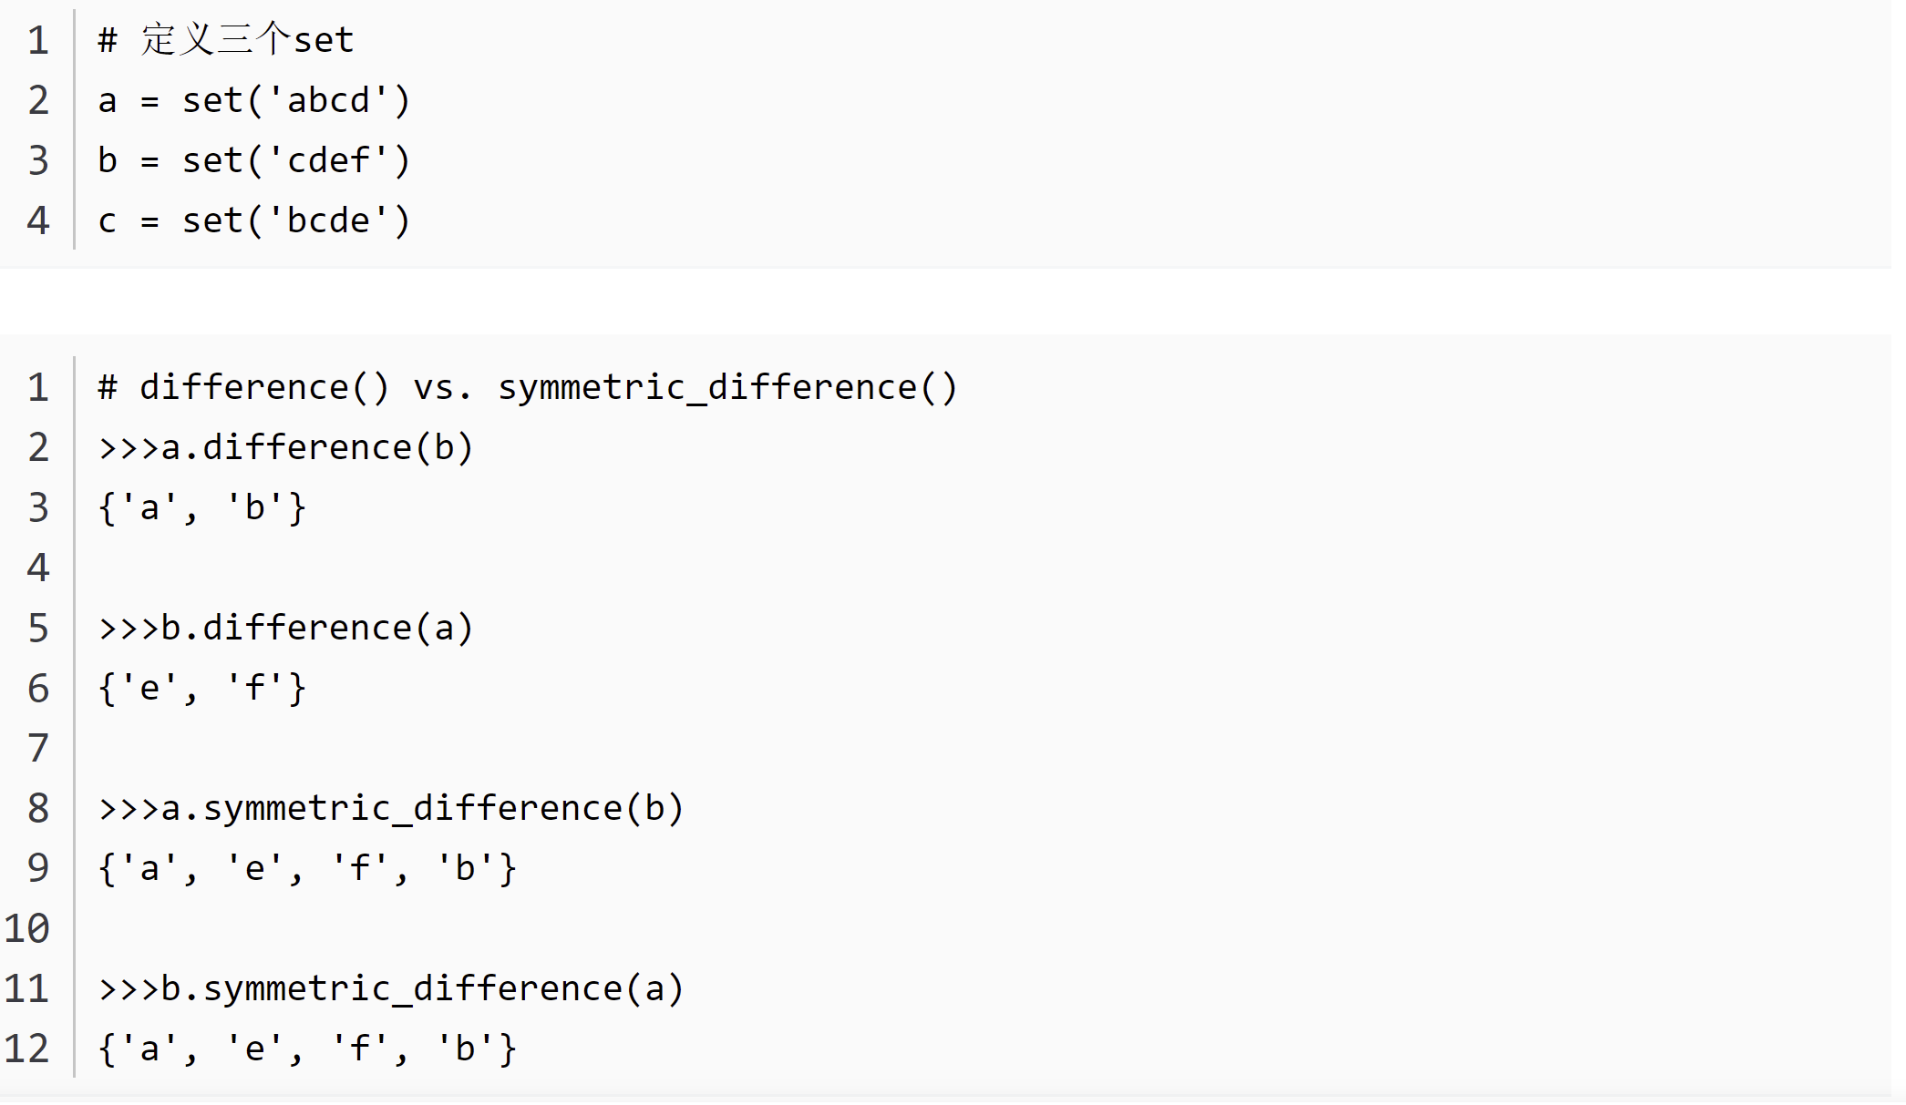

Slide 29

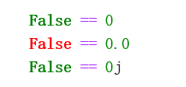
Bool type
Only has two values: True and False
True equals to int 1
Any zero numerical values are False
Associated with Logic and Comparison Operations

Slide 30
Get variable type
If you are not sure what type a variable has, the interpreter can tell you by using type.
>>> type(‘Hello, world!’)
<type ‘str’>
>>> type(17)
<type ‘int’>
>>> type(3.2)
<type ‘float’>
>>> type(‘4.7’)
<type ‘str’>

Slide 31
Type matters
Python knows what “type” everything is.
Some operations are prohibited.
You can not add a string to an integer.
>>> a = '123'
>>> b = a + 1
Traceback (most recent call last):
File "<stdin>", line 1, in <module>
TypeError: cannot concatenate 'str' and 'int' objects

Slide 32
Type matters
Operations on the same type operands will lead to results with the same type, except division
int + int => int
int – int => int
int * int => int
int / int => float (if in Python2, int)

Slide 33
Type conversions
Covert type with the built-in functions int(), float(), str()
int() - constructs an integer number from an integer literal, a float literal (by rounding down to the previous whole number), or a string literal (providing the string represents a whole number)
float() - constructs a float number from an integer literal, a float literal or a string literal (providing the string represents a float or an integer)
str() - constructs a string from a wide variety of data types, including strings, integer literals and float literals

Slide 34
Type conversions
x = int(1) # x will be 1 y = int(2.8) # y will be 2 z = int("3") # z will be 3
x = float(1) # x will be 1.0 y = float(2.8) # y will be 2.8 z = float("3") # z will be 3.0 w = float("4.2") # w will be 4.2
x = str("s1") # x will be 's1' y = str(2) # y will be '2' z = str(3.0) # z will be '3.0'

Slide 35
User input
We can ask Python to pause and read data from the keyboard using input() function.
The input() function returns a string.
>>> name = input(“What’s your name? “)
What’s your name? HP # You type using keyboard
>>> print('Welcome', name)
Welcome HP

Slide 36
If we want to read a number from the keyboard, we must convert it from a string to a number using a type conversion function [int() or float()].
>>> inp = input('Europe floor? ')
Europe floor? 2 # 2 is the input from keyboard
>>> usf = int(inp) + 1
>>> print('US floor', usf)
US floor 3

Slide 37
The assignment statement
A statement is an instruction that the Python interpreter can execute. E.g. if statement, while statement, assignment statement…
An assignment statement creates new variables and gives them values.
An assignment statement consists of an expression on the right-hand side and a variable to store the result.
>>> message = “hello, world”
>>> x = 17
>>> pi = 3.14159

Slide 38
Expressions
An expression is a combination of values, variables, and operators. Not every expression contains all of these elements.
If you type an expression on the command line (after >>>), the interpreter evaluates it and displays the result.
>>> 1+2*7
15
>>>’Hello’
Hello
Notes:
Operators 运算符

Slide 39
Operators
Operators are special symbols that represent computations like addition and multiplication.
The values the operator uses are called operands.
Types of operator
Arithmetic operators
Comparison (Relational) operators
Assignment operators
Logic operators
Bitwise operators
Membership operators
Identity operators
Notes:
Operators 运算符 和 operands 操作数
算术运算符
比较（关系）运算符
赋值运算符
逻辑运算符
位运算符
成员运算符
身份运算符
运算符优先级

Slide 40
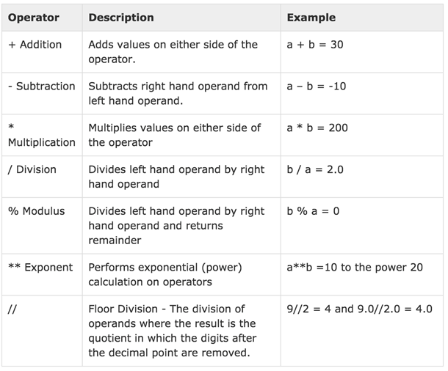
Arithmetic Operators
Arithmetic operators are used with numeric values to perform common mathematical operations:
a = 10
b = 20
Notes:
算术运算符
运算符 描述 实例
+ 加 - 两个对象相加 a + b 输出结果 30
- 减 - 得到负数或是一个数减去另一个数 a - b 输出结果 -10
* 乘 - 两个数相乘或是返回一个被重复若干次的字符串 a * b 输出结果 200
/ 除 - x除以y b / a 输出结果 2
% 取模 - 返回除法的余数 b % a 输出结果 0
** 幂 - 返回x的y次幂 a**b 为10的20次方， 输出结果 100000000000000000000
// 取整除 -小于商的整数中最大的一个 9//2 输出结果 4 , 9.0//2.0 输出结果 4.0

Slide 41
The modulus operator
It works on integers (and integer expressions) and yields the remainder when the first operand is divided by the second.
>>> remainder = 7 % 3
>>> print(remainder)
1

Slide 42
Use case (1)
You can check whether one number is divisible by another – if x % y is zero, the x is divisible by y
>>> is_divisible = 6 % 3
>>> print(is_divisible)
0
>>> is_not_divisible = 7 % 3
>>> print(is_not_divisible)
1

Slide 43
Use case (2)
You can extract the right-most digit or digits from a number.
For example, the last two digits in 123491 is 91.
>>> last_two_digits = 123491 % 100
>>> print(last_two_digits)
91
>>> last_one_digit = 123491 % 10
>>> print(last_one_digit)
1

Slide 44
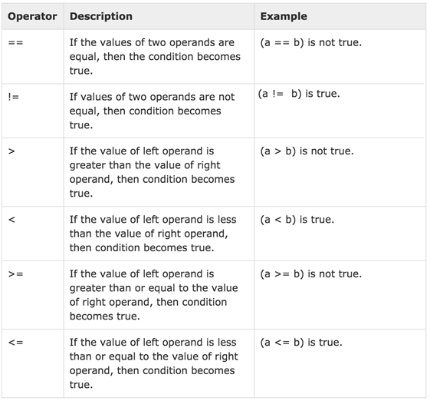
Comparison operators
Compare values on either sides of them and decide the relation among them. Give bool type results.
a = 10
b = 20
Notes:
比较（关系）运算符
运算符 描述 实例
== 等于 - 比较对象是否相等 (a == b) 返回 False。
!= 不等于 - 比较两个对象是否不相等 (a != b) 返回 true.
<> 不等于 - 比较两个对象是否不相等 (a <> b) 返回 true。这个运算符类似 != 。
> 大于 - 返回x是否大于y (a > b) 返回 False。
< 小于 - 返回x是否小于y。所有比较运算符返回1表示真，返回0表示假。这分别与特殊的变量True和False等价。注意，这些变量名的大写。 (a < b) 返回 true。
>= 大于等于 - 返回x是否大于等于y。 (a >= b) 返回 False。
<= 小于等于 - 返回x是否小于等于y。 (a <= b) 返回 true。

Slide 45
Comparison: Example

Slide 46
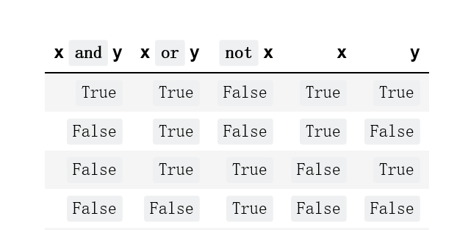
Logic operators
Performs logic operations: and, or, not
or and not
Logical operators
ascending priority

Slide 47
Boolean: Example
Output
True
True
False

Slide 48
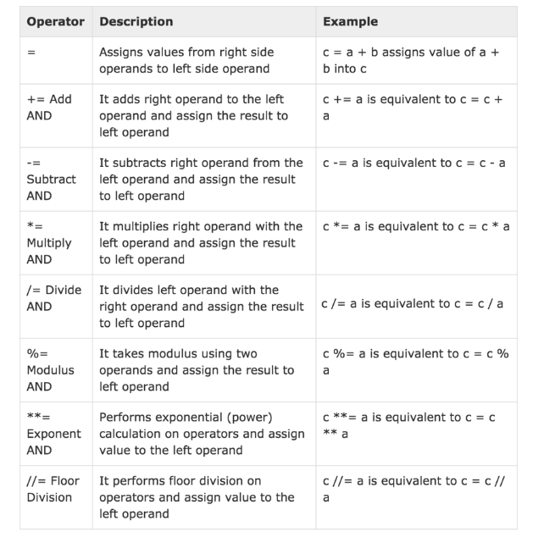
Assignment operators
Notes:
赋值运算符
+= 加法赋值运算符 c += a 等效于 c = c + a
-= 减法赋值运算符 c -= a 等效于 c = c - a
*= 乘法赋值运算符 c *= a 等效于 c = c * a
/= 除法赋值运算符 c /= a 等效于 c = c / a
%= 取模赋值运算符 c %= a 等效于 c = c % a
**= 幂赋值运算符 c **= a 等效于 c = c ** a
//= 取整除赋值运算符 c //= a 等效于 c = c // a

Slide 49
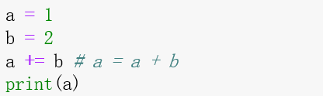
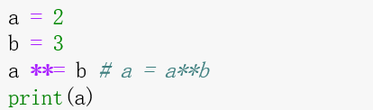

Slide 50
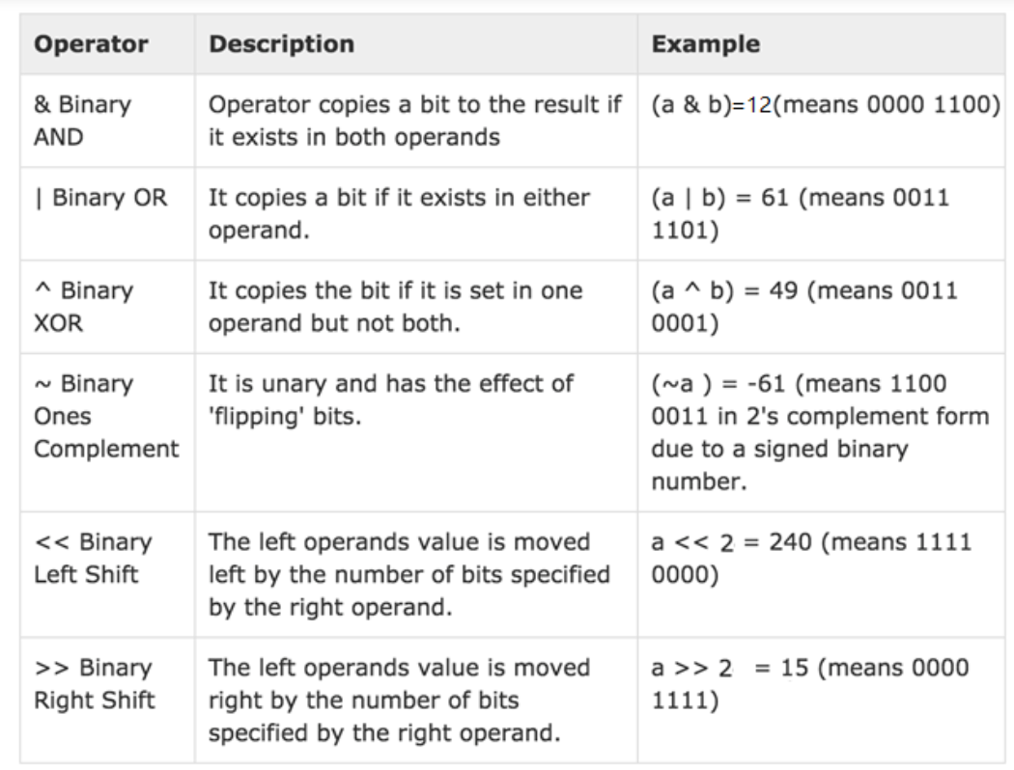
Bitwise operators
Assume variable a holds 60 and variable b holds 13.
Binary representation:
a = 0011 1100
b = 0000 1101
a & b = 0000 1100
a | b = 0011 1101
a ^ b = 0011 0001
Notes:
位运算符
运算符 描述 实例
& 按位与运算符 (a & b) 输出结果 12 ，二进制解释： 0000 1100 只要有一个是0，就是0
| 按位或运算符 (a | b) 输出结果 61 ，二进制解释： 0011 1101 只要有一个是1，就是1
^ 按位异或运算符 (a ^ b) 输出结果 49 ，二进制解释： 0011 0001 一样的话是0，不一样是1
~ 按位取反运算符 (~a ) 输出结果 -61 ，二进制解释： 1100 0011， 在一个有符号二进制数的补码形式。
<< 左移动运算符 a << 2 输出结果 240 ，二进制解释： 1111 0000
>> 右移动运算符 a >> 2 输出结果 15 ，二进制解释： 0000 1111

Slide 51
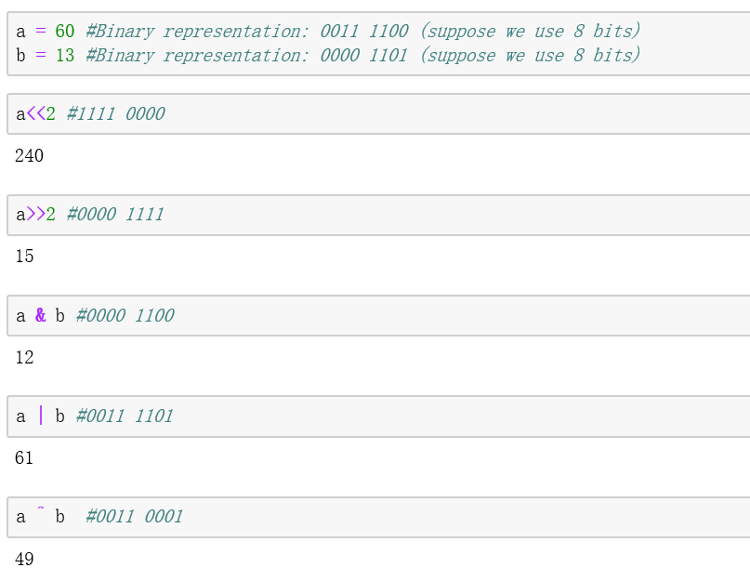

Slide 52
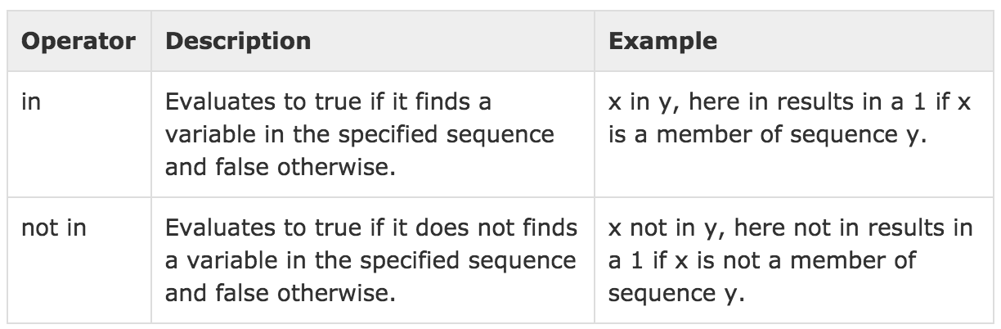
Membership operators
Test for memberships in a sequence, such as strings, lists, or tuples.
Notes:
成员运算符
检查左边操作数是否是右边操作数的成员

Slide 53
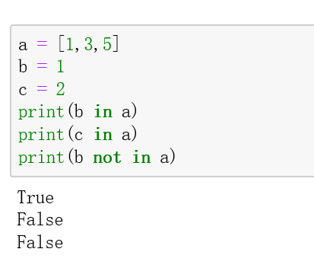

Slide 54
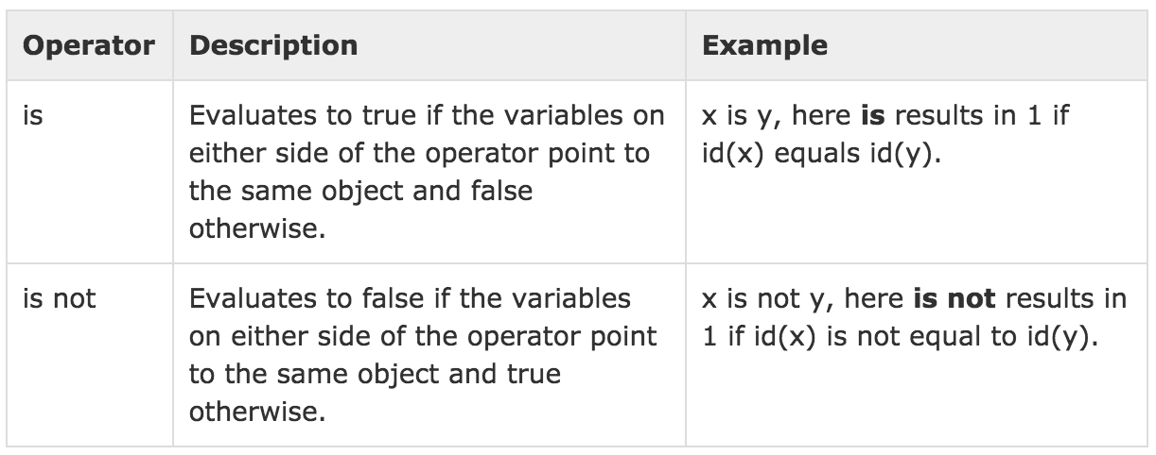
Identity operators
Compare the memory location of two objects.
Notes:
身份运算符
判断两个对象的内存地址是否一样

Slide 55
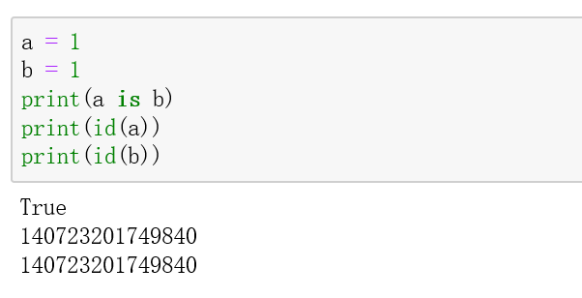

Slide 56
Operator precedence
When more than one operator appears in an expression, the order of evaluation depends on the rules of precedence.
Parentheses have the highest precedence and can be used to force an expression to evaluate in the order you want.
Exponentiation has the next highest precedence.
Multiplication and Division have the same precedence, which is higher than Addition and Subtraction, which also have the same precedence
Operators with the same precedence are evaluated from left to right.
Notes:
运算符的优先级

Slide 57
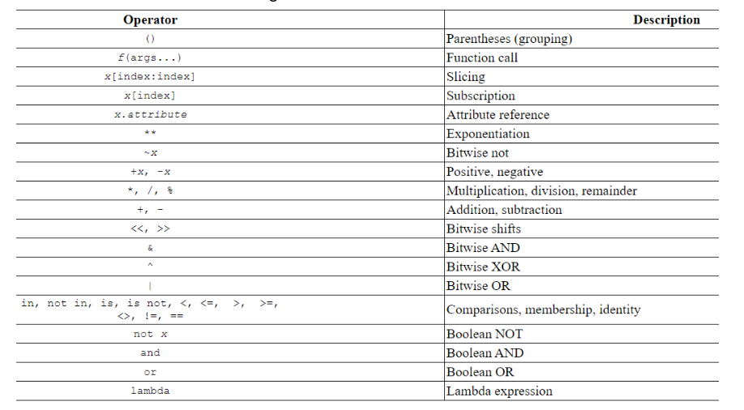
Operator precedence

Slide 58
Assignment statement
An assignment statement consists of an expression on the right-hand side and a variable to store the result.
X = 3.9 * X * (1 - X)

Slide 59
0.6
A variable is a memory location used to store a value (0.6)
>>> X =
0.6
0.6
>>>x = 3.9 * x * ( 1 - x )
2.34
0.4
0.936
The right side is an expression. Once the expression is evaluated, the result is placed in (assigned to) x.

Slide 60
A variable is a memory location used to store a value. The value stored in a variable can be updated by replacing the old value (0.6) with a new value (0.93).
0.6 0.936
X =
x = 3.9 * x * ( 1 - x )
The right side is an expression. Once the expression is evaluated, the result is placed in (assigned to) the variable on the left side (i.e., x).
0.936

Slide 61
Statements
Simple statements: executed sequentially and do not affect the flow of control.
Print statement
Assignment statement
And many others…
Compound statements: may affect the sequence of execution.
| expression_stmt
| assert_stmt
| assignment_stmt
| augmented_assignment_stmt
| pass_stmt
| del_stmt
| return_stmt
| yield_stmt
| raise_stmt
| break_stmt
| continue_stmt
| import_stmt
| global_stmt
| nonlocal_stmt

Slide 62
Readings (recommended)
The Python Tutorial
4.1 to 4.6 in 4. More Control Flow Tools

Slide 63
Recap
Variables
Expressions
Statements

Slide 64
Program practice
Convert a whole integer into binary number.

