Slide 1

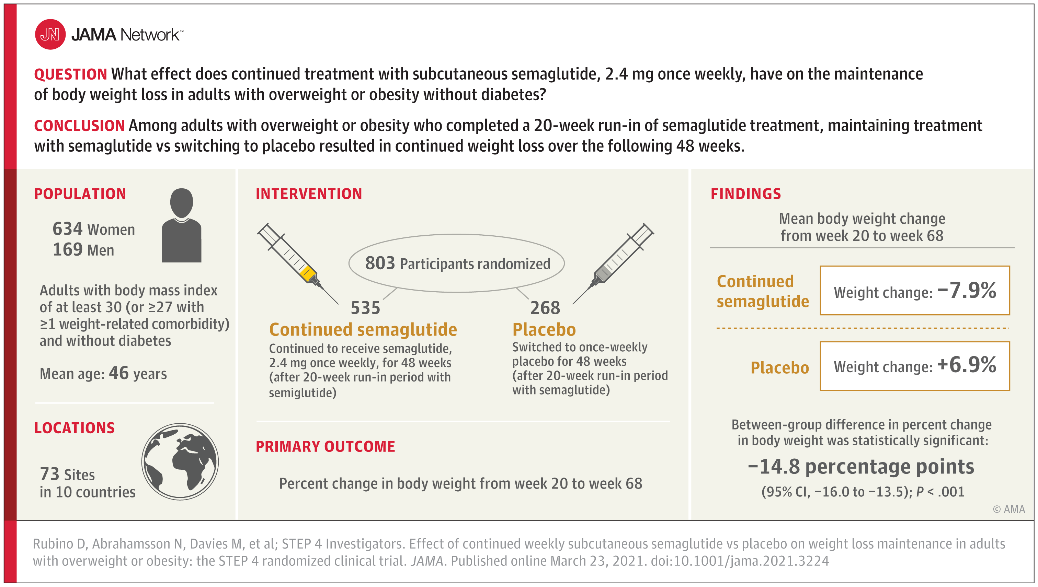
From: Effect of Continued Weekly Subcutaneous Semaglutide vs Placebo on Weight Loss Maintenance in Adults With Overweight or Obesity: The STEP 4 Randomized Clinical Trial
JAMA. 2021;325(14):1414-1425. doi:10.1001/jama.2021.3224
^{Figure Legend:}
Effect of Continued Semaglutide Treatment vs Placebo on Weight Loss Maintenance in Overweight or Obesity
^{Date of download: 5/28/2024}
Copyright 2021 American Medical Association. All Rights Reserved.

