Slide 1

Lecture 1 Introduction CS101 Algorithms and Data Structures
Instructor：Dengji Zhao; Yuyao Zhang; Xin Liu; Hao Geng
2023-09-27
Notes:
Adapted from the slides by Douglas Wilhelm Harder of U Waterloo (https://ece.uwaterloo.ca/~dwharder/aads/Lecture_materials/)
May also contain material from the slides at https://courses.cs.washington.edu/courses/cse326/03wi/326lecturesb.shtml (by Dan Suciu of U Washington)

Slide 2
Outline
What will we learn from this course?
How we manage this course?
Notes:
从不会开始讲
迎头赶上
最重要的课
最好的助教团队
课程调整

Slide 3
Why do we study this course?

Slide 4
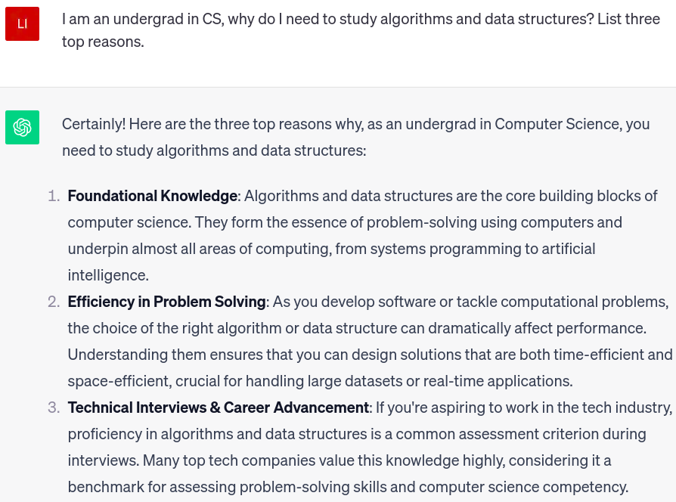
Why do we study this course?
We asked ChatGPT and got the answers:

Slide 5
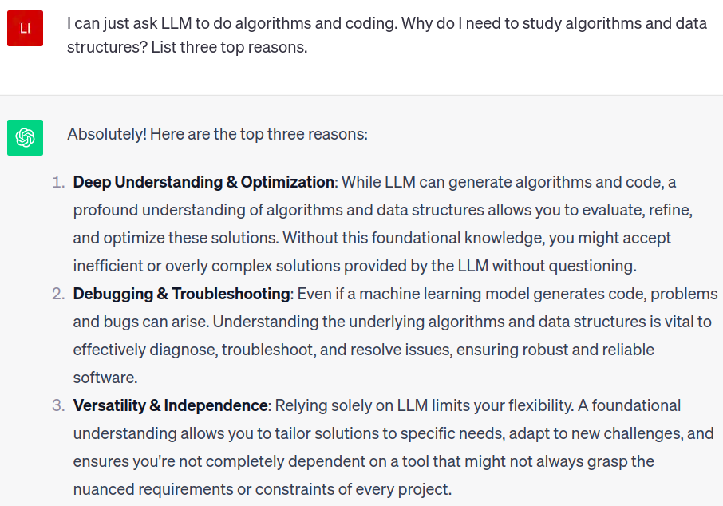
Why do we study this course in the age of AI?
We asked ChatGPT and got the answers:

Slide 6
Definition of Data Structure
A data structure is a scheme for organizing data in the memory of a computer.
The way in which the data is organized affects the performance of an algorithm for different tasks.
数据结构（data structure）是计算机中存储、组织数据的方式。通常情况下，精心选择的数据结构可以带来最优效率的算法（algorithm）。

Slide 7
How to combat problems via a computer
Problem
Modeling
Mathematic
Model
Design
Data
Structure
Algorithmic Analysis
& Design
Problem
Solved
Program
Algorithms
Running
Programming

Slide 8

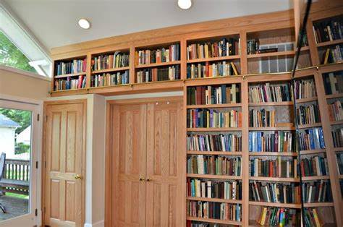

Ex1 How to arrange books on the bookshelf?

Slide 9
Ex1 How to arrange books on the bookshelf?
The following two operations are essential for efficiently arranging your books:
Operation 1: how to insert new books?
Operation 2: how to find/access an existing book?

Slide 10
Ex1 How to arrange books on the bookshelf?
Method 1: randomly insert new books.
Operation 1: how to insert new books?
Insert the book wherever there is an available space. Nice and easy!
Operation 2: how to find/access an existing book?
It depends …

Slide 11
Ex1 How to arrange books on the bookshelf?
Method 2: insert new books according to the alphabets order of the first letter.
Operation 1: how to insert new books?
EX: we bought a new book “Algorithm”.
Operation 2: how to find/access an existing book?
EX: Binary search!

Slide 12
Ex1 How to arrange books on the bookshelf?
Discussion 1: is Method 2 absolutely better/more efficient than Method 1?
Method 1: randomly insert new books.
Method 2: insert new books according to the alphabets order of the first letter.
Discussion 2: how can we further improve Method 2?

Slide 13
Ex1 How to arrange books on the bookshelf?
Method 3: cluster books according to different topics (computer science, economics, agriculture, politics…), then insert new books according to the alphabets order of the first letter.
Operation 1: how to insert new books?
EX: we bought a new book “Algorithm”.
Operation 2: how to find/access an existing book?
EX: Binary search for topic first, then binary search for book title.
Discussion 3: how much space we should preserve for each topic? How many topics is an optimism option?

Slide 14

The efficiency of a method/algorithm highly depends on the organization&amount of the data.

Slide 15
Ex2 How to implement a function PrintN?
Implement a function named PrintN, when input a positive integer N, print all the positive integer from 1 to N.
Let N = 100, 1000, 10000, 100000, … …
void PrintN ( int N )
{ int i;
for ( i=1; i<=N; i++ ) {
printf( “%d\n” , i);
}
return;
}
void PrintN ( int N )
{ if (N);
PrintN( N-1);
printf( “%d\n” , N);
}
return;
}
Loop implementation
Recursive implementation
Notes:
看似递归和循环的代码相似甚至于递归代码还比较方便但是在输入的数字为十万或者更多的时候，使用递归的程序却无法执行了。这恰恰反映了递归对程序的内存占用过大

Slide 16
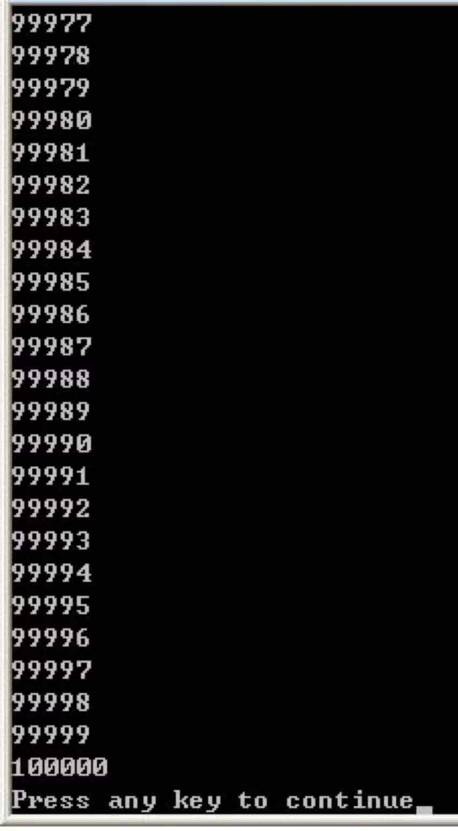
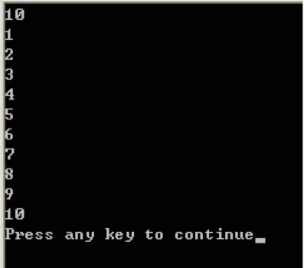
Ex2 How to implement a function PrintN?
Implement a function named PrintN, when input a positive integer N, print all the positive integer from 1 to N.
# include <stdio.h>
void PrintN ( int N );
int main ()
{ int N;
scanf (“%d”, &N);
PrintN(N);
return 0;
}
Loop implementation

Slide 17
The efficiency of a method/algorithm depends on the occupation of RAM.

Slide 18
Ex3 compute the summation for a polynomial at a fixed value x.
$$f\left(x\right)=a_{0}+a_{1}x+a_{2}x^{2}+⋯+a_{n−1}x^{n−1}+a_{n}x^{n}$$
double fpoly1 ( int n, double a[ ], double x )
{ int i;
double p = a[0];
for (i = 1; i <=n; i++)
p += (a[i] * pow( x, i) );
return p;
}
$$f\left(x\right)=a_{0}+x{(a}_{1}+x(a_{2}+⋯x(a_{n−1}+x\left(a_{n}\right))⋯))$$
double fpoly2 ( int n, double a[ ], double x )
{ int i;
double p = a[n];
for (i = n; i > 0; i-- )
p = a[i-1] + x* p;
return p;
}

Slide 19
clock(): capture consumed time for running a function. The unit of the captured time is clock tick, which depends on the CPU.
CLOCKS_PER_SEC is a constant that presents the number of clock ticks per second.
#include <stdio.h>
#include <time.h>
clock_t start, stop;
double duration;
int main ()
{
start = clock ();
Myfunction();
stop = clock ();
duration = ((double) (stop - start))/CLOCKS_PER_SEC;
return 0;
}
/* Clock_t is the variable returned by function clock(). */
/* Record the running time for a function. Time unit is second. */
/* Start timing. */
/* Stop timing. */

Slide 20
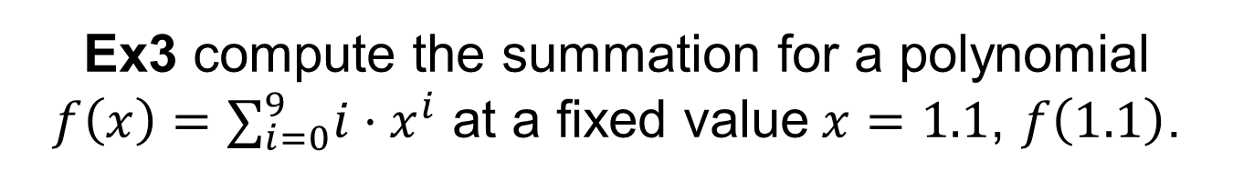
Ex3 compute the summation for a polynomial $f\left(x\right)=∑_{i=0}^{9}i⋅x^{i}$ at a fixed value$x=1.1$, $f\left(1.1\right)$.
double fpoly1 ( int n, double a[ ], double x )
{ int i;
double p = a[0];
for (i = 1; i <=0; i++)
p += (a[i] * pow( x, i) );
return p;
}
double fpoly2 ( int n, double a[ ], double x )
{ int i;
double p = a[n];
for (i = n; i > 0; i-- )
p = a[i-1] + x* p;
return p;
}

Slide 21
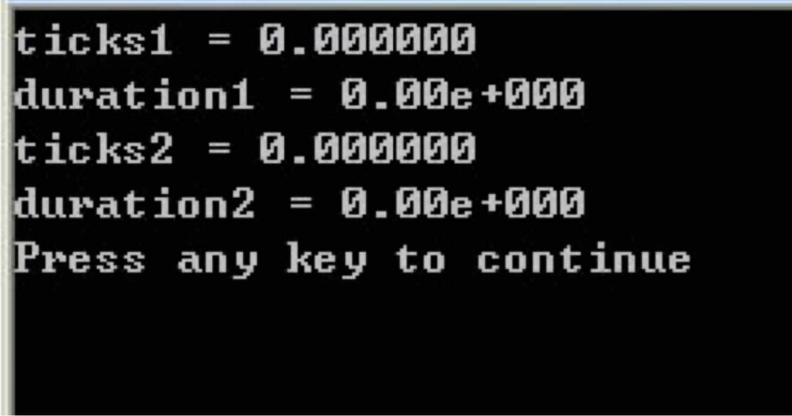

#include <stdio.h> #include <time.h> #include <math.h>
clock_t start, stop;
double duration;
#define MAXN 10 /*maximum order of the polynomial */
double fpoly1 ( int n, double a[ ], double x )
double fpoly2 ( int n, double a[ ], double x )
int main ()
{ int i;
double a[MAXN]; /*save the coefficient of the polynomial*/
for ( i=0; i<MAXN; i++) a[i] = (double) i;
$$f\left(x\right)=∑_{i=0}^{9}i⋅x^{i}$$
start = clock ();
fpoly1(MAXN-1, a, 1.1);
stop = clock ();
duration = ((double) (stop - start))/CLOCKS_PER_SEC;
prinft (“ticks1 = %f\n”,(double) (stop - start));
prinft (“duration1 = %6.2e\n”, duration));
start = clock ();
fpoly2(MAXN-1, a, 1.1);
stop = clock ();
duration = ((double) (stop - start))/CLOCKS_PER_SEC;
prinft (“ticks1 = %f”,(double) (stop - start));
prinft (“duration1 = %6.2e\n”, duration));
return 0;
}

Slide 22
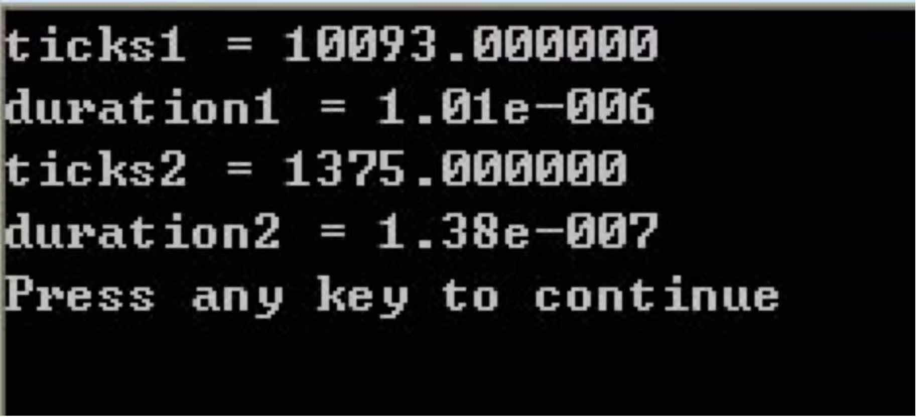
#include <stdio.h>
#include <time.h>
#include <math.h>
……
#define MAXK 1e7
/*maximum repeat time of the test function */
……
int main ()
{ ……
start = clock ();
stop = clock ();
duration = ((double) (stop - start))/CLOCKS_PER_SEC/MAXK;
/* compute running time for single function duration */
prinft (“ticks1 = %f\n”,(double) (stop - start));
prinft (“duration1 = %6.2e\n”, duration));
……
return 0;
}
for ( i=0; i<MAXK; i++)
fpoly1(MAXN-1, a, 1.1); /* repeat the test function to get enough clock ticks*/

Slide 23
The efficiency of a method/algorithm depends on the design of the algorithm.
Notes:
算法选择时效率的考虑：
虽然我们希望所选的算法占用额外空间小，运行时间短，其他性能也好，但计算机的时间和空间这两大资源往往相互抵触。所以，一般算法选择的原则是：
1. 对于反复使用的算法应选择运行时间短的算法；
2. 而使用次数少的算法可力求简明、易于编写和调试；
3. 对于处理的数据量较大的算法可从如何节省空间的角度考虑。

Slide 24
Definition of Data Structure
Data structure, way in which data are stored for efficient search and retrieval.
Different data structures are suited for different operations.
Algorithm is a procedure for solving a mathematical problem in a finite number of steps that frequently involves repetition of an operation.

Slide 25
Abstract Data Type (ADT 抽象数据类型)
Abstract: The method that we describe the data type, does not depend on the implementations.
Not related to the computer that stores the data.
Not related to the physical structure that stores the data.
Not related to the algorithm and language that implements the operation.
We only care about “how to design” the objective data sets and related operations, not how to “implement” a data structure.
Notes:
ADT指一个数学模型以及定义在该模型上的一组操作。
ADT的定义仅取决于它的一组逻辑特性，而与其在计算机内部如何表示和实现无关。
ADT比数据类型的范畴更为广泛，除了具有固有数据类型的特性之外，还包括用户在设计软件系统时自己定义的数据类型。

Slide 26
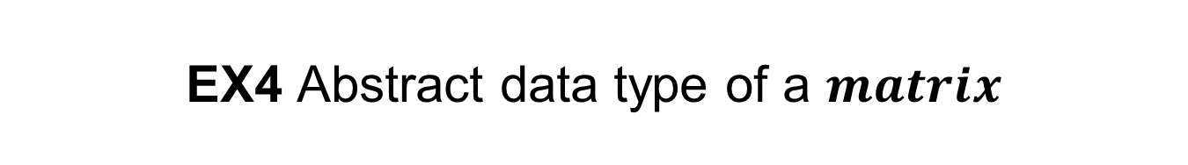
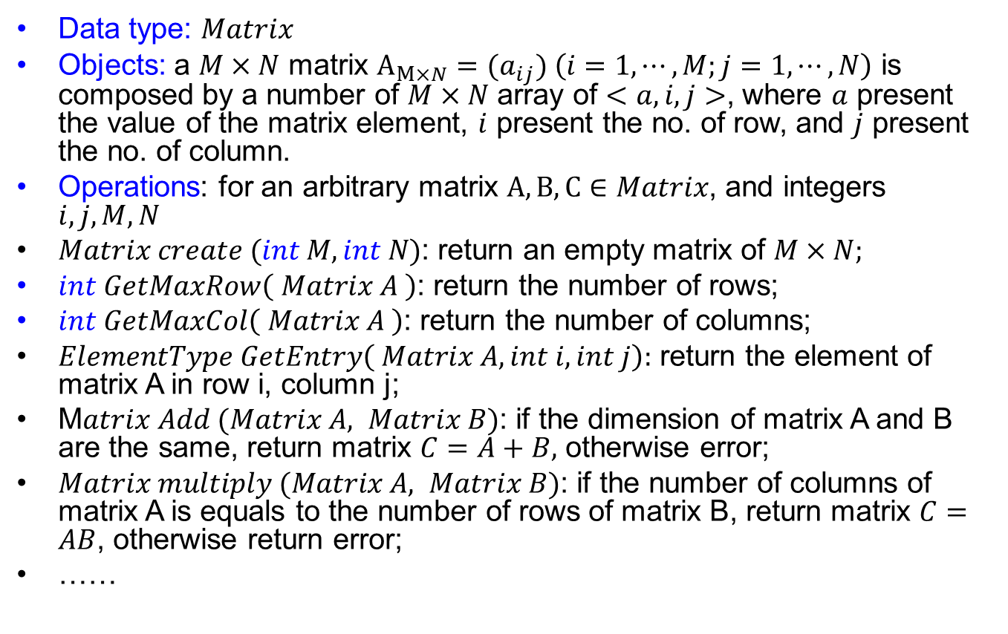
EX4 Abstract data type of a $matrix$
Array?
Structural array? Orthogonal list?
Data type: $Matrix$
Objects: a $M×N$ matrix $A_{M×N}={(a}_{ij}) \left(i=1,⋯,M;j=1,⋯,N\right)$ is composed by a number of $M×N$ array of $<a,i,j>$, where $a$ present the value of the matrix element, $i$ present the no. of row, and $j$ present the no. of column.
Operations: for an arbitrary matrix $A,B,C∈Matrix$, and integers $i,j,M,N$
$Matrix create (int M, int N)$: return an empty matrix of $M×N;$
$int GetMaxRow\left( Matrix A \right)$: return the number of rows;
$int GetMaxCol\left( Matrix A \right)$: return the number of columns;
$ElementType GetEntry\left( Matrix A, int i, int j\right):$ return the element of matrix A in row i, column j;
M$atrix Add (Matrix A, Matrix B)$: if the dimension of matrix A and B are the same, return matrix $C=A+B,$ otherwise error;
$Matrix multiply (Matrix A, Matrix B)$: if the number of columns of matrix A is equals to the number of rows of matrix B, return matrix $C=AB$, otherwise return error;
……
The elements are added in order of rows or columns? C,C++,Python,…?

Slide 27
Outline
What will we learn from this course?
How we manage this course?

Slide 28
Course info
Instructors
Yuyao Zhang zhangyy8@shanghaitech.edu.cn SIST 3-420
Dengji Zhao zhaodj@shanghaitech.edu.cn SIST 1A-304E
Xin Liu liuxin7@shanghaitech.edu.cn SIST 2-302H
Hao Geng genghao@shanghaitech.edu.cn SIST 3-332

Slide 29
Course info
TA Team
Piazza organization group: Ke Gong, Qiyang Jiang
Quiz and homework group: Yinghao Zhang, Weiduo Yuan
Program assignment group: Yuhan Cao, Pengcheng Wang
Blog group: Jintian Hu
Honest check group

Slide 30
Course info
Classes
Wed 8:15-9:55; Fri 8:15-9:55
Review/Quizzes/Discussions
Format: 5 groups, about 45 students each (Week 3-16 Weekly)
Length: 60mins each time
Location: TBA
Time: TBA
Instructors: all TAs
Contents: quizzes, and homework solutions
Notes:
先发作业，再quiz

Slide 31
Course info
Piazza Course Forum
piazza.com/shanghaitech.edu.cn/fall2023/cs101
You are encouraged to ask questions and participate in discussions
Course schedule, slides, office hour etc. are published on the forum
Invitation has been sent to your ShanghaiTech email (haven’t received it?)
Office Hours
Location and Time: see course forum
Homework
Submit to gradescope : see course forum

Slide 32
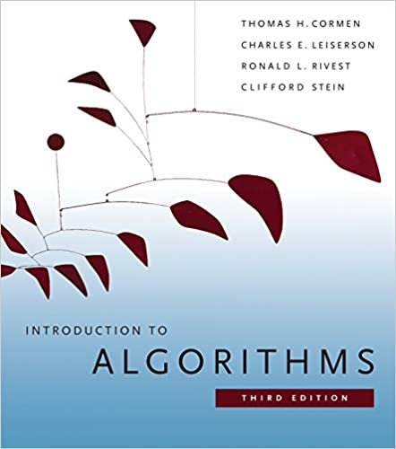
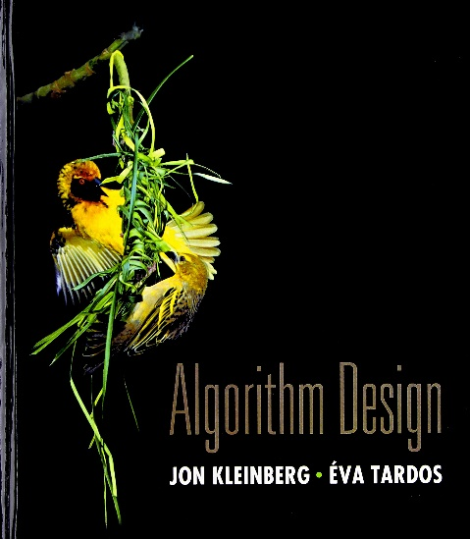
Course info
Reference Book
Introduction to Algorithms (3rd ed.). Cormen, Thomas H., Leiserson, Charles E., Rivest, Ronald L., Stein, Clifford. MIT Press. ISBN，9780262033848.
Algorithm design. Jon Kleinberg, Éva Tardos. Pearson. ISBN, 978-0321295354.

Slide 33
Course Schedule
Week | Date | Content
1 | 9/27 Wed | Introduction
 | 9/29 Fri | Mid-Autumn Festival
2 | 10/04 & 10/06 | National Day
 | 10/08 Sun | Elementary Data Structures: Array and Lists
3 | 10/11 Wed | Stack and Queue
 | 10/13 Fri | Big O/Theta/Omega
4 | 10/18 Wed | Hash Table
 | 10/20 Fri | Sorting: Insertion, Bubble
5 | 10/25 Wed | Sorting: Merge
 | 10/27 Fri | Sorting: Quick
6 | 11/01 Wed | Divide and Conquer
 | 11/03 Fri | Trees: Introduction, DFS, BFS
7 | 11/08 Wed | Binary Trees
 | 11/10 Fri | Heap and Heap Sort
8 | 11/15 Wed | Binary Search Trees + Huffman Coding
 | 11/17 Fri | Balanced Binary Search Trees: AVL

Slide 34
Course Schedule
Week | Date | Content
9 | 11/22 Wed | Red-Black Tree + Disjoint sets 1
 | 11/24 Fri | Middle Term Exam
10 | 11/29 Wed | Disjoint sets 2+ Graphs: Introduction, Traversal
 | 12/01 Fri | Graphs: Traversal
11 | 12/06 Wed | Minimum Spanning Trees
 | 12/08 Fri | Greedy
12 | 12/13 Wed | Topological Sorts
 | 12/15 Fri | Shortest Path Algorithm: Dijkstra
13 | 12/20 Wed | A*
 | 12/22 Fri | Floyd-Warshall Algorithm
14 | 12/27 Wed | Dynamic Programming
 | 12/29 Fri | Knapsack Problem
15 | 01/03 Wed | Reductions
 | 01/05 Fri | P+NP
16 | 01/10 Wed | NPC
 | 01/12 Fri | Review

Slide 35
Course Policy
Plagiarism
All assignments must be done individually
You cannot copy directly from any other source
You cannot share solutions with any other students
Plagiarism detection software will be used on all the assignments
Ways of collaboration
You may discuss together or help another student such as debugging his or her code; however, you cannot dictate or give the exact solutions.

Slide 36
Course Policy
Plagiarism
Punishment
When one student copied from another student, both students are responsible.
Zero point on the assignment or exam in question.
For programming assignment, one violation results in “-10”.
Disqualified from receiving any awards recommended by the school and from any competitive studying opportunities (e.g., international exchange).
Repeated violation will result in a F grade for this course as well as further punishment at the school/university level.

Slide 37
Plagiarism: Example 1
Alex and Bob were roommates.
Bob let Alex use his laptop to complete an assignment.
Alex copied Bob’s solution for the assignment.

Slide 38
Plagiarism: Example 2
Leslie asked if Morgan could send her his code so that she could look at it (promising, of course, not to copy it).
Morgan sent the code.
Leslie copied it and handed it in.

Slide 39
Plagiarism: Example 3
Garry and Harry worked together on a single source file initially and then worked separately to finish off the details.
The result was still noticeably similar with finger-print-like characteristics which left no doubt that some of the code had a common source.

Slide 40
Plagiarism: Example 4
Jordan uploaded the projects to GITHUB.com without setting appropriate permissions. Kasey found this site, downloaded the projects and submitted them. Both are guilty.
This applies to any public forum, news group, etc., not just gitub.com…

Slide 41
Real Plagiarism Examples
Copied a piece of the codes from others or online repositories.
Copied someone’s solution from his/her USB drive.
Copied a piece of others’ codes and change all the variable/function names.
Unusual solutions appeared in different submissions.

Slide 42
Course Policy
Grading
Exams (45%): middle term: 20%; final: 25%
Weekly Homework (20%): non-programming questions
Programming Tasks (20%): 4 programming tasks (each lasts 3 weeks)
In-Class Quizzes (15%): in lectures and discussions

Slide 43
Take Home Message
Algorithms and Data Structure is one of the most important course during your undergraduate.
You will sometimes feel it very tough, but please always keep on going, we are here to help.

