Slide 1

CS101 Data Structures
Binary Trees
Textbook Ch B.5.3, 10.4
Notes:
Adapted from the slides by Douglas Wilhelm Harder of U Waterloo (https://ece.uwaterloo.ca/~dwharder/aads/Lecture_materials/)
May also contain material from the slides at https://courses.cs.washington.edu/courses/cse326/03wi/326lecturesb.shtml (by Dan Suciu of U Washington)

Slide 2
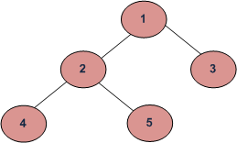

Orders of DFS traversal
Inorder (Left, Root, Right) : 4 2 5 1 3
Preorder (Root, Left, Right) : 1 2 4 5 3
Postorder (Left, Right, Root) : 4 5 2 3 1
Breadth-First or Level Order Traversal: 1 2 3 4 5
Doing HW and PA
day and night ……

Slide 3
Outline
Binary tree
Perfect binary tree
Complete binary tree
Left-child right-sibling binary tree

Slide 4
Outline
In this talk, we will look at the binary tree data structure:
Definition
Properties
Application
Expression trees

Slide 5
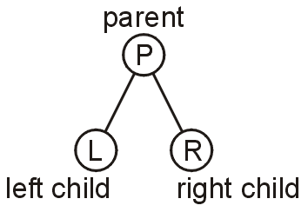
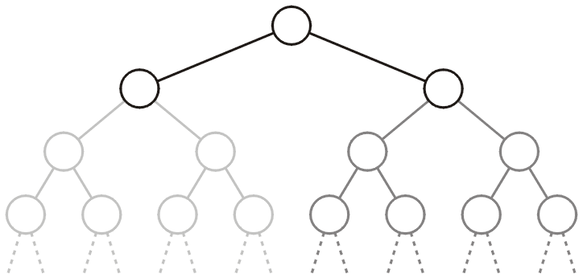
Definition
A binary tree is a restriction where each node has exactly two children:
Each child is either empty or another binary tree
This restriction allows us to label the children as left and right subtrees

Slide 6
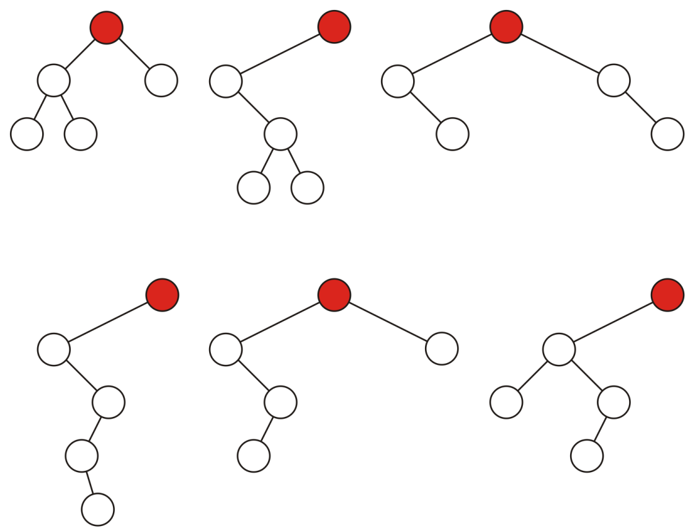
Definition
Some binary trees with five nodes:

Slide 7
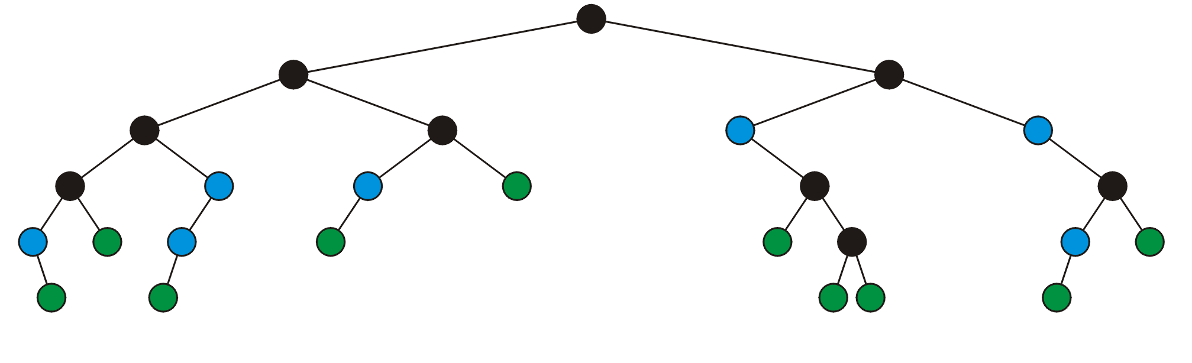
Definition
A full node is a node where both the left and right sub-trees are non-empty trees
Legend:
full nodes neither leaf nodes

Slide 8
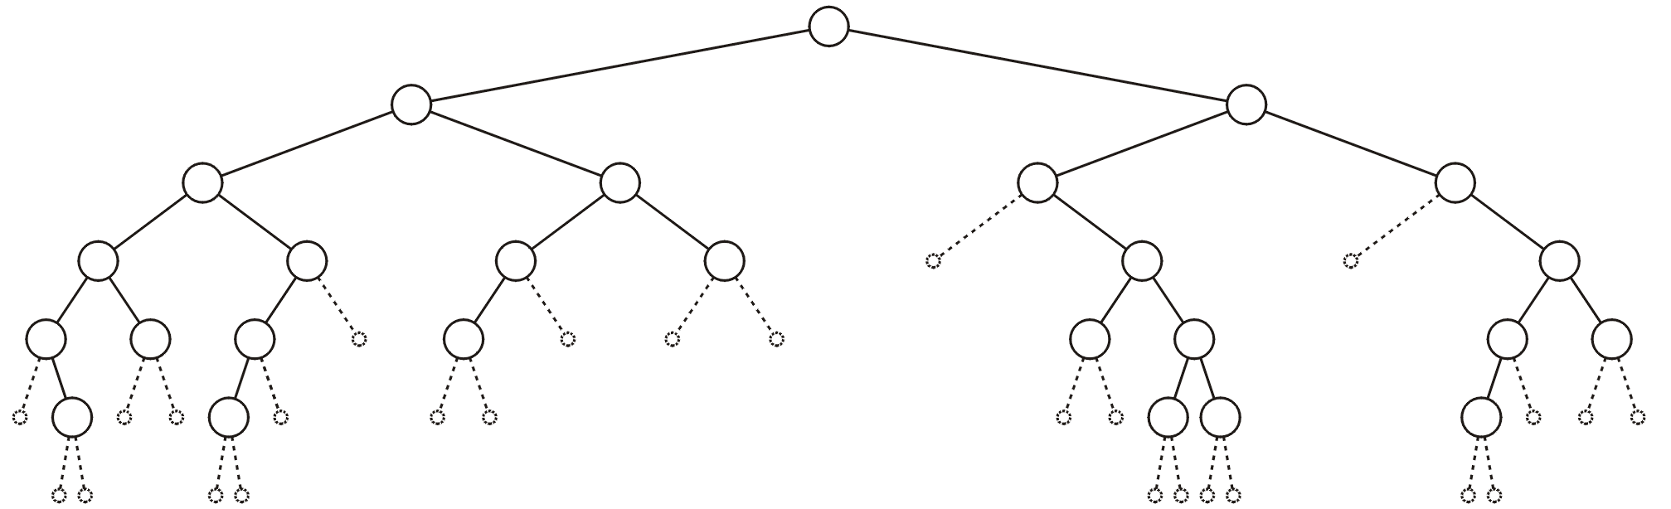
Definition
An empty node or a null sub-tree is any location where a new leaf node could be appended

Slide 9
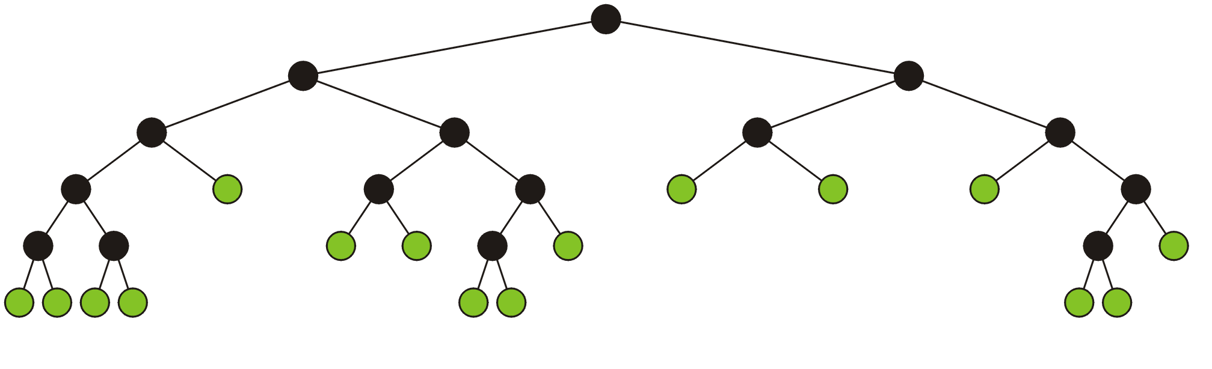
Definition
A full binary tree is where each node is:
A full node, or
A leaf node
These have applications in
Expression trees
Huffman encoding

Slide 10
Binary Node Class
The binary node class is similar to the single node class:
template <typename Type>
class Binary_node {
protected:
Type element;
Binary_node *left_tree;
Binary_node *right_tree;
public:
Binary_node( Type const & );
Type retrieve() const;
Binary_node *left() const;
Binary_node *right() const;
bool is_leaf() const;
int size() const;
int height() const;
}
Notes:
bool empty() const;
int height() const;
void clear();

Slide 11
Binary Node Class
We will usually only construct new leaf nodes
template <typename Type>
Binary_node<Type>::Binary_node( Type const &obj ):
element( obj ),
left_tree( nullptr ),
right_tree( nullptr ) {
// Empty constructor
}

Slide 12
Binary Node Class
The accessors are similar to that of Single_list
template <typename Type>
Type Binary_node<Type>::retrieve() const {
return element;
}
template <typename Type>
Binary_node<Type> *Binary_node<Type>::left() const {
return left_tree;
}
template <typename Type>
Binary_node<Type> *Binary_node<Type>::right() const {
return right_tree;
}

Slide 13
Binary Node Class
template <typename Type>
bool Binary_node<Type>::is_leaf() const {
return left() == nullptr && right() == nullptr;
}
Notes:
template <typename Type>
bool Binary_node<Type>::empty() const {
return ( this == nullptr );
}

Slide 14
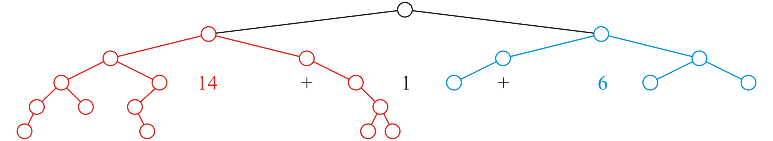
Size
template <typename Type>
int Binary_node<Type>::size() const {
return 1
+ left() == nullptr? 0 : left()->size()
+ right() == nullptr? 0 : right()->size();
}

Slide 15
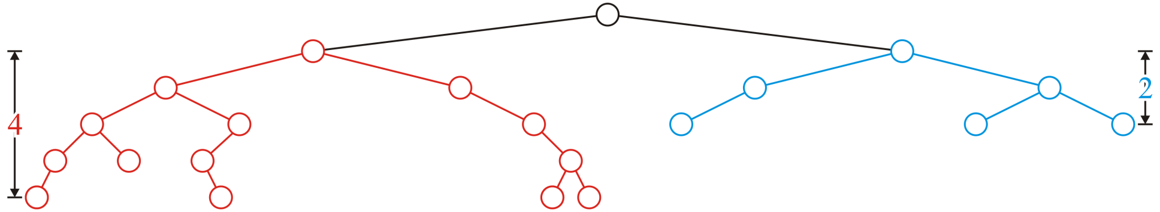
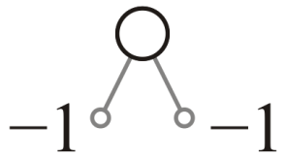
Height
template <typename Type>
int Binary_node<Type>::height() const {
return empty() ? -1 :
1 + std::max( left()->height(), right()->height() );
}

Slide 16
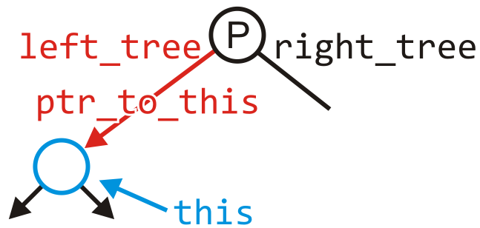
Clear
Removing all the nodes in a tree is similarly recursive:
template <typename Type>
void Binary_node<Type>::clear( Binary_node *&ptr_to_this ) {
if ( empty() ) {
return;
}
left()->clear( left_node );
right()->clear( right_node );
delete this;
ptr_to_this = nullptr;
}

Slide 17
Run Times
Recall that with linked lists and arrays, some operations would run in Θ(n) time
The run times of operations on binary trees, we will see, depends on the height of the tree
We will see that:
The worst is clearly Θ(n)
Under average conditions, the height is
The best case is Θ(ln(n))

Slide 18
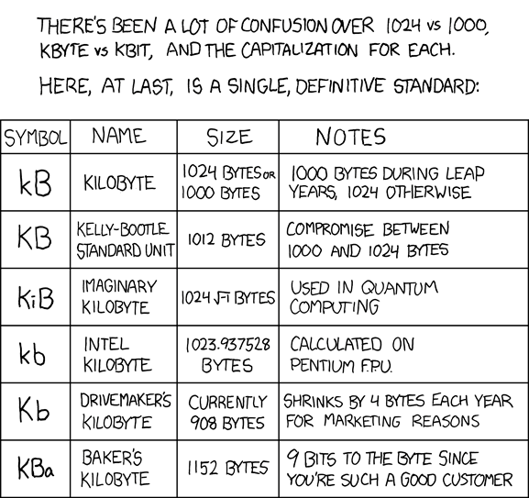
Run Times
If we can achieve and maintain a height Θ(lg(n)), we will see that many operations can run in Θ(lg(n)) we
Logarithmic time is not significantly worse than constant time:
lg( 1000 ) ≈ 10 kB
lg( 1 000 000 ) ≈ 20 MB
lg( 1 000 000 000 ) ≈ 30 GB
lg( 1 000 000 000 000 ) ≈ 40 TB
lg( 1000^{n} ) ≈ 10 n
http://xkcd.com/394/

Slide 19

Application: Ropes
In 1995, Boehm et al. introduced the idea of a rope, or a heavyweight string

Slide 20

Application: Ropes
Alpha-numeric data is stored using a string of characters
A character (or char) is a numeric value from 0 to 255 where certain numbers represent certain letters
For example,
‘A’ 65 01000001₂
‘B’ 66 01000010₂
‘a’ 97 01100001₂
‘b’ 98 01100010₂
‘ ’ 32 00100000₂
Unicode extends character encoding beyond the Latin alphabet
Still waiting for the Tengwar characters…
J.R.R. Tolkien

Slide 21
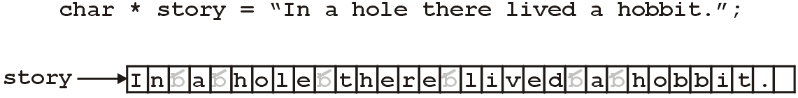
Application: Ropes
A C-style string is an array of characters followed by the character with a numeric value of 0
One problem with using arrays is the runtime required to concatenate two strings

Slide 22
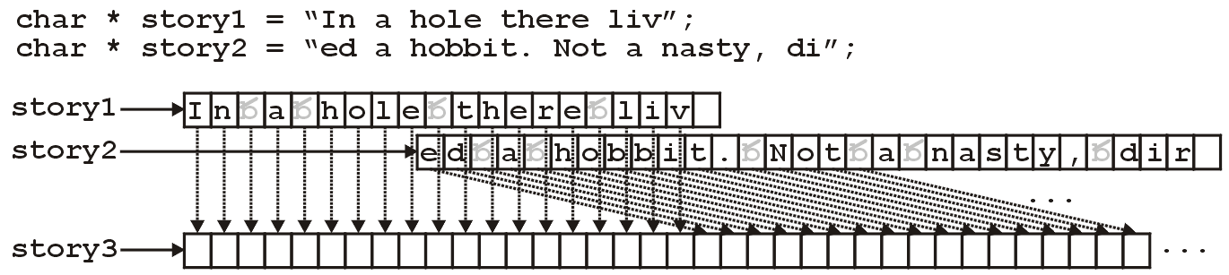
Application: Ropes
Concatenating two strings requires the operations of:
Allocating more memory, and
Coping both strings Θ(n + m)

Slide 23
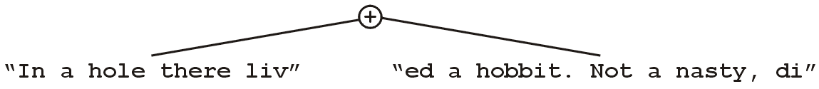
Application: Ropes
The rope data structure:
Stores strings in the leaves,
Internal nodes (full) represent the concatenation of the two strings, and
Represents the string with the right sub-tree concatenated onto the end of the left
The previous concatenation may now occur in Θ(1) time

Slide 24
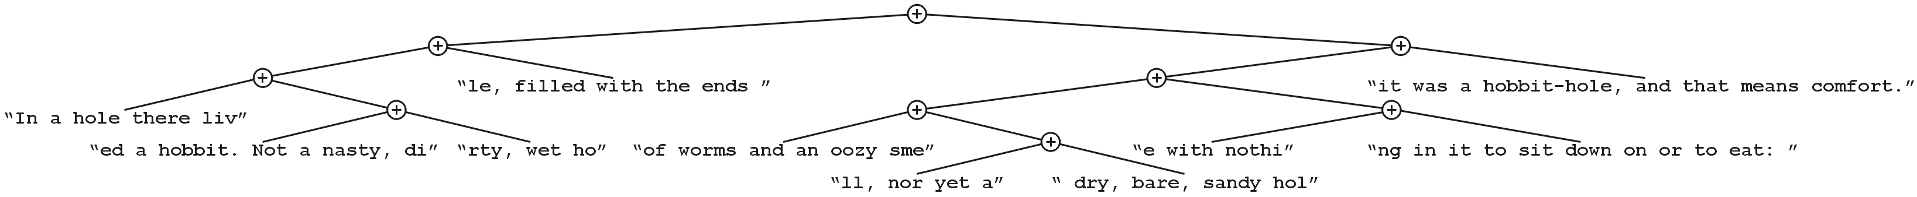
Application: Ropes
The string
may be represented using the rope
References: http://en.wikipedia.org/wiki/Rope_(computer_science) J.R.R. Tolkien, The Hobbit

Slide 25
Application: Ropes
Additional information may be useful:
Recording the number of characters in both the left and right sub-trees
It is also possible to eliminate duplication of common sub-strings
References: http://en.wikipedia.org/wiki/Rope_(computer_science) J.R.R. Tolkien, The Hobbit

Slide 26
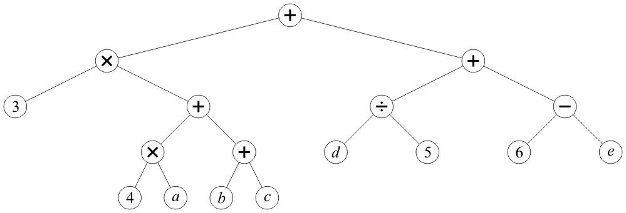
Application: Expression Trees
Any basic mathematical expression containing binary operators may be represented using a (full) binary tree
For example, 3*(4a + b + c) + d/5 + (6 – e)
Internal nodes store operators
Leaf nodes store literals or variables

Slide 27
Application: Expression Trees
Observations:
Internal nodes store operators
Leaf nodes store literals or variables
No nodes have just one sub tree
The order is not relevant for
Addition and multiplication (commutative)
Order is relevant for
Subtraction and division (non-commutative)
It is possible to replace non-commutative operators using the unary negation and inversion:
(a/b) = a b⁻¹ (a – b) = a + (–b)

Slide 28
Application: Expression Trees
A post-order depth-first traversal converts such a tree to the reverse-Polish format
3 4 a × b c + + × d 5 ÷ 6 e – + +

Slide 29

Application: Expression Trees
Computers think in post-order:
Both operands must be loaded into registers
The operation is then called on those registers
Humans think in in-order:
First, the left sub-tree is traversed
Then, the current node is visited
Finally, the right-sub-tree is traversed
This is called an in-order traversal
How do we penguins think questions?

Slide 30
In-order Traversal
3

Slide 31
In-order Traversal
3 ×

Slide 32
In-order Traversal
3 × 4

Slide 33
In-order Traversal
3 × 4 ×

Slide 34
In-order Traversal
3 × 4 × a

Slide 35
In-order Traversal
3 × 4 × a +

Slide 36
In-order Traversal
3 × 4 × a + b

Slide 37
In-order Traversal
3 × 4 × a + b +

Slide 38
In-order Traversal
3 × 4 × a + b + c

Slide 39
In-order Traversal
3 × 4 × a + b + c +

Slide 40
In-order Traversal
3 × 4 × a + b + c + d ÷ 5 + 6 – e

Slide 41
In-order Traversal
3 × (4 × a + (b + c)) + (d ÷ 5 + (6 – e))

Slide 42
In-order Traversal
3 × 4 × a + b + c + d ÷ 5 + 6 – e

Slide 43
Summary
In this talk, we introduced binary trees
Each node has two distinct and identifiable sub-trees
Either sub-tree may optionally be empty
The sub-trees are ordered relative to the other
We looked at:
Properties
Applications

Slide 44
Usage Notes
These slides are made publicly available on the web for anyone to use
If you choose to use them, or a part thereof, for a course at another institution, I ask only three things:
that you inform me that you are using the slides,
that you acknowledge my work, and
that you alert me of any mistakes which I made or changes which you make, and allow me the option of incorporating such changes (with an acknowledgment) in my set of slides
Sincerely,
Douglas Wilhelm Harder, MMath
dwharder@alumni.uwaterloo.ca

Slide 45
Outline
Binary tree
Perfect binary tree
Complete binary tree
Left-child right-sibling binary tree

Slide 46
Outline
Introducing perfect binary trees
Definitions and examples
Number of nodes: 2^{h + 1} – 1
Logarithmic height
Number of leaf nodes: 2^{h}
Applications

Slide 47
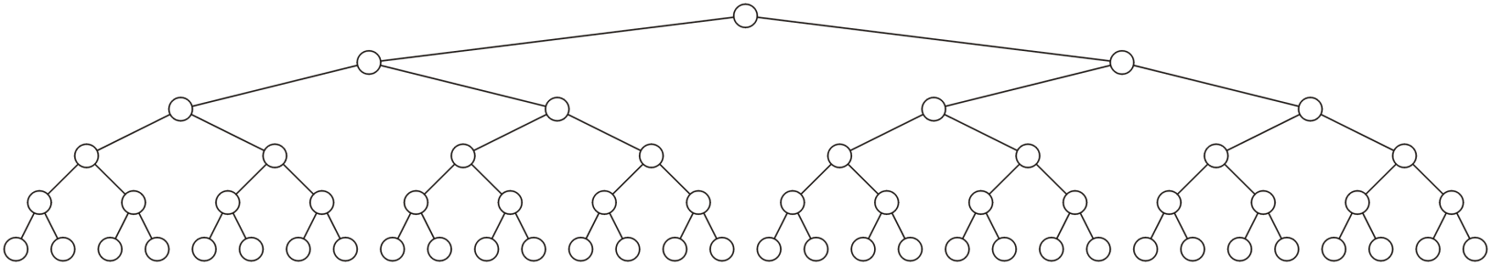
Definition
Standard definition:
A perfect binary tree of height h is a binary tree where
All leaf nodes have the same depth h
All other nodes are full

Slide 48
Definition
Recursive definition:
A binary tree of height h = 0 is perfect
A binary tree with height h > 0 is a perfect if both sub-trees are prefect binary trees of height h – 1

Slide 49
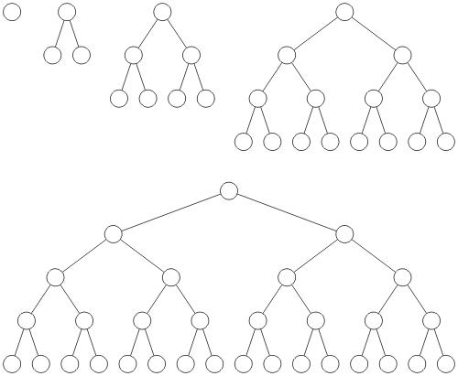
Examples
Perfect binary trees of height h = 0, 1, 2, 3 and 4

Slide 50
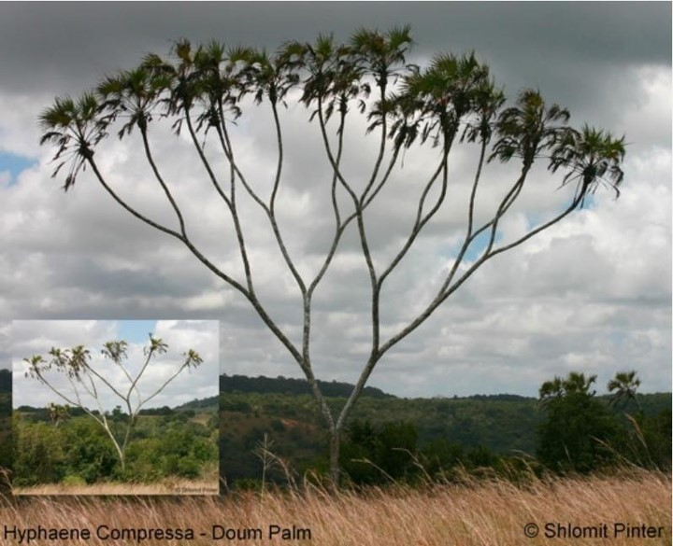

Examples
Perfect binary trees of height h = 3 and h = 4
Fake photo!
Fake Background!

Slide 51
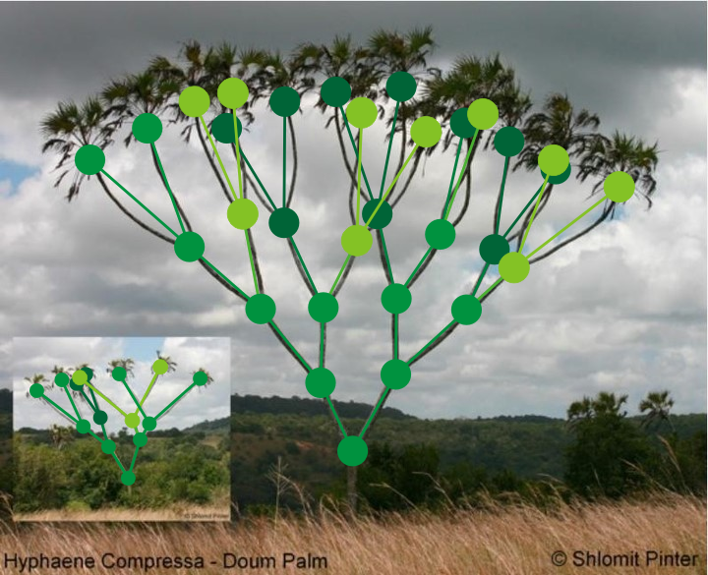
Examples
Perfect binary trees of height h = 3 and h = 4

Slide 52
Theorems
Four theorems of perfect binary trees:
A perfect binary tree of height h has 2^{h + 1} – 1 nodes
The height is Θ(ln(n))
There are 2^{h} leaf nodes
The average depth of a node is Θ(ln(n))
These theorems will allow us to determine the optimal run-time properties of operations on binary trees

Slide 53
2^{h + 1} – 1 Nodes
Theorem
A perfect binary tree of height h has 2^{h + 1} – 1 nodes
Proof:
We will use mathematical induction

Slide 54
2^{h + 1} – 1 Nodes
The base case:
When h = 0 we have a single node n = 1
The formula is correct: 2⁰ ⁺ ¹ – 1 = 1

Slide 55
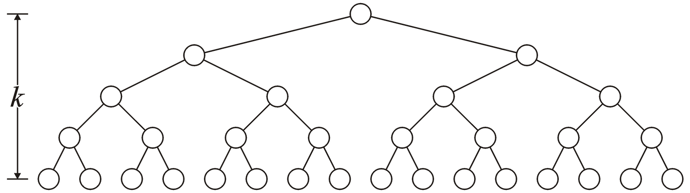
2^{h + 1} – 1 Nodes
The inductive step:
Assume that a tree of height h has n = 2^{h + 1} – 1 nodes
h

Slide 56
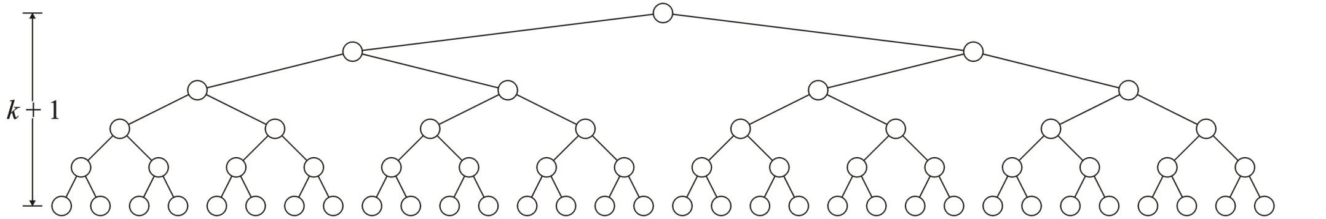
2^{h + 1} – 1 Nodes
We must show that a tree of height h + 1 has n = 2^{(h + 1) + 1} – 1 = 2^{h + 2} – 1 nodes
h + 1

Slide 57
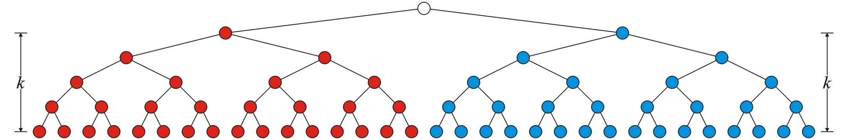
2^{h + 1} – 1 Nodes
Using the recursive definition, both sub-trees are perfect trees of height h
By assumption, each sub-tree has 2^{h + 1} – 1 nodes
Therefore, the total number of nodes is
(2^{h + 1} – 1) + 1 + (2^{h + 1} – 1) = 2^{h + 2} – 1
h
h

Slide 58
2^{h + 1} – 1 Nodes
Consequently
The statement is true for h = 0 and the truth of the statement for an
arbitrary h implies the truth of the statement for h + 1.
Therefore, by the process of mathematical induction, the statement
is true for all h ≥ 0

Slide 59
Logarithmic Height
Theorem
A perfect binary tree with n nodes has height lg(n + 1) – 1
Proof
Solving n = 2^{h + 1} – 1 for h:
n + 1 = 2^{h + 1}
lg(n + 1) = h + 1
h = lg(n + 1) – 1

Slide 60
Logarithmic Height
Lemma
lg(n + 1) – 1 = Θ(ln(n))
Proof

Slide 61
2^{h} Leaf Nodes
Theorem
A perfect binary tree with height h has 2^{h} leaf nodes
Proof (by induction):
When h = 0, there is 2⁰ = 1 leaf node.
Assume that a perfect binary tree of height h has 2^{h} leaf nodes and observe that both sub-trees of a perfect binary tree of height h + 1 have 2^{h} leaf nodes.
Consequence: Over half of the nodes are leaf nodes:

Slide 62
The Average Depth of a Node
The average depth of a node in a perfect binary tree is
Depth
Count
0
1
1
2
2
4
3
8
4
16
5
32
Sum of the
depths
Number of nodes

Slide 63
Applications
Perfect binary trees are considered to be the ideal case
The height and average depth are both Θ(ln(n))
We will attempt to find trees which are as close as possible to perfect binary trees

Slide 64
Summary
We have defined perfect binary trees and discussed:
The number of nodes: n = 2^{h + 1} – 1
The height: lg(n + 1) – 1
The number of leaves: 2^{h}
Half the nodes are leaves
Average depth is Θ(ln(n))
It is an ideal case

Slide 65
Outline
Binary tree
Perfect binary tree
Complete binary tree
Left-child right-sibling binary tree

Slide 66
Outline
Introducing complete binary trees
Background
Definitions
Examples
Logarithmic height
Array storage

Slide 67
Background
We require binary trees which are
Similar to perfect binary trees, but
Defined for any number of nodes

Slide 68
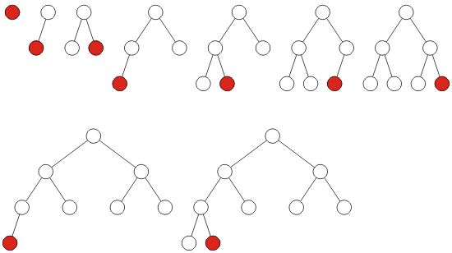
Definition
A complete binary tree filled at each depth from left to right
Identical order to that of a breadth-first traversal

Slide 69
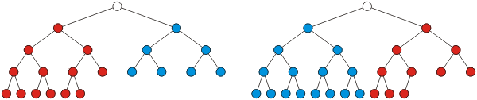
Recursive Definition
Recursive definition: a binary tree with a single node is a complete binary tree of height h = 0 and a complete binary tree of height h is a tree where either:
The left sub-tree is a complete tree of height h – 1 and the right sub-tree is a perfect tree of height h – 2, or
The left sub-tree is perfect tree with height h – 1 and the right sub-tree is complete tree with height h – 1

Slide 70
Height
Theorem
The height of a complete binary tree with n nodes is h = ⌊lg(n)⌋
Proof:
Base case:
When n = 1 then ⌊lg(1)⌋ = 0 and a tree with one node is a complete tree with height h = 0
Inductive step:
Assume that a complete tree with n nodes has height ⌊lg(n)⌋
Must show that ⌊lg(n + 1)⌋ gives the height of a complete tree with n + 1 nodes
Two cases:
If the tree with n nodes is perfect, and
If the tree with n nodes is complete but not perfect

Slide 71
Height
Case 1 (the tree with n nodes is perfect):
If it is a perfect tree then
It had n = 2^{h + 1} – 1 nodes
Adding one more node must increase the height
So, the tree with n+1 nodes has height h+1 and we have:

Slide 72
Height
Case 2 (the tree with n nodes is complete but not perfect):
If it is not a perfect tree then
So, the tree with n+1 nodes has height h and we have ⌊lg( n + 1 )⌋ = h
By mathematical induction, the statement must be true for all n ≥ 1

Slide 73
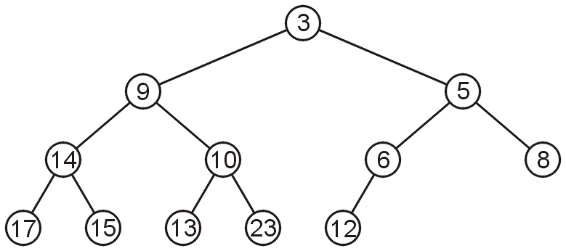
Array storage
We are able to store a complete tree as an array
Traverse the tree in breadth-first order, placing the entries into the array

Slide 74
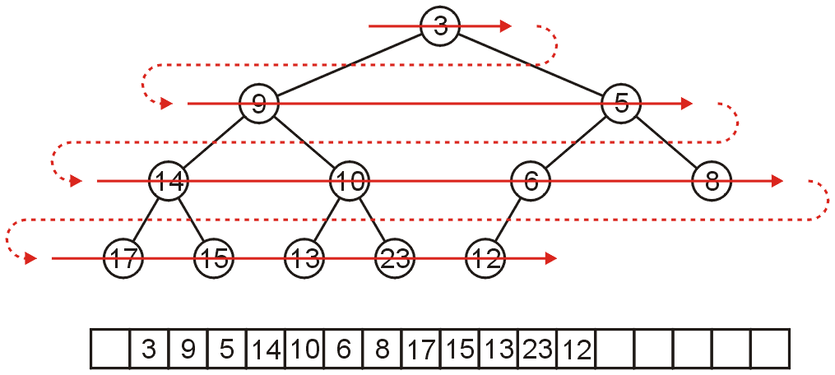
Array storage
We are able to store a complete tree as an array
Traverse the tree in breadth-first order, placing the entries into the array

Slide 75
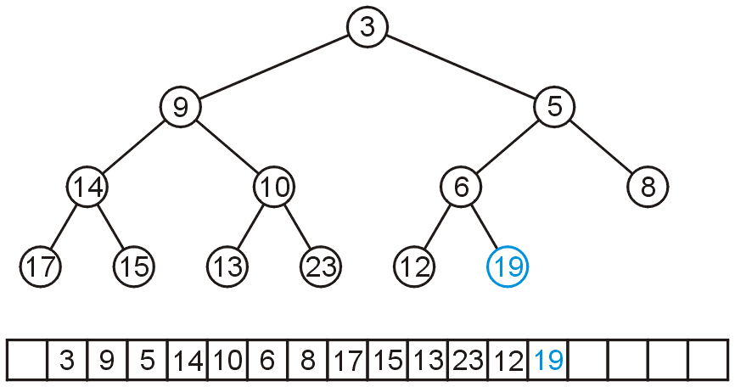
Array storage
To insert another node while maintaining the complete-binary-tree structure, we must insert into the next array location

Slide 76
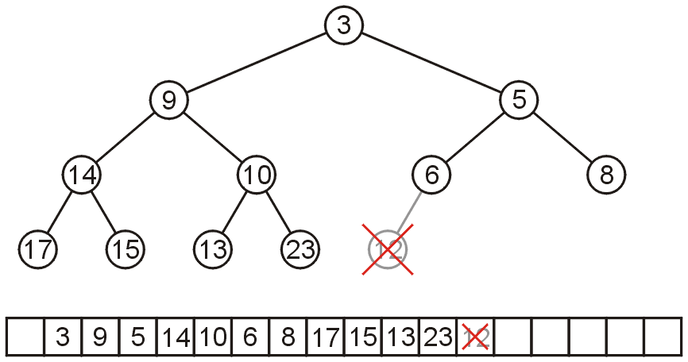
Array storage
To remove a node while keeping the complete-tree structure, we must remove the last element in the array

Slide 77
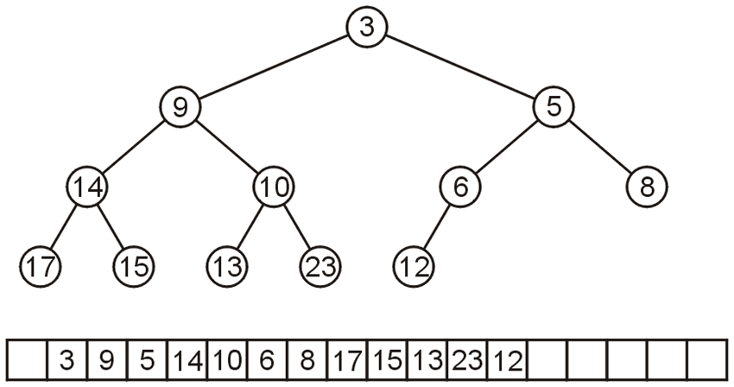
Array storage
Leaving the first entry blank yields a bonus:
The children of the node with index k are in 2k and 2k + 1
The parent of node with index k is in k ÷ 2
0 1 2 3 4 5 6 7 8 9 10 11 12 13 14 15 16 17

Slide 78
Array storage
Leaving the first entry blank yields a bonus:
In C++, this simplifies the calculations:
parent = k >> 1;
left_child = k << 1;
right_child = left_child | 1;
0 1 2 3 4 5 6 7 8 9 10 11 12 13 14 15 16 17

Slide 79
Array storage
For example, node 10 has index 5:
Its children 13 and 23 have indices 10 and 11, respectively
0 1 2 3 4 5 6 7 8 9 10 11 12 13 14 15 16 17

Slide 80
Array storage
For example, node 10 has index 5:
Its children 13 and 23 have indices 10 and 11, respectively
Its parent is node 9 with index 5/2 = 2
0 1 2 3 4 5 6 7 8 9 10 11 12 13 14 15 16 17

Slide 81
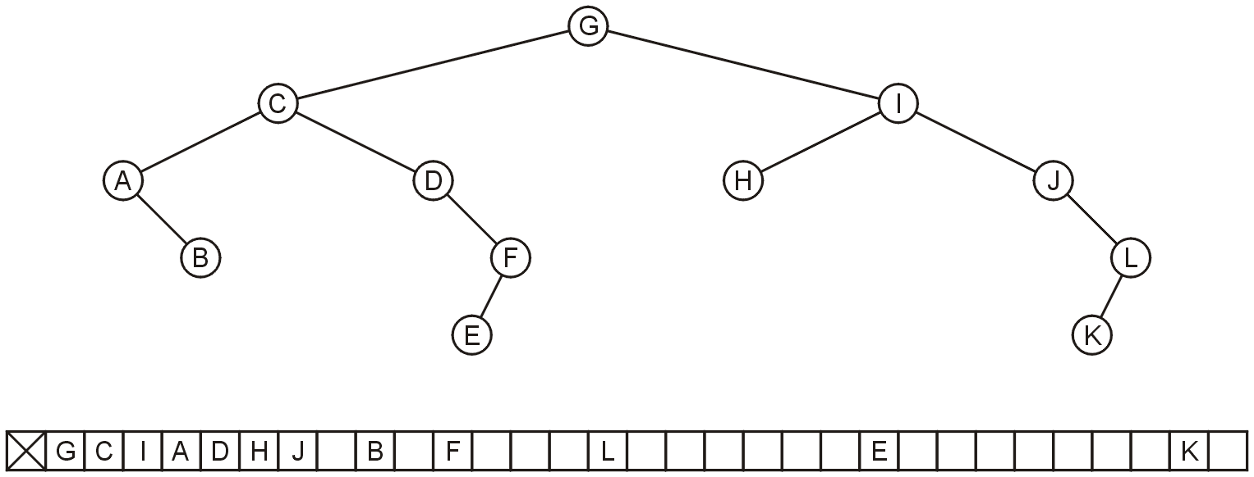
Array storage
Question: why not store any binary tree as an array in this way?
There is a significant potential for a lot of wasted memory
Consider this tree with 12 nodes would require an array of size 32
Adding a child to node K doubles the required memory

Slide 82
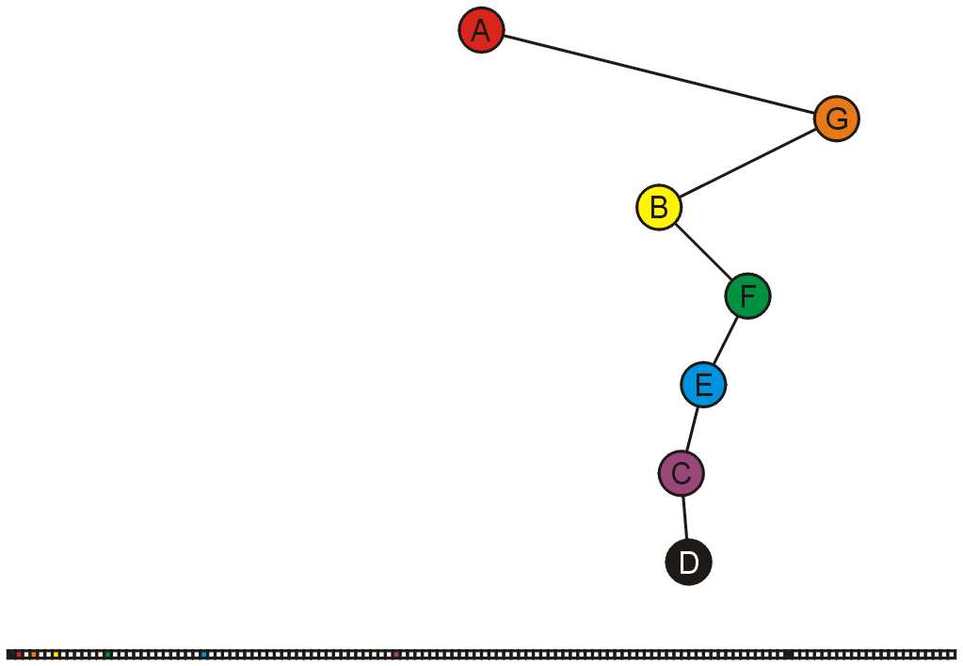
Array storage
In the worst case, an exponential amount of memory is required
These nodes would be stored in entries 1, 3, 6, 13, 26, 52, 105

Slide 83
Summary
In this topic, we have covered the concept of a complete binary tree:
A useful relaxation of the concept of a perfect binary tree
It has a compact array representation

Slide 84
Outline
Binary tree
Perfect binary tree
Complete binary tree
Left-child right-sibling binary tree

Slide 85
Background
Our simple tree data structure is node-based where children are stored as a linked list
Is it possible to store a general tree as a binary tree?

Slide 86
The Idea
Consider the following:
The first child of each node is its left sub-tree
The next sibling of each node is in its right sub-tree
This is called a left-child—right-sibling binary tree

Slide 87
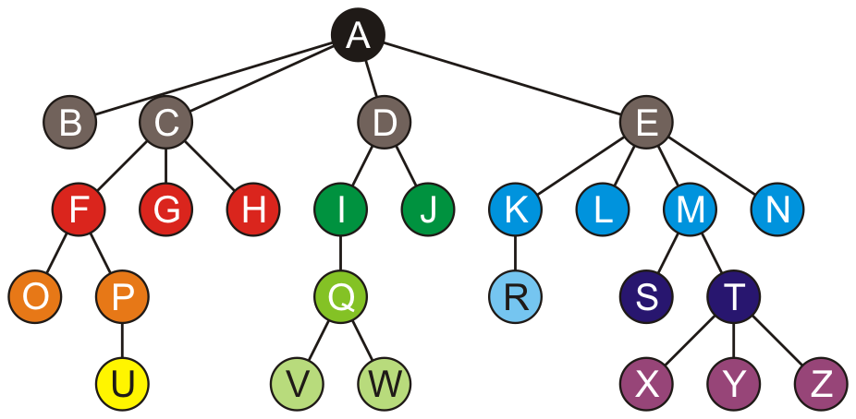
Example
Consider this general tree

Slide 88
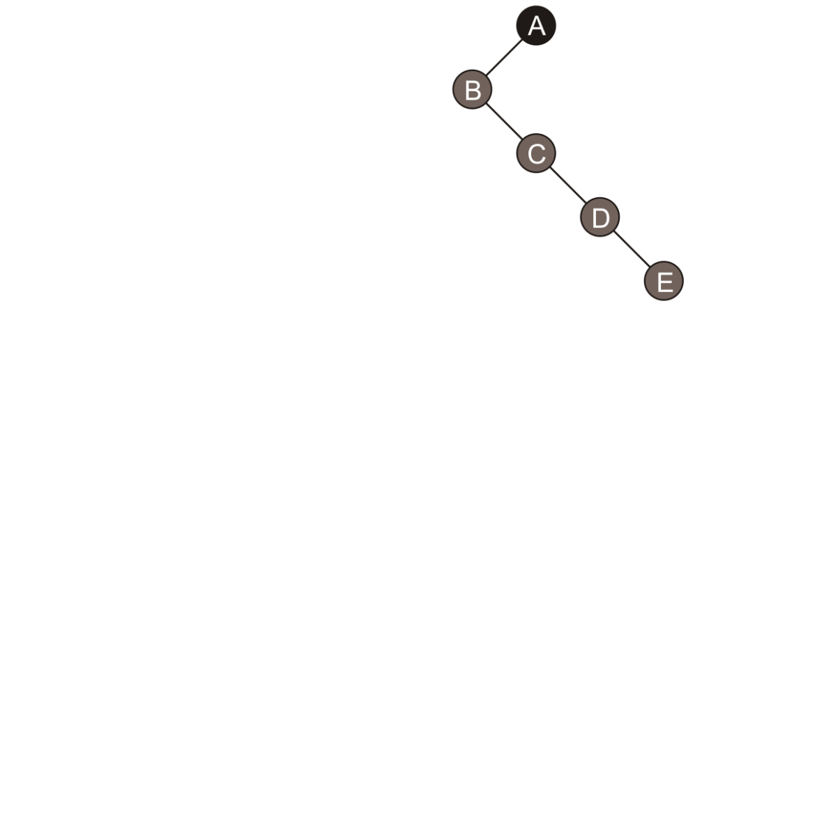
Example
B, the first child of A, is the left child of A
For the three siblings C, D, E:
C is the right sub-tree of B
D is the right sub-tree of C
E is the right sub-tree of D

Slide 89
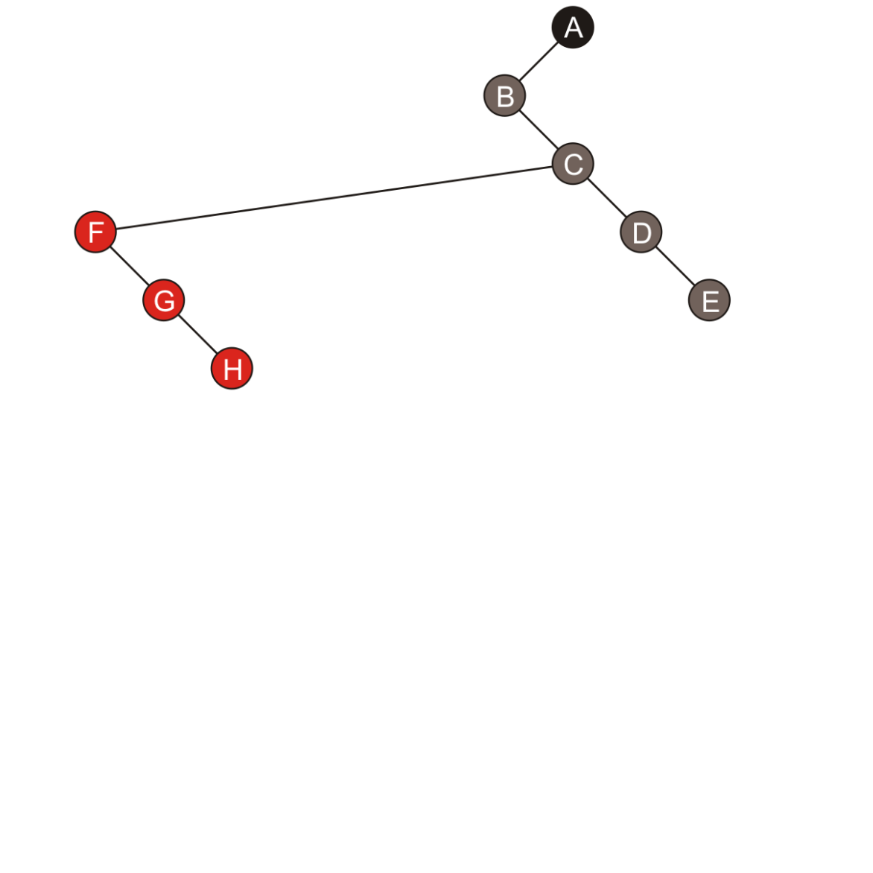
Example
B has no children, so it’s left sub-tree is empty
F, the first child of C, is the left sub-tree of C
For the next two siblings:
G is the right sub-tree of F
H is the right sub-tree of G

Slide 90
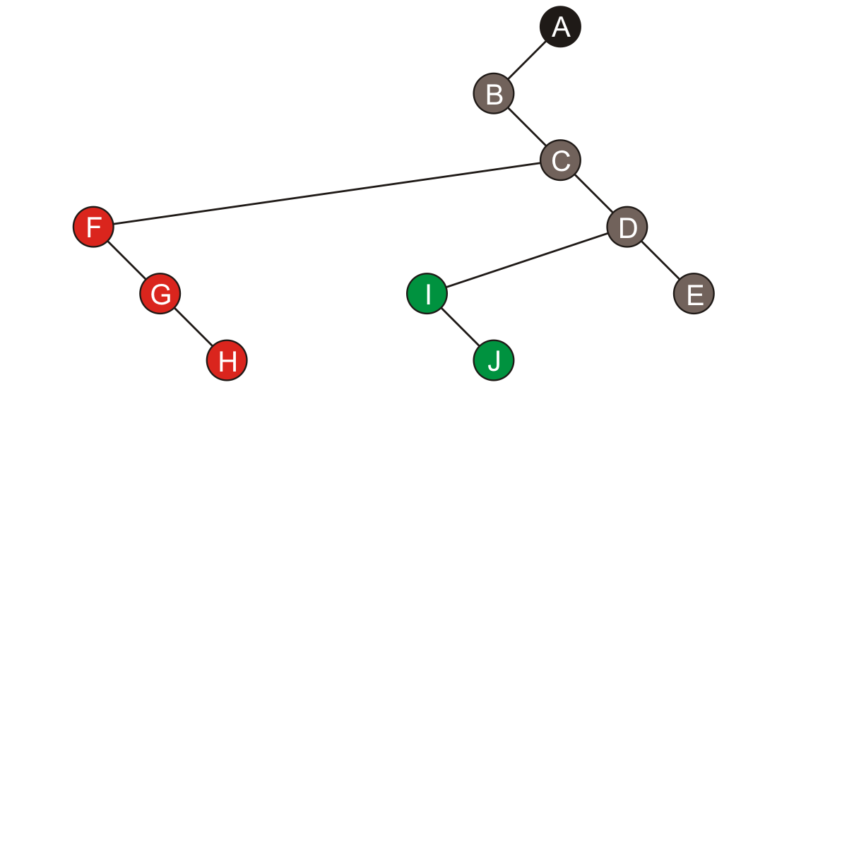
Example
I, the first child of D, is the left child of D
Its sibling J is the right sub-tree of I

Slide 91
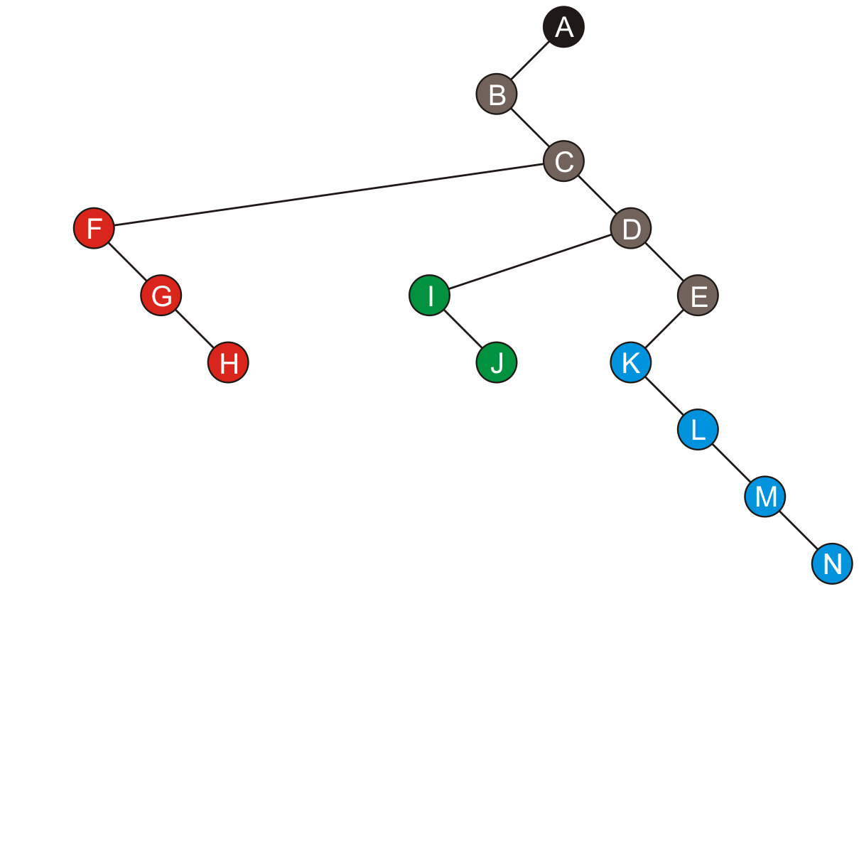
Example
Similarly, the four children of E start with K forming the left sub-tree of E and its three siblings form a chain along the right sub-trees

Slide 92
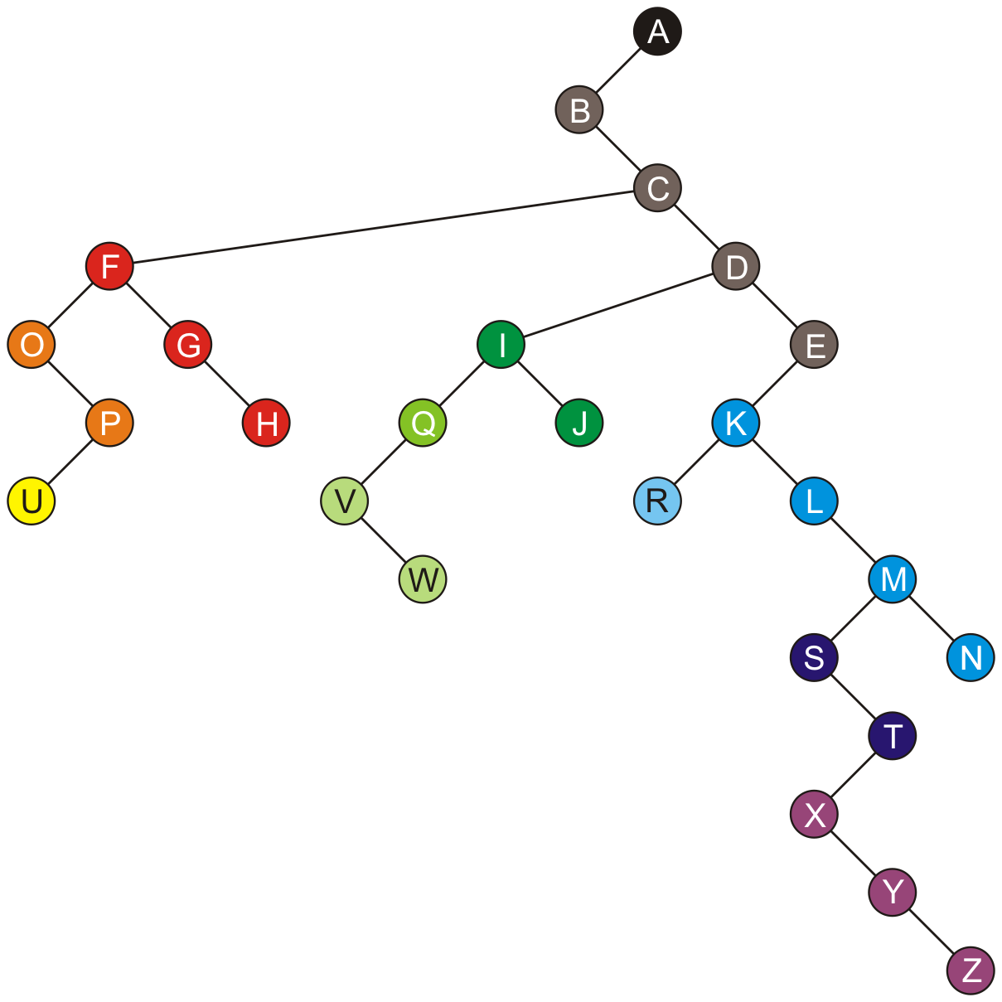
Example

Slide 93
Example
An empty left sub-tree indicates no children

Slide 94
Example
An empty right sub-tree indicates the node is the last of its siblings
The root node, has no siblings

Slide 95
Transformation
The transformation of a general tree into a left-child right-sibling binary tree has been called the Knuth transform

Slide 96


Traversals
A pre-order traversal of the original tree is identical to the pre-order traversal of the Knuth transform
A B C F O P U G H D I Q V W J E K R L M S T X Y Z N

Slide 97
Traversals
A post-order traversal of the original tree is identical to the in-order traversal of the Knuth transform
B O U P F G H C V W Q I J D R K L S X Y Z T M N E A

Slide 98
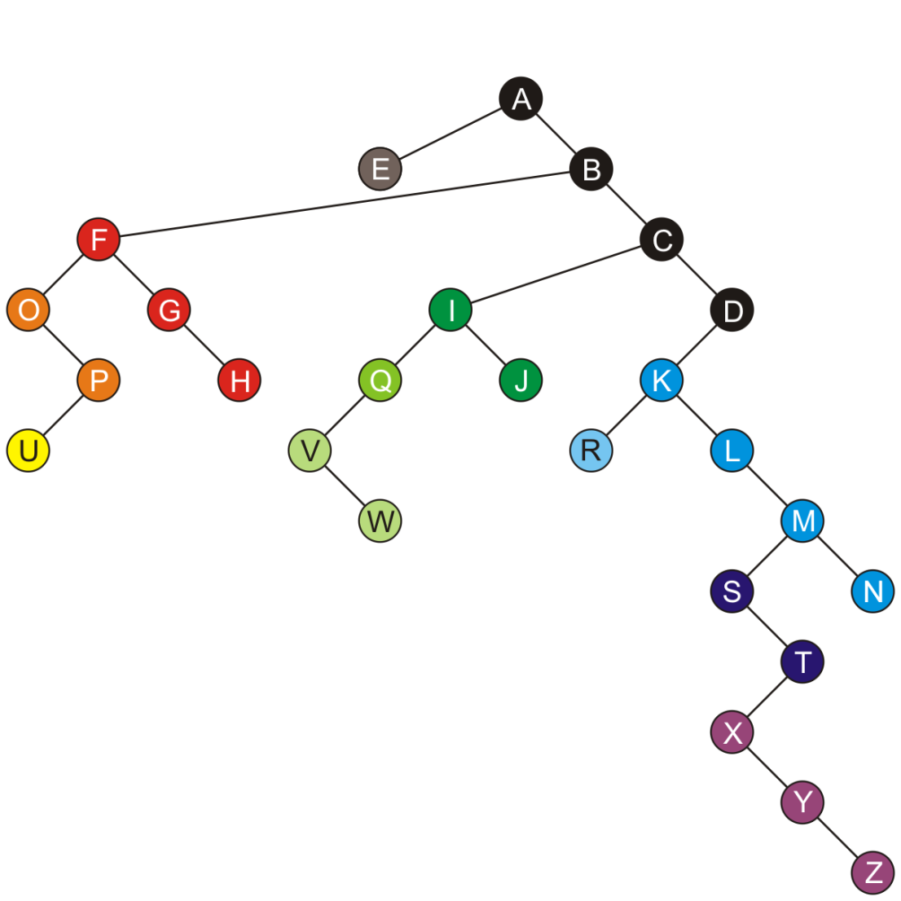
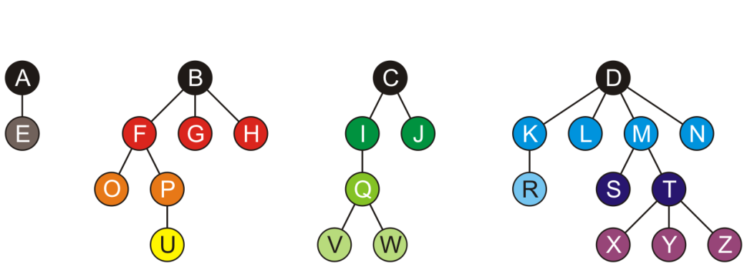
Forests
A forest can be stored in this representation as follows:
Choose one of the roots of the trees as the root of the binary tree
Let each subsequent root of a tree be a right child of the previous root
This is the binary-tree representation of this forest
Think of the roots as siblings of each other

Slide 99
Implementation
The class is similar to that of a binary tree
template <typename Type>
class LCRS_tree {
private:
Type element;
LCRS_tree *first_child_tree;
LCRS_tree *next_sibling_tree;
public:
LCRS_tree();
LCRS_tree *first_child();
LCRS_tree *next_sibling();
// ...
};

Slide 100
Implementation
The implementation of various functions now differs
template <typename Type>
int LCRS_tree<Type>::degree() const {
int count = 0;
for (
LCRS_tree<Type> *ptr = first_child();
ptr != nullptr;
ptr = ptr->next_sibling()
) {
++count;
}
return count;
}

Slide 101
Implementation
The implementation of various functions now differs
template <typename Type>
bool LCRS_tree<Type>::is_leaf() const {
return ( first_child() == nullptr );
}

Slide 102
Implementation
The implementation of various functions now differs
template <typename Type>
LCRS_tree<Type> *LCRS_tree<Type>::child( int n ) const {
if ( n < 0 || n >= degree() ) {
return nullptr;
}
LCRS_tree<Type> *ptr = first_child();
for ( int i = 0; i < n; ++i ) {
ptr = ptr->next_sibling();
}
return ptr;
}

Slide 103
Implementation
The implementation of various functions now differs
template <typename Type>
void LCRS_tree<Type>::append( Type const &obj ) {
if ( first_child() == nullptr ) {
first_child_tree = new LCRS_tree<Type>( obj );
} else {
LCRS_tree<Type> *ptr = first_child();
while ( ptr->next_sibling() != nullptr ) {
ptr = ptr->next_sibling();
}
ptr->next_sibling_tree = new LCRS_tree<Type>( obj );
}
}

Slide 104
Implementation
The implementation of various functions now differs
The size doesn’t care that this is a general tree…
template <typename Type>
int LCRS_tree<Type>::size() const {
return 1
+ ( first_child() == nullptr ? 0 : first_child()->size() )
+ ( next_sibling() == nullptr ? 0 : next_sibling()->size() );
}

Slide 105
Implementation
The implementation of various functions now differs
The height member function is closer to the original implementation
template <typename Type>
int LCRS_tree<Type>::height() const {
int h = 0;
for (
LCRS_tree<Type> *ptr = first_child();
ptr != nullptr;
ptr = ptr->next_sibling()
) {
h = std::max( h, 1 + ptr->height() );
}
return h;
}

Slide 106
Summary
This topic has covered a binary representation of general trees
The first child is the left sub-tree of a node
Subsequent siblings of that child form a chain down the right sub-trees
An empty left sub-tree indicates no children
An empty right sub-tree indicates no other siblings

Slide 107
References
[1] Cormen, Leiserson, Rivest and Stein, Introduction to Algorithms, 2nd Ed., MIT Press, 2001, §19.1, pp.457-9.
[2] Weiss, Data Structures and Algorithm Analysis in C++, 3rd Ed., Addison Wesley, §6.8.1, p.240.

Slide 108
Summary
Binary tree
Each node has two children
In-order traversal
Perfect binary tree
Number of nodes, height, number of leaf nodes, average depth
Complete binary tree
Height, array storage
Left-child right-sibling binary tree

