Slide 1

CS101 Algorithms and Data Structures
Graphs
Textbook Ch B.4, B.5.1, 22.1
Notes:
Adapted from the slides by Douglas Wilhelm Harder of U Waterloo (https://ece.uwaterloo.ca/~dwharder/aads/Lecture_materials/)
May also contain material from the slides at https://courses.cs.washington.edu/courses/cse326/03wi/326lecturesb.shtml (by Dan Suciu of U Washington)

Slide 2
Outline
Definitions
Undirected graphs
Directed graph
Representation
Adjacency matrix
Adjacency list

Slide 3
Outline
A graph is an abstract data type for storing adjacency relations
We start with definitions:
Vertices, edges, degree and sub-graphs
We will describe paths in graphs
Simple paths and cycles
Definition of connectedness
Weighted graphs
We will then reinterpret these in terms of directed graphs
Directed acyclic graphs

Slide 4
Undirected Graphs
We will define an Undirected Graph ADT as a collection of vertices
V = {v₁, v₂, ..., v_{n}}
The number of vertices is denoted by
|V| = n
Associated with this is a collection E of unordered pairs {v_{i}, v_{j}} termed edges which connect the vertices
Notes:
There are a number of data structures that can be used to implement abstract undirected graphs
Adjacency matrices
Adjacency lists

Slide 5
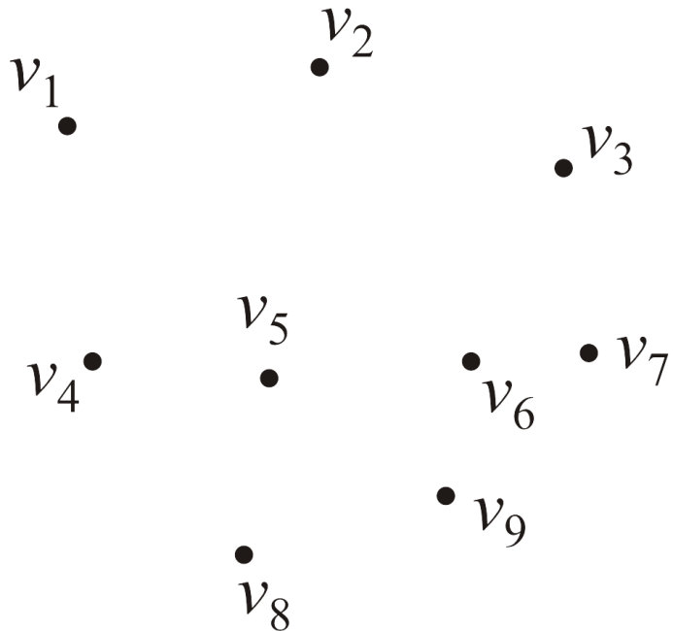
Undirected Graphs
Consider this collection of vertices
V = {v₁, v₂, ..., v₉}
where |V| = n = 9

Slide 6
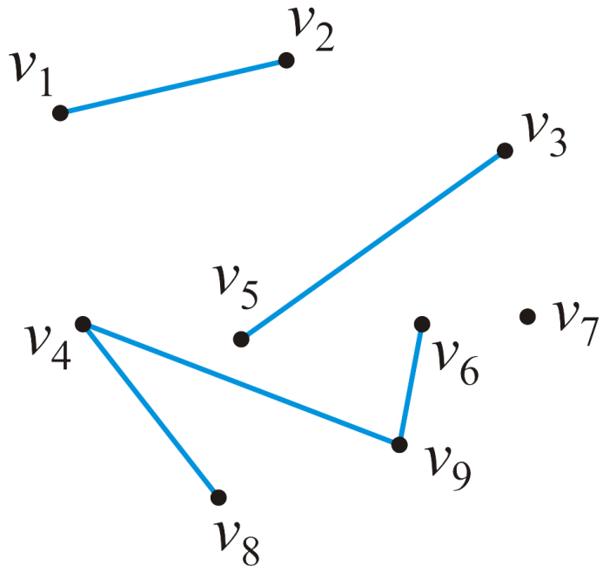
Undirected graphs
Associated with these vertices are |E| = 5 edges
E = {{v₁, v₂}, {v₃, v₅}, {v₄, v₈}, {v₄, v₉}, {v₆, v₉}}
The pair {v_{j} , v_{k}} indicates that both vertex v_{j} is adjacent to vertex v_{k} and vertex v_{k} is adjacent to vertex v_{j}

Slide 7
Undirected graphs
We will assume that a vertex is never adjacent to itself
For example, {v₁, v₁} will not define an edge
The maximum number of edges in an undirected graph is

Slide 8
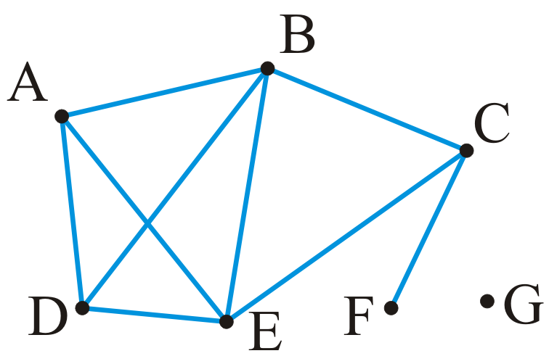
An undirected graph
Example: given the |V| = 7 vertices
V = {A, B, C, D, E, F, G}
and the |E| = 9 edges
E = {{A, B}, {A, D}, {A, E}, {B, C}, {B, D}, {B, E}, {C, E}, {C, F}, {D, E}}

Slide 9
Degree
The degree of a vertex is defined as the number of adjacent vertices
degree(A) = degree(D) = degree(C) = 3
degree(B) = degree(E) = 4
degree(F) = 1 degree(G) = 0
Those vertices adjacent to a given vertex are its neighbors

Slide 10
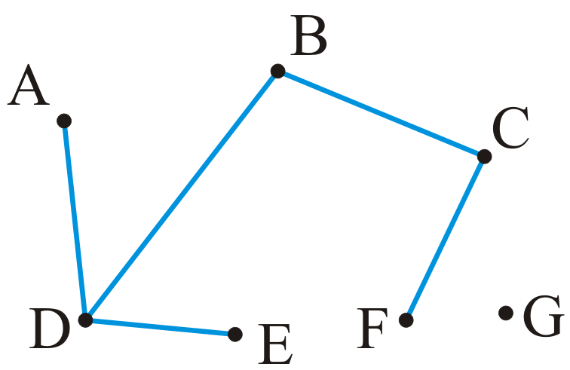

Sub-graphs
A sub-graph of a graph contains a subset of the vertices and a subset of the edges that connect the subset of the vertices in the original graph

Slide 11
Sub-graphs
A sub-graph of a graph contains a subset of the vertices and a subset of the edges that connect the subset of the vertices in the original graph

Slide 12
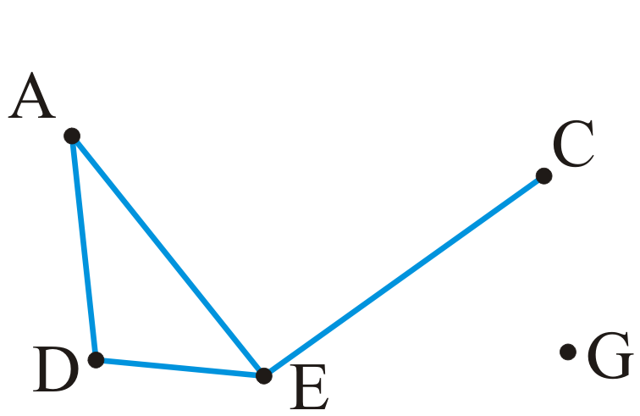
Vertex-induced sub-graphs
A vertex-induced sub-graph contains a subset of the vertices and all the edges in the original graph between those vertices
Notes:
顶点导出子图

Slide 13
Paths
A path in an undirected graph is an ordered sequence of vertices
(v₀, v₁, v₂, ..., v_{k})
where {v_{j – 1}, v_{j}} is an edge for j = 1, ..., k
Termed a path from v₀ to v_{k}
The length of this path is k

Slide 14
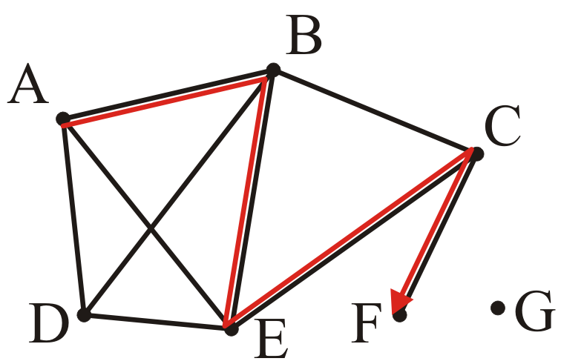
Paths
A path of length 4:
(A, B, E, C, F)

Slide 15
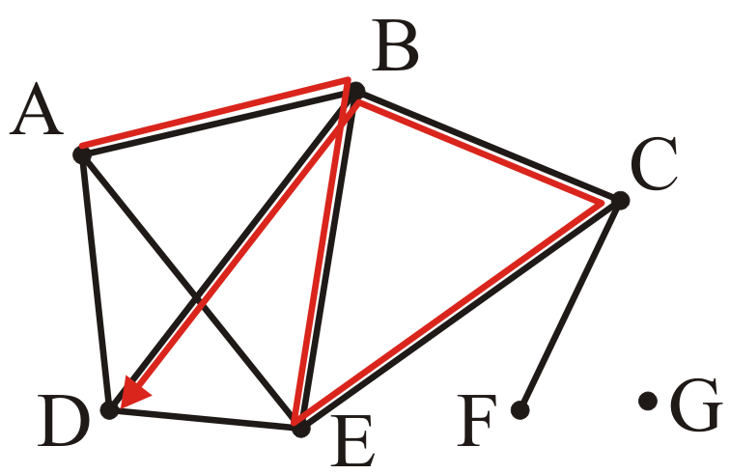
Paths
A path of length 5:
(A, B, E, C, B, D)

Slide 16
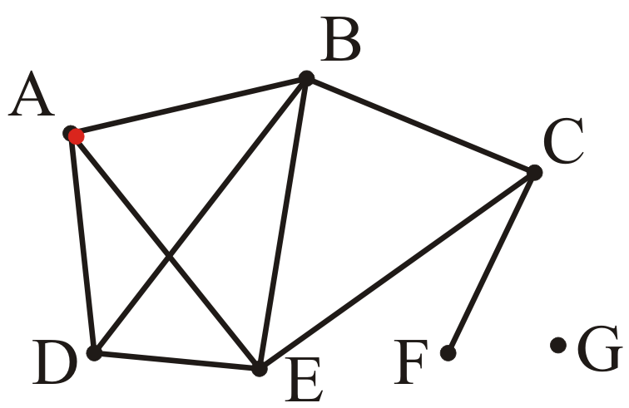
Paths
A trivial path of length 0:
(A)

Slide 17
Simple path
A simple path has no repetitions (other than perhaps the first and last vertices)
(A, B, E, C, F)
(A, B, E, C, B, D)

Slide 18
Simple cycle
A simple cycle is a simple path of at least two vertices with the first and last vertices equal
(A, B, D, A)

Slide 19
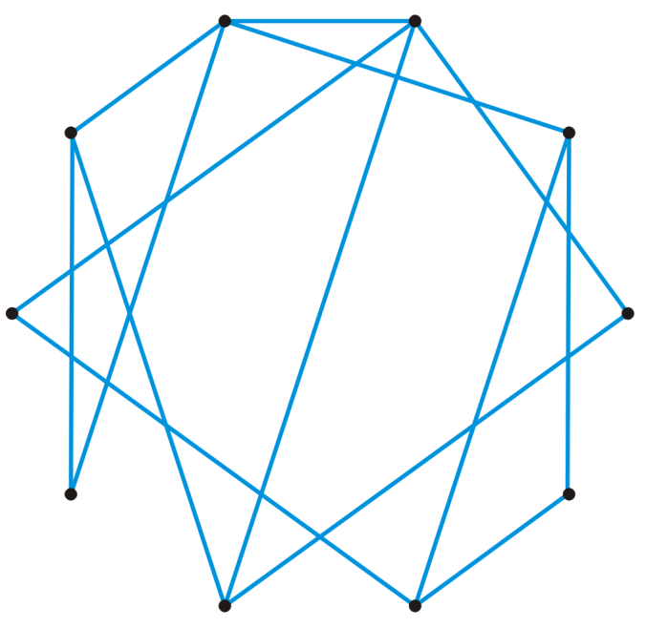
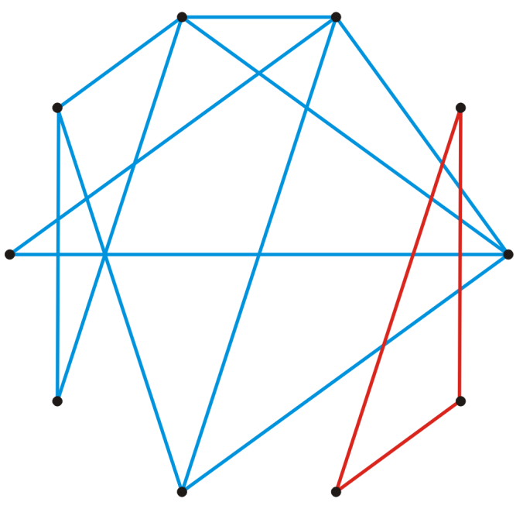
Connectedness
Two vertices v_{i}, v_{j} are said to be connected if there exists a path from v_{i} to v_{j}
A graph is connected if there exists a path between any two vertices
A connected graph
An unconnected graph

Slide 20
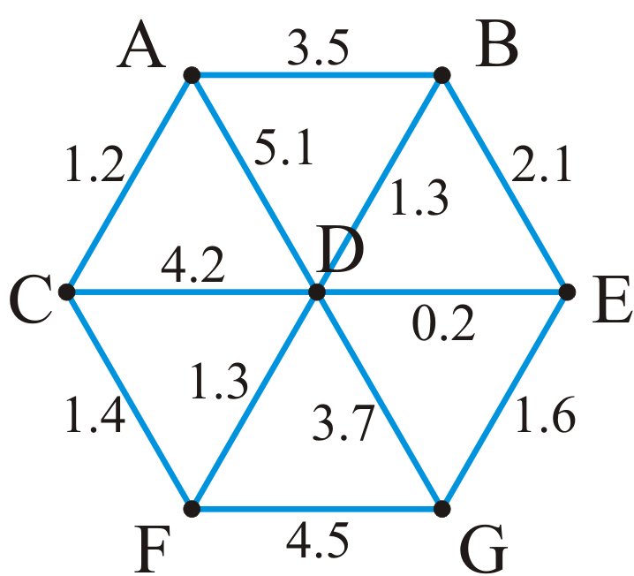
Weighted graphs
A weight may be associated with each edge in a graph
This could represent distance, energy consumption, cost, etc.
Such a graph is called a weighted graph
Notes:
Pictorially, we will represent weights by numbers next to the edges

Slide 21
Weighted graphs
The length of a path within a weighted graph is the sum of all of the edges which make up the path
The length of the path (A, D, G) in the following graph is 5.1 + 3.7 = 8.8

Slide 22
Weighted graphs
Different paths may have different weights
Another path is (A, C, F, G) with length 1.2 + 1.4 + 4.5 = 7.1

Slide 23
Weighted graphs
Problem: find the shortest path between two vertices
Here, the shortest path from A to G is (A, C, F, D, E, G) with length 5.7

Slide 24
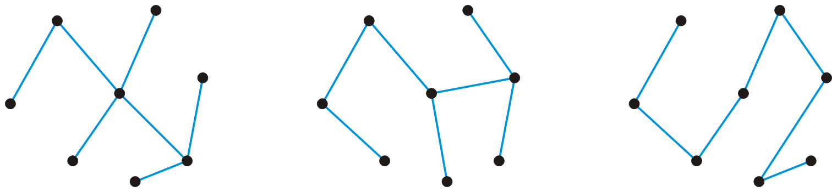
Trees
A graph is a tree if it is connected and there is a unique path between any two vertices
Example: three trees on the same eight vertices
Properties:
The number of edges is |E| = |V| – 1
The graph is acyclic, that is, it does not contain any cycles
Adding one more edge must create a cycle
Removing any one edge creates two unconnected sub-graphs

Slide 25
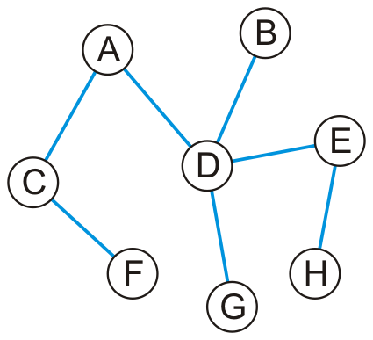
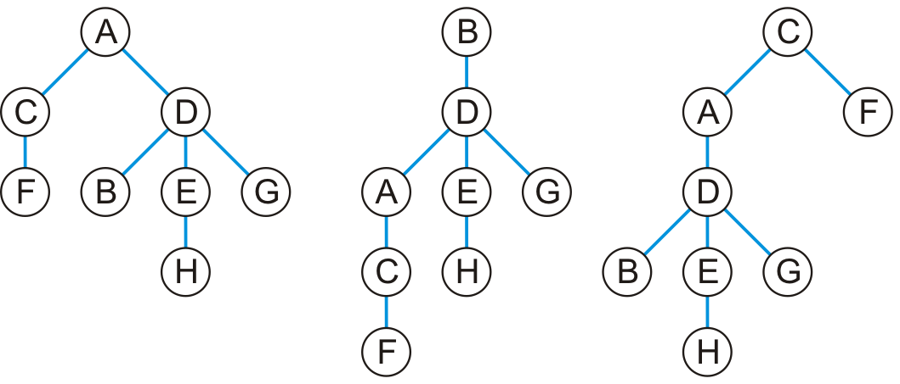
Trees
Any tree can be converted into a rooted tree by:
Choosing any vertex to be the root
Defining its neighboring vertices as its children
and then recursively defining:
All neighboring vertices other than that one designated its parent to be its children
Notes:
Given this tree, here are three rooted trees associated with it

Slide 26
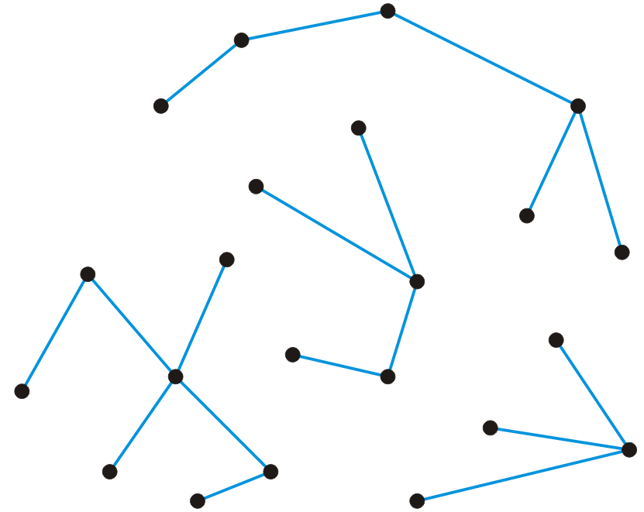
Forests
A forest is any graph that has no cycles
Consequences:
The number of edges is |E| < |V|
The number of trees is |V| – |E|
Removing any one edge adds one more tree to the forest
Here is a forest with 22 vertices and 18 edges
There are four trees

Slide 27
Outline
Definitions
Undirected graphs
Directed graph
Representation
Adjacency matrix
Adjacency list

Slide 28
Directed graphs
In a directed graph, the edges on a graph are be associated with a direction
Edges are ordered pairs (v_{j}, v_{k}) denoting a connection from v_{j} to v_{k}
The edge (v_{j}, v_{k}) is different from the edge (v_{k}, v_{j})
Streets are directed graphs:
In most cases, you can go two ways unless it is a one-way street

Slide 29
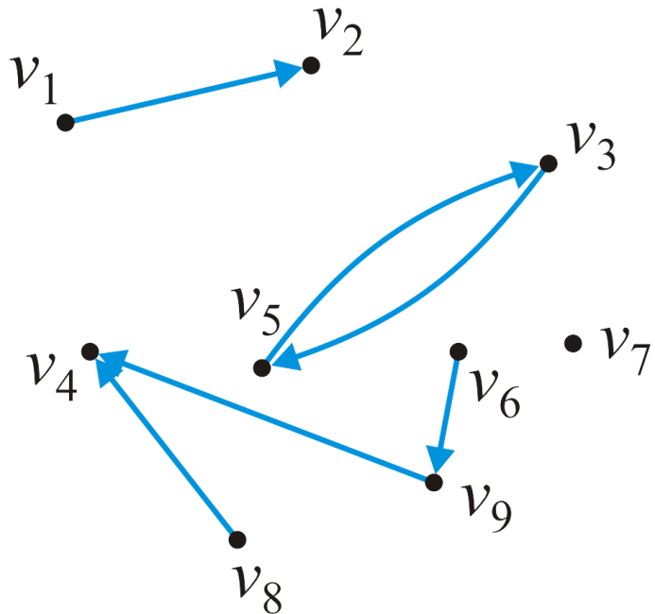
Directed graphs
Given a graph of nine vertices V = {v₁, v₂, …v₉}
These six pairs (v_{j} , v_{k}) are directed edges
E = {(v₁, v₂), (v₃, v₅), (v₅, v₃), (v₆, v₉), (v₈, v₄), (v₉, v₄)}

Slide 30
Directed graphs
The maximum number of directed edges in a directed graph is

Slide 31
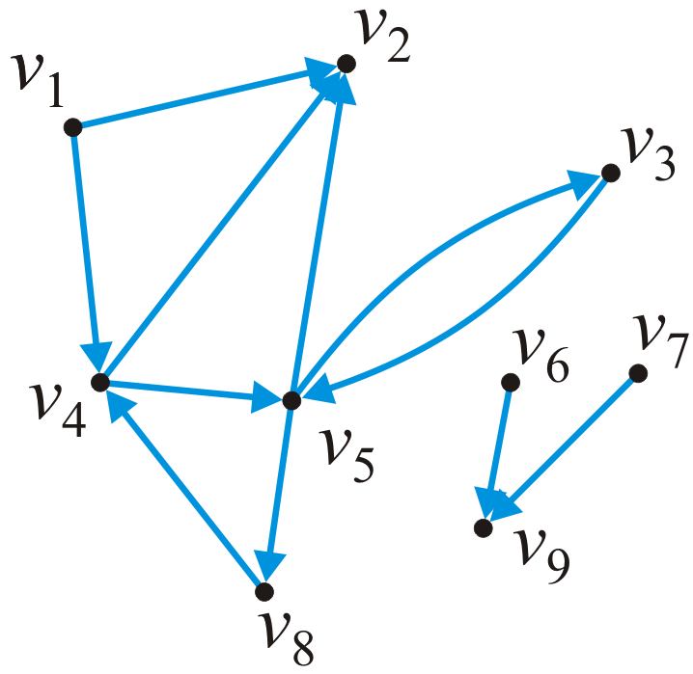
In and out degrees
The degree of a vertex in a directed graph:
The out-degree of a vertex is the number of outward edges from the vertex
The in-degree of a vertex is the number of inward edges to the vertex
In this graph:
in_degree(v₁) = 0 out_degree(v₁) = 2
in_degree(v₅) = 2 out_degree(v₅) = 3

Slide 32
Sources and sinks
Definitions:
Vertices with an in-degree of zero are described as sources
Vertices with an out-degree of zero are described as sinks
In this graph:
Sources: v₁, v₆, v₇
Sinks: v₂, v₉

Slide 33
Paths
A path in a directed graph is an ordered sequence of vertices
(v₀, v₁, v₂, ..., v_{k})
where (v_{j – 1}, v_{j}) is an edge for j = 1, ..., k
A path of length 5 in this graph is (v₁, v₄, v₅, v₃, v₅, v₂)
A simple cycle of length 3 is (v₈, v₄, v₅, v₈)

Slide 34
Connectedness
Two vertices v_{j}, v_{k} are said to be connected if there exists a path from v_{j} to v_{k}
A graph is strongly connected if there exists a directed path between any two vertices
A graph is weakly connected there exists a path between any two vertices that ignores the direction
In this graph:
The sub-graph {v₃, v₄, v₅, v₈} is strongly connected
The sub-graph {v₁, v₂, v₃, v₄, v₅, v₈} is weakly connected

Slide 35
Weighted directed graphs
In a weighted directed graphs, each edge is associated with a value
If both (v_{j}, v_{k}) and (v_{k}, v_{j}) are edges, it is not required that they have the same weight
6.4
7.5
7.3
6.8
6.7
5.9
4.1
3.2
4.7
5.4
4.5

Slide 36
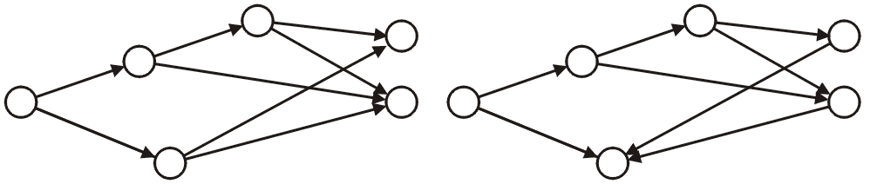
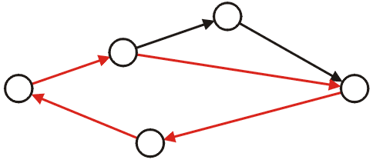
Directed acyclic graphs
A directed acyclic graph is a directed graph which has no cycle
These are commonly referred to as DAGs
They are graphical representations of partial orders on a finite number of elements
These two are DAGs:
This directed graph is not acyclic:

Slide 37
Directed acyclic graphs
Applications of directed acyclic graphs include:
The parse tree constructed by a compiler
A reference graph that can be garbage collected using simple reference counting
Dependency graphs such as those used in instruction scheduling and makefiles
Dependency graphs between classes formed by inheritance relationships in object-oriented programming languages
Information categorization systems, such as folders in a computer
Directed acyclic word graph data structure to memory-efficiently store a set of strings (words)
Reference: http://en.wikipedia.org/wiki/Directed_acyclic_graph

Slide 38
Representations
How do we store the adjacency relations?
Binary-relation list
Adjacency matrix
Adjacency list

Slide 39
Summary
In this topic, we have covered:
Basic graph definitions
Vertex, edge, degree, adjacency
Paths, simple paths, and cycles
Connectedness
Weighted graphs
Directed graphs
Directed acyclic graphs
We will continue by looking at a number of problems related to graphs

Slide 40
References
Wikipedia, http://en.wikipedia.org/wiki/Adjacency_matrix
http://en.wikipedia.org/wiki/Adjacency_list
[1] Donald E. Knuth, The Art of Computer Programming, Volume 1: Fundamental Algorithms, 3rd Ed., Addison Wesley, 1997, §2.2.1, p.238.
[2] Cormen, Leiserson, and Rivest, Introduction to Algorithms, McGraw Hill, 1990, §11.1, p.200.
[3] Weiss, Data Structures and Algorithm Analysis in C++, 3rd Ed., Addison Wesley, §3.6, p.94.
[4] David H. Laidlaw, Course Notes, http://cs.brown.edu/courses/cs016/lectures/13%20Graphs.pdf
These slides are provided for the ECE 250 Algorithms and Data Structures course. The material in it reflects Douglas W. Harder’s best judgment in light of the information available to him at the time of preparation. Any reliance on these course slides by any party for any other purpose are the responsibility of such parties. Douglas W. Harder accepts no responsibility for damages, if any, suffered by any party as a result of decisions made or actions based on these course slides for any other purpose than that for which it was intended.

Slide 41
Outline
Definitions
Undirected graphs
Directed graph
Representation
Adjacency matrix
Adjacency list

Slide 42
The Graph ADT
The Graph ADT describes a container storing an adjacency relation
Queries include:
The number of vertices
The number of edges
List the vertices adjacent to a given vertex
Are two vertices adjacent?
Are two vertices connected?
Modifications include:
Inserting or removing an edge
Inserting or removing a vertex (and all edges containing that vertex)
The run-time of these operations will depend on the representation

Slide 43
Binary-relation list
The most inefficient is a relation list:
A container storing the edges
{(1, 2), (1, 4), (3, 5), (4, 2), (4, 5), (5, 2), (5, 3), (5, 8), (6, 9), (7, 9), (8, 4)}
Requires Θ(|E|) memory
Determining if v_{j} is adjacent to v_{k} is O(|E|)
Finding all neighbors of v_{j} is Θ(|E|)

Slide 44
Adjacency matrix
Requiring more memory but also faster, an adjacency matrix
The matrix entry (j, k) is set to true if there is an edge (v_{j}, v_{k})
Requires Θ(|V|²) memory
Determining if v_{j} is adjacent to v_{k} is O(1)
Finding all neighbors of v_{j} is Θ(|V|)
 | 1 | 2 | 3 | 4 | 5 | 6 | 7 | 8 | 9
1 |  | T |  | T
2
3 |  |  |  |  | T
4 |  | T |  |  | T
5 |  | T | T |  |  |  |  | T
6 |  |  |  |  |  |  |  |  | T
7 |  |  |  |  |  |  |  |  | T
8 |  |  |  | T
9

Slide 45
Adjacency list
Most efficient for algorithms is an adjacency list
Each vertex is associated with a list of its neighbors
Requires Θ(|V| + |E|) memory
On average:
Determining if v_{j} is adjacent to v_{k} is
Finding all neighbors of v_{j} is
1 • → 2 → 4
2 •
3 • → 5
4 • → 2 → 5
5 • → 2 → 3 → 8
6 • → 9
7 • → 9
8 • → 4
9 •

Slide 46
Outline
In this topic, we will cover the representation of graphs on a computer
We will examine:
an adjacency matrix representation
smaller representations and pointer arithmetic
sparse matrices and linked lists

Slide 47
Adjacency Matrix
A graph of n vertices may have up to
edges
The first straight-forward implementation is an adjacency matrix

Slide 48
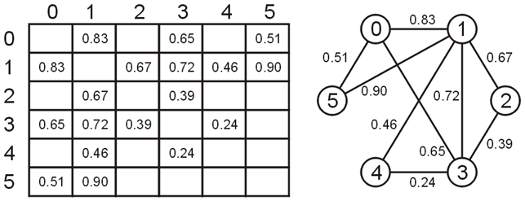
Adjacency Matrix
Define an n × n matrix A = (a_{ij}) and if the vertices v_{i} and v_{j} are connected with weight w, then set a_{ij} = w and a_{ji} = w
That is, the matrix is symmetric, e.g.,

Slide 49
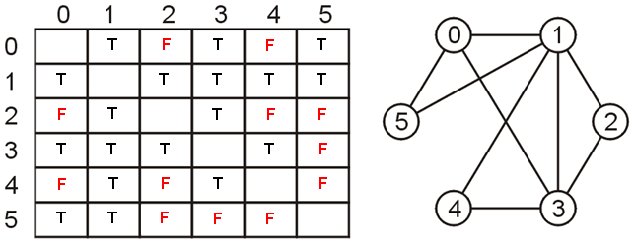
Adjacency Matrix
An unweighted graph may be saved as an array of Boolean values
vertices v_{i} and v_{j} are connected then set a_{ij} = a_{ji} = true

Slide 50
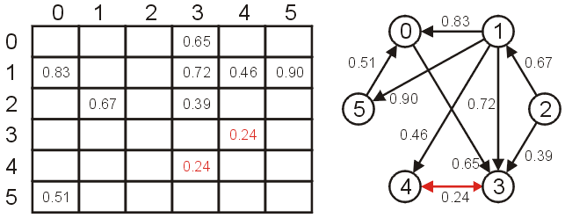
Adjacency Matrix
If the graph was directed, then the matrix would not necessarily be symmetric

Slide 51
Adjacency Matrix
First we must allocate memory for a two-dimensional array
C++ does not have native support for anything more than one-dimensional arrays, thus how do we store a two-dimensional array?
as an array of arrays

Slide 52
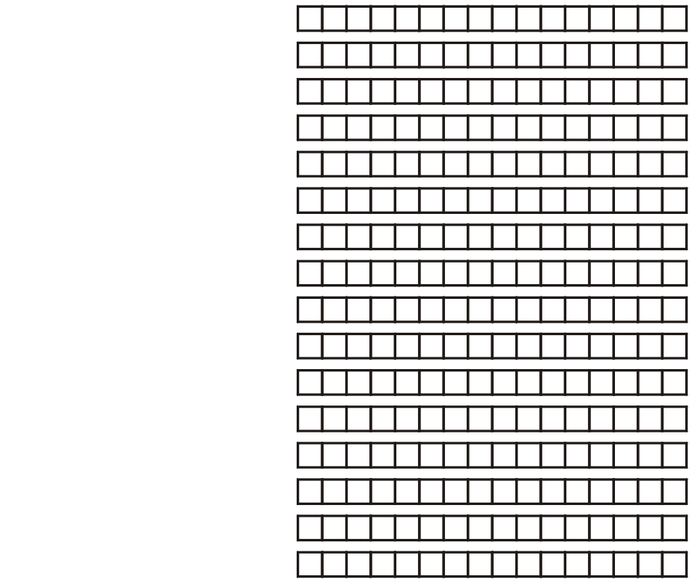
Adjacency Matrix
Suppose we require a 16 × 16 matrix of double-precision floating-point numbers
Each row of the matrix can be represented by an array
The address of the first entry must be stored in a pointer to a double:
double *

Slide 53
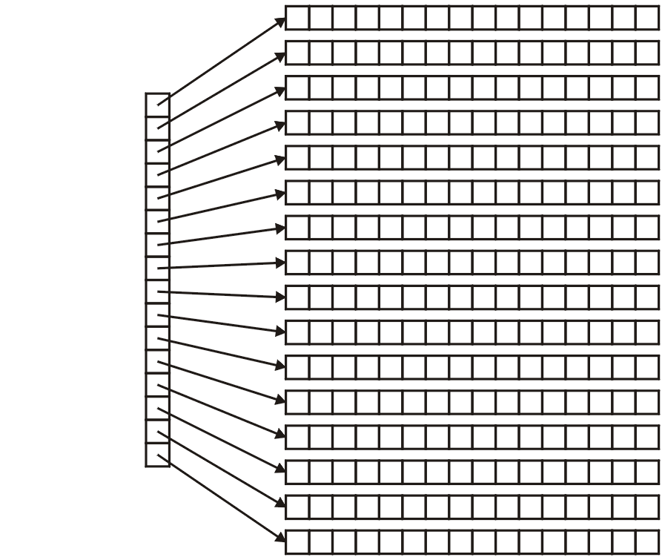
Adjacency Matrix
However, because we must store 16 of these pointers-to-doubles, it makes sense that we store these in an array
What is the declaration of this array?
Well, we must store a pointer to a pointer to a double
That is: double **

Slide 54
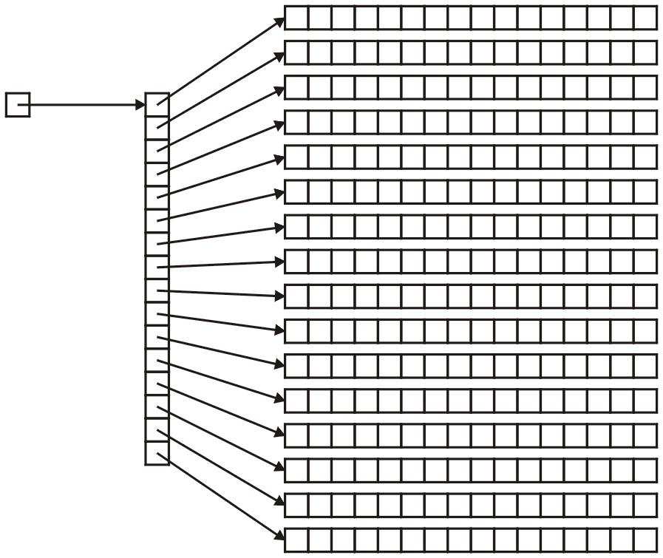
Adjacency Matrix
Thus, the address of the first array must be declared to be:
double **matrix;

Slide 55
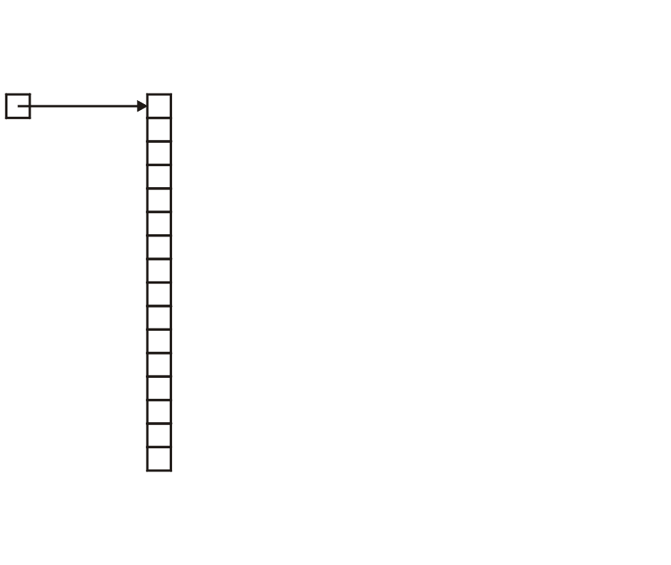
Adjacency Matrix
The next question is memory allocation
First, we must allocate the memory for the array of pointers to doubles:
matrix = new double * [16];

Slide 56
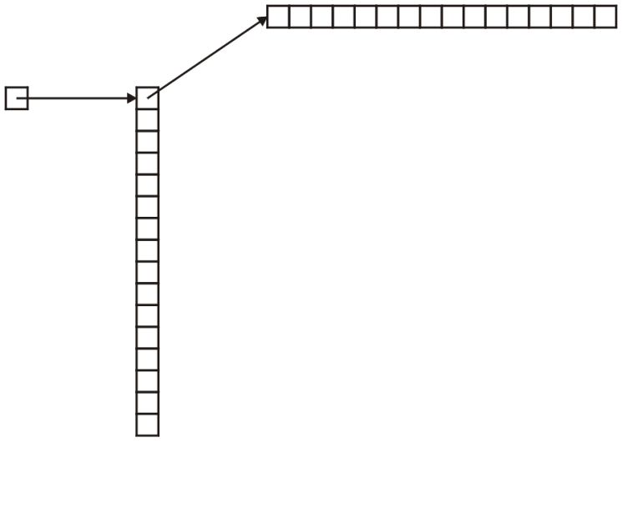
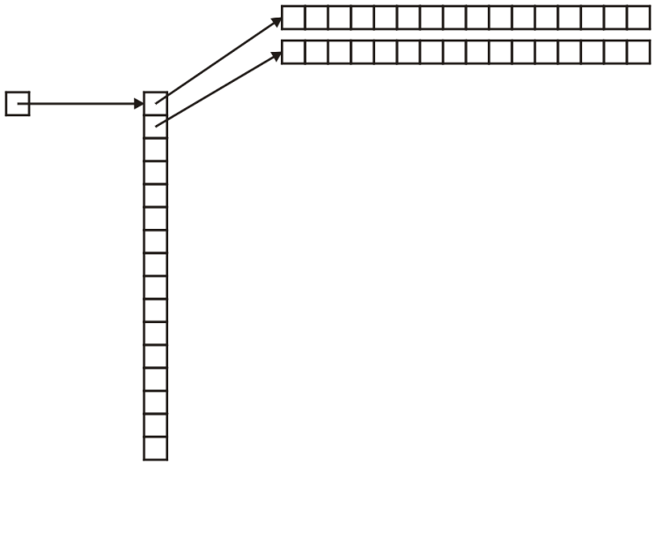
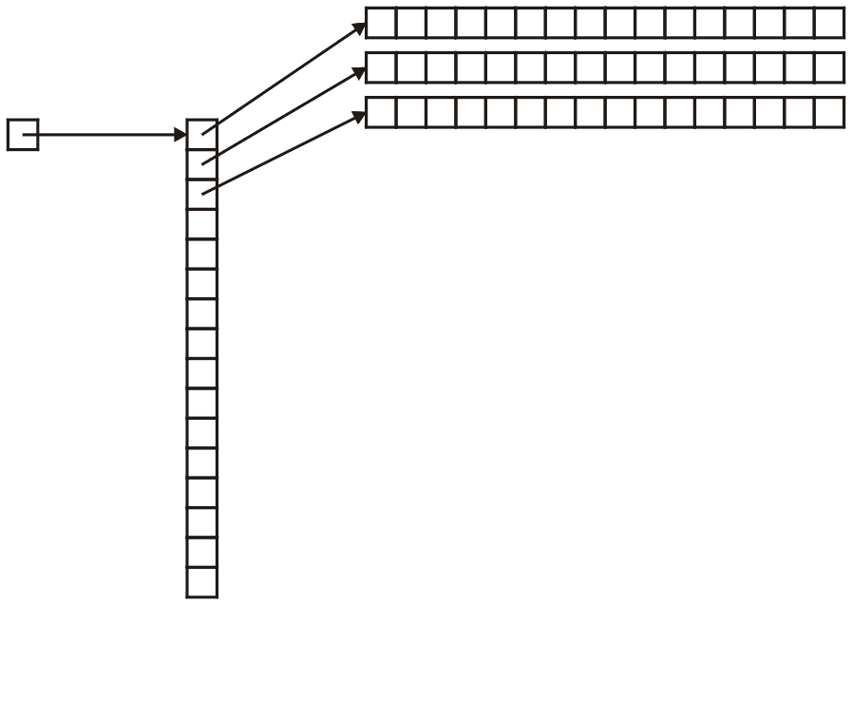
Adjacency Matrix
Next, to each entry of this matrix, we must assign the memory allocated for an array of doubles
for ( int i = 0; i < 16; ++i ) {
matrix[i] = new double[16];
}

Slide 57
Adjacency Matrix
Accessing a matrix is done through a double index, e.g., matrix[3][4]
You can interpret this as (matrix[3])[4]

Slide 58
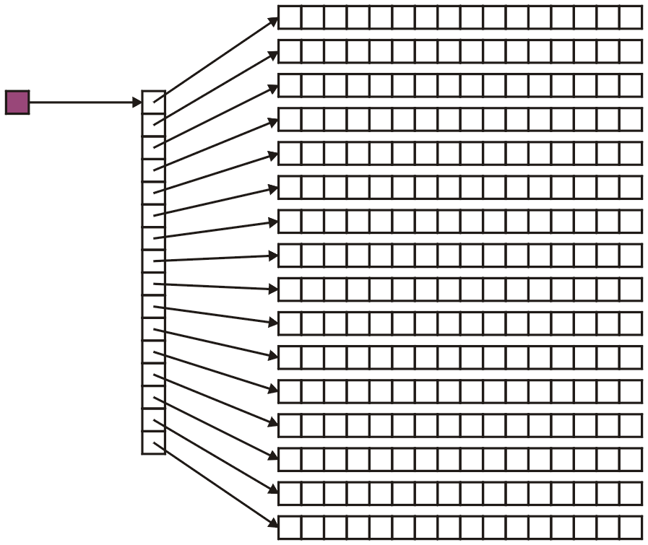
Adjacency Matrix
Recall that in matrix[3][4], the variable matrix is a pointer-to-a-pointer-to-a-double:

Slide 59
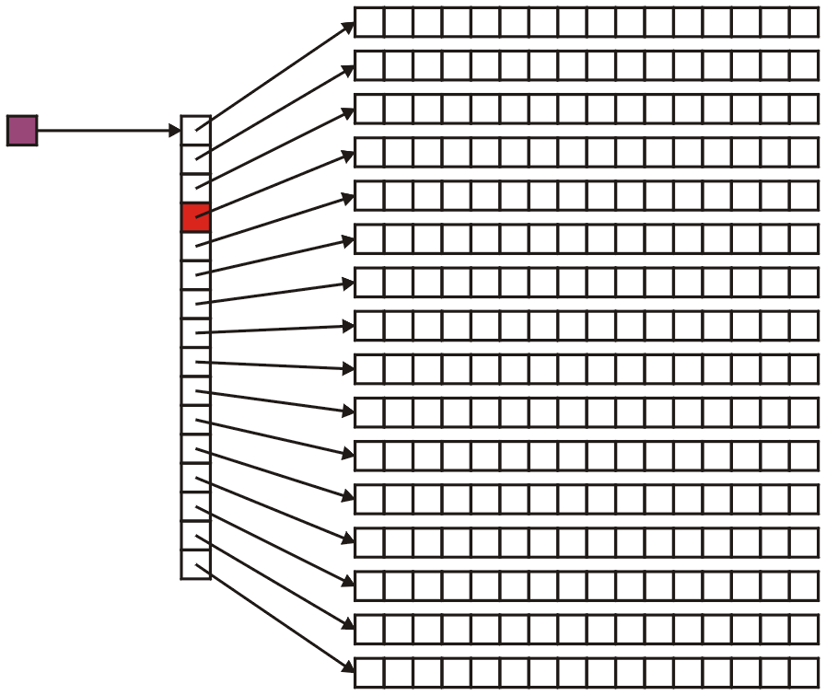
Adjacency Matrix
Therefore, matrix[3] is a pointer-to-a-double:

Slide 60
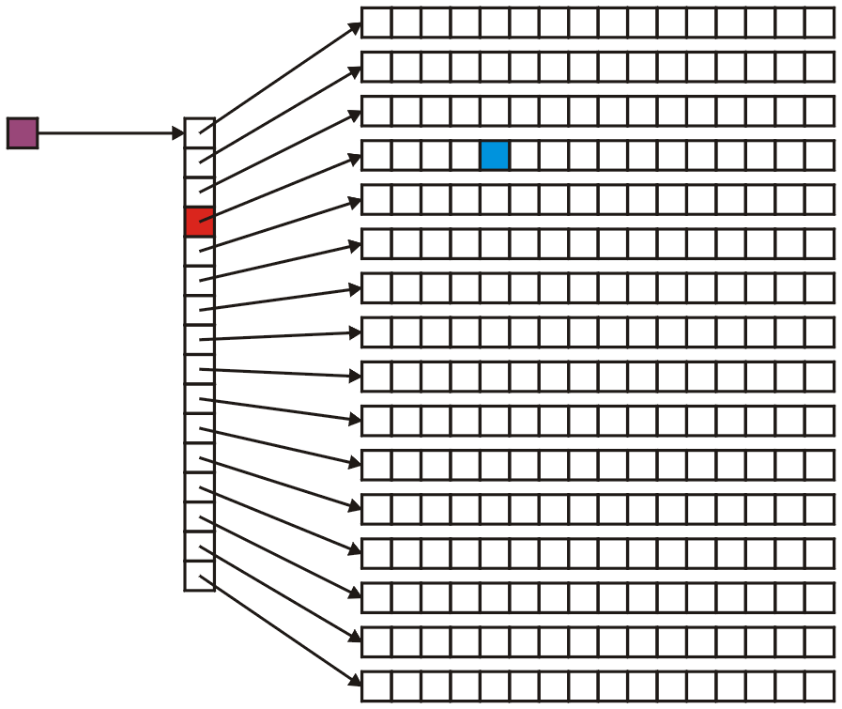
Adjacency Matrix
And consequently, matrix[3][4] is a double:

Slide 61
C++ Notation Warning
Do not use matrix[3, 4] because:
in C++, the comma operator evaluates the operands in order from left-to-right
the value is the last one
Therefore, matrix[3, 4] is equivalent to calling matrix[4]
Try it:
int i = (3, 4);
cout << i << endl;

Slide 62
C++ Notation Warning
Many things will compile if you try to use this notation:
matrix = new double[N, N];
will allocate an array of N doubles, just like:
matrix = new double[N];
However, this is likely not to do what you really expect...

Slide 63
Adjacency Matrix
Recall that for each call to new[],you must have a corresponding call to delete[]
Therefore, we must use a for-loop to delete the arrays
implementation up to you

Slide 64
Default Values
Question: what do we do about vertices which are not connected?
the value 0
a negative number, e.g., –1
positive infinity: ∞
The last is the most logical, in that it makes sense that two vertices which are not connected have an infinite distance between them
The distance from a node to itself is 0

Slide 65
Default Values
To use infinity, you may declare a constant static member variable INF:
#include <limits>
class Weighted_graph {
private:
static const double INF;
// ...
// ...
};
const double Weighted_graph::INF =
std::numeric_limits<double>::infinity();

Slide 66
Default Values
As defined in the IEEE 754 standard, the representation of the double-precision floating-point infinity eight bytes:
0x 7F F0 00 00 00 00 00 00
Incidentally, negative infinity is stored as:
0x FF F0 00 00 00 00 00 00

Slide 67
Default Values
In this case, you can initialize your array as follows:
for ( int i = 0; i < N; ++i ) {
for ( int j = 0; j < N; ++j ) {
matrix[i][j] = INF;
}
matrix[i][i] = 0;
}
It makes intuitive sense that the distance from a node to itself is 0

Slide 68
Default Values
If we are representing an unweighted graph, use Boolean values:
for ( int i = 0; i < N; ++i ) {
for ( int j = 0; j < N; ++j ) {
matrix[i][j] = false;
}
matrix[i][i] = true;
}
It makes intuitive sense that a vertex is connected to itself

Slide 69
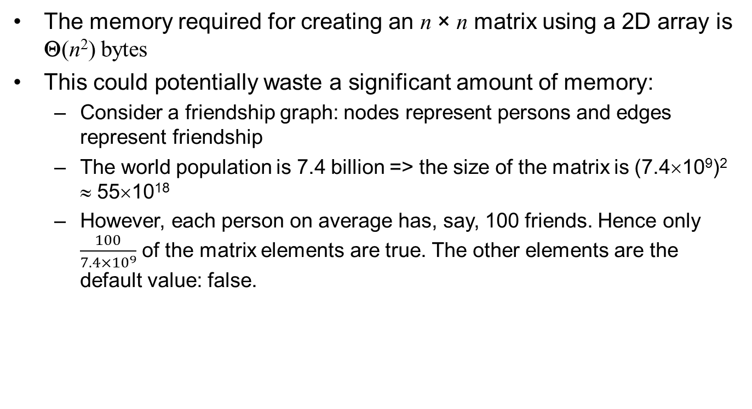
Sparse Matrices
The memory required for creating an n × n matrix using a 2D array is Θ(n²) bytes
This could potentially waste a significant amount of memory:
Consider a friendship graph: nodes represent persons and edges represent friendship
The world population is 7.4 billion => the size of the matrix is (7.4×10⁹)² ≈ 55×10¹⁸
However, each person on average has, say, 100 friends. Hence only $\frac{100}{7.4×{10}^{9}}$ of the matrix elements are true. The other elements are the default value: false.

Slide 70
Sparse Matrices
Matrices where less than 5% of the entries are not the default value (either infinity or 0, or perhaps some other default value) are said to be sparse
Matrices where most entries (25% or more) are not the default value are said to be dense
Clearly, these are not hard limits

Slide 71
Adjacency list
For an undirected graph, use an array of linked lists to store edges
Each vertex has a linked list that stores all the edges connected to the vertex
Each node in a linked list must store two items of information: the connecting vertex and the weight

Slide 72
Adjacency list
We may create a new class which stores a vertex-edge pair
class Pair {
private:
double edge_weight;
int adacent_vertex;
public:
Pair( int, double );
double weight() const;
int vertex() const;
};
Now create an array of linked-lists storing these pairs

Slide 73
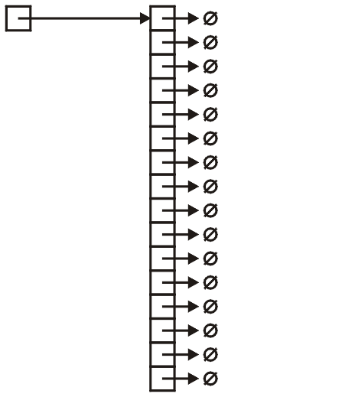
Adjacency list
Thus, we define and create the array:
SingleList<Pair> * array;
array = new SingleList<Pair>[16];

Slide 74
Adjacency list
To reduce redundancy, we would only insert the pair into the linked list corresponding to the larger vertex
void insert( int i, int j, double w ) {
if ( i < j ) {
array[j].push_front( Pair(i, w) );
} else {
array[i].push_front( Pair(j, w) );
}
}

Slide 75
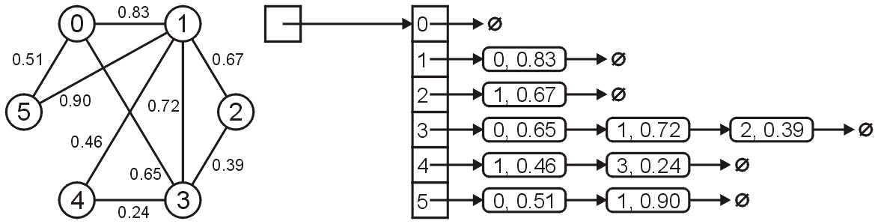
Adjacency list
For example, the graph shown below would be stored as

Slide 76
Adjacency list
2
a
b
a
b,2
d,1
c,3
3
1
2
b
a,2
c,2
c
d
c
d,5
a,3
b,2
5
d
a,1
c,5

Slide 77
Adjacency list
To store a directed graph
Each vertex has a linked list that stores all the edges originated from the vertex
Each node in a linked list stores two items of information: the vertex that the edge connects to, the weight

Slide 78
Adjacency list
2
a
b
a
b,2
d,1
c,3
3
1
2
b
c,2
c
d
c
d,5
5
d

Slide 79
Summary
In this laboratory, we have looked at a number of graph representations
C++ lacks a matrix data structure
must use array of arrays
The possible factors affecting your choice of data structure are:
weighted or unweighted graphs
directed or undirected graphs
dense or sparse graphs

Slide 80
References
Wikipedia, http://en.wikipedia.org/wiki/Adjacency_matrix
http://en.wikipedia.org/wiki/Adjacency_list
These slides are provided for the ECE 250 Algorithms and Data Structures course. The material in it reflects Douglas W. Harder’s best judgment in light of the information available to him at the time of preparation. Any reliance on these course slides by any party for any other purpose are the responsibility of such parties. Douglas W. Harder accepts no responsibility for damages, if any, suffered by any party as a result of decisions made or actions based on these course slides for any other purpose than that for which it was intended.

Slide 81
Summary
Definitions
Undirected graphs
Directed graph
Representation
Adjacency matrix
Adjacency list

