Slide 1

CS101 Algorithms and Data Structures
Shortest Path-Dijkstra’s & Bellman-Ford
Textbook Ch 24, 25
Notes:
Adapted from the slides by Douglas Wilhelm Harder of U Waterloo (https://ece.uwaterloo.ca/~dwharder/aads/Lecture_materials/)
May also contain material from the slides at https://courses.cs.washington.edu/courses/cse326/03wi/326lecturesb.shtml (by Dan Suciu of U Washington)

Slide 2
Outline
Definition and applications
Dijkstra’s algorithm
Bellman-Ford algorithm

Slide 3
Shortest Path
Given a weighted directed graph, one common problem is finding the shortest path between two given vertices
Recall that in a weighted graph, the length of a path is the sum of the weights of each of the edges in that path

Slide 4
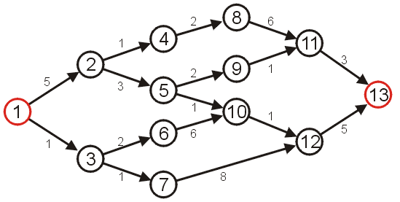
Shortest Path
Given the graph, suppose we wish to find the shortest path from vertex 1 to vertex 13

Slide 5
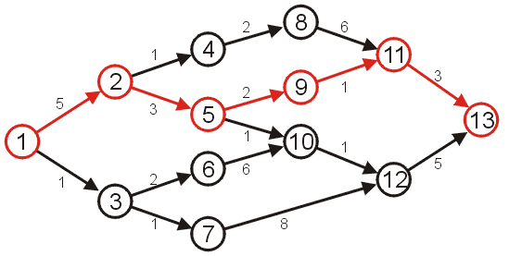
Shortest Path
After some consideration, we may determine that the shortest path is as follows, with length 14
Other paths exists, but they are longer

Slide 6
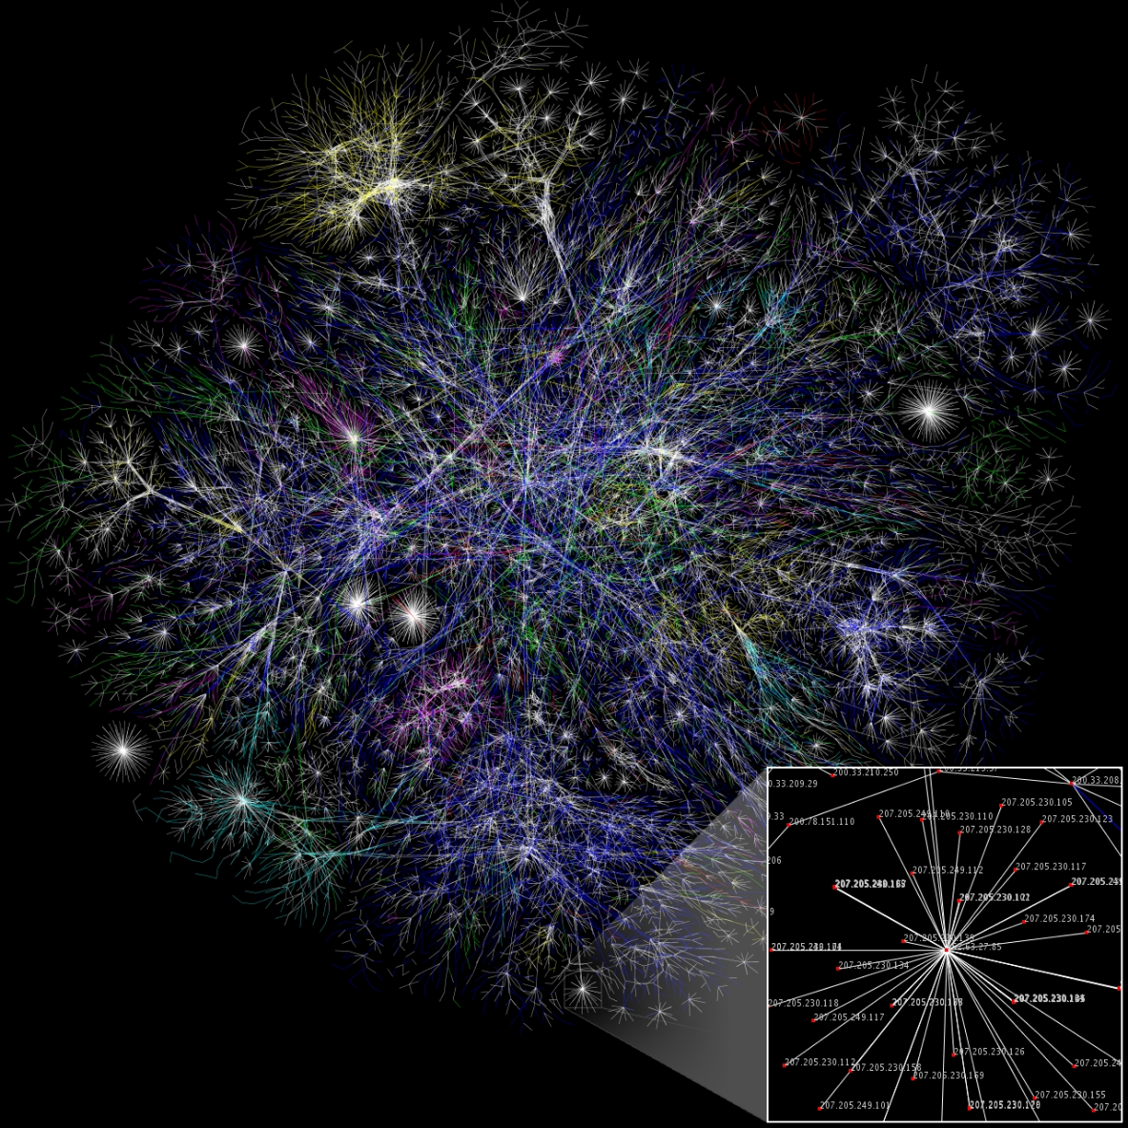
Applications
The Internet is a collection of interconnected devices
Routers, individual computers
These may be represented as graphs

Slide 7
Applications
Information is passed through packets.
Packets are passed from the source, through routers, to their destination.
We would like to pass packets through the shortest path.
Metrics for measuring the shortest path may include:
low latency (minimize time), or
minimum hop count (all edges have weight 1)

Slide 8
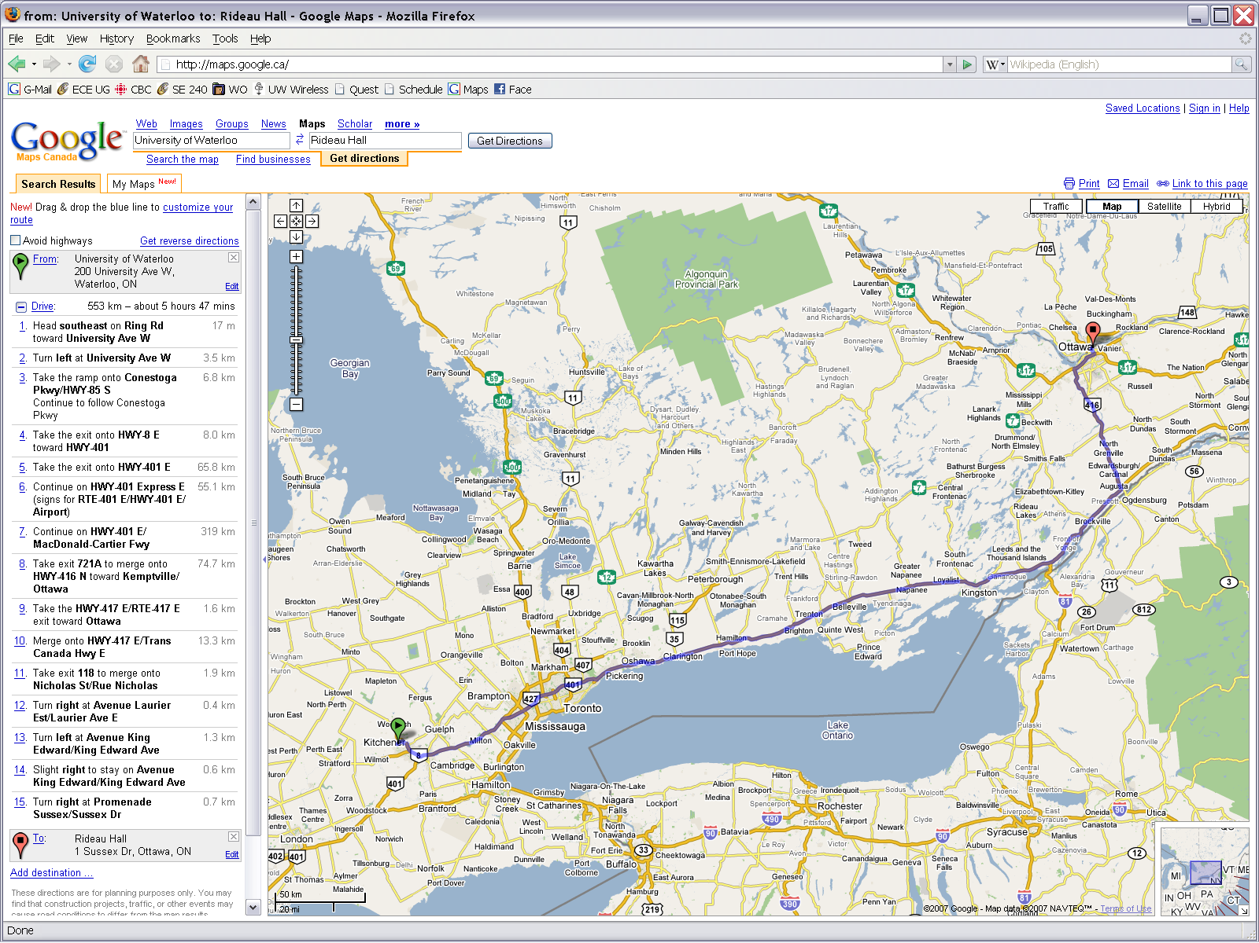
Applications
Another obvious application is finding the shortest route between two points on a map
The shortest path using distance as a metric is obvious, however, a driver may be more interested in minimizing time
Notes:
http://maps.google.com/

Slide 9
Applications
A company will be interested in minimizing the cost which includes the following factors:
salary of the truck driver (overtime?)
possible tolls and administrative costs
bonuses for being early
penalties for being late
cost of fuel

Slide 10
Applications
Very quickly, the definition of the shortest path becomes time-dependant:
rush hour
long weekends
and situation dependant:
scheduled events (e.g., road construction)
unscheduled events (e.g., accidents)

Slide 11
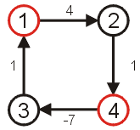
Shortest Path
The goal is to find the shortest path and its length
We will make the assumption that the weights on all edges is a positive number
Why this assumption?
If we have negative weights, it may be possible to end up in a cycle whereby each pass through the cycle decreases the total length
Thus, a shortest length would be undefined for such a graph
Consider the shortest path from vertex 1 to 4...

Slide 12
Algorithms
Algorithms for finding the shortest path include:
Dijkstra’s algorithm
A* search algorithm
Bellman-Ford algorithm
Floyd-Warshall algorithm

Slide 13
Outline
Definition and applications
Dijkstra’s algorithm
Bellman-Ford algorithm

Slide 14
Dijkstra’s algorithm
Dijkstra’s algorithm solves the single-source shortest path problem
It is very similar to Prim’s algorithm
Assumption: all the weights are positive

Slide 15
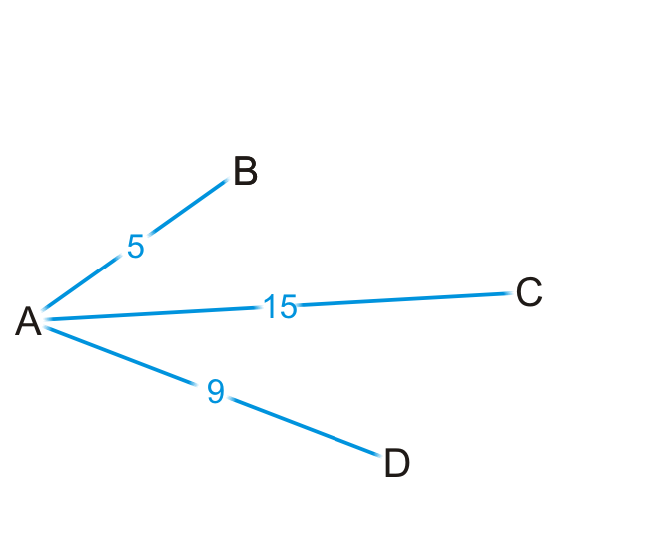
Strategy
Suppose you are at vertex A
You are aware of all vertices adjacent to it
This information is either in an adjacency list or adjacency matrix

Slide 16
Strategy
Is 5 the shortest distance to B via the edge (A, B)?
Why or why not?

Slide 17
Strategy
Are you guaranteed that the shortest path to C is (A, C), or that (A, D) is the shortest path to vertex D?

Slide 18
Strategy
We accept that (A, B) is the shortest path to vertex B from A
Let’s see where we can go from B

Slide 19
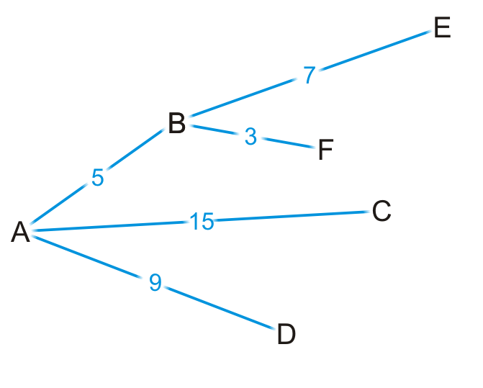
Strategy
By some simple arithmetic, we can determine that
There is a path (A, B, E) of length 5 + 7 = 12
There is a path (A, B, F) of length 5 + 3 = 8

Slide 20
Strategy
Is (A, B, F) is the shortest path from vertex A to F?
Why or why not?

Slide 21
Strategy
Are we guaranteed that any other path we are currently aware of is also going to be the shortest path?

Slide 22
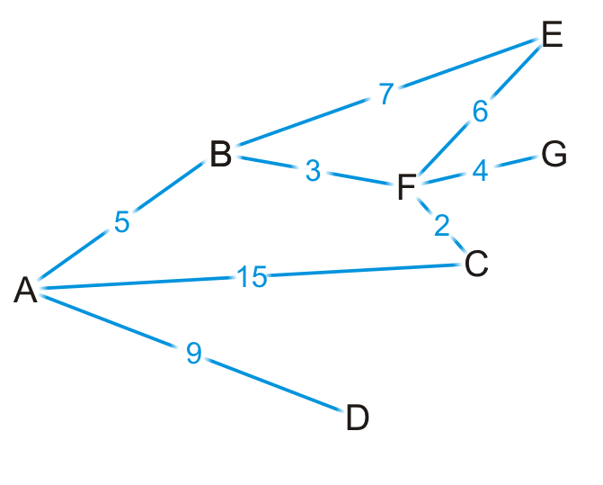
Strategy
Okay, let’s visit vertex F
We know the shortest path is (A, B, F) and it’s of length 8

Slide 23
Strategy
There are three edges exiting vertex F, so we have paths:
(A, B, F, E) of length 8 + 6 = 14
(A, B, F, G) of length 8 + 4 = 12
(A, B, F, C) of length 8 + 2 = 10

Slide 24
Strategy
By observation:
The path (A, B, F, E) is longer than (A, B, E)
The path (A, B, F, C) is shorter than the path (A, C)

Slide 25
Strategy
At this point, we’ve discovered the shortest paths to:
Vertex B: (A, B) of length 5
Vertex F: (A, B, F) of length 8

Slide 26
Strategy
Which remaining vertex are we currently guaranteed to have the shortest distance to?

Slide 27
Strategy
In general
We know the shortest distance to some of the vertices (marked as visited)
We also know the shortest distance to each unvisited vertex through visited vertices (call this the “known distance”)
startNode
Visited

Slide 28
Strategy
Consider the unvisited vertex v that has the shortest known distance
We are guaranteed that the known distance to v is the shortest distance from the start node to it
Proof by contradiction
v
startNode
Visited

Slide 29
Dijkstra’s algorithm
We need to track the known shortest distance to each vertex
We require an array of distances, all initialized to infinity except for the source vertex, which is initialized to 0
Do we need to track the shortest path to each vertex?
Ex: do I have to store (A, B, F) as the shortest path to vertex F?
No. We only have to record that the shortest path to vertex F came from vertex B
The shortest path to F is the shortest path to B followed by the edge (B, F)
Thus, we need an array of previous vertices, all initialized to null
We need to track visited vertices whose shortest paths have been found
a Boolean table of size |V|

Slide 30
Dijkstra’s algorithm
We will iterate |V| times:
Find the unvisited vertex v that has a minimum distance to it
Mark it as visited
Consider its every adjacent vertex w that is unvisited:
Is the distance to v plus the weight of the edge (v, w) less than our currently known shortest distance to w ?
If so, update the shortest distance to w and record v as the previous pointer
Continue iterating until all vertices are visited or all remaining vertices have a distance of infinity

Slide 31
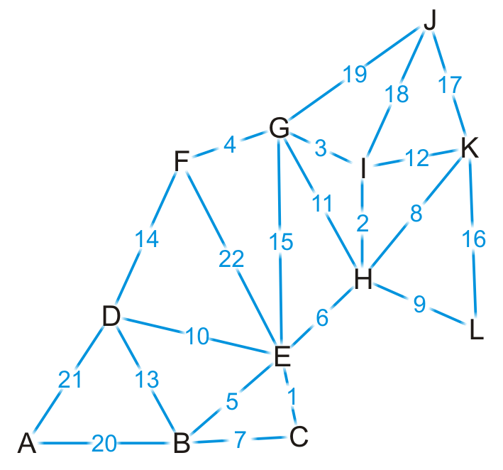
Example
Find the shortest distance from K to every other vertex (BFS?)

Slide 32
Example
We set up our table
Which unvisited vertex has the minimum distance to it?
Vertex | Visited | Distance | Previous
A | F | ∞ | Ø
B | F | ∞ | Ø
C | F | ∞ | Ø
D | F | ∞ | Ø
E | F | ∞ | Ø
F | F | ∞ | Ø
G | F | ∞ | Ø
H | F | ∞ | Ø
I | F | ∞ | Ø
J | F | ∞ | Ø
K | F | 0 | Ø
L | F | ∞ | Ø

Slide 33
Example
We visit vertex K
Vertex | Visited | Distance | Previous
A | F | ∞ | Ø
B | F | ∞ | Ø
C | F | ∞ | Ø
D | F | ∞ | Ø
E | F | ∞ | Ø
F | F | ∞ | Ø
G | F | ∞ | Ø
H | F | ∞ | Ø
I | F | ∞ | Ø
J | F | ∞ | Ø
K | T | 0 | Ø
L | F | ∞ | Ø

Slide 34
Example
Vertex K has four neighbors: H, I, J and L
Vertex | Visited | Distance | Previous
A | F | ∞ | Ø
B | F | ∞ | Ø
C | F | ∞ | Ø
D | F | ∞ | Ø
E | F | ∞ | Ø
F | F | ∞ | Ø
G | F | ∞ | Ø
H | F | ∞ | Ø
I | F | ∞ | Ø
J | F | ∞ | Ø
K | T | 0 | Ø
L | F | ∞ | Ø

Slide 35
Example
We have now found at least one path to each of these vertices
Vertex | Visited | Distance | Previous
A | F | ∞ | Ø
B | F | ∞ | Ø
C | F | ∞ | Ø
D | F | ∞ | Ø
E | F | ∞ | Ø
F | F | ∞ | Ø
G | F | ∞ | Ø
H | F | 8 | K
I | F | 12 | K
J | F | 17 | K
K | T | 0 | Ø
L | F | 16 | K

Slide 36
Example
We’re finished with vertex K
To which vertex are we now guaranteed we have the shortest path?
Vertex | Visited | Distance | Previous
A | F | ∞ | Ø
B | F | ∞ | Ø
C | F | ∞ | Ø
D | F | ∞ | Ø
E | F | ∞ | Ø
F | F | ∞ | Ø
G | F | ∞ | Ø
H | F | 8 | K
I | F | 12 | K
J | F | 17 | K
K | T | 0 | Ø
L | F | 16 | K

Slide 37
Example
We visit vertex H: the shortest path is (K, H) of length 8
Vertex H has four unvisited neighbors: E, G, I, L
Vertex | Visited | Distance | Previous
A | F | ∞ | Ø
B | F | ∞ | Ø
C | F | ∞ | Ø
D | F | ∞ | Ø
E | F | ∞ | Ø
F | F | ∞ | Ø
G | F | ∞ | Ø
H | T | 8 | K
I | F | 12 | K
J | F | 17 | K
K | T | 0 | Ø
L | F | 16 | K

Slide 38
Example
Consider these paths:
(K, H, E) of length 8 + 6 = 14 (K, H, G) of length 8 + 11 = 19
(K, H, I) of length 8 + 2 = 10 (K, H, L) of length 8 + 9 = 17
Which of these are shorter than any known path?
Vertex | Visited | Distance | Previous
A | F | ∞ | Ø
B | F | ∞ | Ø
C | F | ∞ | Ø
D | F | ∞ | Ø
E | F | ∞ | Ø
F | F | ∞ | Ø
G | F | ∞ | Ø
H | T | 8 | K
I | F | 12 | K
J | F | 17 | K
K | T | 0 | Ø
L | F | 16 | K

Slide 39
Example
We already have a shorter path (K, L), but we update the other three
Vertex | Visited | Distance | Previous
A | F | ∞ | Ø
B | F | ∞ | Ø
C | F | ∞ | Ø
D | F | ∞ | Ø
E | F | 14 | H
F | F | ∞ | Ø
G | F | 19 | H
H | T | 8 | K
I | F | 10 | H
J | F | 17 | K
K | T | 0 | Ø
L | F | 16 | K

Slide 40
Example
We are finished with vertex H
Which vertex do we visit next?
Vertex | Visited | Distance | Previous
A | F | ∞ | Ø
B | F | ∞ | Ø
C | F | ∞ | Ø
D | F | ∞ | Ø
E | F | 14 | H
F | F | ∞ | Ø
G | F | 19 | H
H | T | 8 | K
I | F | 10 | H
J | F | 17 | K
K | T | 0 | Ø
L | F | 16 | K

Slide 41
Example
The path (K, H, I) is the shortest path from K to I of length 10
Vertex I has two unvisited neighbors: G and J
Vertex | Visited | Distance | Previous
A | F | ∞ | Ø
B | F | ∞ | Ø
C | F | ∞ | Ø
D | F | ∞ | Ø
E | F | 14 | H
F | F | ∞ | Ø
G | F | 19 | H
H | T | 8 | K
I | T | 10 | H
J | F | 17 | K
K | T | 0 | Ø
L | F | 16 | K

Slide 42
Example
Consider these paths:
(K, H, I, G) of length 10 + 3 = 13 (K, H, I, J) of length 10 + 18 = 28
Vertex | Visited | Distance | Previous
A | F | ∞ | Ø
B | F | ∞ | Ø
C | F | ∞ | Ø
D | F | ∞ | Ø
E | F | 14 | H
F | F | ∞ | Ø
G | F | 19 | H
H | T | 8 | K
I | T | 10 | H
J | F | 17 | K
K | T | 0 | Ø
L | F | 16 | K

Slide 43
Example
We have discovered a shorter path to vertex G, but (K, J) is still the shortest known path to vertex J
Vertex | Visited | Distance | Previous
A | F | ∞ | Ø
B | F | ∞ | Ø
C | F | ∞ | Ø
D | F | ∞ | Ø
E | F | 14 | H
F | F | ∞ | Ø
G | F | 13 | I
H | T | 8 | K
I | T | 10 | H
J | F | 17 | K
K | T | 0 | Ø
L | F | 16 | K

Slide 44
Example
Which vertex can we visit next?
Vertex | Visited | Distance | Previous
A | F | ∞ | Ø
B | F | ∞ | Ø
C | F | ∞ | Ø
D | F | ∞ | Ø
E | F | 14 | H
F | F | ∞ | Ø
G | F | 13 | I
H | T | 8 | K
I | T | 10 | H
J | F | 17 | K
K | T | 0 | Ø
L | F | 16 | K

Slide 45
Example
The path (K, H, I, G) is the shortest path from K to G of length 13
Vertex G has three unvisited neighbors: E, F and J
Vertex | Visited | Distance | Previous
A | F | ∞ | Ø
B | F | ∞ | Ø
C | F | ∞ | Ø
D | F | ∞ | Ø
E | F | 14 | H
F | F | ∞ | Ø
G | T | 13 | I
H | T | 8 | K
I | T | 10 | H
J | F | 17 | K
K | T | 0 | Ø
L | F | 16 | K

Slide 46
Example
Consider these paths:
(K, H, I, G, E) of length 13 + 15 = 28 (K, H, I, G, F) of length 13 + 4 = 17
(K, H, I, G, J) of length 13 + 19 = 32
Which do we update?
Vertex | Visited | Distance | Previous
A | F | ∞ | Ø
B | F | ∞ | Ø
C | F | ∞ | Ø
D | F | ∞ | Ø
E | F | 14 | H
F | F | ∞ | Ø
G | T | 13 | I
H | T | 8 | K
I | T | 10 | H
J | F | 17 | K
K | T | 0 | Ø
L | F | 16 | K

Slide 47
Example
We have now found a path to vertex F
Vertex | Visited | Distance | Previous
A | F | ∞ | Ø
B | F | ∞ | Ø
C | F | ∞ | Ø
D | F | ∞ | Ø
E | F | 14 | H
F | F | 17 | G
G | T | 13 | I
H | T | 8 | K
I | T | 10 | H
J | F | 17 | K
K | T | 0 | Ø
L | F | 16 | K

Slide 48
Example
Where do we visit next?
Vertex | Visited | Distance | Previous
A | F | ∞ | Ø
B | F | ∞ | Ø
C | F | ∞ | Ø
D | F | ∞ | Ø
E | F | 14 | H
F | F | 17 | G
G | T | 13 | I
H | T | 8 | K
I | T | 10 | H
J | F | 17 | K
K | T | 0 | Ø
L | F | 16 | K

Slide 49
Example
The path (K, H, E) is the shortest path from K to E of length 14
Vertex G has four unvisited neighbors: B, C, D and F
Vertex | Visited | Distance | Previous
A | F | ∞ | Ø
B | F | ∞ | Ø
C | F | ∞ | Ø
D | F | ∞ | Ø
E | T | 14 | H
F | F | 17 | G
G | T | 13 | I
H | T | 8 | K
I | T | 10 | H
J | F | 17 | K
K | T | 0 | Ø
L | F | 16 | K

Slide 50
Example
The path (K, H, E) is the shortest path from K to E of length 14
Vertex G has four unvisited neighbors: B, C, D and F
Vertex | Visited | Distance | Previous
A | F | ∞ | Ø
B | F | ∞ | Ø
C | F | ∞ | Ø
D | F | ∞ | Ø
E | T | 14 | H
F | F | 17 | G
G | T | 13 | I
H | T | 8 | K
I | T | 10 | H
J | F | 17 | K
K | T | 0 | Ø
L | F | 16 | K

Slide 51
Example
Consider these paths:
(K, H, E, B) of length 14 + 5 = 19 (K, H, E, C) of length 14 + 1 = 15
(K, H, E, D) of length 14 + 10 = 24 (K, H, E, F) of length 14 + 22 = 36
Which do we update?
Vertex | Visited | Distance | Previous
A | F | ∞ | Ø
B | F | ∞ | Ø
C | F | ∞ | Ø
D | F | ∞ | Ø
E | T | 14 | H
F | F | 17 | G
G | T | 13 | I
H | T | 8 | K
I | T | 10 | H
J | F | 17 | K
K | T | 0 | Ø
L | F | 16 | K

Slide 52
Example
We’ve discovered paths to vertices B, C, D
Vertex | Visited | Distance | Previous
A | F | ∞ | Ø
B | F | 19 | E
C | F | 15 | E
D | F | 24 | E
E | T | 14 | H
F | F | 17 | G
G | T | 13 | I
H | T | 8 | K
I | T | 10 | H
J | F | 17 | K
K | T | 0 | Ø
L | F | 16 | K

Slide 53
Example
Which vertex is next?
Vertex | Visited | Distance | Previous
A | F | ∞ | Ø
B | F | 19 | E
C | F | 15 | E
D | F | 24 | E
E | T | 14 | H
F | F | 17 | G
G | T | 13 | I
H | T | 8 | K
I | T | 10 | H
J | F | 17 | K
K | T | 0 | Ø
L | F | 16 | K

Slide 54
Example
We’ve found that the path (K, H, E, C) of length 15 is the shortest path from K to C
Vertex C has one unvisited neighbor, B
Vertex | Visited | Distance | Previous
A | F | ∞ | Ø
B | F | 19 | E
C | T | 15 | E
D | F | 24 | E
E | T | 14 | H
F | F | 17 | G
G | T | 13 | I
H | T | 8 | K
I | T | 10 | H
J | F | 17 | K
K | T | 0 | Ø
L | F | 16 | K

Slide 55
Example
The path (K, H, E, C, B) is of length 15 + 7 = 22
We have already discovered a shorter path through vertex E
Vertex | Visited | Distance | Previous
A | F | ∞ | Ø
B | F | 19 | E
C | T | 15 | E
D | F | 24 | E
E | T | 14 | H
F | F | 17 | G
G | T | 13 | I
H | T | 8 | K
I | T | 10 | H
J | F | 17 | K
K | T | 0 | Ø
L | F | 16 | K

Slide 56
Example
Where to next?
Vertex | Visited | Distance | Previous
A | F | ∞ | Ø
B | F | 19 | E
C | T | 15 | E
D | F | 24 | E
E | T | 14 | H
F | F | 17 | G
G | T | 13 | I
H | T | 8 | K
I | T | 10 | H
J | F | 17 | K
K | T | 0 | Ø
L | F | 16 | K

Slide 57
Example
We now know that (K, L) is the shortest path between these two points
Vertex L has no unvisited neighbors
Vertex | Visited | Distance | Previous
A | F | ∞ | Ø
B | F | 19 | E
C | T | 15 | E
D | F | 24 | E
E | T | 14 | H
F | F | 17 | G
G | T | 13 | I
H | T | 8 | K
I | T | 10 | H
J | F | 17 | K
K | T | 0 | Ø
L | T | 16 | K

Slide 58
Example
Where to next?
Does it matter if we visit vertex F first or vertex J first?
Vertex | Visited | Distance | Previous
A | F | ∞ | Ø
B | F | 19 | E
C | T | 15 | E
D | F | 24 | E
E | T | 14 | H
F | F | 17 | G
G | T | 13 | I
H | T | 8 | K
I | T | 10 | H
J | F | 17 | K
K | T | 0 | Ø
L | T | 16 | K
Notes:
Doesn’t matter in this example. But in general it may lead to different paths but same distance

Slide 59
Example
Let’s visit vertex F first
It has one unvisited neighbor, vertex D
Vertex | Visited | Distance | Previous
A | F | ∞ | Ø
B | F | 19 | E
C | T | 15 | E
D | F | 24 | E
E | T | 14 | H
F | T | 17 | G
G | T | 13 | I
H | T | 8 | K
I | T | 10 | H
J | F | 17 | K
K | T | 0 | Ø
L | T | 16 | K

Slide 60
Example
The path (K, H, I, G, F, D) is of length 17 + 14 = 31
This is longer than the path we’ve already discovered
Vertex | Visited | Distance | Previous
A | F | ∞ | Ø
B | F | 19 | E
C | T | 15 | E
D | F | 24 | E
E | T | 14 | H
F | T | 17 | G
G | T | 13 | I
H | T | 8 | K
I | T | 10 | H
J | F | 17 | K
K | T | 0 | Ø
L | T | 16 | K

Slide 61
Example
Now we visit vertex J
It has no unvisited neighbors
Vertex | Visited | Distance | Previous
A | F | ∞ | Ø
B | F | 19 | E
C | T | 15 | E
D | F | 24 | E
E | T | 14 | H
F | T | 17 | G
G | T | 13 | I
H | T | 8 | K
I | T | 10 | H
J | T | 17 | K
K | T | 0 | Ø
L | T | 16 | K

Slide 62
Example
Next we visit vertex B, which has two unvisited neighbors:
(K, H, E, B, A) of length 19 + 20 = 39 (K, H, E, B, D) of length 19 + 13 = 32
We update the path length to A
Vertex | Visited | Distance | Previous
A | F | 39 | B
B | T | 19 | E
C | T | 15 | E
D | F | 24 | E
E | T | 14 | H
F | T | 17 | G
G | T | 13 | I
H | T | 8 | K
I | T | 10 | H
J | T | 17 | K
K | T | 0 | Ø
L | T | 16 | K

Slide 63
Example
Next we visit vertex D
The path (K, H, E, D, A) is of length 24 + 21 = 45
We don’t update A
Vertex | Visited | Distance | Previous
A | F | 39 | B
B | T | 19 | E
C | T | 15 | E
D | T | 24 | E
E | T | 14 | H
F | T | 17 | G
G | T | 13 | I
H | T | 8 | K
I | T | 10 | H
J | T | 17 | K
K | T | 0 | Ø
L | T | 16 | K

Slide 64
Example
Finally, we visit vertex A
It has no unvisited neighbors and there are no unvisited vertices left
We are done
Vertex | Visited | Distance | Previous
A | T | 39 | B
B | T | 19 | E
C | T | 15 | E
D | T | 24 | E
E | T | 14 | H
F | T | 17 | G
G | T | 13 | I
H | T | 8 | K
I | T | 10 | H
J | T | 17 | K
K | T | 0 | Ø
L | T | 16 | K

Slide 65
Example
Thus, we have found the shortest path from vertex K to each of the other vertices
Vertex | Visited | Distance | Previous
A | T | 39 | B
B | T | 19 | E
C | T | 15 | E
D | T | 24 | E
E | T | 14 | H
F | T | 17 | G
G | T | 13 | I
H | T | 8 | K
I | T | 10 | H
J | T | 17 | K
K | T | 0 | Ø
L | T | 16 | K

Slide 66
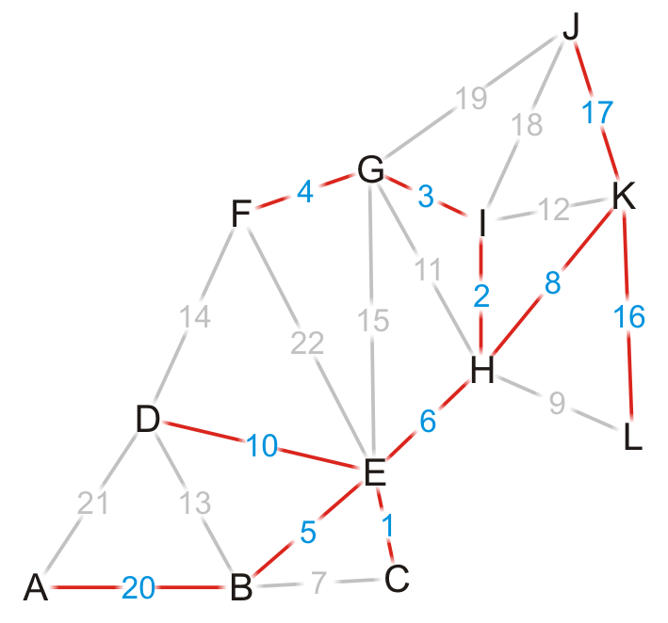
Example
Using the previous pointers, we can reconstruct the paths
Vertex | Visited | Distance | Previous
A | T | 39 | B
B | T | 19 | E
C | T | 15 | E
D | T | 24 | E
E | T | 14 | H
F | T | 17 | G
G | T | 13 | I
H | T | 8 | K
I | T | 10 | H
J | T | 17 | K
K | T | 0 | Ø
L | T | 16 | K

Slide 67
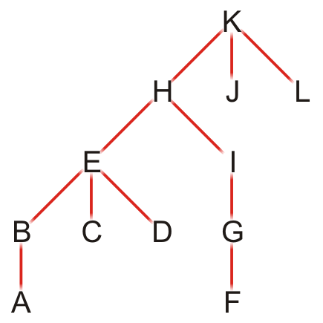
Example
Note that this table defines a rooted parental tree (is it also a minimum spanning tree?)
The source vertex K is at the root
The previous pointer is the parent of the vertex in the tree
Vertex | Previous
A | B
B | E
C | E
D | E
E | H
F | G
G | I
H | K
I | H
J | K
K | Ø
L | K

Slide 68
Comments on Dijkstra’s algorithm
Questions:
What if at some point, all unvisited vertices have a distance ∞?
This means that the graph is unconnected
We have found the shortest paths to all vertices in the connected subgraph containing the source vertex
What if we just want to find the shortest path between vertices v_{j} and v_{k}?
Apply the same algorithm, but stop when we are visiting vertex v_{k}
Does the algorithm change if we have a directed graph?
No

Slide 69
Implementation and analysis
The initialization requires Θ(|V|) memory and run time
We iterate |V| times, each time finding next closest vertex to the source
Iterating through the table requires Θ(|V|) time
Each time we find a vertex, we must check all of its neighbors
With an adjacency matrix, the run time is Θ(|V|(|V| + |V|)) = Θ(|V|²)
With an adjacency list, the run time is Θ(|V|² + |E|) = Θ(|V|²) as |E| = O(|V|²)
Can we do better?
How about using a priority queue to find the closest vertex?
Assume we are using a binary heap

Slide 70
Implementation and analysis
The initialization still requires Θ(|V|) memory and run time
The priority queue will also requires Ο(|V|) memory
We must use an adjacency list, not an adjacency matrix
We iterate |V| times, each time finding the closest vertex to the source
Place the distances into a priority queue
The size of the priority queue is Ο(|V|)
Thus, the work required for this is O(|V| ln(|V|))
Is this all the work that is necessary?
Recall that each edge visited may result in a distance being updated
Thus, the work required for this is O(|E| ln(|V|))
Thus, the total run time is O(|V| ln(|V|) + |E| ln(|V|)) = O(|E| ln(|V|)) ？

Slide 71
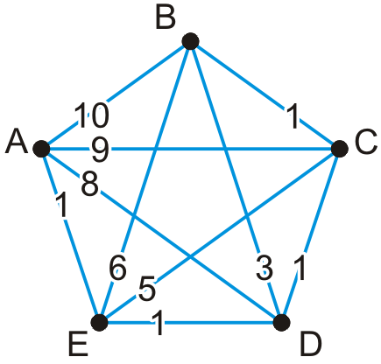
Implementation and analysis
Here is an example of a worst-case scenario:
Immediately, all of the vertices are placed into the queue
Each time a vertex is visited, all the remaining vertices are checked, and in succession, each is pushed to the top of the binary heap

Slide 72
Implementation and analysis
We could use a different heap structure:
A Fibonacci heap is a node-based heap
Pop is still O(ln(|V|)), but inserting and moving a key is Θ(1)
Thus, because we are only calling pop |V| – 1 times, the overall run-time reduces to O(|E| + |V| ln(|V|))

Slide 73
Implementation and analysis
Thus, we have two run times when using
A binary heap: O(|E| ln(|V|))
A Fibonacci heap: O(|E| + |V| ln(|V|))
Questions: Which is faster if |E| = Θ(|V|)? How about if |E| = Θ(|V|²)?

Slide 74
Summary
We have seen an algorithm for finding single-source shortest paths
Start with the initial vertex
Continue finding the next vertex that is closest
Dijkstra’s algorithm always finds the next closest vertex
It solves the problem in O(|E| + |V| ln(|V|)) time

Slide 75
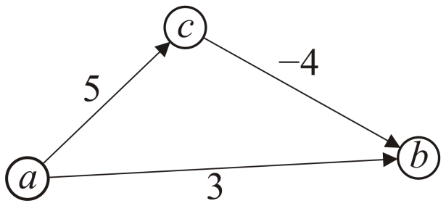
Negative Weights
If some of the edges have negative weight, so long as there are no cycles with negative weight, the Bellman-Ford algorithm will find the minimum distance
It is slower than Dijkstra’s algorithm

Slide 76
What about Dijkstra’s on…?
1
1
B
D
A
5
10
-10
C
E

Slide 77
What about Dijkstra’s on…?
1
1
B
D
A
5
10
-10
C
E

Slide 78
What about Dijkstra’s on…?
Dijkstra’s algorithm only works for positive edge weights
1
1
B
D
A
5
10
C
E

Slide 79
Bounding the distance
Another invariant: For each vertex v, dist[v] is an upper bound on the actual shortest distance
start of at ∞
only update the value if we find a shorter distance
An update procedure

Slide 80
Can we ever go wrong applying this update rule?
We can apply this rule as many times as we want and will never underestimate dist[v]
When will dist[v] be right?
If u is along the shortest path to v and dist[u] is correct

Slide 81
dist[v] will be right if u is along the shortest path to v and dist[u] is correct
Consider the shortest path from s to v
s
p₁
p₂
p₃
p_{k}
v

Slide 82
dist[v] will be right if u is along the shortest path to v and dist[u] is correct
What happens if we update all of the vertices with the above update?
s
p₁
p₂
p₃
p_{k}
v

Slide 83
dist[v] will be right if u is along the shortest path to v and dist[u] is correct
What happens if we update all of the vertices with the above update?
s
p₁
p₂
p₃
p_{k}
v
correct

Slide 84
dist[v] will be right if u is along the shortest path to v and dist[u] is correct
What happens if we update all of the vertices with the above update?
s
p₁
p₂
p₃
p_{k}
v
correct
correct

Slide 85
dist[v] will be right if u is along the shortest path to v and dist[u] is correct
Does the order that we update the vertices matter?
s
p₁
p₂
p₃
p_{k}
v
correct
correct

Slide 86
dist[v] will be right if u is along the shortest path to v and dist[u] is correct
How many times do we have to do this for vertex p_{i} to have the correct shortest path from s?
i times
s
p₁
p₂
p₃
p_{k}
v

Slide 87
dist[v] will be right if u is along the shortest path to v and dist[u] is correct
How many times do we have to do this for vertex p_{i} to have the correct shortest path from s?
i times
s
p₁
p₂
p₃
p_{k}
v
correct
correct

Slide 88
dist[v] will be right if u is along the shortest path to v and dist[u] is correct
How many times do we have to do this for vertex p_{i} to have the correct shortest path from s?
i times
s
p₁
p₂
p₃
p_{k}
v
correct
correct
correct

Slide 89
dist[v] will be right if u is along the shortest path to v and dist[u] is correct
How many times do we have to do this for vertex p_{i} to have the correct shortest path from s?
i times
s
p₁
p₂
p₃
p_{k}
v
correct
correct
correct
correct

Slide 90
dist[v] will be right if u is along the shortest path to v and dist[u] is correct
How many times do we have to do this for vertex p_{i} to have the correct shortest path from s?
i times
s
p₁
p₂
p₃
p_{k}
v
…
correct
correct
correct
correct

Slide 91
dist[v] will be right if u is along the shortest path to v and dist[u] is correct
What is the longest (vetex-wise) the path from s to any node v can be?
|V| - 1 edges/vertices
s
p₁
p₂
p₃
p_{k}
v
…
correct
correct
correct
correct

Slide 92
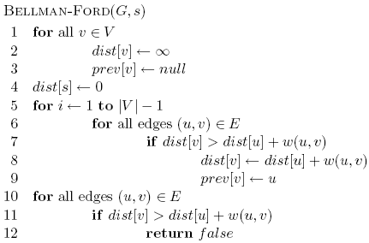
Bellman-Ford algorithm

Slide 93
Bellman-Ford algorithm
Initialize all the distances

Slide 94
Bellman-Ford algorithm
iterate over all edges/vertices and apply update rule

Slide 95
Bellman-Ford algorithm

Slide 96
Bellman-Ford algorithm
check for negative cycles

Slide 97
Negative cycles
What is the shortest path from a to e?
1
1
B
D
A
5
10
-10
C
E
3

Slide 98
Bellman-Ford algorithm
0
∞
10
S
A
Iteration: 0
8
1
∞
∞
G
-4
B
2
1
1
-2
C
∞
F
∞
-1
3
E
D
-1
∞
∞

Slide 99
Bellman-Ford algorithm
0
10
10
S
A
Iteration: 1
8
1
∞
8
G
-4
B
2
1
1
-2
C
∞
F
∞
-1
3
E
D
-1
∞
∞

Slide 100
Bellman-Ford algorithm
0
10
10
S
A
Iteration: 2
8
1
∞
8
G
-4
B
2
1
1
-2
C
∞
F
9
-1
3
E
D
-1
12
∞

Slide 101
Bellman-Ford algorithm
0
5
10
S
A
Iteration: 3
8
1
10
8
G
-4
B
A has the correct distance and path
2
1
1
-2
C
∞
F
9
-1
3
E
D
-1
8
∞

Slide 102
Bellman-Ford algorithm
0
5
10
S
A
Iteration: 4
8
1
6
8
G
-4
B
2
1
1
-2
C
11
F
9
-1
3
E
D
-1
7
∞

Slide 103
Bellman-Ford algorithm
0
5
10
S
A
Iteration: 5
8
1
5
8
G
-4
B
B has the correct distance and path
2
1
1
-2
C
7
F
9
-1
3
E
D
-1
7
14

Slide 104
Bellman-Ford algorithm
0
5
10
S
A
Iteration: 6
8
1
5
8
G
-4
B
2
1
1
-2
C
6
F
9
-1
3
E
D
-1
7
10

Slide 105
Bellman-Ford algorithm
0
5
10
S
A
Iteration: 7
8
1
5
8
G
-4
B
D (and all other nodes) have the correct distance and path
2
1
1
-2
C
6
F
9
-1
3
E
D
-1
7
9

Slide 106
Correctness of Bellman-Ford
Loop invariant: After iteration i, all vertices with shortest paths from s of length i edges or less have correct distances

Slide 107
Runtime of Bellman-Ford
O(|V| |E|)

Slide 108
Runtime of Bellman-Ford
Can you modify the algorithm to run faster (in some circumstances)?

Slide 109
Summary
Definition and applications
Dijkstra’s algorithm
Single source shortest distance (non-negative weights)
Bellman-Ford algorithm
For graphs with negative weights (but no cycles with negative weight)

