Slide 1

CS101 Algorithms and Data Structures
Shortest Path: Floyd-Warshall
Textbook Ch 24, 25
Notes:
Adapted from the slides by Douglas Wilhelm Harder of U Waterloo (https://ece.uwaterloo.ca/~dwharder/aads/Lecture_materials/)
May also contain material from the slides at https://courses.cs.washington.edu/courses/cse326/03wi/326lecturesb.shtml (by Dan Suciu of U Washington)

Slide 2
Outline
Dijkstra’s algorithm
Floyd-Warshall algorithm

Slide 3
Dijkstra’s algorithm
We will iterate |V| times:
Find the unvisited vertex v that has a minimum distance to it
Mark it as visited
Consider its every adjacent vertex w that is unvisited:
Is the distance to v plus the weight of the edge (v, w) less than our currently known shortest distance to w ?
If so, update the shortest distance to w and record v as the previous pointer
Continue iterating until all vertices are visited or all remaining vertices have a distance of infinity

Slide 4
Outline
Dijkstra’s algorithm
Floyd-Warshall algorithm

Slide 5
Background
Dijkstra’s algorithm finds the shortest path between one vertex and other vertices.
Run time: O(|E| ln(|V|))
If we wanted to find the shortest path between all pairs of vertices, we could apply Dijkstra’s algorithm to each vertex:
Run time: O(|V| |E| ln(|V|))

Slide 6
Background
Now, Dijkstra’s algorithm has the following run times:
Best case:
If , running Dijkstra for each vertex is O(|V|² ln(|V|))
Worst case:
If , running Dijkstra for each vertex is O(|V|³ ln(|V|))

Slide 7
Problem
Question: for the worst case, can we find a algorithm?
We will look at the Floyd-Warshall algorithm
It works with positive or negative weights with no negative cycle

Slide 8
Strategy
First, let’s consider only edges that connect vertices directly:
Here, w_{i,j} is the weight of the edge connecting vertices i and j
Note, this can be a directed graph; i.e., it may be that

Slide 9
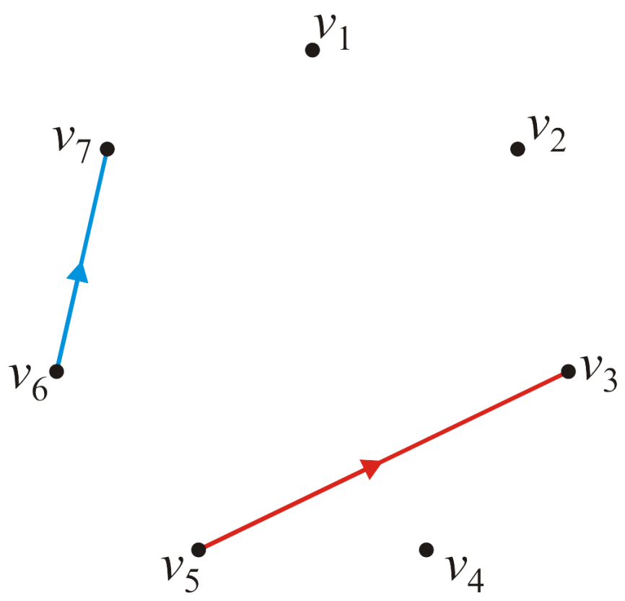
Strategy
Consider this graph of seven vertices
The edges defining the values and are highlighted

Slide 10
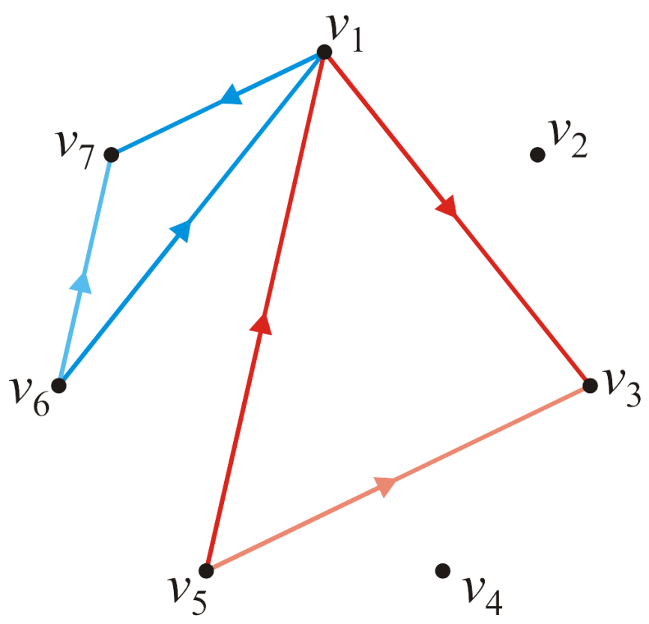
Strategy
Suppose now, we want to see whether or not the path going through vertex v₁ is shorter than a direct edge?
Is ?
Is ?

Slide 11
Strategy
Thus, for each pair of edges, we will define by calculating:

Slide 12
Strategy
We need just run the algorithm for each pair of vertices:
for ( int i = 0; i < num_vertices; ++i ) {
for ( int j = 0; j < num_vertices; ++j ) {
d[i][j] = std::min( d[i][j], d[i][0] + d[0][j] );
}
}

Slide 13
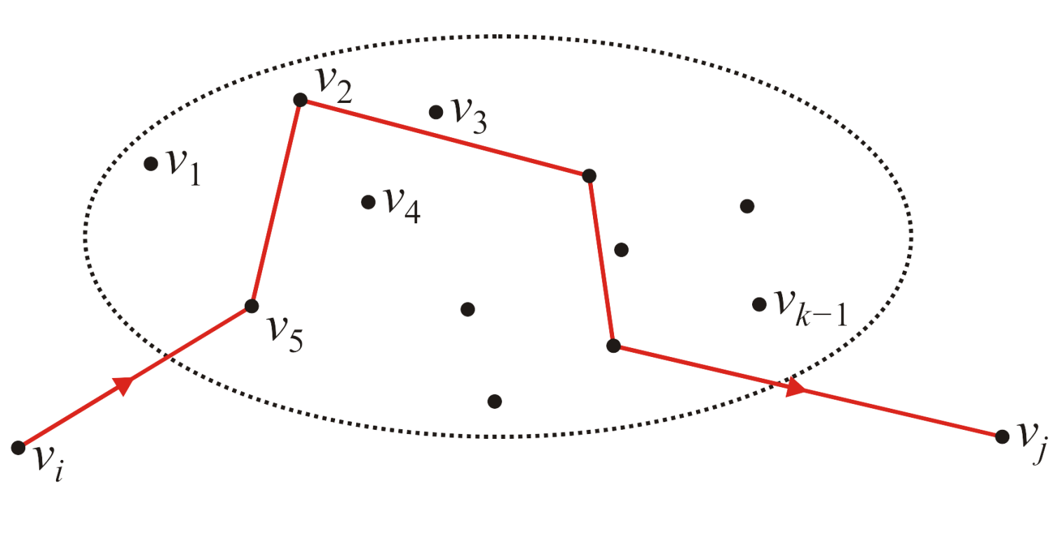
The General Step
Define as the shortest distance, but only allowing intermediate visits to vertices v₁, v₂, …, v_{k–1}
Suppose we have an algorithm that has found these values for all pairs

Slide 14
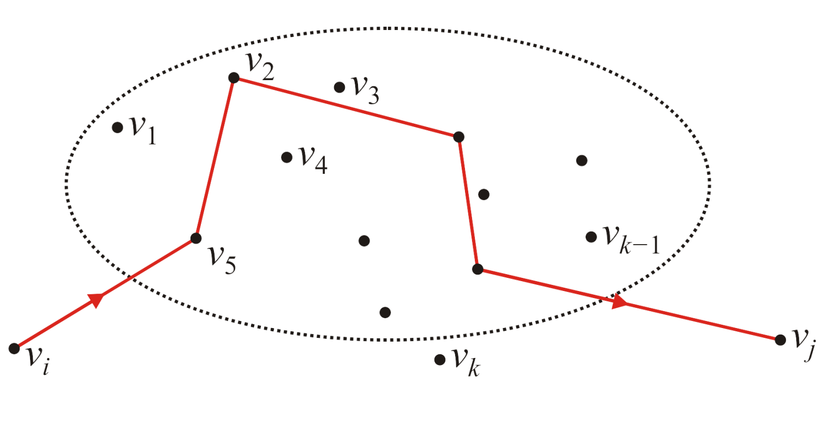
The General Step
How could we find ; that is, the shortest path allowing intermediate visits to vertices v₁, v₂, …, v_{k–1} , v_{k}?
Two possibilities: the shortest path includes or does not include v_{k}

Slide 15
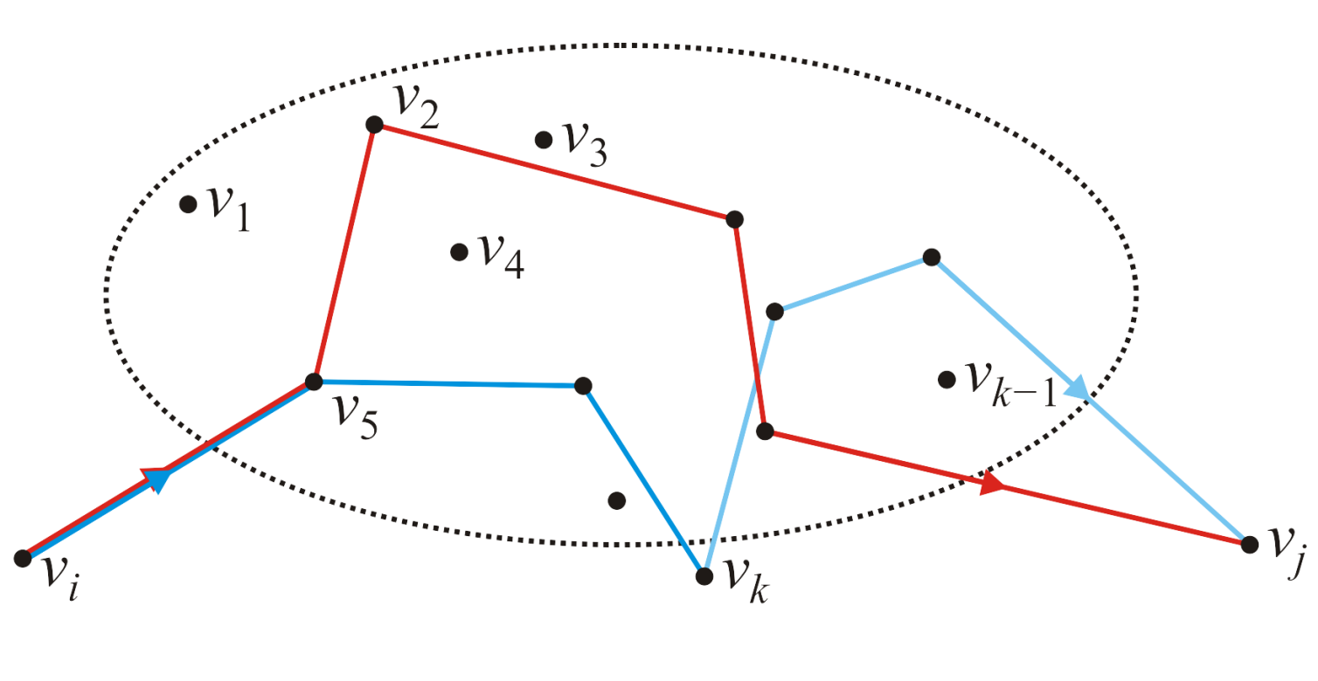
The General Step
If the shortest path includes v_{k}, then it must consist of:
the shortest path from v_{i} to v_{k}
and then the shortest path from v_{k} to v_{j}
both only allowing intermediate visits to vertices v₁, v₂, …, v_{k–1}

Slide 16
The General Step
With v₁, v₂, …, v_{k–1} as intermediates, we already know the shortest paths from v_{i} to v_{j}, v_{i} to v_{k} and v_{k} to v_{j}
Thus, we calculate

Slide 17
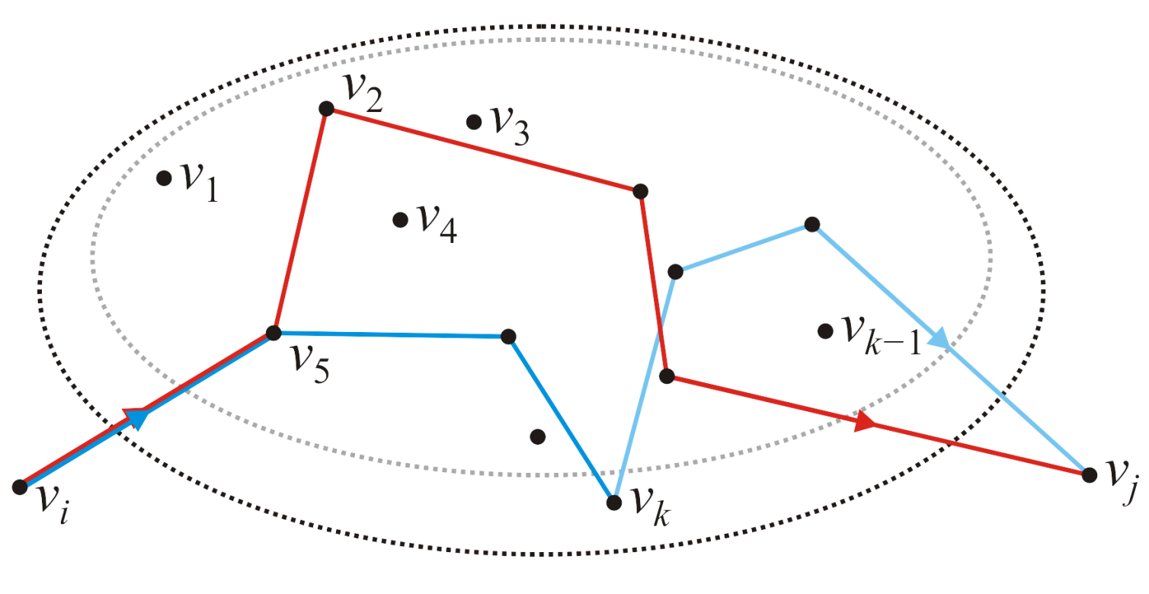
The General Step
Finding for all pairs of vertices gives us all shortest paths from v_{i} to v_{j} possibly going through vertices v₁, v₂, …, v_{k}
Notes:
To simplify the notation, we can remove the superscripts in d^k

Slide 18
The General Step
The calculation is straight forward:
for ( int i = 0; i < num_vertices; ++i ) {
for ( int j = 0; j < num_vertices; ++j ) {
d[i][j] = std::min( d[i][j], d[i][k-1] + d[k-1][j] );
}
}

Slide 19
The Floyd-Warshall Algorithm
// Initialize the matrix d
// ...
for ( int k = 0; k < num_vertices; ++k ) {
for ( int i = 0; i < num_vertices; ++i ) {
for ( int j = 0; j < num_vertices; ++j ) {
d[i][j] = std::min( d[i][j], d[i][k] + d[k][j] );
}
}
}
Run time?

Slide 20
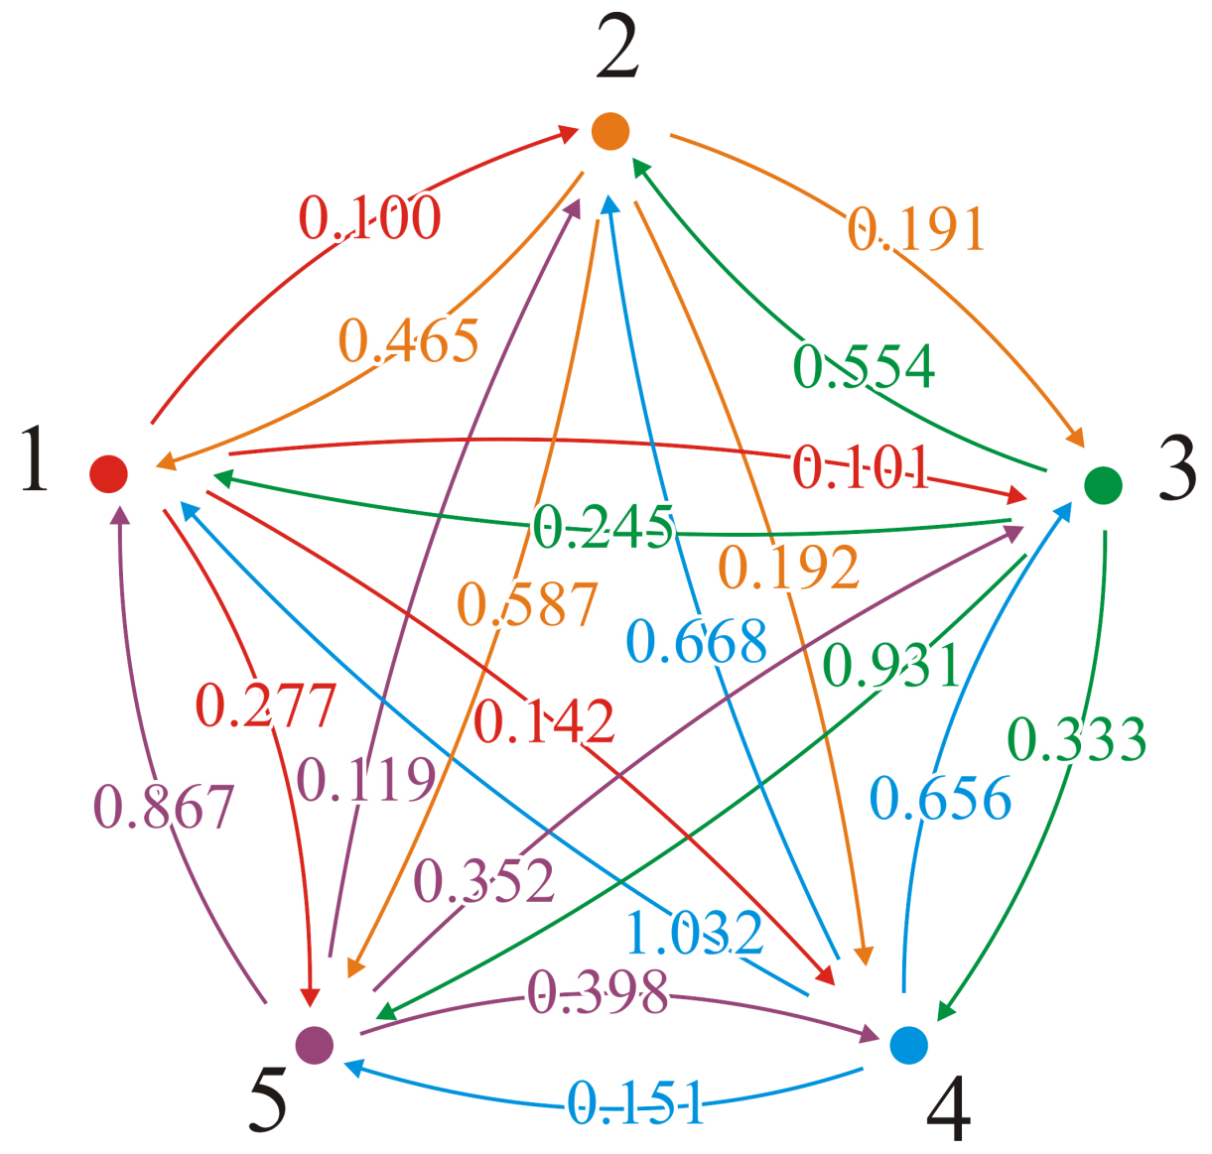
Example
Consider this graph

Slide 21
Example
The adjacency matrix is
This would define our matrix D = (d_{ij})

Slide 22
Example
With the first pass, k = 1, we attempt passing through vertex v₁

Slide 23
Example
With the first pass, k = 1, we attempt passing through vertex v₁
We would start: (2, 3) → (2, 1, 3)
0.191 ≯ 0.465 + 0.101

Slide 24
Example
With the first pass, k = 1, we attempt passing through vertex v₁
We would start: (2, 4) → (2, 1, 4)
0.192 ≯ 0.465 + 0.142

Slide 25
Example
With the first pass, k = 1, we attempt passing through vertex v₁
We would start: (2, 5) → (2, 1, 5)
0.587 ≯ 0.465 + 0.277

Slide 26
Example
With the first pass, k = 1, we attempt passing through vertex v₁
Here is a shorter path: (3, 2) → (3, 1, 2)
0.554 > 0.245 + 0.100 = 0.345

Slide 27
Example
With the first pass, k = 1, we attempt passing through vertex v₁
We update the table (3, 2) → (3, 1, 2)
0.554 > 0.245 + 0.100 = 0.345

Slide 28
Example
With the first pass, k = 1, we attempt passing through vertex v₁
And a second shorter path: (3, 5) → (3, 1, 5)
0.931 > 0.245 + 0.277 = 0.522

Slide 29
Example
With the first pass, k = 1, we attempt passing through vertex v₁
We update the table

Slide 30
Example
With the first pass, k = 1, we attempt passing through vertex v₁
Continuing… We find that no other shorter paths through vertex v₁ exist

Slide 31
Example
With the next pass, k = 2, we attempt passing through vertex v₂
There are three shorter paths: (5, 1) → (5, 2, 1)
0.867 > 0.119 + 0.465 = 0.584 (5, 3) → (5, 2, 3)
0.352 > 0.119 + 0.191 = 0.310
(5, 4) → (5, 2, 4)
0.398 > 0.119 + 0.192 = 0.311

Slide 32
Example
With the next pass, k = 2, we attempt passing through vertex v₂
We update the table

Slide 33
Example
With the next pass, k = 3, we attempt passing through vertex v₃
There are three shorter paths: (2, 1) → (2, 3, 1)
0.465 > 0.191 + 0.245 = 0.436 (4, 1) → (4, 3, 1)
1.032 > 0.656 + 0.245 = 0.901
(5, 1) → (5, 3, 1)
0.584 > 0.310 + 0.245 = 0.555

Slide 34
Example
With the next pass, k = 3, we attempt passing through vertex v₃
We update the table

Slide 35
Example
With the next pass, k = 4, we attempt passing through vertex v₄
There are two shorter paths: (2, 5) → (2, 4, 5)
0.587 > 0.192 + 0.151 (3, 5) → (3, 4, 5)
0.522 > 0.333 + 0.151

Slide 36
Example
With the next pass, k = 4, we attempt passing through vertex v₄
We update the table

Slide 37
Example
With the last pass, k = 5, we attempt passing through vertex v₅
There are three shorter paths: (4, 1) → (4, 5, 1)
0.901 > 0.151 + 0.555 = 0.706 (4, 2) → (4, 5, 2)
0.668 > 0.151 + 0.119 = 0.270
(4, 3) → (4, 5, 3)
0.656 > 0.151 + 0.310 = 0.461

Slide 38
Example
With the last pass, k = 5, we attempt passing through vertex v₅
We update the table

Slide 39
Example
Thus, we have a table of all shortest paths:

Slide 40
What Is the Shortest Path?
This algorithm finds the shortest distances, but what are the paths corresponding to those shortest distances?
Recall that with Dijkstra’s algorithm, we could find the shortest paths by recording the previous vertex
Here we use a similar approach, but we choose to store the next vertex instead of the previous vertex

Slide 41
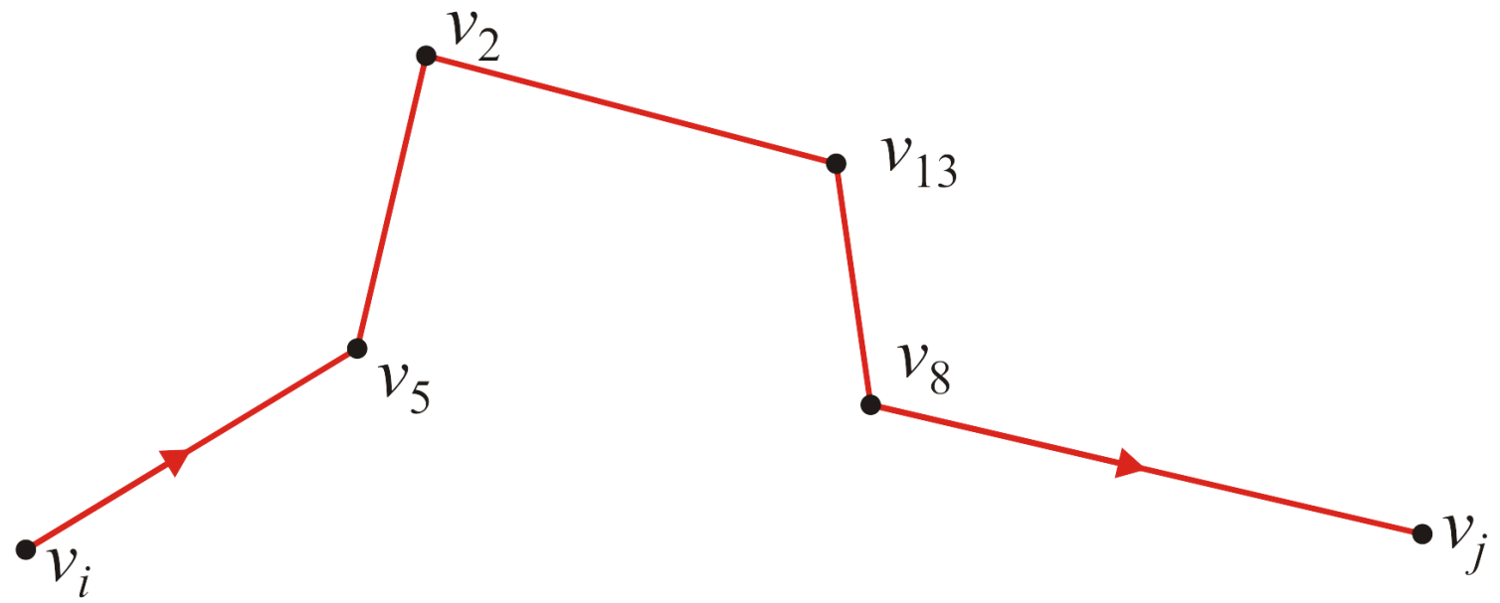
What Is the Shortest Path?
Suppose the shortest path from v_{i} to v_{j} is as follows:

Slide 42
What Is the Shortest Path?
Does this path consist of (v_{i}, v₅) and the shortest path from v₅ to v_{j}?
Yes
If there was a shorter path from v₅ to v_{j}, then we would also find a shorter path from v_{i} to v_{j}

Slide 43
What Is the Shortest Path?
Does this path consist of (v_{i}, v₅) and the shortest path from v₅ to v_{j}?
To find the shortest path from v_{i} to v_{j}, we only need to know that v₅ is the next vertex in the path — the rest of the path would be recursively recovered as the shortest path from v₅ to v_{j}

Slide 44
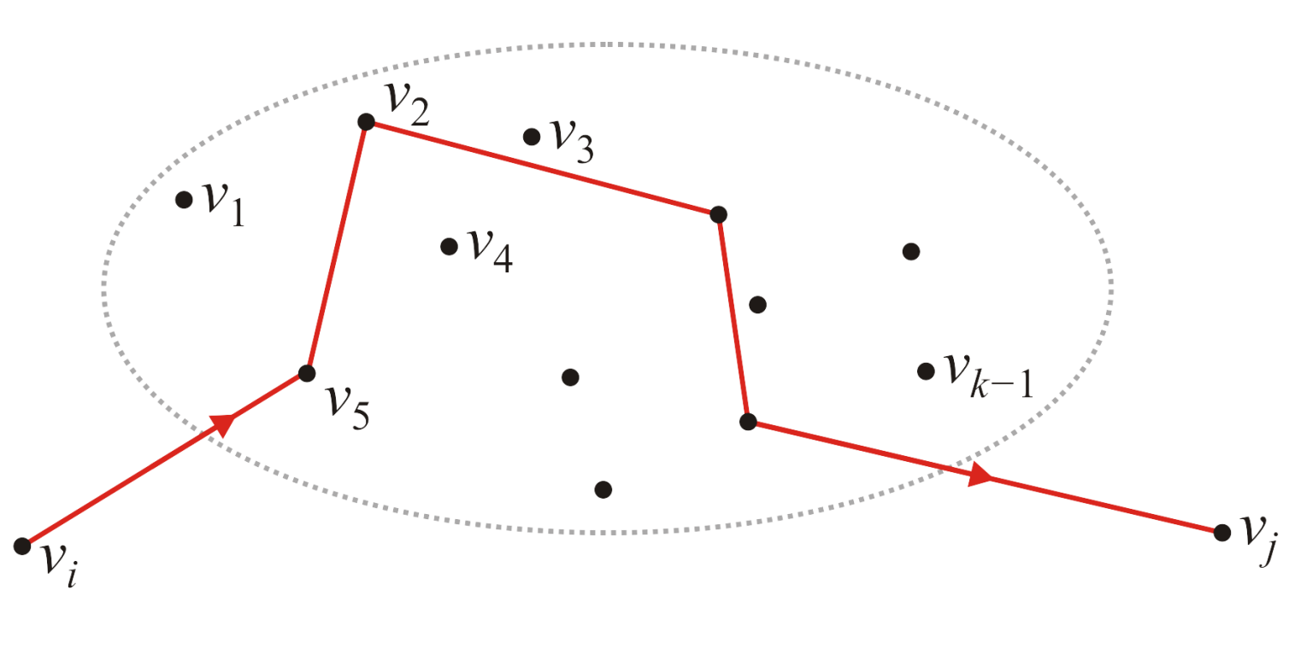
What Is the Shortest Path?
Now, suppose we have the shortest path from v_{i} to v_{j} which passes through the vertices v₁, v₂, …, v_{k–1}
In this example, the next vertex in the path is v₅

Slide 45
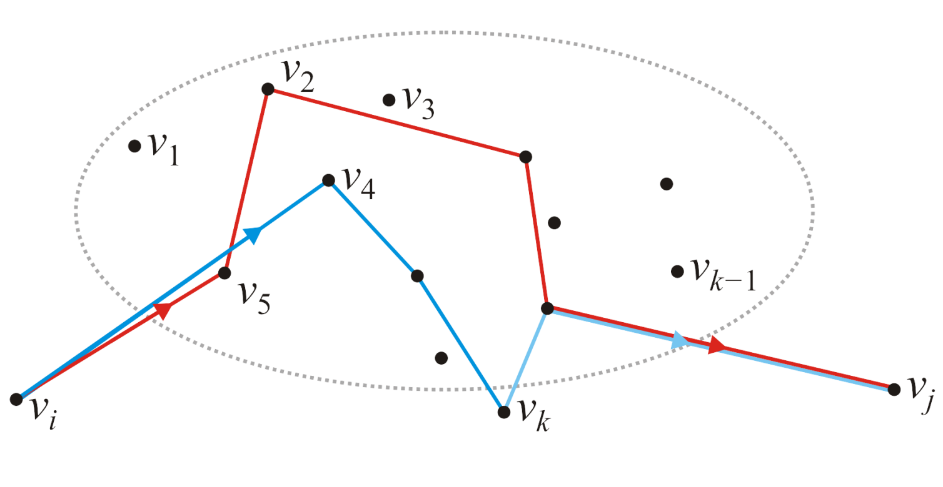
What Is the Shortest Path?
What if we find a shorter path passing through v_{k}?
Now the next vertex in the new path should be the next vertex in the shortest path from v_{i} to v_{k} , which is v₄ in this example

Slide 46
What Is the Shortest Path?
Let us store the next vertex in the shortest path. Initially:

Slide 47
What Is the Shortest Path?
When we find a shorter path, update the next vertex:
// Initialize the matrix p
// ...
for ( int k = 0; k < num_vertices; ++k ) {
for ( int i = 0; i < num_vertices; ++i ) {
for ( int j = 0; j < num_vertices; ++j ) {
if ( d[i][j] > d[i][k] + d[k][j] ) {
p[i][j] = p[i][k];
d[i][j] = d[i][k] + d[k][j];
}
}
}
}

Slide 48
Example
In our original example, initially, the next vertex is exactly that:
This would define our matrix P = (p_{ij})

Slide 49
Example
With the first pass, k = 1, we attempt passing through vertex v₁
There are two shorter paths: (3, 2) → (3, 1, 2)
0.554 > 0.245 + 0.100 (3, 5) → (3, 1, 5)
0.931 > 0.245 + 0.277

Slide 50
Example
With the first pass, k = 1, we attempt passing through vertex v₁
We update each of these

Slide 51
Example
After all the steps, we end up with the matrix P = (p_{i,j}):

Slide 52
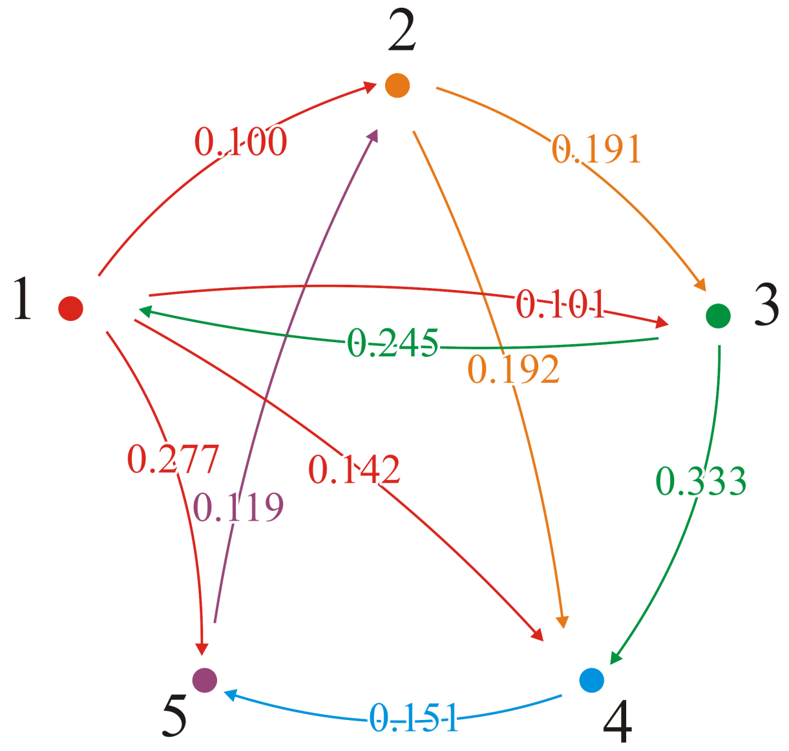
Example
These are all the adjacent edges that are still the shortest distance
For each of these, p_{i,j} = j
In all cases, the shortest distance from vertex 1 is the direct edge

Slide 53
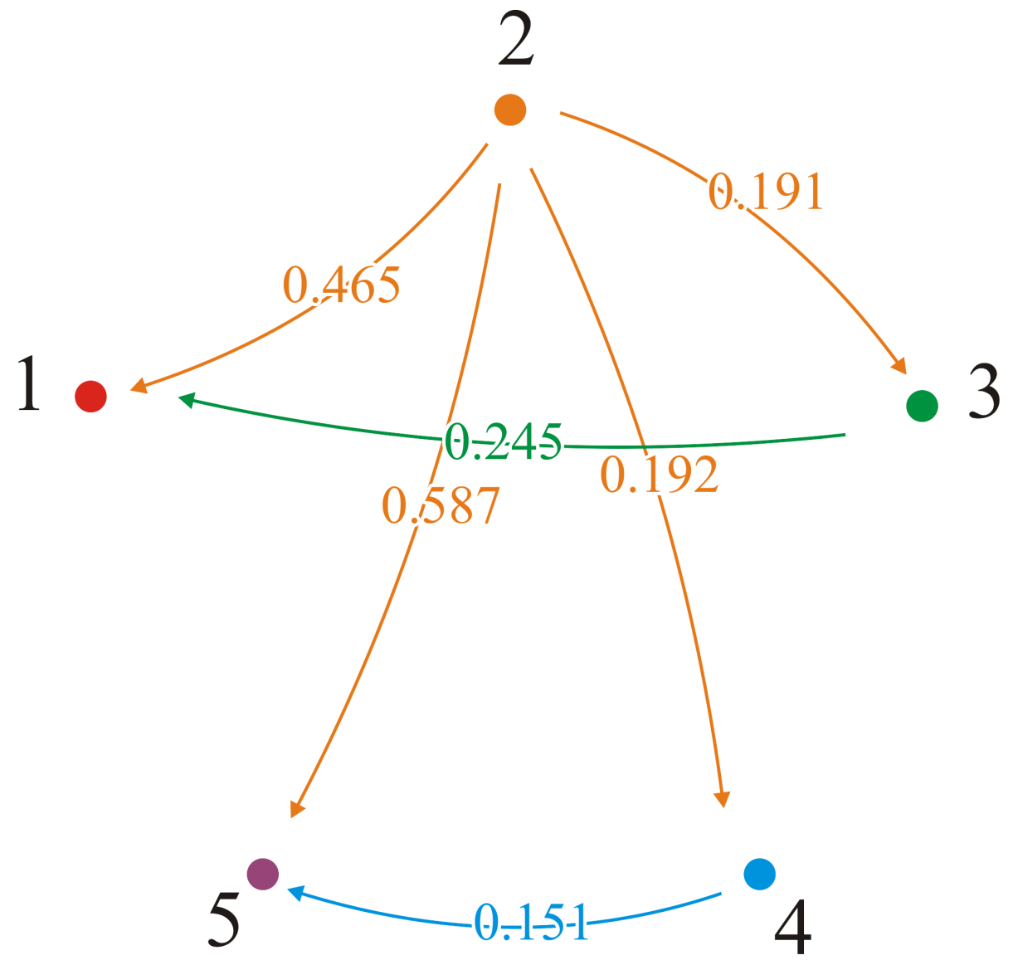
Example
From vertex v₂, p_{2,3} = 3 and p_{2,4} = 4; we go directly to vertices v₃ and v₄
But p_{2,1} = 3 and p_{3,1} = 1; the shortest path to v₁ is (2, 3, 1)
Also, p_{2,5} = 4 and p_{4,5} = 5; the shortest path to v₅ is (2, 4, 5)

Slide 54
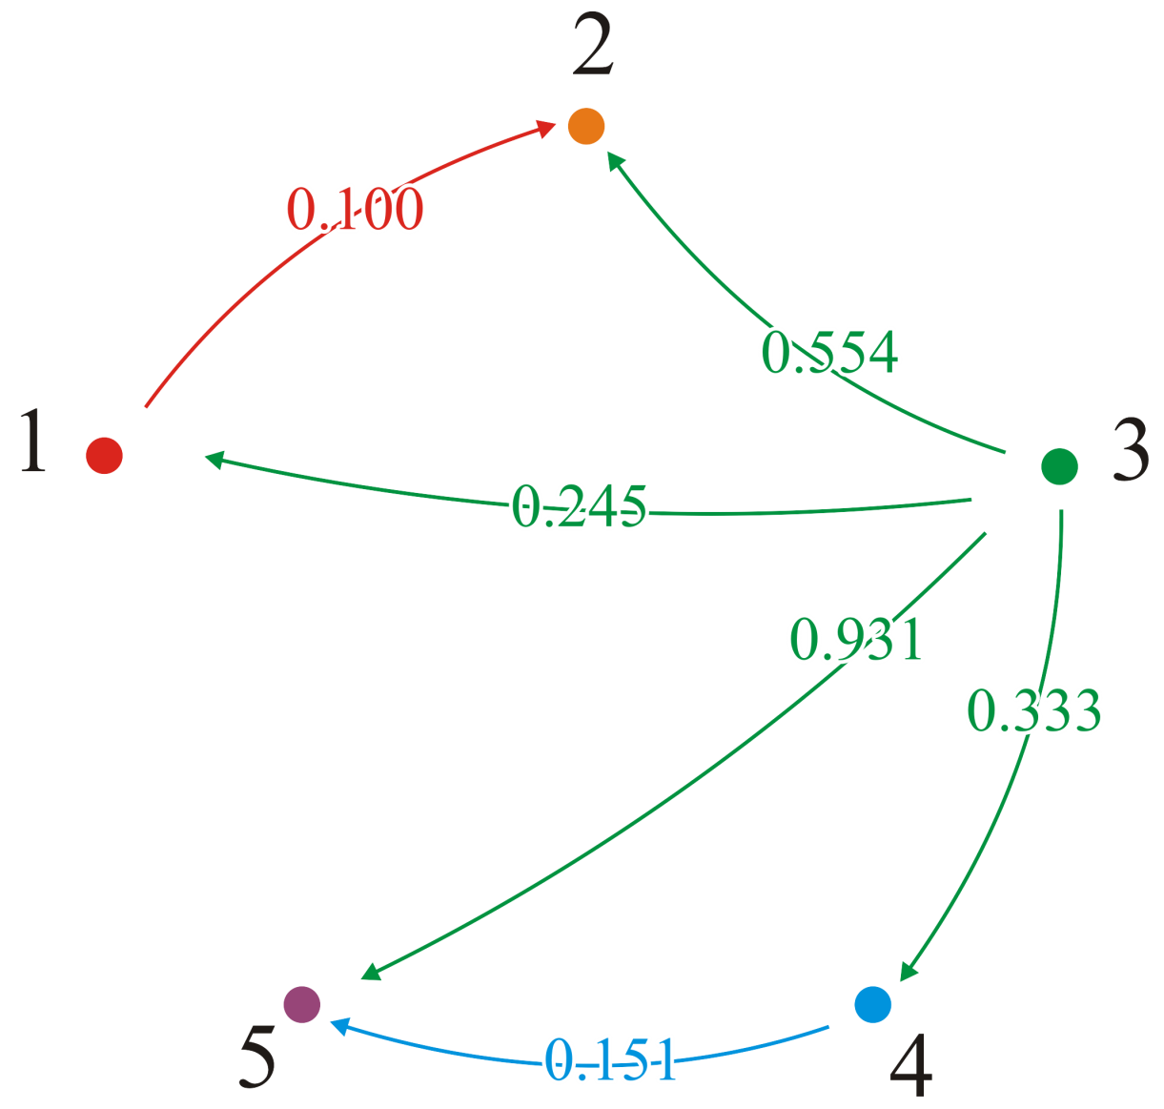
Example
From vertex v₃, p_{3,1} = 1 and p_{3,4} = 4; we go directly to vertices v₁ and v₄
But p_{3,2} = 1 and p_{1,2} = 2; the shortest path to v₂ is (3, 1, 2)
Also, p_{3,5} = 4 and p_{4,5} = 5; the shortest path to v₅ is (3, 4, 5)

Slide 55
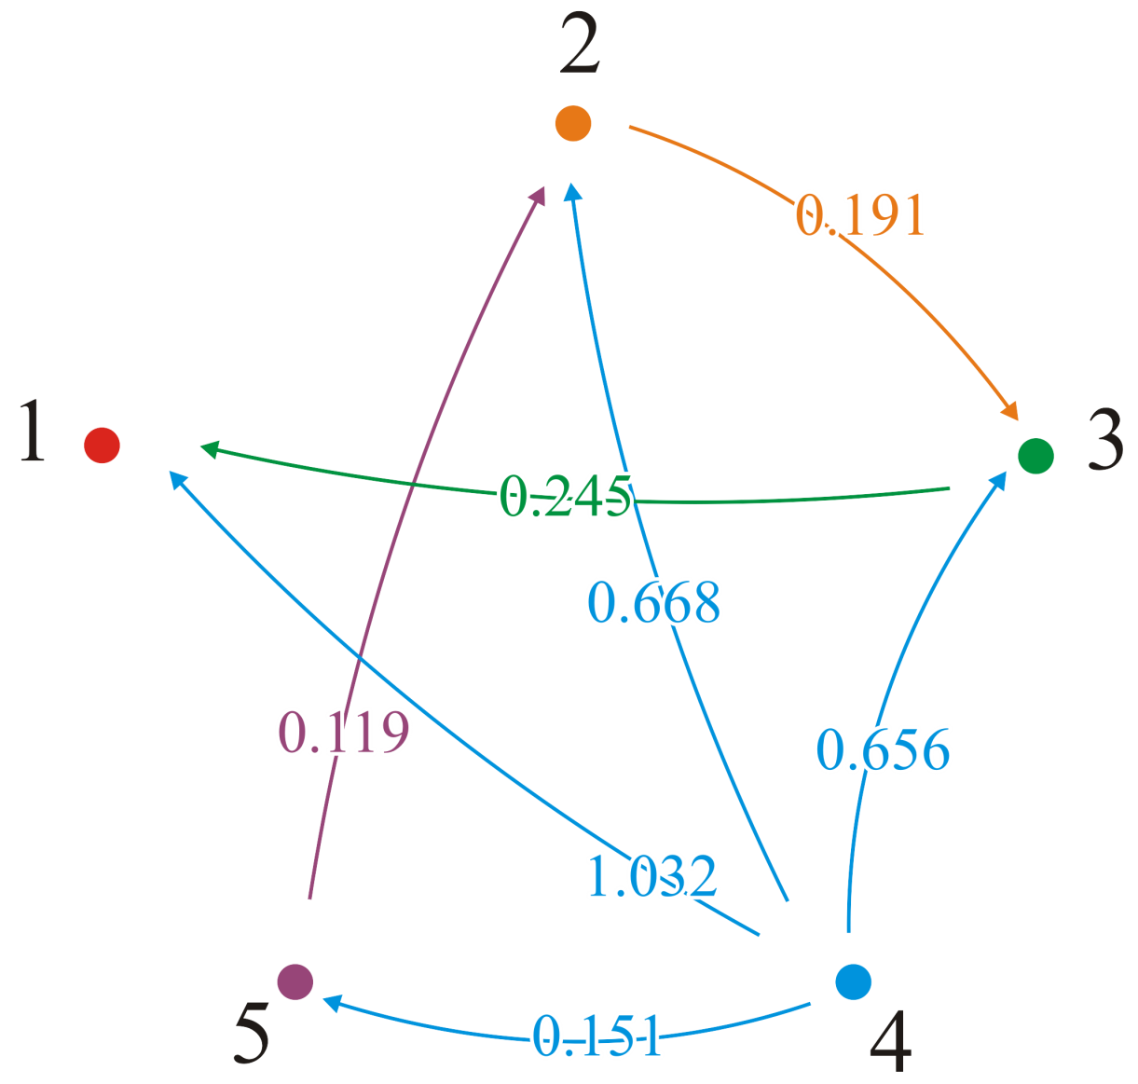
Example
From vertex v₄, p_{4,5} = 5; we go directly to vertex v₅
But p_{4,1} = 5, p_{5,1} = 2, p_{2,1} = 3, p_{3,1} = 1; the shortest path to v₁ is (4, 5, 2, 3, 1)

Slide 56
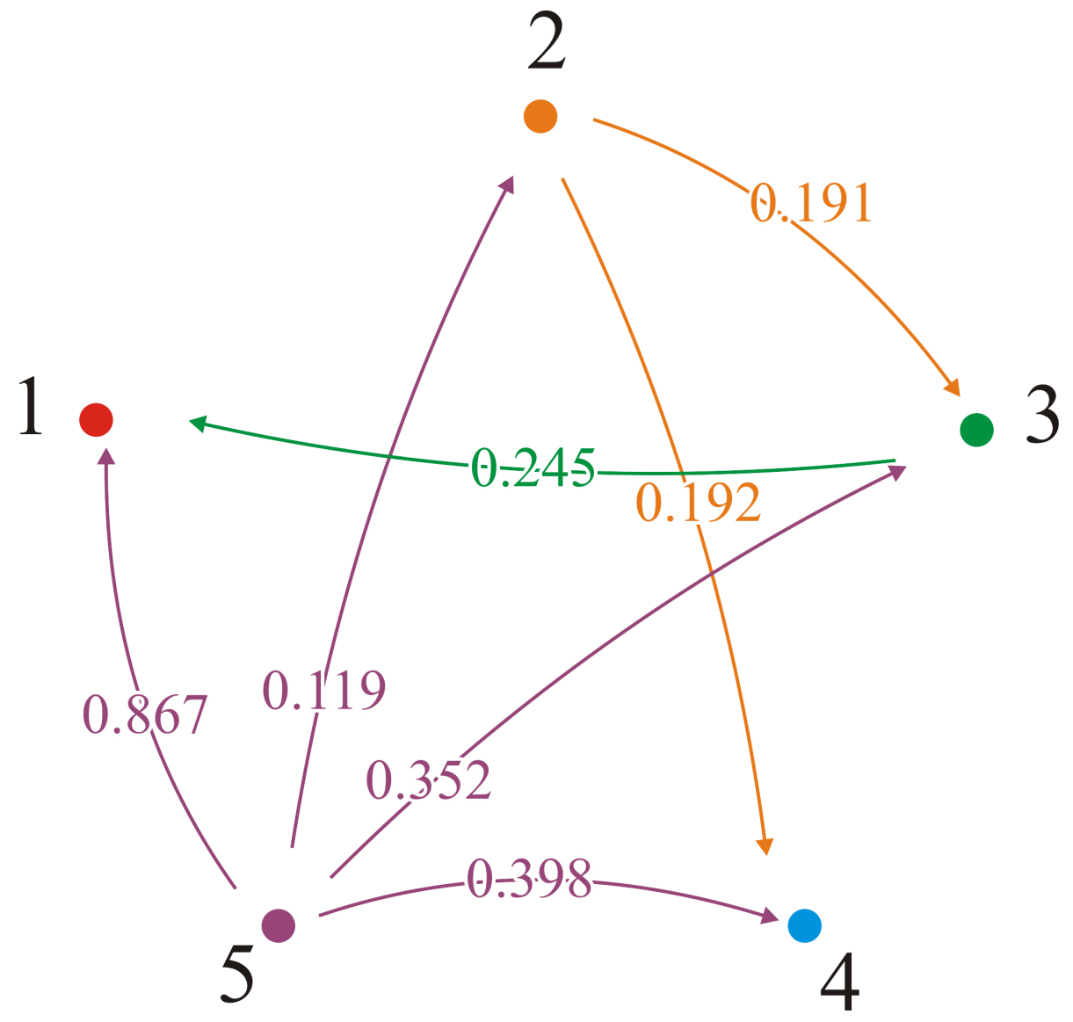
Example
From vertex v₅, p_{5,2} = 2; we go directly to vertex v₂
But p_{5,4} = 2 and p_{2,4} = 4; the shortest path to v₄ is (5, 2, 4)

Slide 57
Which Vertices are Connected?
Finally, what if we only care if a connection exists?
Recall that with Dijkstra’s algorithm, we could find the shortest paths by recording the previous vertex
In this case, can make the observation that:
A path from v_{i} to v_{j} exists if either:
A path exists through the vertices from v₁ to v_{k–1}, or
A path, through those same vertices, exists from v_{i} to v_{k} and a path exists from v_{k} to v_{j}

Slide 58
Which Vertices are Connected?
The transitive closure is a Boolean graph:
bool tc[num_vertices][num_vertices];
// Initialize the matrix tc: Theta(|V|^2)
// ...
// Run Floyd-Warshall
for ( int k = 0; k < num_vertices; ++k ) {
for ( int i = 0; i < num_vertices; ++i ) {
for ( int j = 0; j < num_vertices; ++j ) {
tc[i][j] = tc[i][j] || (tc[i][k] && tc[k][j]);
}
}
}

Slide 59
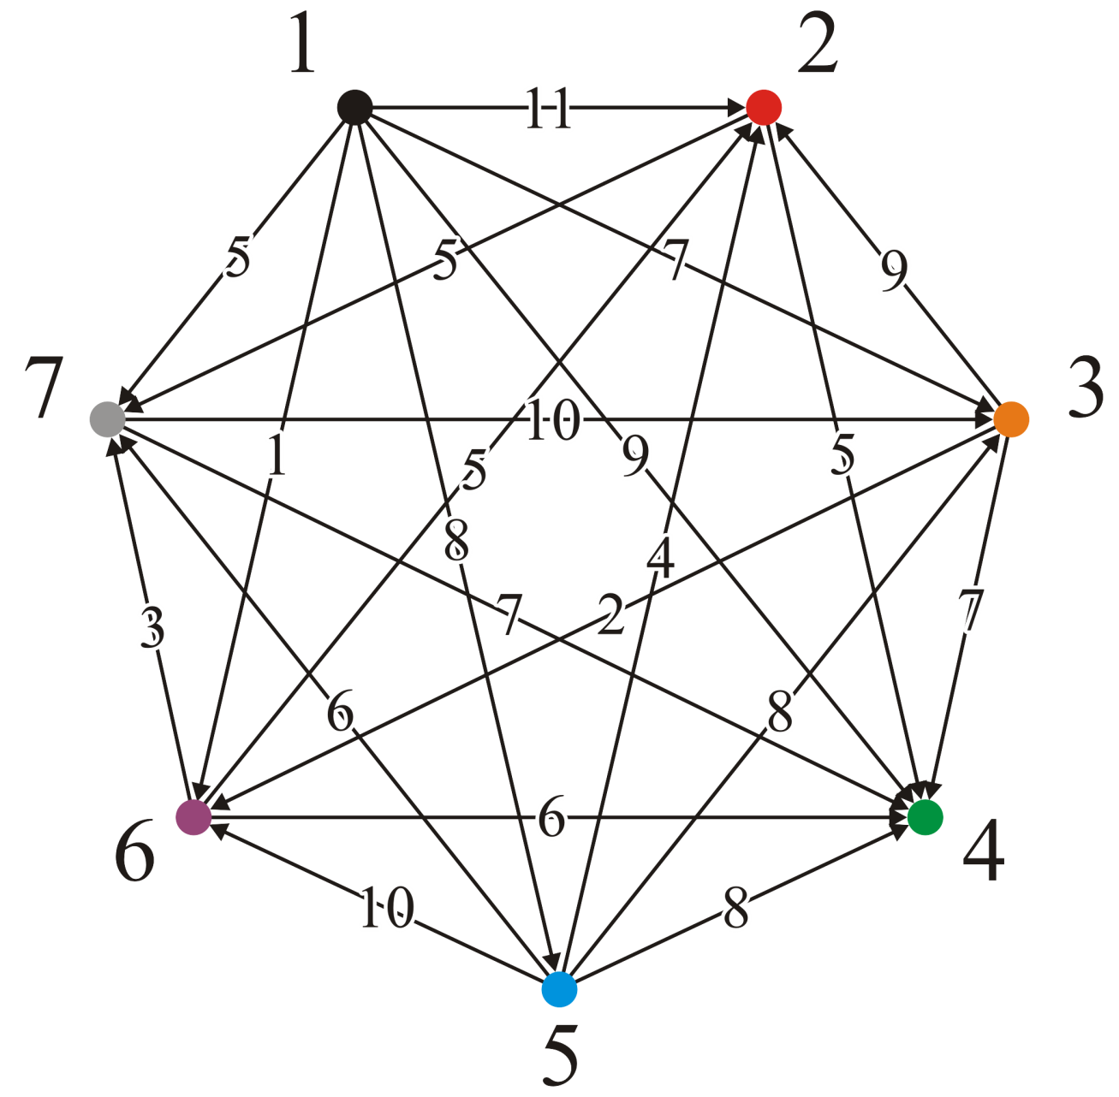
Example
Consider this directed graph
Each pair has only one directed edge
Vertex v₁ is a source and v₄ is a sink
We will apply all three matrices
Shortest distance
Paths
Transitive closure

Slide 60
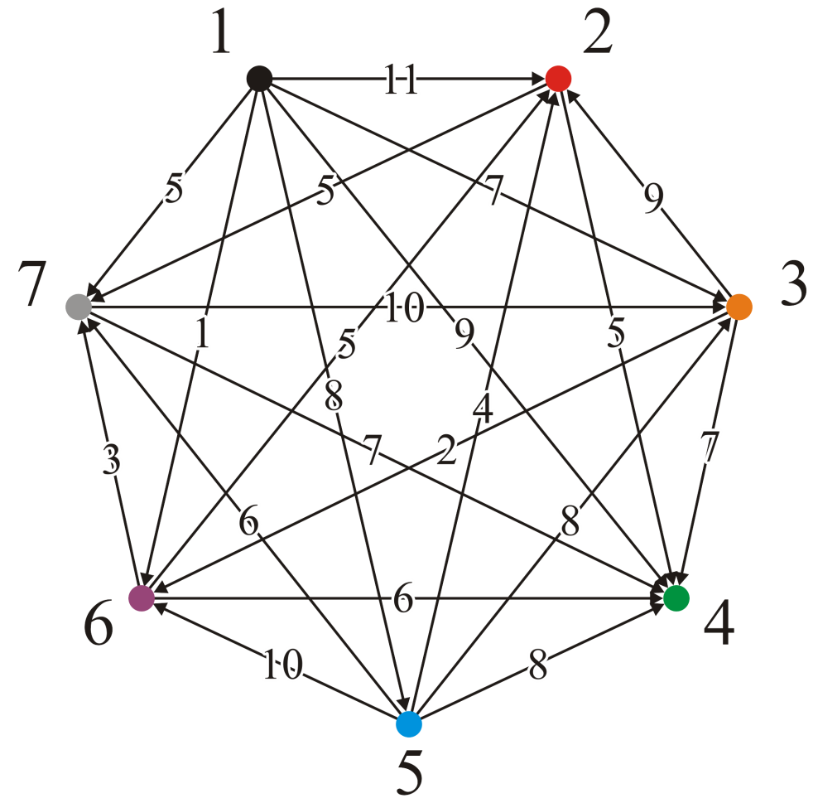
Example
We set up the three initial matrices

Slide 61
Example
At step 1, no path leads to v₁, so no shorter paths could be found passing through v₁

Slide 62
Example
At step 2, we find:
A path (3, 2, 7) of length 14

Slide 63
Example
At step 2, we find:
A path (3, 2, 7) of length 14
We update
d_{3,7} = 14, p_{3,7} = 2 and c_{3,7} = T

Slide 64
Example
At step 3, we find:
A path (7, 3, 2) of length 19
A path (7, 3, 6) of length 12

Slide 65
Example
At step 3, we find:
A path (7, 3, 2) of length 19
A path (7, 3, 6) of length 12
We update
d_{7,2} = 19, p_{7,2} = 3 and c_{7,2} = T
d_{7,6} = 12, p_{7,6} = 3 and c_{7,6} = T

Slide 66
Example
At step 4, there are no paths out of vertex v₄, so we are finished

Slide 67
Example
At step 5, there is one incoming edge from v₁ to v₅, and it doesn’t make any paths out of vertex v₁ any shorter...

Slide 68
Example
At step 6, we find:
A path (1, 6, 2) of length 6
A path (1, 6, 4) of length 7
A path (1, 6, 7) of length 4
A path (3, 6, 2) of length 7
A path (3, 6, 7) of length 5
A path (7, 3, 6, 2) of length 17

Slide 69
Example
At step 6, we find:
A path (1, 6, 2) of length 6
A path (1, 6, 4) of length 7
A path (1, 6, 7) of length 4
A path (3, 6, 2) of length 7
A path (3, 6, 7) of length 5
A path (7, 3, 6, 2) of length 17

Slide 70
Example
At step 7, we find:
A path (2, 7, 3) of length 15
A path (2, 7, 6) of length 17
A path (6, 7, 3) of length 13

Slide 71
Example
Finally, at step 7, we find:
A path (2, 7, 3) of length 15
A path (2, 7, 6) of length 17
A path (6, 7, 3) of length 13

Slide 72
Example
Note that:
From v₁ we can go anywhere
From v₅ we can go anywhere but v₁
We go between any of the vertices in the set {v₂, v₃, v₆, v₇}
We can’t go anywhere from v₄

Slide 73
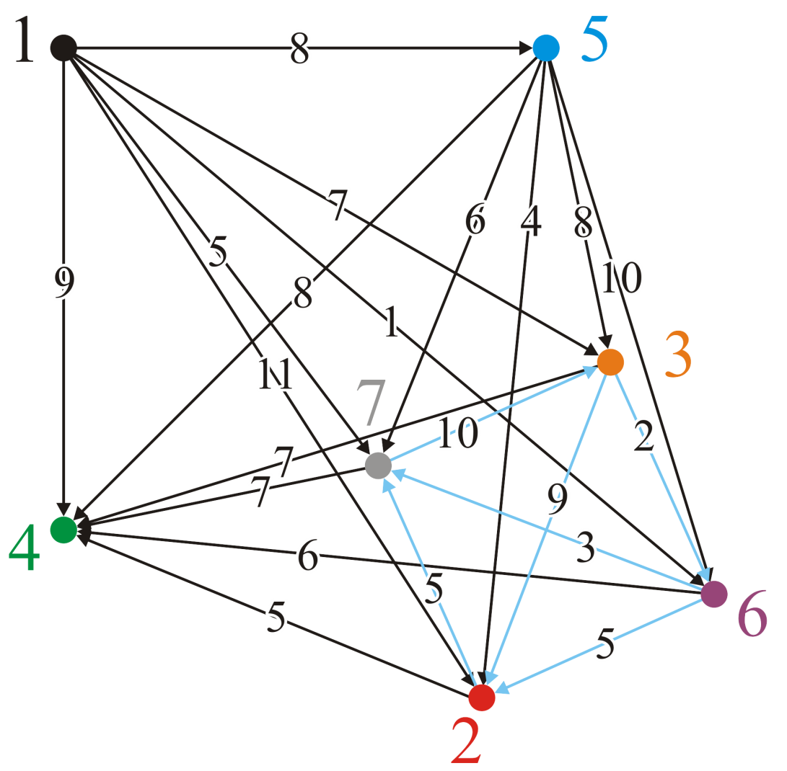
Example
We could reinterpret this graph as follows:
Vertices {v₂, v₃, v₆, v₇} form a strongly connected subgraph
You can get from any one vertex to any other
Given the transitive closure graph, we can find the strongly connected
components

Slide 74
Summary
This topic:
The concept of all-pairs shortest paths
The Floyd-Warshall algorithm
Finding the shortest paths
Finding the transitive closure
Notes:
74

