Slide 1

Algorithm Analysis
Algorithm Analysis
Textbook Ch 2,3
Notes:
Adapted from slides by Douglas Wilhelm Harder of U Waterloo (https://ece.uwaterloo.ca/~dwharder/aads/Lecture_materials/)
Contains material from slides at https://courses.cs.washington.edu/courses/cse326/03wi/326lecturesb.shtml (by Dan Suciu of U Washington)
重点应该是落在各种symbol的意义，关系，以及best worst average case吧。Outline里面4个主题都留了基础的需要总结讲解的例子，后面有一些具体的例子比如selection sort因为后面要单独讲就隐藏了。

Slide 2
Outline
Justification for analysis
Landau symbols
Run time of programs
Best-, worst-, and average-case

Slide 3
Comparing algorithms
Suppose we have two algorithms. How can we tell which is better?
We could implement both algorithms, run them both
Expensive and error prone
Preferably, we should analyze them mathematically
Algorithm analysis

Slide 4
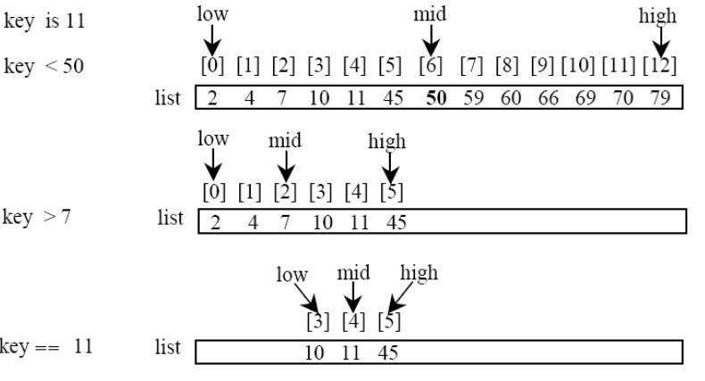
Example
Find a item in a sorted array of length N
Algorithm 1: Linear search (check each item from left to right)
Do you use this approach when looking up a word in a dictionary?
Algorithm 2: Binary search

Slide 5
Implementation
Algorithm 1: Linear search
int lfind(int key, int a[], int n)
{ if (n==0) return –1;
if (key == a[n-1]) return n-1;
return lfind(key, a, n-1);
}
Algorithm 2: Binary search (demo)
int bfind(int key, int a[], int left, int right)
{ if (left+1 == right) return –1;
int m = (left + right) / 2;
if (key == a[m]) return m;
if (key < a[m]) return bfind(key, a, left, m);
else return bfind(key, a, m, right);
}

Slide 6
Empirical comparison
// create an array [0,1,2,…,n-1]
for (i=0; i<n; i++) a[i] = i;
// search each item in the array
for (i=0; i<n; i++) lfind(i,a,n);
or bfind(i,a,-1,n)

Slide 7
Empirical comparison

Slide 8
Empirical comparison

Slide 9
Empirical comparison

Slide 10
Empirical comparison
slope ≈ 2
slope ≈ 1
Recall: we search n times Linear = O(n²)
Binary = O(n log n)

Slide 11
Analytical comparison
Linear search
O(n)
Binary search
O(log n)
So binary search is better than linear search

Slide 12
Asymptotic Analysis
In general, we will always analyze algorithms with respect to one or more variables
We will begin with one variable:
The number of items n currently stored in an array or other data structure
The number of items expected to be stored in an array or other data structure
The dimensions of an n × n matrix
Examples with multiple variables:
Dealing with n objects stored in m memory locations
Multiplying a k × m and an m × n matrix
Dealing with sparse matrices of size n × n with m non-zero entries

Slide 13
Asymptotic Analysis
Given an algorithm, we want to describe its computational cost mathematically and in a machine-independent way
For this, we need Landau symbols (a.k.a. Big-O notation) and the associated asymptotic analysis

Slide 14
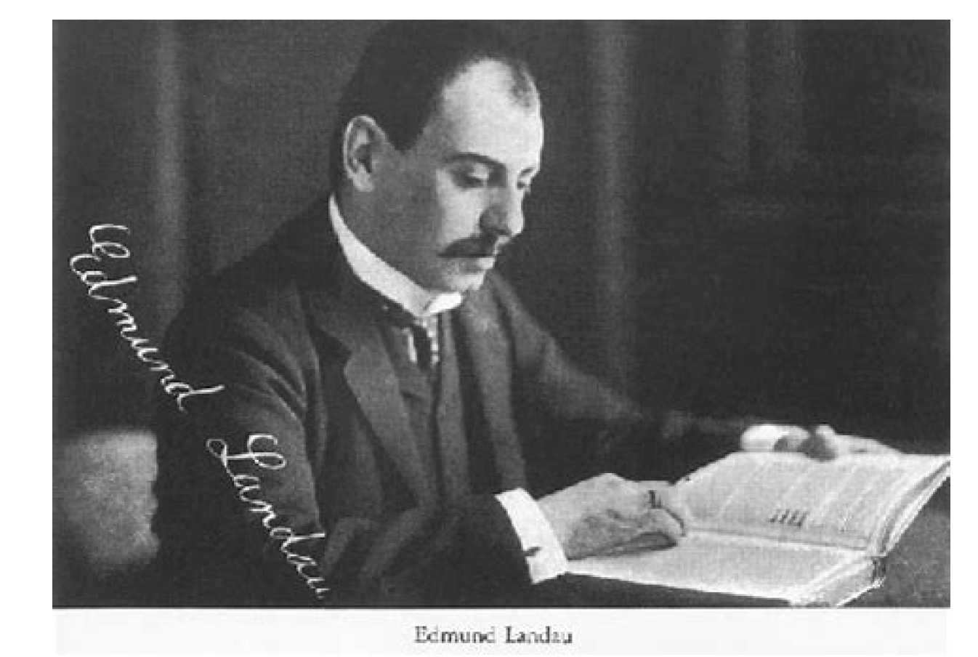
Outline
Justification for analysis
Landau symbols
Run time of programs
Best-, worst-, and average-case

Slide 15
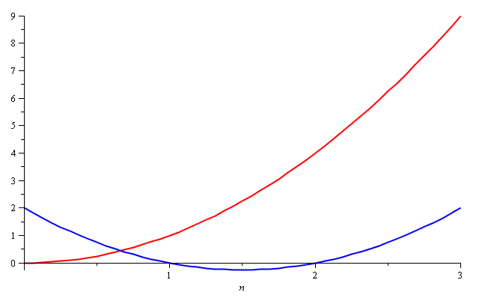
Quadratic Growth
Consider the two functions
f(n) = n² and g(n) = n² – 3n + 2
Around n = 0, they look very different

Slide 16
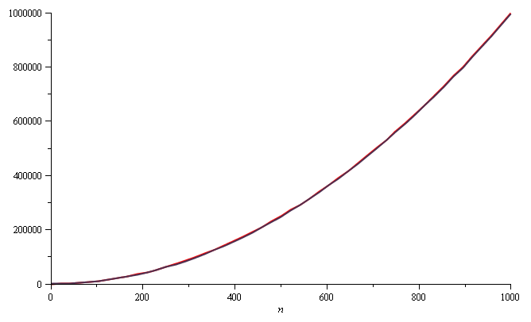
Quadratic Growth
Yet on the range n = [0, 1000], they are (relatively) indistinguishable:

Slide 17
Quadratic Growth
The absolute difference is large, for example,
f(1000) = 1 000 000
g(1000) = 997 002
but the relative difference is very small
and this difference goes to zero as n → ∞

Slide 18
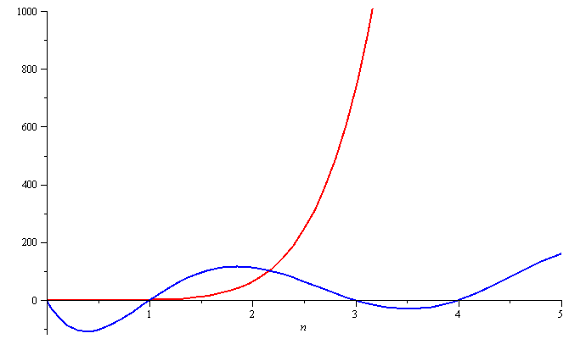
Polynomial Growth
To demonstrate with another example,
f(n) = n⁶ and g(n) = n⁶ – 23n⁵+193n⁴ –729n³+1206n² – 648n
Around n = 0, they are very different

Slide 19
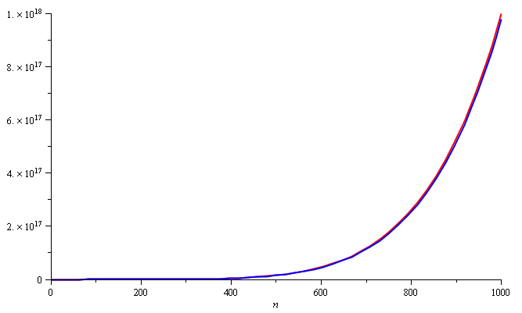
Polynomial Growth
Still, around n = 1000, the relative difference is less than 3%

Slide 20
Polynomial Growth
The justification for both pairs of polynomials being similar is that, in both cases, they each had the same leading term:
n² in the first case, n⁶ in the second
What if the coefficients of the leading terms were different?
In this case, both functions would exhibit the same rate of growth, however, one would always be proportionally larger
However, if the two functions describe the run-time of two algorithms
We can always run the slower algorithm on a faster computer to make them equally fast
In contrast: can we make linear search equally fast to binary search by using a faster computer (say, an Ultimate Laptop)?

Slide 21
Weak ordering
Consider the following definitions:
We will consider two functions to be equivalent, f ~ g, if
where
We will state that f < g if
For functions we are interested in, these define a weak ordering

Slide 22
Weak ordering
Let f(n) and g(n) describe the run-time of two algorithms
If f(n) ~ g(n), then it is always possible to improve the performance of one function over the other by purchasing a faster computer
If f(n) < g(n), then you can never purchase a computer fast enough so that the second function always runs in less time than the first
Notes:
Note that for small values of n, it may be reasonable to use an algorithm that is asymptotically more expensive, but we will consider these on a one-by-one basis

Slide 23
Some Assumptions
We will make some assumptions:
Our functions will describe the time or memory required to solve a problem of size n
We are restricting ourselves to certain functions:
They are defined for n ≥ 0
They are strictly positive for all n
In fact, f(n) > c for some value c > 0
That is, any problem requires at least one instruction and byte
They are increasing (monotonic increasing)

Slide 24
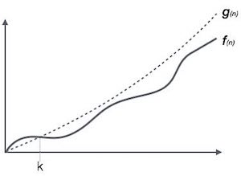
Landau Symbols
Better known as big O notation
A function f(n) = O(g(n)) if there exists k and c such that
f(n) < c g(n)
whenever n > k
The function f(n) has a rate of growth no greater than that of g(n)

Slide 25
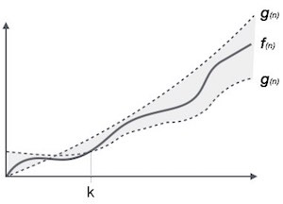
Landau Symbols
Another Landau symbol is Θ
A function f(n) = Θ(g(n)) if there exist positive k, c₁, and c₂ such that
c₁ g(n) < f(n) < c₂ g(n)
whenever n > k
The function f(n) has a rate of growth equal to that of g(n)

Slide 26
Landau Symbols
If f(n) and g(n) are polynomials of the same degree with positive leading coefficients:
where
From the definition, this means given c > ε > 0 there
exists a k > 0 such that whenever n > k
That is,

Slide 27
Landau Symbols
If where , it follows that f(n) = Θ(g(n))

Slide 28
Landau Symbols
We have a similar definition for O:
If where , it follows that f(n) = O(g(n))
There are other possibilities we would like to describe:
If , we will say f(n) = o(g(n))
The function f(n) has a rate of growth less than that of g(n)
We would also like to describe the opposite cases:
The function f(n) has a rate of growth greater than that of g(n)
The function f(n) has a rate of growth greater than or equal to that of g(n)

Slide 29
Landau Symbols
We will at times use five possible descriptions

Slide 30
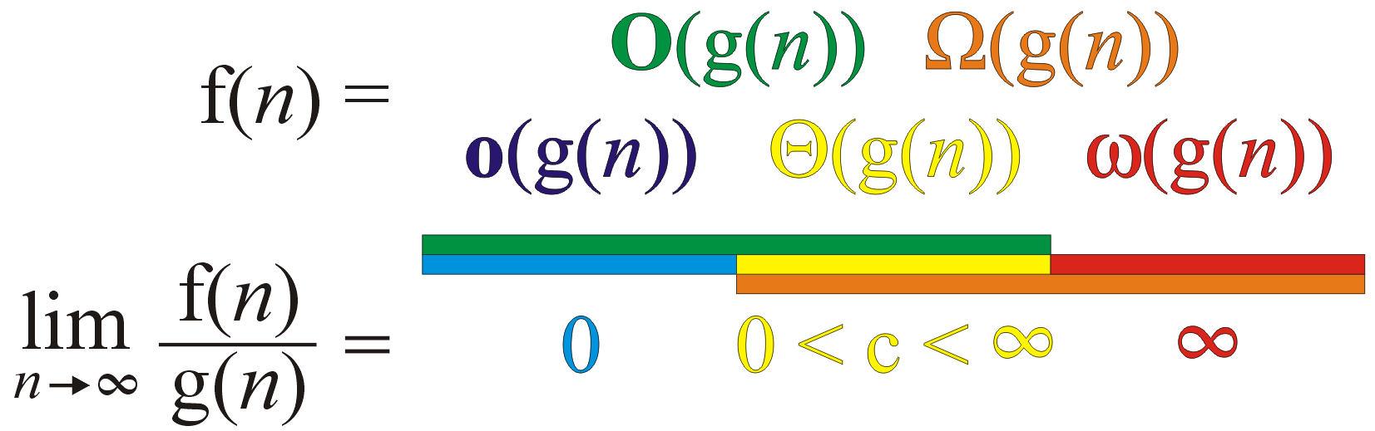
Landau Symbols
Graphically, we can summarize these as follows:
We say
if

Slide 31
Landau Symbols
For the functions we are interested in, it can be said that
f(n) = O(g(n)) is equivalent to f(n) = Θ(g(n)) or f(n) = o(g(n))
and
f(n) = Ω(g(n)) is equivalent to f(n) = Θ(g(n)) or f(n) = ω(g(n))

Slide 32
Landau Symbols
Some other observations we can make are:
f(n) = Θ(g(n)) ⇔ g(n) = Θ(f(n))
f(n) = O(g(n)) ⇔ g(n) = Ω(f(n))
f(n) = o(g(n)) ⇔ g(n) = ω(f(n))

Slide 33
Big-Θ as an Equivalence Relation
If we look at the first relationship, we notice that f(n) = Θ(g(n)) seems to describe an equivalence relation:
1. f(n) = Θ(g(n)) if and only if g(n) = Θ(f(n))
2. f(n) = Θ(f(n))
3. If f(n) = Θ(g(n)) and g(n) = Θ(h(n)), it follows that f(n) = Θ(h(n))
Consequently, we can group all functions into equivalence classes, where all functions within one class are big-theta Θ of each other

Slide 34
Big-Θ as an Equivalence Relation
For example, all of
n² 100000 n² – 4 n + 19 n² + 1000000
323 n² – 4 n ln(n) + 43 n + 10 42n² + 32
n² + 61 n ln²(n) + 7n + 14 ln³(n) + ln(n)
are big-Θ of each other
E.g., 42n² + 32 = Θ( 323 n² – 4 n ln(n) + 43 n + 10 )

Slide 35
Big-Θ as an Equivalence Relation
We will select just one element to represent the entire class of these functions: n²
We could choose any function, but this is the simplest

Slide 36
Big-Θ as an Equivalence Relation
The most common classes are given names:
Θ(1) constant
Θ(ln(n)) logarithmic
Θ(n) linear
Θ(n ln(n)) “n log n”
Θ(n²) quadratic
Θ(n³) cubic
2^{n}, e^{n}, 4^{n}, ... exponential

Slide 37
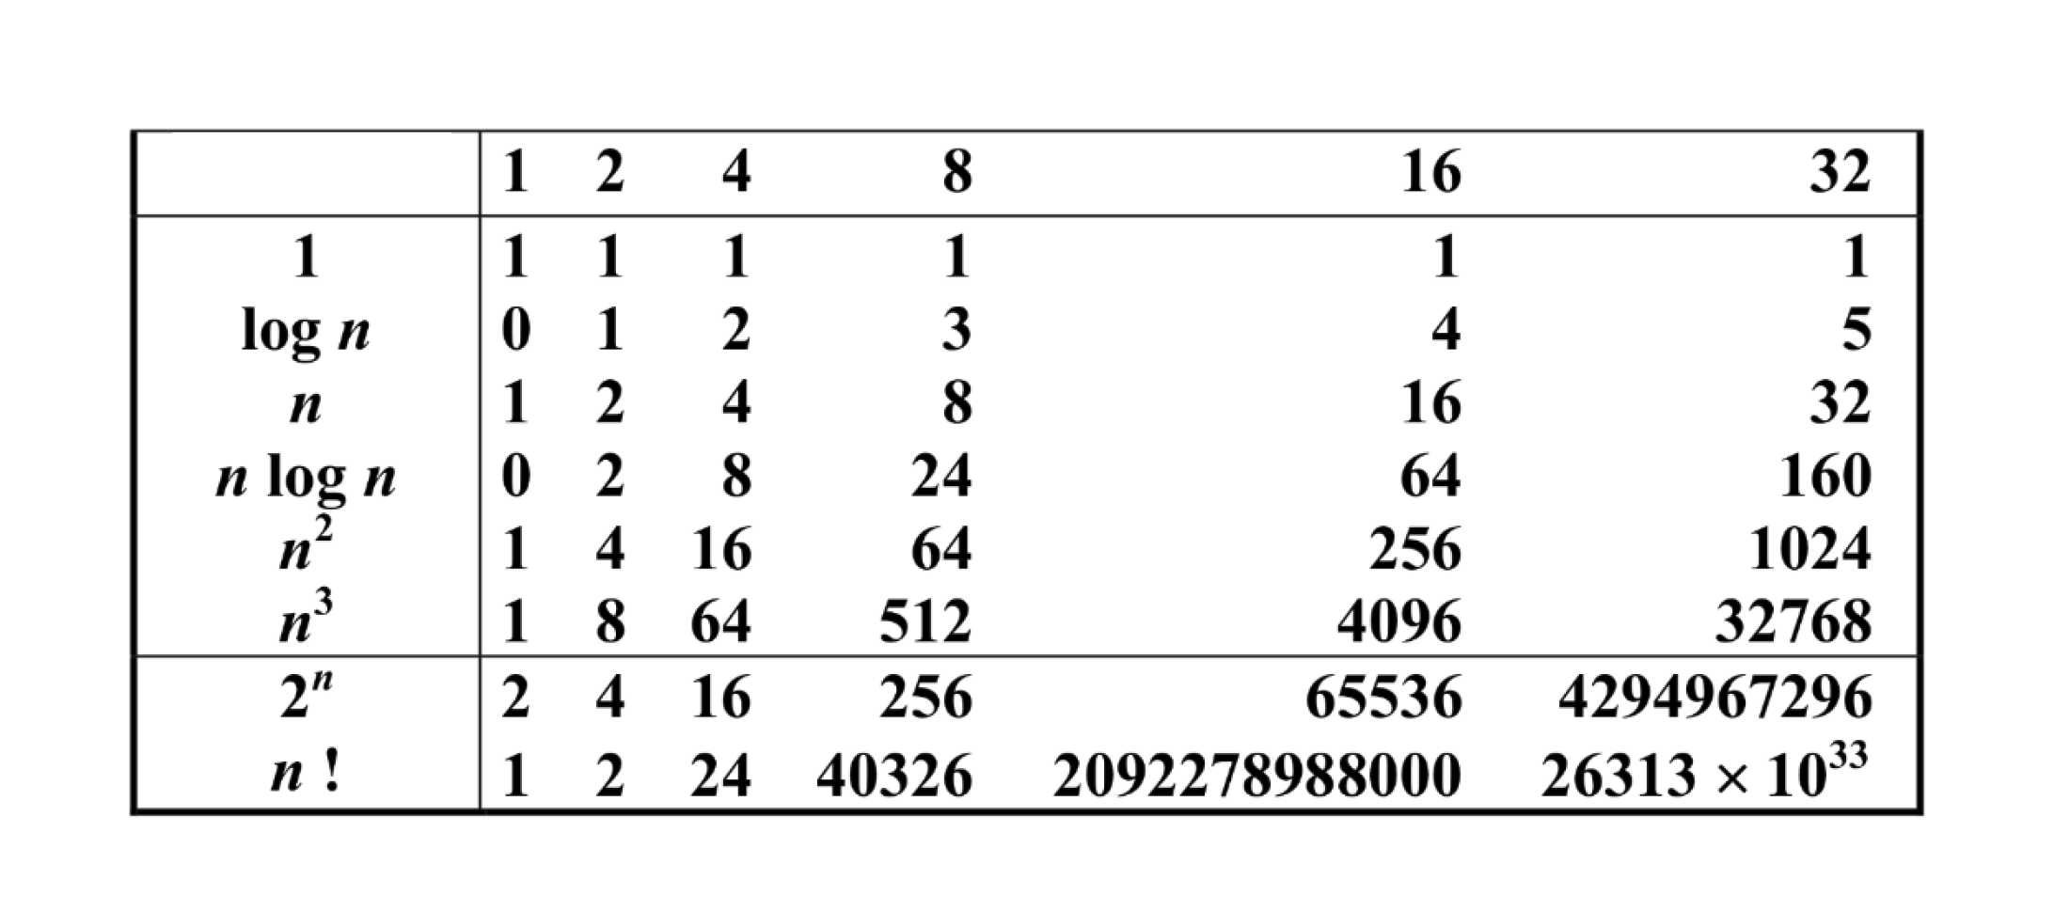
Empirical comparison

Slide 38
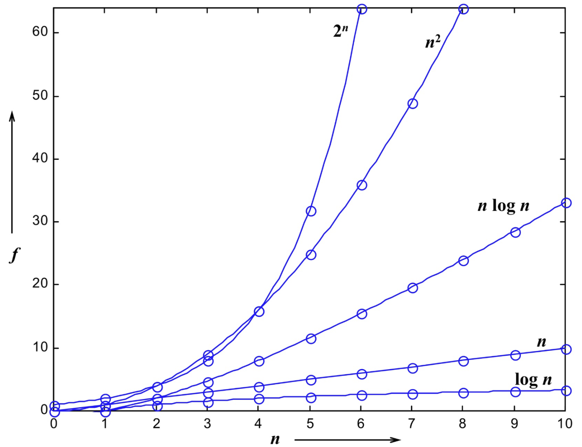
Empirical comparison plot

Slide 39
Logarithms and Exponentials
Recall that all logarithms are scalar multiples of each other
Therefore log_{b}(n)= Θ(ln(n)) for any base b
On the other hand, there is no single equivalence class for exponential functions:
If 1 < a < b,
Therefore a^{n} = o(b^{n})
But any exponentially growing function is almost universally undesirable to have!

Slide 40
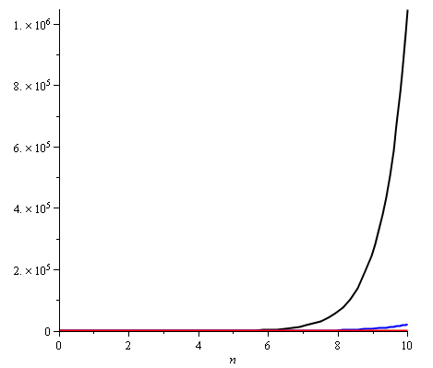
Logarithms and Exponentials
Plotting 2^{n}, e^{n}, and 4^{n} on the range [1, 10] already shows how significantly different the functions grow
Note:
2¹⁰ = 1024
e¹⁰ ≈ 22 026
4¹⁰ = 1 048 576

Slide 41
Little-o as a Weak Ordering
We can show that, for example
ln( n ) = o( n^{p} )
for any p > 0
Proof: Using l’Hôpital’s rule, we have
Conversely, 1 = o(ln( n ))

Slide 42
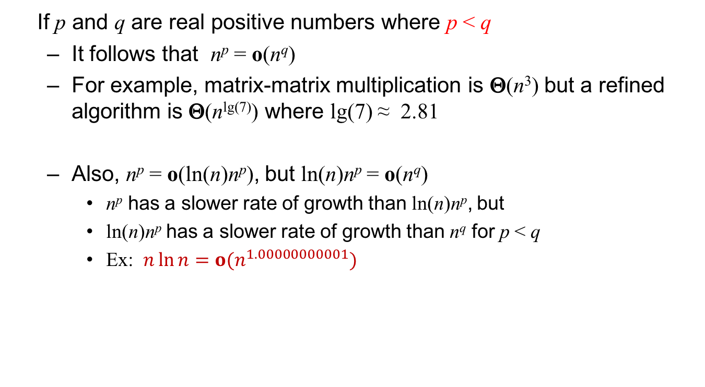
Little-o as a Weak Ordering
If p and q are real positive numbers where p < q
It follows that n^{p} = o(n^{q})
For example, matrix-matrix multiplication is Θ(n³) but a refined algorithm is Θ(n^{lg(7)}) where lg(7) ≈ 2.81
Also, n^{p} = o(ln(n)n^{p}), but ln(n)n^{p} = o(n^{q})
n^{p} has a slower rate of growth than ln(n)n^{p}, but
ln(n)n^{p} has a slower rate of growth than n^{q} for p < q
Ex: $n\ln{n=o(n^{1.00000000001})}$

Slide 43
Little-o as a Weak Ordering
If we restrict ourselves to functions f(n) which are Θ(n^{p}) and Θ(ln(n)n^{p}), we note:
It is never true that f(n) = o(f(n))
If f(n) ≠ Θ(g(n)), it follows that either
f(n) = o(g(n)) or g(n) = o(f(n))
If f(n) = o(g(n)) and g(n) = o(h(n)), it follows that f(n) = o(h(n))
This defines a weak ordering!

Slide 44
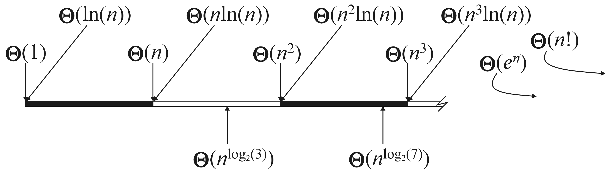
Little-o as a Weak Ordering
Graphically, we can show this relationship by marking these against the real line

Slide 45
Outline
Justification for analysis
Landau symbols
Run time of programs
Best-, worst-, and average-case

Slide 46
Algorithms Analysis
The goal of algorithm analysis is to determine the asymptotic run time or memory requirements based on various parameters
We will use Landau symbols to describe the complexity of algorithms. E.g.,
Given an array of size n:
Selection sort requires Θ(n²) time
Merge sort, quick sort, and heap sort all require Θ(n ln(n)) time
However:
Merge sort requires Θ(n) additional memory
Quick sort requires Θ(ln(n)) additional memory
Heap sort requires Θ(1) additional memory

Slide 47
Algorithms Analysis
An algorithm is said to have polynomial time complexity if its run-time may be described by O(n^{d}) for some fixed d ≥ 0
We will consider such algorithms to be efficient
Problems that have no known polynomial-time algorithms are said to be intractable
Traveling salesman problem: find the shortest path that visits n cities
Best run time: Θ(n² 2^{n})
In general, you don’t want to implement exponential-time or exponential-memory algorithms

Slide 48
Algorithms Analysis
To properly investigate the determination of run times asymptotically:
We will begin with machine instructions and basic operations
Control statements
Conditional-controlled loops
Functions
Recursive functions

Slide 49
Machine Instructions
Given any processor, it is capable of performing only a limited number of operations
These operations are called instructions
The collection of instructions is called the instruction set
The exact set of instructions differs between processors
MIPS, ARM, x86, 6800, 68k
Any instruction runs in a fixed amount of time (an integral number of CPU cycles)

Slide 50
Machine Instructions
Any instruction runs in a fixed amount of time (an integral number of CPU cycles)
An example on the Coldfire is:
0x06870000000F
which adds 15 to the 7th data register
As humans are not good at hex, this can be programmed in assembly language as
ADDI.L #$F, D7
More in ECE 222

Slide 51
Machine Instructions
Assembly language has an almost one-to-one translation to machine instructions
Assembly language is a low-level programming language
Other programming languages are higher-level:
Fortran, Pascal, Matlab, Java, C++, and C#
The adjective “high” refers to the level of abstraction:
Java, C++, and C# have abstractions such as OO
Matlab and Fortran have operations which do not map to relatively small number of machine instructions:
>> 1.27^2.9 % 1.27**2.9 in Fortran
2.0000036616123606774

Slide 52
Machine Instructions
The C programming language (C++ without objects and other abstractions) can be referred to as a mid-level programming language
There is abstraction, but the language is closely tied to the standard capabilities
There is a closer relationship between operators and machine instructions
Consider the operation a += b;
Assume that the compiler has already has the value of the variable a in register D1 and perhaps b is a variable stored at the location stored in address register A1, this is then converted to the single instruction
ADD (A1), D1

Slide 53
Operators
There is a close relationship between basic operations and machine instructions, so we may assume each operation requires a fixed number of CPU cycles, i.e., Θ(1) time:
Variable assignment =
Integer operations + - * / % ++ --
Logical operations && || !
Bitwise operations & | ^ ~
Relational operations == != < <= >= >
Memory allocation and deallocation new delete

Slide 54
Operators
Of these, memory allocation and deallocation are the slowest by a significant factor
A quick test on eceunix shows a factor of over 100
They require communication with the operation system
This does not account for the time required to call the constructor and destructor
Note that after memory is allocated, the constructor is run
The constructor may not run in Θ(1) time

Slide 55
Blocks of Operations
Each operation runs in Θ(1) time and therefore any fixed number of operations also run in Θ(1) time, for example:
// Swap variables a and b
int tmp = a;
a = b;
b = tmp;

Slide 56
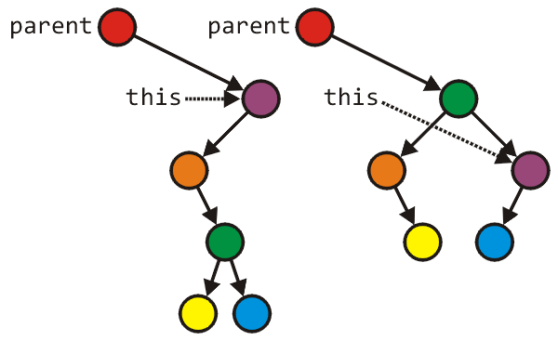
Blocks of Operations
Seldom will you find large blocks of operations without any additional control statements
This example rearranges an AVL tree structure
Tree_node *lrl = left->right->left;
Tree_node *lrr = left->right->right;
parent = left->right;
parent->left = left;
parent->right = this;
left->right = lrl;
left = lrr;
Run time: Θ(1)

Slide 57
Blocks in Sequence
Θ(1)
Θ(n)
Θ(1)
Suppose you have now analyzed a number of blocks of code run in sequence
template <typename T>
void update_capacity( int delta ) {
T *array_old = array;
int capacity_old = array_capacity; array_capacity += delta;
array = new T[array_capacity];
for ( int i = 0; i < capacity_old; ++i ) {
array[i] = array_old[i];
}
delete[] array_old;
}
To calculate the total run time, add the entries: Θ(1 + n + 1) = Θ(n)

Slide 58
Blocks in Sequence
template <int M, int N>
Matrix<M, N> &Matrix<M, N>::operator= ( Matrix<M, N> const &A ) {
if ( &A == this ) {
return *this;
}
if ( capacity != A.capacity ) {
delete [] column_index;
delete [] off_diagonal;
capacity = A.capacity;
column_index = new int[capacity];
off_diagonal = new double[capacity];
}
for ( int i = 0; i < minMN; ++i ) {
diagonal[i] = A.diagonal[i];
}
for ( int i = 0; i <= M; ++i ) {
row_index[i] = A.row_index[i];
}
for ( int i = 0; i < A.size(); ++i ) {
column_index[i] = A.column_index[i];
off_diagonal[i] = A.off_diagonal[i];
}
return *this;
}
Θ(1)
Θ(1 + 1 + min(M, N) + M + n + 1)
= Θ(M + n)
Note that min(M, N) ≤ M
We cannot say anything about M and n. As a convention, we keep both.
Θ(1)
Θ(min(M, N))
Θ(M)
Θ(n)
Θ(1)
Notes:
Defining big-O with multiple variables is tricky. Ref: http://people.cs.ksu.edu/~rhowell/asymptotic.pdf

Slide 59
Blocks in Sequence
Other examples:
Run three blocks of code which are Θ(1), Θ(n²), and Θ(n)
Total run time Θ(1 + n² + n) = Θ(n²)
Run two blocks of code which are Θ(n ln(n)), and Θ(n^{1.5})
Total run time Θ(n ln(n) + n^{1.5}) = Θ(n^{1.5})
Recall this linear ordering from the previous topic
When considering a sum, take the dominant term

Slide 60
Blocks in Sequence
What if we have both big O and big Theta?
if the leading term is big-Θ, then the result must be big-Θ, otherwise
if the leading term is big-O, we can say the result is big-O
For example,
O(n) + O(n²) + O(n⁴) = O(n + n² + n⁴) = O(n⁴)
O(n) + Θ(n²) = Θ(n²)
O(n²) + Θ(n) = O(n²)
O(n²) + Θ(n²) = Θ(n²)

Slide 61
Control Statements
Next, we will look at the following control statements
These are statements which potentially alter the execution of instructions
Conditional statements
if, switch
Condition-controlled loops
for, while, do-while
Count-controlled loops
for i from 1 to 10 do ... end do; # Maple
Collection-controlled loops
foreach ( int i in array ) { ... } // C#

Slide 62
Control Statements
Given any collection of nested control statements, it is always necessary to work inside out
Determine the run times of the inner-most statements and work your way out
for(i=0; i<n; i++) {
// do something...
for(j=0; j<m; j++) {
// do something else...
}
}

Slide 63
Control Statements
Given
if ( condition ) {
// true body
} else {
// false body
}
The run time of a conditional statement is:
the run time of the condition (the test), plus
the run time of the body which is run
In most cases, the run time of the condition is Θ(1)

Slide 64
Control Statements
In some cases, it is easy to determine which statement must be run:
int factorial ( int n ) {
if ( n == 0 ) {
return 1;
} else {
return n * factorial ( n – 1 );
}
}

Slide 65
Control Statements
In others, it is less obvious
Find the maximum entry in an array:
int find_max( int *array, int n ) {
max = array[0];
for ( int i = 1; i < n; ++i ) {
if ( array[i] > max ) {
max = array[i];
}
}
return max;
}

Slide 66
Control Statements
If we had information about the distribution of the entries of the array, we may be able to determine it
if the list is sorted (ascending) it will always be run
if the list is sorted (descending) it will never be run
if the list is randomly distributed, then??? We don’t know.

Slide 67
Control Statements
Conditional
if C then S1 else S2
Suppose you are doing a big O analysis
Time(C) + Max(Time(S1),Time(S2)) or
Time(C)+Time(S1)+Time(S2) ?

Slide 68
Conditional Statements
Consider this example
void Disjoint_sets::clear() {
if ( sets == n ) {
return;
}
max_height = 0;
num_disjoint_sets = n;
for ( int i = 0; i < n; ++i ) {
parent[i] = i;
tree_height[i] = 0;
}
}
Θ(1)
Θ(1)
Θ(n)

Slide 69
Condition-controlled Loops
The C++ for loop is a condition controlled statement:
for ( int i = 0; i < N; ++i ) {
// ...
}
is identical to
int i = 0; // initialization
while ( i < N ) { // condition
// ...
++i; // increment
}

Slide 70
Condition-controlled Loops
The initialization, condition, and increment usually are single statements running in Θ(1)
for ( int i = 0; i < N; ++i ) {
// ...
}

Slide 71
Condition-controlled Loops
If the body does not depend on the variable (in this example, i), then the run time of
for ( int i = 0; i < n; ++i ) {
// code which is Theta(f(n))
}
is Θ(n f(n))
If the body is O(f(n)), then the run time of the loop is O(n f(n))

Slide 72
Condition-controlled Loops
For example,
int sum = 0;
for ( int i = 0; i < n; ++i ) {
sum += 1; // Theta(1)
}
This code has run time
Θ(n·1) = Θ(n)

Slide 73
Condition-controlled Loops
Another example
int sum = 0;
for ( int i = 0; i < n; ++i ) {
for ( int j = 0; j < n; ++j ) {
sum += 1; // Theta(1)
}
}
The previous example showed that the inner loop is Θ(n), thus the outer loop is
Θ(n·n) = Θ(n²)

Slide 74
Analysis of Repetition Statements
Suppose with each loop, we use a linear search an array of size m:
for ( int i = 0; i < n; ++i ) {
// search through an array of size m
// O( m );
}
The inner loop is O(m) and thus the outer loop is
O(n m)

Slide 75
Condition-controlled Loops
Another example
int sum = 0;
for ( int i = 0; i < n; ++i ) {
for ( int j = 0; j < i; ++j ) {
sum += i + j;
}
}
The inner loop is Θ(i), hence the outer is

Slide 76
Analysis of Repetition Statements
Final example:
int sum = 0;
for ( int i = 0; i < n; ++i ) {
for ( int j = 0; j < i; ++j ) {
for ( int k = 0; k < j; ++k ) {
sum += i + j + k;
}
}
}
From inside to out:
Θ(1)
Θ(j)
Θ(i²)
Θ(n³)

Slide 77
Control Statements
Switch statements appear to be nested if statements:
switch( i ) {
case 1: /* do stuff */ break;
case 2: /* do other stuff */ break;
case 3: /* do even more stuff */ break;
case 4: /* well, do stuff */ break;
case 5: /* tired yet? */ break;
default: /* do default stuff */
}

Slide 78
Control Statements
Thus, a switch statement would appear to run in O(n) time where n is the number of cases, the same as nested if statements
Why then not use:
if ( i == 1 ) { /* do stuff */ }
else if ( i == 2 ) { /* do other stuff */ }
else if ( i == 3 ) { /* do even more stuff */ }
else if ( i == 4 ) { /* well, do stuff */ }
else if ( i == 5 ) { /* tired yet? */ }
else { /* do default stuff */ }

Slide 79
Control Statements
Question:
Why would you introduce something into
programming language which is redundant?
There are reasons for this:
your name is Larry Wall and you are creating the Perl (not PERL) programming language
you are introducing software engineering constructs, for example, classes

Slide 80
Control Statements
However, switch statements were included in the original C language... why?
First, you may recall that the cases must be actual values, either:
integers
characters
For example, you cannot have a case with a variable, e.g.,
case n: /* do something */ break; //bad

Slide 81
Control Statements
The compiler looks at the different cases and calculates an appropriate jump
For example, assume:
the cases are 0, 1, 2, 3, 4, 5, 6, 7, 8, 9, 10
each case requires a maximum of 24 bytes (for example, six instructions)
Then the compiler simply makes a jump size based on the variable, jumping ahead either 0, 24, 48, 72, ..., or 240 instructions

Slide 82
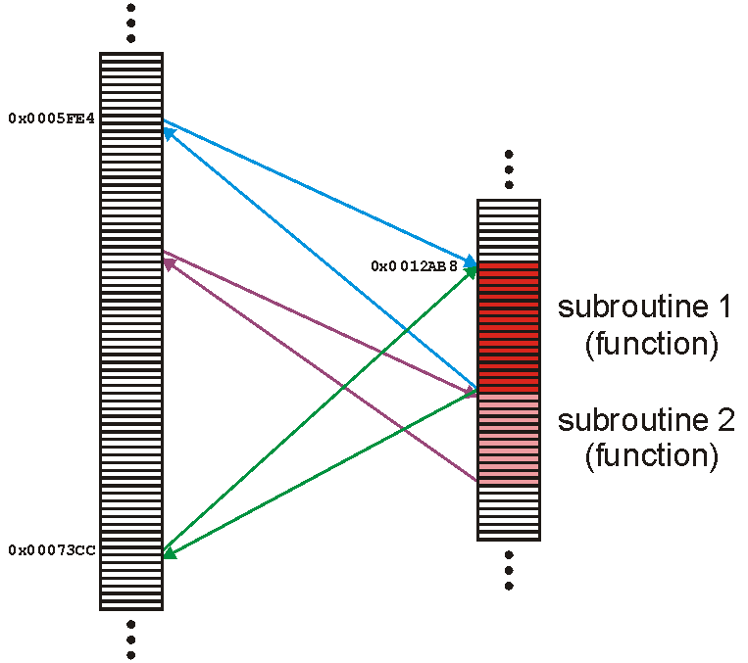
Functions
A function (or subroutine) is code which has been separated out:
repeated operations
e.g., mathematical functions
to group related tasks
e.g., initialization

Slide 83
Functions
Because a subroutine (function) can be called from anywhere, we must:
prepare the appropriate environment
deal with arguments (parameters)
jump to the subroutine
execute the subroutine
deal with the return value
clean up
We will assume that the overhead required to make a function call and to return is Θ(1).

Slide 84
Functions
Fortunately, this is such a common task that all modern processors have instructions that perform most of these steps in one instruction
Thus, we will assume that the overhead required to make a function call and to return is Θ(1) an
We will discuss this later (stacks/ECE 222)

Slide 85
Functions
Because any function requires the overhead of a function call and return, we will always assume that
T_{f} = Ω(1)
That is, it is impossible for any function call to have a zero run time

Slide 86
Functions
Given a function f(n) (the run time of which depends on n) we will associate the run time of f(n) by some function T_{f}(n)
We may write this as T(n)
This includes the time required to both call and return from the function

Slide 87
Functions
T_{set_union}= 2T_{find} + Θ(1)
2T_{find}
Θ(1)
Consider this function:
void Disjoint_sets::set_union( int m, int n ) {
m = find( m );
n = find( n );
if ( m == n ) {
return;
}
--num_disjoint_sets;
if ( tree_height[m] >= tree_height[n] ) {
parent[n] = m;
if ( tree_height[m] == tree_height[n] ) {
++( tree_height[m] );
max_height = std::max( max_height, tree_height[m] );
}
} else {
parent[m] = n;
}
}

Slide 88
Recursive Functions
A function is relatively simple (and boring) if it simply performs operations and calls other functions
Most interesting functions designed to solve problems usually end up calling themselves
Such a function is said to be recursive

Slide 89
Recursive Functions
As an example, we could implement the factorial function recursively:
int factorial( int n ) {
if ( n <= 1 ) {
return 1;
} else {
return n * factorial( n – 1 );
}
}

Slide 90
Recursive Functions
The analysis of the run time of this function yields a recurrence relation:
T!(n) = T!(n – 1) + Θ(1) T!(1) = Θ(1)
This recurrence relation has Landau symbols…
Replace each Landau symbol with a representative function:
T!(n) = T!(n – 1) + 1 T!(1) = 1
Then it is easy to prove that T!(n) = Θ(n)

Slide 91
Recursive Functions
Suppose we want to sort a array of n items
We could:
go through the list and find the largest item
swap the last entry in the list with that largest item
then, go on and sort the rest of the array
This is called selection sort

Slide 92
Recursive Functions
void sort( int * array, int n ) {
if ( n <= 1 ) {
return; // special case: 0 or 1 items are always sorted
}
int posn = 0; // assume the first entry is the smallest
int max = array[posn];
for ( int i = 1; i < n; ++i ) { // search through the remaining entries
if ( array[i] > max ) { // if a larger one is found
posn = i; // update both the position and value
max = array[posn];
}
}
int tmp = array[n - 1]; // swap the largest entry with the last
array[n - 1] = array[posn];
array[posn] = tmp;
sort( array, n – 1 ); // sort everything else
}

Slide 93
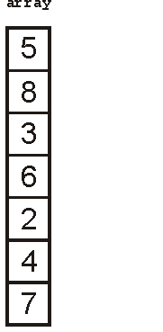
Recursive Functions
We could call this function as follows:
int array[7] = {5, 8, 3, 6, 2, 4, 7};
sort( array, 7 ); // sort an array of seven items

Slide 94
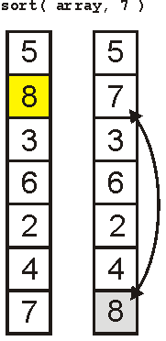
Recursive Functions
The first call finds the largest element

Slide 95
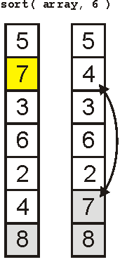
Recursive Functions
The next call finds the 2nd-largest element

Slide 96
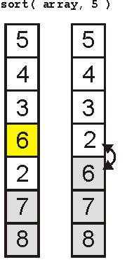
Recursive Functions
The third finds the 3rd-largest

Slide 97
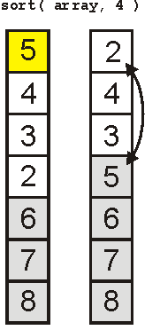
Recursive Functions
And the 4th

Slide 98
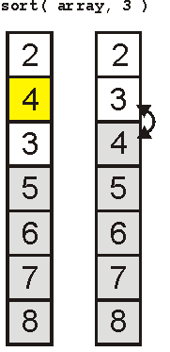
Recursive Functions
And the 5th

Slide 99
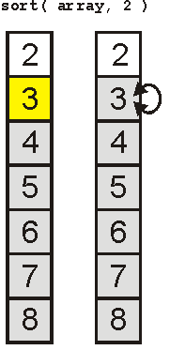
Recursive Functions
Finally the 6th

Slide 100
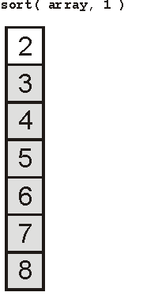
Recursive Functions
And the array is sorted:

Slide 101
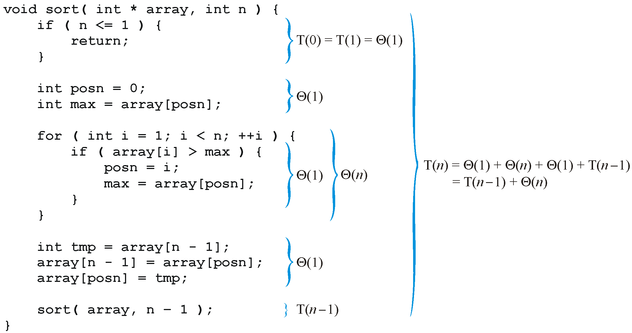
Recursive Functions
Analyzing the function, we get:

Slide 102
Recursive Functions
Thus, replacing each Landau symbol with a representative, we are required to solve the recurrence relation
T(n) = T(n – 1) + n T(1) = 1
The easy way to solve this is with Maple:
> rsolve( {T(n) = T(n – 1) + n, T(1) = 1}, T(n) );
> expand( % );

Slide 103
Recursive Functions
Consequently, the sorting routine has the run time
T(n) = Θ(n²)
To see this by hand, consider the following

Slide 104
Recursive Functions
Now consider binary search of a sorted list:
Check the middle entry
If we do not find it, check either the left- or right-hand side, as appropriate
Thus, T(n) = T((n – 1)/2) + Θ(1)
Also, if n = 1, then T(1) = Θ(1)

Slide 105
Recursive Functions
Thus we have to solve:
Assume n = 2^{k} – 1 where k is an integer
Then (n – 1)/2 = (2^{k} – 1 – 1)/2 = 2^{k – 1} – 1

Slide 106
Recursive Functions
Thus, we can write

Slide 107
Recursive Functions
Notice the pattern with one more step:

Slide 108
Recursive Functions
Thus, in general, we may deduce that after k – 1 steps:
because T(1) = 1

Slide 109
Recursive Functions
Thus, T(n) = k, but n = 2^{k} – 1
Therefore k = lg(n + 1)
Recall that f(n) = Θ(g(n)) if for
Thus, T(n) = Θ(lg(n + 1)) = Θ (ln(n))

Slide 110
Outline
Justification for analysis
Landau symbols
Run time of programs
Best-, worst-, and average-case

Slide 111
Cases
When determining the run time of an algorithm, because the data may not be deterministic, we may be interested in:
Best-case run time
Average-case run time
Worst-case run time
In many cases, these will be significantly different

Slide 112
Cases
Searching a list linearly is simple enough
We will count the number of comparisons
Best case:
The first element is the one we’re looking for: O(1)
Worst case:
The last element is the one we’re looking for, or it is not in the list: O(n)
Average case?
We need some information about the list...

Slide 113
Cases
Assume the item we are looking for is in the list and equally likely distributed
If the list is of size n, then there is a 1/n chance of it being in the ith location
Thus, we sum
which is O(n)

Slide 114
Cases
2
Suppose we have a different distribution:
there is a 50% chance that the element is the first
for each subsequent element, the probability is reduced by ½
We could write:
which is O(1)
Notes:
假设剩下的一半里面，百分之五十的概率在第一个element

Slide 115
Cases
Best-case run time
Not so useful
Average-case run time
Need to choose a distribution over input instances
Average-case analysis may tell us more about the choice of distributions than about the algorithm itself.
Worst-case run time
Most widely used to capture efficiency in practice.
Draconian view, but hard to find effective alternative.
Exceptions: some worst-case exponential-time algorithms are widely used because the worst-case instances seem to be rare.
E.g., the simplex algorithm

Slide 116
Cases
Previously, we had an example where we were looking for the number of times a particular assignment statement was executed:
int find_max( int * array, int n ) {
max = array[0];
for ( int i = 1; i < n; ++i ) {
if ( array[i] > max ) {
max = array[i];
}
}
return max;
}
Notes:
只要max被选出来，后面就不需要执行了
一直需要执行的情况：第i个是前面i个里面最大的

Slide 117
Cases
This example is taken from Preiss
The best case was once (first element is largest)
The worst case was n times
For the average case, we must consider:
What is the probability that the i^{th} object is the largest of the first i objects?
Notes:
一直需要执行的情况：第i个是前面i个里面最大的

Slide 118
Cases
To consider this question, we must assume that elements in the array are evenly distributed
Thus, given a sub-list of size k, the probability that any one element is the largest is 1/k
Thus, given a value i, there are i + 1 objects, hence

Slide 119
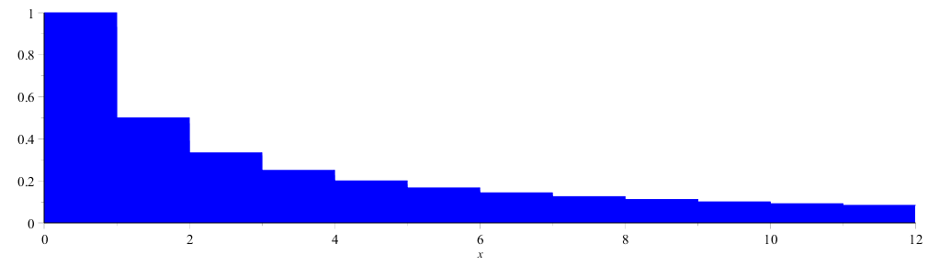
Cases
We can approximate the sum by an integral – what is the area under:

Slide 120
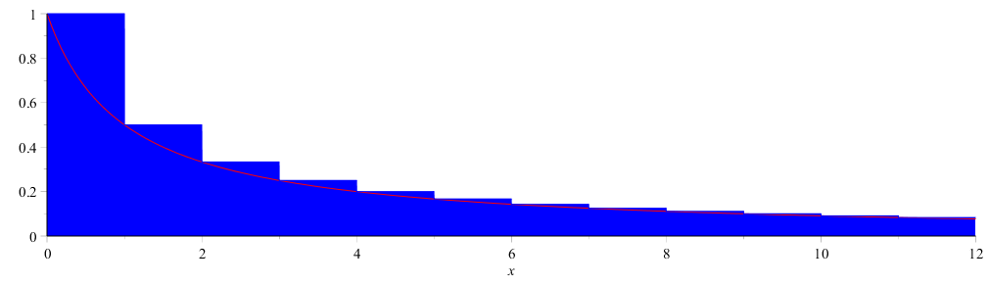
Cases
We can approximate this by the 1/(x + 1) integrated from 0 to n

Slide 121
Cases
From calculus:
How about the error? Our approximation would be useless if the error was O(n)

Slide 122
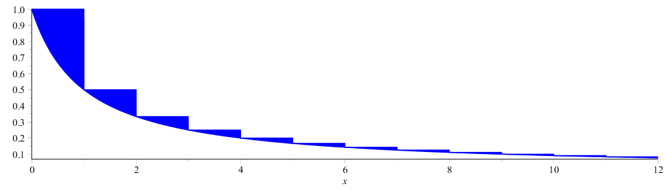
Cases
Consider the following image which highlights the errors
The errors can be fit into the box [0, 1] × [0, 1]

Slide 123
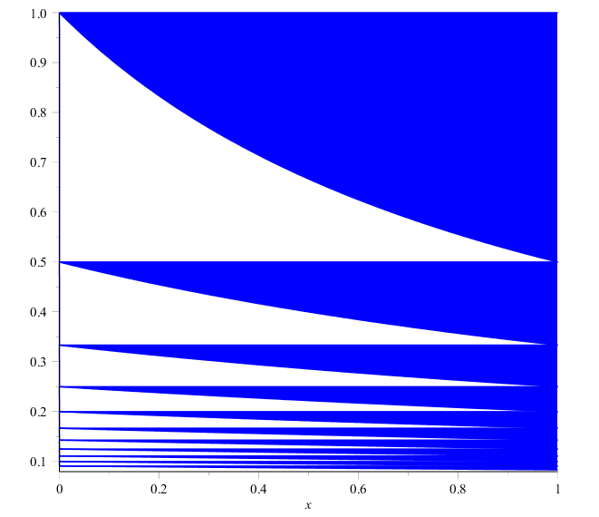
Cases
Consequently, the error must be < 1
In fact, it converges to γ ≈ 0.57721566490
Therefore, the error is Θ(1)

Slide 124
Cases
Thus, the number of times that the assignment statement will be executed, assuming an even distribution is O(ln(n))

Slide 125
Cases
Thus, the total run of:
int find_max( int *array, int n ) {
max = array[0];
for ( int i = 1; i < n; ++i ) {
if ( array[i] > max ) {
max = array[i];
}
}
return max;
}
is

Slide 126
Summary
Justification for analysis
Landau symbols
o O Θ Ω ω
Run time of programs
Basic operations
Control statements
Conditional-controlled loops
Functions
Recursive functions
Best-, worst-, and average-case

