Slide 1

CS101 Algorithms and Data Structures
Hash Table
Textbook Ch 11
Notes:
Adapted from the slides by Douglas Wilhelm Harder of U Waterloo (https://ece.uwaterloo.ca/~dwharder/aads/Lecture_materials/)
May also contain material from the slides at https://courses.cs.washington.edu/courses/cse326/03wi/326lecturesb.shtml (by Dan Suciu of U Washington)

Slide 2
Outline
Introduction
Hash function
Mapping down to 0, ..., M – 1
Dealing with collisions
Chained hash tables
Open addressing

Slide 3
Supporting Example
Suppose we have a system which is associated with approximately 150 error conditions where
Each of which is identified by an 16-bit number from 0 to 65535, and
When an identifier is received, a corresponding error-handling function must be called
We could create an array of 150 function pointers and to then call the appropriate function….

Slide 4
Supporting Example
#include <iostream>
void a() {
std::cout
<< "Calling 'void a()'"
<< std::endl;
}
void b() {
std::cout
<< "Calling 'void b()'"
<< std::endl;
}
int main() {
void (*function_array[150])();
unsigned int error_id[150];
function_array[0] = a;
error_id[0] = 3;
function_array[1] = b;
error_id[1] = 8;
function_array[0]();
function_array[1]();
return 0;
}

Slide 5
Supporting Example
Given an error-condition identifier, e.g., id = 198, how shall we determine which of the 150 slots corresponds to it?
Binary search!
Problems
This is slow: it would require approximately 7 comparisons per error condition
Slow to dynamically add new error conditions or remove defunct conditions

Slide 6
Supporting Example
A better solution:
Create an array of size 65536
Assign those entries corresponding to valid error conditions
Problem: additional memory usage
int main() {
void (*function_array[65536])();
for ( int i = 0; i < 65536; ++i ) {
function_array[i] = nullptr;
}
function_array[3] = a;
function_array[8] = b;
function_array[3]();
function_array[8]();
return 0;
}

Slide 7
IP Addresses
Examples:
Suppose we want to associate IP addresses and any corresponding domain names
Recall that a 32-bit IP address are often written as four byte values from 0 to 255
Consider 10000001 01100001 00001010 10110011₂
This can be written as 129.97.10.179
We use domain names because IP addresses are not human readable

Slide 8
IP Addresses
Given an IP address, sometimes we wanted to quickly find any associated domain name.
We could create an array of size 2³²= 4,294,967,296 of strings!
string domain_name[4294967296];
For example, the IP address of shanghaitech.edu.cn is 10.15.42.202
As 202 + 42×2⁸ + 15×2¹⁶ + 10×2²⁴ = 168766154, it follows that
domain_name[168766154] = "shanghaitech.edu.cn";

Slide 9
IP Addresses
Given an IP address, sometimes we wanted to quickly find any associated domain name.
We could create an array of size 2³²= 4,294,967,296 of strings!
string domain_name[4294967296];
By the end of 2021, the number of domain names is 341.7 million.
So, most part of the array is empty!

Slide 10
IP Addresses
Under IPv6, IP addresses are 128 bits
It combines what is now implemented as subnets as well as allowing for many more IP addresses
We cannot allocate an array of size 2¹²⁸ !

Slide 11
DNS
Given a domain name, we wanted to quickly find the associated IP address.
A domain name can have a maximum of 253 characters!
The number of possible domain names is huge!
Again, we cannot allocate an array for that.

Slide 12

Goal
Our goal:
Store data so that all operations are Θ(1) time
The memory requirement should be Θ(n)
Notes:
In our supporting example, the corresponding function can be called in Θ(1) time and the array is less than twice the optimal size

Slide 13
Simpler problem
Let’s try a simpler problem
How do I store your examination grades so that I can access your grades in Θ(1) time?
Recall that each student is issued an 8-digit number
How do I store your examination grades so that I can access your grades in Θ(1) time?
Create an array of size 10⁸ ≈ 1.5 × 2²⁶ ?

Slide 14
Simpler problem
I could create an array of size 1000
How could you convert an 8-digit number into a 3-digit number?
Idea: the last three digits, which seem random
Therefore, I could store the examination grade of student “10105456” by:
grade[456] = 86;

Slide 15

Simpler problem
Question:
What is the likelihood that in a class of size 100 no two students have the same last three digits?
Not very high :

Slide 16
Simpler problem
Consequently, I have a function that maps a student onto a 3-digit number
I can store the examination grade in that location
Storing it, accessing it, and erasing it is Θ(1)
Problem: two or more students may map to the same number:
Student A has ID 20173456 and scored 85
Student B has ID 20234456 and scored 87
...
...
454
455
456 | 86
457
458
459
460
461
462
463 | 79
464
465
...
...

Slide 17
The hashing problem
The process of mapping an object or a number onto an integer in a given range is called hashing
Problem: multiple objects may hash to the same value
Such an event is termed a collision
Hash tables use a hash function together with a mechanism for dealing with collisions

Slide 18
The hash process
Object
We will break the process into three independent steps:
We will try to get each of these down to Θ(1)
Techniques vary...
32-bit integer
Modulus & Multiplicative
Map to an index 0, ..., M – 1
Deal with collisions
Chained hash tables
Open addressing
Linear probing
Quadratic probing
Double hashing

Slide 19
Outline
Introduction
Hash function
Mapping down to 0, ..., M – 1
Dealing with collisions
Chained hash tables
Open addressing

Slide 20
Definitions
What is a hash of an object?
From Merriam-Webster:
a restatement of something that is already known
The ultimate goal is to map onto an integer range 0, 1, 2, ..., M – 1

Slide 21
Properties
Necessarily, a hash function h should be:
1a. The hash value must be deterministic
It must always return the same 32-bit integer each time
1b. Equal objects hash to equal values
x = y ⇒ h(x) = h(y)
A good hash function h should also be:
1c. Should be fast: e.g. Θ(1)
1d. If two objects are randomly chosen, there should be only a one-in- 2³² chance that they have the same hash value

Slide 22
Types of hash functions
We will look at two classes of hash functions
Predetermined hash functions (explicit)
Arithmetic hash functions (implicit)

Slide 23
Predetermined hash functions
The easiest solution is to give each object a unique number
class Class_name {
private:
unsigned int hash_value; // int: –2³¹, ..., 2³¹ – 1
// unsigned int: 0, ..., 2³² – 1
public:
Class_name();
unsigned int hash() const;
};
Class_name::Class_name() {
hash_value = ???;
}
unsigned int Class_name::hash() const {
return hash_value;
}

Slide 24
Predetermined hash functions
For example, an auto-incremented static member variable
class Class_name {
private:
unsigned int hash_value;
static unsigned int hash_count;
public:
Class_name();
unsigned int hash() const;
};
unsigned int Class_name::hash_count = 0;
Class_name::Class_name() {
hash_value = hash_count;
++hash_count;
}
unsigned int Class_name::hash() const {
return hash_value;
}

Slide 25
Predetermined hash functions
If we only need the hash value while the object exists in memory, use the address:
unsigned int Class_name::hash() const {
return reinterpret_cast<unsigned int>( this );
}
This fails if an object may be stored in secondary memory
It will have a different address the next time it is loaded

Slide 26
Predetermined hash functions
Problem with predetermined hash functions?
Strings with the same characters:
string str1 = "Hello world!";
string str2 = "Hello world!";
Objects which are conceptually equal:
Rational x(1, 2);
Rational y(3, 6);
The previous method would give them different hash values.
But a hash function should “hash equal objects to equal values”
These hash values must depend on the member variables
Usually this uses arithmetic functions

Slide 27
Arithmetic Hash Values
An arithmetic hash value is a deterministic function that is calculated from the relevant member variables of an object
We will look at arithmetic hash functions for:
Strings

Slide 28
Rational number class
What if we just add the numerator and denominator?
class Rational {
private:
int numer, denom;
public:
Rational( int, int );
};
unsigned int Rational::hash() const {
return static_cast<unsigned int>( numer ) +
static_cast<unsigned int>( denom );
}
Very likely to collide!

Slide 29
Rational number class
We could improve on this: multiply the denominator by a large prime:
class Rational {
private:
int numer, denom;
public:
Rational( int, int );
};
unsigned int Rational::hash() const {
return static_cast<unsigned int>( numer ) +
429496751*static_cast<unsigned int>( denom );
}

Slide 30
Rational number class
Problem:
The rational numbers 1/2 and 2/4 have different values
The output of
cout << Rational( 1, 2 ).hash();
cout << Rational( 2, 4 ).hash();
is
858993503
1717987006

Slide 31
Rational number class
Solution: divide through by the greatest common divisor
Rational::Rational( int a, int b ):numer(a), denom(b) {
int divisor = gcd( numer, denom );
numer /= divisor;
denom /= divisor;
}
int gcd( int a, int b) {
while( true ) {
if ( a == 0 ) {
return (b >= 0) ? b : -b;
}
b %= a;
if ( b == 0 ) {
return (a >= 0) ? a : -a;
}
a %= b;
}
}

Slide 32
Rational number class
Problem:
The rational numbers and have different values
The output of
int main() {
cout << Rational( 1, 2 ).hash();
cout << Rational( -1, -2 ).hash();
return 0;
}
is
858993503
3435973793

Slide 33
Rational number class
Solution: define a normal form
Require that the denominator is positive
Rational::Rational( int a, int b ):numer(a), denom(b) {
int divisor = gcd( numer, denom );
divisor = (denom >= 0) ? divisor : -divisor;
numer /= divisor;
denom /= divisor;
}

Slide 34
String class
Two strings are equal if all the characters are equal and in the identical order
A string is simply an array of bytes:
Each byte stores a value from 0 to 255
Any hash function must be a function of these bytes

Slide 35
String class
We could, for example, just add the characters:
unsigned int hash( const string &str ) {
unsigned int hash_value = 0;
for ( int k = 0; k < str.length(); ++k ) {
hash_value += str[k];
}
return hash_value;
}

Slide 36

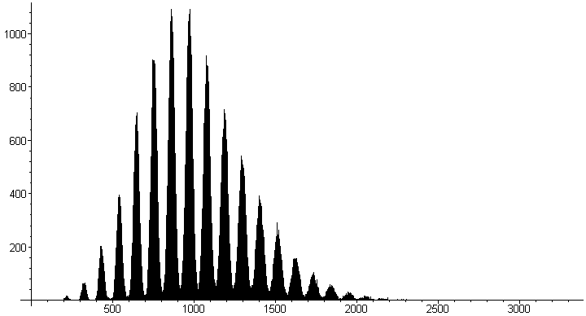
String class
Not very good:
Slow run time: Θ(n)
Words with the same characters hash to the same code:
"form" and "from"
A poor distribution, e.g., all words in MobyTM Words II by Grady Ward:
The distribution peaks about every 109. Why?
Hint: 'a'=97, …, 'z'=122

Slide 37
String class
Let the individual characters represent the coefficients of a polynomial in x:
p(x) = c₀ x^{n – 1} + c₁ x^{n – 2} + ··· + c_{n – 3} x² + c_{n – 2} x + c_{n – 1}
Use Horner’s rule to evaluate this polynomial at a prime number, e.g., x = 12347:
unsigned int hash( string const &str ) {
unsigned int hash_value = 0;
for ( int k = 0; k < str.length(); ++k ) {
hash_value = 12347*hash_value + str[k];
}
return hash_value;
}

Slide 38
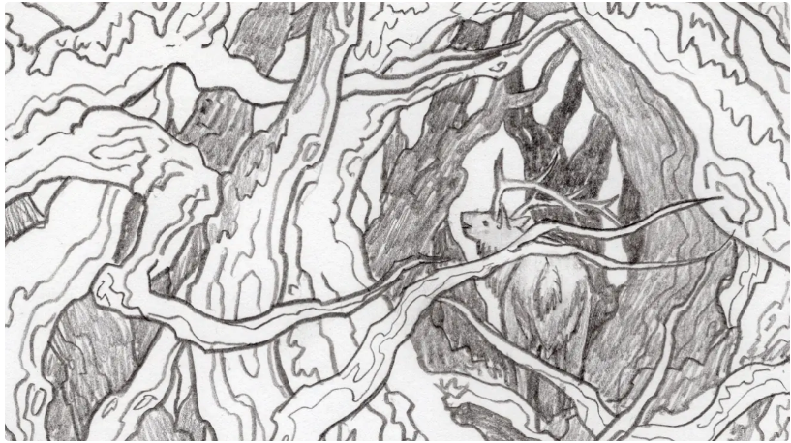
String class
Problem, Horner’s rule runs in Θ(n)
"A Elbereth Gilthoniel,\n
Silivren penna miriel\n
O menal aglar elenath!\n
Na-chaered palan-diriel\n
O galadhremmin ennorath,\n
Fanuilos, le linnathon\n
nef aear, si nef aearon!"
Suggestions?
Notes:
J.R.R. Tolkien
幽谷的精灵献给埃尔贝瑞丝（伊尔碧绿丝）的歌，大意如下：
啊！埃尔贝瑞丝，点亮星星的女王
穹苍间荣耀的星辰啊
她们的光芒如耀眼的珍宝般泄下
我们在远处眺望
从那树木交织的中洲眺望
从海的另一头，从那无边大海的另一头眺望
洁白无瑕的女王啊，我向您歌唱
在海的另一头，在那无边大海的另一头歌唱。

Slide 39
String class
Use characters in locations 2^{k} – 1 for k = 0, 1, 2, ...:
"A_Elbereth Gilthoniel,\n
Silivren_penna miriel\n
O menal aglar elenath!\n
Na-chaered palan-diriel\n
O galadhremmin ennorath,\n
Fanuilos, le linnathon\n
nef aear, si nef aearon!"
J.R.R. Tolkien

Slide 40
String class
The run time is now Θ(ln(n)) :
unsigned int hash( const string &str ) {
unsigned int hash_value = 0;
for ( int k = 1; k <= str.length(); k *= 2 ) {
hash_value = 12347*hash_value + str[k – 1];
}
return hash_value;
}
Notes:
Note: this cannot be used if you require a cryptographic hash function or message d
复杂度变ln（n）

Slide 41
Arithmetic hash functions
In general, any member variables that are used to uniquely define an object may be used as coefficients in such a polynomial
class Person {
string surname;
string given_name;
unsigned short birth_year;
unsigned char birth_month;
unsigned char birth_day;
unsigned int salary;
// ...
};
Notes:
The salary hopefully changes over time…

Slide 42
Arithmetic hash functions
In general, any member variables that are used to uniquely define an object may be used as coefficients in such a polynomial
class Person {
string surname;
string given_name;
unsigned short birth_year;
unsigned char birth_month;
unsigned char birth_day;
unsigned int salary;
// ...
};
Notes:
The salary hopefully changes over time…

Slide 43
Outline
Introduction
Hash function
Mapping down to 0, ..., M – 1
Dealing with collisions
Chained hash tables
Open addressing

Slide 44
The hash process
Object
32-bit integer
Modulus & Multiplicative
Map to an index 0, ..., M – 1
Deal with collisions
Chained hash tables
Open addressing

Slide 45
Properties
A good mapping function h_{M} should have the following properties:
2a. Must be fast: e.g. Θ(1)
2b. The hash value must be deterministic
Given n and M, h_{M}(n) must always return the same value
2c. If two objects are randomly chosen, there should be only a one-in-M chance that they have the same value from 0 to M – 1

Slide 46
Modulus operator
Easiest method: return the value modulus M
unsigned int hash_M( unsigned int n, unsigned int M ) {
return n % M;
}
Unfortunately, calculating the modulus (or remainder) is expensive
If M = 2^{m}, we can simplify the calculation by bitwise operations
left and right shift and bit-wise and

Slide 47
The bitwise operators: & << >>
Suppose I want to calculate
7985325 % 100
The modulo is a power of ten: 100 = 10²
In this case, take the last two decimal digits: 25
Similarly, 7985325 % 10³ = 325
We set the appropriate digits to 0:
0000025 and 0000325

Slide 48
The bitwise operators: & << >>
The same works in base 2:
100011100101₂ % 10000₂
The modulo is a power of 2: 10000₂ = 2⁴
In this case, take the last four bits: 0101
Similarly, 100011100101₂ % 1000000₂ == 100101,
We set the appropriate digits to 0:
000000000101 and 000000100101

Slide 49
The bitwise operators: & << >>
To zero all but the last n bits, select the last n bits using bitwise and:
1000 1110 0101₂ & 0000 0000 1111₂ → 0000 0000 0101₂
1000 1110 0101₂ & 0000 0011 1111₂ → 0000 0010 0101₂

Slide 50
The bitwise operators: & << >>
Similarly, multiplying or dividing by powers of 10 is easy:
7985325 * 100
The multiplier is a power of ten: 100 = 10²
In this case, add two zeros: 798532500
Similarly, 7985325 / 10³ = 7985
Just add the appropriate number of zeros or remove the appropriate number of digits

Slide 51
The bitwise operators: & << >>
The same works in base 2:
100011100101₂ * 10000₂
The multiplier is a power of 2: 10000₂ = 2⁴
In this case, add four zeros: 1000111001010000
Similarly, 100011100101₂ / 1000000₂ == 100011

Slide 52
The bitwise operators: & << >>
This can be done mechanically by shifting the bits appropriately:
1000 1110 0101₂ << 4 == 1000 1110 0101 0000₂
1000 1110 0101₂ >> 6 == 10 0011₂
Powers of 2 are now easy to calculate:
1₂ << 4 == 1 0000₂ // 2⁴ = 16
1₂ << 6 == 100 0000₂ // 2⁶ = 64

Slide 53
Modulo a power of two
The implementation using the modulus/remainder operator:
unsigned int hash_M( unsigned int n, unsigned int m ) {
return n & ((1 << m) – 1);
}

Slide 54

Modulo a power of two
Problem:
Suppose that the hash function h is always even
An even number modulo a power of two is still even
Example: memory allocations are multiples of word size
On a 64-bit computer, addresses returned by new will be multiples of 8
The probability that h_{M}( h(x) ) = h_{M}( h(y) ) is one in M/8
This is not one in M

Slide 55
The multiplicative method
We need to obfuscate the bits
The most common method to obfuscate bits is multiplication
Consider how one bit can affect an entire range of numbers in the result:
10100111
× 11010011
10100111
10100111
10100111
10100111
+ 10100111 .
1000101110100101
The avalanche effect: changing one bits has the potential of affecting all bits in the result:
10100011 × 11010011
= 1000011001011001
Notes:
C++ truncates the product of two n-bit
numbers to n bits

Slide 56
The multiplicative method
Multiplying by a fixed constant is a reasonable method
Take the middle m bits of Cn:
unsigned int const C = 581869333; // some number
unsigned int hash_M( unsigned int n, unsigned int m ) {
unsigned int shift = (32 – m)/2;
return ((C*n) >> shift) & ((1 << m) – 1);
}

Slide 57
The multiplicative method
Suppose that the value m = 10 (M = 1024) and n = 42
const unsigned int C = 581869333; // some number
unsigned int hash_M( unsigned int n, unsigned int m ) {
unsigned int shift = (32 – m)/2;
return ((C*n) >> shift) & ((1 << m) – 1);
}

Slide 58
The multiplicative method
m = 10
n = 42
First calculate the shift
const unsigned int C = 581869333; // some number
unsigned int hash_M( unsigned int n, unsigned int m ) {
unsigned int shift = (32 – m)/2;
return ((C*n) >> shift) & ((1 << m) – 1);
}
shift = 11

Slide 59
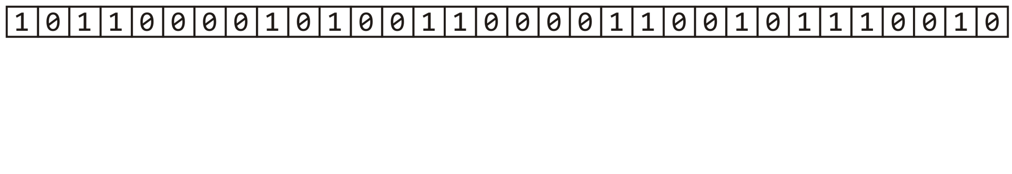
The multiplicative method
m = 10
n = 42
Calculate Cn
const unsigned int C = 581869333; // some number
unsigned int hash_M( unsigned int n, unsigned int m ) {
unsigned int shift = (32 – m)/2;
return ((C*n) >> shift) & ((1 << m) – 1);
}
shift = 11

Slide 60
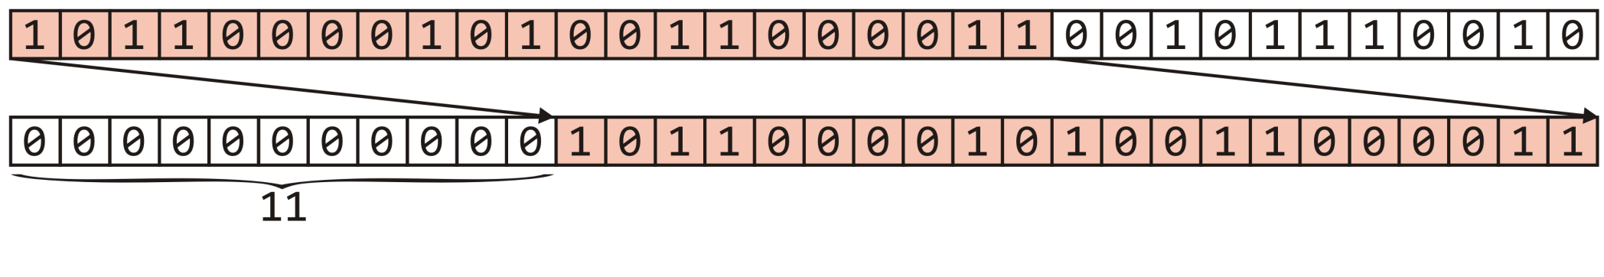
The multiplicative method
m = 10
n = 42
Right shift this value 11 bits—equivalent to dividing by 2¹¹
const unsigned int C = 581869333; // some number
unsigned int hash_M( unsigned int n, unsigned int m ) {
unsigned int shift = (32 – m)/2;
return ((C*n) >> shift) & ((1 << m) – 1);
}
shift = 11

Slide 61
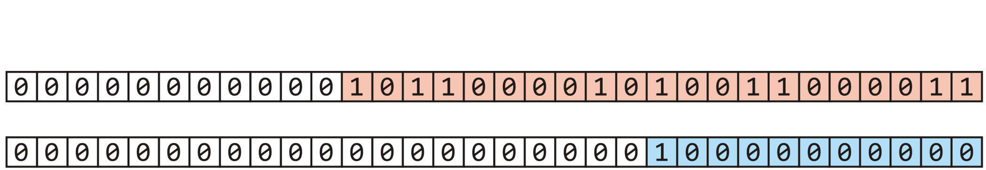

The multiplicative method
m = 10
n = 42
Left shift 1 m = 10 bits yielding 2¹⁰
const unsigned int C = 581869333; // some number
unsigned int hash_M( unsigned int n, unsigned int m ) {
unsigned int shift = (32 – m)/2;
return ((C*n) >> shift) & ((1 << m) – 1);
}

Slide 62
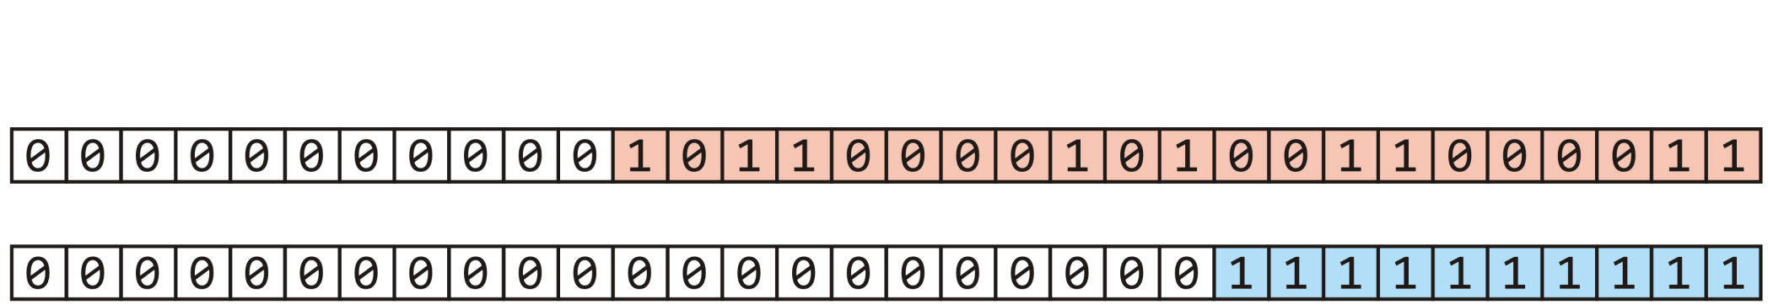
The multiplicative method
m = 10
n = 42
Subtracting 1 yields m = 10 ones
const unsigned int C = 581869333; // some number
unsigned int hash_M( unsigned int n, unsigned int m ) {
unsigned int shift = (32 – m)/2;
return ((C*n) >> shift) & ((1 << m) – 1);
}

Slide 63
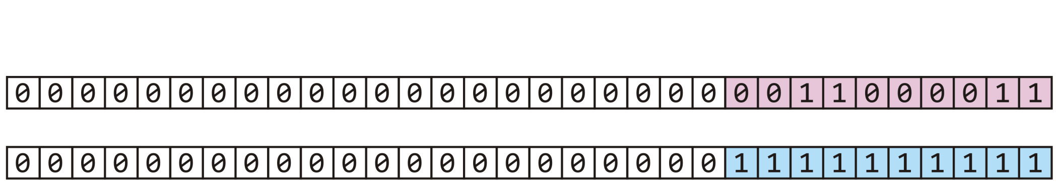
The multiplicative method
m = 10
n = 42
Taken the bitwise to clear all but the last 10 bits
const unsigned int C = 581869333; // some number
unsigned int hash_M( unsigned int n, unsigned int m ) {
unsigned int shift = (32 – m)/2;
return ((C*n) >> shift) & ((1 << m) – 1);
}

Slide 64
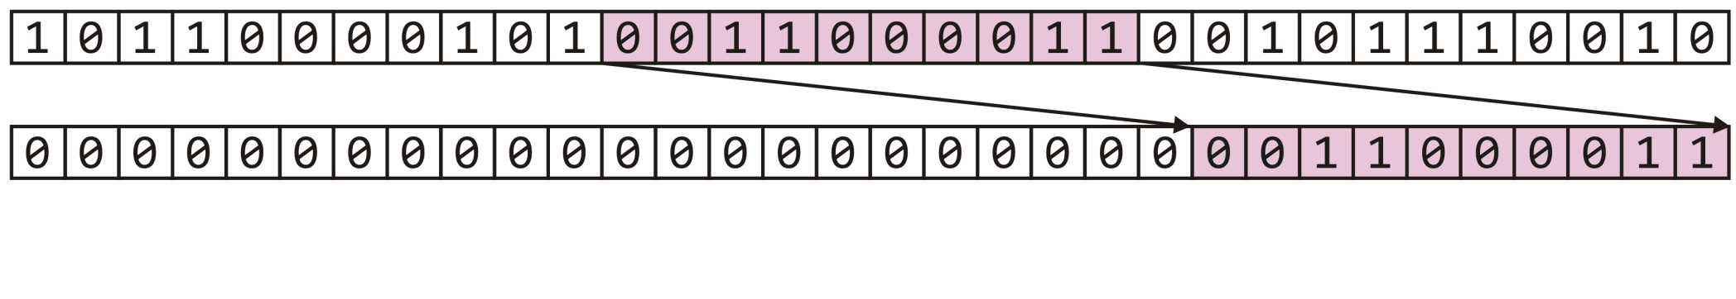
The multiplicative method
We have extracted the middle m = 10 bits—a number in 0, …, 1023
const unsigned int C = 581869333; // some number
unsigned int hash_M( unsigned int n, unsigned int m ) {
unsigned int shift = (32 – m)/2;
return ((C*n) >> shift) & ((1 << m) – 1);
}
h_{M}(42) = 195

Slide 65
Outline
Introduction
Hash function
Mapping down to 0, ..., M – 1
Dealing with collisions
Chained hash tables
Open addressing

Slide 66
The hash process
Object
32-bit integer
Modulus & Multiplicative
Map to an index 0, ..., M – 1
Deal with collisions
Chained hash tables
Open addressing

Slide 67
Chained hash table
Associating each bin with a linked list.
For any object assigned to the bin by the hash function, finding, inserting, and erasing the object is done on the linked list.

Slide 68
Example
As an example, let’s store hostnames and allow a fast look-up of the corresponding IP address
We will choose the bin based on the host name
Associated with the name will be the IP address
E.g., ("optimal", 129.97.94.57)

Slide 69
Example
Suppose the hash value of a string is the last 3 bits of the first character in the host name
The hash of “optimal” is based on “o”
a 01100001 n 01101110
b 01100010 o 01101111
c 01100011 p 01110000
d 01100100 q 01110001
e 01100101 r 01110010
f 01100110 s 01110011
g 01100111 t 01110100
h 01101000 u 01110101
i 01101001 v 01110110
j 01101010 w 01110111
k 01101011 x 01111000
l 01101100 y 01111001
m 01101101 z 01111010

Slide 70
Example
Our hash function is
unsigned int hash( string const &str ) {
// the empty string "" is hashed to 0
if str.length() == 0 ) {
return 0;
}
return str[0] & 7;
}

Slide 71
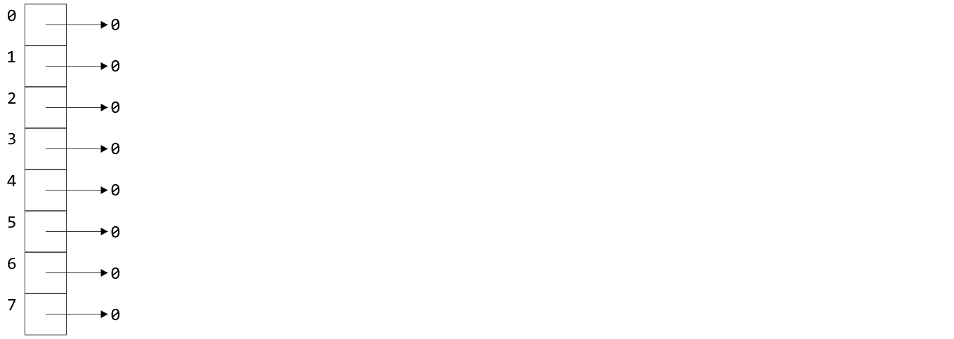
Example
Starting with an array of 8 empty linked lists

Slide 72
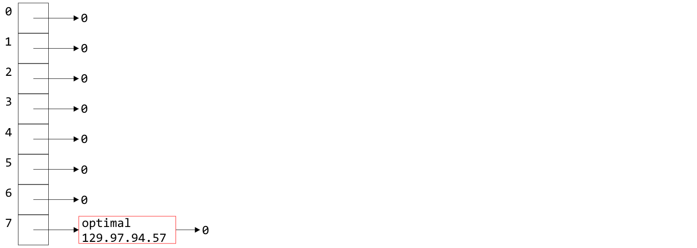
Example
The pair ("optimal", 129.97.94.57) is entered into bin 01101111 = 7

Slide 73
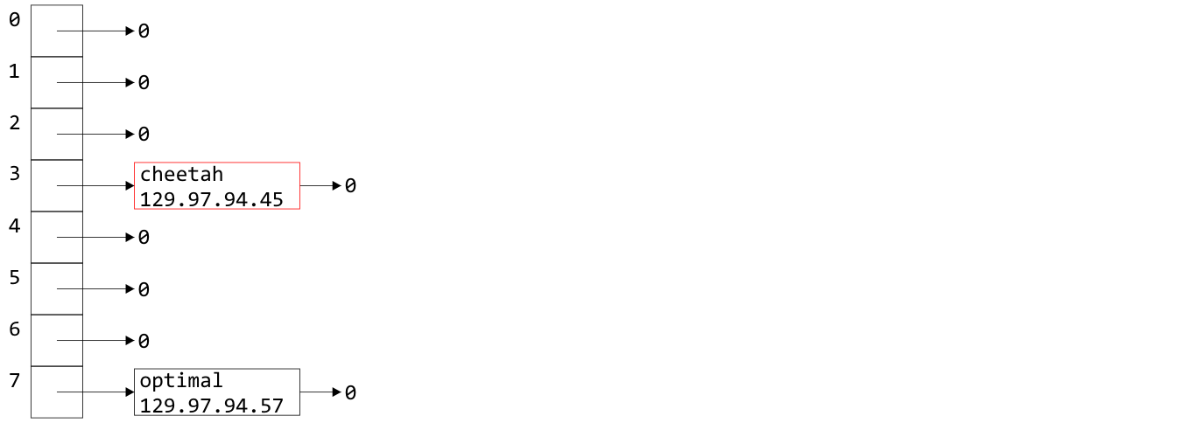
Example
Similarly, as "c" hashes to 3
The pair ("cheetah", 129.97.94.45) is entered into bin 3

Slide 74
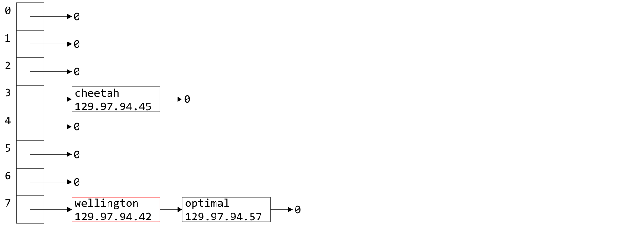
Example
The "w" in Wellington also hashes to 7
("wellington", 129.97.94.42) is entered into bin 7

Slide 75
Example
Why did I use push_front from the linked list?
A good heuristic is
“unless you know otherwise, data which has been
accessed recently will be accessed again in the near future”
It is easiest to access data at the front of a linked list
Heuristics include rules of thumb, educated guesses, and intuition

Slide 76
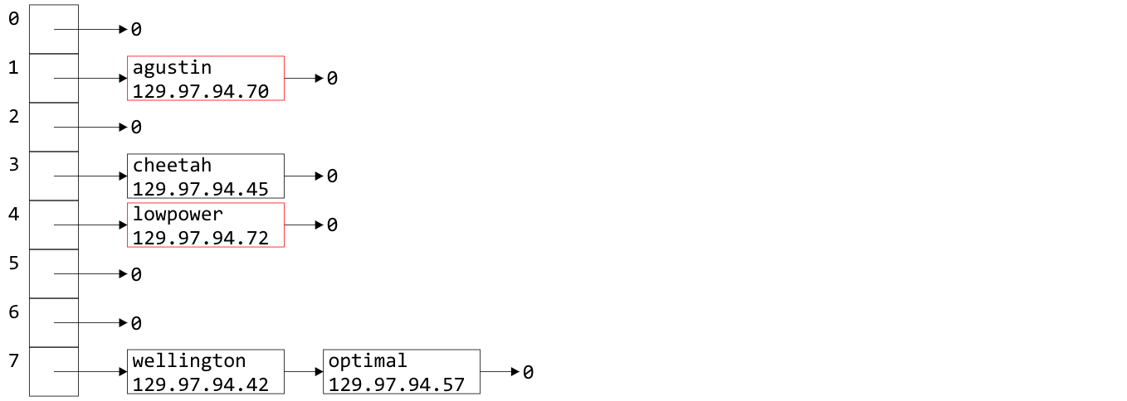
Example
Similarly we can insert the host names "augustin" and "lowpower"

Slide 77
Example
If we now wanted the IP address for "optimal", we would simply hash "optimal" to 7, walk through the linked list, and access 129.97.94.57 when we access the node containing the relevant string

Slide 78
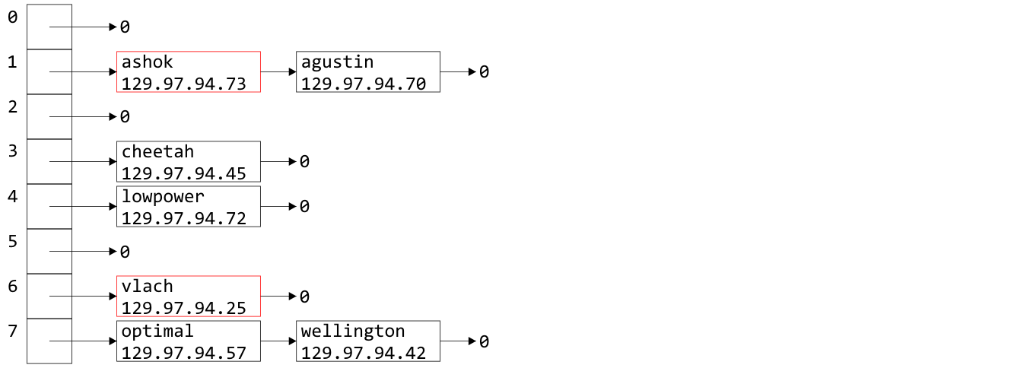
Example
Similarly, "ashok" and "vlach" are entered into bin 1 and 6

Slide 79
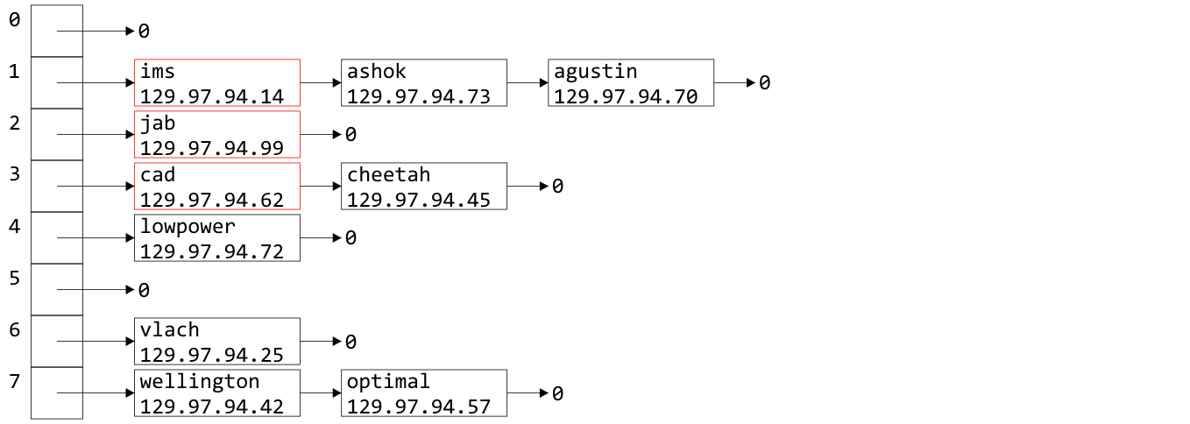
Example
Inserting "ims", "jab", and "cad" doesn’t even out the bins

Slide 80
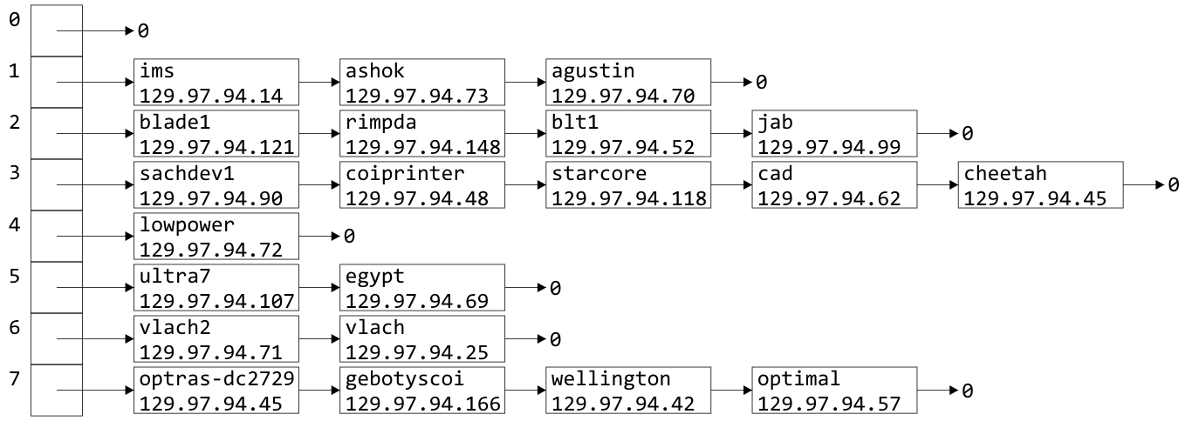
Example
Indeed, after 21 insertions, the linked lists are becoming rather long
We were looking for Θ(1) access time, but accessing something in a linked list with k objects is O(k)

Slide 81
Load Factor
To describe the length of the linked lists, we define the load factor of the hash table:
This is the average number of objects per bin
This assumes an even distribution
Right now, the load factor is λ = 21/8 = 2.625
The average bin has 2.625 objects

Slide 82
Load Factor
If the load factor becomes too large, access times will start to increase: O(λ)
The most obvious solution is to double the size of the hash table and re-insert every object (rehashing)

Slide 83
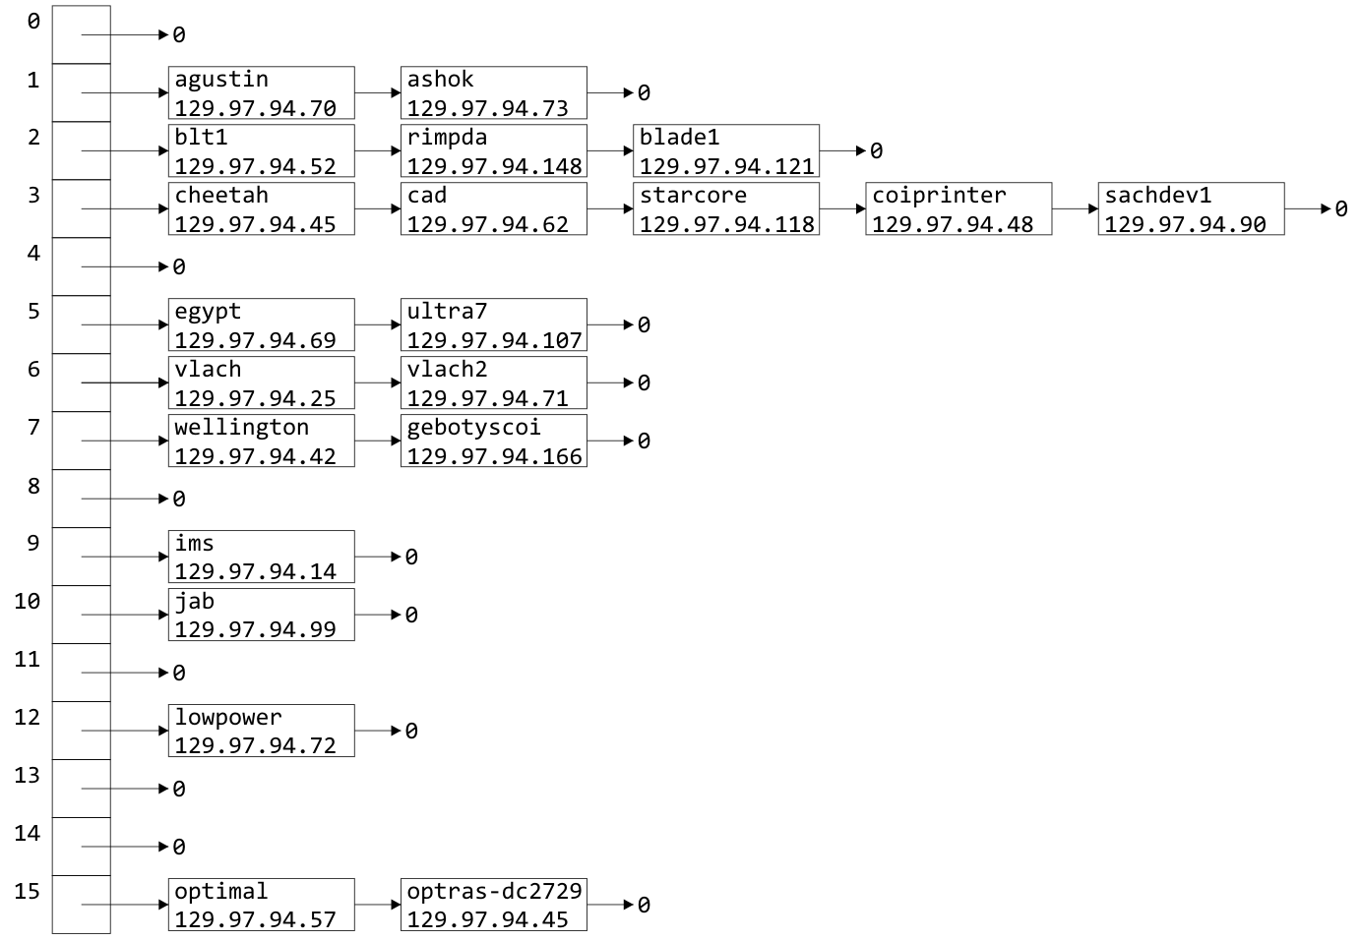
Doubling Size
In our example, suppose we take the last four bits as the hash function after doubling the hash table size

Slide 84
Doubling Size
The load factor is now λ = 1.3125
Unfortunately, the distribution hasn’t improved much

Slide 85
Doubling Size
There is significant clustering in bins 2 and 3 due to the choice of host names

Slide 86

Choosing a Good Hash Function
We choose a very poor hash function:
We looked at the first letter of the host name
Unfortunately, all these are also actual host names:
ultra7 ultra8 ultra9 ultra10 ultra11
ultra12 ultra13 ultra14 ultra15 ultra16 ultra17
blade1 blade2 blade3 blade4 blade5
This will cause clustering in bins 2 and 5
Notes:
Any hash function based on anything other than every letter will cause clustering

Slide 87
Choosing a Good Hash Function
Let’s go back to the hash function defined previously:
unsigned int hash( string const &str ) {
unsigned int hash_value = 0;
for ( int k = 0; k < str.length(); ++k ) {
hash_value = 12347*hash_value + str[k];
}
return hash_value;
}

Slide 88
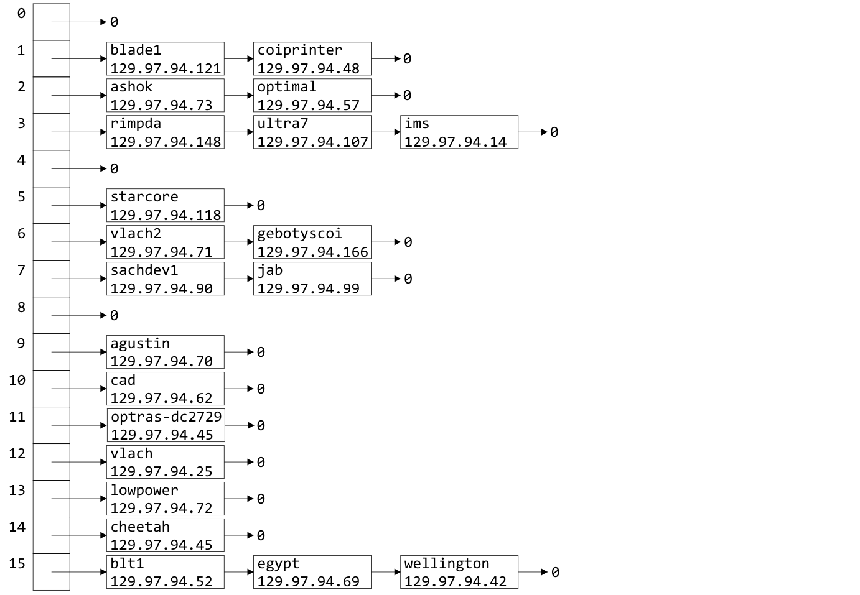
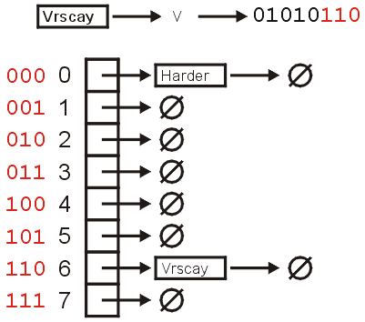
Choosing a Good Hash Function
This hash function yields a much nicer distribution:

Slide 89
Problems with Linked Lists
One significant issue with chained hash tables using linked lists
It requires extra memory
It uses dynamic memory allocation
Another issue is the O(λ) time complexity
For faster access, we could replace each linked list with an AVL tree (assuming we can order the objects)
The access time drops to O(ln(λ))
The memory requirements are increased by Θ(n), as each node will require two pointers
Notes:
Total memory:
16 bytes
A pointer to an array, initial and current number of bins, and the size
+ 12M bytes (8M if we remove count from Single_list)
+ 8n bytes if each object is 4 bytes

Slide 90
Outline
Introduction
Hash function
Mapping down to 0, ..., M – 1
Dealing with collisions
Chained hash tables
Open addressing

Slide 91
Background
Chained hash tables require special memory allocation
Can we create a hash table without significant memory allocation?
We will deal with collisions by storing collisions elsewhere
We will define an implicit rule which tells us where to look next

Slide 92
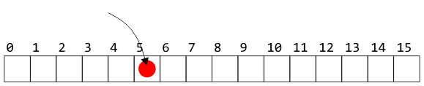
Open Addressing
Suppose an object hashes to bin 5
If bin 5 is empty, we can copy the object into that entry

Slide 93
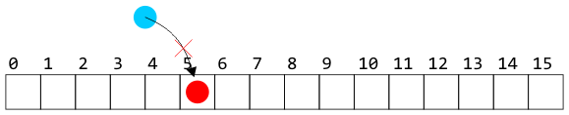
Open Addressing
Suppose, however, another object hashes to bin 5
Without a linked list, we cannot store the object in that bin

Slide 94
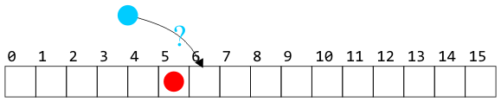
Open Addressing
We need a rule to tells us where to look next
For example, look in the next bin to see if it is occupied
Notes:
Such a rule is implicit—we do not follow an explicit link

Slide 95
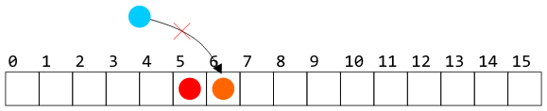
Open Addressing
The rule must be:
simple to follow—i.e., fast
general enough to deal with the fact that the next cell could also be occupied: e.g., continue searching until the first empty bin is found

Slide 96
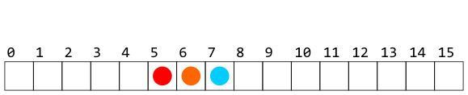
Open Addressing
Of course, whatever rule we use in placing an object must also be used when searching for or removing objects

Slide 97
Open Addressing
Recall, however, that our goal is Θ(1) access times
We cannot, on average, be forced to access too many bins

Slide 98
Open Addressing
There are numerous strategies for defining the order in which the bins should be searched:
Linear probing
Quadratic probing
Double hashing
There are many alternate strategies, as well:
Last come, first served
Always place the object into the bin moving what may be there already
Cuckoo hashing

Slide 99
Outline
Introduction
Hash function
Mapping down to 0, ..., M – 1
Dealing with collisions
Chained hash tables
Open addressing
Linear probing
Quadratic probing

Slide 100
Linear Probing
The easiest method to probe the bins of the hash table is to search forward linearly
Assume we are inserting into bin k:
If bin k is empty, we occupy it
Otherwise, check bin k + 1, k + 2, and so on, until an empty bin is found
If we reach the end of the array, we start at the front (bin 0)

Slide 101
Linear Probing
Consider a hash table with M = 16 bins
Given a 3-digit hexadecimal number:
The least-significant digit is the primary hash function (bin)
Example: for 72A₁₆ , the initial bin is A

Slide 102
Insertion
Insert these numbers into this initially empty hash table:
19A, 207, 3AD, 488, 5BA, 680, 74C, 826, 946, ACD, B32, C8B, DBE, E9C
0 | 1 | 2 | 3 | 4 | 5 | 6 | 7 | 8 | 9 | A | B | C | D | E | F

Slide 103
Example
Start with the first four values:
19A, 207, 3AD, 488
0 | 1 | 2 | 3 | 4 | 5 | 6 | 7 | 8 | 9 | A | B | C | D | E | F

Slide 104
Example
Start with the first four values:
19A, 207, 3AD, 488
0 | 1 | 2 | 3 | 4 | 5 | 6 | 7 | 8 | 9 | A | B | C | D | E | F
 |  |  |  |  |  |  | 207 | 488 |  | 19A |  |  | 3AD

Slide 105
Example
Next, we must insert 5BA
0 | 1 | 2 | 3 | 4 | 5 | 6 | 7 | 8 | 9 | A | B | C | D | E | F
 |  |  |  |  |  |  | 207 | 488 |  | 19A |  |  | 3AD

Slide 106
Example
Next, we must insert 5BA
Bin A is occupied
We search forward for the next empty bin
0 | 1 | 2 | 3 | 4 | 5 | 6 | 7 | 8 | 9 | A | B | C | D | E | F
 |  |  |  |  |  |  | 207 | 488 |  | 19A | 5BA |  | 3AD

Slide 107
Example
Next, we are adding 680, 74C, 826
0 | 1 | 2 | 3 | 4 | 5 | 6 | 7 | 8 | 9 | A | B | C | D | E | F
 |  |  |  |  |  |  | 207 | 488 |  | 19A | 5BA |  | 3AD

Slide 108
Example
Next, we are adding 680, 74C, 826
All the bins are empty—simply insert them
0 | 1 | 2 | 3 | 4 | 5 | 6 | 7 | 8 | 9 | A | B | C | D | E | F
680 |  |  |  |  |  | 826 | 207 | 488 |  | 19A | 5BA | 74C | 3AD

Slide 109
Example
Next, we must insert 946
0 | 1 | 2 | 3 | 4 | 5 | 6 | 7 | 8 | 9 | A | B | C | D | E | F
680 |  |  |  |  |  | 826 | 207 | 488 |  | 19A | 5BA | 74C | 3AD

Slide 110
Example
Next, we must insert 946
Bin 6 is occupied
The next empty bin is 9
0 | 1 | 2 | 3 | 4 | 5 | 6 | 7 | 8 | 9 | A | B | C | D | E | F
680 |  |  |  |  |  | 826 | 207 | 488 | 946 | 19A | 5BA | 74C | 3AD

Slide 111
Example
Next, we must insert ACD
0 | 1 | 2 | 3 | 4 | 5 | 6 | 7 | 8 | 9 | A | B | C | D | E | F
680 |  |  |  |  |  | 826 | 207 | 488 | 946 | 19A | 5BA | 74C | 3AD

Slide 112
Example
Next, we must insert ACD
Bin D is occupied
The next empty bin is E
0 | 1 | 2 | 3 | 4 | 5 | 6 | 7 | 8 | 9 | A | B | C | D | E | F
680 |  |  |  |  |  | 826 | 207 | 488 | 946 | 19A | 5BA | 74C | 3AD | ACD

Slide 113
Example
Next, we insert B32
0 | 1 | 2 | 3 | 4 | 5 | 6 | 7 | 8 | 9 | A | B | C | D | E | F
680 |  |  |  |  |  | 826 | 207 | 488 | 946 | 19A | 5BA | 74C | 3AD | ACD

Slide 114
Example
Next, we insert B32
Bin 2 is unoccupied
0 | 1 | 2 | 3 | 4 | 5 | 6 | 7 | 8 | 9 | A | B | C | D | E | F
680 |  | B32 |  |  |  | 826 | 207 | 488 | 946 | 19A | 5BA | 74C | 3AD | ACD

Slide 115
Example
Next, we insert C8B
0 | 1 | 2 | 3 | 4 | 5 | 6 | 7 | 8 | 9 | A | B | C | D | E | F
680 |  | B32 |  |  |  | 826 | 207 | 488 | 946 | 19A | 5BA | 74C | 3AD | ACD

Slide 116
Example
Next, we insert C8B
Bin B is occupied
The next empty bin is F
0 | 1 | 2 | 3 | 4 | 5 | 6 | 7 | 8 | 9 | A | B | C | D | E | F
680 |  | B32 |  |  |  | 826 | 207 | 488 | 946 | 19A | 5BA | 74C | 3AD | ACD | C8B

Slide 117
Example
Next, we insert D59
0 | 1 | 2 | 3 | 4 | 5 | 6 | 7 | 8 | 9 | A | B | C | D | E | F
680 |  | B32 |  |  |  | 826 | 207 | 488 | 946 | 19A | 5BA | 74C | 3AD | ACD | C8B

Slide 118
Example
Next, we insert D59
Bin 9 is occupied
The next empty bin is 1
0 | 1 | 2 | 3 | 4 | 5 | 6 | 7 | 8 | 9 | A | B | C | D | E | F
680 | D59 | B32 |  |  |  | 826 | 207 | 488 | 946 | 19A | 5BA | 74C | 3AD | ACD | C8B

Slide 119
Example
Finally, insert E9C
0 | 1 | 2 | 3 | 4 | 5 | 6 | 7 | 8 | 9 | A | B | C | D | E | F
680 | D59 | B32 |  |  |  | 826 | 207 | 488 | 946 | 19A | 5BA | 74C | 3AD | ACD | C8B

Slide 120
Example
Finally, insert E9C
Bin C is occupied
The next empty bin is 3
0 | 1 | 2 | 3 | 4 | 5 | 6 | 7 | 8 | 9 | A | B | C | D | E | F
680 | D59 | B32 | E9C |  |  | 826 | 207 | 488 | 946 | 19A | 5BA | 74C | 3AD | ACD | C8B

Slide 121
Example
Having completed these insertions:
The load factor is λ = 14/16 = 0.875
The average number of probes is 38/14 ≈ 2.71
0 | 1 | 2 | 3 | 4 | 5 | 6 | 7 | 8 | 9 | A | B | C | D | E | F
680 | D59 | B32 | E9C |  |  | 826 | 207 | 488 | 946 | 19A | 5BA | 74C | 3AD | ACD | C8B
Notes:
38: the number of probes when inserting all these numbers

Slide 122
Resizing the array
To double the capacity of the array, each value must be rehashed
We use the least-significant five bits for the initial bin
680, B32, ACD, 5BA, 826, 207, 488, D59 may be immediately placed
0 | 1 | 2 | 3 | 4 | 5 | 6 | 7 | 8 | 9 | A | B | C | D | E | F | 10 | 11 | 12 | 13 | 14 | 15 | 16 | 17 | 18 | 19 | 1A | 1B | 1C | 1D | 1E | 1F
680 |  |  |  |  |  | 826 | 207 | 488 |  |  |  |  | ACD |  |  |  |  | B32 |  |  |  |  |  |  | D59 | 5BA

Slide 123
Resizing the array
To double the capacity of the array, each value must be rehashed
19A resulted in a collision
0 | 1 | 2 | 3 | 4 | 5 | 6 | 7 | 8 | 9 | A | B | C | D | E | F | 10 | 11 | 12 | 13 | 14 | 15 | 16 | 17 | 18 | 19 | 1A | 1B | 1C | 1D | 1E | 1F
680 |  |  |  |  |  | 826 | 207 | 488 |  |  |  |  | ACD |  |  |  |  | B32 |  |  |  |  |  |  | D59 | 5BA | 19A

Slide 124
Resizing the array
To double the capacity of the array, each value must be rehashed
946 resulted in a collision
0 | 1 | 2 | 3 | 4 | 5 | 6 | 7 | 8 | 9 | A | B | C | D | E | F | 10 | 11 | 12 | 13 | 14 | 15 | 16 | 17 | 18 | 19 | 1A | 1B | 1C | 1D | 1E | 1F
680 |  |  |  |  |  | 826 | 207 | 488 | 946 |  |  |  | ACD |  |  |  |  | B32 |  |  |  |  |  |  | D59 | 5BA | 19A

Slide 125
Resizing the array
To double the capacity of the array, each value must be rehashed
74C fits into its bin
0 | 1 | 2 | 3 | 4 | 5 | 6 | 7 | 8 | 9 | A | B | C | D | E | F | 10 | 11 | 12 | 13 | 14 | 15 | 16 | 17 | 18 | 19 | 1A | 1B | 1C | 1D | 1E | 1F
680 |  |  |  |  |  | 826 | 207 | 488 | 946 |  |  | 74C | ACD |  |  |  | 946 | B32 |  |  |  |  |  |  | D59 | 5BA | 19A

Slide 126
Resizing the array
To double the capacity of the array, each value must be rehashed
3AD resulted in a collision
0 | 1 | 2 | 3 | 4 | 5 | 6 | 7 | 8 | 9 | A | B | C | D | E | F | 10 | 11 | 12 | 13 | 14 | 15 | 16 | 17 | 18 | 19 | 1A | 1B | 1C | 1D | 1E | 1F
680 |  |  |  |  |  | 826 | 207 | 488 | 946 |  |  | 74C | ACD | 3AD |  |  | 946 | B32 |  |  |  |  |  |  | D59 | 5BA | 19A

Slide 127
Resizing the array
To double the capacity of the array, each value must be rehashed
Both E9C and C8B fit without a collision
The load factor is λ = 14/32 = 0.4375
The average number of probes is 18/14 ≈ 1.29
0 | 1 | 2 | 3 | 4 | 5 | 6 | 7 | 8 | 9 | A | B | C | D | E | F | 10 | 11 | 12 | 13 | 14 | 15 | 16 | 17 | 18 | 19 | 1A | 1B | 1C | 1D | 1E | 1F
680 |  |  |  |  |  | 826 | 207 | 488 | 946 |  | C8B | 74C | ACD | 3AD |  |  | 946 | B32 |  |  |  |  |  |  | D59 | 5BA | 19A | E9C

Slide 128
Searching
Testing for membership is similar to insertions:
Start at the appropriate bin, and searching forward until
The item is found,
An empty bin is found, or
We have traversed the entire array
The third case will only occur if the hash table is full (load factor of 1)

Slide 129
Searching
Searching for C8B
0 | 1 | 2 | 3 | 4 | 5 | 6 | 7 | 8 | 9 | A | B | C | D | E | F
680 | D59 | B32 | E93 |  |  | 826 | 207 | 488 | 946 | 19A | 5BA | 74C | 3AD | ACD | C8B

Slide 130
Searching
Searching for C8B
Examine bins B, C, D, E, F
The value is found in F
0 | 1 | 2 | 3 | 4 | 5 | 6 | 7 | 8 | 9 | A | B | C | D | E | F
680 | D59 | B32 | E93 |  |  | 826 | 207 | 488 | 946 | 19A | 5BA | 74C | 3AD | ACD | C8B

Slide 131
Searching
Searching for 23E
0 | 1 | 2 | 3 | 4 | 5 | 6 | 7 | 8 | 9 | A | B | C | D | E | F
680 | D59 | B32 | E93 |  |  | 826 | 207 | 488 | 946 | 19A | 5BA | 74C | 3AD | ACD | C8B

Slide 132
Searching
Searching for 23E
Search bins E, F, 0, 1, 2, 3, 4
The last bin is empty; therefore, 23E is not in the table
0 | 1 | 2 | 3 | 4 | 5 | 6 | 7 | 8 | 9 | A | B | C | D | E | F
680 | D59 | B32 | E93 | × |  | 826 | 207 | 488 | 946 | 19A | 5BA | 74C | 3AD | ACD | C8B

Slide 133
Erasing
Can we simply remove elements from the hash table?
0 | 1 | 2 | 3 | 4 | 5 | 6 | 7 | 8 | 9 | A | B | C | D | E | F
680 | D59 | B32 | E93 |  |  | 826 | 207 | 488 | 946 | 19A | 5BA | 74C | 3AD | ACD | C8B

Slide 134
Erasing
We cannot simply remove elements from the hash table
For example, consider erasing 3AD
0 | 1 | 2 | 3 | 4 | 5 | 6 | 7 | 8 | 9 | A | B | C | D | E | F
680 | D59 | B32 | E93 |  |  | 826 | 207 | 488 | 946 | 19A | 5BA | 74C | 3AD | ACD | C8B

Slide 135
Erasing
We cannot simply remove elements from the hash table
For example, consider erasing 3AD
If we just erase it, it is now an empty bin
By our algorithm, we cannot find ACD, C8B and D59
0 | 1 | 2 | 3 | 4 | 5 | 6 | 7 | 8 | 9 | A | B | C | D | E | F
680 | D59 | B32 | E93 |  |  | 826 | 207 | 488 | 946 | 19A | 5BA | 74C |  | ACD | C8B

Slide 136
Erasing
Instead, we must attempt to fill the empty bin
0 | 1 | 2 | 3 | 4 | 5 | 6 | 7 | 8 | 9 | A | B | C | D | E | F
680 | D59 | B32 | E93 |  |  | 826 | 207 | 488 | 946 | 19A | 5BA | 74C |  | ACD | C8B

Slide 137
Erasing
Instead, we must attempt to fill the empty bin
We can move ACD into the location
Are we done?
0 | 1 | 2 | 3 | 4 | 5 | 6 | 7 | 8 | 9 | A | B | C | D | E | F
680 | D59 | B32 | E93 |  |  | 826 | 207 | 488 | 946 | 19A | 5BA | 74C | ACD | ACD | C8B

Slide 138
Erasing
Now we have another bin to fill
0 | 1 | 2 | 3 | 4 | 5 | 6 | 7 | 8 | 9 | A | B | C | D | E | F
680 | D59 | B32 | E93 |  |  | 826 | 207 | 488 | 946 | 19A | 5BA | 74C | ACD |  | C8B

Slide 139
Erasing
Now we have another bin to fill
We can move C8B into the location
0 | 1 | 2 | 3 | 4 | 5 | 6 | 7 | 8 | 9 | A | B | C | D | E | F
680 | D59 | B32 | E93 |  |  | 826 | 207 | 488 | 946 | 19A | 5BA | 74C | ACD | C8B | C8B

Slide 140
Erasing
Now we must attempt to fill the bin at F
We cannot move 680
0 | 1 | 2 | 3 | 4 | 5 | 6 | 7 | 8 | 9 | A | B | C | D | E | F
680 | D59 | B32 | E93 |  |  | 826 | 207 | 488 | 946 | 19A | 5BA | 74C | ACD | C8B

Slide 141
Erasing
Now we must attempt to fill the bin at F
We cannot move 680
We can, however, move D59
0 | 1 | 2 | 3 | 4 | 5 | 6 | 7 | 8 | 9 | A | B | C | D | E | F
680 | D59 | B32 | E93 |  |  | 826 | 207 | 488 | 946 | 19A | 5BA | 74C | ACD | C8B | D59

Slide 142
Erasing
At this point, we cannot move B32 or E93 and the next bin is empty
We are finished
0 | 1 | 2 | 3 | 4 | 5 | 6 | 7 | 8 | 9 | A | B | C | D | E | F
680 |  | B32 | E93 |  |  | 826 | 207 | 488 | 946 | 19A | 5BA | 74C | ACD | C8B | D59

Slide 143
Erasing
Suppose we delete 207
0 | 1 | 2 | 3 | 4 | 5 | 6 | 7 | 8 | 9 | A | B | C | D | E | F
680 |  | B32 | E93 |  |  | 826 | 207 | 488 | 946 | 19A | 5BA | 74C | ACD | C8B | D59

Slide 144
Erasing
Suppose we delete 207
Cannot move 488
0 | 1 | 2 | 3 | 4 | 5 | 6 | 7 | 8 | 9 | A | B | C | D | E | F
680 |  | B32 | E93 |  |  | 826 |  | 488 | 946 | 19A | 5BA | 74C | ACD | C8B | D59

Slide 145
Erasing
Suppose we delete 207
We could move 946 into Bin 7
0 | 1 | 2 | 3 | 4 | 5 | 6 | 7 | 8 | 9 | A | B | C | D | E | F
680 |  | B32 | E93 |  |  | 826 | 946 | 488 | 946 | 19A | 5BA | 74C | ACD | C8B | D59

Slide 146
Erasing
Suppose we delete 207
We cannot move any of the next five entries
0 | 1 | 2 | 3 | 4 | 5 | 6 | 7 | 8 | 9 | A | B | C | D | E | F
680 |  | B32 | E93 |  |  | 826 | 946 | 488 |  | 19A | 5BA | 74C | ACD | C8B | D59

Slide 147
Erasing
Suppose we delete 207
We could move D59
0 | 1 | 2 | 3 | 4 | 5 | 6 | 7 | 8 | 9 | A | B | C | D | E | F
680 |  | B32 | E93 |  |  | 826 | 946 | 488 | D59 | 19A | 5BA | 74C | ACD | C8B | D59

Slide 148
Erasing
Suppose we delete 207
We cannot fill this bin with 680, and the next bin is empty
We are finished
0 | 1 | 2 | 3 | 4 | 5 | 6 | 7 | 8 | 9 | A | B | C | D | E | F
680 |  | B32 | E93 |  |  | 826 | 946 | 488 | D59 | 19A | 5BA | 74C | ACD | C8B

Slide 149
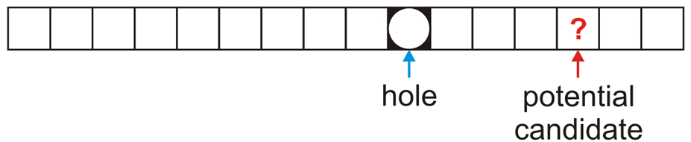
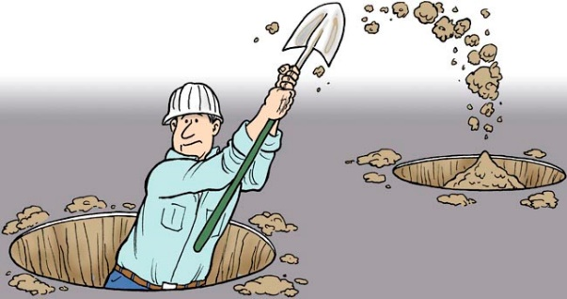
Erasing
In general, assume:
The currently removed object has created a hole at index hole
The object we are checking is located at the position index and has a hash value of hash
Remember: if we are checking the object ? at location index, this means that all entries between hole and index are both occupied and could not have been copied into the hole

Slide 150
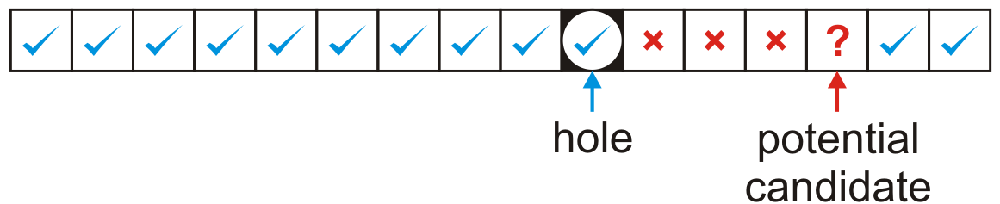
Erasing
The first possibility is that hole < index
In this case, we move the object at index only if its hash value is either
equal to or less than the hole or
greater than the index of the potential candidate

Slide 151
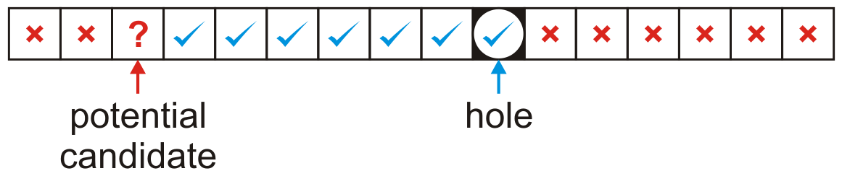
Erasing
The other possibility is we wrapped around the end of the array, that is, hole > index
In this case, we move the object at index only if its hash value is both
greater than the index of the potential candidate and
less than or equal to the hole
In either case, if the move is successful, the ? now becomes the new hole to be filled

Slide 152
Alternative Method: Lazy Erasing
Consider erasing 3AD
0 | 1 | 2 | 3 | 4 | 5 | 6 | 7 | 8 | 9 | A | B | C | D | E | F
680 | D59 | B32 | E93 |  |  | 826 | 207 | 488 | 946 | 19A | 5BA | 74C | 3AD | ACD | C8B

Slide 153
Alternative Method: Lazy Erasing
Consider erasing 3AD
Mark the bin as ERASED
Searching: regard it as occupied
Insertion: regard it as unoccupied
What if we want to insert ACD?
Search before insertion
0 | 1 | 2 | 3 | 4 | 5 | 6 | 7 | 8 | 9 | A | B | C | D | E | F
680 | D59 | B32 | E93 |  |  | 826 | 207 | 488 | 946 | 19A | 5BA | 74C | 3AD | ACD | C8B

Slide 154
Primary Clustering
We have already observed the following phenomenon:
With more insertions, the contiguous regions (or clusters) get larger
The length of these chains will affect the number of probes required to perform insertions, accesses, or removals
0 | 1 | 2 | 3 | 4 | 5 | 6 | 7 | 8 | 9 | A | B | C | D | E | F | 10 | 11 | 12 | 13 | 14 | 15 | 16 | 17 | 18 | 19 | 1A | 1B | 1C | 1D | 1E | 1F
680 |  |  |  |  |  | 826 | 207 | 488 | 946 |  | C8B | 74C | ACD | 3AD |  |  | 946 | B32 |  |  |  |  |  |  | D59 | 5BA | 19A | E9C

Slide 155
Primary Clustering
We currently have three clusters of length four
0 | 1 | 2 | 3 | 4 | 5 | 6 | 7 | 8 | 9 | A | B | C | D | E | F | 10 | 11 | 12 | 13 | 14 | 15 | 16 | 17 | 18 | 19 | 1A | 1B | 1C | 1D | 1E | 1F
680 |  |  |  |  |  | 826 | 207 | 488 | 946 |  | C8B | 74C | ACD | 3AD |  |  | 946 | B32 |  |  |  |  |  |  | D59 | 5BA | 19A | E9C

Slide 156
Primary Clustering
There is a 5/32 ≈ 16 % chance that an insertion will fill A
0 | 1 | 2 | 3 | 4 | 5 | 6 | 7 | 8 | 9 | A | B | C | D | E | F | 10 | 11 | 12 | 13 | 14 | 15 | 16 | 17 | 18 | 19 | 1A | 1B | 1C | 1D | 1E | 1F
680 |  |  |  |  |  | 826 | 207 | 488 | 946 |  | C8B | 74C | ACD | 3AD |  |  | 946 | B32 |  |  |  |  |  |  | D59 | 5BA | 19A | E9C

Slide 157
Primary Clustering
There is a 5/32 ≈ 16 % chance that an insertion will fill A
This causes two clusters to coalesce into one larger cluster of length 9
0 | 1 | 2 | 3 | 4 | 5 | 6 | 7 | 8 | 9 | A | B | C | D | E | F | 10 | 11 | 12 | 13 | 14 | 15 | 16 | 17 | 18 | 19 | 1A | 1B | 1C | 1D | 1E | 1F
680 |  |  |  |  |  | 826 | 207 | 488 | 946 | 747 | C8B | 74C | ACD | 3AD |  |  | 946 | B32 |  |  |  |  |  |  | D59 | 5BA | 19A | E9C

Slide 158
Primary Clustering
There is now a 11/32 ≈ 34 % chance that the next insertion will increase the length of this cluster
0 | 1 | 2 | 3 | 4 | 5 | 6 | 7 | 8 | 9 | A | B | C | D | E | F | 10 | 11 | 12 | 13 | 14 | 15 | 16 | 17 | 18 | 19 | 1A | 1B | 1C | 1D | 1E | 1F
680 |  |  |  |  |  | 826 | 207 | 488 | 946 | 747 | C8B | 74C | ACD | 3AD |  |  | 946 | B32 |  |  |  |  |  |  | D59 | 5BA | 19A | E9C

Slide 159
Primary Clustering
As the cluster length increases, the probability of further increasing the length increases
In general:
Suppose that a cluster is of length ℓ
An insertion either into any bin occupied by the chain or into the locations immediately before or after it will increase the length of the chain
This gives a probability of
0 | 1 | 2 | 3 | 4 | 5 | 6 | 7 | 8 | 9 | A | B | C | D | E | F | 10 | 11 | 12 | 13 | 14 | 15 | 16 | 17 | 18 | 19 | 1A | 1B | 1C | 1D | 1E | 1F
680 |  |  |  |  |  | 826 | 207 | 488 | 946 | 747 | C8B | 74C | ACD | 3AD |  |  | 946 | B32 |  |  |  |  |  |  | D59 | 5BA | 19A | E9C

Slide 160
Run-time analysis
It is possible to estimate the average number of probes for a successful search, where λ is the load factor:
For example: if λ = 0.5, we require 1.5 probes on average
Reference: Knuth, The Art of Computer Programming, Vol. 3, 2nd Ed., Addison Wesley, 1998, p.528.

Slide 161
Run-time analysis
The number of probes for an unsuccessful search or for an insertion is higher:
For 0 ≤ λ ≤ 1, we have (1 – λ)² ≤ 1 – λ, and therefore the reciprocal will be larger
if λ = 0.5 then we require 2.5 probes on average
Reference: Knuth, The Art of Computer Programming, Vol. 3, 2nd Ed., Addison Wesley, 1998, p.528.

Slide 162
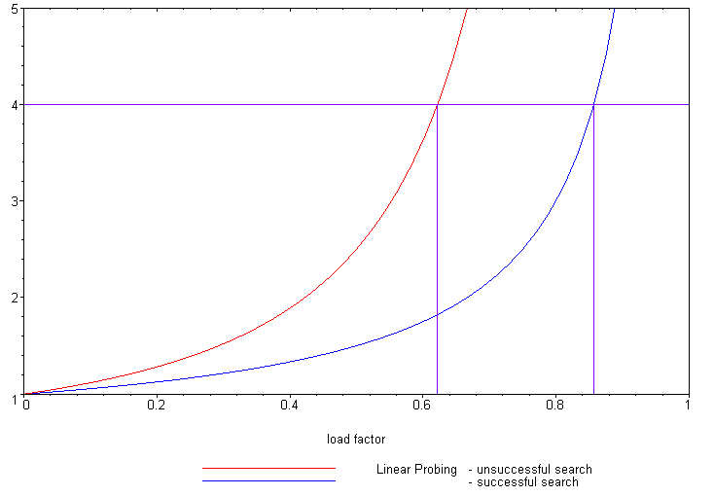
Run-time analysis
The following plot shows how the number of required probes increases

Slide 163
Run-time analysis
Our goal was to keep all operations Θ(1)
Unfortunately, as λ grows, so does the run time
One solution is to keep the load factor under a given bound
If we choose λ = 2/3, then the number of probes for either a successful or unsuccessful search is 2 and 5, respectively

Slide 164
Run-time analysis
Therefore, we have three choices:
Choose M large enough so that we will not pass this load factor
This could waste memory
Double the number of bins if the chosen load factor is reached
Choose a different strategy than linear probing
Two possibilities are quadratic probing and double hashing

Slide 165
Outline
Introduction
Hash function
Mapping down to 0, ..., M – 1
Dealing with collisions
Chained hash tables
Open addressing
Linear probing
Quadratic probing

Slide 166
Outline
This topic covers quadratic probing
Similar to linear probing
Does not step forward one step at a time
Primary clustering no longer occurs
Affected by secondary clustering

Slide 167
Background
Linear probing:
Look at bins k, k + 1, k + 2, k + 3, k + 4, …
Primary clustering

Slide 168
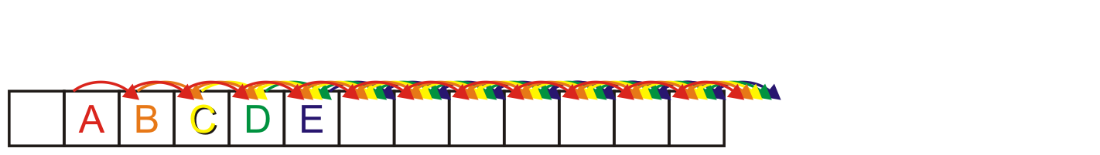
Background
Linear probing causes primary clustering
All entries follow the same search pattern for bins:
int initial = hash_M( x.hash(), M );
for ( int k = 0; k < M; ++k ) {
bin = (initial + k) % M;
// ...
}

Slide 169
Description
Quadratic probing suggests moving forward by different amounts
For example,
int initial = hash_M( x.hash(), M );
for ( int k = 0; k < M; ++k ) {
bin = (initial + k*k) % M;
}

Slide 170
Description
Problem:
Will initial + k*k step through all of the bins?
Here, the array size is 10:
M = 10;
initial = 5
for ( int k = 0; k <= M; ++k ) {
std::cout << (initial + k*k) % M << ' ';
}
The output is
5 6 9 4 1 0 1 4 9 6 5

Slide 171
Description
Problem:
Will initial + k*k step through all of the bins?
Now the array size is 12:
M = 12;
initial = 5
for ( int k = 0; k <= M; ++k ) {
std::cout << (initial + k*k) % M << ' ';
}
The output is now
5 6 9 2 9 6 5 6 9 2 9 6 5

Slide 172
Making M Prime
If we make the table size M = p a prime number, quadratic probing is guaranteed to iterates through entries
Problems:
All operations must be done using %
Cannot use &, <<, or >>
The modulus operator % is relatively slow
Doubling the number of bins is difficult:
What is the next prime after 2 × 263?
Notes:
Warning: most text books stop here!
– Never use a prime table size if at all possible

Slide 173
Generalization
More generally, we could consider an approach like:
int initial = hash_M( x.hash(), M );
for ( int k = 0; k < M; ++k ) {
bin = (initial + c1*k + c2*k*k) % M;
}

Slide 174
Using M = 2^{m}
If we ensure M = 2^{m} then choose
c₁ = c₂ = ½
int initial = hash_M( x.hash(), M );
for ( int k = 0; k < M; ++k ) {
bin = (initial + (k + k*k)/2) % M;
}
Note that k + k*k is always even
The growth is still Θ(k²)
This guarantees that all M entries are visited before the pattern repeats
This only works for powers of two
Notes:
For proof, see solution to textbook problem 11-3

Slide 175
Using M = 2^{m}
For example:
Use an array size of 16:
M = 16;
initial = 5
for ( int k = 0; k <= M; ++k ) {
std::cout << (initial + (k + k*k)/2) % M << ' ';
}
The output is now
5 6 8 11 15 4 10 1 9 2 12 7 3 0 14 13 13

Slide 176
Using M = 2^{m}
There is an even easier means of calculating this approach
int bin = hash_M( x.hash(), M );
for ( int k = 0; k < M; ++k ) {
bin = (bin + k) % M;
}
Recall that , so just keep adding the next highest value

Slide 177
Example
Consider a hash table with M = 16 bins
Given a 2-digit hexadecimal number:
The least-significant digit is the primary hash function (bin)
Example: for 7A₁₆ , the initial bin is A

Slide 178
Example
Insert these numbers into this initially empty hash table
9A, 07, AD, 88, BA, 80, 4C, 26, 46, C9, 32, 7A, BF, 9C
0 | 1 | 2 | 3 | 4 | 5 | 6 | 7 | 8 | 9 | A | B | C | D | E | F

Slide 179
Example
Start with the first four values:
9A, 07, AD, 88
0 | 1 | 2 | 3 | 4 | 5 | 6 | 7 | 8 | 9 | A | B | C | D | E | F

Slide 180
Example
Start with the first four values:
9A, 07, AD, 88
0 | 1 | 2 | 3 | 4 | 5 | 6 | 7 | 8 | 9 | A | B | C | D | E | F
 |  |  |  |  |  |  | 07 | 88 |  | 9A |  |  | AD

Slide 181
Example
Next, we must insert BA
0 | 1 | 2 | 3 | 4 | 5 | 6 | 7 | 8 | 9 | A | B | C | D | E | F
 |  |  |  |  |  |  | 07 | 88 |  | 9A |  |  | AD

Slide 182
Example
Next, we must insert BA
The next bin is empty
0 | 1 | 2 | 3 | 4 | 5 | 6 | 7 | 8 | 9 | A | B | C | D | E | F
 |  |  |  |  |  |  | 07 | 88 |  | 9A | BA |  | AD

Slide 183
Example
Next we are adding 80, 4C, 26
0 | 1 | 2 | 3 | 4 | 5 | 6 | 7 | 8 | 9 | A | B | C | D | E | F
 |  |  |  |  |  |  | 07 | 88 |  | 9A | BA |  | AD

Slide 184
Example
Next, we are adding 80, 4C, 26
All the bins are empty—simply insert them
0 | 1 | 2 | 3 | 4 | 5 | 6 | 7 | 8 | 9 | A | B | C | D | E | F
80 |  |  |  |  |  | 26 | 07 | 88 |  | 9A | BA | 4C | AD

Slide 185
Example
Next, we must insert 46
0 | 1 | 2 | 3 | 4 | 5 | 6 | 7 | 8 | 9 | A | B | C | D | E | F
80 |  |  |  |  |  | 26 | 07 | 88 |  | 9A | BA | 4C | AD

Slide 186
Example
Next, we must insert 46
Bin 6 is occupied
Bin 6 + 1 = 7 is occupied
Bin 7 + 2 = 9 is empty
0 | 1 | 2 | 3 | 4 | 5 | 6 | 7 | 8 | 9 | A | B | C | D | E | F
80 |  |  |  |  |  | 26 | 07 | 88 | 46 | 9A | BA | 4C | AD

Slide 187
Example
Next, we must insert C9
0 | 1 | 2 | 3 | 4 | 5 | 6 | 7 | 8 | 9 | A | B | C | D | E | F
80 |  |  |  |  |  | 26 | 07 | 88 | 46 | 9A | BA | 4C | AD

Slide 188
Example
Next, we must insert C9
Bin 9 is occupied
Bin 9 + 1 = A is occupied
Bin A + 2 = C is occupied
Bin C + 3 = F is empty
0 | 1 | 2 | 3 | 4 | 5 | 6 | 7 | 8 | 9 | A | B | C | D | E | F
80 |  |  |  |  |  | 26 | 07 | 88 | 46 | 9A | BA | 4C | AD |  | C9

Slide 189
Example
Next, we insert 32
Bin 2 is unoccupied
0 | 1 | 2 | 3 | 4 | 5 | 6 | 7 | 8 | 9 | A | B | C | D | E | F
80 |  | 32 |  |  |  | 26 | 07 | 88 | 46 | 9A | BA | 4C | AD |  | C9

Slide 190
Example
Next, we insert 7A
Bin A is occupied
Bins A + 1 = B, B + 2 = D and D + 3 = 0 are occupied
Bin 0 + 4 = 4 is empty
0 | 1 | 2 | 3 | 4 | 5 | 6 | 7 | 8 | 9 | A | B | C | D | E | F
80 |  | 32 |  | 7A |  | 26 | 07 | 88 | 46 | 9A | BA | 4C | AD |  | C9

Slide 191
Example
Next, we insert BF
Bin F is occupied
Bins F + 1 = 0 and 0 + 2 = 2 are occupied
Bin 2 + 3 = 5 is empty
0 | 1 | 2 | 3 | 4 | 5 | 6 | 7 | 8 | 9 | A | B | C | D | E | F
80 |  | 32 |  | 7A | BF | 26 | 07 | 88 | 46 | 9A | BA | 4C | AD |  | C9

Slide 192
Example
Finally, we insert 9C
Bin C is occupied
Bins C + 1 = D, D + 2 = F, F + 3 = 2, 2 + 4 = 6 and 6 + 5 = B are occupied
Bin B + 6 = 1 is empty
0 | 1 | 2 | 3 | 4 | 5 | 6 | 7 | 8 | 9 | A | B | C | D | E | F
80 | 9C | 32 |  | 7A | BF | 26 | 07 | 88 | 46 | 9A | BA | 4C | AD |  | C9

Slide 193
Example
Having completed these insertions:
The load factor is λ = 14/16 = 0.875
The average number of probes is 32/14 ≈ 2.29
0 | 1 | 2 | 3 | 4 | 5 | 6 | 7 | 8 | 9 | A | B | C | D | E | F
80 | 9C | 32 |  | 7A | BF | 26 | 07 | 88 | 46 | 9A | BA | 4C | AD |  | C9

Slide 194
Erase
Can we erase an object like we did with linear probing?
Consider erasing 9A from this table
There are M – 1 possible locations where an object which could have occupied a position could be located
Instead, we use lazy erasing
Mark a bin as ERASED; however, when searching, treat the bin as occupied and continue
0 | 1 | 2 | 3 | 4 | 5 | 6 | 7 | 8 | 9 | A | B | C | D | E | F
80 | 21 |  | 43 |  |  | 76 |  |  |  | 9A |  |  |  |  | 50
Notes:
We must have a separate ternary-valued flag for each bin

Slide 195
Erase
If we erase AD, we must mark that bin as erased
0 | 1 | 2 | 3 | 4 | 5 | 6 | 7 | 8 | 9 | A | B | C | D | E | F
80 | 9C | 32 |  | 7A | BF | 26 | 07 | 88 | 46 | 9A | BA | 4C | AD |  | C9

Slide 196
Find
When searching, it is necessary to skip over this bin
For example, find AD: D, E
find 5C: C, D, F, 2, 6, B, 1, 8, 0, 9, 3
0 | 1 | 2 | 3 | 4 | 5 | 6 | 7 | 8 | 9 | A | B | C | D | E | F
80 | 9C | 32 |  | 7A | BF | 26 | 07 | 88 | 46 | 9A | BA | 4C | AD |  | C9

Slide 197
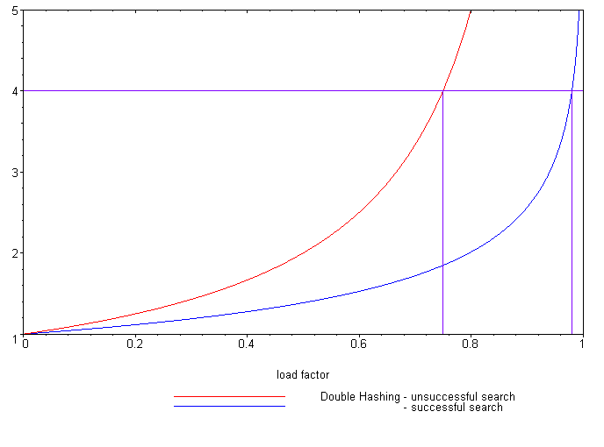
Expected number of probes
Load Factor (λ)
Unsuccessful search
Successful search
Reference: Knuth, The Art of Computer Programming,
Vol. 3, 2nd Ed., 1998, Addison Wesley, p. 530.
It is possible to calculate the expected number of probes for quadratic probing, again, based on the load factor:
Successful searches:
Unsuccessful searches:
When λ = 2/3, we requires 1.65 and 3 probes, respectively
Linear probing required 3 and 5 probes, respectively

Slide 198
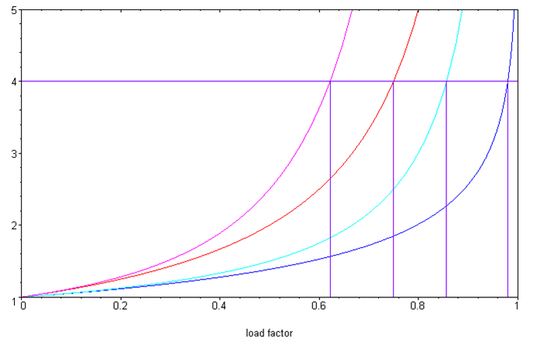
Quadratic probing versus linear probing
Comparing the two:
Linear probing
Unsuccessful search
Successful search
Quadratic probing
Unsuccessful search
Successful search
Examined Bins
Load Factor (λ)

Slide 199
Secondary clustering
Weakness with quadratic problem
Clustering may still occur: objects placed in the same bin will follow the same sequence
Less severe than linear probing

Slide 200
Summary
In this topic, we have looked at quadratic probing:
An open addressing technique
Steps forward by a quadratically growing steps
Insertions and searching are straight forward
Removing objects is more complicated: use lazy deletion
Still subject to secondary probing

Slide 201
Summary
Object
Predetermined hash functions (explicit)
Arithmetic hash functions (implicit)
32-bit integer
Modulus (bitwise operations for M = 2^{m}) Obfuscate via multiplication
Map to an index 0, ..., M – 1
Chained hash tables
Open addressing
Linear probing
Quadratic probing
Deal with collisions

