Slide 1

CS101 Algorithms and Data Structures
Merge Sort
Textbook Ch 1.4, 7
Notes:
Adapted from the slides by Douglas Wilhelm Harder of U Waterloo (https://ece.uwaterloo.ca/~dwharder/aads/Lecture_materials/)
May also contain material from the slides at https://courses.cs.washington.edu/courses/cse326/03wi/326lecturesb.shtml (by Dan Suciu of U Washington)
因为Merge Sort内容比较简单，所以前面加了一点对bubble sort和insertion sort的前情提要，另外添加了selection sort来说明排序算法稳定性的问题。之后只Merge sort的主体部分。后面结合已经讲过的binary search和 merge sort总结了一下分治的主体思路和特点。

Slide 2
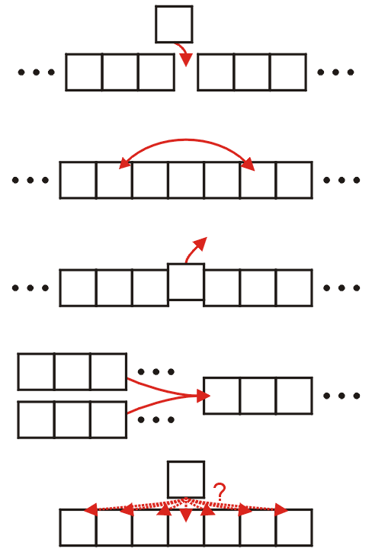
Classifications
The operations of a sorting algorithm are based on the actions performed:
Insertion
Exchanging
Selection
Merging
Distribution

Slide 3
Which sort algorithm?
7
8
5
2
4
6
3
7
5
2
4
6
3
8
5
2
4
6
3
7
8
2
4
5
3
6
7
8

Slide 4
Bubble Sort
2
4
3
5
6
7
8
2
3
4
5
6
7
8
2
3
4
5
6
7
8
2
3
4
5
6
7
8

Slide 5
Flagged Bubble Sort
Check if the list is sorted (no swaps)
template <typename Type>
void bubble( Type *const array, int const n ) {
for ( int i = n - 1; i > 0; --i ) {
Type max = array[0];
bool sorted = true;
for ( int j = 1; j <= i; ++j ) {
if ( array[j] < max ) {
array[j - 1] = array[j];
sorted = false;
} else {
array[j – 1] = max;
max = array[j];
}
}
array[i] = max;
if ( sorted ) {
break;
}
}
}

Slide 6
Flagged Bubble Sort
2
4
3
5
6
7
8
2
3
4
5
6
7
8
2
3
4
5
6
7
8

Slide 7
Range-limiting Bubble Sort
Update i to at the place of the last swap
template <typename Type>
void bubble( Type *const array, int const n ) {
for ( int i = n - 1; i > 0; ) {
Type max = array[0];
int ii = 0;
for ( int j = 1; j <= i; ++j ) {
if ( array[j] < max ) {
array[j - 1] = array[j];
ii = j - 1;
} else {
array[j – 1] = max;
max = array[j];
}
}
array[i] = max;
i = ii;
}
}

Slide 8
Range-limiting Bubble Sort
2
4
3
5
6
7
8
2
3
4
5
6
7
8
2
3
4
5
6
7
8

Slide 9
Which sort algorithm?
7
8
5
2
4
6
3
7
8
5
2
4
6
3
5
7
8
2
4
6
3
2
5
7
8
4
6
3

Slide 10
Insertion Sort
2
4
5
7
8
6
3
2
4
5
6
7
8
3
2
3
4
5
6
7
8

Slide 11
Which sort algorithm?
7
8
5
2
4
6
3
7
3
5
2
4
6
8
6
3
5
2
4
7
8
4
3
5
2
6
7
8

Slide 12
Selection Sort
4
3
5
2
6
7
8
4
3
2
5
6
7
8
2
3
4
5
6
7
8
2
3
4
5
6
7
8

Slide 13
Stability in sorting algorithms
The stability of a sorting algorithm is concerned with how the algorithm treats equal (or repeated) elements. Stable sorting algorithms preserve the relative order of equal elements, while unstable sorting algorithms don’t. In other words, stable sorting maintains the position of two equals elements relative to one another.

Slide 14

Stability in sorting algorithms
Let $A$ be a collection of elements and < be a strict weak ordering on the elements. Further, let $B$ be the collection of elements in $A$ in the sorted order. Let’s consider two equal elements in $A$ at indices $i$ and $j$, i.e., $A\left[i\right]$ and $A\left[j\right]$, that end up at indices $m$ and $n$ respectively in $B$. We can classify the sorting as stable if:
$$i<j, A\left[i\right]=A\left[j\right], and m<n$$

Slide 15
Selection Sort
8B
5A
1C
2E
1G
1G
5A
1C
2E
8B
1G
2E
1C
5A
8B
1G
1C
2E
5A
8B

Slide 16
Outline
Insertion sort
Bubble sort
Merge sort

Slide 17
Outline
This topic covers merge sort
A recursive divide-and-conquer algorithm
Merging two lists
The merge sort algorithm
A run-time analysis

Slide 18
Merge Sort
The merge sort algorithm is defined recursively:
If the list is of size 1, it is sorted—we are done;
Otherwise:
Divide an unsorted list into two sub-lists,
Sort each sub-list recursively using merge sort, and
Merge the two sorted sub-lists into a single sorted list
This strategy is called divide-and-conquer
Question: How can we merge two sorted sub-lists into a single sorted list?

Slide 19




Merging Example
Consider the two sorted arrays and an empty array
Define three indices at the start of each array
3
5
18
21
24
$$⋯$$
$$⋯$$
Hmmm
Merging?
2
7
12
16
33
$$⋯$$

Slide 20
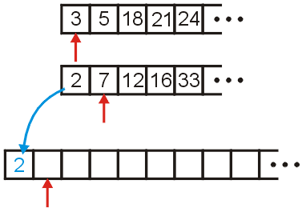
Merging Example
We compare 2 and 3: 2 < 3
Copy 2 down
Increment the corresponding indices

Slide 21
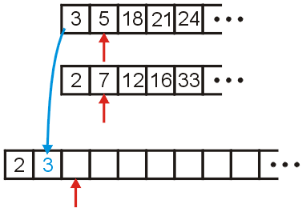
Merging Example
We compare 3 and 7
Copy 3 down
Increment the corresponding indices
Still Merging?

Slide 22
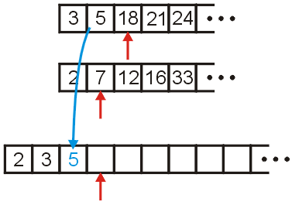
Merging Example
We compare 5 and 7
Copy 5 down
Increment the appropriate indices

Slide 23
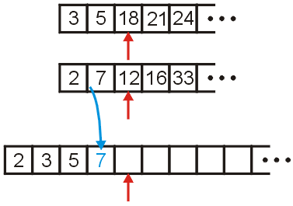
Merging Example
We compare 18 and 7
Copy 7 down
Increment...

Slide 24
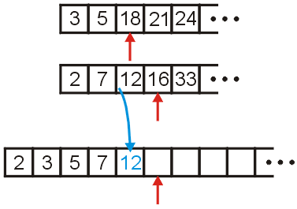

Merging Example
We compare 18 and 12
Copy 12 down
Increment...
Merging?
Kidding!

Slide 25
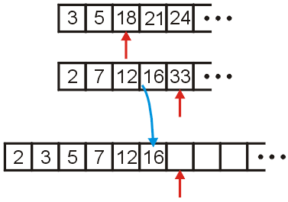
Merging Example
We compare 18 and 16
Copy 16 down
Increment...

Slide 26
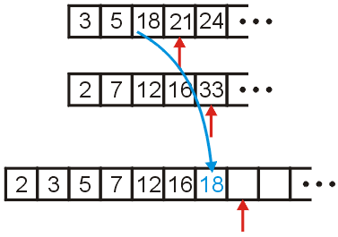

Merging Example
We compare 18 and 33
Copy 18 down
Increment...
… … …

Slide 27
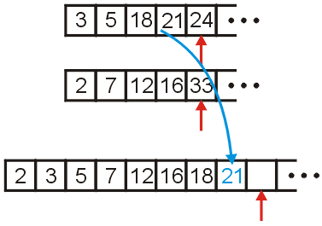
Merging Example
We compare 21 and 33
Copy 21 down
Increment...

Slide 28
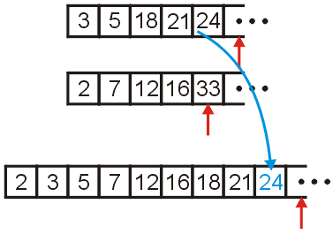

Merging Example
We compare 24 and 33
Copy 24 down
Increment...
Hi! Do u want to do merging? It is interesting.

Slide 29
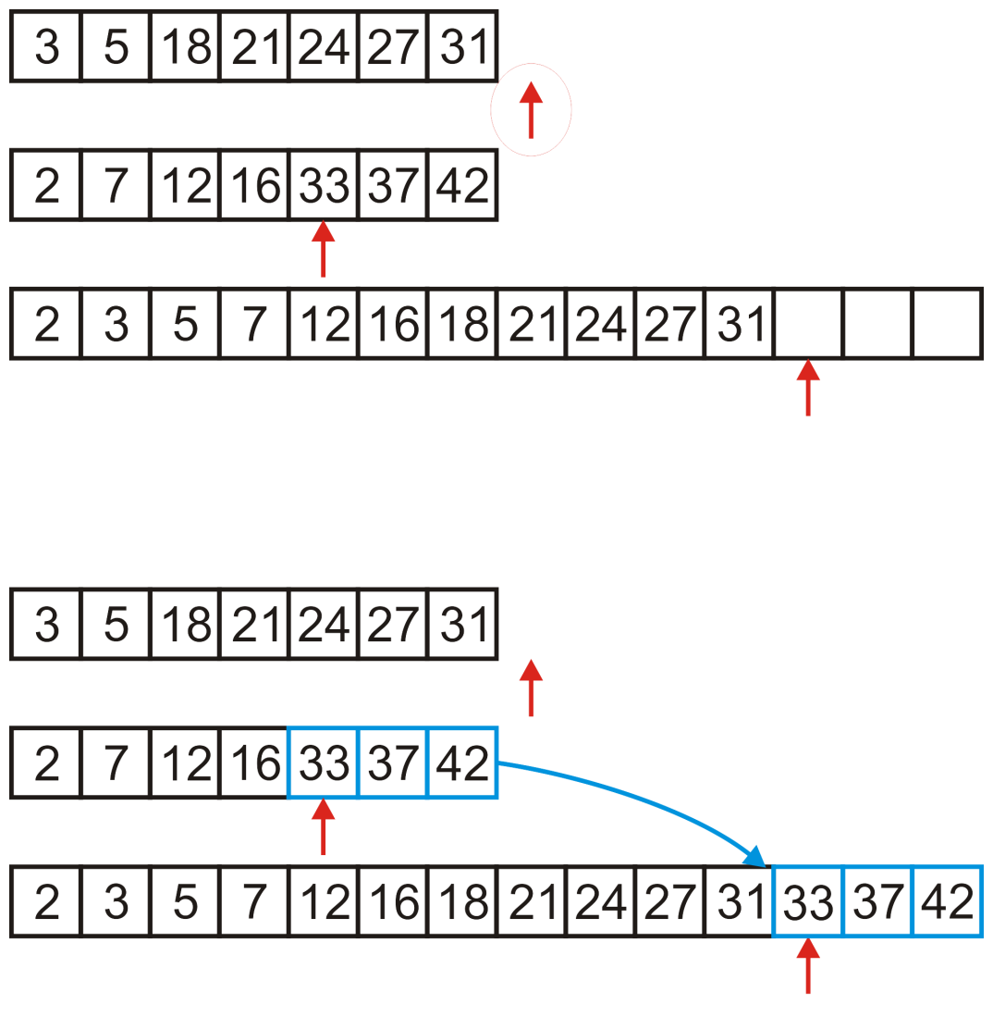
Merging Example
We would continue until we have passed beyond the limit of one of the two arrays
After this, we simply copy over all remaining entries in the non- empty array

Slide 30
Merging Two Lists
Programming a merge is straight-forward:
the sorted arrays, array1 and array2, are of size n1 and n2, respectively, and
we have an empty array, arrayout, of size n1 + n2
Define three variables int i1 = 0, i2 = 0, k = 0;
which index into these three arrays

Slide 31
Merging Two Lists
We can then run the following loop:
#include <cassert>
//...
int i1 = 0, i2 = 0, k = 0;
while ( i1 < n1 && i2 < n2 ) {
if ( array1[i1] < array2[i2] ) {
arrayout[k] = array1[i1];
++i1;
} else {
assert( array1[i1] >= array2[i2] );
arrayout[k] = array2[i2];
++i2;
}
++k;
}

Slide 32
Merging Two Lists
We’re not finished yet, We have to empty out the remaining array
for ( ; i1 < n1; ++i1, ++k ) {
arrayout[k] = array1[i1];
}
for ( ; i2 < n2; ++i2, ++k ) {
arrayout[k] = array2[i2];
}

Slide 33
Analysis of merging
Time: we have to copy n₁ + n₂ elements
Hence, merging may be performed in Θ(n₁ + n₂) time
If the arrays are approximately the same size, n = n₁ ≈ n₂, we can say that the run time is Θ(n)
Space: we cannot merge two arrays in-place
This algorithm always required the allocation of a new array
Therefore, the memory requirements are also Θ(n)

Slide 34
The Algorithm
Recall the five sorting techniques:
Insertion
Exchange
Selection
Merging
Distribution
Clearly merge sort falls into the fourth category

Slide 35
The Algorithm
The merge sort algorithm is defined recursively:
If the list is of size 1, it is sorted—we are done;
Otherwise:
Divide an unsorted list into two sub-lists,
Sort each sub-list recursively using merge sort, and
Merge the two sorted sub-lists into a single sorted list
In practice:
If the list size is less than a threshold, use an algorithm like insertion sort
Otherwise:
Divide…

Slide 36
Implementation
Suppose we already have a function
template <typename Type>
void merge( Type *array, int a, int b, int c );
that assumes that the entries
array[a] through array[b - 1], and
array[b] through array[c - 1]
are sorted and merges these two sub-arrays into a single sorted array from index a through index c - 1, inclusive

Slide 37
Implementation
For example, given the array,
a call to
void merge( array, 14, 20, 26 );
merges the two sub-lists
forming
9 | 10 | 11 | 12 | 13 | 14 | 15 | 16 | 17 | 18 | 19 | 20 | 21 | 22 | 23 | 24 | 25 | 26 | 27 | 28 | 29 | 30 | 31 | 32 | 33
13 | 77 | 49 | 35 | 61 | 3 | 23 | 48 | 73 | 89 | 95 | 17 | 32 | 37 | 57 | 94 | 99 | 28 | 15 | 55 | 7 | 51 | 88 | 97 | 62
9 | 10 | 11 | 12 | 13 | 14 | 15 | 16 | 17 | 18 | 19 | 20 | 21 | 22 | 23 | 24 | 25 | 26 | 27 | 28 | 29 | 30 | 31 | 32 | 33
13 | 77 | 49 | 35 | 61 | 3 | 23 | 48 | 73 | 89 | 95 | 17 | 32 | 37 | 57 | 94 | 99 | 28 | 15 | 55 | 7 | 51 | 88 | 97 | 62
9 | 10 | 11 | 12 | 13 | 14 | 15 | 16 | 17 | 18 | 19 | 20 | 21 | 22 | 23 | 24 | 25 | 26 | 27 | 28 | 29 | 30 | 31 | 32 | 33
13 | 77 | 49 | 35 | 61 | 3 | 17 | 23 | 32 | 37 | 48 | 57 | 73 | 89 | 94 | 95 | 99 | 28 | 15 | 55 | 7 | 51 | 88 | 97 | 62

Slide 38
Implementation
We implement a function
template <typename Type>
void merge_sort( Type *array, int first, int last );
that will sort the entries in the positions first <= i and i < last
If the number of entries is less than N, call insertion sort
Otherwise:
Find the mid-point,
Call merge sort recursively on each of the halves, and
Merge the results

Slide 39
Implementation
template <typename Type>
void merge_sort( Type *array, int first, int last ) {
if ( last - first <= N ) {
insertion_sort( array, first, last );
} else {
int midpoint = (first + last)/2;
merge_sort( array, first, midpoint );
merge_sort( array, midpoint, last );
merge( array, first, midpoint, last );
}
}

Slide 40

Implementation
Like merge sort, insertion sort will sort a sub-range of the array:
template <typename Type>
void insertion_sort( Type *array, int first, int last ) {
for ( int k = first + 1; k < last; ++k ) {
Type tmp = array[k];
for ( int j = k; k > first; --j ) {
if ( array[j - 1] > tmp ) {
array[j] = array[j - 1];
} else {
array[j] = tmp;
goto finished;
}
}
array[first] = tmp;
finished: ;
}
}

Slide 41
Example
Consider the following is of unsorted array of 25 entries
We will call insertion sort if the list being sorted of size N = 6 or less
0 | 1 | 2 | 3 | 4 | 5 | 6 | 7 | 8 | 9 | 10 | 11 | 12 | 13 | 14 | 15 | 16 | 17 | 18 | 19 | 20 | 21 | 22 | 23 | 24
13 | 77 | 49 | 35 | 61 | 48 | 73 | 23 | 95 | 3 | 89 | 37 | 57 | 99 | 17 | 32 | 94 | 28 | 15 | 55 | 7 | 51 | 88 | 97 | 62

Slide 42
Example
We call merge_sort( array, 0, 25 )
0 | 1 | 2 | 3 | 4 | 5 | 6 | 7 | 8 | 9 | 10 | 11 | 12 | 13 | 14 | 15 | 16 | 17 | 18 | 19 | 20 | 21 | 22 | 23 | 24
13 | 77 | 49 | 35 | 61 | 48 | 73 | 23 | 95 | 3 | 89 | 37 | 57 | 99 | 17 | 32 | 94 | 28 | 15 | 55 | 7 | 51 | 88 | 97 | 62
merge_sort( array, 0, 25 )

Slide 43
Example
We are calling merge_sort( array, 0, 25 )
First, 25 – 0 > 6, so find the midpoint and call merge_sort recursively
midpoint = (0 + 25)/2; // == 12
merge_sort( array, 0, 12 );
0 | 1 | 2 | 3 | 4 | 5 | 6 | 7 | 8 | 9 | 10 | 11 | 12 | 13 | 14 | 15 | 16 | 17 | 18 | 19 | 20 | 21 | 22 | 23 | 24
13 | 77 | 49 | 35 | 61 | 48 | 73 | 23 | 95 | 3 | 89 | 37 | 57 | 99 | 17 | 32 | 94 | 28 | 15 | 55 | 7 | 51 | 88 | 97 | 62
merge_sort( array, 0, 25 )

Slide 44

Example
We are now executing merge_sort( array, 0, 12 )
First, 12 – 0 > 6, so find the midpoint and call merge_sort recursively
midpoint = (0 + 12)/2; // == 6
merge_sort( array, 0, 6 );
0 | 1 | 2 | 3 | 4 | 5 | 6 | 7 | 8 | 9 | 10 | 11 | 12 | 13 | 14 | 15 | 16 | 17 | 18 | 19 | 20 | 21 | 22 | 23 | 24
13 | 77 | 49 | 35 | 61 | 48 | 73 | 23 | 95 | 3 | 89 | 37 | 57 | 99 | 17 | 32 | 94 | 28 | 15 | 55 | 7 | 51 | 88 | 97 | 62
This Structure looks familiar.
merge_sort( array, 0, 12 )
merge_sort( array, 0, 25 )

Slide 45
Example
We are now executing merge_sort( array, 0, 6 )
Now, 6 – 0 ≤ 6, so find we call insertion sort
0 | 1 | 2 | 3 | 4 | 5 | 6 | 7 | 8 | 9 | 10 | 11 | 12 | 13 | 14 | 15 | 16 | 17 | 18 | 19 | 20 | 21 | 22 | 23 | 24
13 | 77 | 49 | 35 | 61 | 48 | 73 | 23 | 95 | 3 | 89 | 37 | 57 | 99 | 17 | 32 | 94 | 28 | 15 | 55 | 7 | 51 | 88 | 97 | 62
merge_sort( array, 0, 6 )
merge_sort( array, 0, 12 )
merge_sort( array, 0, 25 )

Slide 46
Example
Insertion sort just sorts the entries from 0 to 5
0 | 1 | 2 | 3 | 4 | 5 | 6 | 7 | 8 | 9 | 10 | 11 | 12 | 13 | 14 | 15 | 16 | 17 | 18 | 19 | 20 | 21 | 22 | 23 | 24
13 | 77 | 49 | 35 | 61 | 48 | 73 | 23 | 95 | 3 | 89 | 37 | 57 | 99 | 17 | 32 | 94 | 28 | 15 | 55 | 7 | 51 | 88 | 97 | 62
insertion_sort( array, 0, 6 )
merge_sort( array, 0, 6 )
merge_sort( array, 0, 12 )
merge_sort( array, 0, 25 )

Slide 47
Example
Insertion sort just sorts the entries from 0 to 5
This function call completes and so we exit
0 | 1 | 2 | 3 | 4 | 5 | 6 | 7 | 8 | 9 | 10 | 11 | 12 | 13 | 14 | 15 | 16 | 17 | 18 | 19 | 20 | 21 | 22 | 23 | 24
13 | 35 | 48 | 49 | 61 | 77 | 73 | 23 | 95 | 3 | 89 | 37 | 57 | 99 | 17 | 32 | 94 | 28 | 15 | 55 | 7 | 51 | 88 | 97 | 62
insertion_sort( array, 0, 6 )
merge_sort( array, 0, 6 )
merge_sort( array, 0, 12 )
merge_sort( array, 0, 25 )

Slide 48
Example
This call to merge_sort is now also finished, so it, too, exits
0 | 1 | 2 | 3 | 4 | 5 | 6 | 7 | 8 | 9 | 10 | 11 | 12 | 13 | 14 | 15 | 16 | 17 | 18 | 19 | 20 | 21 | 22 | 23 | 24
13 | 35 | 48 | 49 | 61 | 77 | 73 | 23 | 95 | 3 | 89 | 37 | 57 | 99 | 17 | 32 | 94 | 28 | 15 | 55 | 7 | 51 | 88 | 97 | 62
merge_sort( array, 0, 6 )
merge_sort( array, 0, 12 )
merge_sort( array, 0, 25 )

Slide 49
Example
We return to continue executing merge_sort( array, 0, 12 )
We continue calling
midpoint = (0 + 12)/2; // == 6
merge_sort( array, 0, 6 );
merge_sort( array, 6, 12 );
0 | 1 | 2 | 3 | 4 | 5 | 6 | 7 | 8 | 9 | 10 | 11 | 12 | 13 | 14 | 15 | 16 | 17 | 18 | 19 | 20 | 21 | 22 | 23 | 24
13 | 35 | 48 | 49 | 61 | 77 | 73 | 23 | 95 | 3 | 89 | 37 | 57 | 99 | 17 | 32 | 94 | 28 | 15 | 55 | 7 | 51 | 88 | 97 | 62
merge_sort( array, 0, 12 )
merge_sort( array, 0, 25 )

Slide 50
Example
We are now executing merge_sort( array, 6, 12 )
Now, 12 – 6 ≤ 6, so find we call insertion sort
0 | 1 | 2 | 3 | 4 | 5 | 6 | 7 | 8 | 9 | 10 | 11 | 12 | 13 | 14 | 15 | 16 | 17 | 18 | 19 | 20 | 21 | 22 | 23 | 24
13 | 35 | 48 | 49 | 61 | 77 | 73 | 23 | 95 | 3 | 89 | 37 | 57 | 99 | 17 | 32 | 94 | 28 | 15 | 55 | 7 | 51 | 88 | 97 | 62
merge_sort( array, 6, 12 )
merge_sort( array, 0, 12 )
merge_sort( array, 0, 25 )

Slide 51
Example
Insertion sort just sorts the entries from 6 to 11
0 | 1 | 2 | 3 | 4 | 5 | 6 | 7 | 8 | 9 | 10 | 11 | 12 | 13 | 14 | 15 | 16 | 17 | 18 | 19 | 20 | 21 | 22 | 23 | 24
13 | 35 | 48 | 49 | 61 | 77 | 73 | 23 | 95 | 3 | 89 | 37 | 57 | 99 | 17 | 32 | 94 | 28 | 15 | 55 | 7 | 51 | 88 | 97 | 62
insertion_sort( array, 6, 12 )
merge_sort( array, 6, 12 )
merge_sort( array, 0, 12 )
merge_sort( array, 0, 25 )

Slide 52
Example
Insertion sort just sorts the entries from 6 to 11
This function call completes and so we exit
0 | 1 | 2 | 3 | 4 | 5 | 6 | 7 | 8 | 9 | 10 | 11 | 12 | 13 | 14 | 15 | 16 | 17 | 18 | 19 | 20 | 21 | 22 | 23 | 24
13 | 35 | 48 | 49 | 61 | 77 | 3 | 23 | 37 | 73 | 89 | 95 | 57 | 99 | 17 | 32 | 94 | 28 | 15 | 55 | 7 | 51 | 88 | 97 | 62
insertion_sort( array, 6, 12 )
merge_sort( array, 6, 12 )
merge_sort( array, 0, 12 )
merge_sort( array, 0, 25 )

Slide 53
Example
This call to merge_sort is now also finished, so it, too, exits
0 | 1 | 2 | 3 | 4 | 5 | 6 | 7 | 8 | 9 | 10 | 11 | 12 | 13 | 14 | 15 | 16 | 17 | 18 | 19 | 20 | 21 | 22 | 23 | 24
13 | 35 | 48 | 49 | 61 | 77 | 3 | 23 | 37 | 73 | 89 | 95 | 57 | 99 | 17 | 32 | 94 | 28 | 15 | 55 | 7 | 51 | 88 | 97 | 62
merge_sort( array, 6, 12 )
merge_sort( array, 0, 12 )
merge_sort( array, 0, 25 )

Slide 54
Example
We return to continue executing merge_sort( array, 0, 12 )
We continue calling
midpoint = (0 + 12)/2; // == 6
merge_sort( array, 0, 6 );
merge_sort( array, 6, 12 );
merge( array, 0, 6, 12 );
0 | 1 | 2 | 3 | 4 | 5 | 6 | 7 | 8 | 9 | 10 | 11 | 12 | 13 | 14 | 15 | 16 | 17 | 18 | 19 | 20 | 21 | 22 | 23 | 24
13 | 35 | 48 | 49 | 61 | 77 | 3 | 23 | 37 | 73 | 89 | 95 | 57 | 99 | 17 | 32 | 94 | 28 | 15 | 55 | 7 | 51 | 88 | 97 | 62
merge_sort( array, 0, 12 )
merge_sort( array, 0, 25 )

Slide 55
Example
We are executing merge( array, 0, 6, 12 )
These two sub-arrays are merged together
0 | 1 | 2 | 3 | 4 | 5 | 6 | 7 | 8 | 9 | 10 | 11 | 12 | 13 | 14 | 15 | 16 | 17 | 18 | 19 | 20 | 21 | 22 | 23 | 24
13 | 35 | 48 | 49 | 61 | 77 | 3 | 23 | 37 | 73 | 89 | 95 | 57 | 99 | 17 | 32 | 94 | 28 | 15 | 55 | 7 | 51 | 88 | 97 | 62
merge( array, 0, 6, 12 )
merge_sort( array, 0, 12 )
merge_sort( array, 0, 25 )

Slide 56
Example
We are executing merge( array, 0, 6, 12 )
These two sub-arrays are merged together
This function call exists
0 | 1 | 2 | 3 | 4 | 5 | 6 | 7 | 8 | 9 | 10 | 11 | 12 | 13 | 14 | 15 | 16 | 17 | 18 | 19 | 20 | 21 | 22 | 23 | 24
3 | 13 | 23 | 35 | 37 | 48 | 49 | 61 | 73 | 77 | 89 | 95 | 57 | 99 | 17 | 32 | 94 | 28 | 15 | 55 | 7 | 51 | 88 | 97 | 62
merge( array, 0, 6, 12 )
merge_sort( array, 0, 12 )
merge_sort( array, 0, 25 )

Slide 57
Example
We return to executing merge_sort( array, 0, 12 )
We are finished calling this function as well
midpoint = (0 + 12)/2; // == 6
merge_sort( array, 0, 6 );
merge_sort( array, 6, 12 );
merge( array, 0, 6, 12 );
Consequently, we exit
0 | 1 | 2 | 3 | 4 | 5 | 6 | 7 | 8 | 9 | 10 | 11 | 12 | 13 | 14 | 15 | 16 | 17 | 18 | 19 | 20 | 21 | 22 | 23 | 24
3 | 13 | 23 | 35 | 37 | 48 | 49 | 61 | 73 | 77 | 89 | 95 | 57 | 99 | 17 | 32 | 94 | 28 | 15 | 55 | 7 | 51 | 88 | 97 | 62
merge_sort( array, 0, 12 )
merge_sort( array, 0, 25 )

Slide 58
Example
We return to executing merge_sort( array, 0, 25 )
We continue calling
midpoint = (0 + 25)/2; // == 12
merge_sort( array, 0, 12 );
merge_sort( array, 12, 25 );
0 | 1 | 2 | 3 | 4 | 5 | 6 | 7 | 8 | 9 | 10 | 11 | 12 | 13 | 14 | 15 | 16 | 17 | 18 | 19 | 20 | 21 | 22 | 23 | 24
3 | 13 | 23 | 35 | 37 | 48 | 49 | 61 | 73 | 77 | 89 | 95 | 57 | 99 | 17 | 32 | 94 | 28 | 15 | 55 | 7 | 51 | 88 | 97 | 62
merge_sort( array, 0, 25 )

Slide 59
Example
We are now executing merge_sort( array, 12, 25 )
First, 25 – 12 > 6, so find the midpoint and call merge_sort recursively
midpoint = (12 + 25)/2; // == 18
merge_sort( array, 12, 18 );
0 | 1 | 2 | 3 | 4 | 5 | 6 | 7 | 8 | 9 | 10 | 11 | 12 | 13 | 14 | 15 | 16 | 17 | 18 | 19 | 20 | 21 | 22 | 23 | 24
3 | 13 | 23 | 35 | 37 | 48 | 49 | 61 | 73 | 77 | 89 | 95 | 57 | 99 | 17 | 32 | 94 | 28 | 15 | 55 | 7 | 51 | 88 | 97 | 62
merge_sort( array, 12, 25 )
merge_sort( array, 0, 25 )

Slide 60
Example
We are now executing merge_sort( array, 12, 18 )
Now, 18 – 12 ≤ 6, so find we call insertion sort
0 | 1 | 2 | 3 | 4 | 5 | 6 | 7 | 8 | 9 | 10 | 11 | 12 | 13 | 14 | 15 | 16 | 17 | 18 | 19 | 20 | 21 | 22 | 23 | 24
3 | 13 | 23 | 35 | 37 | 48 | 49 | 61 | 73 | 77 | 89 | 95 | 57 | 99 | 17 | 32 | 94 | 28 | 15 | 55 | 7 | 51 | 88 | 97 | 62
merge_sort( array, 12, 18 )
merge_sort( array, 12, 25 )
merge_sort( array, 0, 25 )

Slide 61
Example
Insertion sort just sorts the entries from 12 to 17
0 | 1 | 2 | 3 | 4 | 5 | 6 | 7 | 8 | 9 | 10 | 11 | 12 | 13 | 14 | 15 | 16 | 17 | 18 | 19 | 20 | 21 | 22 | 23 | 24
3 | 13 | 23 | 35 | 37 | 48 | 49 | 61 | 73 | 77 | 89 | 95 | 57 | 99 | 17 | 32 | 94 | 28 | 15 | 55 | 7 | 51 | 88 | 97 | 62
insertion_sort( array, 12, 18 )
merge_sort( array, 12, 18 )
merge_sort( array, 12, 25 )
merge_sort( array, 0, 25 )

Slide 62
Example
Insertion sort just sorts the entries from 12 to 17
This function call completes and so we exit
0 | 1 | 2 | 3 | 4 | 5 | 6 | 7 | 8 | 9 | 10 | 11 | 12 | 13 | 14 | 15 | 16 | 17 | 18 | 19 | 20 | 21 | 22 | 23 | 24
3 | 13 | 23 | 35 | 37 | 48 | 49 | 61 | 73 | 77 | 89 | 95 | 17 | 28 | 32 | 57 | 94 | 99 | 15 | 55 | 7 | 51 | 88 | 97 | 62
insertion_sort( array, 12, 18 )
merge_sort( array, 12, 18 )
merge_sort( array, 12, 25 )
merge_sort( array, 0, 25 )

Slide 63
Example
This call to merge_sort is now also finished, so it, too, exits
0 | 1 | 2 | 3 | 4 | 5 | 6 | 7 | 8 | 9 | 10 | 11 | 12 | 13 | 14 | 15 | 16 | 17 | 18 | 19 | 20 | 21 | 22 | 23 | 24
3 | 13 | 23 | 35 | 37 | 48 | 49 | 61 | 73 | 77 | 89 | 95 | 17 | 28 | 32 | 57 | 94 | 99 | 15 | 55 | 7 | 51 | 88 | 97 | 62
merge_sort( array, 12, 18 )
merge_sort( array, 12, 25 )
merge_sort( array, 0, 25 )

Slide 64
Example
We return to continue executing merge_sort( array, 12, 25 )
We continue calling
midpoint = (12 + 25)/2; // == 18
merge_sort( array, 12, 18 );
merge_sort( array, 18, 25 );
0 | 1 | 2 | 3 | 4 | 5 | 6 | 7 | 8 | 9 | 10 | 11 | 12 | 13 | 14 | 15 | 16 | 17 | 18 | 19 | 20 | 21 | 22 | 23 | 24
3 | 13 | 23 | 35 | 37 | 48 | 49 | 61 | 73 | 77 | 89 | 95 | 17 | 28 | 32 | 57 | 94 | 99 | 15 | 55 | 7 | 51 | 88 | 97 | 62
merge_sort( array, 12, 25 )
merge_sort( array, 0, 25 )

Slide 65
Example
We are now executing merge_sort( array, 18, 25 )
First, 25 – 18 > 6, so find the midpoint and call merge_sort recursively
midpoint = (18 + 25)/2; // == 21
merge_sort( array, 18, 21 );
0 | 1 | 2 | 3 | 4 | 5 | 6 | 7 | 8 | 9 | 10 | 11 | 12 | 13 | 14 | 15 | 16 | 17 | 18 | 19 | 20 | 21 | 22 | 23 | 24
3 | 13 | 23 | 35 | 37 | 48 | 49 | 61 | 73 | 77 | 89 | 95 | 17 | 28 | 32 | 57 | 94 | 99 | 15 | 55 | 7 | 51 | 88 | 97 | 62
merge_sort( array, 18, 25 )
merge_sort( array, 12, 25 )
merge_sort( array, 0, 25 )

Slide 66
Example
We are now executing merge_sort( array, 18, 21 )
Now, 21 – 18 ≤ 6, so find we call insertion sort
0 | 1 | 2 | 3 | 4 | 5 | 6 | 7 | 8 | 9 | 10 | 11 | 12 | 13 | 14 | 15 | 16 | 17 | 18 | 19 | 20 | 21 | 22 | 23 | 24
3 | 13 | 23 | 35 | 37 | 48 | 49 | 61 | 73 | 77 | 89 | 95 | 17 | 28 | 32 | 57 | 94 | 99 | 15 | 55 | 7 | 51 | 88 | 97 | 62
merge_sort( array, 18, 21 )
merge_sort( array, 18, 25 )
merge_sort( array, 12, 25 )
merge_sort( array, 0, 25 )

Slide 67
Example
Insertion sort just sorts the entries from 18 to 20
0 | 1 | 2 | 3 | 4 | 5 | 6 | 7 | 8 | 9 | 10 | 11 | 12 | 13 | 14 | 15 | 16 | 17 | 18 | 19 | 20 | 21 | 22 | 23 | 24
3 | 13 | 23 | 35 | 37 | 48 | 49 | 61 | 73 | 77 | 89 | 95 | 17 | 28 | 32 | 57 | 94 | 99 | 15 | 55 | 7 | 51 | 88 | 97 | 62
insertion_sort( array, 18, 21 )
merge_sort( array, 18, 21 )
merge_sort( array, 18, 25 )
merge_sort( array, 12, 25 )
merge_sort( array, 0, 25 )

Slide 68
Example
Insertion sort just sorts the entries from 18 to 20
This function call completes and so we exit
0 | 1 | 2 | 3 | 4 | 5 | 6 | 7 | 8 | 9 | 10 | 11 | 12 | 13 | 14 | 15 | 16 | 17 | 18 | 19 | 20 | 21 | 22 | 23 | 24
3 | 13 | 23 | 35 | 37 | 48 | 49 | 61 | 73 | 77 | 89 | 95 | 17 | 28 | 32 | 57 | 94 | 99 | 7 | 15 | 55 | 51 | 88 | 97 | 62
insertion_sort( array, 18, 21 )
merge_sort( array, 18, 21 )
merge_sort( array, 18, 25 )
merge_sort( array, 12, 25 )
merge_sort( array, 0, 25 )

Slide 69
Example
This call to merge_sort is now also finished, so it, too, exits
0 | 1 | 2 | 3 | 4 | 5 | 6 | 7 | 8 | 9 | 10 | 11 | 12 | 13 | 14 | 15 | 16 | 17 | 18 | 19 | 20 | 21 | 22 | 23 | 24
3 | 13 | 23 | 35 | 37 | 48 | 49 | 61 | 73 | 77 | 89 | 95 | 17 | 28 | 32 | 57 | 94 | 99 | 7 | 15 | 55 | 51 | 88 | 97 | 62
merge_sort( array, 18, 21 )
merge_sort( array, 18, 25 )
merge_sort( array, 12, 25 )
merge_sort( array, 0, 25 )

Slide 70
Example
We return to executing merge_sort( array, 18, 25 )
We continue calling
midpoint = (18 + 25)/2; // == 21
merge_sort( array, 18, 21 );
merge_sort( array, 21, 25 );
0 | 1 | 2 | 3 | 4 | 5 | 6 | 7 | 8 | 9 | 10 | 11 | 12 | 13 | 14 | 15 | 16 | 17 | 18 | 19 | 20 | 21 | 22 | 23 | 24
3 | 13 | 23 | 35 | 37 | 48 | 49 | 61 | 73 | 77 | 89 | 95 | 17 | 28 | 32 | 57 | 94 | 99 | 7 | 15 | 55 | 51 | 88 | 97 | 62
merge_sort( array, 18, 25 )
merge_sort( array, 12, 25 )
merge_sort( array, 0, 25 )

Slide 71
Example
We are now executing merge_sort( array, 21, 25 )
Now, 25 – 21 ≤ 6, so find we call insertion sort
0 | 1 | 2 | 3 | 4 | 5 | 6 | 7 | 8 | 9 | 10 | 11 | 12 | 13 | 14 | 15 | 16 | 17 | 18 | 19 | 20 | 21 | 22 | 23 | 24
3 | 13 | 23 | 35 | 37 | 48 | 49 | 61 | 73 | 77 | 89 | 95 | 17 | 28 | 32 | 57 | 94 | 99 | 7 | 15 | 55 | 51 | 88 | 97 | 62
merge_sort( array, 21, 25 )
merge_sort( array, 18, 25 )
merge_sort( array, 12, 25 )
merge_sort( array, 0, 25 )

Slide 72
Example
Insertion sort just sorts the entries from 21 to 24
0 | 1 | 2 | 3 | 4 | 5 | 6 | 7 | 8 | 9 | 10 | 11 | 12 | 13 | 14 | 15 | 16 | 17 | 18 | 19 | 20 | 21 | 22 | 23 | 24
3 | 13 | 23 | 35 | 37 | 48 | 49 | 61 | 73 | 77 | 89 | 95 | 17 | 28 | 32 | 57 | 94 | 99 | 7 | 15 | 55 | 51 | 88 | 97 | 62
insertion_sort( array, 21, 25 )
merge_sort( array, 21, 25 )
merge_sort( array, 18, 25 )
merge_sort( array, 12, 25 )
merge_sort( array, 0, 25 )

Slide 73
Example
Insertion sort just sorts the entries from 21 to 24
This function call completes and so we exit
0 | 1 | 2 | 3 | 4 | 5 | 6 | 7 | 8 | 9 | 10 | 11 | 12 | 13 | 14 | 15 | 16 | 17 | 18 | 19 | 20 | 21 | 22 | 23 | 24
3 | 13 | 23 | 35 | 37 | 48 | 49 | 61 | 73 | 77 | 89 | 95 | 17 | 28 | 32 | 57 | 94 | 99 | 7 | 15 | 55 | 51 | 62 | 88 | 97
insertion_sort( array, 21, 25 )
merge_sort( array, 21, 25 )
merge_sort( array, 18, 25 )
merge_sort( array, 12, 25 )
merge_sort( array, 0, 25 )

Slide 74
Example
This call to merge_sort is now also finished, so it, too, exits
0 | 1 | 2 | 3 | 4 | 5 | 6 | 7 | 8 | 9 | 10 | 11 | 12 | 13 | 14 | 15 | 16 | 17 | 18 | 19 | 20 | 21 | 22 | 23 | 24
3 | 13 | 23 | 35 | 37 | 48 | 49 | 61 | 73 | 77 | 89 | 95 | 17 | 28 | 32 | 57 | 94 | 99 | 7 | 15 | 55 | 51 | 62 | 88 | 97
merge_sort( array, 21, 25 )
merge_sort( array, 18, 25 )
merge_sort( array, 12, 25 )
merge_sort( array, 0, 25 )

Slide 75
Example
We return to continue executing merge_sort( array, 18, 25 )
We continue calling
midpoint = (18 + 25)/2; // == 21
merge_sort( array, 18, 21 );
merge_sort( array, 21, 25 );
merge( array, 18, 21, 25 );
0 | 1 | 2 | 3 | 4 | 5 | 6 | 7 | 8 | 9 | 10 | 11 | 12 | 13 | 14 | 15 | 16 | 17 | 18 | 19 | 20 | 21 | 22 | 23 | 24
3 | 13 | 23 | 35 | 37 | 48 | 49 | 61 | 73 | 77 | 89 | 95 | 17 | 28 | 32 | 57 | 94 | 99 | 7 | 15 | 55 | 51 | 62 | 88 | 97
merge_sort( array, 18, 25 )
merge_sort( array, 12, 25 )
merge_sort( array, 0, 25 )

Slide 76
Example
We are executing merge( array, 18, 21, 25 )
These two sub-arrays are merged together
0 | 1 | 2 | 3 | 4 | 5 | 6 | 7 | 8 | 9 | 10 | 11 | 12 | 13 | 14 | 15 | 16 | 17 | 18 | 19 | 20 | 21 | 22 | 23 | 24
3 | 13 | 23 | 35 | 37 | 48 | 49 | 61 | 73 | 77 | 89 | 95 | 17 | 28 | 32 | 57 | 94 | 99 | 7 | 15 | 55 | 51 | 62 | 88 | 97
merge( array, 18, 21, 25 )
merge_sort( array, 18, 25 )
merge_sort( array, 12, 25 )
merge_sort( array, 0, 25 )

Slide 77
Example
We are executing merge( array, 18, 21, 25 )
These two sub-arrays are merged together
This function call exists
0 | 1 | 2 | 3 | 4 | 5 | 6 | 7 | 8 | 9 | 10 | 11 | 12 | 13 | 14 | 15 | 16 | 17 | 18 | 19 | 20 | 21 | 22 | 23 | 24
3 | 13 | 23 | 35 | 37 | 48 | 49 | 61 | 73 | 77 | 89 | 95 | 17 | 28 | 32 | 57 | 94 | 99 | 7 | 15 | 51 | 55 | 62 | 88 | 97
merge( array, 18, 21, 25 )
merge_sort( array, 18, 25 )
merge_sort( array, 12, 25 )
merge_sort( array, 0, 25 )

Slide 78
Example
We return to executing merge_sort( array, 18, 25 )
We are finished calling this function as well
midpoint = (18 + 25)/2; // == 21
merge_sort( array, 18, 21 );
merge_sort( array, 21, 25 );
merge( array, 18, 21, 25 );
Consequently, we exit
0 | 1 | 2 | 3 | 4 | 5 | 6 | 7 | 8 | 9 | 10 | 11 | 12 | 13 | 14 | 15 | 16 | 17 | 18 | 19 | 20 | 21 | 22 | 23 | 24
3 | 13 | 23 | 35 | 37 | 48 | 49 | 61 | 73 | 77 | 89 | 95 | 17 | 28 | 32 | 57 | 94 | 99 | 7 | 15 | 51 | 55 | 62 | 88 | 97
merge_sort( array, 18, 25 )
merge_sort( array, 12, 25 )
merge_sort( array, 0, 25 )

Slide 79
Example
We return to continue executing merge_sort( array, 12, 25 )
We continue calling
midpoint = (12 + 25)/2; // == 18
merge_sort( array, 12, 18 );
merge_sort( array, 18, 25 );
merge( array, 12, 18, 25 );
0 | 1 | 2 | 3 | 4 | 5 | 6 | 7 | 8 | 9 | 10 | 11 | 12 | 13 | 14 | 15 | 16 | 17 | 18 | 19 | 20 | 21 | 22 | 23 | 24
3 | 13 | 23 | 35 | 37 | 48 | 49 | 61 | 73 | 77 | 89 | 95 | 17 | 28 | 32 | 57 | 94 | 99 | 7 | 15 | 51 | 55 | 62 | 88 | 97
merge_sort( array, 12, 25 )
merge_sort( array, 0, 25 )

Slide 80
Example
We are executing merge( array, 12, 18, 25 )
These two sub-arrays are merged together
0 | 1 | 2 | 3 | 4 | 5 | 6 | 7 | 8 | 9 | 10 | 11 | 12 | 13 | 14 | 15 | 16 | 17 | 18 | 19 | 20 | 21 | 22 | 23 | 24
3 | 13 | 23 | 35 | 37 | 48 | 49 | 61 | 73 | 77 | 89 | 95 | 17 | 28 | 32 | 57 | 94 | 99 | 7 | 15 | 51 | 55 | 62 | 88 | 97
merge( array, 12, 18, 25 )
merge_sort( array, 12, 25 )
merge_sort( array, 0, 25 )

Slide 81
Example
We are executing merge( array, 12, 18, 25 )
These two sub-arrays are merged together
This function call exists
0 | 1 | 2 | 3 | 4 | 5 | 6 | 7 | 8 | 9 | 10 | 11 | 12 | 13 | 14 | 15 | 16 | 17 | 18 | 19 | 20 | 21 | 22 | 23 | 24
3 | 13 | 23 | 35 | 37 | 48 | 49 | 61 | 73 | 77 | 89 | 95 | 7 | 15 | 17 | 28 | 32 | 51 | 55 | 57 | 62 | 88 | 94 | 97 | 99
merge( array, 12, 18, 25 )
merge_sort( array, 12, 25 )
merge_sort( array, 0, 25 )

Slide 82
Example
We return to executing merge_sort( array, 12, 25 )
We are finished calling this function as well
midpoint = (12 + 25)/2; // == 18
merge_sort( array, 12, 18 );
merge_sort( array, 18, 25 );
merge( array, 12, 18, 25 );
Consequently, we exit
0 | 1 | 2 | 3 | 4 | 5 | 6 | 7 | 8 | 9 | 10 | 11 | 12 | 13 | 14 | 15 | 16 | 17 | 18 | 19 | 20 | 21 | 22 | 23 | 24
3 | 13 | 23 | 35 | 37 | 48 | 49 | 61 | 73 | 77 | 89 | 95 | 7 | 15 | 17 | 28 | 32 | 51 | 55 | 57 | 62 | 88 | 94 | 97 | 99
merge_sort( array, 12, 25 )
merge_sort( array, 0, 25 )

Slide 83
Example
We return to continue executing merge_sort( array, 0, 25 )
We continue calling
midpoint = (0 + 25)/2; // == 12
merge_sort( array, 0, 12 );
merge_sort( array, 12, 25 );
merge( array, 0, 12, 25 );
0 | 1 | 2 | 3 | 4 | 5 | 6 | 7 | 8 | 9 | 10 | 11 | 12 | 13 | 14 | 15 | 16 | 17 | 18 | 19 | 20 | 21 | 22 | 23 | 24
3 | 13 | 23 | 35 | 37 | 48 | 49 | 61 | 73 | 77 | 89 | 95 | 7 | 15 | 17 | 28 | 32 | 51 | 55 | 57 | 62 | 88 | 94 | 97 | 99
merge_sort( array, 0, 25 )

Slide 84
Example
We are executing merge( array, 0, 12, 25 )
These two sub-arrays are merged together
0 | 1 | 2 | 3 | 4 | 5 | 6 | 7 | 8 | 9 | 10 | 11 | 12 | 13 | 14 | 15 | 16 | 17 | 18 | 19 | 20 | 21 | 22 | 23 | 24
3 | 13 | 23 | 35 | 37 | 48 | 49 | 61 | 73 | 77 | 89 | 95 | 7 | 15 | 17 | 28 | 32 | 51 | 55 | 57 | 62 | 88 | 94 | 97 | 99
merge( array, 0, 12, 25 )
merge_sort( array, 0, 25 )

Slide 85
Example
We are executing merge( array, 0, 12, 25 )
These two sub-arrays are merged together
This function call exists
0 | 1 | 2 | 3 | 4 | 5 | 6 | 7 | 8 | 9 | 10 | 11 | 12 | 13 | 14 | 15 | 16 | 17 | 18 | 19 | 20 | 21 | 22 | 23 | 24
3 | 7 | 13 | 15 | 17 | 23 | 28 | 32 | 35 | 37 | 48 | 49 | 51 | 55 | 57 | 61 | 62 | 73 | 77 | 88 | 89 | 94 | 95 | 97 | 99
merge( array, 0, 12, 25 )
merge_sort( array, 0, 25 )

Slide 86
Example
We return to executing merge_sort( array, 0, 25 )
We are finished calling this function as well
midpoint = (0 + 25)/2; // == 12
merge_sort( array, 0, 12 );
merge_sort( array, 12, 25 );
merge( array, 0, 12, 25 );
Consequently, we exit
0 | 1 | 2 | 3 | 4 | 5 | 6 | 7 | 8 | 9 | 10 | 11 | 12 | 13 | 14 | 15 | 16 | 17 | 18 | 19 | 20 | 21 | 22 | 23 | 24
3 | 7 | 13 | 15 | 17 | 23 | 28 | 32 | 35 | 37 | 48 | 49 | 51 | 55 | 57 | 61 | 62 | 73 | 77 | 88 | 89 | 94 | 95 | 97 | 99
merge_sort( array, 0, 25 )

Slide 87
Example
The array is now sorted
0 | 1 | 2 | 3 | 4 | 5 | 6 | 7 | 8 | 9 | 10 | 11 | 12 | 13 | 14 | 15 | 16 | 17 | 18 | 19 | 20 | 21 | 22 | 23 | 24
3 | 7 | 13 | 15 | 17 | 23 | 28 | 32 | 35 | 37 | 48 | 49 | 51 | 55 | 57 | 61 | 62 | 73 | 77 | 88 | 89 | 94 | 95 | 97 | 99

Slide 88
Run-time Analysis of Merge Sort
The time required to sort an array of size n > 1 is:
the time required to sort the first half,
the time required to sort the second half, and
the time required to merge the two lists
That is:
Solution: T(n) = Θ(n ln(n))

Slide 89
Proof by Recursion Tree
T(n)
n
T(n/2)
T(n/2)
2(n/2)
T(n/4)
T(n/4)
T(n/4)
T(n/4)
4(n/4)
log₂n
. . .
T(n / 2^{k})
2^{k} (n / 2^{k})
. . .
T(2)
T(2)
T(2)
T(2)
T(2)
T(2)
T(2)
T(2)
n/2 (2)
n log₂n

Slide 90
Run-time Summary
The following table summarizes the run-times of merge sort
Case | Run Time | Comments
Worst | Θ(n ln(n)) | No worst case
Average | Θ(n ln(n))
Best | Θ(n ln(n)) | No best case

Slide 91
Why is it not O(n²)
When we are merging, we are comparing values
What operation prevents us from performing O(n²) comparisons?
During the merging process, if 2 came from the second half, it was only compared to 3 and it was not compared to any other of the other n – 1 entries in the first array
In this case, we remove n inversions with one comparison

Slide 92
Comments
In practice, merge sort is faster than heap sort, though they both have the same asymptotic run times
Merge sort requires an additional array
Heap sort does not require
Next we see quick sort
Faster, on average, than either heap or quick sort
Requires o(n) additional memory

Slide 93
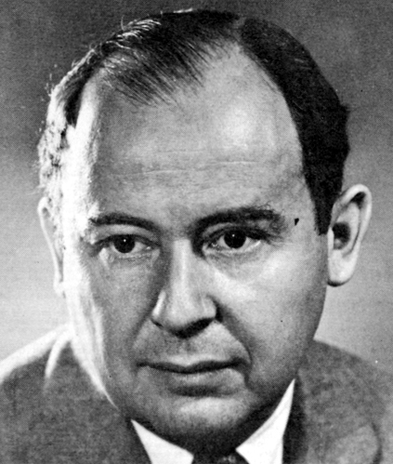
Merge Sort
The (likely) first proposal of merge sort was by John von Neumann in 1945
The creator of the von Neumann architecture used by all modern computers:
http://en.wikipedia.org/wiki/Von_Neumann

Slide 94
Divide and Conquer
Divide-and-conquer.
Divide up problem into several subproblems (of the same kind).
Solve (conquer) each subproblem recursively.
Combine solutions to subproblems into overall solution.
Most common usage.
Divide problem of size n into two subproblems of size n / 2.
Solve (conquer) two subproblems recursively.
Combine two solutions into overall solution.
Consequence.
Brute force: Θ(n²).
Divide-and-conquer: O(n log n).

Slide 95
Divide and Conquer
Two typical divide and conquer algorithm we have already known:
- Merge Sort
- Binary Search

Slide 96
Binary Search
int bfind(int key, int a[], int left, int right)
{ if (left+1 == right) return –1;
int m = (left + right) / 2;
if (key == a[m]) return m;
if (key < a[m]) return bfind(key, a, left, m);
else return bfind(key, a, m, right);
}

Slide 97
Examples
Binary Search
- Key problem can be divide up problem into several sub-problems.
- Sub-problems are with same type and independent from each other.
- It is not necessary to merge Sub-problems to get the key problem solved.
Merge Sort
- Key problem can be divide up problem into several sub-problems.
- Sub-problems are with same type and independent from each other.
- Sub-problems need to be merged to get the key problem solved.

Slide 98

Count Inversions in an array
Inversion Count for an array indicates – how far (or close) the array is from being sorted. If array is already sorted, then inversion count is 0. If array is sorted in reverse order that inversion count is the maximum.
Section 5.3

Slide 99
METHOD 1 (Simple)
Approach :Traverse through the array and for every index find the number of smaller elements on its right side of the array. This can be done using a nested loop. Sum up the counts for all index in the array and print the sum.
Algorithm :
- Traverse through the array from start to end
- For every element find the count of elements smaller than the current - number upto that index using another loop.
- Sum up the count of inversion for every index.
Print the count of inversions.

Slide 100

METHOD 1 (Simple)
Complexity Analysis: Time Complexity: $O(n^{2}),$Two nested loops are needed to traverse the array from start to end so the Time complexity is $O\left(n^{2}\right).$
Space Compelxity: $O(1),$ No extra space is required.

Slide 101








METHOD 2 (Enhance Merge Sort)
Approach: Suppose the number of inversions in the left half and right half of the array (let be$inv1$and $inv2$), what kinds of inversions are not accounted for in $inv1 + inv2$?
The answer is : the inversions that need to be counted during the merge step. Therefore, to get a number of inversions, that needs to be added a number of inversions in the left subarray, right subarray and $merge()$.
First half
A
Second half
B
$$a_{1}…$$
$$a_{i}…$$
$$b_{1}…$$
$$b_{j}…$$
$$inv1$$
$$inv2$$
# of inversions in each half
$$inv3$$
?
How to count inversions (a, b) with a ∈ A and b ∈ B?

Slide 102







METHOD 2(Enhance Merge Sort)
Q. How to count inversions (a, b) with a ∈ A and b ∈ B?
A. Easy if A and B are sorted!
Warmup algorithm.
Sort A and B.
For each element b ∈ B,
binary search in A to find how many elements in A are greater than b.
A
B
$$7 10 18 3 14$$
$$20 24 2 1 16$$
Sort A
Sort B
$$3 7 10 14 18$$
$$2 11 16 20 23$$
Binary search to count inversions (a, b) with a ∈ A and b ∈ B
$$3 7 10 14 18$$
$$2 11 16 20 23$$
$$5 2 1 0 0$$

Slide 103



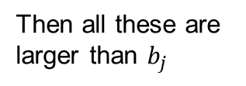


METHOD 2(Enhance Merge Sort)
How to get number of inversions in merge()?
In merge process, let $i$ is used for indexing left sub-array and j for right sub-array. At any step in $merge()$, if $a[i]$is greater than $b[j]$, then there are $(mid – i+1)$inversions. because left and right subarrays are sorted, so all the remaining elements in left-subarray ($a[i+1], a[i+2] … a[mid]$) will be greater than $b[j]$
First half
Second half
$$\#=(mid – i+1)$$
A
B
$$a_{i}$$
$$b_{j}$$
Suppose ${a_{i}>b}_{j}$
Then all these are larger than $b_{j}$

Slide 104


METHOD 2(Enhance Merge Sort)
The complete picture:
Count inversions (a, b) with a ∈ A and b ∈ B
$$3 7 10 14 18$$
$$2 11 16 20 23$$
$$a_{0}$$
$$b_{0}$$

Slide 105




METHOD 2(Enhance Merge Sort)
The complete picture:
Count inversions (a, b) with $a_{i}$ ∈ A and $b_{j}$ ∈ B
$$3 7 10 14 18$$
$$2 11 16 20 23$$
$$a_{0}$$
$$b_{0}$$
$a_{0}$ > $b_{0}$
Inv3 = Inv3+ mid-i+1 = 0+ 4-0+1 = 5
j++;

Slide 106



METHOD 2(Enhance Merge Sort)
The complete picture:
Count inversions (a, b) with a ∈ A and b ∈ B
$$3 7 10 14 18$$
$$2 11 16 20 23$$
$$a_{0}$$
$$b_{1}$$
$a_{0}$ < $b_{1}$
i++

Slide 107



METHOD 2(Enhance Merge Sort)
The complete picture:
Count inversions (a, b) with a ∈ A and b ∈ B
$$3 7 10 14 18$$
$$2 11 16 20 23$$
$$a_{1}$$
$$b_{1}$$
$a_{1}$ < $b_{1}$
i++

Slide 108


METHOD 2(Enhance Merge Sort)
The complete picture:
Count inversions (a, b) with a ∈ A and b ∈ B
$$3 7 10 14 18$$
$$2 11 16 20 23$$
$$a_{2}$$
$$b_{1}$$
$a_{2}$ < $b_{1}$
i++

Slide 109


METHOD 2(Enhance Merge Sort)
The complete picture:
Count inversions (a, b) with a ∈ A and b ∈ B
$$3 7 10 14 18$$
$$2 11 16 20 23$$
$$a_{3}$$
$$b_{1}$$
$a_{3}$ > $b_{1}$
Inv3 = Inv3+ mid-i+1 = 5+ 4-3+1 = 7
j++;

Slide 110


METHOD 2(Enhance Merge Sort)
The complete picture:
Count inversions (a, b) with a ∈ A and b ∈ B
$$3 7 10 14 18$$
$$2 11 16 20 23$$
$$a_{3}$$
$$b_{2}$$
$a_{3}$ < $b_{2}$
i++

Slide 111


METHOD 2(Enhance Merge Sort)
The complete picture:
Count inversions (a, b) with a ∈ A and b ∈ B
$$3 7 10 14 18$$
$$2 11 16 20 23$$
$$a_{4}$$
$$b_{2}$$
$a_{4}$ > $b_{2}$
Inv3 = Inv3+ mid-i+1 = 7 + 4 – 4 + 1 = 8
j++;

Slide 112
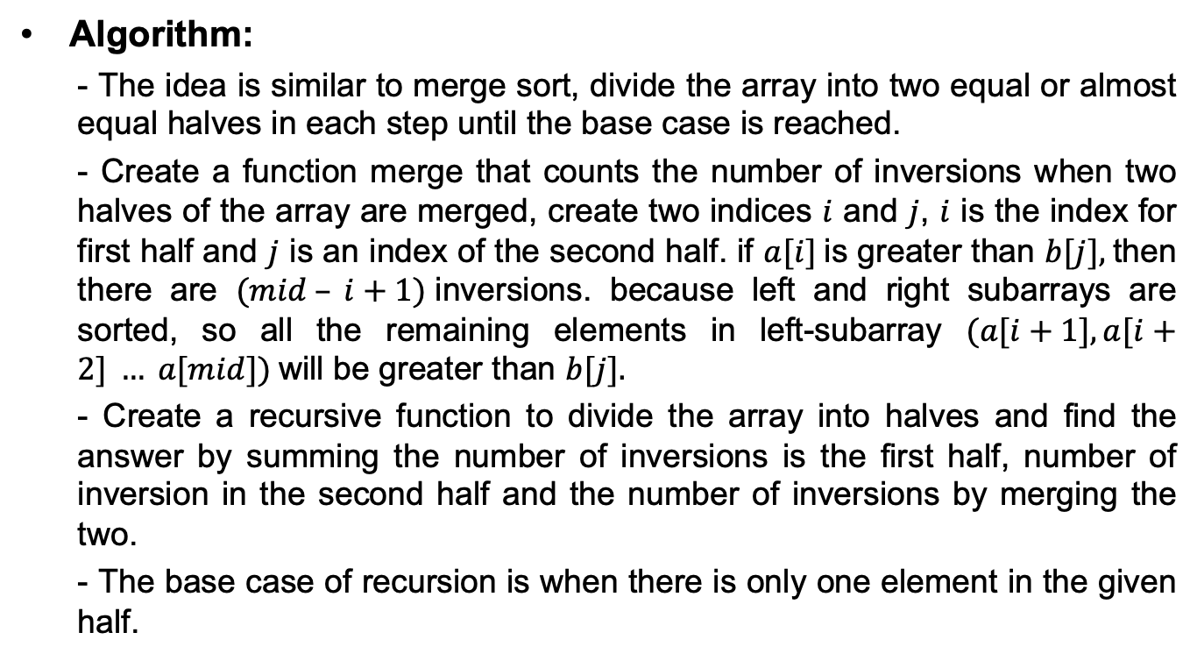
METHOD 2(Enhance Merge Sort)
Algorithm:
- The idea is similar to merge sort, divide the array into two equal or almost equal halves in each step until the base case is reached.
- Create a function merge that counts the number of inversions when two halves of the array are merged, create two indices $i$ and $j$, $i$ is the index for first half and $j$ is an index of the second half. if $a[i]$is greater than $b[j],$then there are $(mid – i+1)$inversions. because left and right subarrays are sorted, so all the remaining elements in left-subarray $(a[i+1], a[i+2] … a[mid])$will be greater than $b[j].$
- Create a recursive function to divide the array into halves and find the answer by summing the number of inversions is the first half, number of inversion in the second half and the number of inversions by merging the two.
- The base case of recursion is when there is only one element in the given half.

Slide 113

Summary
This topic covered merge sort:
Divide an unsorted list into two equal or nearly equal sub lists,
Sorts each of the sub lists by calling itself recursively, and then
Merges the two sub lists together to form a sorted list

