Slide 1

CS101 Algorithms and Data Structures
Divide and Conquer
Textbook Ch 1.4
Notes:
Adapted from the slides by Douglas Wilhelm Harder of U Waterloo (https://ece.uwaterloo.ca/~dwharder/aads/Lecture_materials/)
May also contain material from the slides at https://courses.cs.washington.edu/courses/cse326/03wi/326lecturesb.shtml (by Dan Suciu of U Wash

Slide 2
Outline
Master Theorem
Integer Multiplication
Matrix Multiplication
Convolution and FFT
Notes:
https://zhuanlan.zhihu.com/p/100531135

Slide 3

Master Theorem
Goal. Recipe for solving common divide-and-conquer recurrences: with T(0) = 0 and T(1) = Θ(1).
Terms.
a ≥ 1 is the number of subproblems.
b ≥ 2 is the factor by which the subproblem size decreases.
f (n) ≥ 0 is the work to divide and combine subproblems.
Recursion tree. [ assuming n is a power of b ]
a = branching factor.
a^{k} = number of subproblems at level k.
log_{b} n levels.
n / b^{k} = size of subproblem at level k.

Slide 4
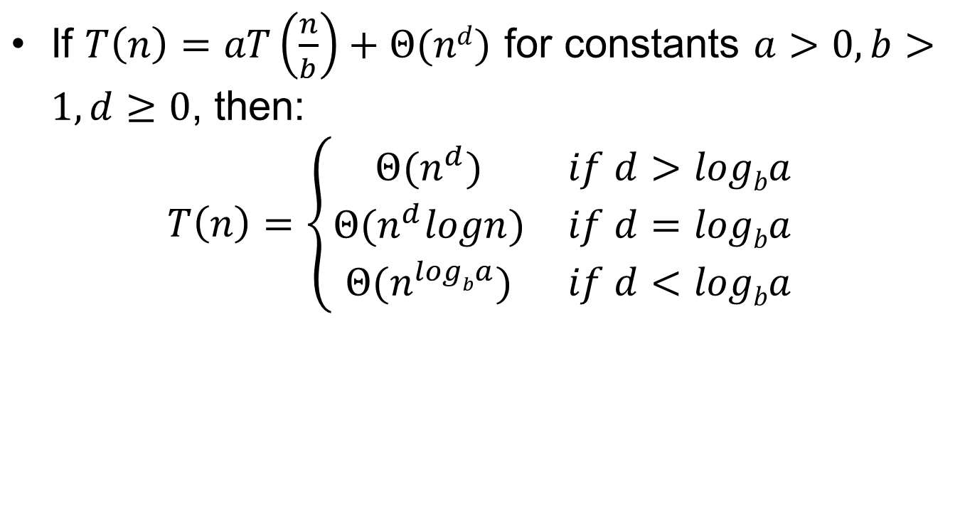
Master Theorem
If $T\left(n\right)=aT\left(\frac{n}{b}\right)+Θ(nd)$ for constants $a>0, b>1, d≥0$, then:
$$T\left(n\right)=\left\{\begin{matrix}Θ(n^{d}) & if d>logba \\ Θ(n^{d}logn) & if d=logba \\ Θ(n^{logba}) & if d<logba\end{matrix}\right.$$

Slide 5

Master Theorem
If $T\left(n\right)=aT\left(\frac{n}{b}\right)+Θ(nd)$ for constants $a>0, b>1, d≥0$, then:
$$T\left(n\right)=\left\{\begin{matrix}Θ(n^{d}) & if d>logba \\ Θ(n^{d}logn) & if d=logba \\ Θ(n^{logba}) & if d<logba\end{matrix}\right.$$
We study three cases in Master Theorem:
Case 1: $d>logba$ implies the “work” is decreasing as the level increases, then the total work is dominated by $Θ(n^{d})$
Case 2: $d=logba$ implies the “work” is almost the same across the levels, then the total work is $Θ\left(n^{d}logn\right)$
Case 3: $d<logba$ implies the “work” is increasing as the level increases, then the total work is dominated by $Θ(n^{logba})$

Slide 6
Outline
Master Theorem
Integer Multiplication
Matrix Multiplication
Convolution and FFT

Slide 7
Integer addition and subtraction
Addition. Given two n-bit integers x and y, compute x + y.
Subtraction. Given two n-bit integers x and y, compute x – y.
Grade-school algorithm. Θ(n) bit operations.
Remark. Grade-school addition and subtraction algorithms are optimal.
 | 1 | 1 | 1 | 1 | 1 | 1 | 0 | 1
 |  | 1 | 1 | 0 | 1 | 0 | 1 | 0 | 1
 | + | 0 | 1 | 1 | 1 | 1 | 1 | 0 | 1
 | 1 | 0 | 1 | 0 | 1 | 0 | 0 | 1 | 0

Slide 8
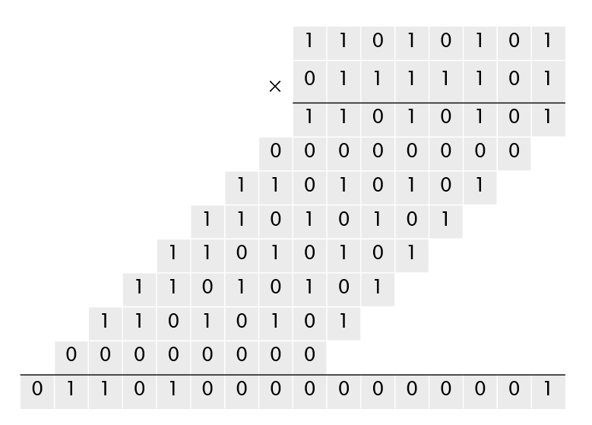
Integer multiplication
Multiplication. Given two n-bit integers x and y, compute x × y.
Grade-school algorithm (long multiplication). Θ(n²) bit operations.

Slide 9
Divide-and-conquer multiplication
To multiply two n-bit integers x and y:
Divide x and y into low- and high-order bits.
Multiply four ½n-bit integers, recursively.
Add and shift to obtain result.
n
n
x =
y =
a
b
c
d
m=n/2
m=n/2
m=n/2
m=n/2
Then
x y = (2^{m} a + b) (2^{m} c + d) = 2^{2m} ac + 2^{m} (bc + ad) + bd
1
2
3
4
Ex. x = 10001101 y = 11100001
a
b
c
d

Slide 10
Multiply(x, y, n) _______________________________________________________________________________________________________________________________________________________________________________________________________________________________________________________________________________________________________________________________________________________________________________________________________________________________________________________________________________________________________________________________________________________________________________________________________________________________________________________________________________________________________________________________________________________________________________________________________________________________________________________
If (n = 1)
Return x y.
Else
m ← ⎡ n / 2 ⎤.
a ← ⎣ x / 2^{m} ⎦; b ← x mod 2^{m}.
c ← ⎣ y / 2^{m} ⎦; d ← y mod 2^{m}.
e ← Multiply(a, c, m).
f ← Multiply(b, d, m).
g ← Multiply(b, c, m).
h ← Multiply(a, d, m).
Return 2^{2m} e + 2^{m} (g + h) + f.
_______________________________________________________________________________________________________________________________________________________________________________________________________________________________________________________________________________________________________________________________________________________________________________________________________________________________________________________________________________________________________________________________________________________________________________________________________________________________________________________________________________________________________________________________________________________________________________________________________________________________________________________
Θ(n)
4 T((n / 2))
Θ(n)

Slide 11


Question 1
How many bit operations to multiply two n-bit integers using the divide-and-conquer multiplication algorithm?
A. T(n) = Θ(n^{1/2}).
B. T(n) = Θ(n log n).
C. T(n) = Θ(n^{log23}) = O(n^{1.585}).
D. T(n) = Θ(n²).
I can solve it. Can I be your BF?

Slide 12

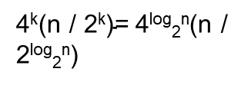
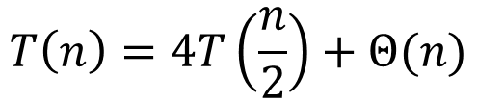
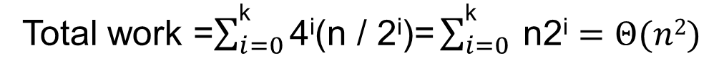
Recursion Tree for Integer Multiplication
Level
Problem #
Problem size
Work
0
1
n
n
1
4
(n/2)
4(n/2)
2
. . .
. . .
. . .
. . .
4²
(n/4)
4²(n/4)
4
4
4
4
. . .
. . .
. . .
. . .
. . .
k=log₂n
. . . . . .
$\text{4}\text{k}$=4^{log}₂^{n}
1
$\text{4}\text{k}\text{(}\text{n}\text{ / 2}\text{k}\text{)=}$4^{log}₂^{n}(n / 2^{log}₂^{n})
$$T\left(n\right)=4T\left(\frac{n}{2}\right)+Θ(n)$$
Total work =$\sum_{i=0}^{\text{k}}{\text{4}\text{i}\text{(}\text{n}\text{ / 2}\text{i}\text{)}\text{=}\sum_{i=0}^{\text{k}}{ \text{n}\text{2}\text{i}}}=Θ(n2)$

Slide 13
Karatsuba trick
To multiply two n-bit integers x and y:
Divide x and y into low- and high-order bits.
To compute middle term bc + ad, use identity:
Multiply only three ½n-bit integers, recursively.
bc + ad = ac + bd – (a – b) (c – d)

Slide 14
Divide-and-conquer multiplication
To multiply two n-bit integers x and y:
Divide x and y into low- and high-order bits.
Multiply four ½n-bit integers, recursively.
Add and shift to obtain result.
n
n
x =
y =
a
b
c
d
Then
m=n/2
m=n/2
m=n/2
m=n/2
x y = (2^{m} a + b) (2^{m} c + d) = 2^{2m} ac + 2^{m} (bc + ad) + bd
1
2
3
4
= 2^{2m} ac + 2^{m} (ac + bd – (a – b)(c – d)) + bd
1
1
2
3
2

Slide 15
Karatsuba-Multiply(x, y, n) _______________________________________________________________________________________________________________________________________________________________________________________________________________________________________________________________________________________________________________________________________________________________________________________________________________________________________________________________________________________________________________________________________________________________________________________________________________________________________________________________________________________________________________________________________________________________________________________________________________________________________________________
If (n = 1)
Return x y.
Else
m ← ⎡ n / 2 ⎤.
a ← ⎣ x / 2^{m} ⎦; b ← x mod 2^{m}.
c ← ⎣ y / 2^{m} ⎦; d ← y mod 2^{m}.
e ← Karatsuba-Multiply(a, c, m).
f ← Karatsuba-Multiply(b, d, m).
g ← Karatsuba-Multiply((a – b), (c – d), m).
Flip sign of g if needed.
Return 2^{2m} e + 2^{m} (e + f – g) + f.
_____________________________________________________________________________________________________________________________________________________________________________________________________________________________________________________________________
Θ(n)
3 T((n / 2))
Θ(n)

Slide 16
Question 2
How many bit operations to multiply two n-bit integers using the divide-and-conquer multiplication algorithm?
A. T(n) = Θ(n^{1/2}).
B. T(n) = Θ(n log n).
C. T(n) = Θ(n^{log23}) = O(n^{1.585}).
D. T(n) = Θ(n²).
3

Slide 17
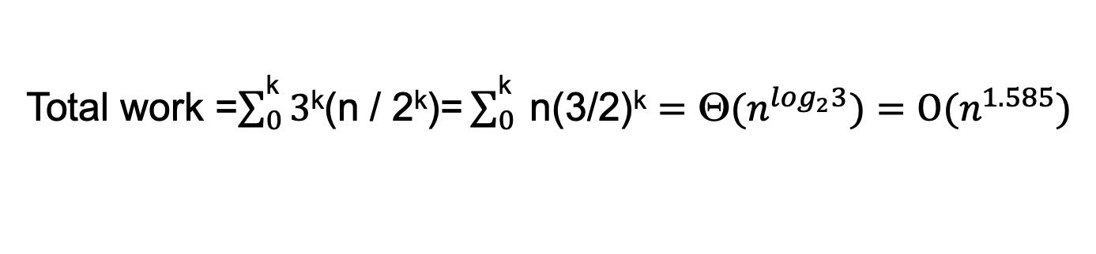
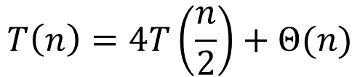
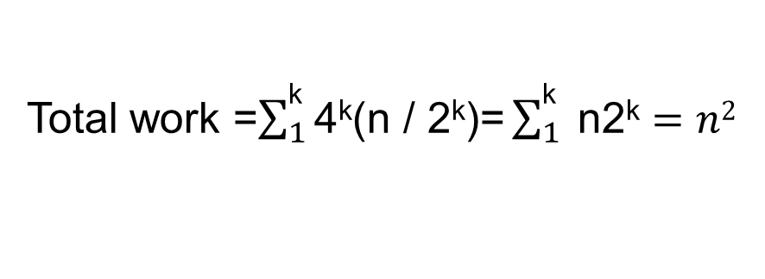

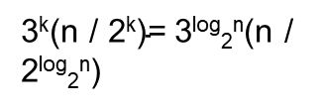
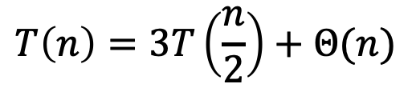
Recursion Tree for Integer Multiplication
Level
Problem #
Work
Problem #
Problem size
Work
1
n
0
1
n
n
3
4(n/2)
1
4
(n/2)
3(n/2)
4²(n/4)
2
4²
(n/4)
3²(n/4)
. . .
. . .
. . .
. . .
3²
4
4
4
4
3
3
3
3
. . .
. . .
. . .
. . .
. . .
. . .
. . .
k=log₂n
. . . . . .
$\text{3}\text{k}$=3^{log}₂^{n}
$\text{4}\text{k}$=4^{log}₂^{n}
1
$\text{4}\text{k}\text{(}\text{n}\text{ / 2}\text{k}\text{)=}$4^{log}₂^{n}(n / 2^{log}₂^{n})
$\text{3}\text{k}\text{(}\text{n}\text{ / 2}\text{k}\text{)=}$3^{log}₂^{n}(n / 2^{log}₂^{n})
$$T\left(n\right)=3T\left(\frac{n}{2}\right)+Θ(n)$$
$$T\left(n\right)=4T\left(\frac{n}{2}\right)+Θ(n)$$
Total work =$\sum_{0}^{\text{k}}{\text{3}\text{k}\text{(}\text{n}\text{ / 2}\text{k}\text{)}\text{=}\sum_{0}^{\text{k}}{ \text{n}\text{(3/}\text{2}\text{)}\text{k}}}={\text{Θ}(n}^{\log_{2}3})=O(n^{1.585})$
Total work =$\sum_{1}^{\text{k}}{\text{4}\text{k}\text{(}\text{n}\text{ / 2}\text{k}\text{)}\text{=}\sum_{1}^{\text{k}}{ \text{n}\text{2}\text{k}}}=n2$

Slide 18
Outline
Master Theorem
Integer Multiplication
Matrix Multiplication
Convolution and FFT
Notes:
https://zhuanlan.zhihu.com/p/100531135

Slide 19


Dot product
Dot product. Given two length-n vectors a and b, compute c = a ⋅ b.
Grade-school. Θ(n) arithmetic operations.

Slide 20



Matrix multiplication
Matrix multiplication.
Given two n-by-n matrices A and B, compute C = AB.
Θ(n³) arithmetic operations.

Slide 21

Block matrix multiplication
A₁₁
A₁₂
B₁₁
C₁₁
B₂₁

Slide 22

Block matrix multiplication
A₁₁
A₁₂
B₂₁
C₁₂
B₂₂
B₂₂

Slide 23



Block matrix multiplication: warmup
To multiply two n-by-n matrices A and B:
Divide: partition A and B into ½n-by-½n blocks.
Conquer: multiply 8 pairs of ½n-by-½n matrices, recursively.
Combine: add appropriate products using 4 matrix additions.
8 matrix multiplications
(of ½n-by-½n matrices)
n-by-n matrices
½n-by-½n matrices
4 matrix additions
(of ½n-by-½n matrices)

Slide 24

Strassen’s trick
Key idea. Can multiply two 2-by-2 matrices via 7 scalar multiplications (plus 11 additions and 7 subtractions).
P1 ← A11 (B12 – B22)
P2 ← (A11 + A12) B22
P3 ← (A21 + A22) B11
P4 ← A22 (B21 – B11)
P5 ← (A11 + A22) (B11 + B22)
P6 ← (A12 – A22) (B21 + B22)
P7 ← (A11 – A21) (B11 + B12)
scalars
C11 = P5 + P4 – P2 + P6
C12 = P1 + P2
C21 = P3 + P4
C22 = P1 + P5 – P3 – P7
7 scalar multiplications

Slide 25
Strassen’s trick
n-by-n
½n-by-½n matrix
Key idea. Can multiply two 2-by-2 matrices via 7 scalar multiplications (plus 11 additions and 7 subtractions).
P1 ← A11 (B12 – B22)
P2 ← (A11 + A12) B22
P3 ← (A21 + A22) B11
P4 ← A22 (B21 – B11)
P5 ← (A11 + A22) (B11 + B22)
P6 ← (A12 – A22) (B21 + B22)
P7 ← (A11 – A21) (B11 + B12)
scalars
C11 = P5 + P4 – P2 + P6
C12 = P1 + P2
C21 = P3 + P4
C22 = P1 + P5 – P3 – P7
7 scalar multiplications

Slide 26
assume n is a power of 2
Strassen(n, A, B)
If (n = 1) Return A B.
Partition A and B into ½n-by-½n blocks.
P1 ← Strassen(n / 2, A11, (B12 – B22)).
P2 ← Strassen(n / 2, (A11 + A12), B22).
P3 ← Strassen(n / 2, (A21 + A22), B11).
P4 ← Strassen(n / 2, A22, (B21 – B11)).
P5 ← Strassen(n / 2, (A11 + A22), (B11 + B22)).
P6 ← Strassen(n / 2, (A12 – A22), (B21 + B22)).
P7 ← Strassen(n / 2, (A11 – A21), (B11 + B12)).
C11 = P5 + P4 – P2 + P6.
C12 = P1 + P2.
C21 = P3 + P4.
C22 = P1 + P5 – P3 – P7.
Return C.
7 T(n / 2) + Θ(n²)
Θ(n²)
Notes:
We ½ to choose the first half nodes and then on avg we will separate the half into anther half, the same separation happens if we choose one item from the second half.

Slide 27

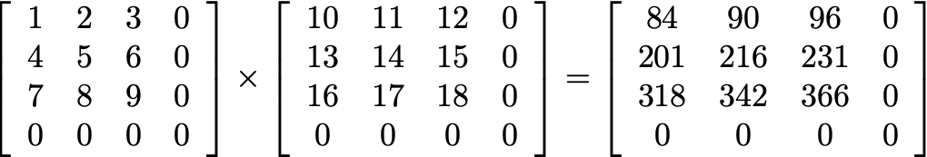
Analysis of Strassen’s algorithm
Theorem. Strassen’s algorithm requires O(n^{2.81}) arithmetic operations to multiply two n-by-n matrices.
Pf.
When n is a power of 2, apply Case 1 of the master theorem:
When n is not a power of 2, pad matrices with zeros to be n′-by-n′, where n ≤ n′ < 2n and n′ is a power of 2.

Slide 28
Strassen’s algorithm: practice
Implementation issues.
Sparsity.
Caching.
n not a power of 2.
Numerical stability.
Non-square matrices.
Storage for intermediate submatrices.
Crossover to classical algorithm when n is “small.”
Parallelism for multi-core and many-core architectures.
Common misperception. “Strassen’s algorithm is only a theoretical curiosity.”
Apple reports 8x speedup when n ≈ 2,048.
Range of instances where it’s useful is a subject of controversy.

Slide 29
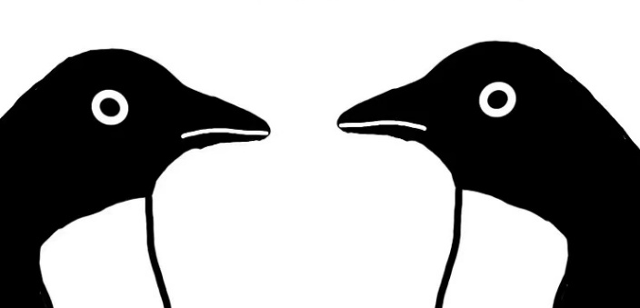
Question 3
Suppose that you could multiply two 3-by-3 matrices with 21 scalar multiplications. How fast could you multiply two n-by-n matrices?
A. Θ(n^{log321})
B. Θ(n^{log221})
C. Θ(n^{log921})
D. Θ(n²)
We are just penguins. Why do we need to care about this?

Slide 30

Question 4
Is it possible to multiply two 3-by-3 matrices using only 21 scalar multiplications?
A. Yes.
B. No.
C. Unknown.
Do you think you're funny?

Slide 31
Fast matrix multiplication: theory
Q. Multiply two 2-by-2 matrices with 7 scalar multiplications?
A. Yes! [Strassen 1969] Θ(n^{log27}) = O(n^{2.81})
Q. Multiply two 2-by-2 matrices with 6 scalar multiplications?
A. Impossible. [Hopcroft–Kerr, Winograd 1971] Θ(n^{log26}) = O(n^{2.59})
Begun, the decimal wars have. [Pan 1978, Bini et al., Schönhage, …]
Two 70-by-70 matrices with 143,640 scalar multiplications. O(n^{2.7962})
Two 48-by-48 matrices with 47,217 scalar multiplications. O(n^{2.7801})
A year later. O(n^{2.7799})
December 1979. O(n^{2.521813})
January 1980. O(n^{2.521801})

Slide 32
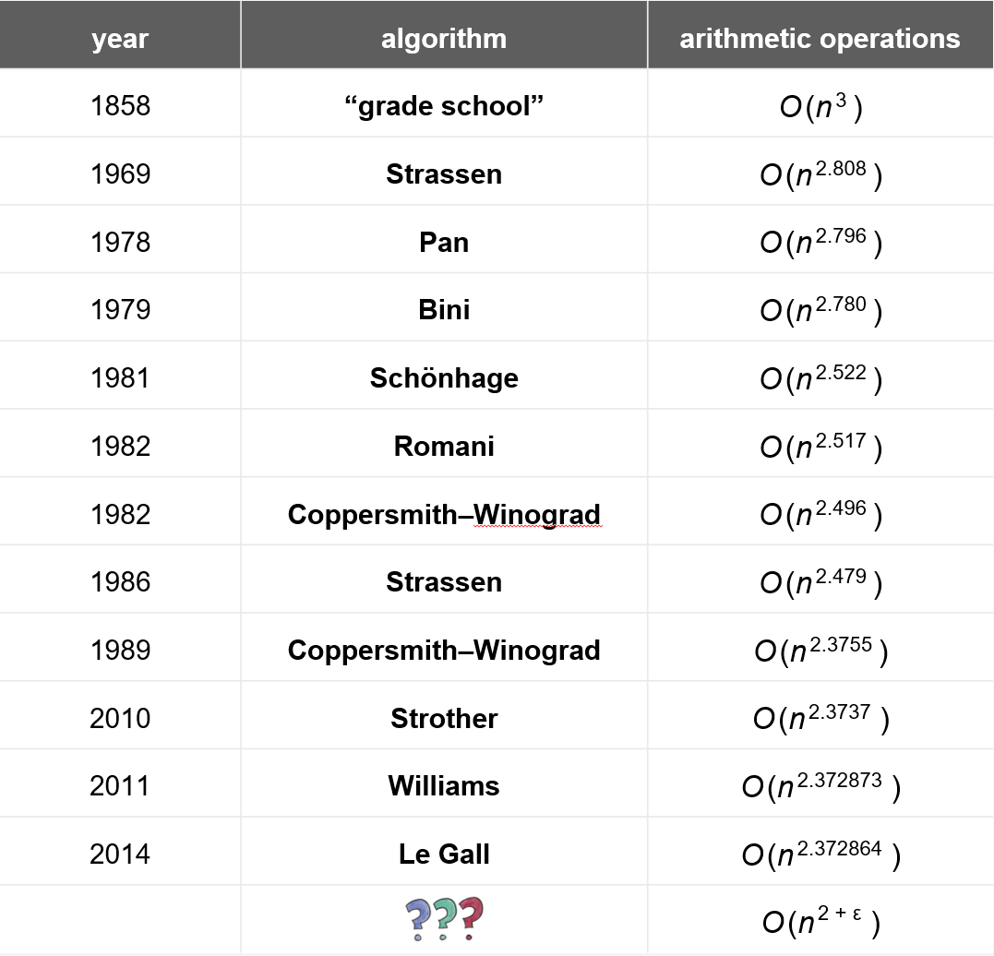
History of arithmetic complexity of matrix multiplication
Galactic
algoithms
Number of arithmetic operations to multiply two n-by-n matrices.
Notes:
20年点数再次刷新，但是是在小数点后面4-5位，前进脚步大幅度放缓. 2022年采用强化学习方法在典型例子可进一步提升 Discovering faster matrix multiplication algorithms with reinforcement learning。比如 4*4 的情况从49提高至47。

Slide 33
Outline
Master Theorem
Integer Multiplication
Matrix Multiplication
Convolution and FFT
Notes:
https://zhuanlan.zhihu.com/p/100531135

Slide 34
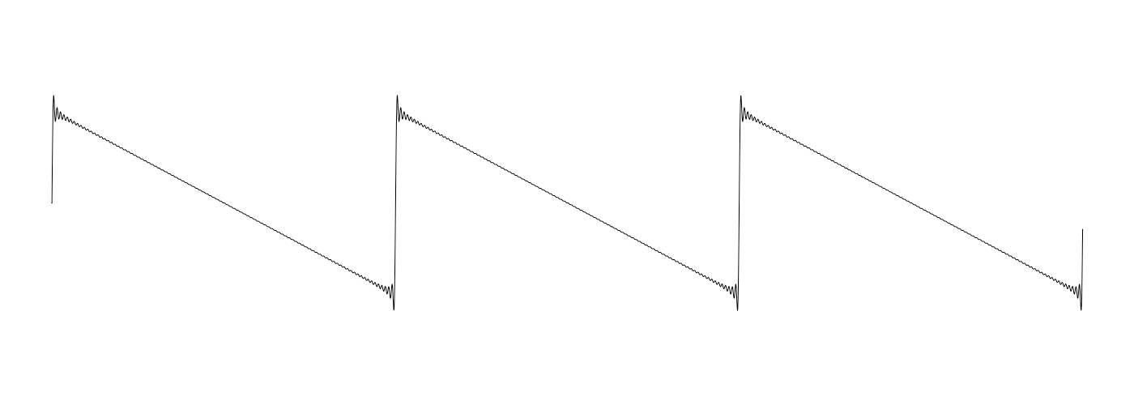
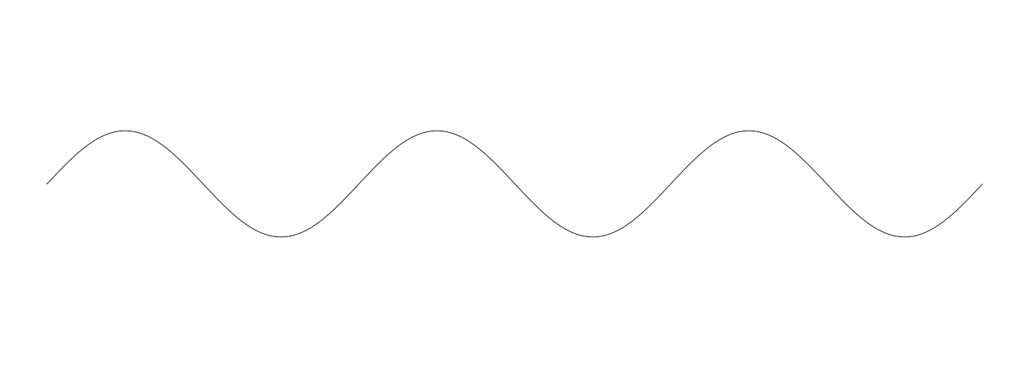
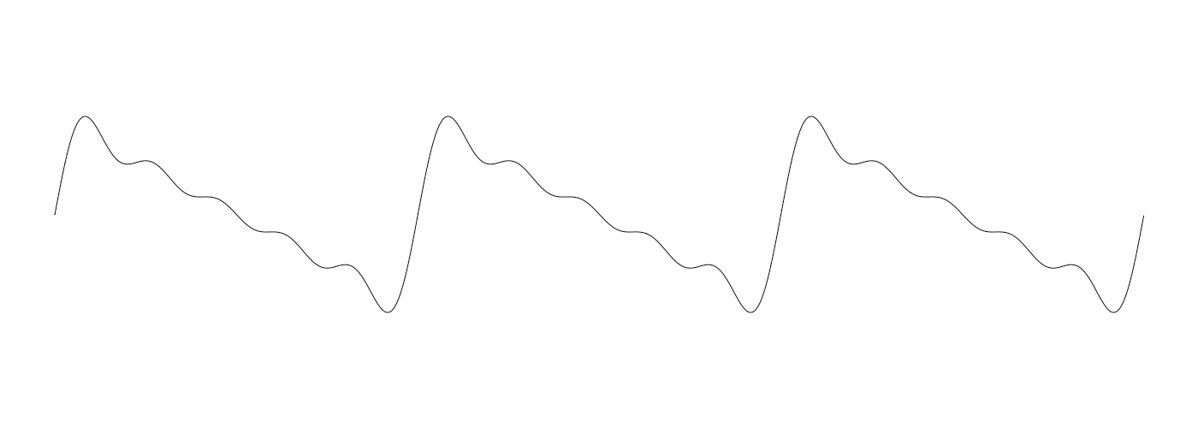
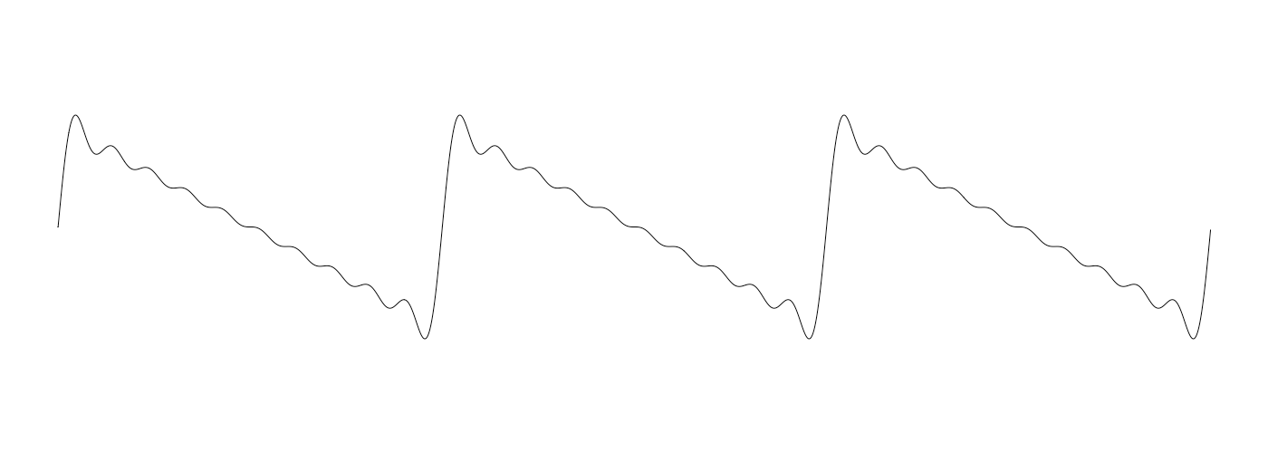

Outline
Fourier theorem. [Fourier, Dirichlet, Riemann] Any (sufficiently smooth) periodic function can be expressed as the sum of a series of sinusoids.
n = 1
t
n = 5
n = 10
n = 100

Slide 35
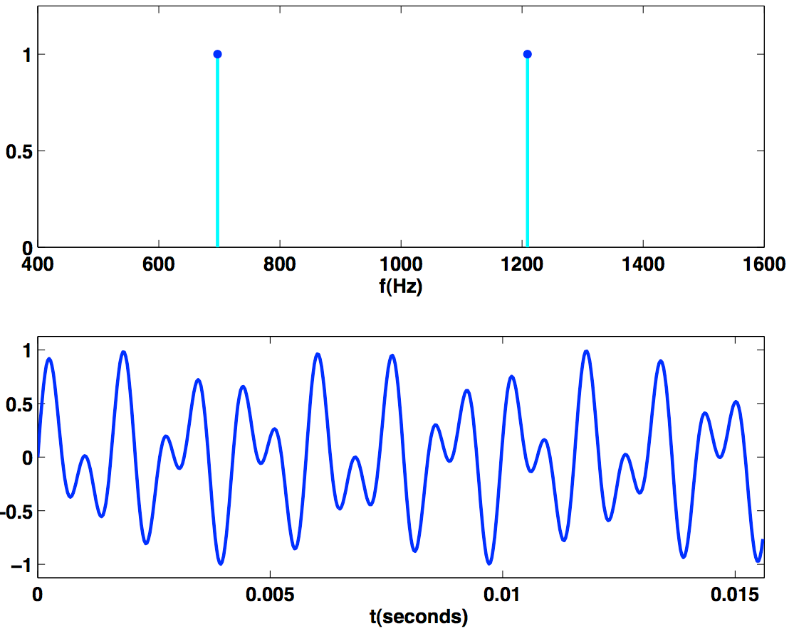
Time domain vs. frequency domain
Signal. [touch tone button 1]
Time domain.
Frequency domain.
sound
pressure
0.5
amplitude
Reference: Cleve Moler, Numerical Computing with MATLAB
Notes:
最左下图（左边时域，右边频域）是对频域概念的解释。最前面红色的近似方波是其后所有蓝色的正弦波线性叠加而成的总和。后面依次排列的正弦波就是组合为这个近似矩形波的各个分量。这些正弦波按照频率从低到高从前向后排列开来，而每一个波的振幅满足傅立叶合成公式。每两个正弦波之间都还有一条直线，并不是分割线，而是振幅为 0 的偶数谐波。（组成方波的正弦波中，偶数次谐波的幅值均为零）
如果不关心相位或假设所有正弦波之间的相位差为零，往右边方向看去，时域的方波信号就被投影到了频域。因为前面的方波信号的横轴为时间轴，而在频域，横轴为频率。这样，一组随时间变化的时域正弦信号被表示为了频域的一组离散点。频域每个立柱/离散点的横坐标代表一个谐波频率，而其纵坐标则代表该频率的谐波所对应的振动幅度。

Slide 36
Fast Fourier Transform (FFT)
FFT. Fast way to convert between time domain and frequency domain.
Alternate viewpoint. Fast way to multiply and evaluate polynomials.
we take this approach

Slide 37
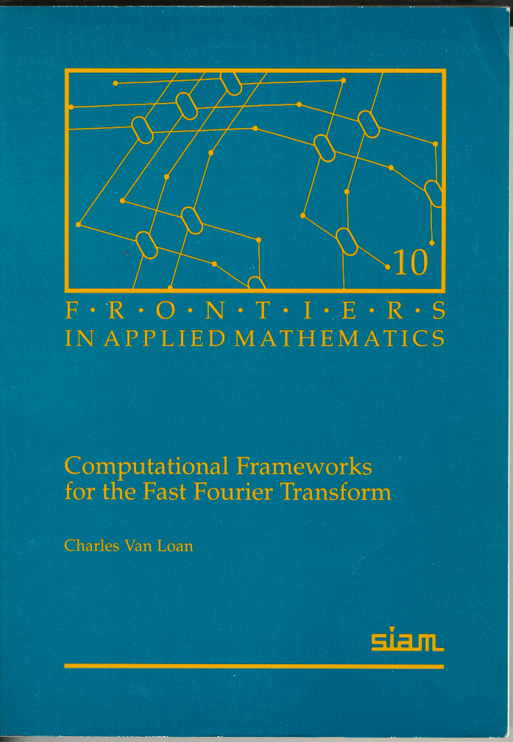
Fast Fourier transform: applications
Applications.
Optics, acoustics, quantum physics, telecommunications, radar, control systems, signal processing, speech recognition, data compression, image processing, seismology, mass spectrometry, …
Digital media. [DVD, JPEG, MP3, H.264]
Medical diagnostics. [MRI, CT, PET scans, ultrasound]
Numerical solutions to Poisson’s equation.
Integer and polynomial multiplication.
Shor’s quantum factoring algorithm.
“ The FFT is one of the truly great computational developments of [the 20th] century. It has changed the face of science and engineering so much that it is not an exaggeration to say that life as we know it would be very different without the FFT. ” — Charles van Loan

Slide 38
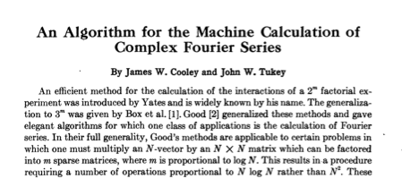
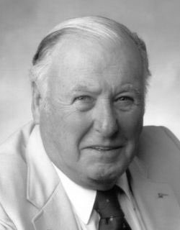
Fast Fourier transform: brief history
Gauss (1805, 1866). Analyzed periodic motion of asteroid Ceres.
Runge–König (1924). Laid theoretical groundwork.
Danielson–Lanczos (1942). Efficient algorithm, x-ray crystallography.
Cooley–Tukey (1965). Detect nuclear tests in Soviet Union and track submarines. Rediscovered and popularized FFT.
Importance not fully realized until emergence of digital computers.

Slide 39


Polynomials: coefficient representation
Univariate polynomial. [ coefficient representation ]
Addition. O(n) arithmetic operations.
Evaluation. O(n) using Horner’s method.
Multiplication (linear convolution). O(n²) using brute force.

Slide 40
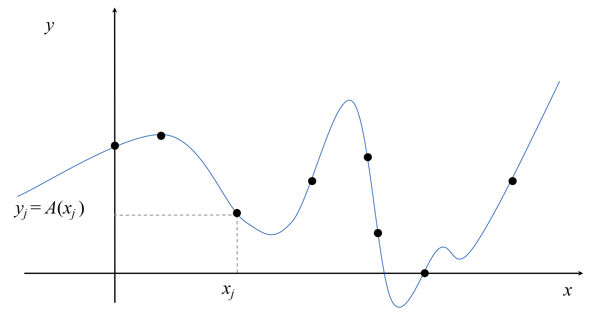
Polynomials: point-value representation
Fundamental theorem of algebra. A degree n univariate polynomial with complex coefficients has exactly n complex roots.
Corollary. A degree n – 1 univariate polynomial A(x) is uniquely specified by its evaluation at n distinct values of x.

Slide 41
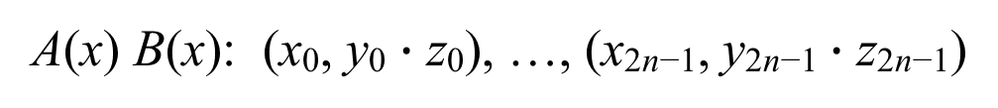
Polynomials: point-value representation
Univariate polynomial. [ point-value representation ]
Addition. O(n) arithmetic operations.
Multiplication. O(n), but represent A(x) and B(x) using 2n points.
A(x): (x₀, y₀), …, (x_{n−1}, y_{n−1})
B(x): (x₀, z₀), …, (x_{n−1}, z_{n−1})
A(x) + B(x): (x₀, y₀ + z₀), …, (x_{n−1}, y_{n−1} + z_{n−1})
A(x) B(x): (x₀, y₀ $∙$ z₀), …, (x_{2n−1}, y_{2n−1} $∙$ z_{2n−1})

Slide 42
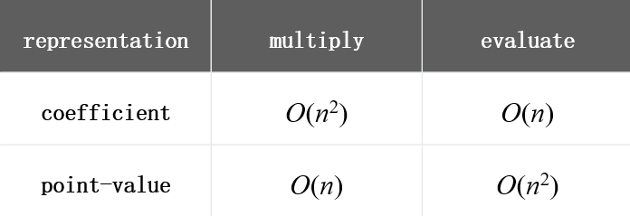

Converting between two representations
Tradeoff. Either fast evaluation or fast multiplication. We want both!
Goal. Efficient conversion between two representations ⇒ all ops fast.
coefficient representation
point-value representation
Notes:
The reason we need n^2 to do an evaluation with point-value representation is by Lagrange’s formula.

Slide 43





Converting between two representations
Application. Polynomial multiplication (coefficient representation).
DFT: $X\left(k\right)=\sum_{n=0}^{N−1}{x\left(n\right)e^{−i\frac{2πk}{N}n}=\sum_{n=0}^{N−1}{x\left(n\right)W_{N}^{kn}}}$
$$W_{N}^{k}=e^{−i\frac{2πk}{N}}$$
$a_{0}$, $a_{1}$, $⋯,a_{n−1}$
$1,x^{1}$, $x^{2}$,…, $x^{n−1}$
Coefficient representation
Point value representation
FFT
O(n log n)
Point-value multiplication
O(n)
Inverse FFT
O(n log n)
Coefficient representation
Point value representation

Slide 44
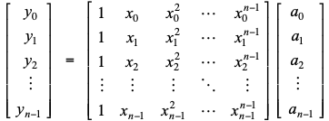
Converting between two representations: brute force
Coefficient ⇒ point-value. Given a polynomial A(x) = a₀ + a₁ x + ... + a_{n–1} x^{n–1},evaluate it at n distinct points x₀ , ..., x_{n–1}.
Running time. O(n²) via matrix–vector multiply (or n Horner’s).

Slide 45
Converting between two representations: brute force
Point-value ⇒ coefficient. Given n distinct points x₀, ... , x_{n–1} and values y₀, ... , y_{n–1}, find unique polynomial A(x) = a₀ + a₁ x + ... + a_{n–1} x^{n–1}, that has given values at given points.
Running time. O(n³) via Gaussian elimination.
Vandermonde matrix is invertible if xi distinct
or O(n^{2.38}) via fast matrix multiplication

Slide 46
Question 5
Which divide-and-conquer approach to use to evaluate polynomials?
Divide polynomial into low- and high-degree terms.
B. Divide polynomial into even- and odd-degree terms.
C. Either A or B.
D. Neither A nor B.
A(x) = a₀ + a₁ x + a₂ x² + a₃ x³ + a₄ x⁴ + a₅ x⁵ + a₆ x⁶ + a₇ x⁷.
A_{low}(x) = a₀ + a₁ x + a₂ x² + a₃ x³.
A_{high} (x) = a₄ + a₅ x + a₆ x² + a₇ x³.
A_{even}(x) = a₀ + a₂ x + a₄ x² + a₆ x³.
A_{odd} (x) = a₁ + a₃ x + a₅ x² + a₇ x³.

Slide 47
Divide-and-conquer
Decimation in time. Divide into even- and odd- degree terms.
A(x) = a₀ + a₁ x + a₂ x² + a₃ x³ + a₄ x⁴ + a₅ x⁵ + a₆ x⁶ + a₇ x⁷.
A_{even}(x) = a₀ + a₂ x + a₄ x² + a₆ x³.
A_{odd} (x) = a₁ + a₃ x + a₅ x² + a₇ x³.
A(x) = A_{even}(x²) + x A_{odd}(x²).
Decimation in frequency. Divide into low- and high-degree terms.
A(x) = a₀ + a₁ x + a₂ x² + a₃ x³ + a₄ x⁴ + a₅ x⁵ + a₆ x⁶ + a₇ x⁷.
A_{low}(x) = a₀ + a₁ x + a₂ x² + a₃ x³.
A_{high} (x) = a₄ + a₅ x + a₆ x² + a₇ x³.
A(x) = A_{low}(x) + x⁴ A_{high}(x).

Slide 48
Coefficient to point-value representation: intuition
Coefficient ⇒ point-value. Given a polynomial A(x) = a₀ + a₁ x + ... + a_{n–1} x^{n–1},evaluate it at n distinct points x₀ , ..., x_{n–1}.
Divide. Break up polynomial into even- and odd-degree terms.
A(x) = a₀ + a₁ x + a₂ x² + a₃ x³ + a₄ x⁴ + a₅ x⁵ + a₆ x⁶ + a₇ x⁷.
A_{even}(x) = a₀ + a₂ x + a₄ x² + a₆ x³.
A_{odd} (x) = a₁ + a₃ x + a₅ x² + a₇ x³.
A(x) = A_{even}(x²) + x A_{odd}(x²).
A(−x) = A_{even}(x²) – x A_{odd}(x²).
Intuition. Choose two points to be ±1.
A( 1) = A_{even}(1) + 1 A_{odd}(1).
A(−1) = A_{even}(1) – 1 A_{odd}(1).
We get to choose which ones!
Can evaluate polynomial of degree n-1 at 2 points by evaluating two polynomials of degree ½n - 1 at only 1 point.

Slide 49
Coefficient to point-value representation: intuition
Coefficient ⇒ point-value. Given a polynomial A(x) = a₀ + a₁ x + ... + a_{n–1} x^{n–1},evaluate it at n distinct points x₀ , ..., x_{n–1}.
Divide. Break up polynomial into even- and odd-degree terms.
A(x) = a₀ + a₁ x + a₂ x² + a₃ x³ + a₄ x⁴ + a₅ x⁵ + a₆ x⁶ + a₇ x⁷.
A_{even}(x) = a₀ + a₂ x + a₄ x² + a₆ x³.
A_{odd} (x) = a₁ + a₃ x + a₅ x² + a₇ x³.
A(x) = A_{even}(x²) + x A_{odd}(x²).
A(−x) = A_{even}(x²) – x A_{odd}(x²).
Intuition. Choose two points to be ±1 (note i² = –1).
A( 1) = A_{even}(1) +1 A_{odd}(1).
A(−1) = A_{even}(1) –1 A_{odd}(1).
A( i ) = A_{even}(−1) +i A_{odd}(−1).
A( −i ) = A_{even}(−1) –i A_{odd}(−1).
We get to choose which ones!
Can evaluate polynomial of degree n-1 at 4 points by evaluating two polynomials of degree ½n - 1 at only 2 points.

Slide 50

Euler’s identity
Euler’s identity. e^{ix} = cos x + i sin x.
Sinusoids. Sum of sine and cosines = sum of complex exponentials.
Sorry, all I want to do is sleep.

Slide 51
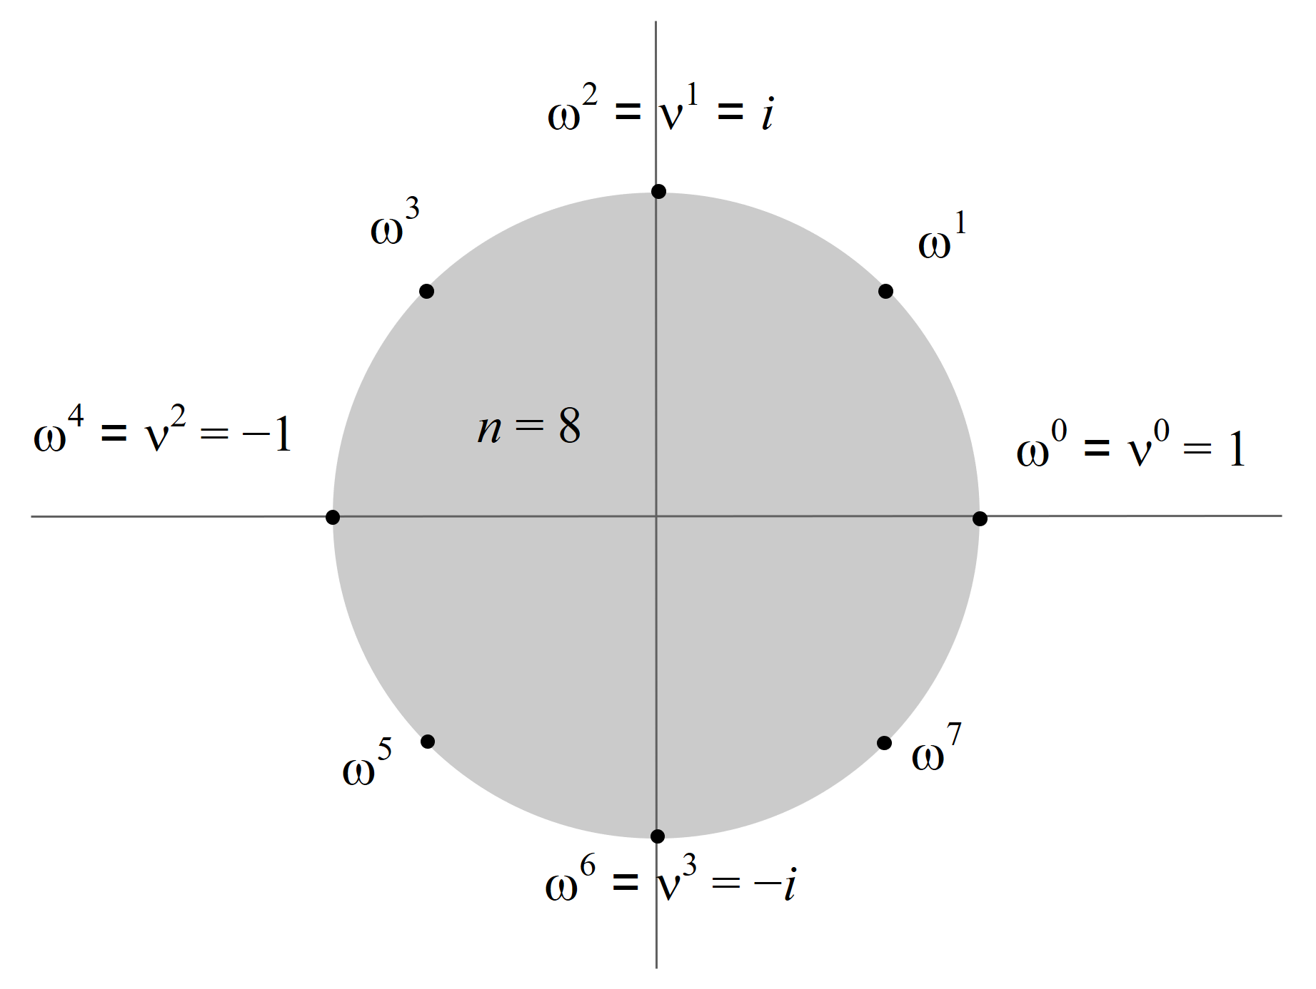
Roots of unity
Def. An n^{th} root of unity is a complex number x such that x^{n} = 1.
Fact. The n^{th} roots of unity are: ω⁰, ω¹, …, ω^{n–1} where ω = e^{2π i / n}.
Pf. (ω^{k})^{n} = (e^{2π i k / n})^{n} = (e^{π i} )^{2k} = (−1)^{2k} = 1.
Fact. The ½n^{th} roots of unity are: ν⁰, ν¹, …, ν^{n/2–1} where ν = ω² = e^{4π i / n}.
ω^{k} =−ω^{k+ ½n}

Slide 52
Fast Fourier transform
Goal. Evaluate a degree n – 1 polynomial A(x) = a₀ + ... + a_{n–1} x^{n–1} at its n^{th} roots of unity: ω⁰, ω¹, …, ω^{n–1}.
Divide. Break up polynomial into even- and odd-degree terms.
A_{even}(x) = a₀ + a₂ x + a₄ x² + … + a_{n−2} x^{n/2–1}.
A_{odd} (x) = a₁ + a₃ x + a₅ x² + … + a_{n−1} x^{n/2–1}.
A(x) = A_{even}(x²)+ x A_{odd}(x²).
A(−x) = A_{even}(x²) – x A_{odd}(x²).
Conquer. Evaluate A_{even}(x) and A_{odd}(x) at the ½n^{th} roots of unity: ν⁰, ν¹, …, ν^{n/2–1}.
Combine.
y_{k} = A(ω^{k}) = A_{even}(ν^{k}) + ω^{k} A_{odd} (ν^{k}), 0 ≤ k < n/2.
y_{k+ ½n} = A(ω^{k+ ½n}) = A_{even}(ν^{k}) – ω^{k} A_{odd} (ν^{k}), 0 ≤ k < n/2.
ω^{k} =−ω^{k+ ½n}

Slide 53
FFT: implementation
Goal. Evaluate a degree n – 1 polynomial A(x) = a₀ + ... + a_{n–1} x^{n–1} at its n^{th} roots of unity: ω⁰, ω¹, …, ω^{n–1}.
y_{k} = A(ω^{k}) = A_{even}(ν^{k}) + ω^{k} A_{odd} (ν^{k}), 0 ≤ k < n/2.
y_{k+ ½n}= A(ω^{k+ ½n}) = A_{even}(ν^{k}) – ω^{k} A_{odd} (ν^{k}), 0 ≤ k < n/2.
FFT(n, a0, a1, a2, …, an–1)
If (n = 1) Return a0.
(e0, e1, …, en/2–1) ← FFT(n / 2, a0, a2, a4, …, an–2).
(d0, d1, …, dn/2–1) ← FFT(n / 2, a1, a3, a5, …, an–1).
For k = 0 to n / 2 – 1.
ω^{k} ← e^{2π i k/n}.
yk ← ek + ω^{k} dk.
yk + n/2 ← ek – ω^{k} dk .
Return (y0, y1, y2, …, yn–1).
2 T(n / 2)
Θ(n)

Slide 54

FFT: summary
Theorem. The FFT algorithm evaluates a degree n – 1 polynomial at each of the n^{th} roots of unity in O(n log n) arithmetic operations and O(n) extra space.
Pf.
Coefficient representation
O(n log n)
FFT
Point-value representation
???

Slide 55
Question 6
When computing the FFT of (a0, a1, a2, …, a7), which are the first two coefficients involved in an arithmetic operation?
A. a0 and a1.
B. a0 and a2.
C. a0 and a4.
D. a0 and a7.
E. None of the above.

Slide 56
Integer multiplication, redux
Integer multiplication. Given two n-bit integers a = a_{n–1} … a₁a₀ and b = b_{n–1} … b₁b₀, compute their product a ⋅ b.
Convolution algorithm.
Form two polynomials.
Note: a = A(2), b = B(2).
Compute C(x) = A(x) ⋅ B(x).
Evaluate C(2) = a ⋅ b.
Running time: O(n log n) floating-point operations.
Theory. [Schönhage–Strassen 1971]
O(n log² n) bit operations.
O(n log n ⋅ log log n) bit operations.
Practice. [GNU Multiple Precision Arithmetic Library] Switches to FFT-based algorithm when n is large (≥ 5–10K).
FFT over complex numbers; need O(log n) bits of precision
FFT over ring of integers (modulo a Fermat number)

Slide 57
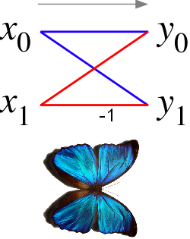
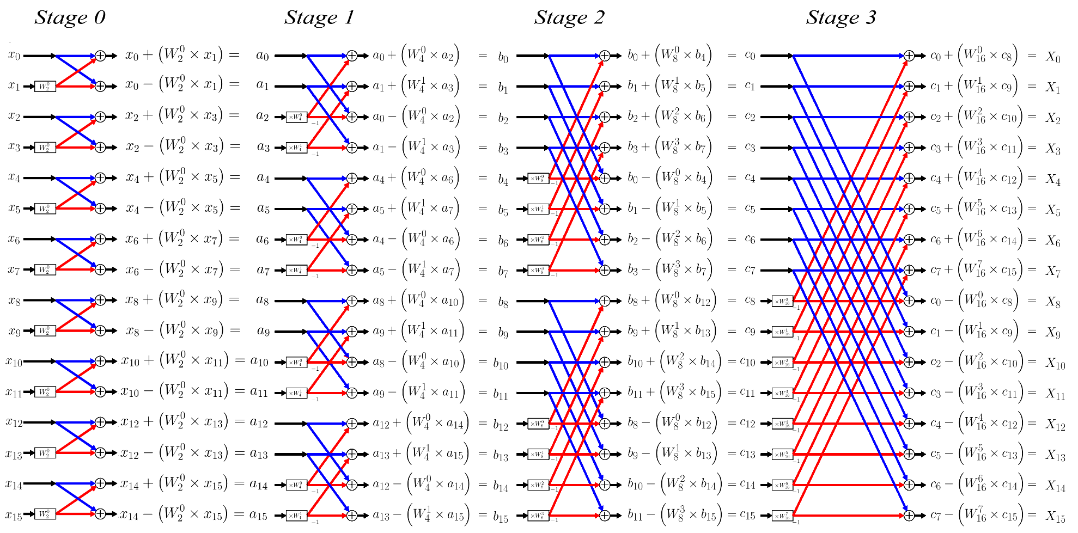
FFT Butterfly
Ref: http://en.wikipedia.org/wiki/Butterfly_diagram

