Slide 1
Unsupervised Data Quality Monitoring
THREE APPROACHES TO DETERMINE BATCH ACCEPTABILITY
Sheetal Laad, Micaela Flores, Ziv Schwartz, Kelly Sooch
Data Engineering for Machine Learning
NYU Center For Data Science
Notes:
@Ziv

Slide 2
Introduction & Background
Task
Given a chronological series dataset batches, decide whether the next batch has acceptable data quality
Goal
Create and compare different methodologies that can discern which data batches are sufficiently clean by only training the model on a sample of clean batches
Motivation
When working with large amounts of data, it becomes too difficult to manually check if each input data batch maintains its integrity. Providing a dynamic data auditing system that performs unsupervised data quality monitoring given a chronological set of clean and dirty data batches to combat this issue.
Notes:
@Ziv

Slide 3
Data
Data is comprised of Flights data and Facebook Posts
Facebook: 53 clean csv files and 53 dirty csv files
'line', 'page',
'week', 'num_likes',
'domain', 'outlet',
'title', 'description',
'contenttype', 'image',
'url', 'text',
'id', 'right_of_center'
Flights: 31 clean csv files and 31 dirty csv files
'RowId', 'Source',
'Flight', 'ScheduledDeparture',
'ActualDeparture', 'DepartureGate'
'ScheduledArrival', 'ActualArrival',
'ArrivalGate', 'for_key', 'date'
Add NA stuff
Notes:
@Ziv

Slide 4
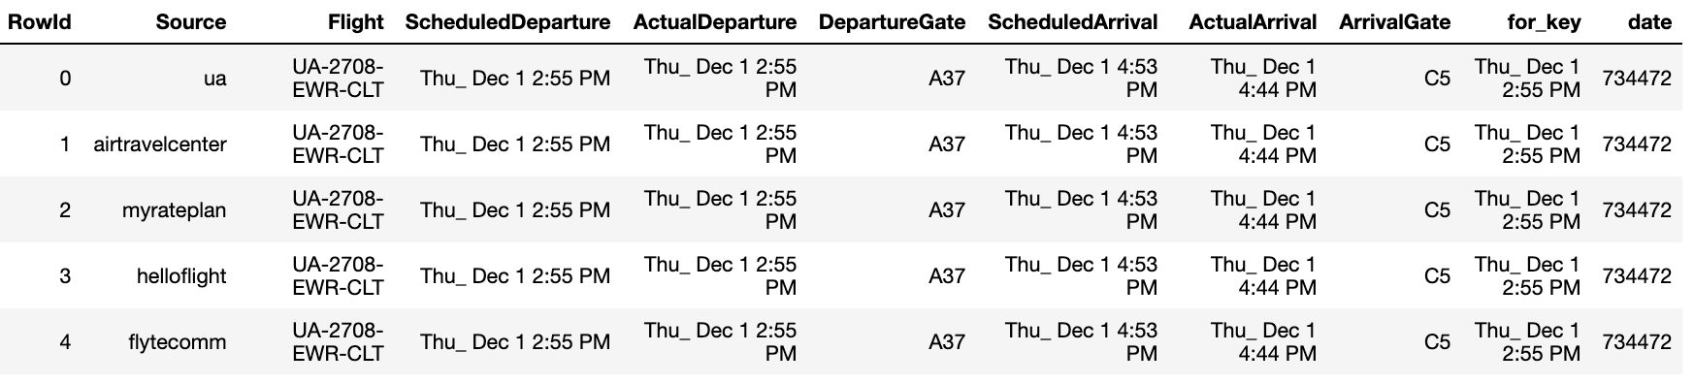
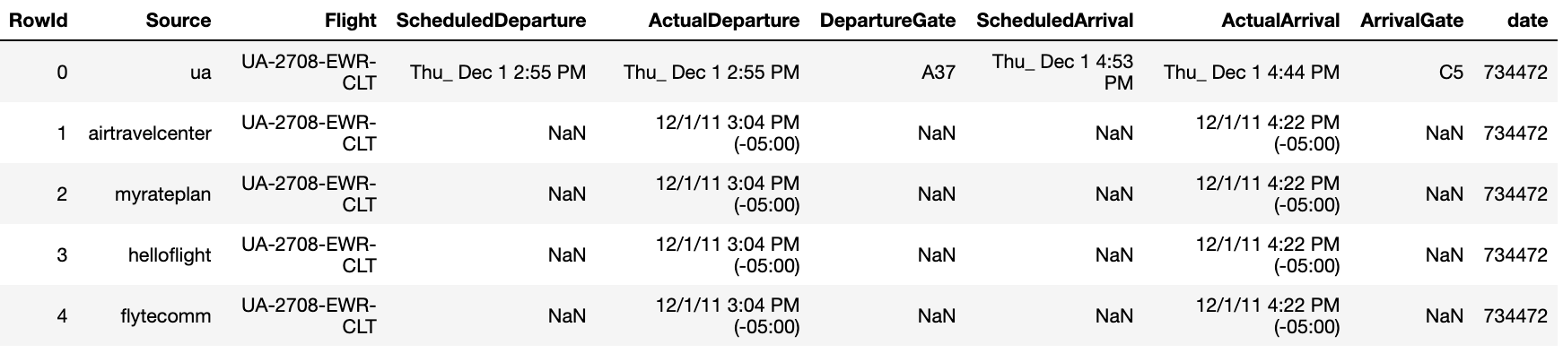
Data
Example Flight Data (same batch)
Clean
Dirty
Notes:
@Ziv

Slide 5
Training Methodology
There were two different ways in which our group decided to handle the batch size used to train our models:
Increasing:
Predetermined starting batch size is set and for every new batch that is read in, it is included as part of the whole training set.
Example: Starting batch size of 3, the first example would get trained on clean batches 1 to 3 and batch 4 will be tested. For the second example, clean batches 1 to 4 would be used to train and batch 5 will be tested.
Rolling:
Predetermined batch size is used for the training criterion and moves from subsequent batch to batch
Example: Batch size set to 3, first example trained on batches 1 to 3 and batch 4 is tested. Second example is trained on batches 2 to 4, batch 5 tested.
Notes:
@Kelly

Slide 6
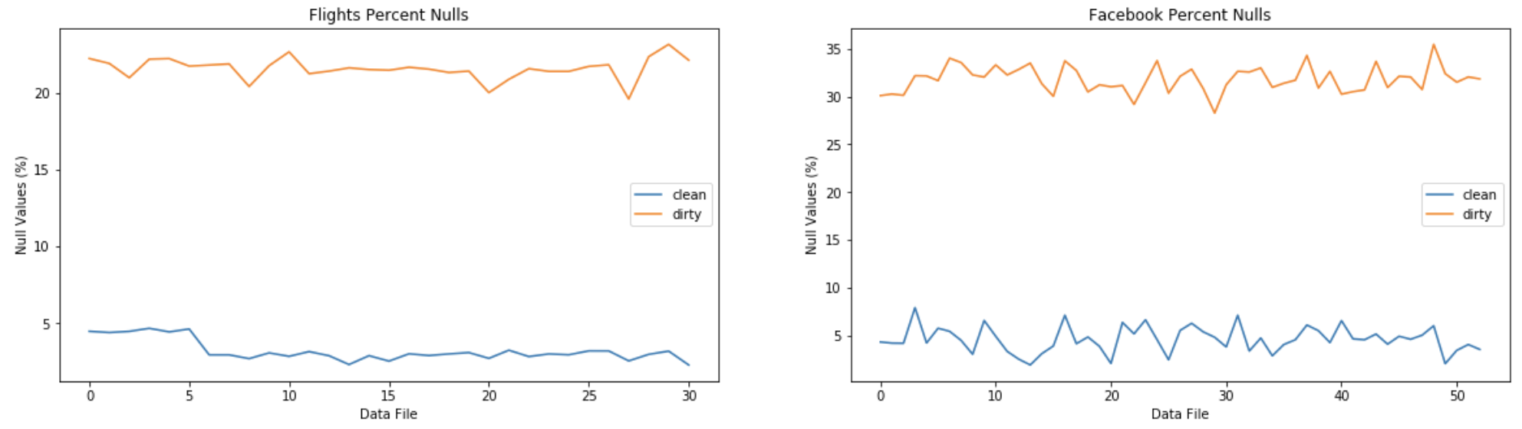
Criterion Approach 1: Baseline Methodology
Percentage of null values per data batch
Criterion Explained:
Percentage of null values in each batch of the training data
If the percentage of nulls in the test batch is not within the minimum and maximum percentage of nulls of the training batches, the batch is classified as not acceptable
Notes:
@Kelly

Slide 7
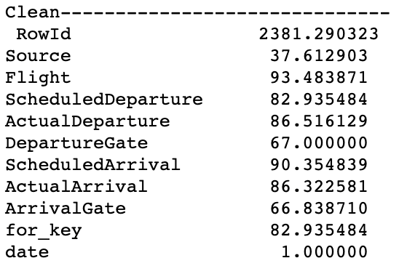
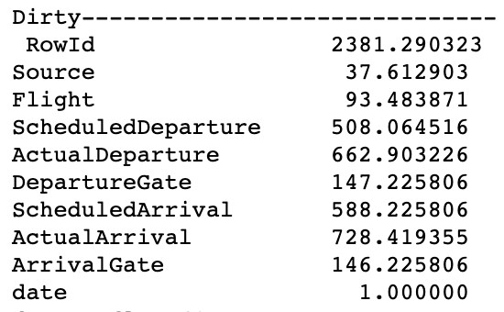
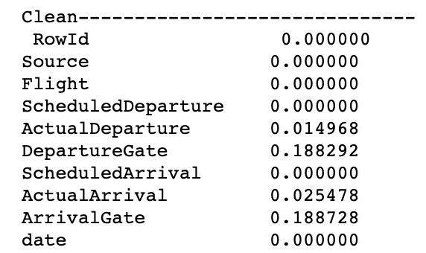
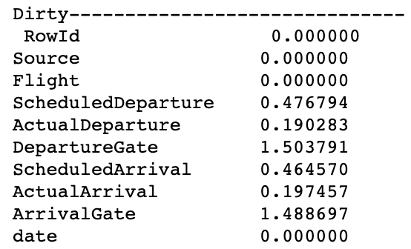
Criterion Approach 2: Range Methodology
Uniqueness = count of distinct values by field
Completeness = count of records that have a missing value for that field / count of records that don’t have a missing value by field
Aggregated the mean values across all batches for each given column:
Uniqueness
Completeness
Notes:
@Sheetal
We define completeness as _____, therefore, this value would be higher in the dirty data

Slide 8
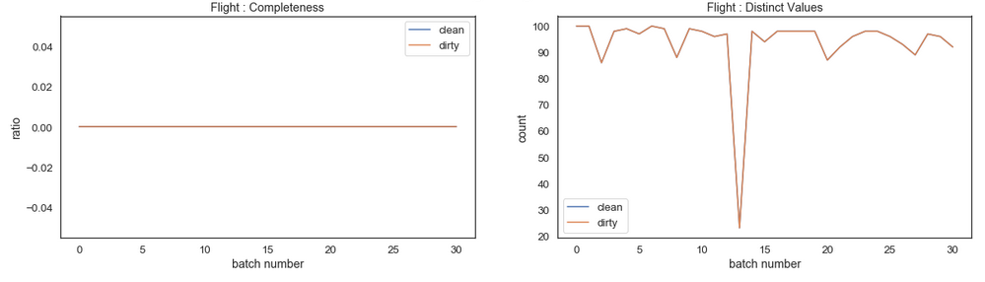
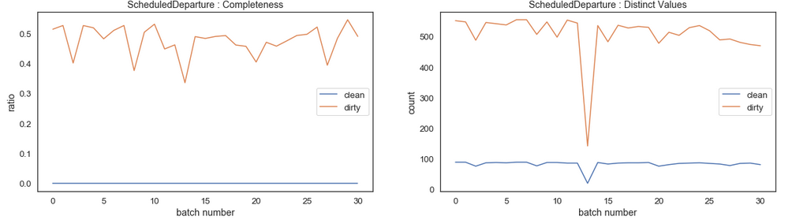
Criterion Approach 2: Range Methodology
Completeness and Uniqueness by batch
Criterion Explained:
If 80% of fields are within +/- 2 stds of completeness mean and of uniqueness mean, batch is determined to be acceptable
Notes:
@Sheetal

Slide 9
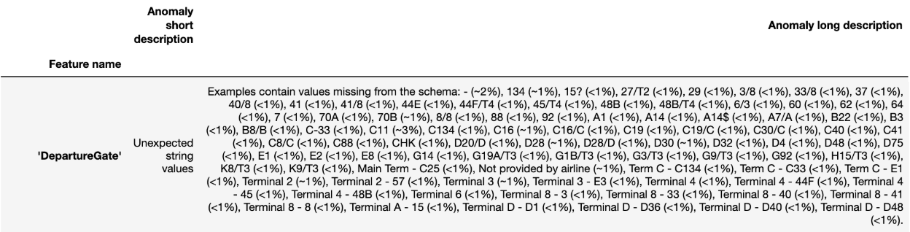
Criterion Approach 3: TensorFlow Data Validation
Example of anomalies for a field:
Criterion Explained:
TensorFlow Data Validation library to create an acceptable schema from the training batches and measure the number anomalies
Anomalies are counted before and after schema adjustment, which consists of relaxing certain columns’ domain mass requirements in the trained schema
Flights: ‘DepartureGate’ and ‘ArrivalGate’ were both reduced to 80% adherence
Facebook: ‘outlet’ and ‘domain’ were relaxed to 65% and 60% adherence
Then number of anomalies is calculated again, using the same method from before. If the schema adjustment reduces the number of anomalies, then the test batch is considered acceptable
Notes:
@Micaela

Slide 10
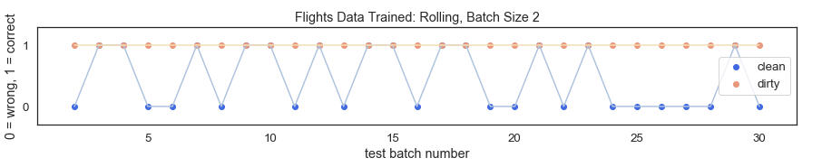
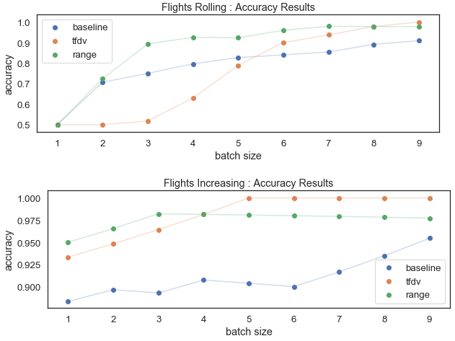
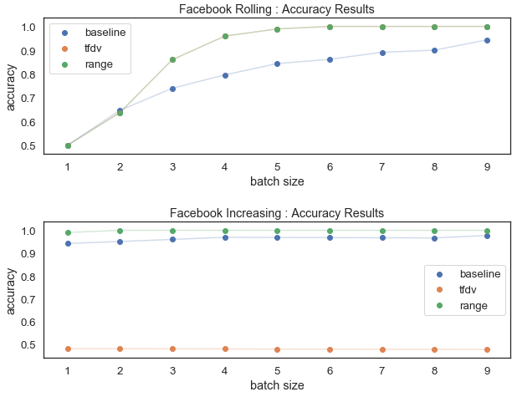
Evaluation/Results
Example of experiment results:
Final Results:
Notes:
@Micaela

Slide 11
Discussion
The results of this project provides great insight into data quality monitoring in a production environment.
There exists an optimal batch size
Rolling training methods: faster runtimes, give less importance on older information (helpful in production when a field starts getting recorded different, when data seems to be changing, to capture seasonal trends)
Range method: faster runtimes, more intuitive and generalizable
Some of the challenges that we faced:
Inherent differences in production batches (Flights data)
TensorFlow Data Validation’s very long runtime
TensorFlow Data Validation is not very generalizable
Future work for this topic could include:
Looking more at the data values themselves
Involving more analysis of data trends (seasonal, yearly, etc.)
Notes:
@Micaela

