Slide 1




BackEnd 스터디 3주차
Cors?

Slide 2
학습 목표
CORS 이해하기

Slide 3
Cross Origin Resource Sharing

Slide 4
Cross Origin Resource Sharing
교차 출처 자원 공유
Cross Origin Resource Sharing

Slide 5
CORS 이해하기
Cross Origin
Resource Sharing

Slide 6
Cross Origin

Slide 7
Origin?

Slide 8
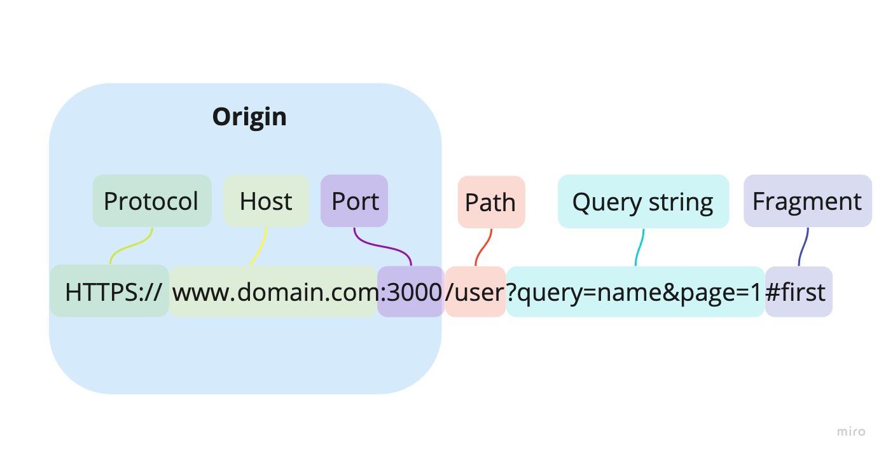
1. Origin

Slide 9
Cross Origin?

Slide 10
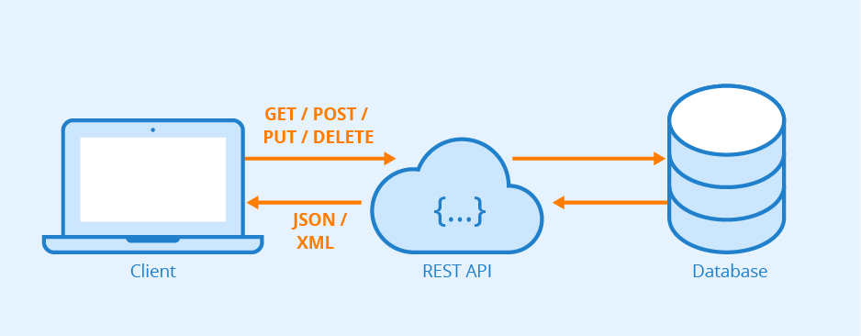
REST API

Slide 11
2. Cross
https://domainA/page.html
Same Origin
https://domainA/index.html
https://domainB/page.html
https://domainC/page.html
Cross Origin

Slide 12
Django?

Slide 13
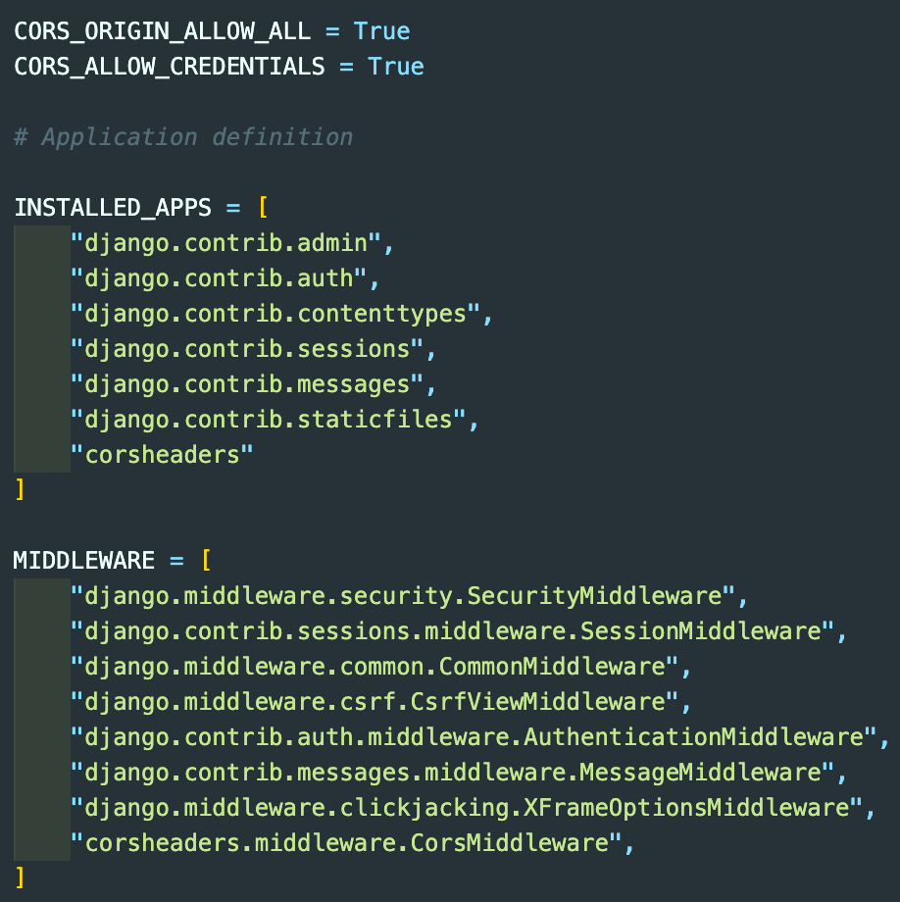
3. Resource Sharing
모든 호스트를 허용(쿠키 포함)

