Slide 1
A G C T T T T C A T
Step1:
T→C
A→G
G G C C C C C C G C
Step2:
C→0.5 G
→0.5 A
G→0.5C
→0.5T
C C A A A A A A C A
T T G G G G G G T G

Slide 2
Original
A
G
100%
50%
??? In 2 steps?
- Back to A
50%
50%
50%
T
C
100%

Slide 3
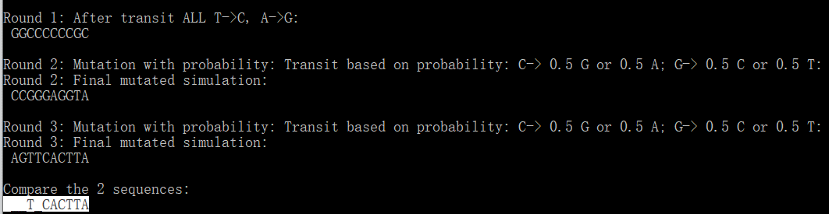
Difference

Slide 4
Deprecated
New .nex file
GBAC1_7_001 CACGACAAT…
GBAC1_7_002 GCTAGGCTA…
GBAC1_7_003 CTAGGTACG…
GBAC1_7_004 TAGATACGA…
GBAC1_7_005 GATCGATCG…
Simulated 4 seqs by probabilities
Original seq

Slide 5
New .nex file
Mutation
Rate (lambda)
Generation
GBAC_7_0.1151 TCTACGCTA …
GBAC_7_0.2351 GCTAGGCTA…
GBAC_7_0.1887 CTAGGTACG…
GBAC_7_0.2804 TAGATACGA…
Original_seque GATCGATCG…
Simulated 4 seqs by probabilities
Original seq
- Out put should all be the same number of generations .. GCAT is fine;
GCAT_7_XXXXXXX ... where X is the mutation rate at each generation;
mutation rate: You set that in your script; it can have many rates for each generation.

Slide 6
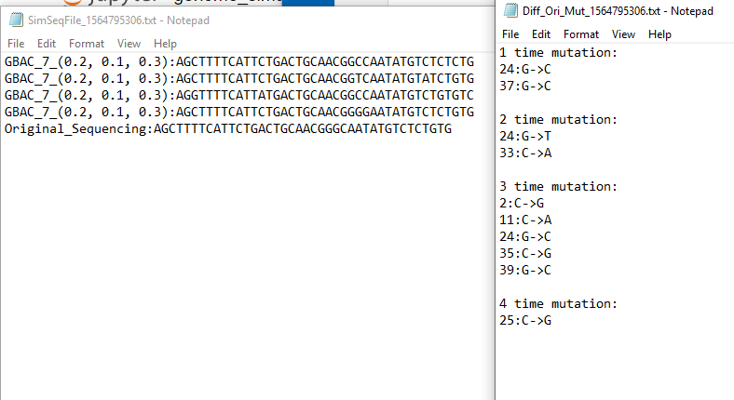
Check the difference_08022019
File1:
Mutated sequences:
File2:
Difference: index+change
.txt
Origin:
0:
1:
2:
3:
4:
TCTACGCTA
T

Slide 7
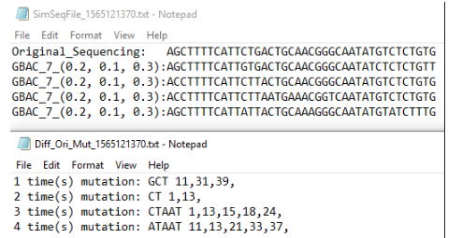
Check the difference_08062019
Output file 1:
original;
Mutated simulation for N times.
Output file 2:
Mutated bases
Index(position) mutated
Sub-list
index

Slide 8
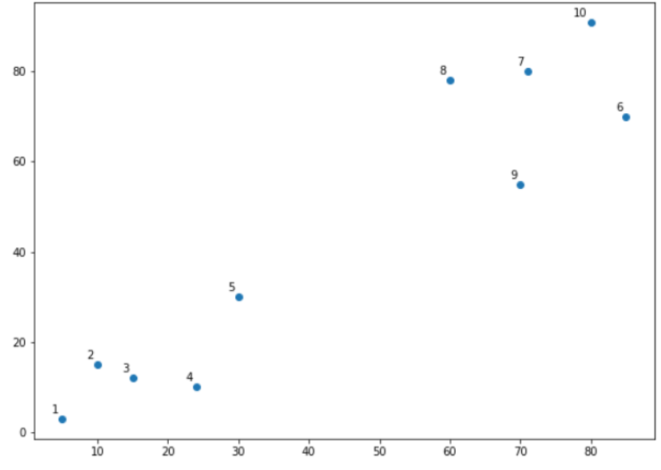
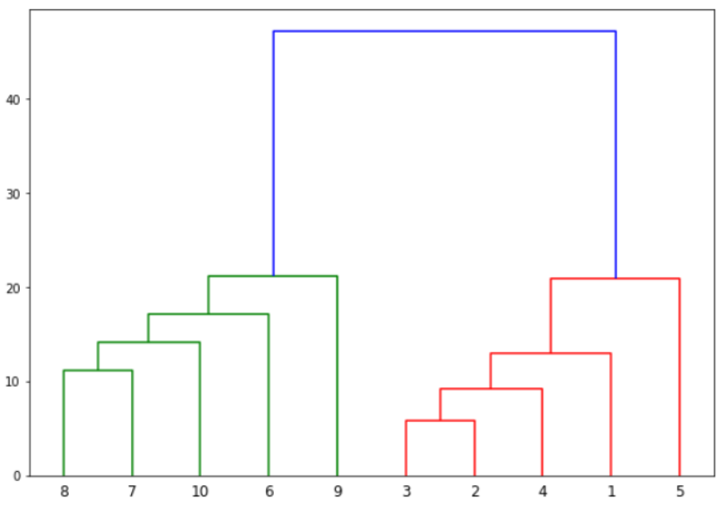
Dendrogram
1. Euclidean distance basis;
2. vertical height of the dendogram :
the Euclidean distances between points.
2 and 3 are closest to each other while points 7 and 8 are closes to each other. Therefore a cluster will be formed between these two points first.

