Slide 1
Analysis & Predict trip duration of taxi Based on Climate & Geospatial data
Ziwei Fan

Slide 2
Outline
Introduction
Related works
Approach
Result
Future work
Reference

Slide 3


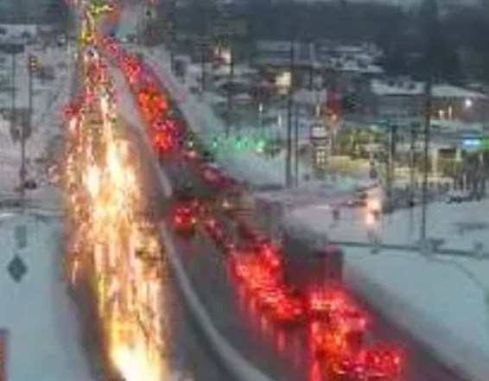
Introduction:
Taxi trip Analysis:
5:00-7:00
Geospatial Animation: Heat map of Number of Request + Time?
Passenger
Predict the Total Ride Duration of taxi trips in NY
Weather-Traffic Analysis:
How will weather factor affect traffic?
pavement friction
lower visibility distance
Notes:
A. Taxi Trip analysis:
From the driver’s:
What the hot areas for passenger to request taxi? And what the time slot? I will analysis based on geospatial data & time data.
The drivers could go to these areas during some exact time slot. It more likely they could have more passengers.
It is more likely that there is increasing number of passenger around downtown of Manhattan during 5:00-7:00, is it true?
From the driver’s side:
I will predict the total ride duration based on historical records, such as longitude, latitude, .
B. Weather-Traffic Analysis:
Is there any relationship between weather and duration?
(In rainy days, pavement friction goes down with the higher wetness, and lower visibility distance goes with the rainfall. Accordingly, it is more likely that these aspects will affect the performance of the drivers. The duration will go with these aspects.)

Slide 4

Related Work:
Taxi trip Analysis-1:
Visualization-Geospatial Animation
Bokeh
Flare
Data
Processing
Geo-Distributions
Geo-Image processing
Find the
hot area
Improper data?
Outlier?
Timestamp?
Interactive visualization library to target web browsers
How to label the areas?
Number of Request ?

Slide 5
Related Work:
Taxi trip Analysis-2:
Prediction
Mini-Batches K-means
PCA
Data
Process
Extract Features
Prediction
Get Result
Improper data?
Outlier?
Timestamp?
Preferred?
Removed?
How to reduce computation time?
Predicts the Total Ride Duration of taxi trips in NY
Notes:
Data process:
handle with improper data,
pick out the outlier,
unify the timestamp.
Extract features-PCA:
Find out what dimension preferred and which dimension should be removed? Apply dimensionality reduction by PCA.
Mini-Batches K-means:
uses mini-batches to reduce the computation time, while it still attempt to optimise the same objective function.

Slide 6
Related Work:
Weather-Traffic Analysis:
Data
Processing
Data
Visualization
Analyze features
Find correlation
What weather factor will affect traffic?

Slide 7
Approach
Taxi trip
Weather-Traffic
Data Processing
Geo information Distribution: Bokeh
Geospatial graph Visualization
Geospatial graph Animation-Flare
Feature Extraction: PCA
K Fold Cross validation
Predict with Mini-Batches K-means
Heat map Correlation
Pearson Correlation
Notes:
PCA: Principal Component Analysis (PCA) to apply dimensionality reduction. Which features should be preferred and which ones should be removed from a high dimensional feature vector?
Mini-batch K means: uses mini-batches and is attempting to optimize the same objective function, while is to reduce the computation time.
TPOT is an Automated Machine Learning tool that optimizes machine learning pipelines using genetic programming. It could explore thousands of possible pipelines to find the best one for the data.
Animation of cab pickups: Plot the heatmap and make an animation of pickup and see how the traffic changes with hours.
Heat map Correlation: Check how the features are correlated. Assign a different color for different count range.

Slide 8
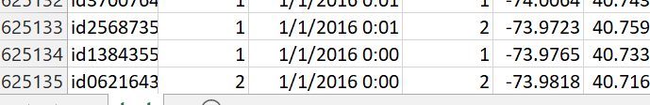
Mini-batch Kmeans:
very useful in case of extremely large datasets and/or very high dimensional data
batch_size: controls the number of randomly selected observations in each batch.
The larger the the size of the batch,
the more computationally costly the training process.

Slide 9
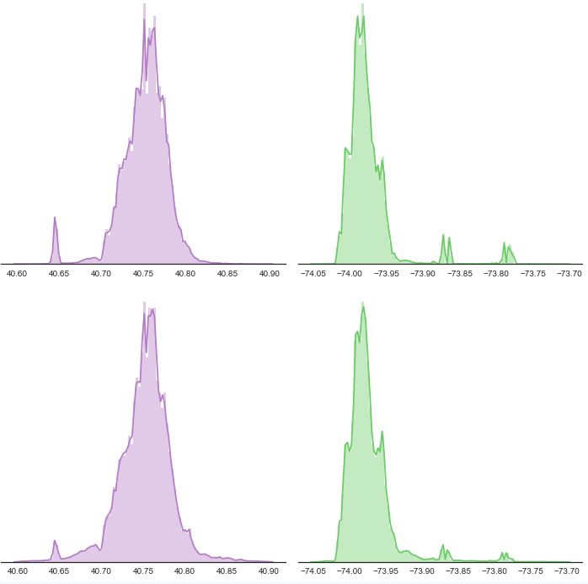
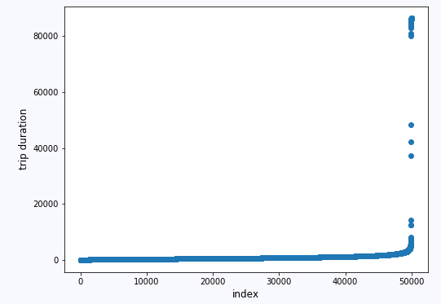
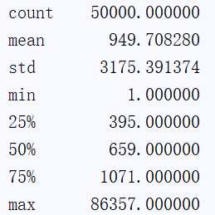
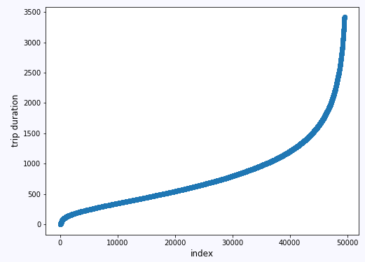
Result
Latitude & Longitude Distribution
Outlier
Preprocess
Notes:
Outlier:
trainDF.trip_duration.quantile(0.99)

Slide 10
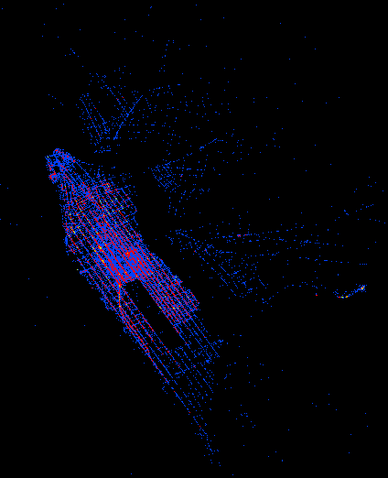
Result-Hot map
A summary of lat-long and their count, assign a different color for different count range:
Blue: others.
Red: Label the count>10;
Green: Label the count>50;

Slide 11
Flare-Amazing

Slide 12
Future work
Best practice & Validation on Mini-Batches K-means
Dynamic Animation based on Geographic Info.
Analysis on Correlation of Weather-Traffic

Slide 13
Reference
[1] TPOT: http://epistasislab.github.io/tpot/
[2] What Is K-Fold Cross Validation? https://magoosh.com/data-science/2017/12/08/k-fold-cross-validation/
[3] 3.3. Model evaluation: quantifying the quality of predictions: http://scikitlearn.org/stable/modules/model_evaluation.html#accuracy-score
[4] XGBoost Guidance:
https://xgboost.readthedocs.io/en/latest/build.html#building-on-windows
[5]Clustering-Mini Batches K-means:
http://scikit-learn.org/stable/modules/clustering.html#mini-batch-kmeans
[6] PCA for Data Visualization:
https://towardsdatascience.com/pca-using-python-scikit-learn-e653f8989e60
[7] TPOT: A Python tool for automating data science http://www.randalolson.com/2016/05/08/tpot-a-python-tool-for-automating-data-science/

