Slide 1


AKA 第三期 讲座
IT 新技术 之（一）
The evolution:
CISC, RISC and EPIC
by Perseus
A K A
www.aka.org.cn

Slide 2
Review of Instruction Set Architecture
Adapted from
CS152
Computer Architecture and Engineering
Lecture 2
August 29, 1997
Dave Patterson (http.cs.berkeley.edu/~patterson)

Slide 3
Computer Organization
All computers consist of five components
  Processor: (1) datapath and (2) control
  (3) Memory
  (4) Input devices and (5) Output devices
Not all Memory are created equally
  Cache: fast (expensive) memory are placed closer to the processor
  Main memory: less expensive memory--we can have more
Input and output (I/O) devices have the messiest organization
  Wide range of speed: graphics vs. keyboard
  Wide range of requirements: speed, standard, cost ...
  Least amount of research (so far)
Notes:
Let me summarize what I have said so far.
The most important thing I want you to remember is that: all computers, no matter how complicated or expensive, can be divided into five components:
(1) The datapath and (2) control that make up the processor.
(3) The memory system that supplies data to the processor.
And last but not least, the (4) input and (5) output devices that get data in and out of the computer.
One thing about memory is that Not all 搈emory?are created equally.
Some memory are faster but more expensive and we place them closer to the processor and call them 揷ache.
The main memory can be slower than the cache so we usually use less expensive parts so we can have more of them.
Finally as you can see from the last few slides, the input and output devices usually has the messiest organization. There are several reasons for it:
(1) First of all, I/O devices can have a wide range of speed.
(2) Then I/O devices also have a wide range of requirements.
(s) Finally to make matters worse, historically I/O has attracted the least amount of research interest. But hopefully this is changing.
In this class, you will learn about all these five components and we will try to make this as enjoyable as possible. So have fun.

Slide 4
Computer System Components
Proc
Caches
Busses
adapters
Memory
Controllers
Disks
Displays
Keyboards
I/O Devices:
Networks
All have interfaces & organizations

Slide 5
Review: Instruction Set Design
software
instruction set
hardware
Which is easier to change?

Slide 6
Instruction Set Architecture
Instruction Format or Encoding
  how is it decoded?
Location of operands and result
  where other than memory?
  how many explicit operands?
  how are memory operands located?
    which can or cannot be in memory?
Data type and Size
Operations
  what are supported
Successor instruction
  jumps, conditions, branches
Instruction
Fetch
Instruction
Decode
Operand
Fetch
Execute
Result
Store
Next
Instruction

Slide 7
Basic ISA Classes
Accumulator (1 register):
1 address add A acc ← acc + mem[A]
1+x address addx A acc ← acc + mem[A + x]
Stack:
0 address add tos ← tos + next
General Purpose Register:
2 address add A B EA(A) ← EA(A) + EA(B)
3 address add A B C EA(A) ← EA(B) + EA(C)
Load/Store:
3 address add Ra Rb Rc Ra ← Rb + Rc
load Ra Rb Ra ← mem[Rb]
store Ra Rb mem[Rb] ← Ra
Comparison:
Bytes per instruction? Number of Instructions? Cycles per instruction?
Notes:
Invented index register
Reverse polish stack = HP calculator
GPR = last 20 years
L/S variant = last 10 years

Slide 8
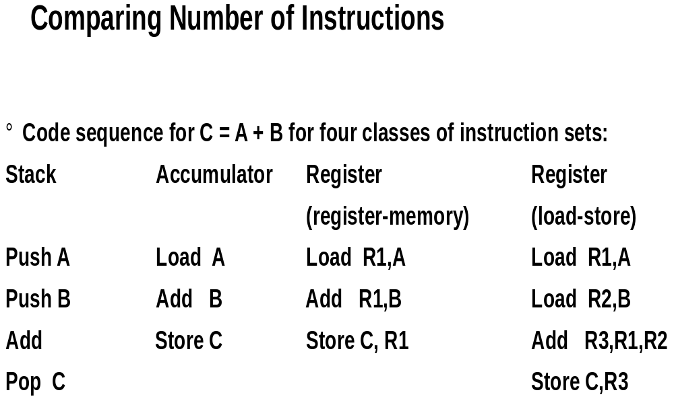

Slide 9
General Purpose Registers Dominate
1975-1995 all machines use general purpose registers
Advantages of reginsters
  Registers are faster than memory
  Registers are easier for a compiler to use
    e.g., (A*B) ?(C*D) ?(E*F) can do multiplies in any order vs. stak
  registers can hold variables
    memory traffic is reduced, so program is sped up (since registers are faster than memory)
    code density improves (since register named with fewer bits than memory location)

Slide 10
Summary on Instruction Classes
Expect new instruction set architecture to use
general purpose register
Pipelining => Expect it to use load store variant
of GPR ISA

Slide 11
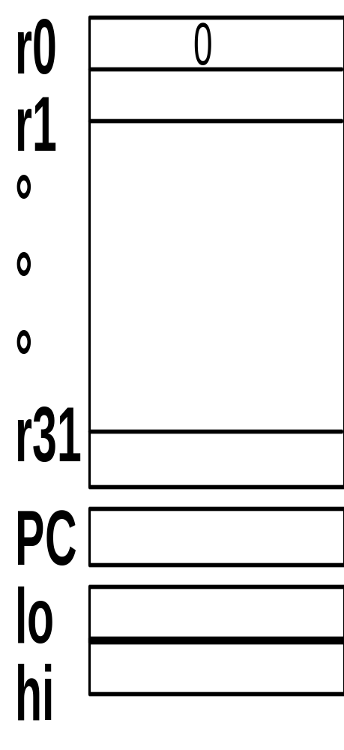
MIPS I Registers
Programmable storage
  2^32 x bytes of memory
  31 x 32-bit GPRs (R0 = 0)
  32 x 32-bit FP regs (paired DP)
  HI, LO, PC

Slide 12
Memory Addressing
Since 1980 almost every machine uses addresses to level of 8-bits (byte)
2 questions for design of ISA:
  Since could read a 32-bit word as four loads of bytes from sequential byte addresses or as one load word from a single byte address, how do byte addresses map onto words?
  Can a word be placed on any byte boundary?

Slide 13
Addressing Objects:
Endianess and Alignment
Big Endian: address of most significant
  IBM 360/370, Motorola 68k, MIPS, Sparc, HP PA
Little Endian: address of least significant
  Intel x86, DEC Vax, DEC Alpha (Windows NT)
little endian byte 0
3 2 1 0
msb
lsb
0 1 2 3
0 1 2 3
big endian byte 0
Aligned
Alignment: require that objects fall on address
that is multiple of their size.
Not
Aligned

Slide 14
Addressing Modes
Addressing mode
Example
Meaning
Register
Add R4,R3
R4
←
R4+R3
Immediate
Add R4,#3
R4
←
R4+3
Displacement
Add R4,100(R1)
R4
←
R4+Mem[100+R1]
Register indirect
Add R4,(R1)
R4
←
R4+Mem[R1]
Indexed / Base
Add R3,(R1+R2)
R3
←
R3+Mem[R1+R2]
Direct or absolute
Add R1,(1001)
R1
←
R1+Mem[1001]
Memory indirect
Add R1,@(R3)
R1
←
R1+Mem[Mem[R3]]
Auto-increment
Add R1,(R2)+
R1
←
R1+Mem[R2]; R2
←
R2+d
Auto-decrement
Add R1,?R2)
R2
←
R2-d; R1
←
R1+Mem[R2]
Scaled
Add R1,100(R2)[R3]
R1
←
R1+Mem[100+R2+R3*d]
Why Auto-increment/decrement? Scaled?
Notes:
Autoinc/dec change source register!
Why auto inc/dec
Why reverse order of inc/dec?
Scaled multiples by d, a small constant
Why? Hint: byte addressing

Slide 15
Addressing Mode Usage?
(ignore register mode)
3 programs
--- Displacement: 42% avg, 32% to 55% 75%
--- Immediate: 33% avg, 17% to 43% 85%
--- Register deferred (indirect): 13% avg, 3% to 24%
--- Scaled: 7% avg, 0% to 16%
--- Memory indirect: 3% avg, 1% to 6%
--- Misc: 2% avg, 0% to 3%
75% displacement & immediate
88% displacement, immediate & register indirect

Slide 16
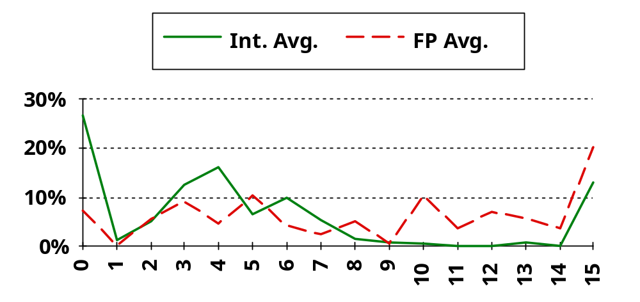
Displacement Address Size?
Address Bits
Avg. of 5 SPECint92 programs v. avg. 5 SPECfp92 programs
3
4
X-axis is in powers of 2: 4 => addresses > 2
(8) and ?2
(16)
1% of addresses > 16-bits
12 - 16 bits of displacement needed

Slide 17
Immediate Size?
?50% to 60% fit within 8 bits
?75% to 80% fit within 16 bits

Slide 18
Addressing Summary
Data Addressing modes that are important:
  Displacement, Immediate, Register Indirect
Displacement size should be 12 to 16 bits
Immediate size should be 8 to 16 bits

Slide 19
Generic Examples of
Instruction Format Widths
Variable:
Fixed:
Hybrid:

Slide 20
Summary of Instruction Formats
If code size is most important, use variable length instructions
If performance is most important, use fixed length instructions
Recent embedded machines (ARM, MIPS) added optional mode to execute subset of 16-bit wide instructions (Thumb, MIPS16); per procedure decide
performance or density

Slide 21
Instruction Format
If have many memory operands per instructions and many addressing modes,
=>Address Specifier per operand
If have load-store machine with 1 address per instr. and one or two addressing modes,
=> encode addressing mode in the opcode

Slide 22
MIPS Instruction Formats
All instructions 32 bits wide
Register (direct)
op
rs
rt
rd
register
Immediate
op
rs
rt
immed
Base+index
op
rs
rt
immed
Memory
register
+
PC-relative
op
rs
rt
immed
Memory
PC
+
Register Indirect?

Slide 23
Typical Operations (little change since 1960)
Data Movement
Load (from memory)
Store (to memory)
memory-to-memory move
register-to-register move
input (from I/O device)
output (to I/O device)
push, pop (to/from stack)
Arithmetic
integer (binary + decimal) or FP
Add, Subtract, Multiply, Divide
Shift
shift left/right, rotate left/right
Logical
not, and, or, set, clear
Control (Jump/Branch)
unconditional, conditional
Subroutine Linkage
call, return
Interrupt
trap, return
Synchronization
test & set (atomic r-m-w)
String
search, translate
Graphics (MMX)
parallel subword ops (4 16bit add)

Slide 24
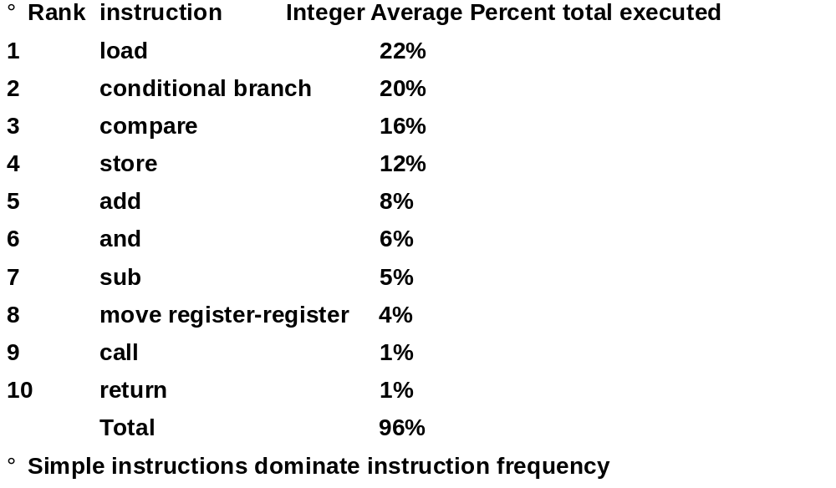
Top 10 80x86 Instructions

Slide 25
Operation Summary
?Support these simple instructions, since they
will dominate the number of instructions executed:
load,
store,
add,
subtract,
move register-register,
and,
shift,
compare equal, compare not equal,
branch,
jump,
call,
return;

Slide 26
Compilers and ISA
Ease of compilation
  orthogonality: no special registers, few special cases,
  all operand modes available with any data type or instruction type
  completeness: support for a wide range of operations
  and target applications
  regularity: no overloading for the meanings of instruction fields
  streamlined: resource needs easily determined
Register Assignment is critical too
  Easier if lots of registers

Slide 27
Summary of Compiler Considerations
Provide at least 16 general purpose registers plus separate floating-point registers,
Be sure all addressing modes apply to all data transfer instructions,
Aim for a minimalist instruction set.

