Slide 1
High Performance TCP/IP Communication with BCL-4
Ma Jie
National Research Center for Intelligent Computing Systems
Institute of Computing Technology
Chinese Academy of Sciences

Slide 2
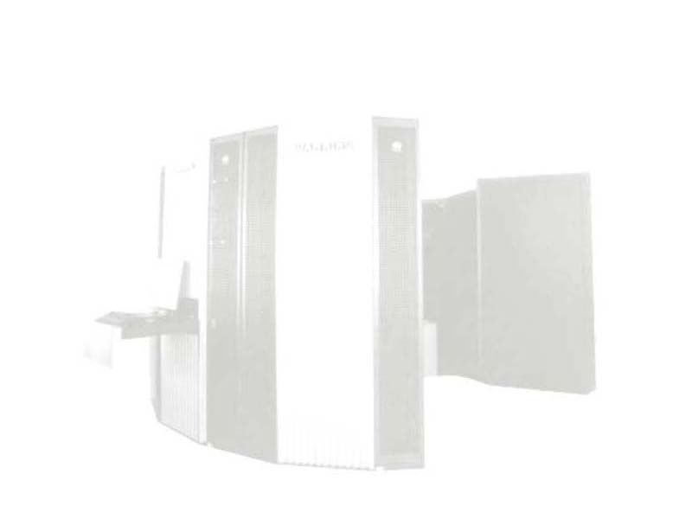
Dawning Super-servers
Supported by National ‘863’ High-Tech Programme of China
Dawning Super-servers
  Dawning-1 SMP (1993)
  Dawning 1000 MPP (1995)
  Dawning 2000-I Super-server (1998)
  Dawning 2000-II Super-server (1999)
  Dawning 3000 Super-server (2000)
  Dawning 4000 Super-servers

Slide 3
BCL Communication Protocols
BCL: Basic Communication Library
  Low-level Communication Layer for DAWNING Super-servers
BCL-4
  Designed for Dawning 4000 Super-servers
  Former versions
    BCL-1
    BCL-2: User-level Protocol, 0-copy
    BCL-3: SMP Support, Semi-user-level Protocol

Slide 4
New Features of BCL-4
Fine-grain Parallel Communication
Remote Memory Access
Unreliable Communication Protocol

Slide 5
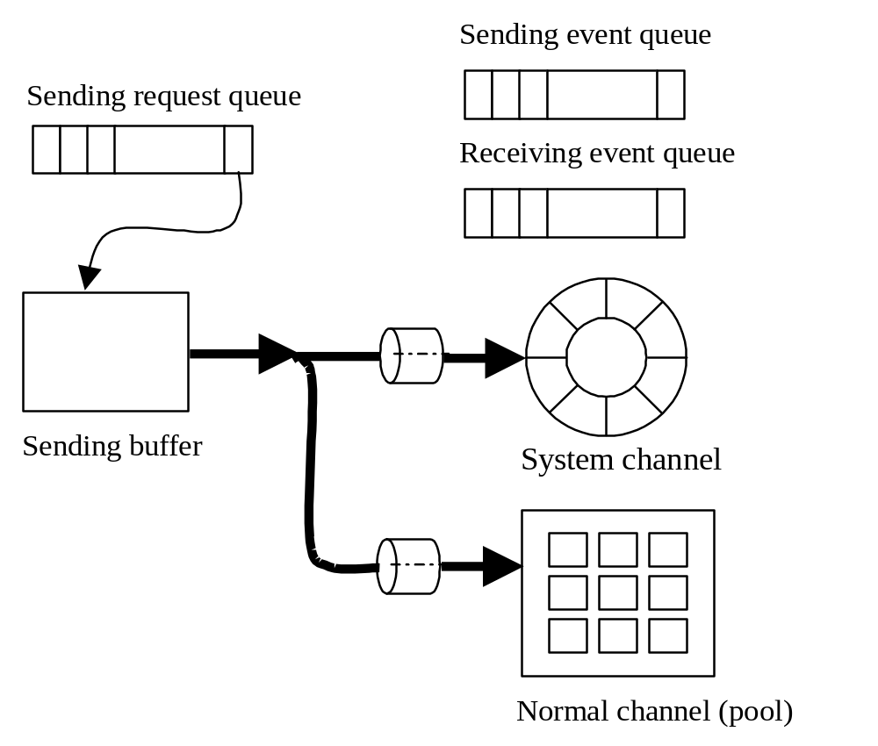
Communication Mechanism

Slide 6
Design Issues
Reliability and Scalability
Adaptability and Compatibility
Security
Portability
High Performance TCP/IP Networking

Slide 7
Performance Optimization
Scatter/Gather DMA support
Checksum offloading
Interrupt storing and suppressing
Extended MTU
PIO and DMA

Slide 8
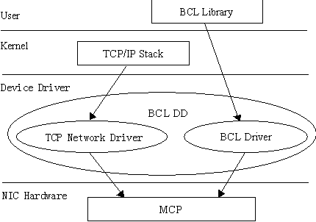
BCL-4/IP Architecture

Slide 9
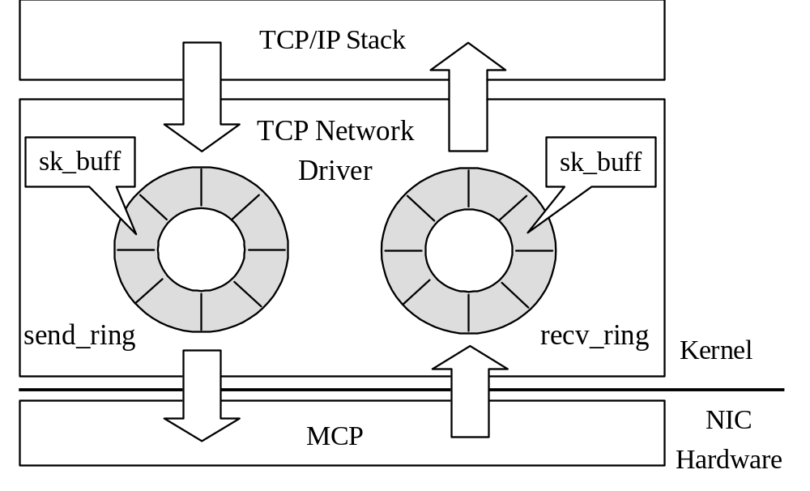
Communication Mechanism

Slide 10
Performance Analysis
Testbed
  16 2-way 1GHz PIII, 1GB memory
  M3S-PCI64B on each node
  Linux 2.4

Slide 11
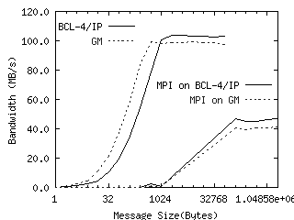
Bandwidth

Slide 12
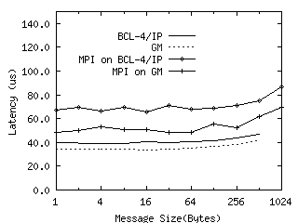
Latency

Slide 13
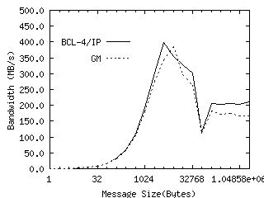
All-to-all Bandwidth

Slide 14
Conclusion
IP over BCL-4
High performance IP implementation
  Linux
  AIX
Performance optimization

Slide 15
Future Work
Parallel communication
Simplified IP protocol stack
Router and gateway

Slide 16
Thank you! 8-)

