Slide 1
MyVIA: High Performance VIA design for Myrinet
Chen Yu
http://hpclab.cs.tsinghua.edu.cn/~chenyu/
Tsinghua University, P.R.China

Slide 2
Overview
Existed VIA implementations
  Berkeley VIA is based on Myrinet hardware, and could run on Solaris, Linux 2.2.x and Windows NT.
  Modular VIA could run on Linux and supported some high speed Ethernet card, such as Packet Engines GNIC-I/II Gigabit Ethernet cards, etc.
  Other projects include IBM FirmVIA, GigaNet, VI-GM, etc.

Slide 3
Overview
VIA is a Industry Driven Standard – promoted by Intel, Compaq and Microsoft
  VIA is thin software layer, OS bypass and asynchronous processed by intelligent NIC
  Unified API for application programmers (VIPL)
  Well defined Application-Hardware Interaction
  VIA is key component of Infiniband technology
  VI Developers Forum (VIDF) – Stewardship of current standard.

Slide 4
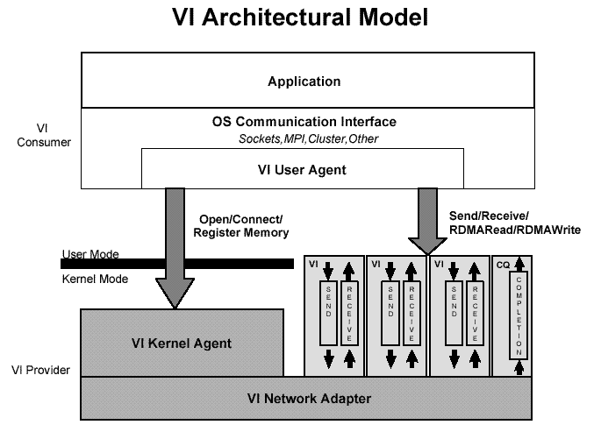

Slide 5
Research Background
We developed a high-perfomance computer cluster in Tsinghua University.
  36 nodes, 4 Intel xeon CPUS & 1GB mem in one node,
  Cluster is connected by 2Gb/s Myrinet, 100Mb/s ethernet and 1Gb/s TH-net
  VIA communication software subsystem is running on the three hardware network.
  Our VIA implemantation for Myrinet is MyVIA

Slide 6
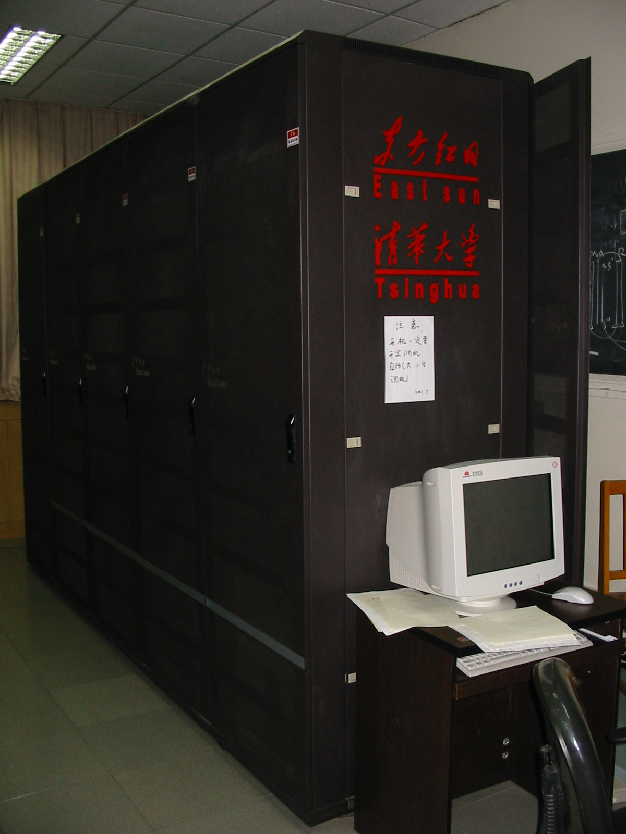
Tsinghua Computer Cluster

Slide 7
Architecture of MyVIA
Three Components of MyVIA
User Agent (UA) is user-oriented VIA library: It provides VIA program interface for users, including data sending, data receiving, communication polling and so on.
NIC Agent (NA) is NIC-oriented agent component: It manages VIA resources in NIC and the DMA sending or receiving, etc. NA is located in Myrinet NIC.
Kernel Agent (KA): It runs as a device driver. The main functions that KA provided include: VI management, Memory Register and Protection, Device initiation and contact, Network and Connection Management

Slide 8
Architecture of MyVIA
Application
OS Communication Interface
Sockets,MPI,Cluster,Other
VI User Agent
User Mode
VI
VI
CQ
Send Recv
Send Recv
Completion
queues
Kernel Mode
VI Kernel Agent
VI NIC Agent (Firmware)
VI Network Adapter (Hardware)

Slide 9
Architecture of MyVIA
Application
VI User Agent
VI Kernel Agent
VI Send
VI Recv
Door Bell process
Big PD Ring Mangement
RDMA Read
RDMA Write
Complete Queue
The Functions of Components
VI connect
TLB Management
Mem Management
Interrupt Management
IOCTL Management
VI NIC Agent
PD process , Small PD Ring Management,
HOST-NIC DMA process, NIC-Net DMA process
Send/Recv Limited State Machine

Slide 10
Implementations of MyVIA
Virtual-to-Physical Memory Address Translation
  TLB is located in host memory and host CPU executes address translation.
  Registered Memory Manage Table (RMMT) is used to keep memory registration information (such as the TLB entries) for VIA applications.

Slide 11
Implementations of MyVIA
Pipelining communication based on resource for Myrinet LANai4
  LANai4 NIC doesn’t support hardware DMA chain
  MyVIA NIC Agent refines the sending process to seven pipelining stages and receiving process to five pipelining stages according to the NIC resources (two buffers, three DMA engines and physical descriptors in NIC).

Slide 12
Implementations of MyVIA
Pipelining communication based on DMA chain for Myrinet LANai9
  Myrinet LANai9 supports hardware DMA chain
  MyVIA NIC Agent uses DMA chain to decrease the DMA startup overheads of transferring data with discontinuous host physical pages in host
  MyVIA for LANai9 refines the sending and receiving processes to two-stage pipeline based on DMA chain, and uses double buffers to store communication data in different stage

Slide 13
Implementations of MyVIA
Doorbell mechanism based on Physical Descriptor Ring
  Building physical descriptor rings on host and NIC
  Physical Descriptor (16 Bytes) can replace original VIA descriptor (64 Bytes) and realize the doorbell mechanism
  Using one Host-NIC PIO process to push doorbell on NIC and transfer VIA descriptor info (reduce Host <-> NIC communication overheads)

Slide 14
Implementations of MyVIA
Memory Management (Kernel Agent)
  We develop technology of continuous host physical memory allocation in Linux kernel and variable-length buffer management in NIC.
  The NIC Agent can use one DMA process to get >4KB register memory on host.
  Range from 4K Bytes to 128K Bytes
  Support >1GB mem host node

Slide 15
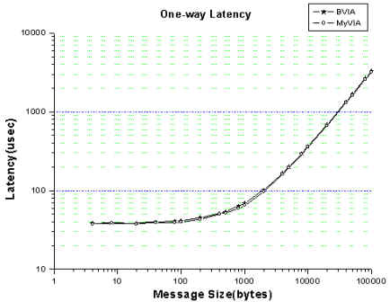
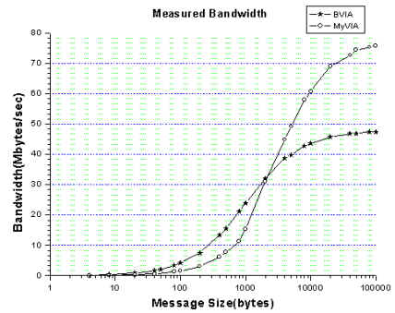
Performance of MyVIA
Performance Analysis on MyVIA and Berkeley VIA in Myrinet LANai4

Slide 16
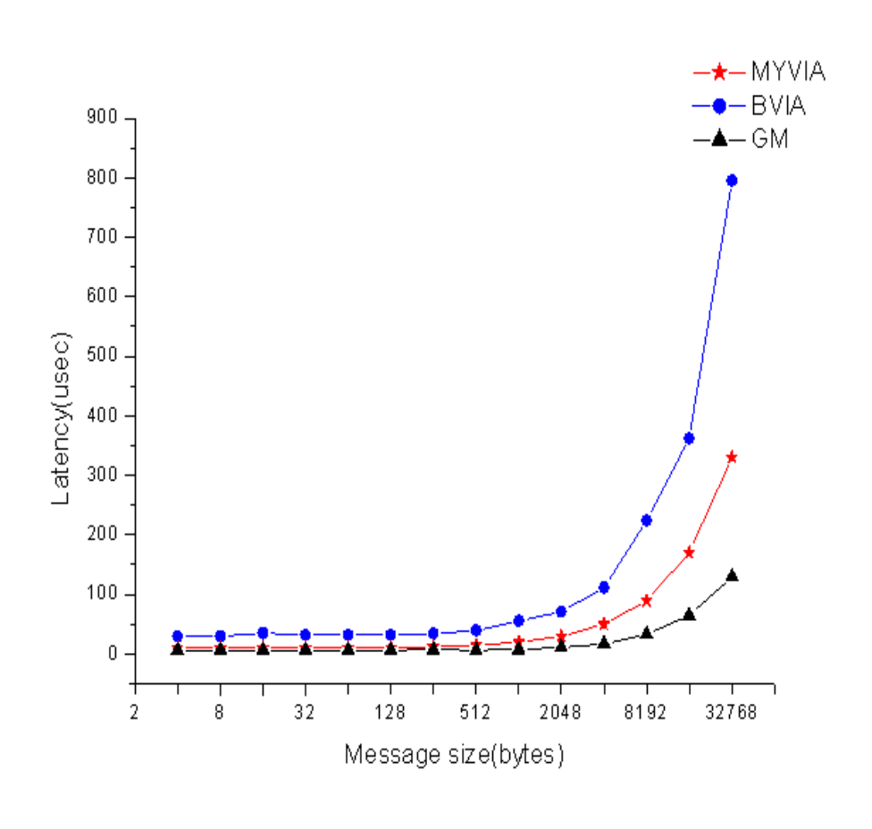
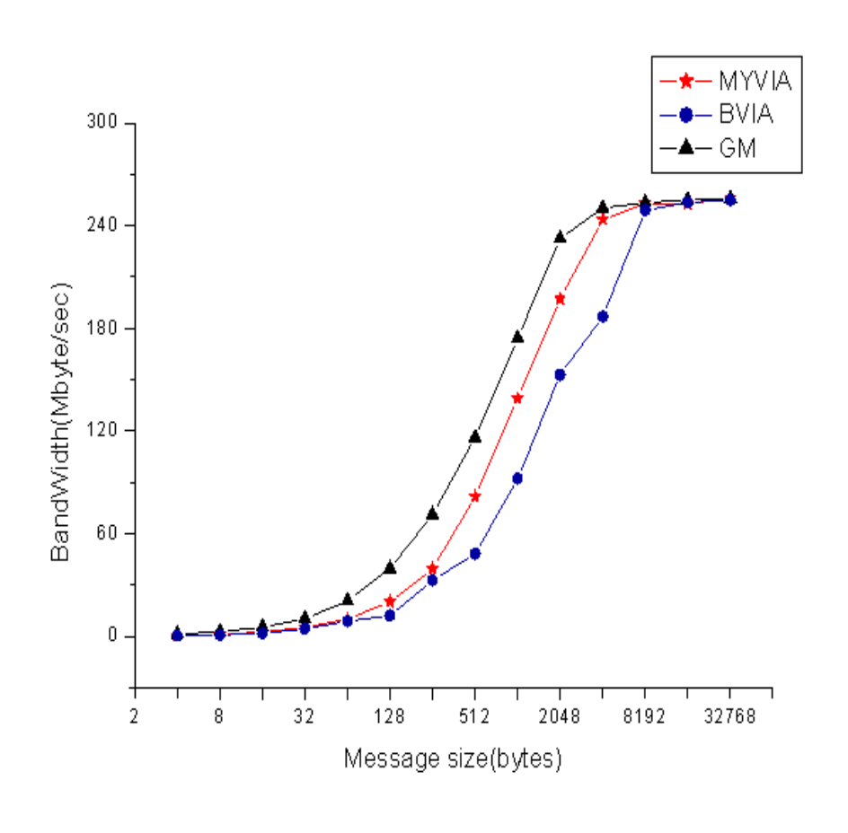
Performance of MyVIA
Performance of MyVIA、BVIA and GM on LANai9

Slide 17
Future of MyVIA
Support RDMA process (the prototype which based on Berkeley VIA was released)
Support MPICH (The revised MVICH prototype can support MyVIA now)
Develop multithread-MPICH for MyVIA (We are doing now!)
Develop TCP/IP for MyVIA (in the future)

Slide 18
Thanks
Jiesheng Wu in Ohio State University
Philip Buonadonna in U.C. Berkeley
Patrick Geoffray in Myricom Inc.
William Gropp in ANL
Please visit our WEB site for newest information
http://hpclab.cs.tsinghua.edu.cn/~chenyu/myvia.html

Slide 19
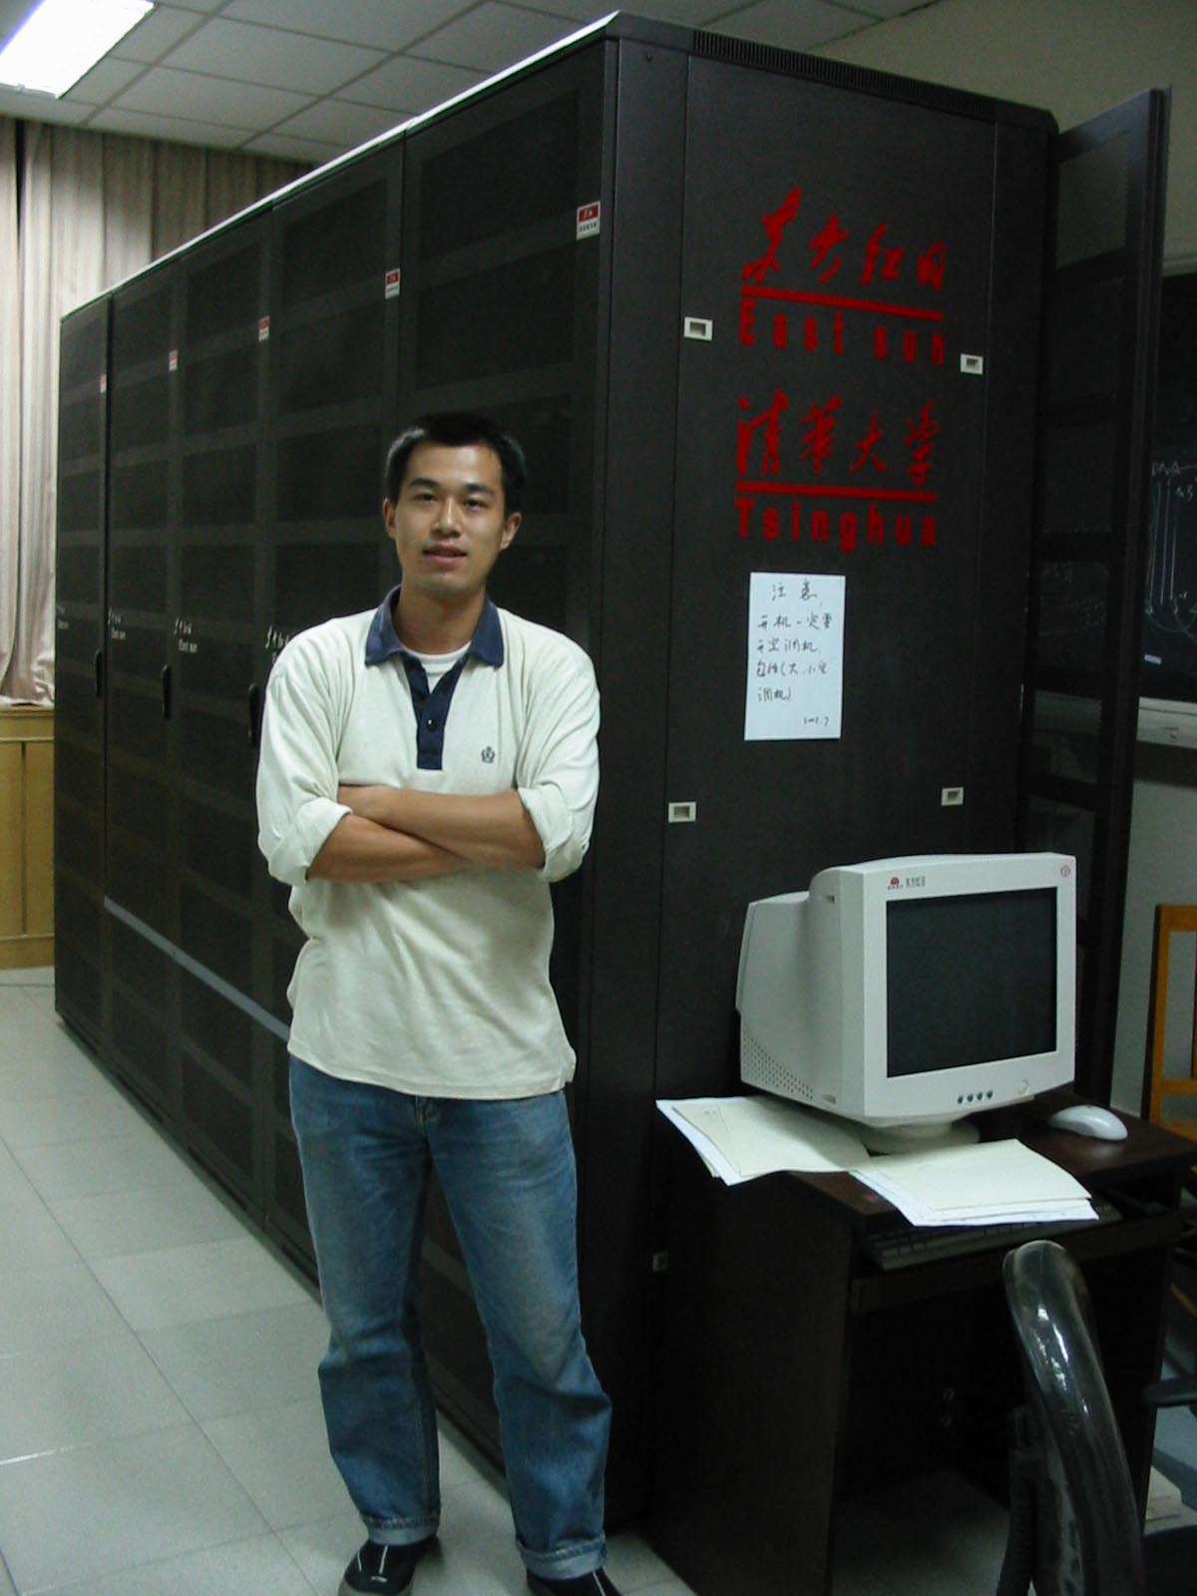
Wellcome to
Visit Tsinghua University

