Slide 1


AKA第三期 讲座
IT 新技术 之（一）
The evolution:
CISC, RISC and EPIC
by Perseus
A K A
www.aka.org.cn

Slide 2
Review: Instruction Set Design
software
instruction set
hardware
Which is easier to change?

Slide 3
Instruction Set Architecture
Instruction Format or Encoding
  how is it decoded?
Location of operands and result
  where other than memory?
  how many explicit operands?
  how are memory operands located?
    which can or cannot be in memory?
Data type and Size
Operations
  what are supported
Successor instruction
  jumps, conditions, branches
Instruction
Fetch
Instruction
Decode
Operand
Fetch
Execute
Result
Store
Next
Instruction

Slide 4
Basic ISA Classes
Accumulator (1 register):
1 address add A acc ← acc + mem[A]
1+x address addx A acc ← acc + mem[A + x]
Stack:
0 address add tos ← tos + next
General Purpose Register:
2 address add A B EA(A) ← EA(A) + EA(B)
3 address add A B C EA(A) ← EA(B) + EA(C)
Load/Store:
3 address add Ra Rb Rc Ra ← Rb + Rc
load Ra Rb Ra ← mem[Rb]
store Ra Rb mem[Rb] ← Ra
Comparison:
Bytes per instruction? Number of Instructions? Cycles per instruction?
Notes:
Invented index register
Reverse polish stack = HP calculator
GPR = last 20 years
L/S variant = last 10 years

Slide 5
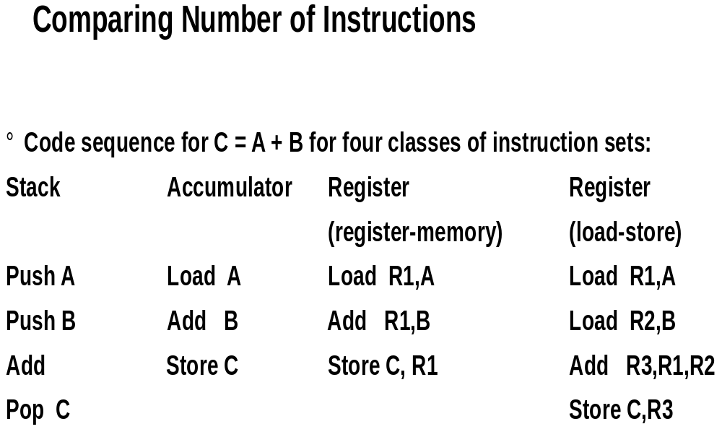

Slide 6
General Purpose Registers Dominate
1975-1995 all machines use general purpose registers
Advantages of reginsters
  Registers are faster than memory
  Registers are easier for a compiler to use
    e.g., (A*B) ?(C*D) ?(E*F) can do multiplies in any order vs. stak
  registers can hold variables
    memory traffic is reduced, so program is sped up (since registers are faster than memory)
    code density improves (since register named with fewer bits than memory location)

Slide 7
Summary on Instruction Classes
Expect new instruction set architecture to use
general purpose register
Pipelining => Expect it to use load store variant
of GPR ISA

Slide 8
Memory Addressing
Since 1980 almost every machine uses addresses to level of 8-bits (byte)
2 questions for design of ISA:
  Since could read a 32-bit word as four loads of bytes from sequential byte addresses or as one load word from a single byte address, how do byte addresses map onto words?
  Can a word be placed on any byte boundary?

Slide 9
Addressing Modes
Addressing mode
Example
Meaning
Register
Add R4,R3
R4
←
R4+R3
Immediate
Add R4,#3
R4
←
R4+3
Displacement
Add R4,100(R1)
R4
←
R4+Mem[100+R1]
Register indirect
Add R4,(R1)
R4
←
R4+Mem[R1]
Indexed / Base
Add R3,(R1+R2)
R3
←
R3+Mem[R1+R2]
Direct or absolute
Add R1,(1001)
R1
←
R1+Mem[1001]
Memory indirect
Add R1,@(R3)
R1
←
R1+Mem[Mem[R3]]
Auto-increment
Add R1,(R2)+
R1
←
R1+Mem[R2]; R2
←
R2+d
Auto-decrement
Add R1,?R2)
R2
←
R2-d; R1
←
R1+Mem[R2]
Scaled
Add R1,100(R2)[R3]
R1
←
R1+Mem[100+R2+R3*d]
Why Auto-increment/decrement? Scaled?
Notes:
Autoinc/dec change source register!
Why auto inc/dec
Why reverse order of inc/dec?
Scaled multiples by d, a small constant
Why? Hint: byte addressing

Slide 10
Addressing Mode Usage?
(ignore register mode)
3 programs
--- Displacement: 42% avg, 32% to 55% 75%
--- Immediate: 33% avg, 17% to 43% 85%
--- Register deferred (indirect): 13% avg, 3% to 24%
--- Scaled: 7% avg, 0% to 16%
--- Memory indirect: 3% avg, 1% to 6%
--- Misc: 2% avg, 0% to 3%
75% displacement & immediate
88% displacement, immediate & register indirect

Slide 11
Addressing Summary
Data Addressing modes that are important:
  Displacement, Immediate, Register Indirect
Displacement size should be 12 to 16 bits
Immediate size should be 8 to 16 bits

Slide 12
Generic Examples of
Instruction Format Widths
Variable:
Fixed:
Hybrid:

Slide 13
Summary of Instruction Formats
If code size is most important, use variable length instructions
If performance is most important, use fixed length instructions
Recent embedded machines (ARM, MIPS) added optional mode to execute subset of 16-bit wide instructions (Thumb, MIPS16); per procedure decide
performance or density

Slide 14
Instruction Format
If have many memory operands per instructions and many addressing modes,
=>Address Specifier per operand
If have load-store machine with 1 address per instr. and one or two addressing modes,
=> encode addressing mode in the opcode

Slide 15
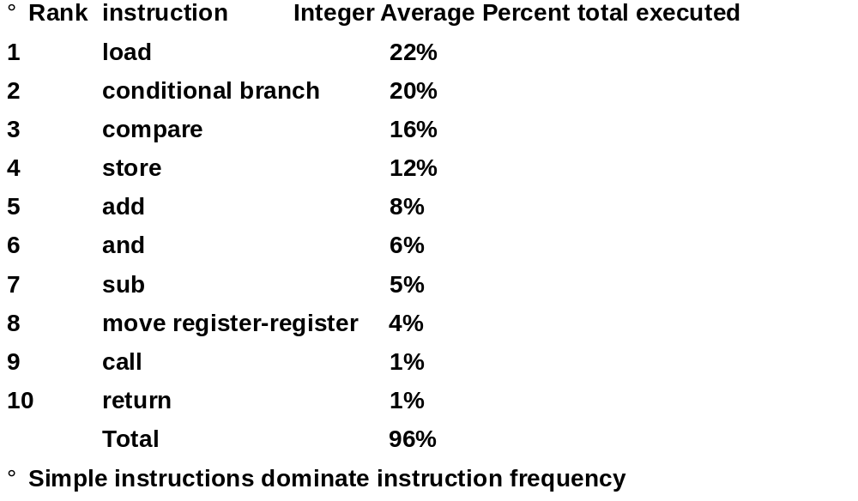
Top 10 80x86 Instructions

Slide 16
Operation Summary
?Support these simple instructions, since they
will dominate the number of instructions executed:
load,
store,
add,
subtract,
move register-register,
and,
shift,
compare equal, compare not equal,
branch,
jump,
call,
return;

Slide 17
Compilers and ISA
Ease of compilation
  orthogonality: no special registers, few special cases,
  all operand modes available with any data type or instruction type
  completeness: support for a wide range of operations
  and target applications
  regularity: no overloading for the meanings of instruction fields
  streamlined: resource needs easily determined
Register Assignment is critical too
  Easier if lots of registers

Slide 18
Summary of Compiler Considerations
Provide at least 16 general purpose registers plus separate floating-point registers,
Be sure all addressing modes apply to all data transfer instructions,
Aim for a minimalist instruction set.

