Slide 19
Introduction to the IA-64 Architecture
The evolution:
CISC, RISC and EPIC

Slide 20
Architecture Evolution
IA-64
Maximize performance via
hardware & software synergy
Advanced features enhance
instruction level parallelism
Massive hardware resources
for parallel execution
Fully compatible with IA32
VLIW
OOO/SuperScalar
RISC
Performance
CISC
Time
Achieving performance at the most fundamental level
Notes:
The transition from CISC to RISC was based on the concept of transitioning complexity from hardware to software. This allowed RISC processors to devote more die size to processing. In order to continue increasing processor capabilities, architects needed to enable parallel execution, more than one instruction per cycle. VLIW was the first attempt at parallel execution, but was saddled with scalability and compatibility problems. Out-of-order (OOO) Superscalar engines have made progress toward parallel execution, but are limited in the amount they can achieve. A new architecture is required to overcome the limitations of traditional architectures.

Slide 21
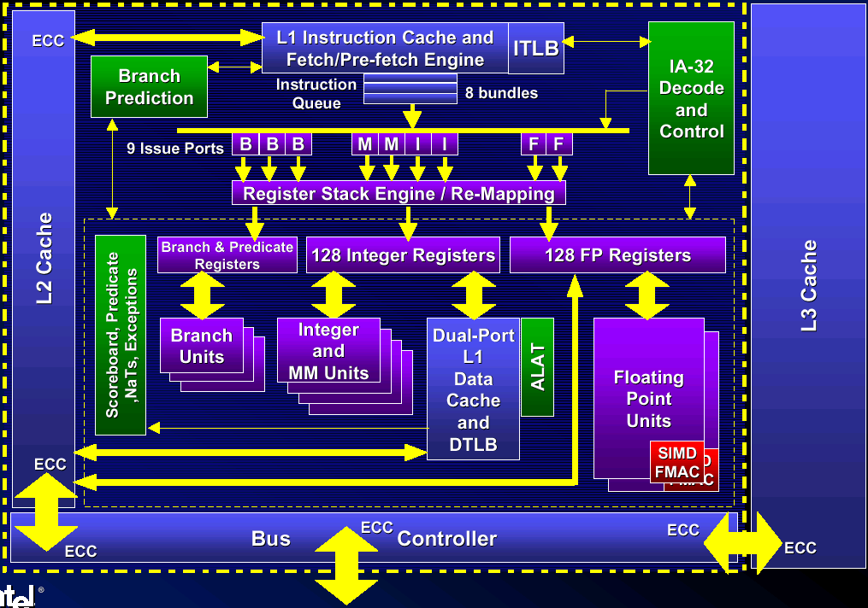
Intel® Itanium ™ Processor Block Diagram
Notes:
Branches represent divergent paths of code. The path taken depends on some outcome that was determined by an earlier instruction. As machines become faster, branches are an ever increasing performance bottleneck - especially in high performance applications.
Branches create a break in the flow of instructions. Today抯 machines need to fetch many instructions ahead of their actual execution. To accomplish this, today抯 architectures use branch prediction to predict which set of instructions to load even before the decision has been made. If the branch was mispredicted, then a huge time penalty is incurred while the correct path is loaded.
Branches effectively separate code into small blocks. This underutilizes the capabilities of the machine.

Slide 22
Instruction Format: Explicit Parallelism
Breaking the sequential execution paradigm
  Explicit instruction dependency: template
  Flexibly groups any number of independent instructions
Explicitly scheduled parallelism
  Enables compiler to create greater parallelism
  Simplifies hardware by removing dynamic mechanisms
  Fully interlocked- hardware provides compatibility
128-bit bundle
127
0
Instruction 2
Instruction 1
Instruction 0
Template
Modest code size expansion
The new instruction format enables scalability w/ compatibility
Notes:
The IA-64 instruction format enables explicit parallelism. The template, in the picture above, defines the relationship between instructions. This allows multiple instructions to be grouped together while providing scalability and compatibility.

Slide 23
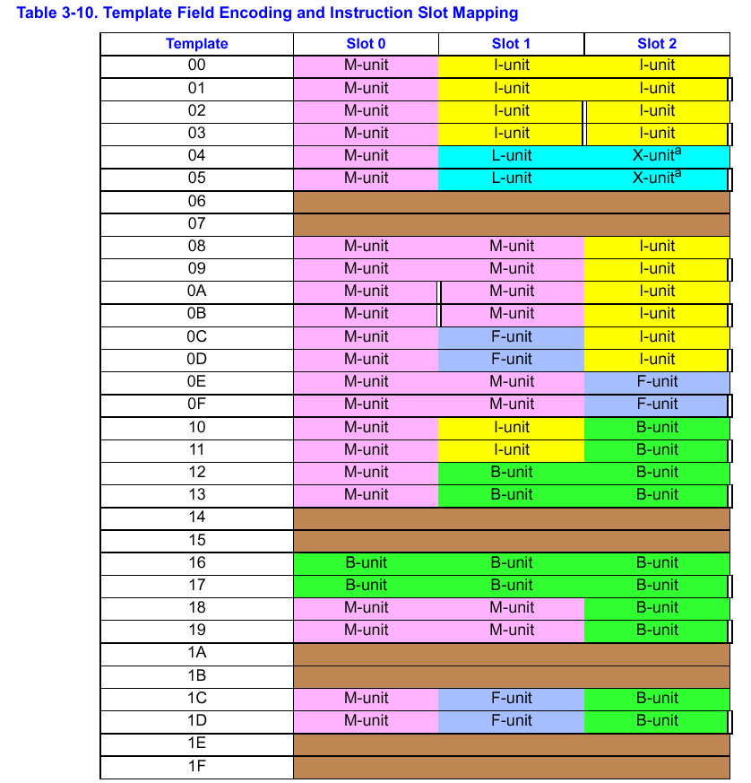

Slide 24
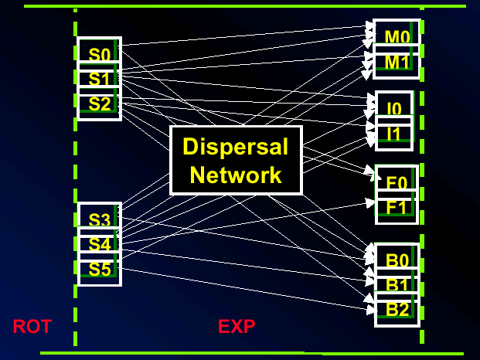
Instruction Delivery: Dispersal
Stop bits eliminate dependency checking
Templates simplify routing
1st available dispersal from 6 syllables to 9 issue ports
  Keep issuing until stop bit, resource oversubscription, or asymmetry

Slide 25
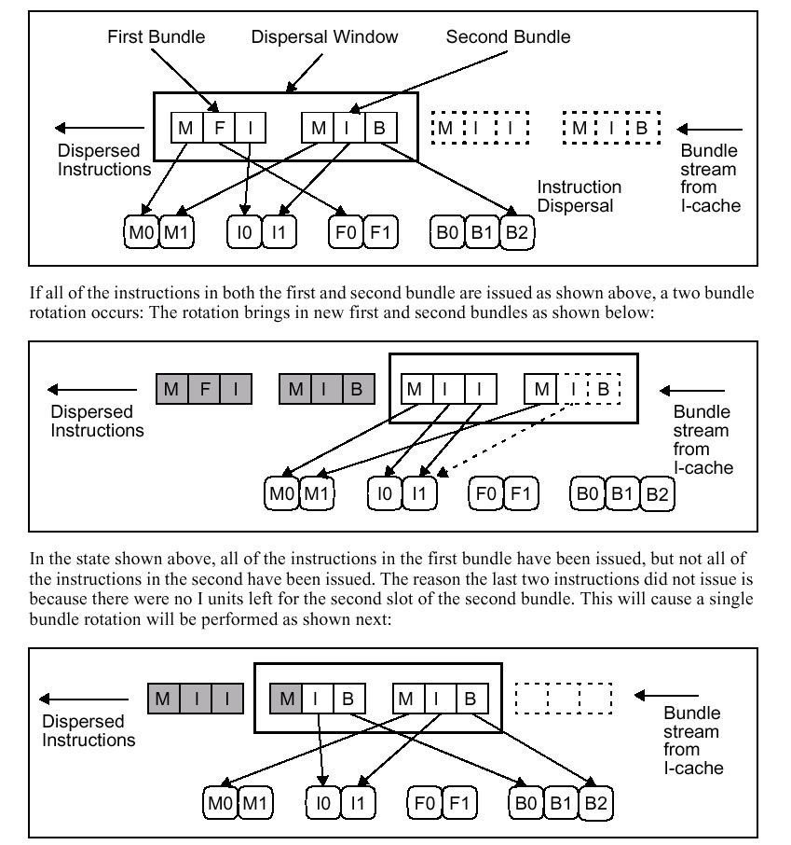

Slide 26
Predication Enhances Parallelism
Traditional Architectures: 4 basic blocks
EPIC Architectures: 1 basic block
instr 2
instr 1
if
:
if
instr 2
p1, p2 <-cmp(a==b)
:
jump p2
p1, p2 <- cmp(a==b)
instr 3
then
else
instr 4
(p1)
instr 3
(p2)
instr 5
then
:
(p1)
instr 4
(p2)
instr 6
jump
:
:
instr 5
else
instr 6
instr 7
:
instr 8
:
instr 7
instr 8
:
new Basic Block
Predication enables more effective use of parallel hardware
Notes:
In traditional architectures, the compiler is constrained by the fragmentation of code in small blocks. By removing branches, the compiler has greater freedom to schedule instructions. This results in greater parallelism and better utilization of an IA-64 based processor抯 performance capabilities.

Slide 27
Predication: Features and Benefits
Compiler given larger scheduling scope
  Nearly all instructions can be predicated
  State updated if an instruction’s predicate is true, otherwise acts as a NOP
  Compiler assigns predicates, compare instructions set them
  Architecture provides 64 1-bit predicate registers (PR)
Predicated execution removes branches
  Convert a control dependence to a data dependence
  Reduce mispredict penalties
Parallel execution through larger basic blocks
  Effective use of parallel hardware

Slide 28
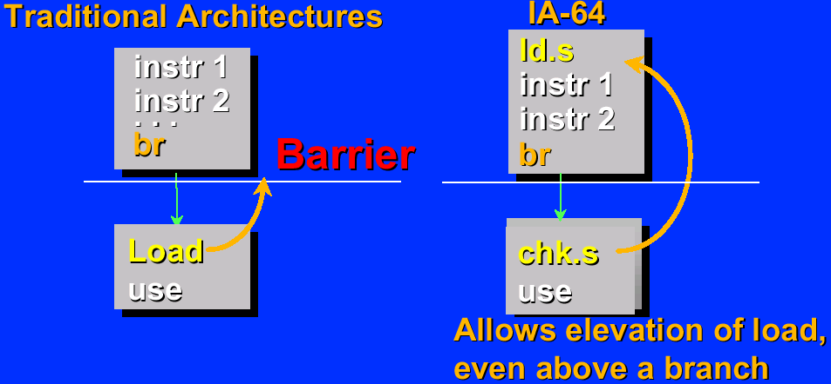
Control Speculation
Loads significantly affect performance
  Often first instruction in dependency chain of instructions
  Can incur high latencies
Loads can cause exceptions

Slide 29
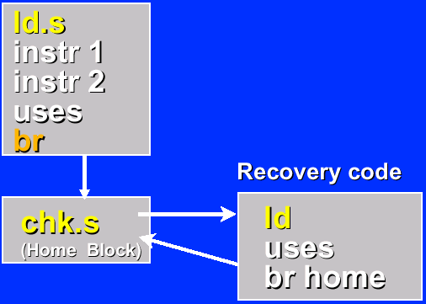
Exception Deferral
Deferral allows the efficient delay of costly exceptions
OS controlled deferral by hardware of:
  Page faults
  Protection violations
  …
NaTs enable deferral with recovery
Efficiently support structured exception handling in C/C++
Notes:
By initiating the load speculatively, the compiler allows more time for data to arrive without stalling the processor or slowing its performance.

Slide 30
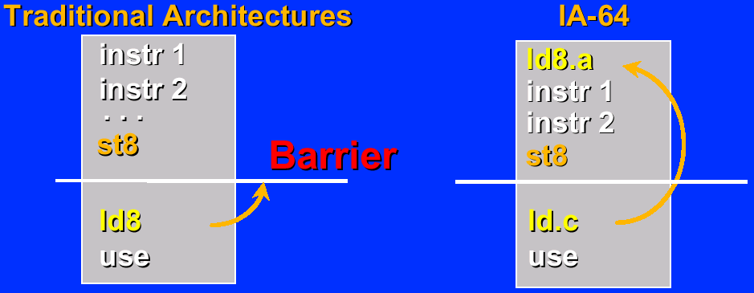
Data Speculation
Compiler can issue a load prior to a preceding, possibly-conflicting store
Advanced load (ld.a, ldf.a, ldfp.a) and check load (ld.c, ...)

Slide 31
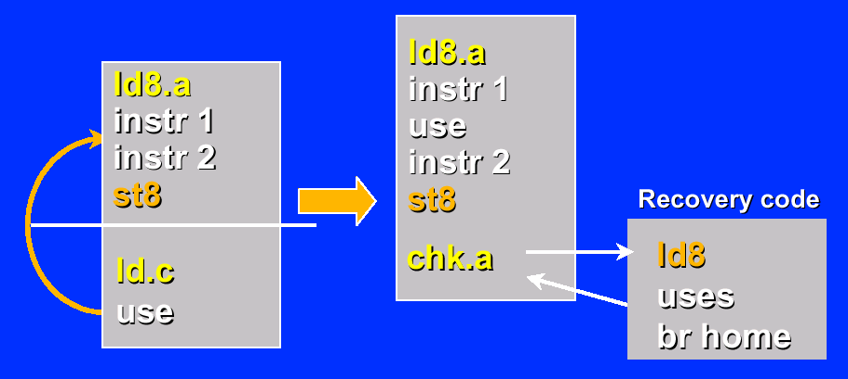
Hoisting Uses
Uses can be hoisted
Using advanced load check (chk.a) instead of check load

Slide 32
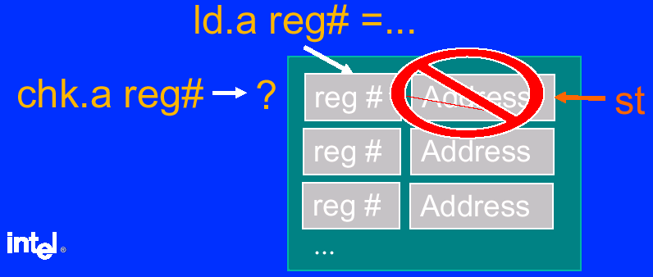
Advanced Load Address Table - ALAT
ld.a inserts entries.
Conflicting stores remove entries
  Also: ld.c.clr, chk.a.clr,
Presence of entry indicates success
  chk.a branches when no entry is found

Slide 33
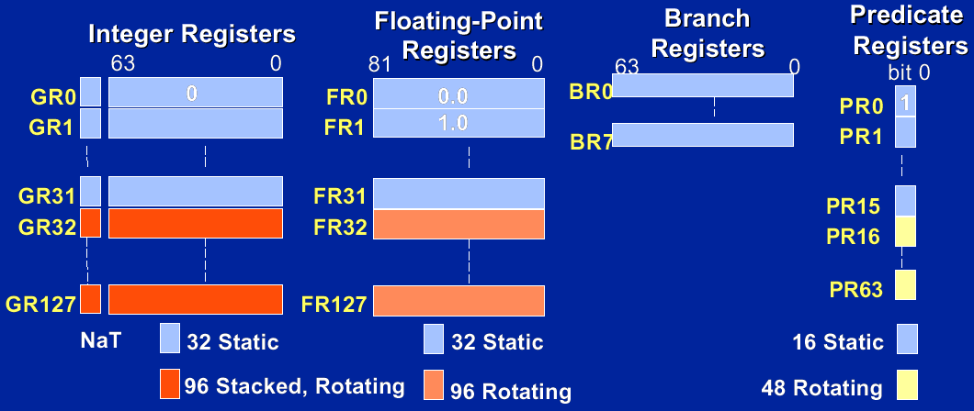
Register Files

Slide 34
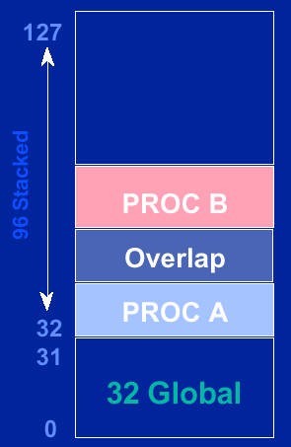
Register Stack
GR Stack reduces need for
save/restore across calls
Procedure stack frame of
programmable size (0 to 96 regs)
Mechanism implemented by
renaming register addresses

Slide 35
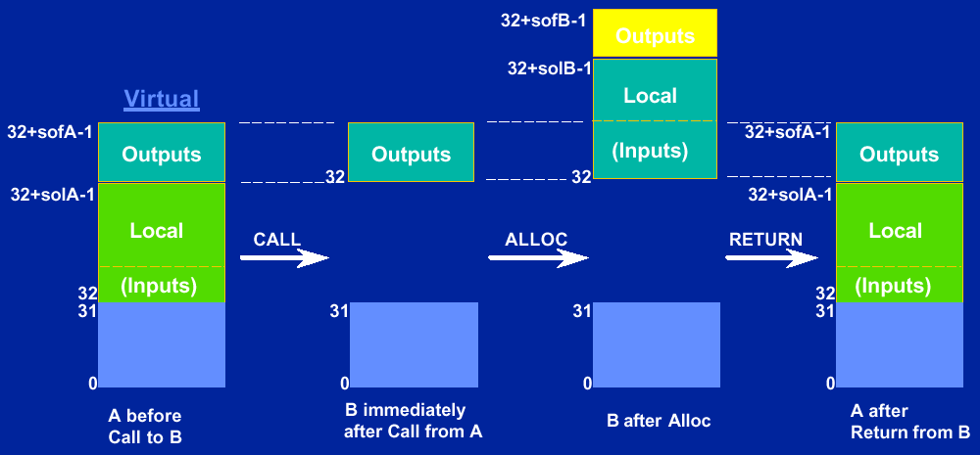
Register Stack Behavior on Call and Return

