Slide 1


AKA 第三期 讲座
IT 新技术 之（一）
The evolution:
CISC, RISC and EPIC
by Perseus
A K A
www.aka.org.cn

Slide 2
Introduction to the IA-64 Architecture
The evolution:
CISC, RISC and EPIC

Slide 3
Agenda
Architecture design principles
Resources and execution model
Predication
Speculation
Branch hints and memory locality hints
Register stack and rotation
Concluding remarks

Slide 4
Architecture Challenges
Sequentiality inherent in traditional architectures
Complex hardware needed to (re)extract ILP
Limited ILP available within basic blocks
Branches make extracting ILP difficult
Memory dependencies further limit ILP
Increasing latency exacerbates ILP need
Limited resources : A fundamental constraint
Shared resources create more overhead
Loop ILP extraction costs code size
...

Slide 5
IA-64 Design Principles
Explicitly parallelism:
  Instruction level parallelism (ILP) in machine code
  Maximize performance via hardware & software synergy
Advanced features enhance ILP:
  Predication, Speculation, Branch Prediction, Branch hints, Locality hints, ...
  Overcoming traditional barriers (branches/stores), hides memory latency
Massively resourced:
  Large register files
  Duplicated functional units
Fully compatible:
  Across all IA-64 family members and Inherently scalable
  IA-32 in hardware and PA-RISC through instruction mapping

Slide 6
Architecture Evolution
IA-64
Maximize performance via
hardware & software synergy
Advanced features enhance
instruction level parallelism
Massive hardware resources
for parallel execution
Fully compatible with IA32
VLIW
OOO/SuperScalar
RISC
Performance
CISC
Time
Achieving performance at the most fundamental level
Notes:
The transition from CISC to RISC was based on the concept of transitioning complexity from hardware to software. This allowed RISC processors to devote more die size to processing. In order to continue increasing processor capabilities, architects needed to enable parallel execution, more than one instruction per cycle. VLIW was the first attempt at parallel execution, but was saddled with scalability and compatibility problems. Out-of-order (OOO) Superscalar engines have made progress toward parallel execution, but are limited in the amount they can achieve. A new architecture is required to overcome the limitations of traditional architectures.

Slide 7
Agenda
Architecture design principles
Resources and execution model
Predication
Speculation
Branch hints and memory locality hints
Register stack and rotation
Concluding remarks

Slide 8
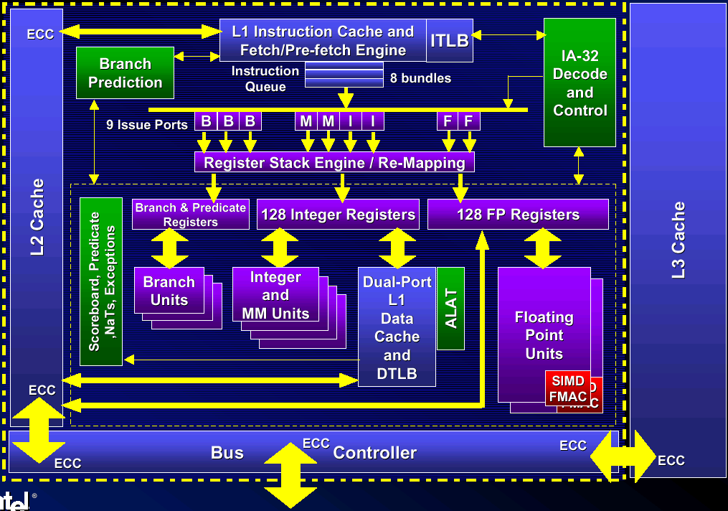
Intel® Itanium ™ Processor Block Diagram
Notes:
Branches represent divergent paths of code. The path taken depends on some outcome that was determined by an earlier instruction. As machines become faster, branches are an ever increasing performance bottleneck - especially in high performance applications.
Branches create a break in the flow of instructions. Today抯 machines need to fetch many instructions ahead of their actual execution. To accomplish this, today抯 architectures use branch prediction to predict which set of instructions to load even before the decision has been made. If the branch was mispredicted, then a huge time penalty is incurred while the correct path is loaded.
Branches effectively separate code into small blocks. This underutilizes the capabilities of the machine.

Slide 9
Instruction Format: Explicit Parallelism
Breaking the sequential execution paradigm
  Explicit instruction dependency: template
  Flexibly groups any number of independent instructions
Explicitly scheduled parallelism
  Enables compiler to create greater parallelism
  Simplifies hardware by removing dynamic mechanisms
  Fully interlocked- hardware provides compatibility
128-bit bundle
127
0
Instruction 2
Instruction 1
Instruction 0
Template
Modest code size expansion
The new instruction format enables scalability w/ compatibility
Notes:
The IA-64 instruction format enables explicit parallelism. The template, in the picture above, defines the relationship between instructions. This allows multiple instructions to be grouped together while providing scalability and compatibility.

Slide 10
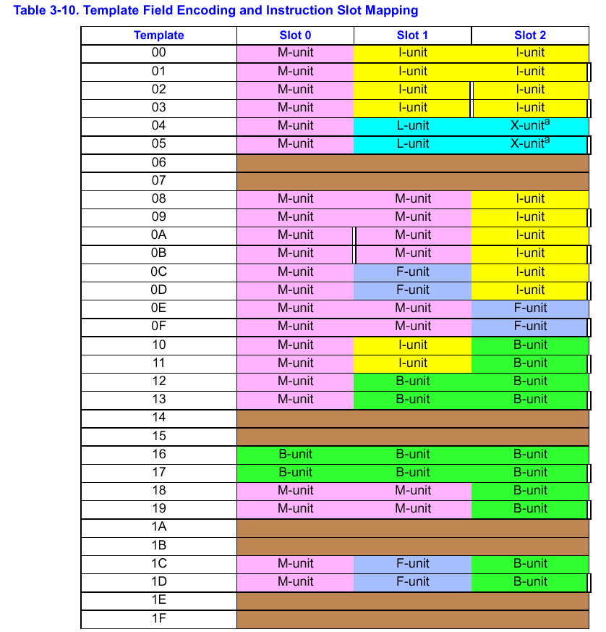

Slide 11
Instruction Sequencing
Four phases of instruction execution:
  fetch, read, execute, update
Instruction sequencing rules:
  Between fetch of insn and its dynamically pre insn: no a priori relationship, syn.i and srlz.i
  Between groups: all reads occurred after the updates of previous group
  Within a group, memory and ALAT : read occurred after the update of all prior insns.
  Within a group, register: read occurred before the update of any insns.

Slide 12
Dependency Restrictions
Register dependencies:
  Within a group, RAW, WAW are not allowed
  WAR are allowed
Memory dependencies:
  Within a group: RAW, WAW, and WAR are allowed
Effect: a legal instruction group could be executed concurrently or serially with the end result being identical.

Slide 13
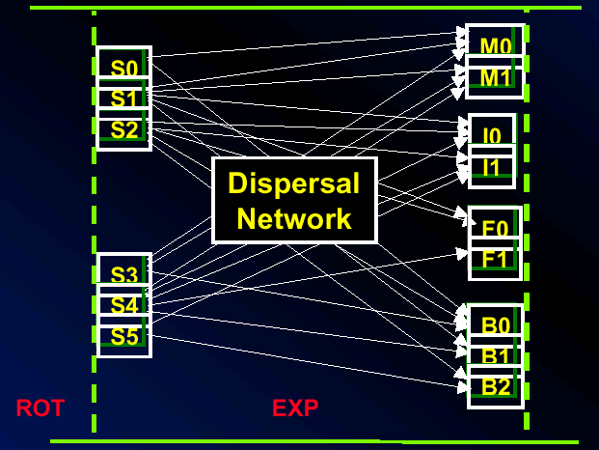
Instruction Delivery: Dispersal
Stop bits eliminate dependency checking
Templates simplify routing
1st available dispersal from 6 syllables to 9 issue ports
  Keep issuing until stop bit, resource oversubscription, or asymmetry

Slide 14
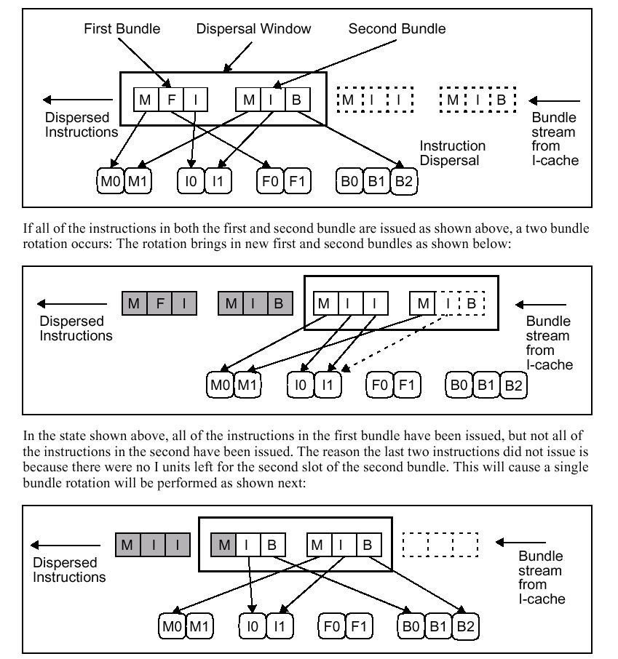

Slide 15
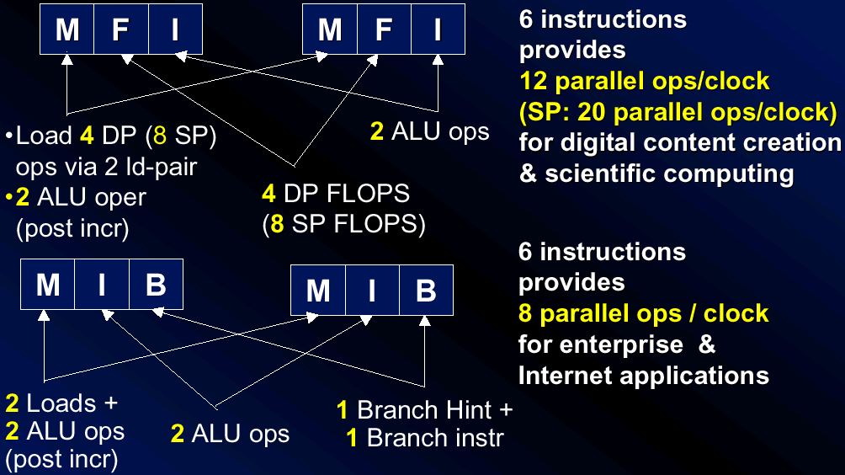
Breakthrough Levels of Parallelism

Slide 16
Agenda
Architecture design principles
Resources and execution model
Predication
Speculation
Branch hints and memory locality hints
Register stack and rotation
Concluding remarks

Slide 17
Predication Enhances Parallelism
Traditional Architectures: 4 basic blocks
EPIC Architectures: 1 basic block
instr 2
instr 1
if
:
if
instr 2
p1, p2 <-cmp(a==b)
:
jump p2
p1, p2 <- cmp(a==b)
instr 3
then
else
instr 4
(p1)
instr 3
(p2)
instr 5
then
:
(p1)
instr 4
(p2)
instr 6
jump
:
:
instr 5
else
instr 6
instr 7
:
instr 8
:
instr 7
instr 8
:
new Basic Block
Predication enables more effective use of parallel hardware
Notes:
In traditional architectures, the compiler is constrained by the fragmentation of code in small blocks. By removing branches, the compiler has greater freedom to schedule instructions. This results in greater parallelism and better utilization of an IA-64 based processor抯 performance capabilities.

Slide 18
Predication: Features and Benefits
Compiler given larger scheduling scope
  Nearly all instructions can be predicated
  State updated if an instruction’s predicate is true, otherwise acts as a NOP
  Compiler assigns predicates, compare instructions set them
  Architecture provides 64 1-bit predicate registers (PR)
Predicated execution removes branches
  Convert a control dependence to a data dependence
  Reduce mispredict penalties
Parallel execution through larger basic blocks
  Effective use of parallel hardware

Slide 19
Predication Increases Performance
100%
Branches
Removed
90%
80%
Mispredicts
Removed
70%
60%
50%
40%
30%
20%
10%
0%
li
ear
sc
cmp
eqn
lex
wc
eqntott
alvinn
cccp
grep
qsort
yacc
espresso
compress
AVERAGE
On average, over half of all branches are removed
Source: ISCA 95 S.Mahlke, et.al.
Notes:
This graph shows the effect that predication has on popular benchmark programs. On average, predication removed over 50% of the branches and mispredicted branches from these programs. These third party results indicate the benefits of predication in general and were not performed with IA-64 based processors.

Slide 20
Agenda
Architecture design principles
Resources and execution model
Predication
Speculation
Branch hints and memory locality hints
Register stack and rotation
Concluding remarks

Slide 21
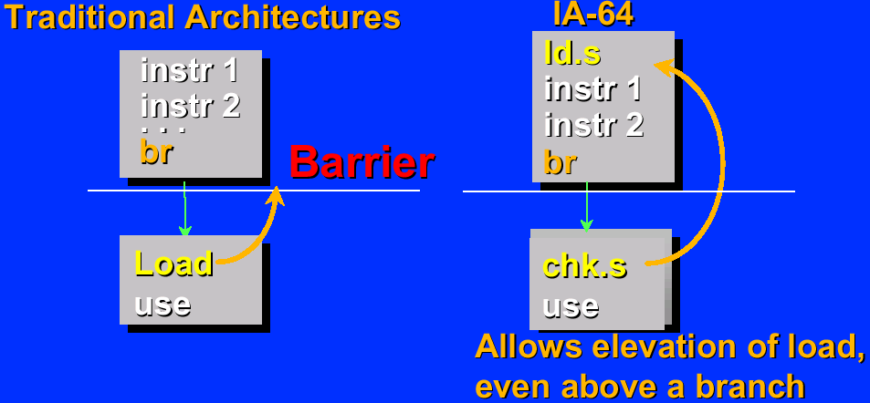
Control Speculation
Loads significantly affect performance
  Often first instruction in dependency chain of instructions
  Can incur high latencies
Loads can cause exceptions

Slide 22
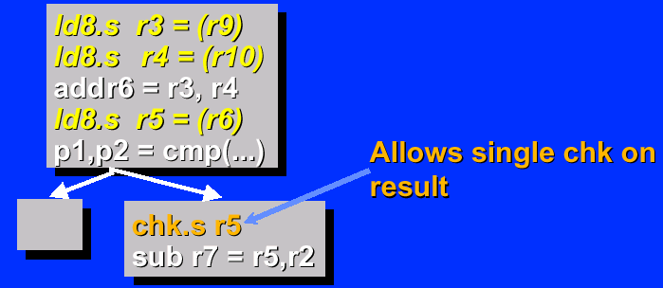
Propagation
Instructions divided into two categories: speculative v.s nonspeculative
  Speculative Instructions: ld.s, ldf.s, ldfp.s, and computation instructions that only write GRs or FRs
  Nonspeculative Instructions: any computation instruction that modifies state other than GRs or FRs
Speculative loads can generate exceptions, and all computation instructions propagate NaTs to reduce number of checks
Notes:
By initiating the load speculatively, the compiler allows more time for data to arrive without stalling the processor or slowing its performance.

Slide 23
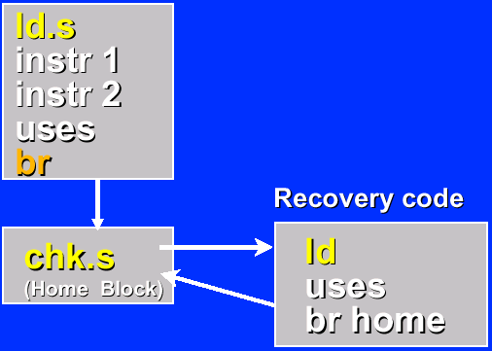
Exception Deferral
Deferral allows the efficient delay of costly exceptions
OS controlled deferral by hardware of:
  Page faults
  Protection violations
  …
NaTs enable deferral with recovery
Efficiently support structured exception handling in C/C++
Notes:
By initiating the load speculatively, the compiler allows more time for data to arrive without stalling the processor or slowing its performance.

Slide 24
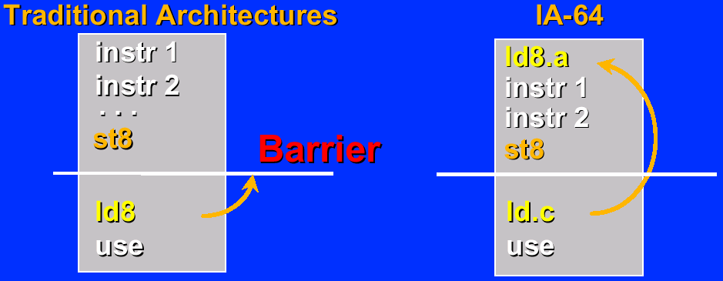
Data Speculation
Compiler can issue a load prior to a preceding, possibly-conflicting store
Advanced load (ld.a, ldf.a, ldfp.a) and check load (ld.c, ...)

Slide 25
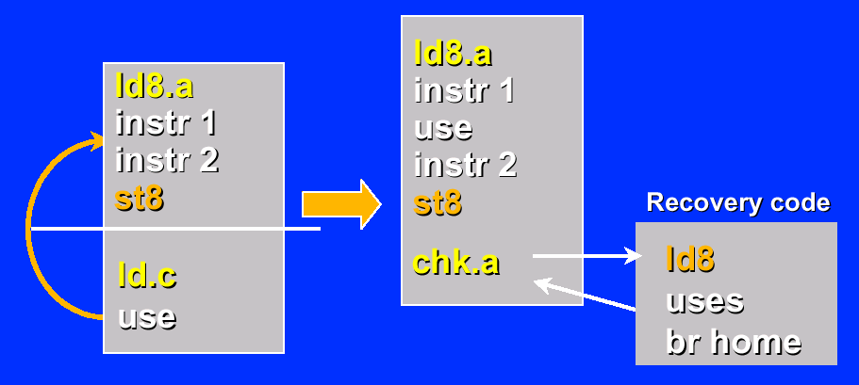
Hoisting Uses
Uses can be hoisted
Using advanced load check (chk.a) instead of check load

Slide 26
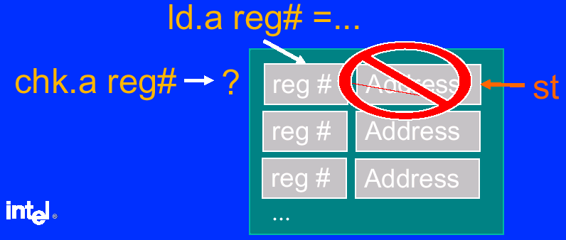
Advanced Load Address Table - ALAT
ld.a inserts entries.
Conflicting stores remove entries
  Also: ld.c.clr, chk.a.clr,
Presence of entry indicates success
  chk.a branches when no entry is found

Slide 27
Agenda
Architecture design principles
Resources and execution model
Predication
Speculation
Branch hints and memory locality hints
Register stack and rotation
Concluding remarks

Slide 28
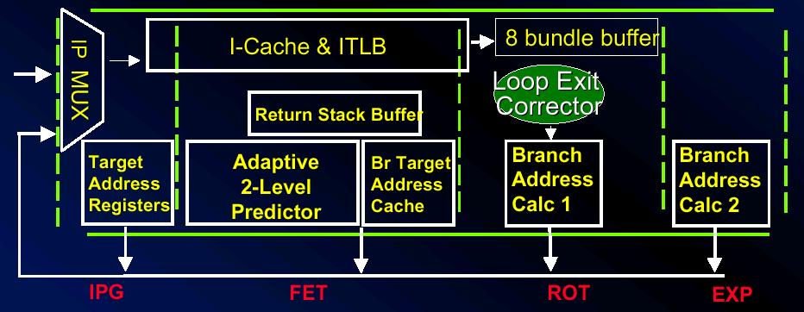
Branch Prediction
Branch hints combined with predictor hierarchy to improve branch prediction: four progressive resteers
  4 TARs programmed by “importance” hints
  512- entry 2- level predictor provides dynamic direction prediction
  64- entry BTAC contains footprint of upcoming branch targets (programmed by branch hints, and allocated dynamically)

Slide 29
Branch Prediction Hints and Instructions
Three types of hints:
  Whether prediction: spnt, sptk, dpnt, dptk
  Sequential prefetch: few, many
  Predictor deallocation: none, clr
Branch predict instructions( brp ):
  Location of the branch: disp + IP(brp) = addr_of_future_branch
  Target of the branch: displacement or branch register
  Branch importance: employ very fast prediction structure, useful on tight loops
  Whether prediction: same as above

Slide 30
Memory Hierarchy Control
Three levels of cache:
  L1-D, L1-I, L2-Unified, L3-Unified
Each consist of two structures:
  temporal structure: accessed with temporal and spatial locality
  non-temporal structure: accessed with spatial locality only
Three mechanisms for allocaion contol:
  locality hints: none, nt1, nt2, nta
  explicit prefetch: lfetch, lfetch.fault
  implicit prefetch: addr. post-inc of load, store, lfetch and lfetch.fault

Slide 31
Memory Hierarchy Control
Level 1
Level 2
Level 3
Memory
Temporal
Structure
Temporal
Structure
Temporal
Structure
Register
Files
Non-temporal
Structure
Non-temporal
Structure
Non-temporal
Structure
Cache

Slide 32
Agenda
Architecture design principles
Resources and execution model
Predication
Speculation
Branch hints and memory locality hints
Register stack and rotation
Concluding remarks

Slide 33
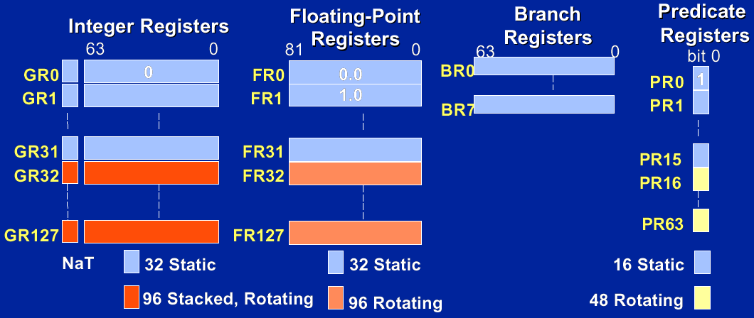
Register Files

Slide 34
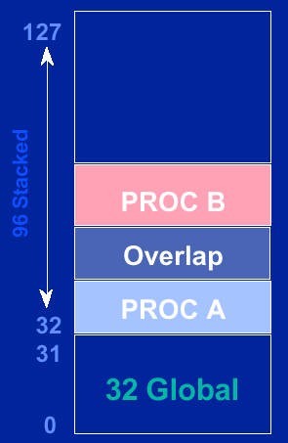
Register Stack
GR Stack reduces need for
save/restore across calls
Procedure stack frame of
programmable size (0 to 96 regs)
Mechanism implemented by
renaming register addresses

Slide 35
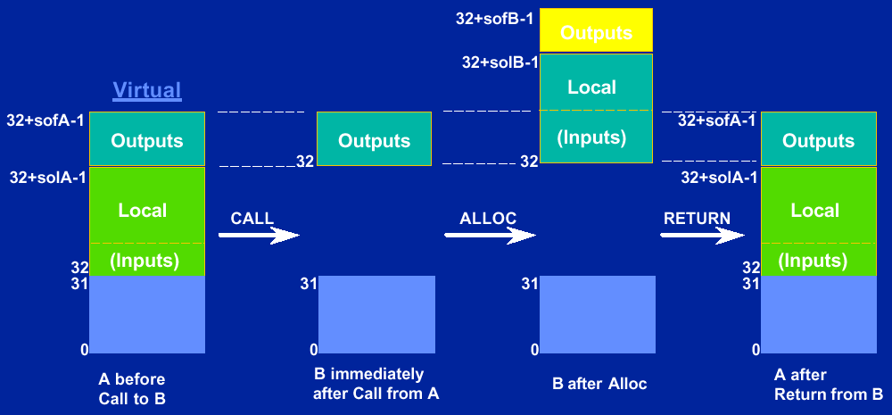
Register Stack Behavior on Call and Return

Slide 36
Register Rotation
RRB, br.ctop( br.cexit, br.wtop, br.wexit ), LC and EC
An example:
1 2 3 4 5
ld4
ld4
add ld4
st4 add ld4
st4 add ld4
st4 add
st4 add
st4
stage1: ld4 r4 = [r5], 4
stage2: nop
stage3: add r7 = r4, r9
stage4: st4 [r6] = r7, 4
mov lc =199 || mov ec = 4 || mov pr.rot = 1<<16 ;;
L1: (p16) ld4 r32 = [r5], 4 || (p18) add r35 = r34, r9 || (p19) st4 [r6] = r36, 4 || br.ctop L1 ;;

Slide 37
Agenda
Architecture design principles
Resources and execution model
Predication
Speculation
Branch hints and memory locality hints
Register stack and rotation
Concluding remarks

Slide 38
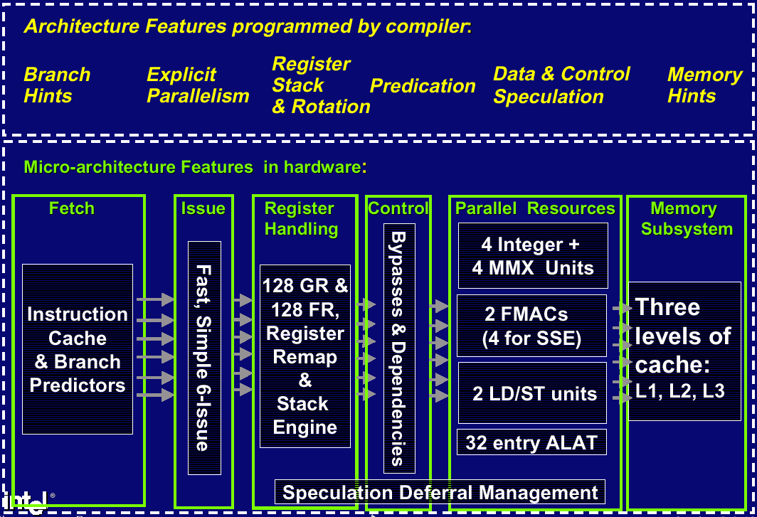
SW- HW Synergy: The IA-64 Approach

