Slide 1
NASA Airathon: Predict Air Quality (Particulate Track)
Hosted by NASA
Link: https://www.drivendata.org/competitions/88/competition-air-quality-pm/
For Columbia University Deep Learning COMSW4995-012
Zixiang Loh (zl3021) & John William Blackwelder (jwb2168)

Slide 2
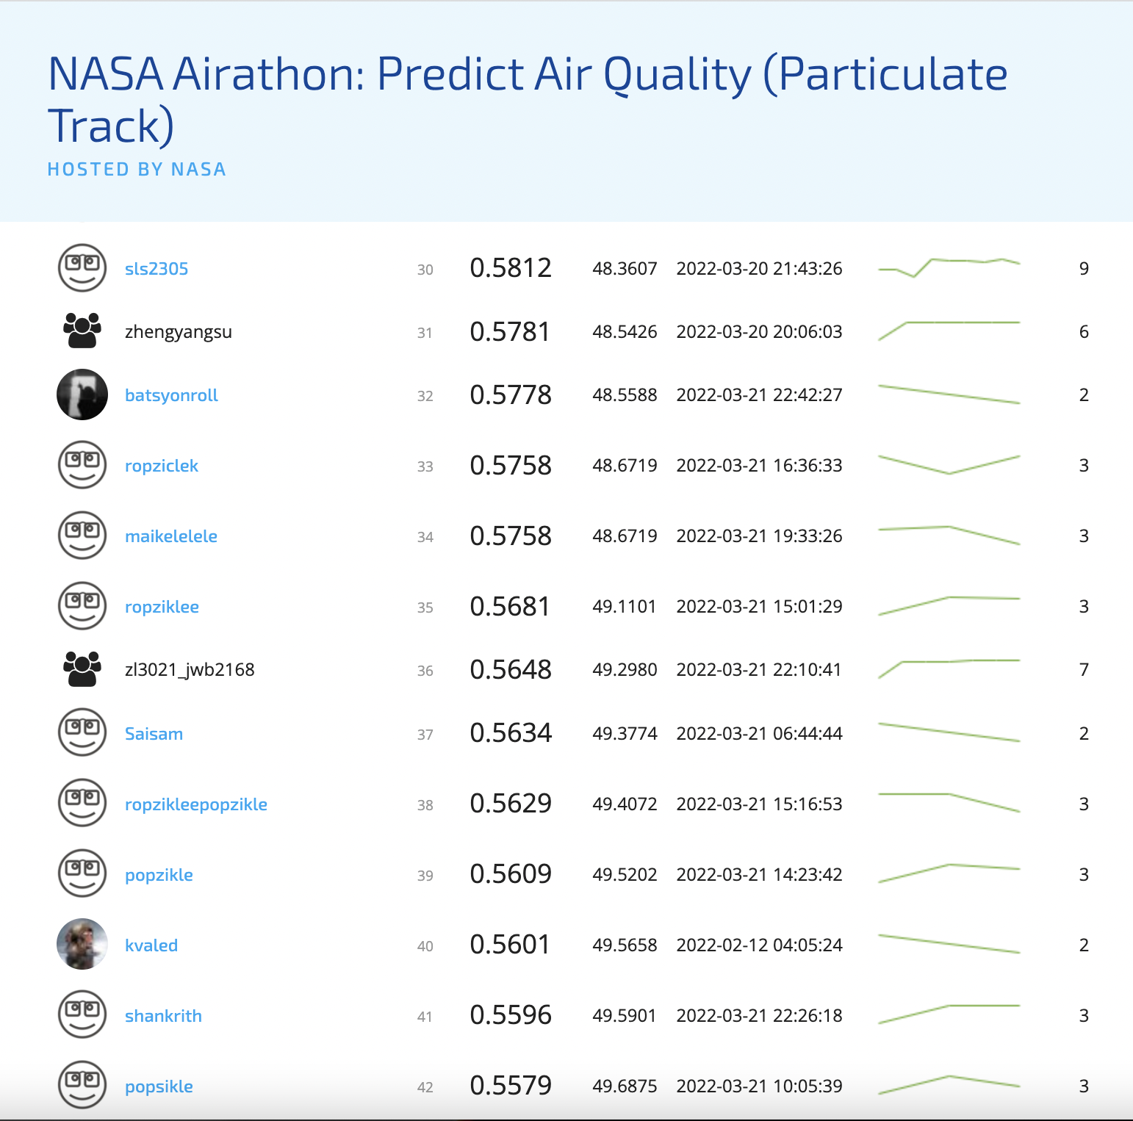
Summary
The goal is to predict PM2.5 concentration data using either one or the combination of the data from 2 satellites:
MODIS/Terra and Aqua MAIAC Land Aerosol Optical Depth (AOD)
MISR Level 2 FIRSTLOOK Aerosol Product
We only used the MODIS satellite data (MAIAC) HDF files.
The MAIAC HDF files have multiple SDS layers, of which we only processed the following for features:
Optical_Depth_047 (also known as the blue band AOD)
Optical Depth_055 (also known as the green band AOD)
AOD_Uncertainty
Column_WV (Column Water Vapor)
Screenshot of leadership board showing R² & Position. The best model gave R² of 0.56.

Slide 3
Methodology & Challenges
The most amount of time is spent processing the massive amount of data.
The complete data download (both *.hdf and *.nc files) for both satellites in train and test has a combined size > 100GB.
The MAIAC HDF files have multiple SDS layers (13 in total) per file (we named them as fields in the code), of which each of them have different number of bands (or orbits).
A lot of guidance we obtained are from the tutorial provided by the competition site: https://www.drivendata.co/blog/predict-pm25-benchmark/
We wrote wrappers around the code, made functions/loops to automatically crunched all 4 SDS layers.
We first process each MAIAC HDF file in the train_labels.csv and submission_format.csv, putting all 4 SDS layers into Geopanda Dataframes (GDF).
2 of the other SDS layers that we wanted to use initially (FineModFraction & Injection Height) had mostly empty frames, and we had to remove them from our analysis.
We used similar methods to those provided in the tutorial, masking out invalid fills, scaling and using data offsets, using sinusoidal latitude & longitude intersections, and then further using a bounding box for each city grid (LA, Taipei, Delhi) to limit the amount of data in each GDF.
Each data is parsed into a dictionary that contains all 4 subsets of smaller GDF for each HDF file, and then packed away as pbz2 files (Pickle, Bzip2 compressed files)
Once we have a smaller search grid in these pbz2 files, it then becomes straightforward to intersect each grid polygon in the training or test data set and extract features from these files.
We used [min, max, mean, std dev] as features from each of the 4 layers as extracted features for training.

Slide 4
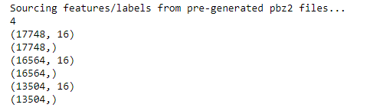

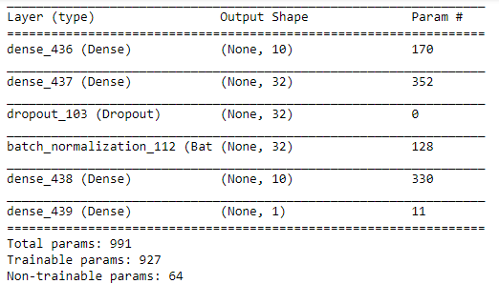
Methodology & Challenges (Con’t)
Even after extracting features from the pbz2 files, the bigger challenge is then processing the number of NaNs (not a number) in the extracted features.
This is mainly because there are occasions when clouds or snow or other objects obscure the measurements on the satellite. (these show up as empty GDFs)
We measured that there are roughly 13% - 25% of the features contain some amount of NaN
The training/cross validation split was done by year. Anything > 2019 is used for cross validation, and everything else is used for training. This gives us a decent equal split.
We tried many ways to impute the missing data. Ultimately, we found that using the average of previous 2 features will give a decent convergence for the neural network and provide a lower training and cross validation loss.
We wanted to use other sources of data in conjunction with the satellite data, in particular the Global Forecast System (GFS) weather model produced by National Centers for Environmental Prediction (NCEP), but ultimately we could not develop the code in time to generate the features and test it.
Link to code on GitHub: https://github.com/zixiangloh/nasa-dl-competition (There should be a copy of this slide in the Github Repo)
Train
Cross Validation
Test
Split between training/cross validation/test
Neural Network Architecture. Had to use dropout to prevent overfitting (we started without dropout). Batch normalization helped stabilized the weights.

