Slide 1
Trinity Transcriptome

Slide 2
cDNA Assembler
cDNA
Combination of single DNA chain and complement RNA chain
Same task for DNA assembly

Slide 3
Debruijn Graph Approach Challenges
Construct k-mer graph with large set of reads
How to resolve non-linear structure
Sequencing errors

Slide 4
Main Steps
Inchworm
Chrysalis
Butterfly
Build local debruijn graph component, Cluster, independently assemble

Slide 5
Inchworm
constructs a k-mer dictionary from all sequence
removes likely error-containing k-mers from the k-mer dictionary
selects the most frequent k-mer in the dictionary to seed a contig assembly
extends the seed in each direction

Slide 6
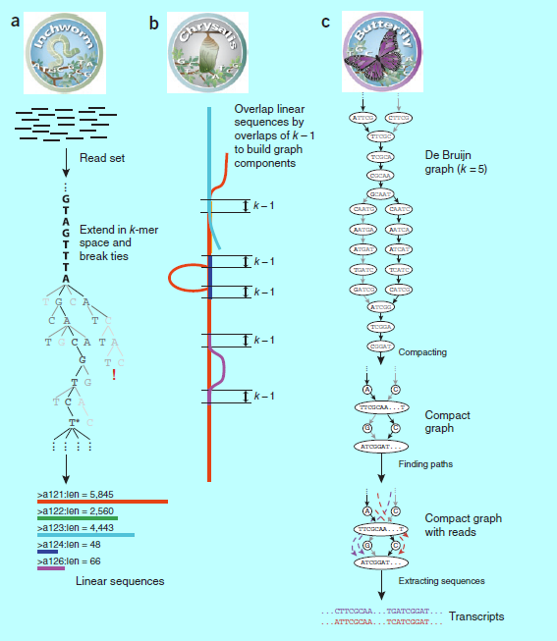

Slide 7
Chrysalis
It recursively groups Inchworm contigs into connected components. Contigs are grouped if there is a perfect overlap of k – 1 bases between them and if there is a minimal number of reads that span the junction
Build a de Bruijn graph
It assigns each read to the component with which it shares the largest number of k-mers, and determines the regions within each read that contribute k-mers to the component

Slide 9
Group contigs to component
- one component have many contigs that share k-1 mer overlap
(k-1)/2
k-1
(k-1)/2
Contig 1
Reads
Contig 2

Slide 10
Butterfly
merging consecutive nodes
pruning edges that represent minor deviations
plausible path scoring

