Slide 1
Velvet_Oases Analysis
Reporter: Sun Zhao

Slide 2
Agenda
Assembly experiment results on S.pombe(fission yeast)
Velvet_Oases implementation

Slide 3
S.pombe Assembly
Input: 7GB fastq data. Output: 4.5MB contigs
Cmdlist:
velveth.exe silly 21,25,2 -fastq *.fastq
velvetg silly_21 -read_trkg yes
velvetg silly_23 -read_trkg yes
velvetg silly_25 -read_trkg yes
oases.exe silly_21 -ins_length 326 -cov_cutoff 3
oases.exe silly_23 -ins_length 326 -cov_cutoff 3
oases.exe silly_25 -ins_length 326 -cov_cutoff 3
velveth.exe mergedAssembly 23 -long silly_21/transcripts.fa
velveth.exe mergedAssembly 23 -long silly_22/transcripts.fa
velveth.exe mergedAssembly 23 -long silly_23/transcripts.fa
velvetg.exe mergedAssembly -read_trkg yes -conserveLong yes
oases.exe mergedAssembly -merge yes

Slide 4
S.pombe Assembly
Input: 7GB fastq data. Output: 4.5MB contigs
Cmdlist:
velveth.exe silly 21,25,2 -fastq *.fastq 40mins 4.5GB
velvetg silly_21 -read_trkg yes
velvetg silly_23 -read_trkg yes 250mins 21.5GB
velvetg silly_25 -read_trkg yes
oases.exe silly_21 -ins_length 326 -cov_cutoff 3
oases.exe silly_23 -ins_length 326 -cov_cutoff 3 45mins 15.7GB 5.7h
oases.exe silly_25 -ins_length 326 -cov_cutoff 3 21.5G
velveth.exe mergedAssembly 23 -long silly_21/transcripts.fa
velveth.exe mergedAssembly 23 -long silly_22/transcripts.fa 1min 0.5GB
velveth.exe mergedAssembly 23 -long silly_23/transcripts.fa
velvetg.exe mergedAssembly -read_trkg yes -conserveLong yes 20s 0.27GB
oases.exe mergedAssembly -merge yes 28s 0.026GB

Slide 5
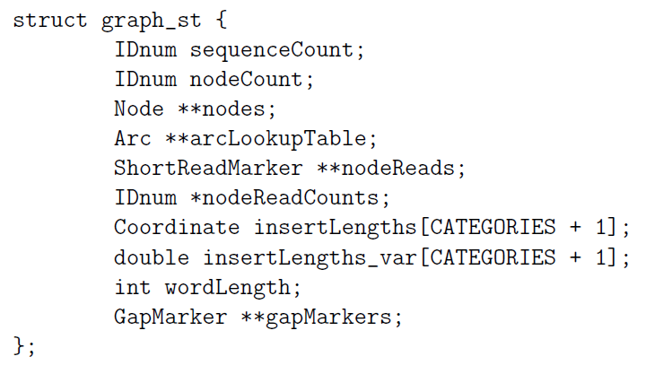
Implementation:Core Data Structure
Graph

Slide 6
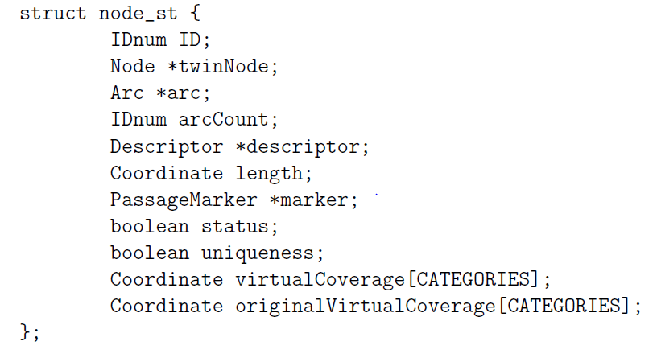
Implementation:Core Data Structure
Node
Notes:
Reads are associated to nodes in two different manners.

Slide 7
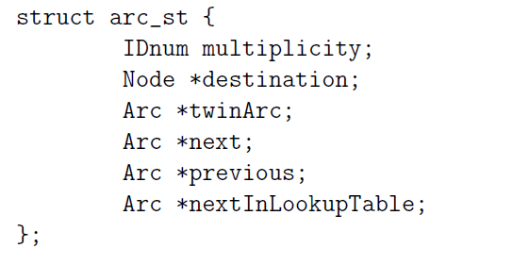
Implementation:Core Data Structure
Arc

Slide 8
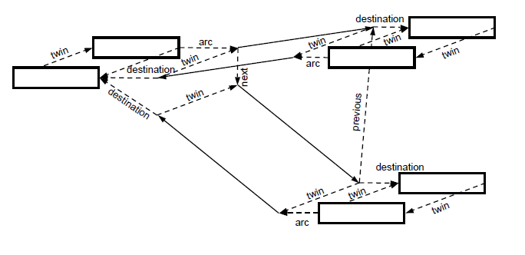
Implementation:Core Data Structure

Slide 9
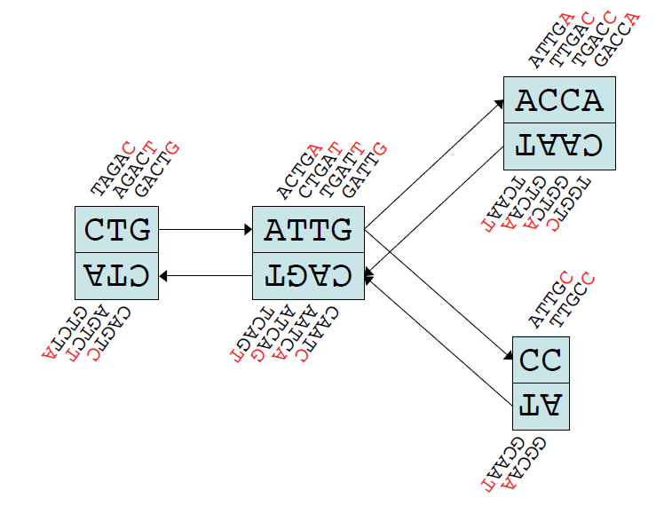
Velvet Implementation

Slide 10
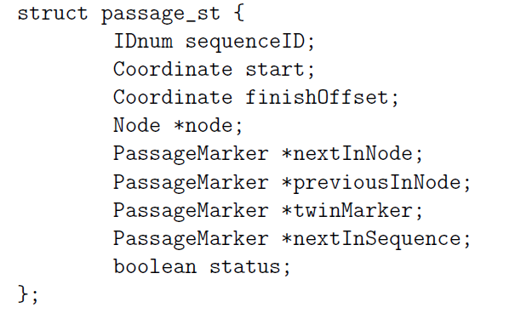
Implementation:Core Data Structure
Long read markers(associate to node)

Slide 11
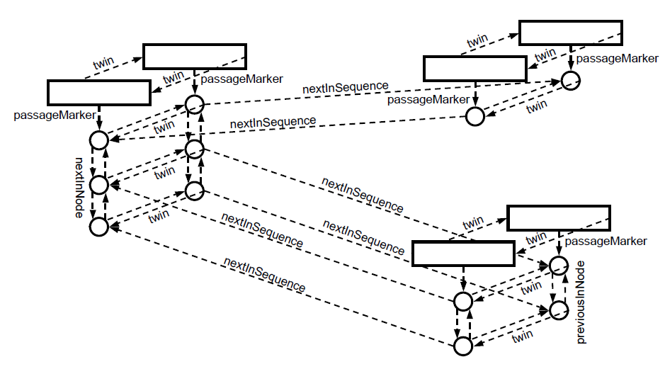
Implementation:Core Data Structure
Long read markers

Slide 12
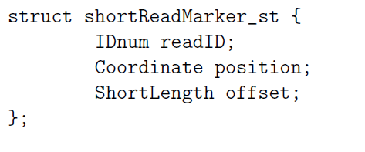
Implementation:Core Data Structure
Short read markers(through graph nodeReads)

Slide 13
Implementation: Graph Construction
Splay table based hash
Create RoadMaps
First scan to record previous overlap
Second scan to record subsequent overlap
Create nodes and arcs based on RoadMaps
Alternative parallel approach from ABYSS

Slide 14
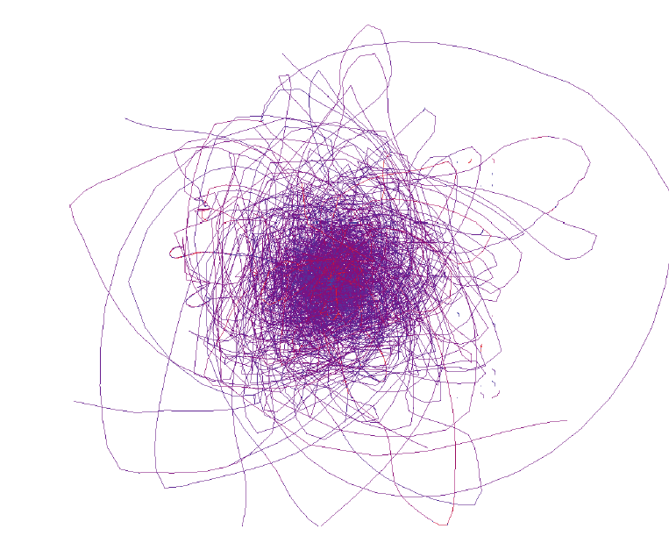
Graphic of De.Graph

Slide 15
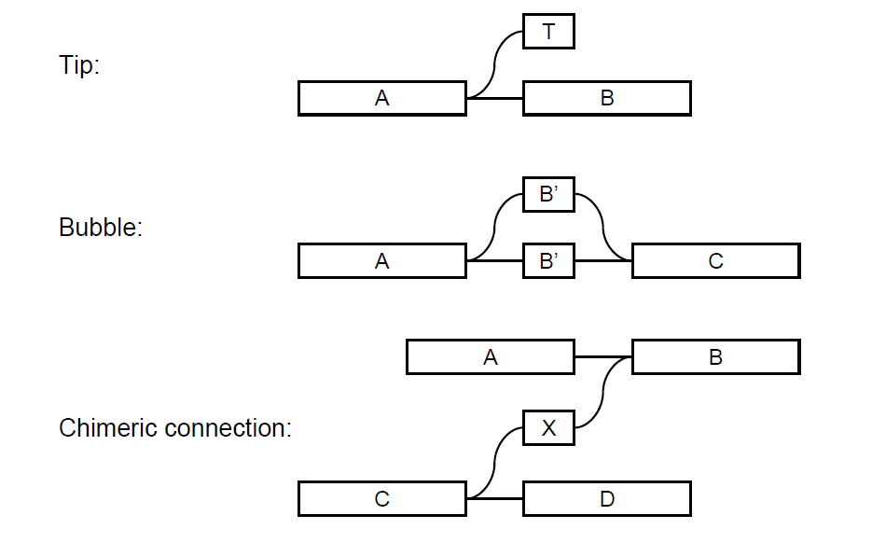
Implementation: Graph Correction

Slide 16
Implementation: Graph Correction
Tips
shorter than 2k bp
at least one arc going back into the graph which has a multiplicity higher than that of the arc going into the tip

Slide 17

Implementation: Graph Correction
Bubbles
Dijkstra-like breadth-first search and backtrace

Slide 18
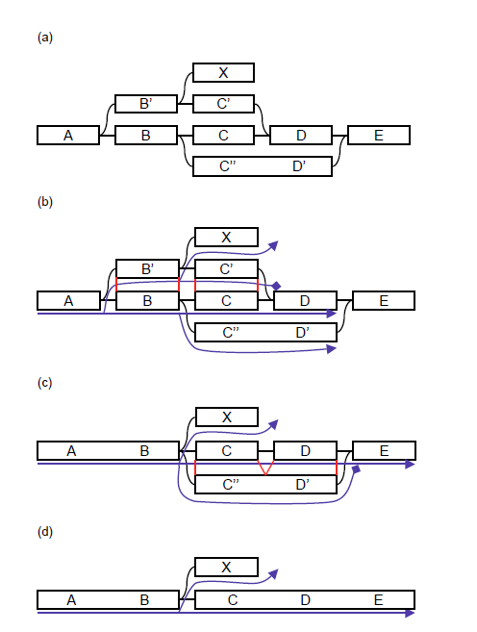
Implementation: Graph Correction
Bubbles
Dijkstra-like breadth-first search and backtrace

Slide 19
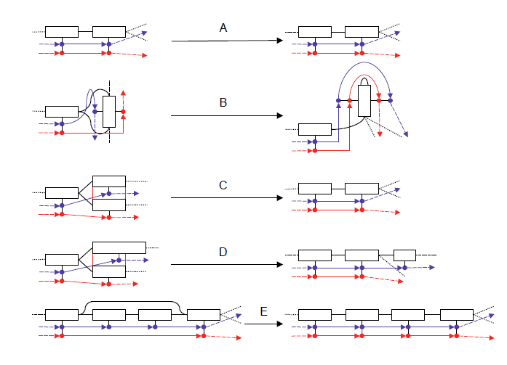
Implementation: Graph Correction
Path merge
Notes:
If two nodes have sequences which were
perfectly matched in the alignment, then they are merged. However, if the
sequences were not aligned along their entire length, then it is necessary
to break up the nodes and merge the corresponding fragments.

