Slide 1
Trinity Analysis
Author：Sun Zhao
Mail: zixiaojindao@gmail.com

Slide 2
Trinity
Full-length transcriptome assembly from RNA-Seq data without a reference genome. Nat Biotechnol. 2011 May 15
Inchworm
Chrysalis
Butterfly
Pipeline-Trinity.pl
Call inchworm (c++)
Call chrysalis (c++)
Call Butterfly.jar (java), using cmd_process_forker.pl for parallel-computing command lines.
Result:
'find ./chrysalis -name "*allProbPaths.fasta" -exec cat {} \; > Trinity.fasta'

Slide 3
Inchworm
Constructs a k-mer dictionary from all sequence reads (in practice, k = 25)
Removes likely error-containing k-mers from the k-mer dictionary
Selects the most frequent k-mer in the dictionary to seed a contig assembly excluding both low-complexity and singleton k-mers
Extends the seed in each direction by finding the highest occurring k-mer with a k – 1 overlap with the current contig
5.Repeat until kmer dictionary is empty

Slide 4
Generate all k-mers from the reads and store them in a library

Slide 5
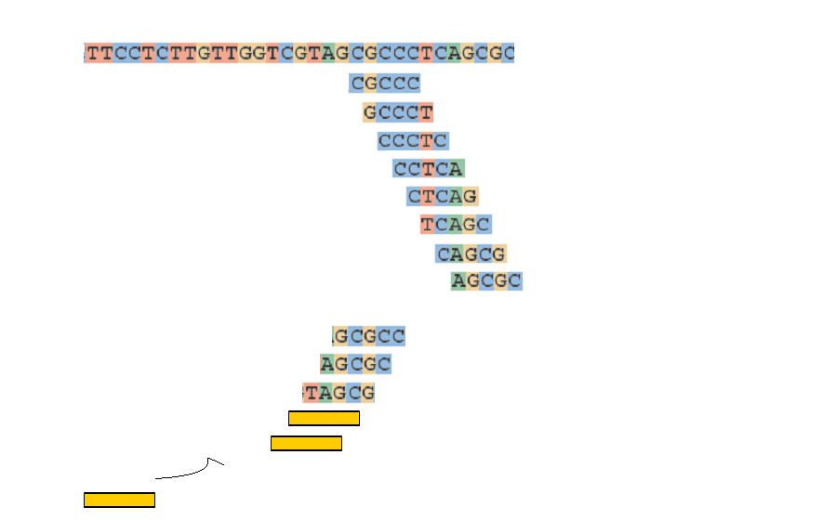
Extend k-mers to contigs
Draft contig 1
Seed k-mer
First 5’->3’ extension
Second 3’>5’extension

Slide 6
Chrysalis
Recursively groups Inchworm contigs into connected components. Contigs are grouped if there is a perfect overlap of k – 1 bases between them and if there is a minimal number of reads that span the junction across both contigs with a (k – 1)/2 base match on each side of the (k – 1)-mer junction.
Builds a de Bruijn graph for each component using a word size of k – 1
Assigns each read to the component with which it shares the largest number of k-mers, and determines the regions within each read that contribute k-mers to the component

Slide 7
Group contigs to component
- one component have many contigs that share k-1 mer overlap
(k-1)/2
k-1
(k-1)/2
Contig 1
Reads
Contig 2

Slide 8
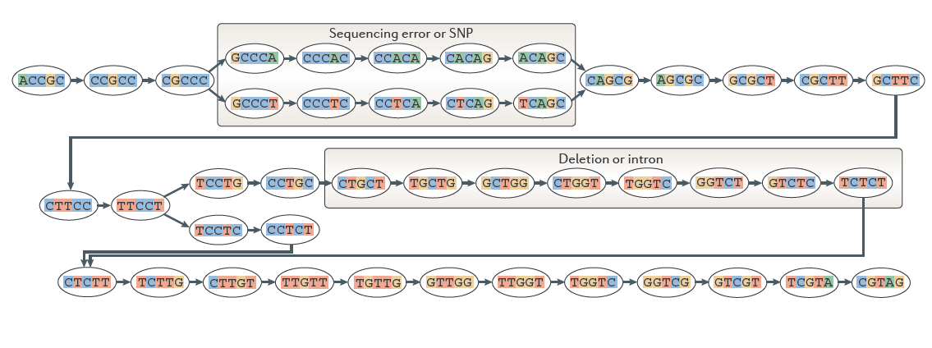
Creat a De Bruijn graph from one component
one node is k-1 mer , here k=6

Slide 9
Butterfly
Merging consecutive nodes in linear paths in the de Bruijn graph to form nodes that represent longer sequences and
pruning edges that represent minor deviations
Search all plausible paths

Slide 10
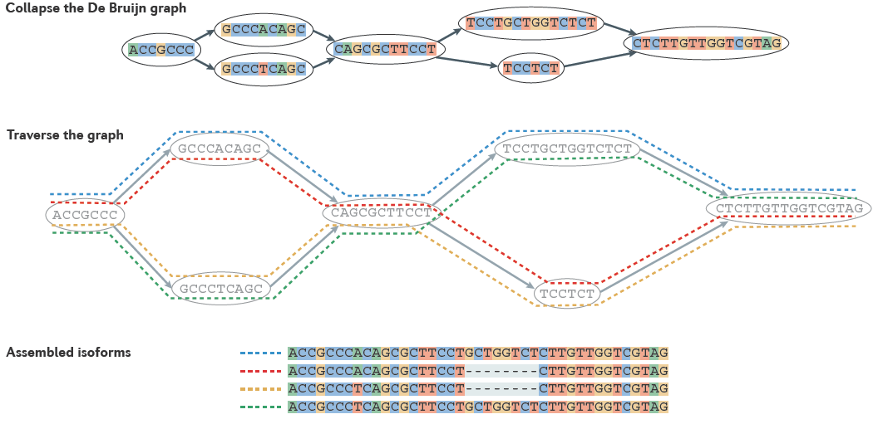
Butterfly

Slide 11
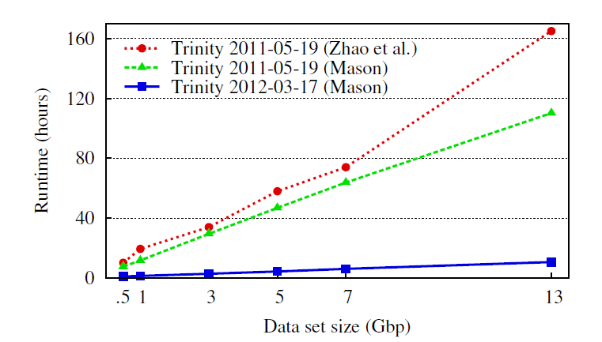
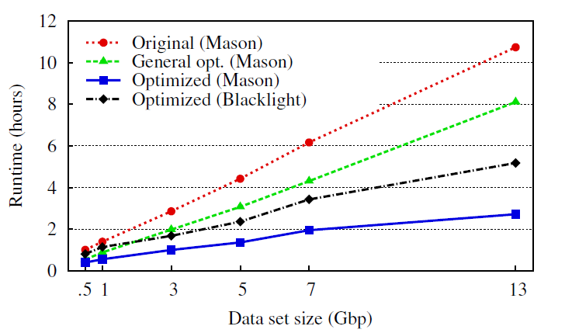
Performance tune
http://dl.acm.org/citation.cfm?id=2335842

