Slide 1
RNA-seq
AATGATACGGCGACCACCGAGATCTACACTCTTTCCCTACACGACGCTCTTCCGATCT
P1
A
B
ACACTCTTTCCCTACACGA
CGCTCTTCCGATCT
Barcode
T
A
p
Barcode
AGATCGGAAGAGCG
GTTCAGCAGGAATGCCGAG
GAATGCCGAGGACGACTTG
GCGAGAAGGCTAGA
Barcode
p
A
T
Barcode
TCTAGCCTTCTCGC
AGCACATCCCTTTCTCACA
P2
TCTAGCCTTCTCGCCAAGTCGTCCTTACGGCTCTGGCTAGAGCATACGGCAGAAGACGAAC
ACACTCTTTCCCTACACGACGCTCTTCCGATCT
S1
AATGATACGGCGACCACCGAGATCTACACTCTTTCCCTACACGACGCTCTTCCGATCT
Barcode
T
A
Barcode
AGATCGGAAGAGCGGTTCAGCAGGAATGCCGAGACCGATCTCGTATGCCGTCTTCTGCTTG
TTACTATGCCGCTGGTGGCTCTAGATGTGAGAAAGGGATGTGCTGCGAGAAGGCTAGA
Barcode
A
T
Barcode
TCTAGCCTTCTCGCCAAGTCGTCCTTACGGCTCTGGCTAGAGCATACGGCAGAAGACGAAC
S2
TCTAGCCTTCTCGCCAAGTCGTCCTTACGGCTCTGGC
AATGATACGGCGACCACCGAGATCTACACTCTTTCCCTACACGACGCTCTTCCGATCT
P1
ACACTCTTTCCCTACACGAC
A
ACACGTCTGAACTCCAGTCAC
B
GCTCTTCCGATCT
A
p
GATCGGAAGAGC
CACTGACCTCAAGTCTGCACA
CGAGAAGGCTAG
p
A
TCTAGCCTTCTCG
CAGCACATCCCTTTCTCACA
P2
TCTAGCCTTCTCGTGTGCAGACTTGAGGTCAGTG
Barcode
TAGAGCATACGGCAGAAGACGAAC
ACACTCTTTCCCTACACGACGCTCTTCCGATCT
S1
GATCGGAAGAGCACACGTCTGAACTCCAGTCAC
Sb
AATGATACGGCGACCACCGAGATCTACACTCTTTCCCTACACGACGCTCTTCCGATCT
A
GATCGGAAGAGCACACGTCTGAACTCCAGTCAC
Barcode
ATCTCGTATGCCGTCTTCTGCTTG
TTACTATGCCGCTGGTGGCTCTAGATGTGAGAAAGGGATGTGCTGCGAGAAGGCTAG
A
S2
TCTAGCCTTCTCGTGTGCAGACTTGAGGTCAGTG
Barcode
TAGAGCATACGGCAGAAGACGAAC
TCTAGCCTTCTCGTGTGCAGACTTGAGGTCAGTG
A. Adaptor a; B. Adaptor b ; P1. PCR primer 1 (forward); P2. PCR primer 2 (reverse)
S1. Sequencing primer 1; S2. Sequencing primer 2; Sb. Sequencing primer for barcode

Slide 2
Adaptor self legation
AATGATACGGCGACCACCGAGATCTACACTCTTTCCCTACACGACGCTCTTCCGATCT
1
A
ACACTCTTTCCCTACACGACGCTCTTCCGATCT
Barcode
p
Barcode
AGATCGGAAGAGCGGTTCAGCAGGAATGCCGAG
B
TGTGAGAAAGGGATGTGCTGCGAGAAGGCTAGA
Barcode
p
Barcode
TCTAGCCTTCTCGCCAAGTCGTCCTTACGGCTC
2
TCTAGCCTTCTCGCCAAGTCGTCCTTACGGCTCTGGCTAGAGCATACGGCAGAAGACGAAC
3
ACACTCTTTCCCTACACGACGCTCTTCCGATCT
AATGATACGGCGACCACCGAGATCTACACTCTTTCCCTACACGACGCTCTTCCGATCT
Barcode
Barcode
AGATCGGAAGAGCGGTTCAGCAGGAATGCCGAGACCGATCTCGTATGCCGTCTTCTGCTTG
TTACTATGCCGCTGGTGGCTCTAGATGTGAGAAAGGGATGTGCTGCGAGAAGGCTAGA
Barcode
Barcode
TCTAGCCTTCTCGCCAAGTCGTCCTTACGGCTCTGGCTAGAGCATACGGCAGAAGACGAAC
TCTAGCCTTCTCGCCAAGTCGTCCTTACGGCTCTGGC
4

Slide 3
Small RNA - seq
AATGATACGGCGACCACCGACAGGTTCAGAGTTCTACAGTCCGACGATC
P2
GUUCAGAGUUCUACAGUCCGACGAUC
A
UCGUAUGCCGUCUUCUGCUUGUidT
B
CAAGTCTCAAGATGTCAGGCTGCTAG
AGCATACGGCAGAAGACGAACAA
RT
P1
AGCATACGGCAGAAGACGAAC
CGACAGGTTCAGAGTTCTACAGTCCGACGATC
S1
AATGATACGGCGACCACCGACAGGTTCAGAGTTCTACAGTCCGACGATC
TCGTATGCCGTCTTCTGCTTC
TTACTATGCCGCTGGTGGCTGTCCAAGTCTCAAGATGTCAGGCTGCTAG
AGCATACGGCAGAAGACGAAC
P1
A
B
RT
P2
CTGTAGGCACCATCAATAGATCGGAAGAGCACACGTCTGAACTCCAGTCAC
Barcode
ATCTCGTATGCCGTCTTCTGCTTG
S1
Barcode
A. Adaptor a; B. Adaptor b ; P1. PCR primer 1 (forward); P2. PCR primer 2 (reverse)
S1. Sequencing primer 1; RT. RT PCR primer

Slide 4
Trimming 5’ barcode should allow 1 mismatch
Trimming 3’ end by fastx and R bioconductor
Comparison of results of tophat between original data and cleaned data

Slide 5
cleanRead (fastqfile, outfile, qualityCutoff=20, nCutoff=2, readLength=40, PCR2=PCR2, barcodeB=barcodeB)
Parameters
paired-end | 200bp
non strand-specific
qualityCutoff | 20 | nucleotides<20 will be replaced into "N"
nCutoff | 2 | reads with middleN >= nCutoff will be removed
readLength | 40 | reads with length < readLength will be removed
3' clipper mismatch ratio | 0.25
PCR2rc mismatch ratio | 0.2
clean#0
CAAGCAGAAGACGGCATACG
GTGACTGGAGTTCAGACGTG
CACGTCTGAACTCCAGTCAC
CGTATGCCGTCTTCTGCTTG
AATGATACGGCGACCACCGA
AATGATACGGCGACCACCGA
removePatterns (fastqfile, outfile=, patterns)

Slide 6
Report file information
File | PCR_primer_name | Length | Total reads | N number(nt) | High quality
G14-1_0_sequence.txt | I-MID1 PCR primer | 90 | 3042280 | 226902 | 3032962
Cleaned | Cleaned(>40) | Final | Length_final | Removed_reads | Removed_nt
3029567 | 3028296 | 3027853 | 88.83 | 0.004742167 | 3542588.01

Slide 7
Trinity
Full-length transcriptome assembly from RNA-Seq data without a reference genome. Nat Biotechnol. 2011 May 15
Inchworm
Chrysalis
Butterfly
Pipeline-Trinity.pl
Call inchworm (c++)
Call chrysalis (c++)
Call Butterfly.jar (java), using cmd_process_forker.pl for parallel-computing command lines.
Result:
'find ./chrysalis -name "*allProbPaths.fasta" -exec cat {} \; > Trinity.fasta'

Slide 8
Inchworm
Create k-mer library (k=25)
– “meryl.kmers.min2.fa”
Remove error-containing k-mers
Seed k-mer selection and extension
Draft contigs output
– “inchworm.K25.L48[.DS].fa”

Slide 9
Chrysalis
Group inchworm contigs in to components.
Construct a de Bruijn graph for each component.
RawComps.0/comp9.raw.graph
RawComps.0/comp9.raw.fasta
RawComps.0/comp9.out
RawComps.0/comp9.reads
3. Create the butterfly_commands.adj

Slide 10
Butterfly
Execute commands in the butterfly_commands.adj
java -Xmx1G -jar /home/gaoshan/trinity/Butterfly/Butterfly.jar -N 130303646 -L 200 -F 300 -C chrysalis/RawComps.0/comp0
java -Xmx1G -jar /home/gaoshan/trinity/Butterfly/Butterfly.jar -N 130303646 -L 200 -F 300 -C chrysalis/RawComps.0/comp1
2. Failed commands are written in failed_cmds.xxxxx.txt

Slide 11
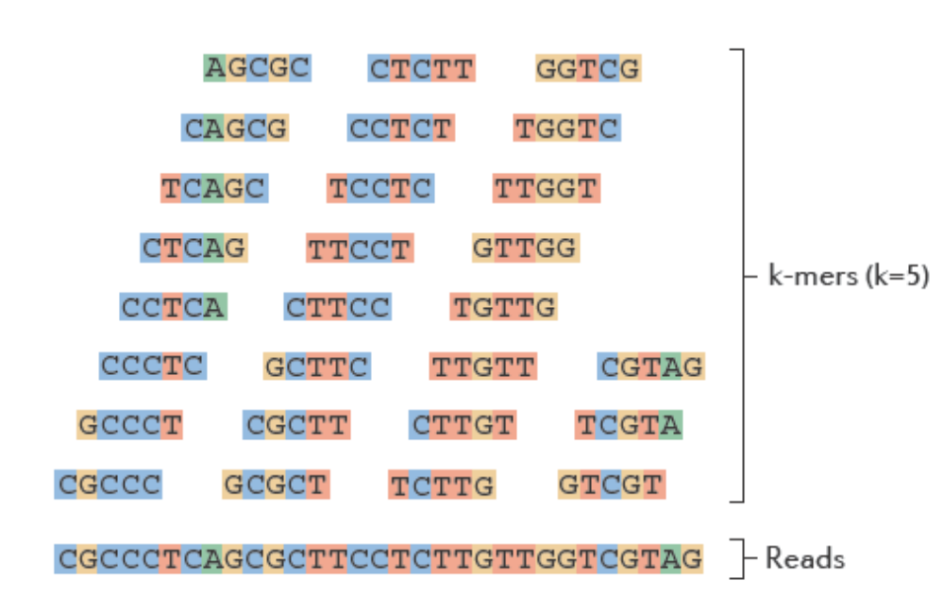
Generate all k-mers from the reads and store them in a library

Slide 12
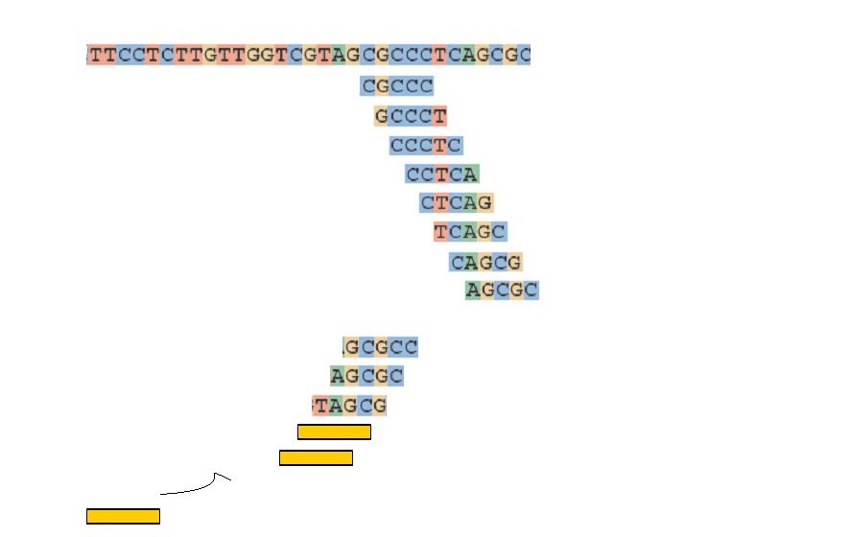
Extend k-mers to contigs
Draft contig 1
Seed k-mer
First 5’->3’ extension
Second 3’>5’extension

Slide 13
Group contigs to component
- one component have many contigs that share k-1 mer overlap
(k-1)/2
k-1
(k-1)/2
Contig 1
Reads
Contig 2

Slide 14
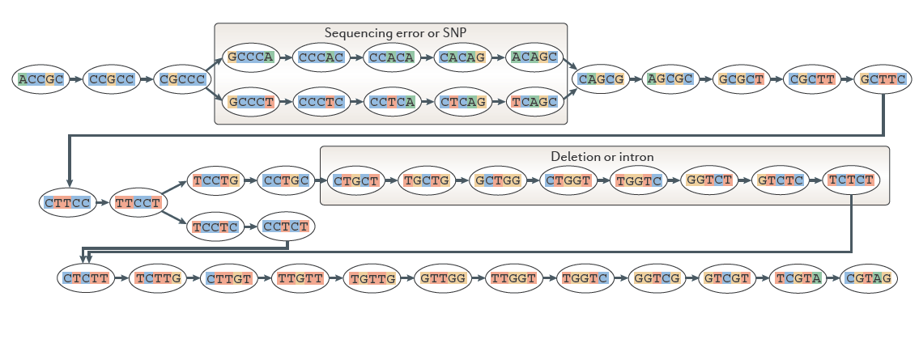
Creat a De Bruijn graph from one component
one node is k-1 mer , here k=6

Slide 15
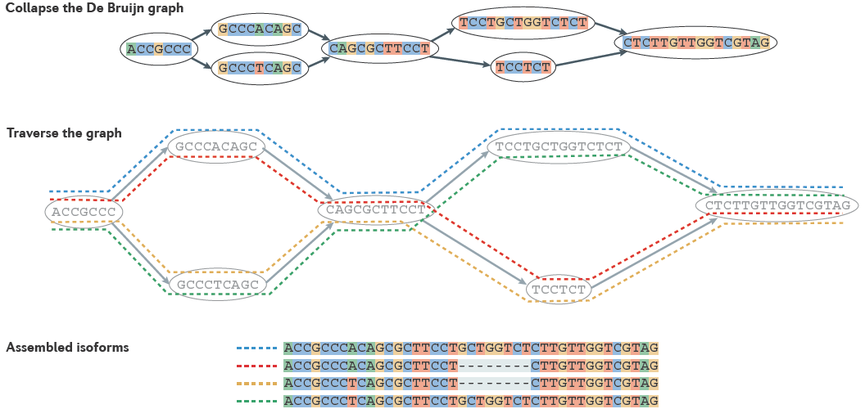
Butterfly

Slide 16
Trinity need much more memory
~1G of RAM per 1M reads
Inchworm loads the entire k-mer composition of reads into physical memory. In double-stranded mode, it loads the forward and reverse-complemented k-mers into memory, so even more RAM is utilized.
Chrysalis need recursive processes, so it should set the stack size to unlimited : ulimit -s unlimited

Slide 17
Non strand specific kmer extension
adaptor A adaptor B
AAAGT
AGTCC
AAAGT
TTTCA
AGTCC
TCAGG
AGTCC
TCAGG
GGACT
CCTGA
GGACT
CCTGA
AAAGTCC
TTTCAGG
AAAGTGGACT
TTTCACCTGA

Slide 18
Paired end definition in trinity
Left (PCR primer 1), right (PCR primer 2)
Forward, Reverse usually correspond to left and right.
But nothing related with sense or antisense strand.
My opinion is 1&2, F&R is just definition. If you define one is forward, the other is reverse. The program will know they are from reverse direction, then the output will follow the direction of F.
In trinity,
“/1”(PCR primer 1), “/2” (PCR primer 2), donot use “#0” & “#1”
The ordering in the file shouldn't matter to trinity.
trinity will use data which lose pairs as single reads automatically.

Slide 19
Future work
Statistics
used reads -> assembly
mapped -> transcriptomes, detailed information
unmapped -> what reason?
unused reads
mapped -> what reason?
Estimate the expression value and later analysis

Slide 20
--paired_fragment_length
If they're outside this distance, they're treated as individual reads on a case-by-case basis. If you fragment length is ~200, then you can use 200 as the setting.

Slide 21
R – make and install
for centOS higher than 5.6 version
wget http://ftp.ctex.org/mirrors/CRAN/src/base/R-2/R-2.13.1.tar.gz
tar zxvf R-2.13.1.tar.gz
cd R-2.13.1
./configure
make
N25 N50 N75 Longest Mean Median Shortest N_Contigs
assembly1 399 284 232 3056 298.5036 254 201 73187

Slide 22
Gene expression analysis
Data n
BWA
Transcriptome
Sample1
R package
Rsamtools
Gene expression
Value (count)
R package
edgeR, DESeq, DEXSeq
Significant
Differential genes
Gene ontology
analysis
Pathways
analysis
Network
analysis
Interaction
analysis
Systems biology

Slide 23
Transcripsome quality control
BWA
bowtie
Trinity.fasta
MCL
iAssembler
Data n
unigenes.fasta
Sample1
Read (flag=4)
Unmapped
Read (flag=0)
Forward mapped
Read (flag=16)
Reverse mapped
Read (flag=20)
Single-end, strand-specific

Slide 24
Results |  | "+" | "-" |  | both
trinity.fasta | 73187 contigs | 65951 contigs | 7236 contiges
./iAssembler.pl -i Trinity.fasta -e 6 -h 30 -p 99 | 54021 unigenes | 48637 unigenes | 2 unigenes |  |  | 5382 unigenes
 | 5382 unigenes | 8416 contigs | 7228 contigs
./iAssembler.pl -i trinity1 -e 6 -h 30 -p 99 -s 54022 |  | trinity1 | ./iAssembler.pl -i trinity2 -e 6 -h 30 -p 99 -s 59816
./iAssembler.pl -i trinity11 -e 6 -h 30 -p 99 -s 65641
./iAssembler.pl -i trinity12 -e 6 -h 30 -p 99 -s 65672
unigenes.fasta | 60290 genes | 0 | 4 | 16 |  |  | 20 | mapped ratio
s_5_1-IS_sequence.sam | 108796242 | 36292929 | 50701527 | 21524320 |  |  | 277466 | 0.54

Slide 25
Algae
We acquired more than 30% total hits than BWA
I think the problem happened in sai file to sam file
bwa samse -n 10000 Algae s_5_1-IS_sequence.sai s_5_1-IS_sequence.clean > s_5_1-IS_sequence.sam
Trinity group suggest me their tool alignReads.pl, etc. it call bowtie/bwa/blat and improves some paried end mapping
http://trinityrnaseq.sourceforge.net/analysis/align_visualize_quantify.html
For bowtie
-k $num_hits
--a --best --strata

Slide 26
Velvet
Construct de Bruijn graph
Remove errors
Tips (length and minority count)
Bubbles (tour bus algorithm)
Erroneous connections

Slide 27
SNP discovery from transciptom
Genotype 1
Genotype 2
Data n
Data n
Sample1
Sample1
Bowtie2> sam
samtools sam > bam
samtools rmdup
Data n
Data n
Sample1
Sample1
samtools merge
samtools sorted
samtools mpileup
Genotype1.pileup
Genotype2.pileup
combine2PileFiles
SNP reports

Slide 28
Remove PCR duplicates
For example:
F10D_I.sam 21148759 reads
remove reads have the same starting position 9338762 reads
remove reads have the same end position 8327644 reads
removing rate 60.6%

