Slide 1
Genome Assembly Status Report
Reporter: Sun Zhao
Date: 12/3/2012

Slide 2
RNA Assembly(10/10-11/12)
Review state of art RNA Assembly algorithms including Velvet, Trinity and Trans-Abyss
Conclusion: The scale of the RNA Assembly is almost bounded by 512GB physical memory; The latest version of Trinity is good at accomplishing this task.

Slide 3
Whole Genome Assembly(11/12-Present)
Select Abyss as our target Program
39 modules and 1 driver script
Configured with boost, google sparse hash, optional OpenMP and MPI
Review Abyss paper and related paper to find the scale of this approach
Familiar with algorithm but left scale unknown
Ask author and evaluation by ourselves
Port Linux Abyss to Window Abyss
Complied ok, and run ok without OpenMP and MPI
Results of Windows and Linux Abyss are exactly identical on a synthetic data(500MB pair-end fastq sequence of fission yeast)

Slide 4
About Abyss
From Author:
A 3TB fastq file size seems quite large to me; possibly by a factor of 3-4. I believe that the 180Gbp (or 60x) of read sequence I mentioned in my previous email would expand out to be a file size of ~500-600GB. However, I've also assembled datasets of 120x (800-1000GB), and it still fit in 5 Computers with 48GB of RAM each.

Slide 5
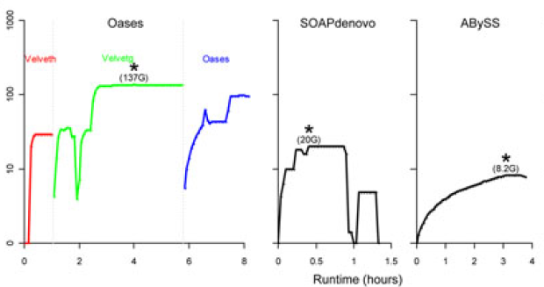
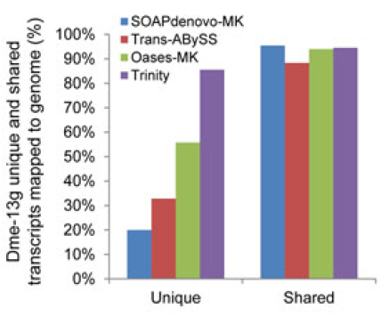
My thoughts
Abyss maintains less data structure than velvet and produces worth results than velvet(RNA data, but their base version can assemble genome data)
Abyss is much easier to be paralleled and understood
Continue to evaluate Abyss on human genome data by ourselves
Compare velvet and Abyss on human genome data
If experiments show that velvet have better result and much more memory usage than Abyss, we should focus on velvet

