Slide 1
Embedding-Based Subsequence Matching in
Large Sequence Databases
Doctoral Dissertation Defense
Panagiotis Papapetrou
Committee:
George Kollios
Stan Sclaroff
Margrit Betke
Vassilis Athitsos (University of Texas at Arlington)
Dimitrios Gunopulos (University of Athens)
Committee Chair: Steve Homer

Slide 2
Subsequence matching
General Problem
  Given:
    Sequence S.
    Query Q.
    Similarity measure D.
  Find the best subsequence of S that matches Q.
Types of Sequences:
  Time Series.
  Biological sequences (e.g. DNA).

Slide 3
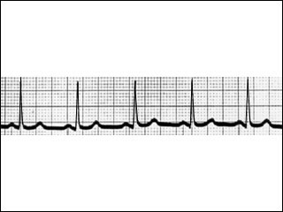
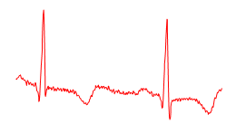
Types of Sequences (1/2)
Time Series
  Ordered set of events X = {x₁, x₂, …, x_{n}}.
  Weather measurements (temperature, humidity, etc).
  Stock prices.
  Gestures, motion, sign language.
  Geological or astronomical observations.
  Medicine: ECG, …
X
Q

Slide 4
Types of Sequences (2/2)
Strings
  Defined over an alphabet Σ.
  Text documents.
  Biological sequences (DNA).
  Near homology search:
    Deviation from Q does not exceed a threshold δ (δ ≤ 15%).
Q:
TCTAGGGCA
…ACTTAGCTGTAGTCGTTCTATGGCATATGCATGCTGATCTCGTGCGTCATG…

Slide 5
Searching Time Series Databases
EBSM
Embedding-Based Subsequence Matching
V. Athitsos, P. Papapetrou, M. Potamias, G. Kollios, and D. Gunopulos, “Approximate embedding-based subsequence matching of time series” SIGMOD2008

Slide 6
Time Series
A sequence of observations.
  (X₁, X₂, X₃, X₄, …, X_{m}).
Each X_{i} is a real number, or a vector.
  E.g., (2.0, 2.4, 4.8, 5.6, 6.3, 5.6, 4.4, 4.5, 5.8, 7.5)
value axis
time axis

Slide 7
Subsequence Matching in a Database
query
What subsequence of any database sequence is the best match for Q?
database
Naïve approach: brute-force search.

Slide 8
Our Contribution
query
What subsequence of any database sequence is the best match for Q?
database
Partial reduction to vector search, via an embedding.
  Quick way to identify a few candidate matches.

Slide 9
How to Compare Time Series
Euclidean distance:
  Matches rigidly along the time axis.
Dynamic Time Warping (DTW):
  Allows stretching and shrinking along the time axis.
In our method, we use DTW.
Notes:
Emphasize that in many applications this warping is desirable.

Slide 10
DTW: Dynamic time warping (1/2)
Each cell c = (i, j) is a pair of indices whose corresponding values will be computed, (x_{i}–y_{j})², and included in the sum for the distance.
Euclidean path:
  i = j always.
  Ignores off-diagonal cells.
Y
y_{j}
x_{i}
X
(x₂–y₂)² + (x₁–y₁)²
(x₁–y₁)²

Slide 11
DTW: Dynamic time warping (2/2)
b
DTW allows more paths.
Examine all valid paths:
Standard dynamic programming to fill in the table.
The top-right cell contains final result.
shrink x / stretch y
(i-1, j)
(i, j)
(i, j)
Y
(i-1, j-1)
(i, j-1)
stretch x / shrink y
X
a
Notes:
Say: gray cells are prefix subsequences – we use only these in recursive definition/estimation

Slide 12
J-Position Subsequence Match
X: long sequence
What subsequence of X is
the best match for Q …
such that the match ends at position j?
Q: short sequence

Slide 13
J-Position Subsequence Match
X: long sequence
position j
What subsequence of X is
the best match for Q …
such that the match ends at position j?
Q: short sequence

Slide 14
J-Position Subsequence Match
X: long sequence
position j
What subsequence of X is
the best match for Q …
such that the match ends at position j?
Q: short sequence

Slide 15
Dynamic Programming (1/2)
query
(i, j)
Q[1:i]
Is matched
*
0
0
0
0
0
0
0
0
0
0
0
0
0
0
0
database sequence X
For each (i, j):
  Compute the j-position subsequence match
  of the first i items of Q.
Sakurai, Y., Faloutsos, C., & Yoshikawa, M. “Stream Monitoring under the Time Warping Distance”, ICDE2007

Slide 16
Dynamic Programming (2/2)
query
(i, j)
*
0
0
0
0
0
0
0
0
0
0
0
0
0
0
0
database sequence X
For each (i, j):
  Compute the j-position subsequence match
  of the first i items of Q.
Top row: j-position subsequence match of Q.
Final answer: best among j-position matches.
  Look at answers stored at the top row of the table.

Slide 17
Time Complexity
query
database sequence X
Assume that the database is one very long sequence.
  Concatenate all sequences into one sequence.
O(length of query * length of database).
Does not scale to large database sizes.

Slide 18
Strategy: Identify Candidate Endpoints
database sequence X

Slide 19
Strategy: Identify Candidate Endpoints
database sequence X
indexing structure

Slide 20
Strategy: Identify Candidate Endpoints
database sequence X
indexing structure
query Q

Slide 21
Strategy: Identify Candidate Endpoints
database sequence X
candidate
endpoints
candidate
endpoints
indexing structure
query Q

Slide 22
Strategy: Identify Candidate Endpoints
database sequence X
candidate
endpoints
candidate
endpoints
indexing structure
query Q
Candidate endpoint: last element of a possible subsequence match.

Slide 23
Strategy: Identify Candidate Endpoints
database sequence X
candidate
endpoints
candidate
endpoints
indexing structure
query Q
Use dynamic programming only to evaluate the candidates.

Slide 24
Vector Embedding
database
sequence
X₁
X₂
X₃
X₄
X₅
X₆
X₇
X₈
X₉
X₁₀
X₁₁
X₁₂
X₁₃
X₁₄
X₁₅

Slide 25
Vector Embedding
database
sequence
X₁
X₂
X₃
X₄
X₅
X₆
X₇
X₈
X₉
X₁₀
X₁₁
X₁₂
X₁₃
X₁₄
X₁₅
vector
set

Slide 26
Vector Embedding
database
sequence
X₁
X₂
X₃
X₄
X₅
X₆
X₇
X₈
X₉
X₁₀
X₁₁
X₁₂
X₁₃
X₁₄
X₁₅
vector
set
query
Q₁
Q₂
Q₃
Q₄
Q₅

Slide 27
Vector Embedding
database
sequence
X₁
X₂
X₃
X₄
X₅
X₆
X₇
X₈
X₉
X₁₀
X₁₁
X₁₂
X₁₃
X₁₄
X₁₅
vector
set
query
Q₁
Q₂
Q₃
Q₄
Q₅
query
vector

Slide 28
Vector Embedding
subsequence match
database
sequence
X₁
X₂
X₃
X₄
X₅
X₆
X₇
X₈
X₉
X₁₀
X₁₁
X₁₂
X₁₃
X₁₄
X₁₅
vector
set
query
Q₁
Q₂
Q₃
Q₄
Q₅
query
vector
Embedding should be such that:
  Query vector is similar to vector of match endpoint.

Slide 29
Vector Embedding
database
sequence
X₁
X₂
X₃
X₄
X₅
X₆
X₇
X₈
X₉
X₁₀
X₁₁
X₁₂
X₁₃
X₁₄
X₁₅
vector
set
query
Q₁
Q₂
Q₃
Q₄
Q₅
query
vector
Using vectors we identify candidate endpoints.
  Much faster than brute-force search.

Slide 30
Using Reference Sequences
reference
row |R|
database sequence X
For each cell (|R|, j), DTW computes:
  cost of best subsequence match of R ending in the j-th position of X.
Define F^{R}(X, j) to be that cost.
F^{R} is a 1D embedding.
  Each (X, j) → single real number.

Slide 31
Using Reference Sequences
reference
reference
database sequence X
query Q
Cell (|R|, |Q|), DTW computes:
  cost of best subsequence match of R with a suffix of Q.
Define F^{R}(Q) to be that cost.

Slide 32
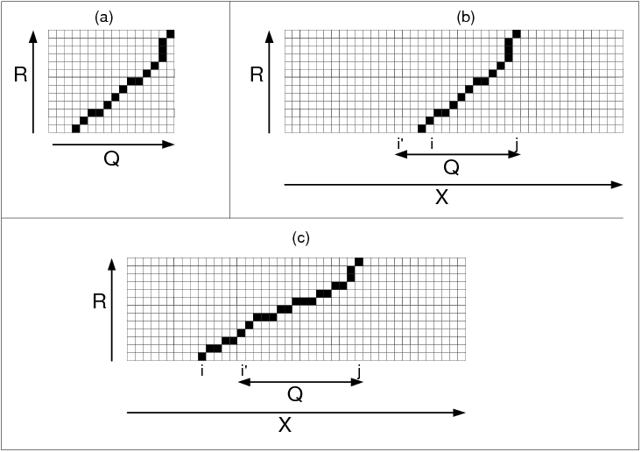
Intuition About This Embedding
Suppose Q appears exactly as (X_{i’}, …, X_{j}).
If j-position match of R in X starts after i’, then:
  Warping paths are the same.
  F^{R}(Q) = F^{R}(X, j).

Slide 33
Intuition About This Embedding
Suppose Q appears inexactly as (X_{i’}, …, X_{j}).
If j-position match of R in X starts after i’:
  We expect F^{R}(Q) to be similar to F^{R}(X, j).
  Why? Little tweaks should affect F^{R}(X, j) little.

Slide 34
Intuition About This Embedding
Suppose Q appears inexactly as (X_{i’}, …, X_{j}).
If j-position match of R in X starts after i’:
  We expect F^{R}(Q) to be similar to F^{R}(X, j).
  Why? Little tweaks should affect F^{R}(X, j) little.
  No proof, but intuitive, and lots of empirical evidence.

Slide 35
Intuition About This Embedding
If (X_{i’}, …, X_{j}) is the subsequence match of Q:
If j-position match of R in X starts after i’:
  F^{R}(Q) should (for most Q) be more similar to F^{R}(X, j) than to most F^{R}(X, t).

Slide 36
Multi-Dimensional Embedding
R₁
R₁
database sequence X
query Q
One reference sequence → 1D embedding.

Slide 37
Multi-Dimensional Embedding
R₁
R₁
database sequence X
query Q
R₂
R₂
database sequence X
query Q
One reference sequence → 1D embedding.
2 reference sequences → 2-dimensional embedding.

Slide 38
Multi-Dimensional Embedding
R₁
R₁
database sequence X
query Q
R₂
R₂
database sequence X
query Q
d reference sequences → d-dim. embedding F.
If (X_{i’}, …, X_{j}) is the subsequence match of Q:
  F(Q) should (for most Q) be more similar to F (X, j) than to most F^{R}(X, t).
Notes:
If we expected this for 1D embeddings, our expectation is even stronger for the multi-dimensional embeddings.

Slide 39
Filter-and-Refine Retrieval
Offline step:
Compute F(X, j) for all j.
Online steps, given a query Q:
Embedding step:
  Compute F(Q).
Filter step:
  Compare F(Q) to all F(X, j).
  Select p best matches → p candidate endpoints.
Refine step:
  Use DTW to evaluate each candidate endpoint.

Slide 40
Filter-and-Refine Performance
database sequence X
candidate
endpoints
Accuracy: correct match must be among p candidates, for most queries.
Larger p → higher accuracy, lower efficiency.

Slide 41
Experiments - Datasets
3 datasets from the UCR Time Series Data Mining Repository:
  50Words, Wafer, Yoga.
All database sequences concatenated →
one big sequence, of length 2,337,778.
Query lengths 152, 270, 426.

Slide 42
Experiments - Methods
Brute force:
  Full DTW between each query and entire database sequence.
  Similar to SPRING of Sakurai et al.
PDTW (Keogh et al. 2004, modified by us):
  Makes time series smaller by factor of k.
  Each chunk of k values replaced by their average.
  Matching on smaller series used as filter step.
EBSM (our method).
  40-dimensional embedding.

Slide 43
Experiments – Performance Measures
Accuracy:
  Percentage of queries giving correct results.
Efficiency:
  DTW cell cost: cost of dynamic programming, as percentage of brute-force search cost.
  Runtime cost: CPU time per query, as percentage of brute-force CPU time.
By definition, brute-force has:
  accuracy 100%,
  cell cost 100%,
  runtime cost 100%.

Slide 44
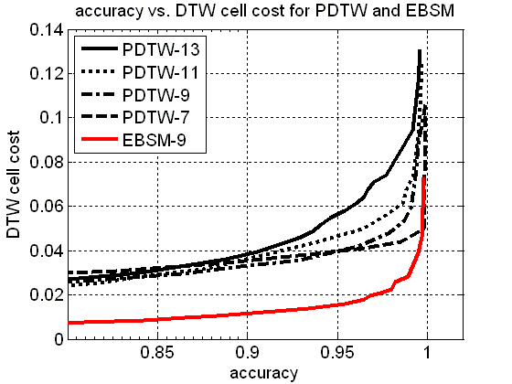
Results – DTW Cell Cost
highlights
Acc | PDTW | EBSM
99 | 4.5 | 2.8
95 | 3.9 | 1.6
90 | 3.6 | 1.2

Slide 45
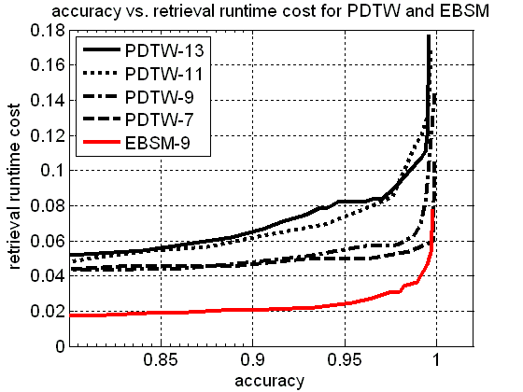
Results – Running Time
highlights
Acc | PDTW | EBSM
99 | 5.6 | 3.8
95 | 5.0 | 2.4
90 | 4.6 | 2.1

Slide 46
Conclusions on EBSM
EBSM: Indexing method for subsequence matching of time series.
  Embeddings → fast filter step using vector search.
State-of-the-art results in our experiments.
No guarantees as DTW is non-metric.
Embedding-based techniques for subsequence matching are promising.

Slide 47
Reference-Based Alignment of Strings
RBSA
Reference-Based Sequence Alignment
P. Papapetrou, V. Athitsos, G. Kollios, and D. Gunopulos, “Reference-Based Alignment of Large Sequence Databases”
VLDB2009 (To Appear)

Slide 48
String Matching
Given:
  S: collection of sequences defined over an alphabet Σ.
  Q: query sequence defined over Σ.
  D: similarity measure.
Find the most similar subsequence in S.

Slide 49
Our focus: DNA
S: a set of DNA sequences.
Q: DNA sequence
  with a small deviation from the database match.
    within δ |Q|, for δ ≤ 15%.
  can be large (up to 10,000 nucleotides).

Slide 50
The Edit Distance [Levenshtein et al.1966]
Measures how dissimilar two strings are.
ED (A,B) = minimum number of operations needed to transform A into B.
Operations = [insertion, deletion, substitution].
Example:
    A = ATC and B = ACTG
A = A – T C
ED (A,B) = 2
B = A C T G

Slide 51
The Edit Distance
Initialization:
 |  | A | C | T | G
 | 0 | 1 | 2 | 3 | 4
A | 1
T | 2
C | 3

Slide 52
The Edit Distance
- Match = 0
- In/del/sub = 1
First column:
 |  | A | C | T | G
 | 0 | 1 | 2 | 3 | 4
A | 1 | 0
T | 2 | 1
C | 3 | 2

Slide 53
The Edit Distance
Second column:
 |  | A | C | T | G
 | 0 | 1 | 2 | 3 | 4
A | 1 | 0 | 1
T | 2 | 1 | 1
C | 3 | 2 | 2

Slide 54
The Edit Distance
Final Matrix:
 |  | A | C | T | G
 | 0 | 1 | 2 | 3 | 4
A | 1 | 0 | 1 | 2 | 3
T | 2 | 1 | 1 | 1 | 2
C | 3 | 2 | 2 | 2 | 2

Slide 55
The Edit Distance
A = A – T C
Alignment Path:
B = A C T G
 |  | A | C | T | G
 | 0 | 1 | 2 | 3 | 4
A | 1 | 0 | 1 | 2 | 3
T | 2 | 1 | 1 | 1 | 2
C | 3 | 2 | 2 | 2 | 2

Slide 56
The Edit Distance: Subsequence matching
Initialization:
 |  | A | C | T | G
 | 0 | 0 | 0 | 0 | 0
A | 1
T | 2
C | 3

Slide 57
The Edit Distance: Subsequence matching
Final Matrix:
 |  | A | C | T | G
 | 0 | 0 | 0 | 0 | 0
A | 1 | 0 | 1 | 1 | 1
T | 2 | 1 | 1 | 1 | 2
C | 3 | 2 | 2 | 2 | 2

Slide 58
The Edit Distance: Subsequence matching
One path:
A = A T C
 |  | A | C | T | G
 | 0 | 0 | 0 | 0 | 0
A | 1 | 0 | 1 | 1 | 1
T | 2 | 1 | 1 | 1 | 2
C | 3 | 2 | 2 | 2 | 2
B = A C T G

Slide 59
Smith-Waterman
[Smith&Waterman et al. 1981]
Is a similarity measure used for local alignment:
  Match can be a subsequence of the query sequence.
Define three penalties:
  match, mismatch, gap.
  Scoring parameters are defined by the user.
Example:
    A = ATC and B = TATTCG
    match = 2, mismatch = -1, gap = -1.

Slide 60
Smith-Waterman
Initialization:
 |  | T | A | T | T | C | G
 | 0 | 0 | 0 | 0 | 0 | 0 | 0
A | 0
T | 0
C | 0
A | 0

Slide 61
Smith-Waterman
First column:
 |  | T | A | T | T | C | G
 | 0 | 0 | 0 | 0 | 0 | 0 | 0
A | 0 | -1
T | 0 | 2
C | 0 | 1
A | 0 | 0

Slide 62
Smith-Waterman
First column:
 |  | T | A | T | T | C | G
 | 0 | 0 | 0 | 0 | 0 | 0 | 0
A | 0 | 0
T | 0 | 2
C | 0 | 1
A | 0 | 0

Slide 63
Smith-Waterman
Second column:
 |  | T | A | T | T | C | G
 | 0 | 0 | 0 | 0 | 0 | 0 | 0
A | 0 | 0 | 2
T | 0 | 2 | 1
C | 0 | 1 | 1
A | 0 | 0 | 3

Slide 64
Smith-Waterman
Final Matrix:
 |  | T | A | T | T | C | G
 | 0 | 0 | 0 | 0 | 0 | 0 | 0
A | 0 | 0 | 2 | 1 | 0 | 0 | 0
T | 0 | 2 | 1 | 2 | 3 | 2 | 1
C | 0 | 1 | 1 | 1 | 2 | 5 | 4
A | 0 | 0 | 3 | 2 | 1 | 4 | 4

Slide 65
Smith-Waterman
Detect highest value:
 |  | T | A | T | T | C | G
 | 0 | 0 | 0 | 0 | 0 | 0 | 0
A | 0 | 0 | 2 | 1 | 0 | 0 | 0
T | 0 | 2 | 1 | 2 | 3 | 2 | 1
C | 0 | 1 | 1 | 1 | 2 | 5 | 4
A | 0 | 0 | 3 | 2 | 1 | 4 | 4

Slide 66
Smith-Waterman
A = A – T C A
Alignment Path:
B = T A T T C G
 |  | T | A | T | T | C | G
 | 0 | 0 | 0 | 0 | 0 | 0 | 0
A | 0 | 0 | 2 | 1 | 0 | 0 | 0
T | 0 | 2 | 1 | 2 | 3 | 2 | 1
C | 0 | 1 | 1 | 1 | 2 | 5 | 4
A | 0 | 0 | 3 | 2 | 1 | 4 | 4

Slide 67
RBSA
Decompose subsequence matching into two distinct problems:
  Fixed query length:
    Assumes all queries have the same length.
  Variable query length:
    Uses the solution to the fixed query length problem.
    Achieves efficient retrieval for queries of arbitrary length.

Slide 68

RBSA: Fixed query length
Q: query.
(X, t): database position t.
Q and (X, t) are mapped into a number:
D: the Edit Distance.
R: a reference sequence.

Slide 69
RBSA: Lower-bounding the Edit Distance
Edit Distance:
  Metric Property!
M (Q, X, t): match of Q in X at position t.
X
M (Q, X, t)
R
Q
F^{R} (X, t)
F^{R} (Q)
ED (Q, X, t) ≥ F^{R} (X, t) – F^{R} (Q)

Slide 70
Strategy: Identify Candidate Endpoints
database sequence X
candidate
endpoints
candidate
endpoints
indexing structure
query Q
Use dynamic programming only to evaluate the candidates.

Slide 71
Database Embedding
database
sequence
X₁
X₂
X₃
X₄
X₅
X₆
X₇
X₈
X₉
X₁₀
X₁₁
X₁₂
X₁₃
X₁₄
X₁₅

Slide 72
Database Embedding
database
sequence
X₁
X₂
X₃
X₄
X₅
X₆
X₇
X₈
X₉
X₁₀
X₁₁
X₁₂
X₁₃
X₁₄
X₁₅
reference
set R
per DB point

Slide 73
Database Embedding
database
sequence
X₁
X₂
X₃
X₄
X₅
X₆
X₇
X₈
X₉
X₁₀
X₁₁
X₁₂
X₁₃
X₁₄
X₁₅
reference
set R
per DB point
query
Q

Slide 74
Database Embedding
database
sequence
X₁
X₂
X₃
X₄
X₅
X₆
X₇
X₈
X₉
X₁₀
X₁₁
X₁₂
X₁₃
X₁₄
X₁₅
reference
set R
per DB point
query
embedding
query
Q
F^{R} (Q)

Slide 75
Database Embedding
database
sequence
X₁
X₂
X₃
X₄
X₅
X₆
X₇
X₈
X₉
X₁₀
X₁₁
X₁₂
X₁₃
X₁₄
X₁₅
reference
set R
per DB point
query
embedding
For each position (X, t):
each R_{i} is considered.
until an R_{j} prunes (X, t).
query
Q
F^{R} (Q)
Prune using the lower bound

Slide 76
RBSA: Filter step
Example of filtering:
  Assume that |Q| = 100 and δ = 10%.
  We are looking for matches within ED = 10.
X_{t}
Q
R₁
12
13
14
15
R₁
2
3
3
4
R₂
R₂
R₃
R₃
R₄
R₄

Slide 77
RBSA: Filter step
Example of filtering:
  Assume that |Q| = 100 and δ = 10%.
  We are looking for matches within ED = 10.
ED (Q, X, t) ≥ F^{Ri} (X, t) – F^{Ri} (Q)
X_{t}
Q
R₁
12
13
14
15
R₁
2
3
3
4
R₂
R₂
R₃
R₃
R₄
R₄

Slide 78
RBSA: Filter step
Example of filtering:
  Assume that |Q| = 100 and δ = 10%.
  We are looking for matches within ED = 10.
ED (Q, X, t) ≥ F^{Ri} (X, t) – F^{Ri} (Q)
X_{t}
Q
R₁
12
13
14
15
R₁
2
3
3
4
ED (Q, X, t) ≥ 12-2 = 10
R₂
R₂
R₃
R₃
R₄
R₄

Slide 79
RBSA: Filter step
Example of filtering:
  Assume that |Q| = 100 and δ = 10%.
  We are looking for matches within ED = 10.
ED (Q, X, t) ≥ F^{Ri} (X, t) – F^{Ri} (Q)
X_{t}
Q
R₁
12
13
14
15
R₁
2
3
3
4
R₂
R₂
R₃
R₃
R₄
R₄

Slide 80
RBSA: Filter step
Example of filtering:
  Assume that |Q| = 100 and δ = 10%.
  We are looking for matches within ED = 10.
ED (Q, X, t) ≥ F^{Ri} (X, t) – F^{Ri} (Q)
X_{t}
Q
R₁
12
13
14
15
R₁
2
3
3
4
R₂
R₂
ED (Q, X, t) ≥ 13-3 = 10
R₃
R₃
R₄
R₄

Slide 81
RBSA: Filter step
Example of filtering:
  Assume that |Q| = 100 and δ = 10%.
  We are looking for matches within ED = 10.
ED (Q, X, t) ≥ F^{Ri} (X, t) – F^{Ri} (Q)
X_{t}
Q
R₁
12
13
14
15
R₁
2
3
3
4
R₂
R₂
R₃
R₃
R₄
R₄

Slide 82
RBSA: Filter step
Example of filtering:
  Assume that |Q| = 100 and δ = 10%.
  We are looking for matches within ED = 10.
ED (Q, X, t) ≥ F^{Ri} (X, t) – F^{Ri} (Q)
X_{t}
Q
R₁
12
13
14
15
R₁
2
3
3
4
R₂
R₂
R₃
R₃
ED (Q, X, t) ≥ 14-3 = 11
R₄
R₄

Slide 83
RBSA: Filter step
Example of filtering:
  Assume that |Q| = 100 and δ = 10%.
  We are looking for matches within ED = 10.
ED (Q, X, t) ≥ F^{Ri} (X, t) – F^{Ri} (Q)
X_{t}
Q
R₁
12
13
14
15
R₁
2
3
3
4
R₂
R₂
R₃
R₃
ED (Q, X, t) ≥ 14-3 = 11 ≥ 10
R₄
R₄

Slide 84
RBSA: Filter step
Example of filtering:
  Assume that |Q| = 100 and δ = 10%.
  We are looking for matches within ED = 10.
ED (Q, X, t) ≥ F^{Ri} (X, t) – F^{Ri} (Q)
X_{t}
Q
R₁
12
13
14
15
R₁
2
3
3
4
R₂
R₂
R₃
R₃
PRUNE!
R₄
R₄

Slide 85
RBSA: Refine step
Refine only those database positions that were not pruned by filtering.
For refinement we can use either the Edit Distance or the Smith-Waterman dynamic programming algorithms.

Slide 86
Offline selection of reference sequences
Goal: represent each database position (X, t) using a set of reference sequences R^{t}.
Given:
  Q_{sample} : a set of random queries, of size q.
  R: a set of random reference sequences of size q.
For each (X, t):
  Choose R^{t}: that prunes (X, t) for the largest number of queries in Q_{sample}.
  Greedy selection.

Slide 87
RBSA: Alphabet Reduction
Improve filtering power of RBSA by applying alphabet reduction:
  Σ = {A, C, G, T}.
  Use four letter collapsing schemes:
    Scheme 0: no collapsing.
    Scheme 1: A, C -> X and G, T -> Y.
    Scheme 2: A, G -> X and C, T -> Y.
    Scheme 3: A, T -> X and C, G -> Y.
The number of possible reference sequences decreases with the alphabet size: 4^{q} = (2^{q})² vs. 2^{q}

Slide 88
RBSA: Alphabet Reduction
Example:
  S = ACTGATGGC
  Scheme 0: A C T G A T G G C
  Scheme 1: X X Y Y X Y Y Y X
  Scheme 2: X Y Y X X Y X X Y
  Scheme 3: X Y X Y X X Y Y Y
Use a combination of the four schemes to improve filtering.

Slide 89
RBSA: Alphabet Reduction
T_{i}: transformation to scheme i.
Reference selection updated:
  For each R compute: T₀(R), T₁(R), T₂(R), T₃(R).
  Apply the same transformations to X.
T_{i}(R) can be used to obtain bounds for (X, t) by comparing
F^{Ti(R)} (T_{i}(Q)) with F ^{Ti(R)} (T_{i}(X),t).
Bounds are still true for the untransformed sequences, since
ED (A,B) ≥ ED (T_{i}(A), T_{i}(B)).
For each (X, t) choose reference sequences from all four schemes.

Slide 90
RBSA: Alphabet Reduction
At query time:
  Q is converted to T₀(Q), T₁(Q), T₂(Q) and T₃(Q).
  Filtering is modified to include transformations.
  For each (X, t), bounds are computed for each T_{i}.
We have found empirically that combining bounds from all four schemes improves the filtering power of RBSA:
  Reference sequences obtained from alphabet reduction have a larger variance in their distances to database subsequences.

Slide 91
RBSA: Variable Query Length
So far we assumed that |Q_{i}| = q, for every Q_{i}.
Q can have arbitrary size:
  For simplicity assume that Q = αq.
At query time:
  Break Q into non-overlapping segments of size q.
Two versions of RBSA:
  Exact and approximate.

Slide 92
RBSA: Exact version
Observe that:
  If Q has a subsequence match with
  ED (Q, X, M) ≤ δ|Q|.
  At least one of the query segments has a subsequence match with
  ED (Q^{i}, X, M^{i}) ≤ δq.
Q¹
Q²
Q³
Q
q
q
q
…ACTTAGCTGTAGTCGTTCTATGGCATATGCATGCTGATCTCGTGCGTCATG…
X^{s:t}

Slide 93
RBSA: Exact version
Observe that:
  If Q has a subsequence match with
  ED (Q, X, M) ≤ δ|Q|.
  At least one of the query segments has a subsequence match with
  ED (Q^{i}, X, M^{i}) ≤ δq.
Proof:
  Assume that
    ED (Q^{i}, X, M^{i}) > δq for every Q^{i}.
  Then
    ED (Q, X, M) > αδq = δ|Q|.

Slide 94
RBSA: Exact version
Let X^{s:t} be a subsequence match for Q, within δ |Q|.
At least one Q^{i} has within X^{s:t} a subsequence match X^{s’:t’} with
ED (Q^{i}, X^{s’:t’}) ≤ δ q, such that:
t’ in { t – q (α – i) – δ |Q|, …, t – q (α – i) + δ |Q| }
Q¹
Q²
Q³
α = 3
Q
q
q
q
t’ in [ t – q – δ |Q| , t – q + δ |Q| ]
…ACTTAGCTGTAGTCGTTCTATGGCATATGCATGCTGATCTCGTGCGTCATG…
s
X^{s:t}
t

Slide 95
RBSA: Exact version
Filter and refine:
Break Q into α non-overlapping segments: Q¹, Q², …, Q^{α}.
Q¹
Q²
Q³
Q
q
q
q
If for some Q^{i} :
ED (Q^{i}, X^{s’:t’}) ≤ δ q
consider the following candidates:
{ t’ + q (α – i) – δ |Q|, …, t’ + q (α – i) + δ |Q| }
Take the union of all candidates from all Q^{i}s.
Perform the refinement step.

Slide 96
RBSA: Approximate version
Question:
  Use only one segment Q^{i} of Q.
  What is the probability P (Q^{i}) that the subsequence match of Q is included in the candidates of Q^{i}?
Proposition:
  Under fairly reasonable assumptions.
  P (Q^{i}) ≥ 50%.
  Using [Hamza et. al. 1995].

Slide 97
RBSA: Approximate version
By the previous proposition:
  If a single Q^{i} is chosen and all candidate endpoints are generated.
  There is at least 50% probability of finding the correct endpoint of the optimal subsequence match.

Slide 98
RBSA: Approximate version
By the previous proposition:
  Assume that the optimal match was not found under Q^{i}.
  P’ (Q^{j}): probability of not finding the optimal match under Q^{j}, with P (Q^{j}) ≤ ½, for j=1,…,α.
  If we use p segments: Q¹, Q², …, Q^{p}
    P’ (Q¹, Q², …, Q^{p}) ≤ (½)^{p}.
  Thus, the probability of retrieving the optimal match is
    1 – (½)^{p}
  For p=10, this probability is at least 99.9%.

Slide 99
RBSA: Experimental Setup
Datasets:
  Database:
    Human Chromosome 21 (35,059,634 bases).
  Queries:
    Mouse genome (random chromosomes).
    Variable size: 40, …, 10K bases.
    Similarity to DB varied within 5%, 10% and 15%.
  Each dataset contains 200 queries.

Slide 100
RBSA: Performance Measures
Accuracy:
  Percentage of queries giving correct results.
Efficiency:
  DP cell cost: cost of dynamic programming, as percentage of brute-force search cost.
  Retrieval Runtime cost: CPU time per query, as percentage of brute-force CPU time.
Brute force:
  Full Dynamic Programming Algorithm:
    Edit Distance or Smith-Waterman.

Slide 101
RBSA: Competitors
Competitors for Edit Distance:
  Q-grams [Burkhardt et al. 1999].
Competitors for Local Alignment:
  BLAST [Altschul et al. 1990].
  BWT-SW [Lam et al. 2008].

Slide 102
Q-grams
Q is broken into a set of overlapping segments of size q.
Index built on database: for each non-overlapping segment of size q.
Search for matches with at most k edit operations.
By the pigeon-hole principle:
  q can be at most |Q|/ (k+1) to guarantee no false dismissals.

Slide 103
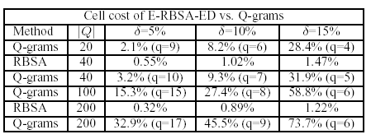
RBSA: Results on Q-grams
Database:
  First 184,309 bases of Human Chromosome 22.

Slide 104
RBSA: Results on Q-grams
Database:
  First 184,309 bases of Human Chromosome 22.

Slide 105
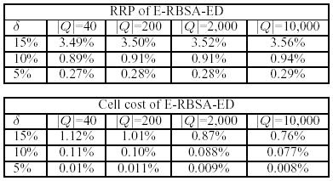
RBSA: Results on Edit Distance
Retrieval Runtime Percentage and Cell Cost

Slide 106
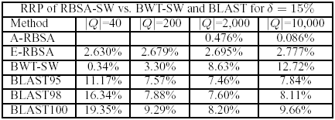
RBSA: Results on S-W
Retrieval Runtime Percentage

Slide 107
RBSA: Results on S-W
Retrieval Runtime Percentage

Slide 108
RBSA: Conclusions
RBSA: identifies subsequence matches in large sequence databases.
Two versions: exact and approximate.
Is designed for near homology search.
Can handle large query sizes.
Future directions:
  Speed up the reference sequence selection process.
  Extend RBSA for remote homology search.

Slide 109
Related Work – Time Series Matching
Full Matching | Subsequence Matching
 | Constrained | Unconstrained
Euclidean + DFT/Wavelets/etc F-Index [Agrawal et al. 1993] | Sliding window of size |Q| DTK [Han et al.2007] | SPRING [Sakurai et al. 2007]
DTW + LB_keogh / LB_PAA [Keogh et al. 2004] |  | EBSM [Athitsos et al. 2008]
FTW [Sakurai et al. 2005] | BSE
Bi-directional embedding

Slide 110
Related Work – String Matching
Global Alignment
Edit Distance [Levenshtein et al. 1995] and variants |  | MV,MP [Venkateswaran et al. 2006] VGRAM [Li et al. 2007] and variants
Subsequence Matching
Endpoint Subsequence Matching | Local Alignment
Q-gram-based methods | Smith-Waterman [Smith et al. 1981]
 | BLAST [Altschul et al. 1990], variants
QUASAR [Burkhardt et al. 1999]
 | BWT-SW [Lam et al. 2008]
RBSA [Papapetrou et al. 2009]

Slide 111
Summary of Contributions
An embedding-based framework for subsequence matching.
For the case of Time Series
  Approximate.
  Significant speedups vs. state-of-the-art methods.
  Hard to define bounds and prove guarantees.
For the case of Strings:
  Exploit metric property of Edit Distance -> bounds.
  Exact and Approximate.
  Can be used to solve real problems in biology (near homology search).
  Significant speedups for near homology search with large queries.

Slide 112
Future Work
Time Series:
  Provide some theoretical guarantees for EBSM.
  Define robust and metric similarity measures for subsequence matching in time series.
  Query-by-humming: (on-going work)
    Preliminary results are promising.
    Find better representations of songs.
    Similarity measures that can increase retrieval accuracy.

Slide 113
Future Work
Strings:
  Extend RBSA for remote homology search (proteins).
  Improve the reference sequence selection process.
  Reduce the embedding size (compression).

Slide 114
Future Work
Overall:
  Develop index structures for non-Euclidean and non-metric spaces that allow approximate nearest neighbor retrieval in time sublinear to the database size.
  Many important applications:
    fast recognition and similarity-based matching in
      medical, financial, speech and audio data.
      large databases of DNA and protein sequences.

Slide 115
Appendix

Slide 116
Subsequence Matching
X: long (database) sequence
Goal: determine optimal
start point and end point.
Q: short (query) sequence

Slide 117
Subsequence Matching
X: long (database) sequence
Goal: determine optimal
start point and end point.
Q: short (query) sequence
Notes:
Example: small piece of melody

Slide 118
Optimizing Performance
database sequence X
candidate
endpoints
Embedding optimization using training queries:
  Choose reference sequences greedily, based on performance on training queries.

Slide 119
Warping Path Example
Q = (3, 5, 6, 5).
X = (7, 6, 6, 5, 4, 3, 4, 5, 5, 6, 4, 4, 6, 8, 9).
W: ((1, 6), (1, 7), (2,8), (2,9), (3,10), (4, 11))
query
database sequence X

Slide 120
Warping Path Cost
Q = (3, 5, 6, 5).
X = (7, 6, 6, 5, 4, 3, 4, 5, 5, 6, 4, 4, 6, 8, 9).
W: ((1, 6), (1, 7), (2,8), (2,9), (3,10), (4, 11))
Cost: sum of individual matching costs.
Example: contribution of element (4, 11):
  4th element of Q matches 11th element of X.
  5 matches 4.
  Cost: |5 – 4| = 1.

Slide 121
Selecting Reference Sequences
Select K reference sequences from the database with lengths between m/2 and M.
  M: maximum expected query size.
  m: minimum expected query size.
From those K select the top K’ reference sequences with the maximum variance.
Given a set of training queries:
  Choose reference sequences that minimize the total DTW cost.
J. Venkateswaran, D. Lachwani, T. Kahveci and C. Jermaine,“Reference-based indexing of sequence databases” VLDB2006

Slide 122
Limitations
Is EBSM always going to work well?
  There is no theoretical guarantee.
Reference sequence selection:
  Training: costly.
Space:
  (number of reference sequences) x (database size)
  In our experiments: 40 x (database size)
    Is there any way of compression?
Supporting variable query sizes.

Slide 123
Query-by-Humming (1/2)
Database of 500 songs.
Set of 1000 hummed queries.
  Shorter than the song size.
  Only include the main melody.
Time Series contains pitch value of each note.
  Pitch value: frequency of the sound of that note.
  Pitch normalized.
  Time Series contains pitch differences (to handle queries that are sung at a higher/lower scale.
Used 500 queries for training and 500 queries for testing EBSM.

Slide 124
Query-by-Humming (2/2)
Results
For all queries, DTW can find the correct song when looking at the nearest 5% of the songs (i.e. top 25).
Rank | DTW | EBSM
 | Success | Success | Cell Cost | RRT
top 25 | 100% | 99% | 4.1 | 5.8
top 15 | 94% | 90% | 3.4 | 4.5
top 5 | 82% | 78% | 2.9 | 3.8

Slide 125
Experiments - Datasets
3 datasets from UCR Time Series Data Mining Archive:
  50Words, Wafer, Yoga.
All database sequences concatenated →
one big sequence, of length 2,337,778.
1750 queries, of lengths 152, 270, 426.
  750 queries used for embedding optimization.
  1000 queries used for performance evaluation.

Slide 126

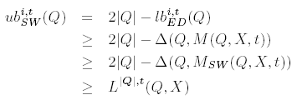
Smith-Waterman Upper-bound
Bound:
Proof:

Slide 127
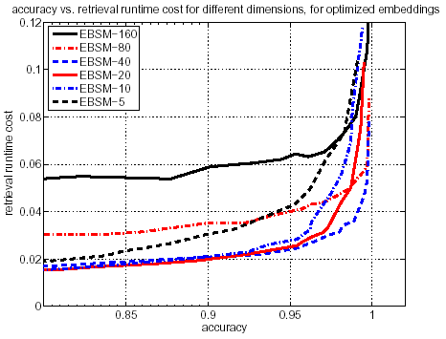
Results – Effect of Dimensionality

Slide 128
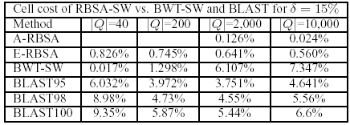
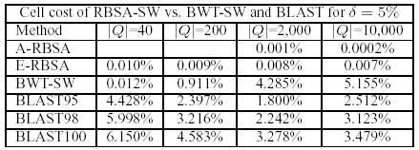
RBSA: Results on S-W
Cell Cost

Slide 129

Proof of Lower Bound
Two auxiliary definitions:
M (A, B, t): subsequence of B ending at position (B, t) with the smallest edit distance from A.
Q’: suffix of Q with the smallest edit distance from R_{i}.

Slide 130
Proof of Lower Bound
We have:
LB^{R} (Q, X, t) = F^{R} (X, t) – F^{R} (Q)

Slide 131
Proof of Lower Bound
We have:
LB^{R} (Q, X, t) = F^{R} (X, t) – F^{R} (Q)
= ED (R, M (R, X, t)) – ED (R, Q’)

Slide 132
Proof of Lower Bound
We have:
LB^{R} (Q, X, t) = F^{R} (X, t) – F^{R} (Q)
= ED (R, M (R, X, t)) – ED (R, Q’)
≤ ED (R, M (Q’, X, t)) – ED (R, Q’)

Slide 133
Proof of Lower Bound
We have:
LB^{R} (Q, X, t) = F^{R} (X, t) – F^{R} (Q)
= ED (R, M (R, X, t)) – ED (R, Q’)
≤ ED (R, M (Q’, X, t)) – ED (R, Q’)
- M (R, X, t) and M (Q’, X, t): subsequences of X ending at
(X, t).
- M (R, X, t): has the smallest distance from R.

Slide 134
Proof of Lower Bound
We have:
LB^{R} (Q, X, t) = F^{R} (X, t) – F^{R} (Q)
= ED (R, M (R, X, t)) – ED (R, Q’)
≤ ED (R, M (Q’, X, t)) – ED (R, Q’)
≤ ED (M (Q’, X, t), Q’)

Slide 135
Proof of Lower Bound
We have:
LB^{R} (Q, X, t) = F^{R} (X, t) – F^{R} (Q)
= ED (R, M (R, X, t)) – ED (R, Q’)
≤ ED (R, M (Q’, X, t)) – ED (R, Q’)
≤ ED (M (Q’, X, t), Q’)
- Since ED is metric, the triangle inequality holds

Slide 136
Proof of Lower Bound
We have:
LB^{R} (Q, X, t) = F^{R} (X, t) – F^{R} (Q)
= ED (R, M (R, X, t)) – ED (R, Q’)
≤ ED (R, M (Q’, X, t)) – ED (R, Q’)
≤ ED (M (Q’, X, t), Q’)
≤ ED (M (Q, X, t), Q)

Slide 137
Proof of Lower Bound
We have:
LB^{R} (Q, X, t) = F^{R} (X, t) – F^{R} (Q)
≤ ED (M (Q’, X, t), Q’)
≤ ED (M (Q, X, t), Q)
- the minimal set of edit operations to convert Q to M(Q, X, t)
suffices to convert Q’ to a suffix of M(Q, X, t).
- the smallest possible edit distance between Q’ and a
subsequence of X at (X, t) is bounded by ED (M (Q, X, t), Q).

Slide 138
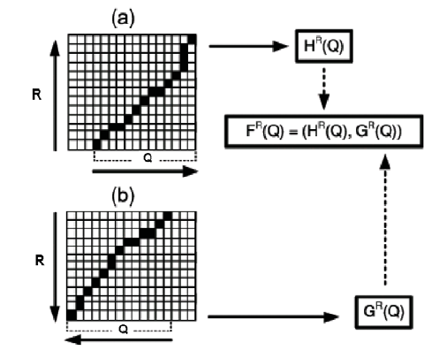
BSE
BSE Construction

Slide 139
RBSA: Approximate version
Question:
  Use only one segment Q^{i} of Q.
  What is the probability that the subsequence match of Q is included in the candidates of Q^{i}?
M (Q,X,t): best subsequence match of Q in X.
Assume: ED (Q, M (Q,X,t)) ≤ δ |Q|.
  δ |Q| edit operations are needed to convert Q to M (Q,X,t).
  Each of these operations is applied to ONLY one segment of Q.

Slide 140
RBSA: Approximate version
S_{ED}: optimal sequence of edit operations to convert Q into M (Q,X,t).
Proposition:
  Given any Q^{i}.
  P (out of S_{ED}, at most δq EO are applied to Q^{i}) ≥ 50%.
[Hamza et. al. 1995]

Slide 141
RBSA: Approximate version
Q^{cm}: segment where the c_{m}^{th} edit operation is applied.
P (m = i): probability that the c_{m}^{th} edit operation is applied to Q^{i}.
Assume that:
  P (m = i) is uniform over all i.
  The distribution of c_{m} is independent of any c_{n}, for n ≠ m.
S_{ED}: optimal sequence of edit operations (EO): Q -> M (Q,X).
Given any Q^{i} :
P (out of S_{ED}, at most δq EO are applied to Q^{i}) ≥ 50%
using [Hamza et. al. 1995]

Slide 142
RBSA: Approximate version
Proof:
  The probability that exactly k out of n EO are applied to Q^{i} follows a binomial distribution:
    n trials.
    success: an EO is applied to Q^{i}.
    P (success) = 1/α.
  The expected number of successes over n trials is n/α.

Slide 143
RBSA: Approximate version
Proof:
  The expected number of successes over n trials is n/α.
  If α ≥ 4, then P (success) ≤ 25%.
  Then, as shown in [Hamza et. al. 1995]
    P (number of successes ≤ n/α) ≥ 50%.
  Since n ≤ δ|Q|:
    n/α ≤ (δ|Q|) / α = δq.
  Thus: P (at most δq are applied to Q^{i}) ≥ 50%

Slide 144
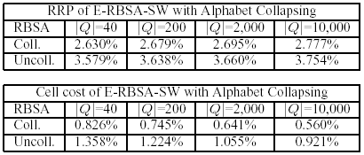
RBSA: Effect of Alphabet Reduction
Retrieval Runtime Percentage and Cell Cost

Slide 145
Contributions: Time Series
EBSM:
  The first embedding-based approach for subsequence matching in Time Series databases.
  Achieves speedups of more than an order of magnitude vs. state-of-the-art methods.
  Uses DTW (non metric) and thus it is hard to provide any theoretical guarantees.

Slide 146
Contributions: Time Series
BSE:
  A bi-directional embedding for time series subsequence matching under cDTW,
  The embedding is enforced and training is not necessary.
  For more details refer to my thesis…

Slide 147
Contributions: Strings
RBSA:
  The first embedding-based approach for subsequence matching in large string databases.
  Exploits the metric properties of the edit distance measure.
    Have defined bounds for subsequence matching under the edit distance and the Smith-Waterman similarity measure.
    Have proved that under some realistic assumptions the probability of failure to identify the best match drops exponentially as the number of segments increases.

Slide 148
Contributions: Strings
RBSA:
  Has been applied to real biological problems:
    Near homology search in DNA.
    Finding near matches of the Mouse Genome in the Human Genome.
    Supports large queries, which is necessary for searches in EST (Expressed Sequence Tag) databases.
  Has shown significant speedups compared to
    the most commonly used method for near homology search in DNA sequences (BLAST).
    state-of-the-art methods (Q-grams, BWT-SW) for near homology
    search in DNA sequences, for small |Q| (<200).

Slide 149
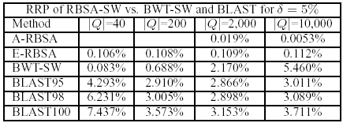
RBSA: Results on S-W
Retrieval Runtime Percentage

Slide 150
Wafer Dataset
A collection of inline process control measurements recorded from various sensors during the processing of silicon wafers for semiconductor fabrication.
Each data set in the wafer database contains the measurements recorded by one sensor during the processing of one wafer by one tool.

Slide 151
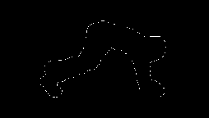

Yoga Dataset
0.92
0.9
0.88
Precision-recall breakeven point
-2
-1.5
-1
-0.5
0
0.5
1
1.5
2
0.86
Figure 12: Shapes can be converted to time series. The distance from every point on the profile to the center is measured and treated as the Y-axis of a time series
0.84
0.82
0.8
20
40
60
80
100
120
140
Number of iterations
Figure 13: Classification performance on Yoga Dataset

Slide 152
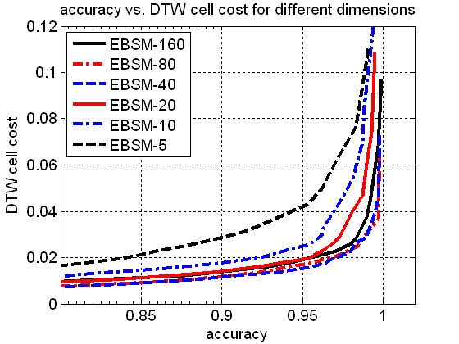
Varying Embedding Dimensionality

