Slide 1

STA 610: Case Study
Zixiao Tan

Slide 2
Content
Introduction

Slide 3
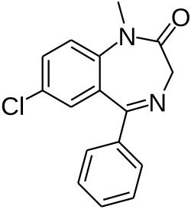
Introduction
Background: Help CloverShield Insurance Company to reduce call center costs and optimize resource allocation
Interest:
(1) Which variables are associated with pricing per milligram of Diazepam?
(2)

Slide 4
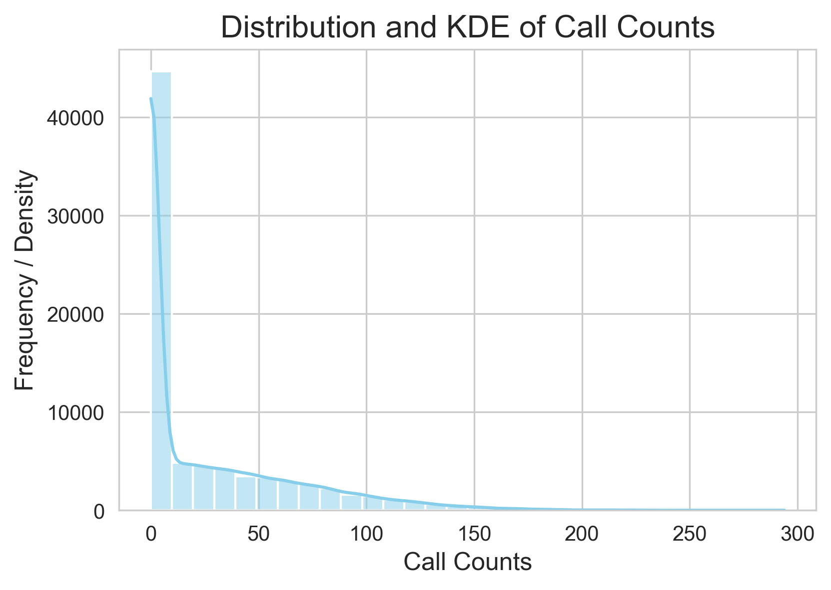
Exploratory Data Analysis
Target variables: call counts
Feature 1: Excessive Zero
Total policies: 80000
Policies with no call counts: 40144
Feature 2: Imbalanced Data
Mean(call counts) = 25.91
Variance(call counts) = 1434.03
Variance is greater than mean!

Slide 5
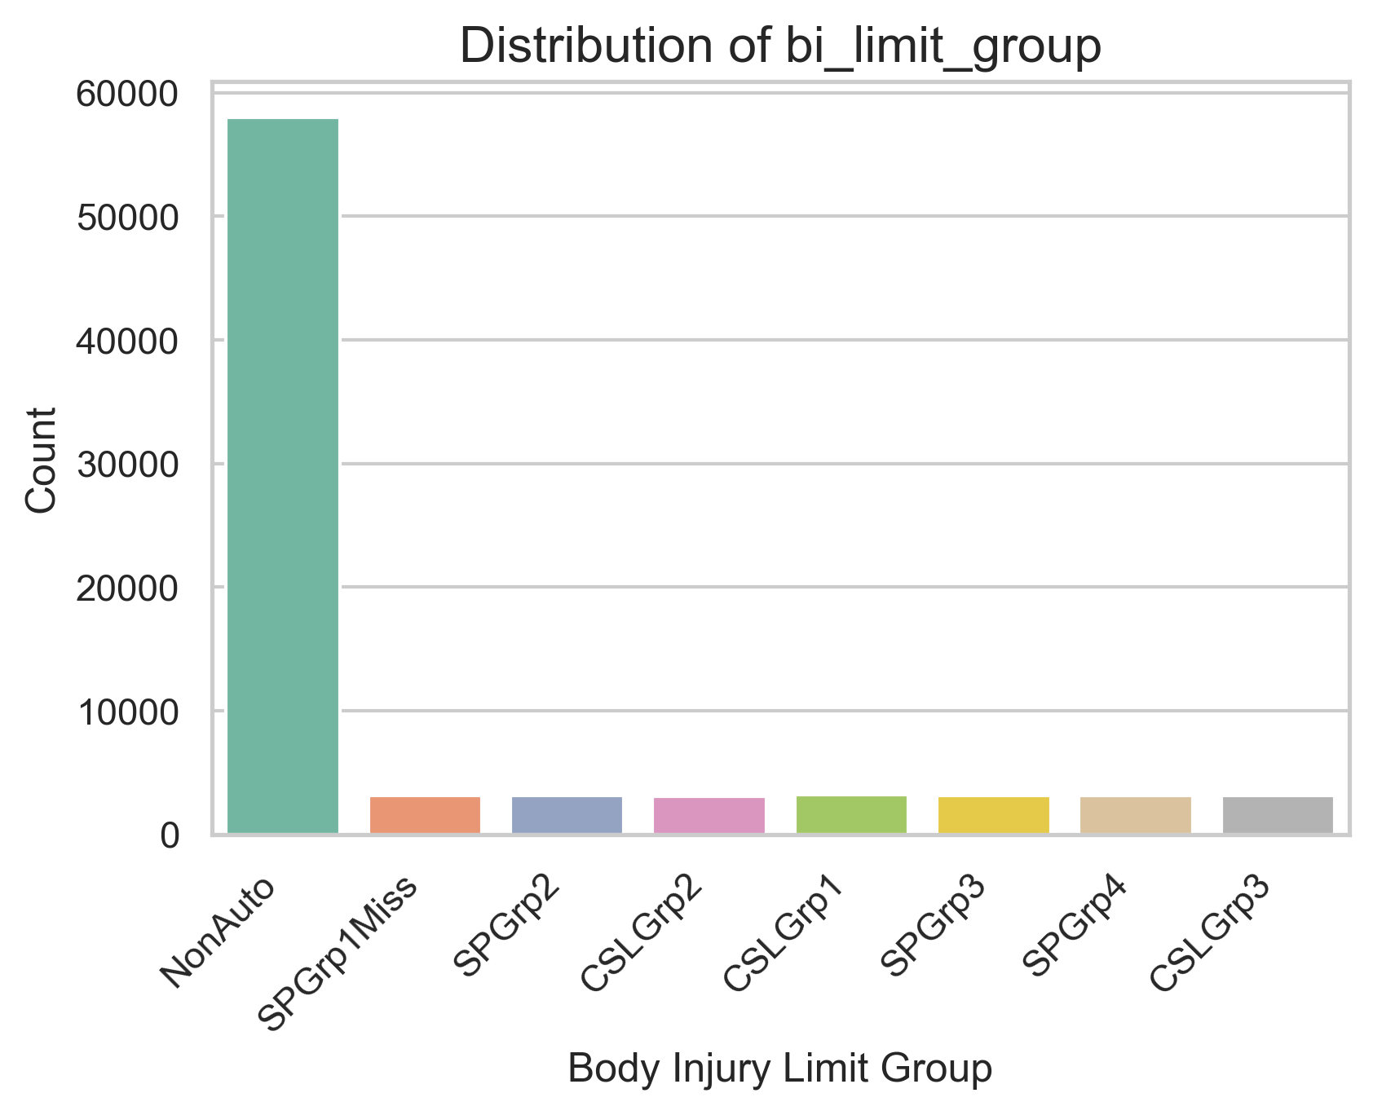
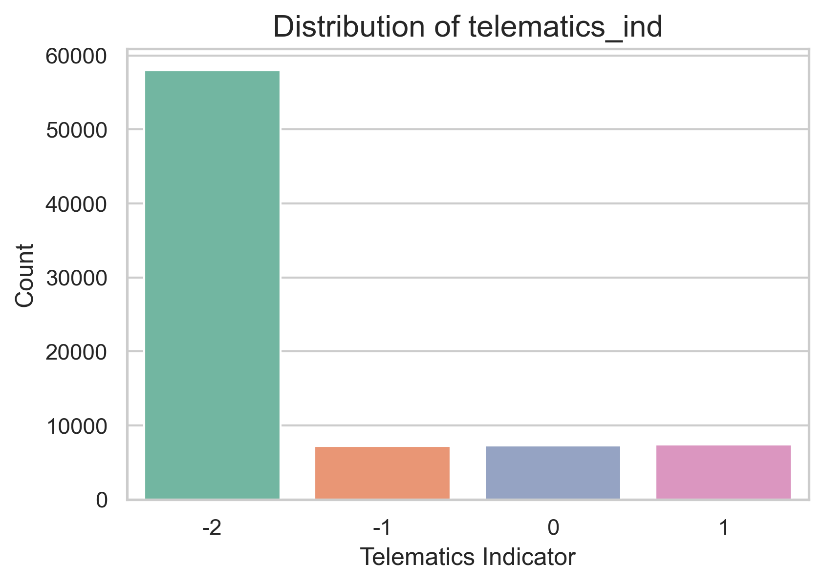
Exploratory Data Analysis
Predictive variables: 18 variables in total
Numerical: 7 variables
ann_prm_amt, newest_veh_age, home_lot_sq_footage, household_policy_counts, 12m_call_history, tenure_at_snapshot, trm_len_mo,
Categorical: 11 variables
bi_limit_group, channel, geo_group, has_prior_carrier, telematics_ind, digital_contacts_ind, pay_type_code, acq_mthd, pol_edeliv_ind, product_sbtyp_grp, product_sbtyp

Slide 6
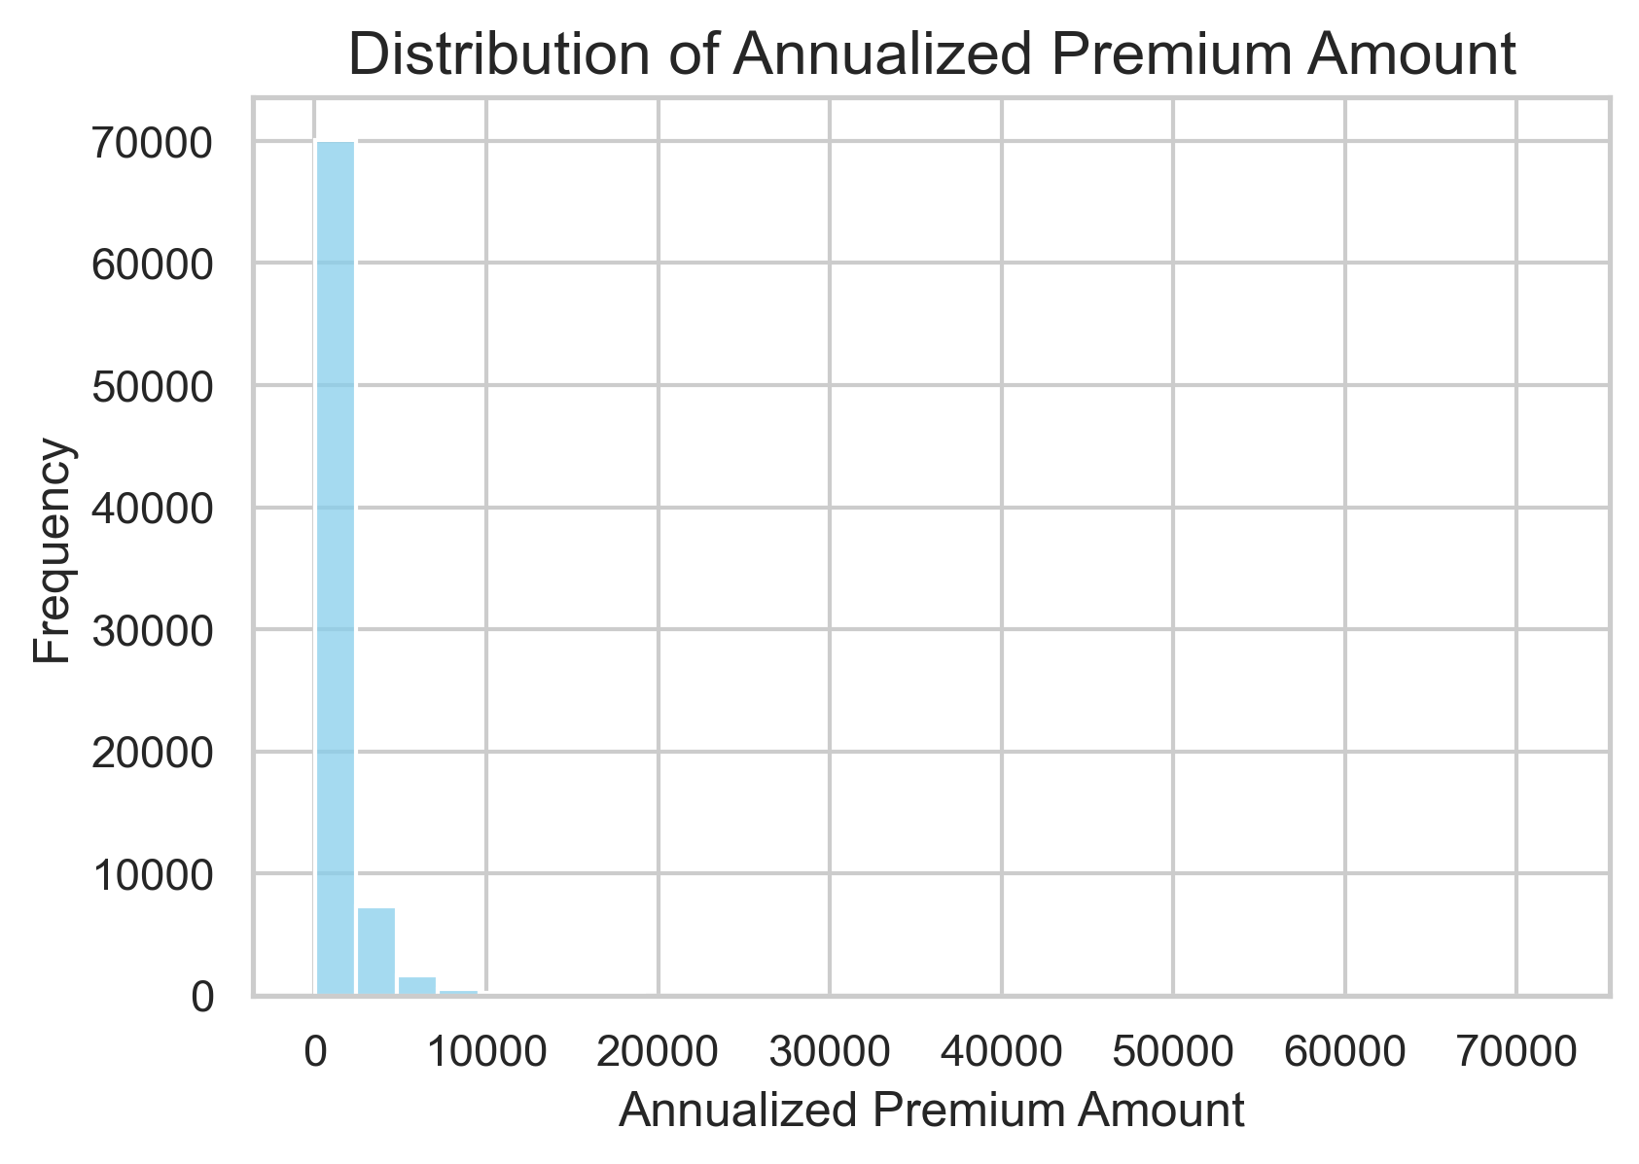
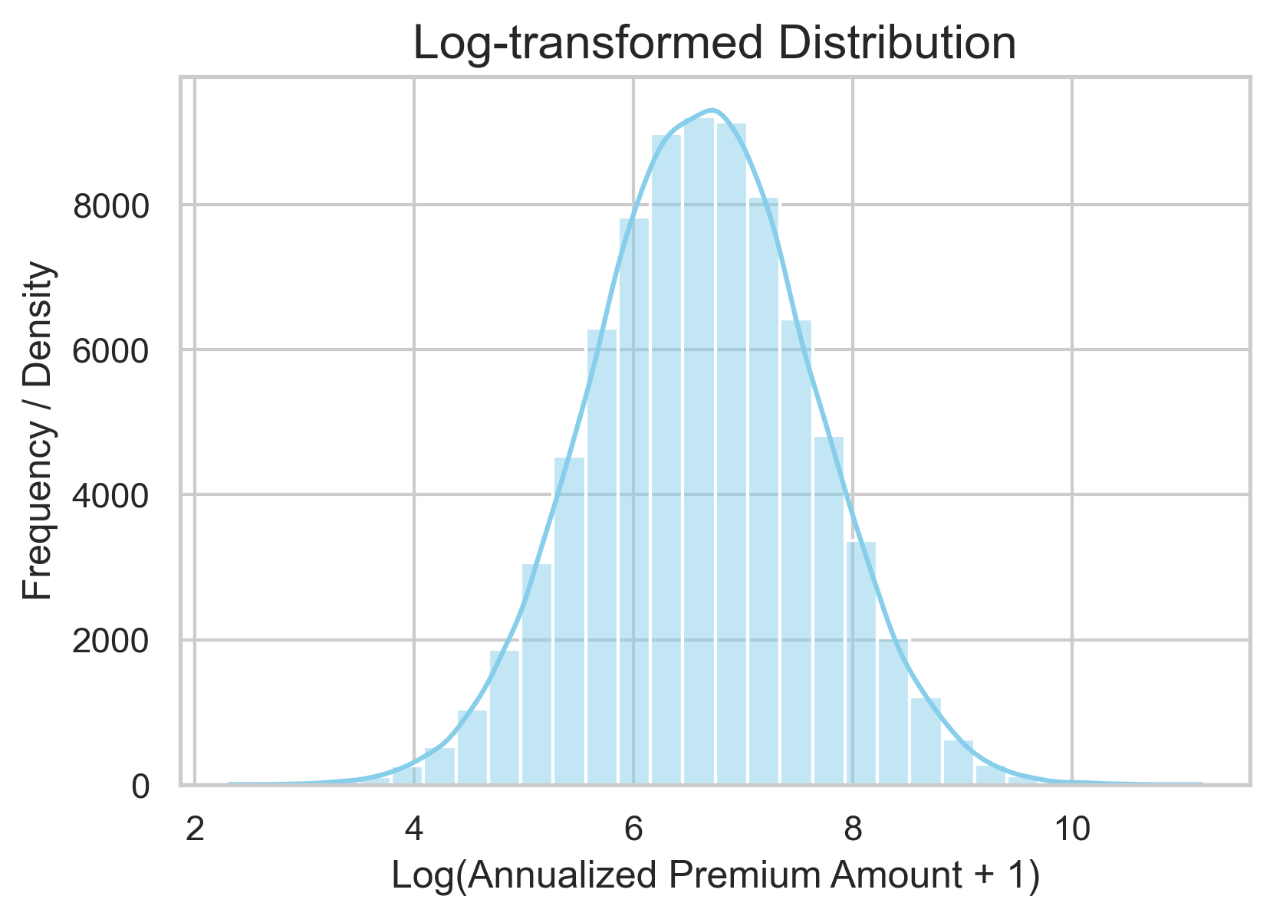
Feature Engineering
Log Transformation: applied to ann_prm_amt and home_lot_sq_footage to compress the data.
Binary Encoding: converted bi_limit_group to binary (1 for "NonAuto", otherwise 0).
Handling Missing Values: replaced -1 and -2 in pol_edeliv_ind and telematics_ind with 0 or 1, based on observed proportions.
Created new variable tenure_ratio: ratio of tenure_at_snapshot to trm_len_mo.
Created new variable contact_edeliv_ind: maximum of digital_contact_ind and pol_edeliv_ind (digital/email-delivery preference).

Slide 7
Model Selection
Part 1
Loss Function
Part 2
Base Framework
Part 3
Data Characteristics Analysis
Model 02
Hierarchical Models
Option 01
GOSDT
Loss 01
Pairwise ranking loss
Loss 02
Mean squared error
Model 01
Boosting methods
Option 01
Zero-Inflated Poisson
Option 01
XGBoost
Option 02
Zero-Inflated
Negative Binomial
Model 03
Zero-Inflated Models
Option 02
LightGBM
Option 03
Zero-Inflated Tweedie

Slide 8
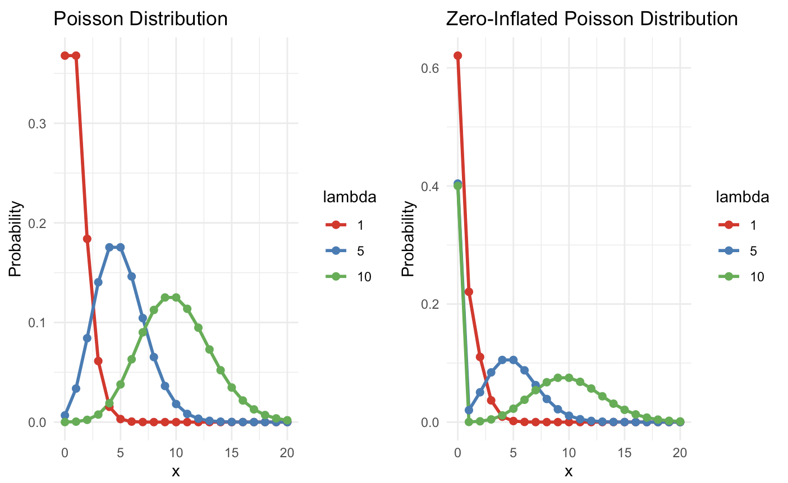
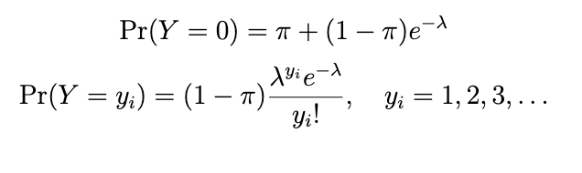
Zero-Inflated Models
Model excess zeros: using a logistic distribution to forecast zero
Model counts : using Poisson, Negative Binomial and Tweedie distribution to predict non-zero observations

Slide 9
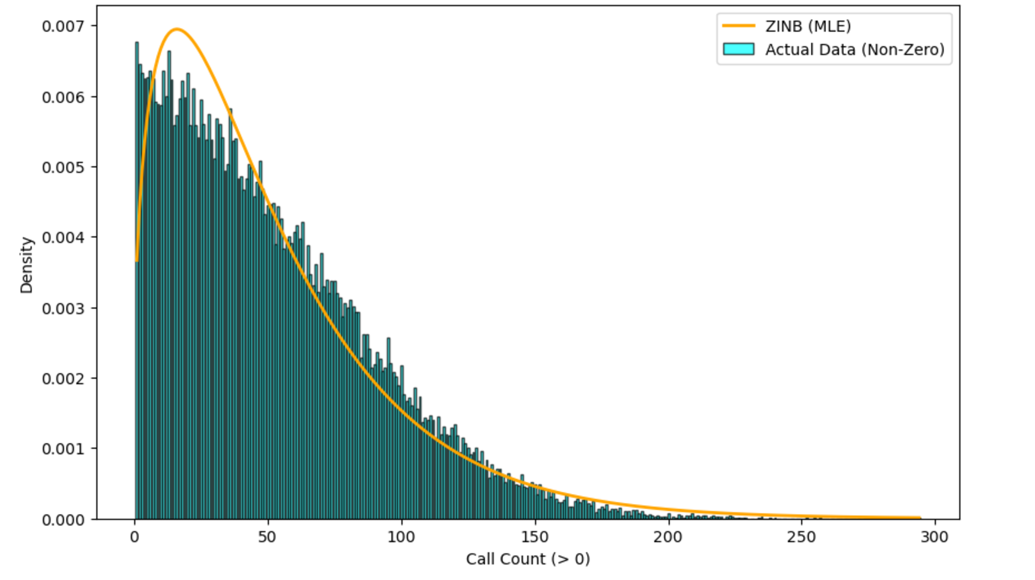
Zero-Inflated Models Selection
AIC: the lower, the best
Poisson AIC | Negative Binomial AIC | Tweedie AIC
1375599.11 | 391966.36 | 393634.87
ZINB Fit vs Call Counts

Slide 10
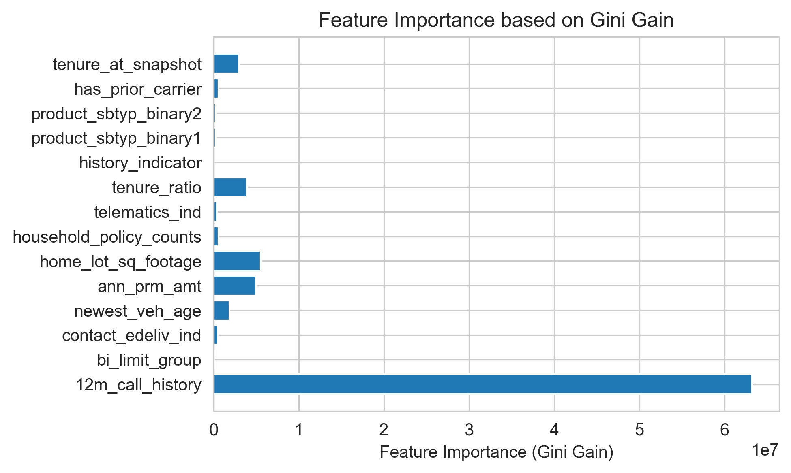
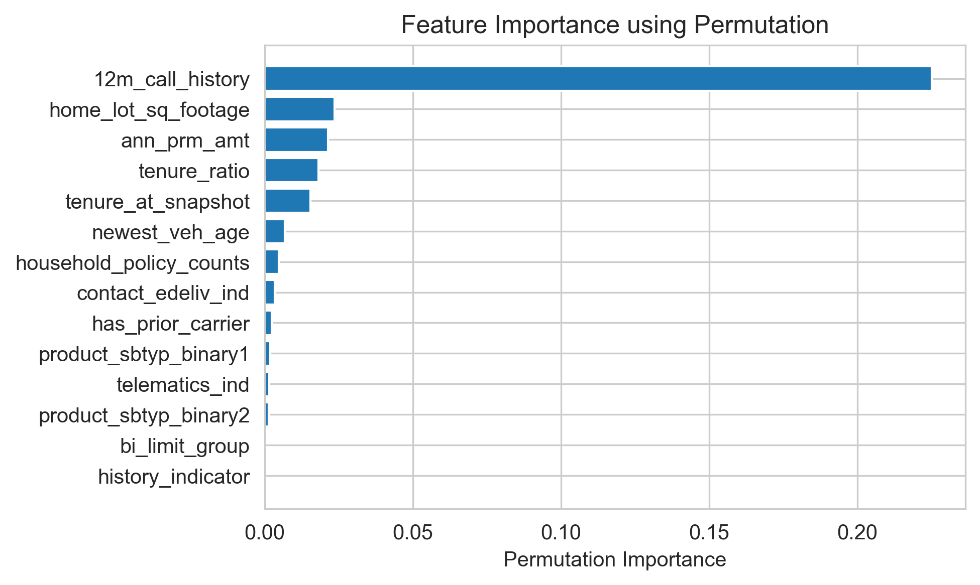
Variable Selection
Feature importance analysis: identify key predictors: 12m_call_history, tenure_ratio,
ann_prm_amt, home_lot_sq_footage, tenere_at_snapshot

Slide 11
Data we wish to Have
Personal Info:
Name, Age, Sex, Nationality,
Family Status ( whether marriage and have children)
Auto Info:
Ownership Status, Maintenance History, Driving History
# of tickets, # of accidents
Others:
policyholder address, Home Ownership
# of people covered by one policy
# of polices one people purchased

Slide 12
Questions about Data
Variables Meaning:
For categorical variable pay_type_code, prdct_sbtyp_grp,
What do the categories "Method 1, 2, 3" and "A, B, C" represent?
Reasons for call:
Is it call two-way? Between policyholder and insurance company?
Potentials of Insurance Fraud:
We noticed that someone have too many call counts (near 200), while lived
in a small house. It is abnormal.

Slide 13
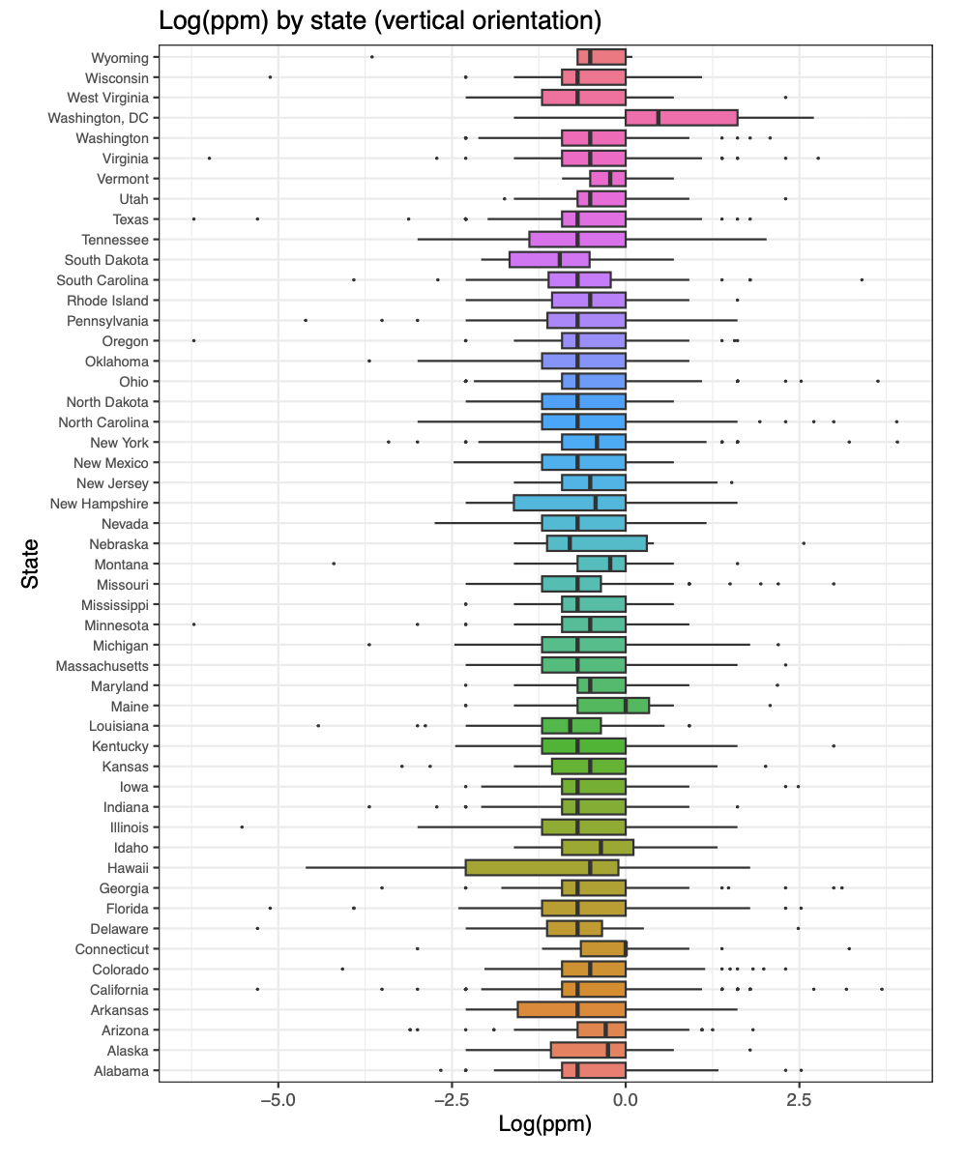
Thank you!

